Slide 1
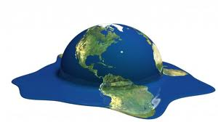
Climate Change
By C. Kohn
Agricultural Sciences
Waterford WI

Slide 2
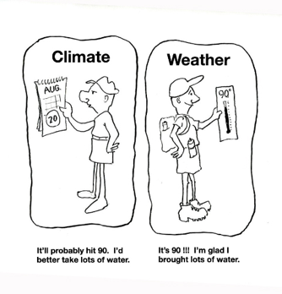
Global Warming vs. Climate Change
Climate is the long-term average of the weather in a given place.
While weather can change over hours (or even minutes), climatological changes occur over decades, centuries, or millennia.
Climate is not just temperature, but also precipitation, type of weather, and the frequency, duration, and intensity of that weather.
Global warming is the recent and ongoing rise in the global average temperatures near the surface of the Earth.
It is caused mostly by increasing concentrations of greenhouse gases in the atmosphere.
Climate change refers to all the changes that have resulted from increased greenhouse gases.
These include changes such as increased temperature as well as precipitation and weather patterns.
Source: bethhatephila.org

Slide 3
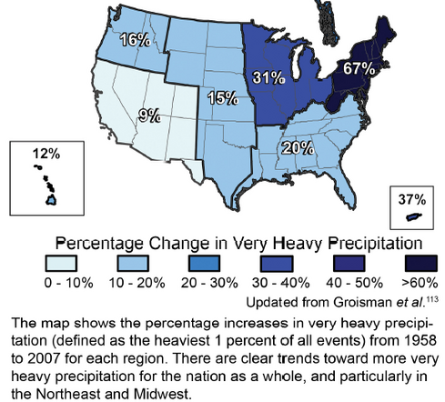
More GHG = More Changes
Warmer temperatures from increased greenhouse gases will likely cause major changes to the climate of the earth.
Warmer surface temperatures are only one expected change.
More energy in the atmosphere will also result in longer periods between episodes of precipitation.
Longer periods between episodes of precipitation will likely result in an increase in the frequency of droughts.
An atmosphere with more energy can hold onto precipitation longer.
When it does rain or snow, there may be more episodes of flooding or heavy snowfall.
Furthermore, the strength of storms is expected to increase, resulting in stronger, more damaging storms.
Source: http://publicradio1.wpengine.netdna-cdn.com/updraft/files/legacy/assets_c/2012/06/65%20Midwest%20ex%20rafl-thumb-490x573.png

Slide 4
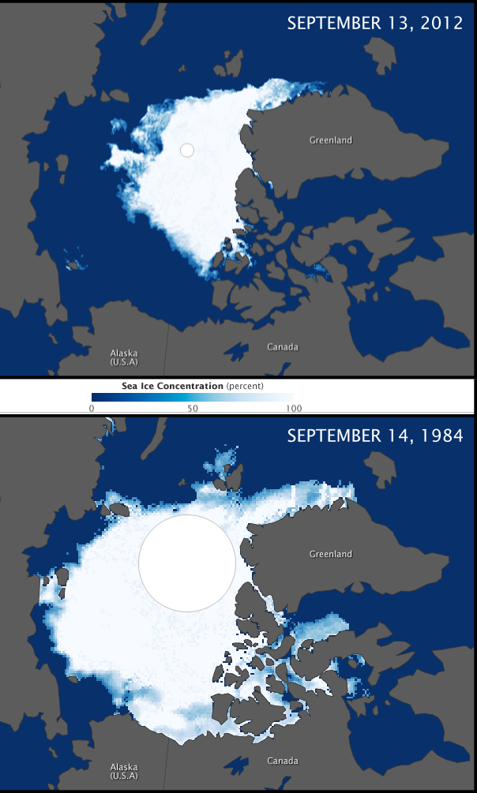
Is Climate Change Real?
What evidence suggests that climate change is real?
We know that the Earth’s average temperature has risen by 1.4º F in the last 100 years.
The rise in temperature coincides with the rise in greenhouse gases since the start of the industrial revolution.
While 1.4º does not seem like much, this is a rate that is about 5 times faster than the previous fastest rate of change.
We know that since satellites began monitoring the polar ice caps in the 1970s, total sea ice has declined by 15-20%.
We know that climatological changes that would normally occur over 100,000’s of years are now occurring over a period of decades.
Source: http://upload.wikimedia.org/wikipedia/commons/b/b1/Arctic_Sea_Ice_Minimum_Comparison.png

Slide 5
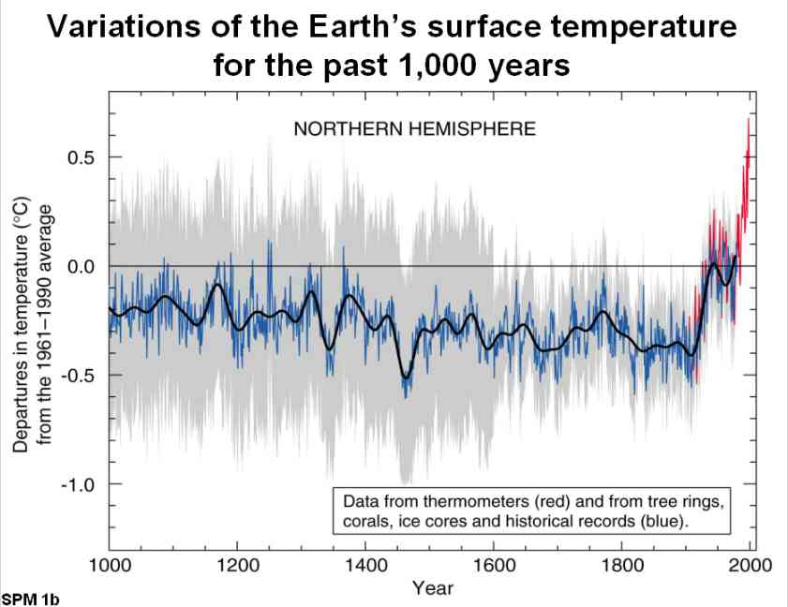
Presentation to Forum 2002, St Anne’s College, Oxford, 15 July 2002 by Sir John Houghton

Slide 6
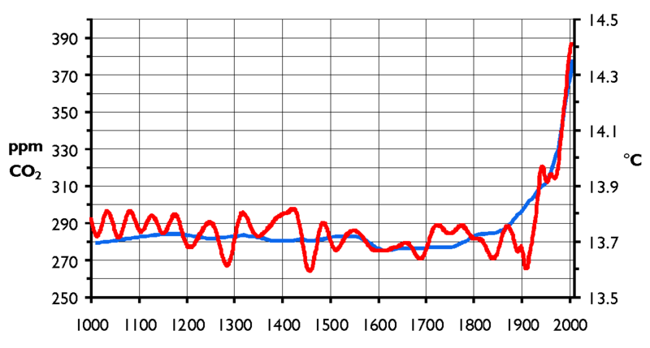
Is Climate Change Real?
We know that seven of the eight warmest winters on record have occurred since 2001.
All ten warmest years on record have occurred since 1995.
Evidence from ice core data, tree rings, coral reefs, lake sediments, pollen deposits, and ocean sediments correlate with each other.
All indicate the same message – the earth’s climate is changing at a rate faster than has ever occurred in measurable history.
These changes all coincide with the Industrial Revolution.
We know the earth is warming, and we know it is warming at a rate faster than it ever could from natural forces.
Given the rate of change, and the timing of these changes, there is little reason to believe that anything other than human activity is to blame.
Source: climateaudit.org

Slide 7
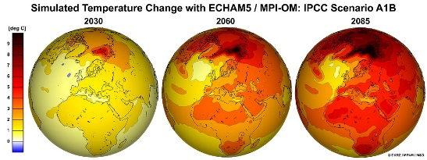
Greenhouse Gases
Climate Change today is largely the result of an increase in greenhouse gases.
Greenhouse gases are a variety of different gases that absorb and emit infrared radiation.
Examples include water vapor, carbon dioxide, methane, and nitrous oxide, among others.
We know that greenhouse gases are much higher now than they were prior to the Industrial Revolution and are increasing every year.
By the end of this century, we could expect to see CO­₂ levels between 490 and 1260 ppm unless drastic changes occur.
Source: http://www.dkrz.de/bilder/bilder-klimaforschung/T2M_A1B_2030_2060_2085ano1961-1990_globe_en.jpg

Slide 8
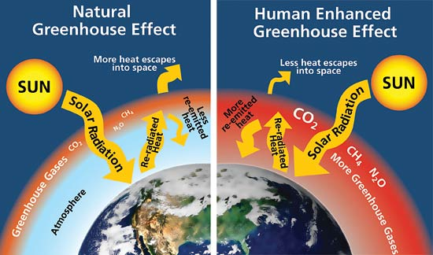
How do GHG’s warm the atmosphere?
Greenhouse gases contribute to the greenhouse effect of our atmosphere.
By absorbing and emitting infrared radiation, greenhouse gases slow the loss of heat from the surface of the earth.
When greenhouse gases slow the loss of heat, they hold this energy in the atmosphere for longer periods of time, causing warming.
The greenhouse effect is not necessarily bad.
Without it, the temperature of the surface of the earth would be 0º F.
However, too many greenhouse gases in the atmosphere are like you if you wore too many fur coats.
Your body would overheat quickly with too many coats.
Too many “coats” of greenhouse gases will keep excess amounts of heat in the atmosphere longer.
Source; http://www.nps.gov/goga/naturescience/images/Greenhouse-effect.jpg

Slide 9
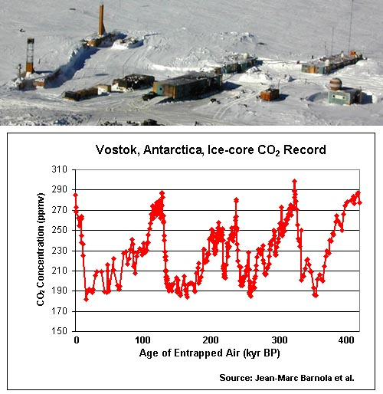
How do we know this is not just a natural cycle?
Scientists are able to use a number of measurements to determine what is “natural” and what isn’t in regards to atmospheric levels of greenhouse gases.
One of the most widely used sets of data is from the Vostok research station in Antarctica.
The ice under Vostok has undisturbed air trapped for thousands of years in the ice.
Scientists can measure the levels of greenhouse gases in these bubbles and compare how the levels of greenhouse gases fluctuate over time.
This gives scientists a natural range by which we can determine whether our greenhouse gas levels today are normal or excessively high.
Source: http://www.chemistryland.com/CHM107/GlobalWarming/iceCoreCO2deepest.jpg

Slide 10
Vostok Evidence
The main evidence from Vostok is the levels of greenhouse gases preserved in thick layers of ancient ice.
Vostok evidence shows that for hundreds of thousands of years, CO₂ levels stayed roughly between 200-300 ppm.
Today, at 400 ppm, we know that CO­₂ levels are higher than any point in the past hundreds of thousands of years.
Scientists are also able to measure an isotope of hydrogen called deuterium.
Deuterium is essentially a ‘heavy’ form of hydrogen.
The more deuterium in the air, the warmer the atmosphere was for that particular year.
The ratio of deuterium to other isotopes of hydrogen enables scientists to determine the average temperature for each year.
Source: http://genesismission.jpl.nasa.gov/science/mod2_aei/fig12.gif

Slide 11
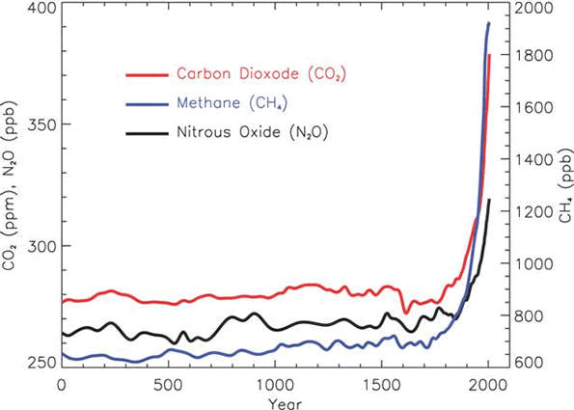
How do we know that this is caused by human activity?
For the last 10,000 years, the concentrations of CO₂, methane, and other greenhouse gases were relatively stable.
In the last 150 years, CO₂ has increased 70% (280 ppm to 400 ppm), while methane has increased 148%.
This coincides perfectly with the start of the Industrial Revolution.
It as at this time that greenhouse gases were released in larger quantities than could be reabsorbed by plants during photosynthesis.
Greenhouse gases increased with each passing year at a rate never before seen in measurable history.
Source: http://www.climatechange.govt.nz/science/gases.gif

Slide 12
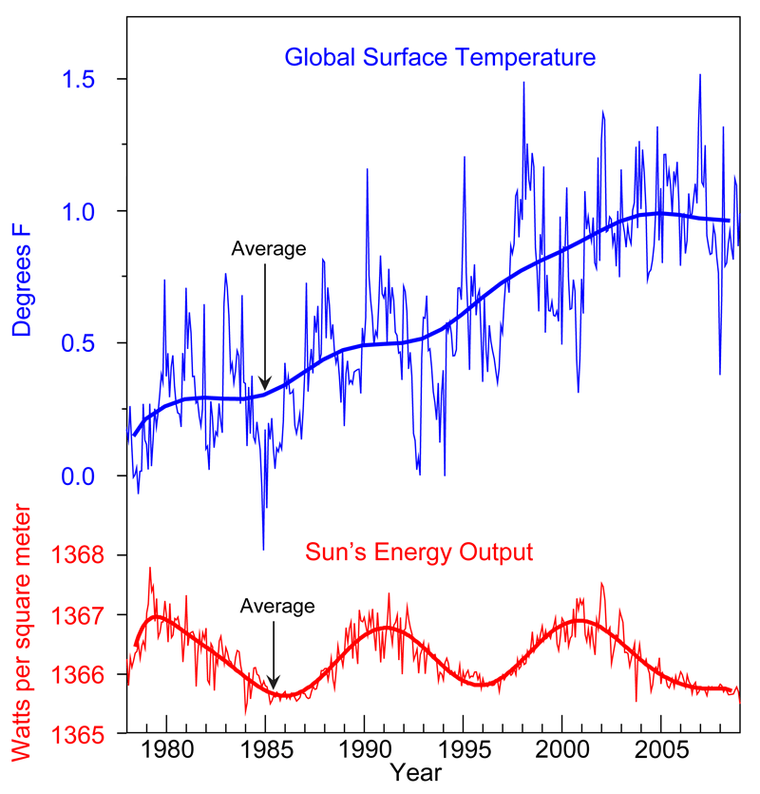
How do we know this is not due to changes in the sun?
The sun’s energy-output does fluctuate on a fairly regular basis.
However, while these long-term fluctuations have remained fairly consistent, the temperature on the surface of the earth has continued to rise.
This relationship strongly indicates that the cause of the warming of the earth is unrelated to the output of energy from the sun.
Source: http://www1.ncdc.noaa.gov/pub/data/cmb/images/indicators/solar-variability.gif

Slide 13
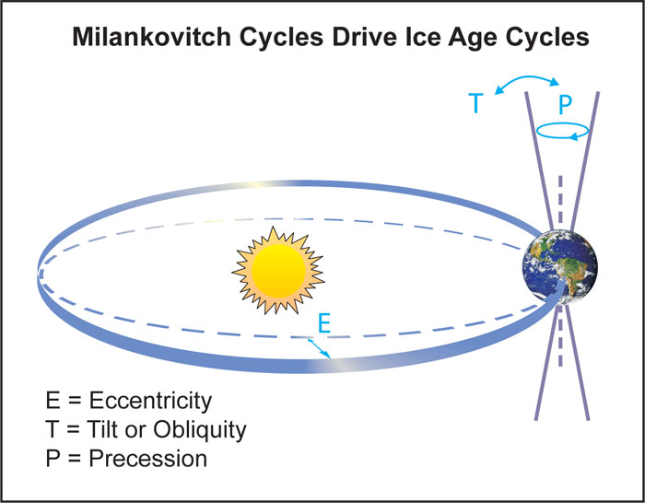
Milankovitch Cycles
The earth has a constantly changing relationship with the sun.
Changes in the earth’s orbit around the sun follow predictable patterns known as the Milankovitch Cycles.
These cycles include three ways in which the earth’s orbit can change:
1. The earth’s orbit can go from circular to a more oval shape. This cycle lasts 100,000 years. (E in the image below)
2. The earth wobbles as it spins. This cycle lasts 21,000 years. (P)
3. The earth’s axis tilts more or less. This cycle lasts 41,000 years. (T)
These Milankovitch Cycles are a major cause of changes to the Earth’s climate, including ice ages.
However, the rate of change is in the tens, if not hundreds of thousands of years.
The rate of change we are currently experiencing is happening in a matter of decades.
This is thousands of times faster than what would occur from the Milankovitch Cycles if it were the cause of the change.
Source: http://www.southwestclimatechange.org/files/cc/figures/milankovitch.jpg

Slide 14
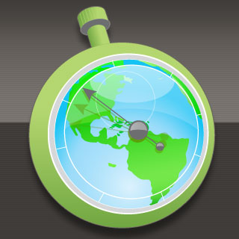
A Future of Climate Change
What to expect in your lifetime.

Slide 15
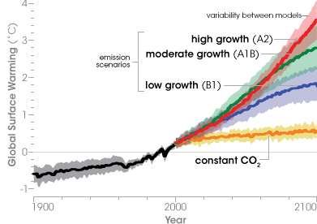
Temperature projections for 2100.
Temperature projections to the year 2100, based on a range of emission scenarios and global climate models. The orange line (“constant CO2”) projects global temperatures with greenhouse gas concentrations stabilized at year 2000 levels.
Source: NASA Earth Observatory, based on IPCC Fourth Assessment Report (2007)

Slide 16
What can we expect in the future?
As greenhouse gas levels increase, patterns of US precipitation and storm events will change as well.
Northern areas will likely become wetter, especially in winter and spring.
Southern areas (especially in the West) will likely become drier.
Heavy precipitation will be more frequent as the atmosphere will have more energy to hold more moisture.
Heavy downpours that once occurred every 20 years are projected to occur as often as every 4 years, raising the risk of flooding in many areas.
The intensity of Atlantic hurricanes is likely to increase.
For each 1.8º F increase in tropical sea temperatures, there is a projected hurricane rainfall increase of 6-18%.
Snow accumulation will begin later and end earlier.
This will likely decrease snow cover by approximately 15%.
Warming is expected to occur at a faster rate as less snow reflects sunlight away from the earth’s surface.

Slide 17
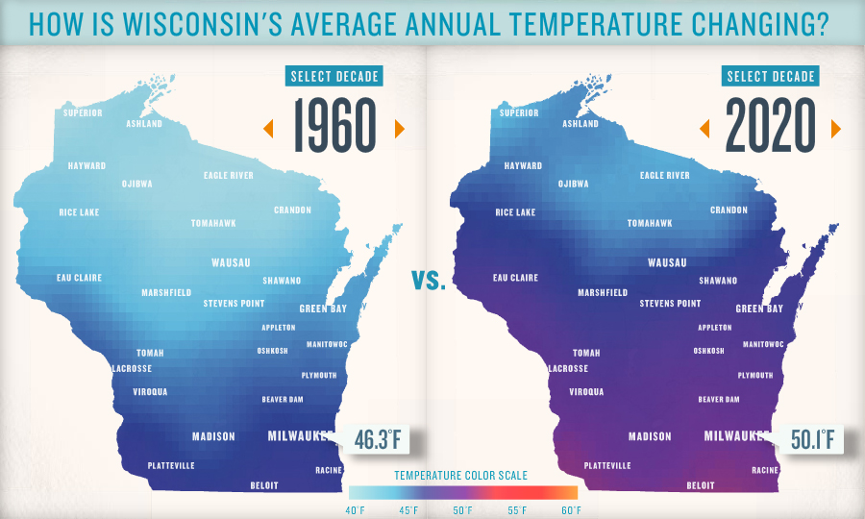
How will the Midwest change?
For the Midwest, the changes will be pronounced as well.
In 1995, the Midwest endured a 4-day heat wave that caused over 700 deaths in Chicago alone.
Similar heat waves are projected to occur up to three times per year by 2100 as the climate of the Great Lakes begins to resemble the climate of Texas and Oklahoma.
Heavy downpours and severe droughts in the Midwest are projected to occur twice as often as they did in 1900.
Floods like those of 2008 and droughts like those of 2012 are expected to continue to occur with more frequency.
Source: wptschedule.org

Slide 18
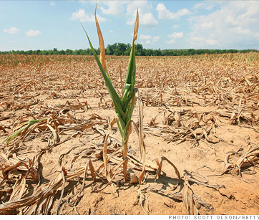
How will this affect agriculture?
Midwestern farmers are also expected to be strongly affected by increased greenhouse gases.
Increased CO₂ levels could potentially lead to more crop production.
However, changes to soil nutrient levels, soil moisture, and heat and weather patterns will likely offset any gains from increased photosynthesis.
Agriculture depends on highly-specific climate conditions.
Wetter conditions in spring will make planting much more difficult.
More frequent heat waves, droughts, and floods will place added stress on crops and livestock.
As insects are able to tolerate more mild winters, diseases are expected to become a bigger problem in agricultural production.
Ground and surface water are expected to become more scarce with increased evaporation.
Warmer temperatures will also increase the maturation of crops.
However, for some crops (especially grains), faster maturation results in reduced yields.
This is because the seedlings have less time to acquire and store energy before they mature.
Source: money.cnn.com

Slide 19
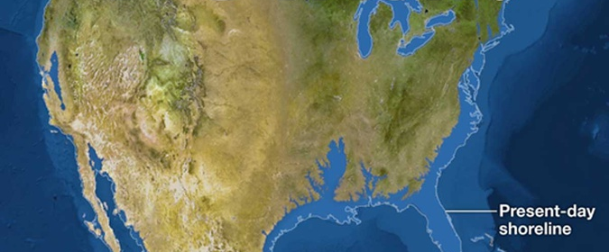
How will this affect the oceans?
Oceans are expanding.
Due to melting ice and the fact that warm water expands, sea levels could rise 2 feet.
Given 39% of Americans live on the coasts, this could be a costly and potentially deadly problem (much like Hurricane Sandy created).
As oceans warm, they are also becoming more acidic.
Increased acidity of the oceans reduces the availability of minerals.
This reduces the ability of shellfish and corals to produce their shells and skeletons, resulting in large-scale losses of ocean biodiversity.
Because the oceans contain much of the world’s biodiversity, this could exacerbate what is already the fastest rate of extinction in the Earth’s history.
Source: http://cdn.theatlantic.com/newsroom/old_wire/img/upload/2013/11/04/america/lead_large.jpg

Slide 20
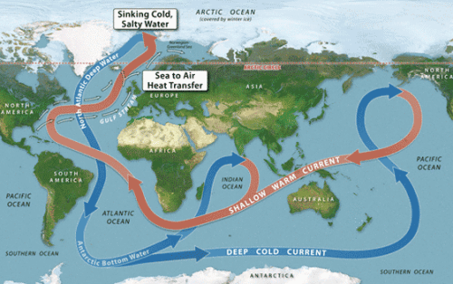
Thermohaline Currents
Thermohaline currents may be at risk.
Thermohaline currents are the movement of ocean water due to changes in the temperature and salinity of ocean water.
When ocean water is chilled by artic temperatures, sea ice forms.
Salt does not freeze and is left behind, causing the ocean water to become denser as it becomes saltier.
This denser, saltier ocean water sinks; and warmer, lighter surface water replaces it.
The sinking of cold, saltier water and the movement of warmer, lighter water to its place forms the thermohaline ocean current.
Source: http://hwsclimatology.wordpress.com/2009/05/03/homework-7-due-monday-may-4/

Slide 21
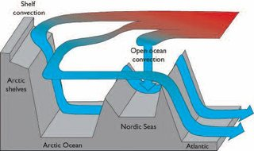
Thermohaline Currents
The thermohaline current brings warm air to northern latitudes in places such as Europe and western North America.
Many northern latitudes have warmer climates due largely to these currents.
If the thermohaline currents were exposed to too much cold freshwater (such as from melting ice), the entire current could be disrupted.
Fresh water dilutes the dense, cold, salty water.
Dilution reduces the density of this seawater, preventing it from sinking as quickly.
With too much fresh water, the thermohaline current would stop altogether.
This would cause drastic shifts in the global climate.
Source: www.eoearth.org

Slide 22
How will this affect the ecosystems on land?
Terrestrial ecosystems are especially at risk due to climate change.
Rapid changes to the habitats of species will likely cause the extinction of many of those species and a reduction in the services they provide to humans.
Climate change is also expected to exacerbate other human stressors such as habitat loss and the spread of invasive species.
As native species face these changes, they will be less able to compete with invasive species that are introduced and can better tolerate changes to a habitat.
While species can adapt over millions of years, they cannot change in only one century.
Migratory species today are already exhibiting climate change-related changes.
Warmer springs have led to earlier nesting for at least 28 migratory birds in the US.
Northeastern birds are returning 13 days earlier on average than they did in the 20th century.
In California, 16 of 23 butterfly species have already adjusted migration timing.
Changes to migratory patterns can lead to mismatches in breeding and food availability.
Species with specific niche needs will face increased likelihoods of extinction as their growth and survival are reduced by changes to their availability of food

Slide 23
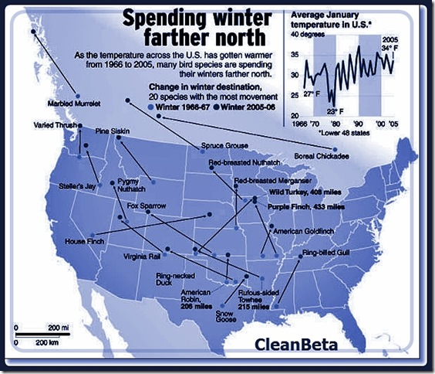
Shifting Habitats
As habitat ranges shift northward in the US, it will result in less hospitable habitat and increased competition for some species.
Some species may have nowhere to go because they are already at the northern limit of their habitat range.
For example, shifting boreal forests in Alaska are reducing the amount of tundra available for species such as the caribou, arctic fox, and snowy owl.
Oak-hickory forest expansion is decreasing the amount of maple- beech forest habitat available.
Cold water fish, such as trout, are completely losing their habitat as aquatic ecosystem species cannot move as easily as terrestrial species.
Source: earthtosky.org

Slide 24
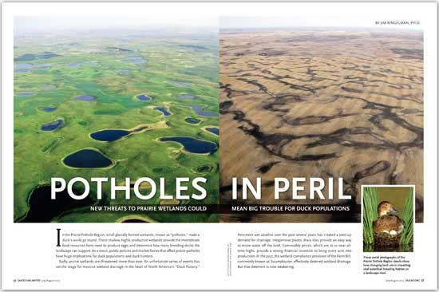
Ecosystem Tipping Points
Ecosystem change may occur rapidly and irreversibly because a threshold (or “tipping point”) is passed.
For example, the Prairie Pothole Region in the north-central US is an ecosystem made up of numerous small, shallow lakes.
These small lakes are called prairie potholes.
These wetlands are critical for breeding grounds for migratory waterfowl (and the duck hunters who depend on them).
A permanently warmer, drier future for the Dakotas may drop prairie pothole water levels below what is needed for waterfowl reproduction.
The effects on hunting from temporary droughts of the past may become a permanent fixture.
Similar effects may be felt in other recreational areas, including ice fishing, snowmobiling, skiing, and other winter- or water-based sports.
Source: www.ducks.org

Slide 25
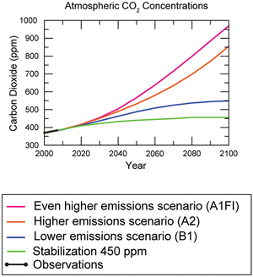
What would we have to do to fix this?
Because carbon dioxide stays in the atmosphere for nearly a century on average, and because it has a delayed effect on climate, the Earth will continue to warm in the coming decades.
This would occur even if we stopped human-caused CO₂ emissions today.
Current estimates predict that global CO­­₂ levels will increase by 46% in the next 30 years.
Global greenhouse gas emissions would have to be reduced by 50-85% from the levels they had in 2000 by 2050 in order to keep global CO₂ levels beneath 400 ppm.
Source: http://www.epa.gov/climatechange/images/science/ScenarioCO2.jpg

Slide 26
What can you do?
1. Change five lights.
Replace your five most frequently used lights with compact fluorescent lights (CFLs).
This will also help you save $70 a year on energy bills. While using about 75% less energy than standard lighting.
Each CFL lasts from 10 to 50 times longer than a standard light bulb.
2. Heat and cool smartly.
Heating and cooling accounts for almost half your energy bill--about $1,000 a year!
Changing air filters, using a programmable thermostat, and having your heating and cooling equipment maintained can save energy and increase comfort, while helping to protect the environment.
Source: http://www.epa.gov/climatechange/wycd/home.html

Slide 27
What can you do?
3. Reduce, reuse, recycle
Reducing, reusing, and recycling in your home helps conserve energy and reduces pollution and greenhouse gas emissions.
If there is a recycling program in your community, recycle your newspapers, beverage containers, paper, and other goods.
Compost your food and yard waste to keep them out of landfills.
4. Use water efficiently
It takes lots of energy to pump, treat, and heat water.
Repair all toilet and faucet leaks right away.
Leaky toilets alone can waste 200 gallons of water per day.
Running your dishwasher only with a full load can save 100 pounds of carbon dioxide and $40 per year.
Only water your lawn when needed, and do it during the coolest part of the day; early morning is best
Source: http://www.epa.gov/climatechange/wycd/home.html

Slide 28
What can you do?
5. Purchase green power
Power your home by purchasing green power, or power that is environmentally friendly and is generated from renewable energy sources such as wind and the sun.
Some utility companies allow this option for a slightly higher rate than coal-power.
6. Spread the word
Tell family and friends that energy efficiency is good for their homes and good for the environment because it lowers greenhouse gas emissions and air pollution.
Write to your representatives in Congress – your letters to Washington can have great impact on future legislation!
Source: http://www.epa.gov/climatechange/wycd/home.html

