Slide 1
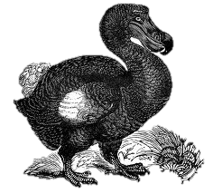
Biodiversity & Extinctions
By C. Kohn, Agricultural Sciences
Waterford, WI

Slide 2
Biodiversity
Biodiversity is a mix of two words – diversity and biology.
Biodiversity is a measure of the genetic diversity within a species, the number of species in an ecosystem, and the variety of habitats within a landscape.
It is the job of a natural resources manager or an environmental scientist to maximize the amount of biodiversity found in an area.
The greater the biodiversity, the healthier an ecosystem will be.
Source: www.birdlife.org

Slide 3
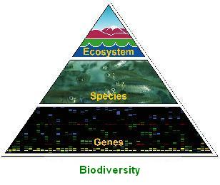
Terms
Genetic diversity is the genetic variation and genetic traits found within a population of a species.
E.g. if there are few bucks to breed does, the genetic variation of whitetail deer will be very low, putting the deer population at risk.
Species diversity is the variety of species found in a landscape.
E.g. a corn field has very little species diversity.
A wetland or prairie will be very diverse.
Ecosystem diversity is a measure of the number of different habitats found in a landscape.
An ecosystem is the interactions between living and nonliving components of an area.
Ecosystem types in this area include forests, prairies, wetlands, aquatic habitats, and more.
ahs-enviro.blogspot.com

Slide 4
Diversity = Resilience
The greater the genetic diversity, species diversity, and habitat diversity in a landscape, the greater the resilience of that landscape to disturbances such as pollution, invasive species, etc.
This is similar to a city – the more variety you have in people, businesses, and buildings, the more secure a community will be.
E.g. if one kind of business is hit by poor sales, there will be others to keep the local economy thriving.
If one business disappears, the community will change but if there are a diversity of businesses, the community will continue to function.

Slide 5
Biodiversity Scores
Environmental scientists and natural resources managers must ensure that biodiversity is maintained at as high of a level as possible in the landscape they are assessing.
To determine biodiversity, a scientist could use the following simple formula:
Biodiversity = No. of Species/ No. of Individuals
E.g. a corn field has very low biodiversity
10,000 individual corn stalks but one species = 1/10000, or a biodiversity score of 0.0001
A prairie with many species might have a biodiversity score that is much higher.
The maximum biodiversity score using this formula = 1.0
Source: www.stolaf.edu

Slide 6
Why Does Biodiversity Matter?
Biodiversity matters because it is a measure of the health of an ecosystem.
To understand why this is the case, we have to understand the basics of how an ecosystem works.
For an ecosystem to function, it must be able to serve different roles and provide various services.
The main ecosystem services are energy flow, nutrient cycling, waste removal, and reproduction.
Source: oregonstate.edu

Slide 7
Examples of Ecosystem Services
Energy flow – without plants to photosynthesize, no other species could acquire the energy of the sun or survive.
Without photosynthesis, no organism could survive!
Nutrient cycling –
Plants convert inorganic carbon (CO2) to organic carbon (sugars, cellulose, living tissue) for use by all carbon-based living species.
Some plants and fungi convert inorganic nitrogen (N2) into organic nitrogen (amino acids, peptides, proteins) so that plants, animals, and other living species can make their own proteins.
Filtration & Removal of waste and pollutants
Purification of groundwater by soil. Air purification by plants such as trees.
Reproduction and Genetic Diversity
Species vigor (“weeding out the sick and lame”) created by predation and competition.
Pollination of immobile plants by mobile animals such as bees and butterflies.

Slide 8
Hypothetical relationship between biodiversity and ecosystem function.
This graph shows two possible relationships between biodiversity loss and changes to ecosystem function.
In the case of Type A ecosystems, any loss of biodiversity is immediately noticeable. These ecosystems tend to be the most fragile.
In the case of Type B ecosystems, losses to biodiversity show little impact on ecosystem function and services until it is likely too late to repair it. This means that by the time the damage is noticeable, it is probably too late.
Most ecosystems resemble Type B.
Source: Schwartz, et. al. 1999. Linking biodiversity to ecosystem function: implications for conservation ecology. UC-Davis
http://bio.research.ucsc.edu/people/thompson/PublPDFs/Schwartzetal00.pdf

Slide 9
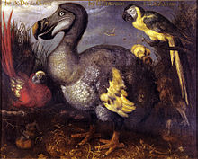
As biodiversity is lost…
As biodiversity is lost, ecosystem function and ecosystem services decrease.
The permanent loss of a species makes it harder for all other species to survive.
Extinction: the permanent loss of a species.
As ecosystem functions decrease, each individual and each species is put at greater risk for loss due to the fact that the other species that they depend upon will decrease in numbers.
The loss of one species increases the risk of losing more species.
Source: www.answers.com

Slide 10
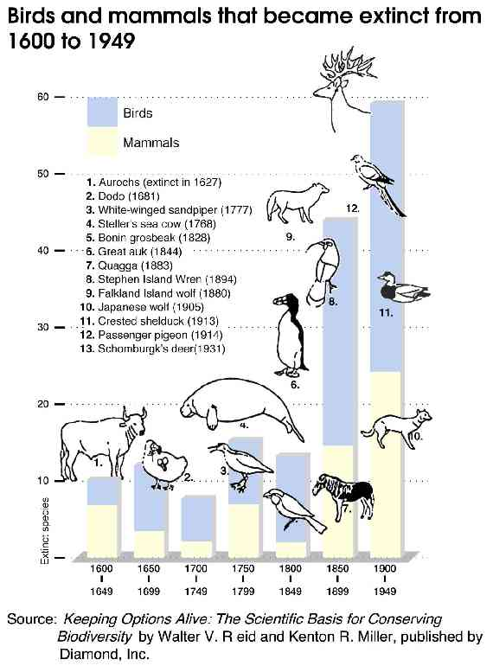
When do extinctions occur?
Extinctions occur when the environment of a species changes faster than the species can adapt.
In other words, a species’ adaptations are no longer sufficient in allowing that species to acquire and compete for resources.
Extinctions can be local, widespread, or global.
For example, the timber wolf was until recently extinct in Wisconsin but not in Minnesota
Wild elk and woodland caribou are now extinct in Wisconsin but are prevalent in other parts of North America.
Source: www.env.go.jp

Slide 11
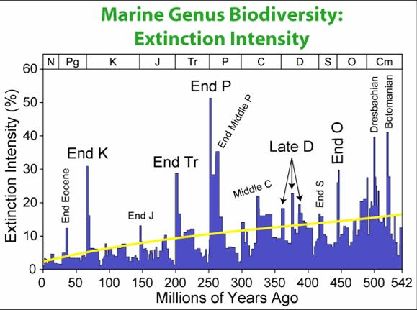
Extinctions can be Natural
Extinctions can occur naturally.
Nearly all of the species that have existed on earth have gone extinct.
There have been 5 major mass extinction s in geological history.
Recovery from these events took millions of years.
Source: http://www.uwec.edu/jolhm/EH4/Extinction/Extinction.ppt

Slide 12
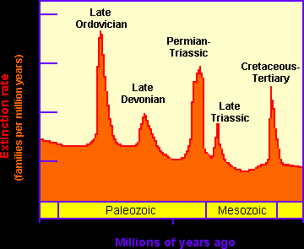
The 5 (now 6) Mass Extinctions
Ordovician-Silurian Extinction (440 mya).
Late Devonian Extinction (364 mya).
Permian Triassic Extinction (250 mya).
End Triassic Extinction (200 mya).
Cretaceous-Tertiary Extinction (65 mya).
Holocene Extinction (0 mya)
(#= millions of years ago)
Source: http://www.uwec.edu/jolhm/EH4/Extinction/Extinction.ppt
Source: www.enchantedlearning.com

Slide 13
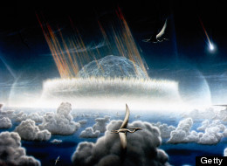
The Holocene Extinction
Today’s massive loss of species has been dubbed the “Holocene Extinction” (we are currently in the Holocene epoch)
Epoch: a portion of a geological period
Catastrophic extinctions, as was the case when an asteroid-strike wiped out the dinosaurs, actually took many thousands of years to occur.
What took thousands of years for the dinosaurs is taking decades for us today.
The current extinction rate appears significantly greater than that of the dinosaurs.
In other words, human-activity is killing off species faster than an asteroid could 65 million years ago.
Source: United States Committee on Scientific Issues in the Endangered Species Act, National Research Council. Science and the Endangered Species Act. National Academy Press, Washington D.C. 1995
Source: www.huffingtonpost.com

Slide 14
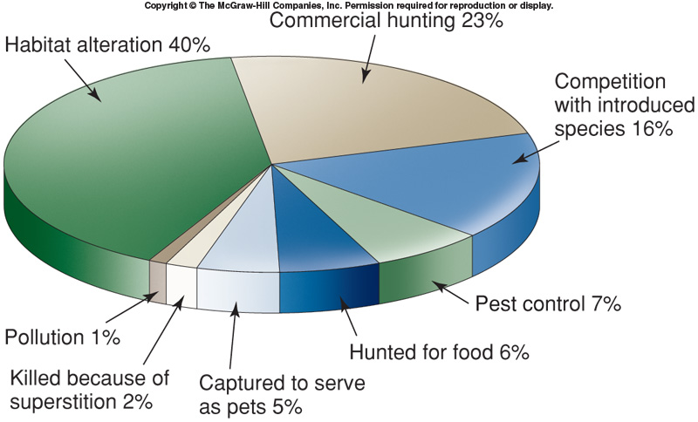
Modern Causes of Extinctions
Major current causes of extinctions include:
Habitat Loss: fragmentation, degradation, and outright destruction of ecosystems that support native ecosystems (leading cause).
Invasive Species: the introduction or overpopulation of species that over-consume natural resources and are uncontrolled by predators (second leading cause).
Over-harvesting: the removal of species at rates that exceed reproduction.
Pollution: introduction of harmful agents that reduce the effectiveness of a species’ adaptations.
Source: www.bio.utexas.edu

Slide 15
Current Stats
90% of all large fish have disappeared in the last 50 years due to over-fishing.
Myers, Ransom. Worm, Boris. Biology Department, Dalhousie University, Halifax, Nova Scotia, Canada, Rapid Worldwide Depletion of Predatory Fish Communities. Nature. Volume 423. P. 280. May 2003
The Audubon Society reports that 30% of North American songbird species are in significant decline.
One in eight plant species are in danger of extinction within the next 30 years (ICUN Red List)
The current rate of extinction is 1500 times greater than the normal, sustainable extinction rate.
Bjørn Lomborg, The Skeptical Environmentalist: Measuring the Real State of the World, Cambridge U. Press, Cambridge, 2001.
“Half of bird and mammal species will be gone in 200 to 300 years”
Levin, Phillip and Levin, Donald. The Real Biodiversity Crisis. January, 2002. American Scientist, Volume 90, Number 1, Page 6
One species is going extinct every 20 minutes.
Levin, Phillip and Levin, Donald. The Real Biodiversity Crisis. January, 2002. American Scientist, Volume 90, Number 1, Page

Slide 16
Biodiversity & Medicine
More than a quarter of all prescriptions written annually in the United States contain chemicals discovered in plants and animals.
A few hundred wild species have stocked our pharmacies with antibiotics, anti-cancer agents, pain killers, and blood thinners.
We have only discovered 10-20% of living species so far!
http://www.fws.gov/endangered/esa-library/pdf/Why_Save_Endangered_Species_Brochure.pdf
Source: sitn.hms.harvard.edu

Slide 17
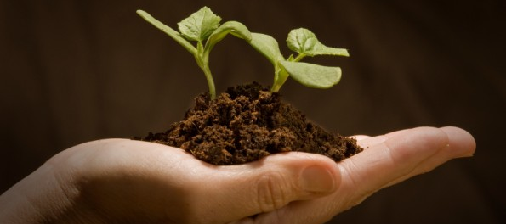
Biodiversity & Agriculture
There are almost 80,000 species of edible plants.
Fewer than 20 produce 90 percent of the world’s food.
4 crops (wheat, corn, rice, soybeans) provide most of the world’s food.
If underutilized species are conserved, they could help to feed growing populations.
http://www.fws.gov/endangered/esa-library/pdf/Why_Save_Endangered_Species_Brochure.pdf
Source: www.sustainabilityninja.com

Slide 18
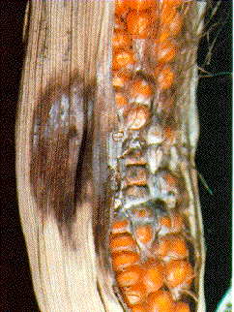
Biodiversity & Crops
During the 1970s the U.S. corn crop was almost completely wiped out by a leaf fungus.
The corn crop was saved by interbreeding it with a rare species of wild corn from Mexico.
Genetic engineering may also offer some hope by facilitating transfer of genes between species.
This increases the value of wild strains which can be used as sources for new traits to be introduced into crops.
http://www.emc.maricopa.edu/faculty/farabee/biobk/biobookcycles.html
Source: ipm.ncsu.edu

Slide 19
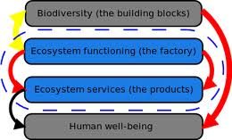
Biodiversity & Ecosystem Services
Ecosystem services include air and water purification, detoxification and decomposition of wastes, climate regulation, regeneration of soil fertility, and the production and maintenance of biological diversity.
These are the key ingredients of our agricultural, pharmaceutical, and industrial enterprises.
Such services are estimated to be worth trillions of dollars annually.
We get these services for free… for now.
http://www.fws.gov/endangered/esa-library/pdf/Why_Save_Endangered_Species_Brochure.pdf
Source: www.diversitas-international.org

Slide 20
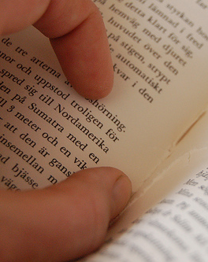
Biodiversity & Moral Obligations
What would it be like if we had the same genetic diversity today that was here 300 years ago?
Would our descendants forgive us for exterminating a unique form of life?
How much more difficult will the lives of future generations be because of our choices today?
Eliminating entire species is similar to ripping pages out of books that have not yet been read.
Imagine what answers might lie within!
http://www.fws.gov/endangered/esa-library/pdf/Why_Save_Endangered_Species_Brochure.pdf
Source: www.ihanna.nu

