Slide 1
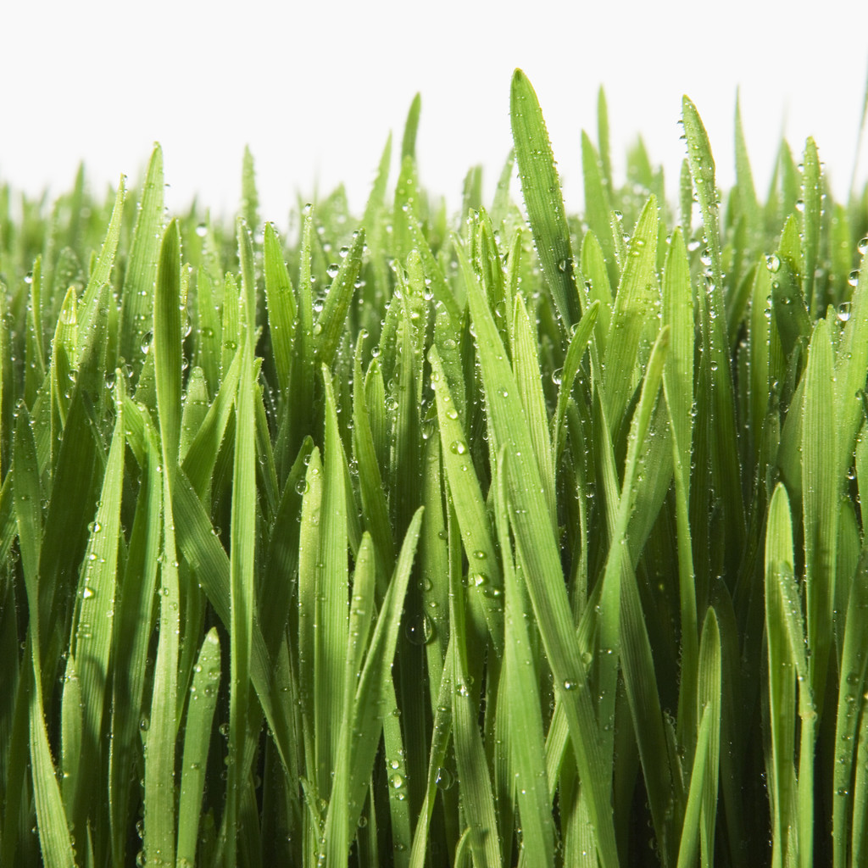
Habitats
By C. Kohn, Agricultural Sciences
Waterford, WI

Slide 2
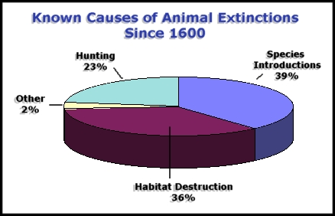
Habitats
A habitat is the home of a species.
Living organisms have evolved through natural selection over millions of years to a specific set of conditions.
A living species cannot exist outside of an environment that supports these needs and adaptations.
A habitat is an environment in which the specific needs of a living species are met.
When a habitat is destroyed, changed, or degraded, the species that live there are affected.
Currently habitat loss/degradation represents one of the greatest causes of extinction on the planet today.
Source: http://www.globalchange.umich.edu/globalchange2/current/lectures/biodiversity/biodiversity.html

Slide 3
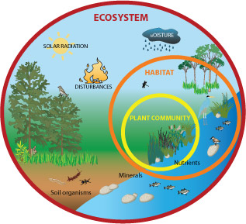
The Needs of Species
All species depend on habitats for three things:
Shelter: physical structures that a species lives near, around, on top of, or inside of.
It could be a specific structure as specific as a log, nest, or burrow.
It could also refer to cover, or the assortment of plants, rocks, water, decomposing matter, in which an organism can remain protected or hidden.
Physical needs: water, food, oxygen, adequate temperatures, sunlight (plants), etc.
Space: all living species have a limit to how closely they can be crowded. Living species need adequate space in order to have adequate access to the previously-listed components.
For example, too many trees in one area would limit their access to light and their ability to photosynthesize.
Too many animals in one area would result in starvation and disease outbreaks.
Every habitat has a carrying capacity for every kind of living species.
Source: ecopediakids.wikispaces.com

Slide 4
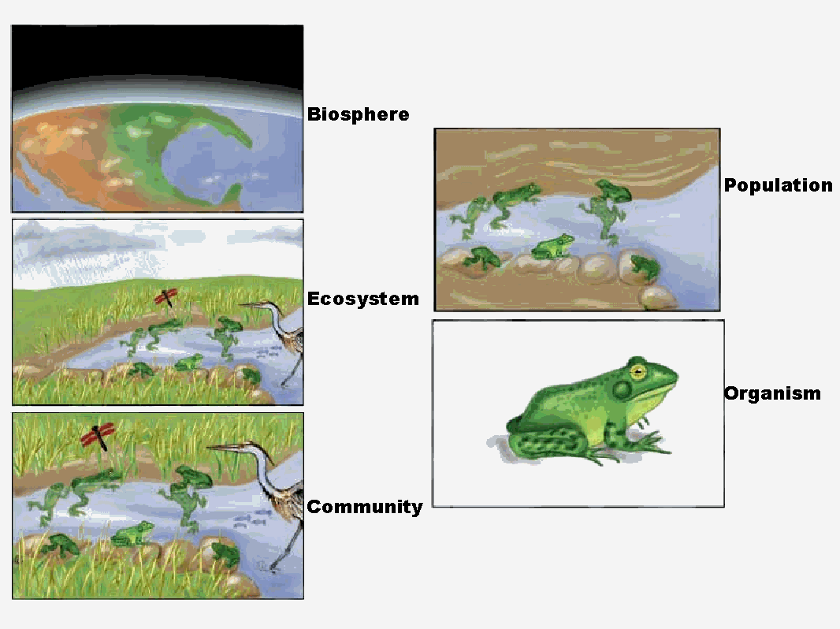
Populations
A carry capacity is the maximum population that can be sustainably supported by a habitat.
A population is a group of living organisms of the same kind living in the same place at the same time.
All of the populations of living species interact and form a community.
A community is group of interacting living species sharing the non-living resources of a specific area
The interaction of the living species of the community and the non-living resources is an ecosystem
Source: http://www.csus.edu/indiv/l/loom/preview%2024.htm

Slide 5
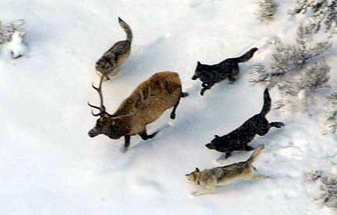
Niches
Every living species occupies a niche, or particular role in a habitat
E.g. bees fill a reproductive niche for flowers
Wolves fill a predatory niche that improves the genetic quality of a herd of elk
A habitat has a limited amount of niches to fill.
Because of this, different kinds of interactions will occur between the living species of an environment in order to create the functional ecosystem.
anniekatec.blogspot.com

Slide 6
Kinds of Niches
Competition: when multiple species compete for the same resources.
E.g. when multiple species of trees compete for space, sunlight, and the ability to reproduce.
Predation & Parasitism: when one species benefits at the harm of another species.
E.g. when wolves attack a wounded deer; when mosquitoes suck blood from a person.
Mutualism (or cooperation): when multiple species interact in a way that is beneficial to all involved.
E.g. humans and milking cows benefit from their cooperation (the humans get food, the cow gets cared for; note: neither are dependent on the other to exist).

Slide 7
Kinds of Niches
Symbiosis: when two species cooperate to the extent that they each become completely dependent on each other
E.g. bacteria in a cow’s rumen; both need each other to function – one cannot survive without the other.
Commensalism: when one species benefits without affecting another species.
E.g. when maggots decompose a carcass, the carcass was already dead and therefore is not affected.
Amensalism: when one species harms another species without any gain or impact to itself.
E.g. pine needles reduce the ability of other plant species to grow by changing the pH of the soil.

Slide 8
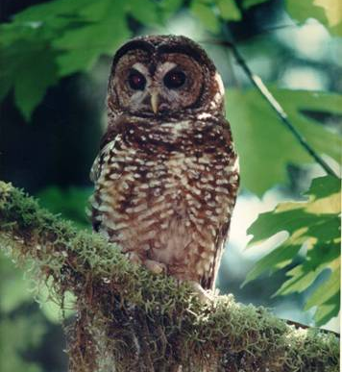
Competitive Exclusion Principle
The Competitive Exclusion Principle states that if two competing species occupy the same niche in the same habitat, one species will eliminate the other over time.
This concept becomes very important when considering how a species will respond to a habitat disturbance (later slides).
For example, if an invasive species is introduced that occupies the same niche as a native species, the native species may be outcompeted and may go extinct in that particular habitat (especially if the invasive species has no predators).
A species with a very narrow niche is called a specialist.
Specialist species are usually dependent on a very small number of other species and/or on very specific environmental conditions.
For example, spotted owls only live in the cavities of trees that are 200 years older or more – if all old-growth trees are cut, the spotted owl cannot survive.
Many endangered species are threatened because they depend on a specific set of environmental conditions which are affected by human development.
Source: gorgenewscenter.com

Slide 9
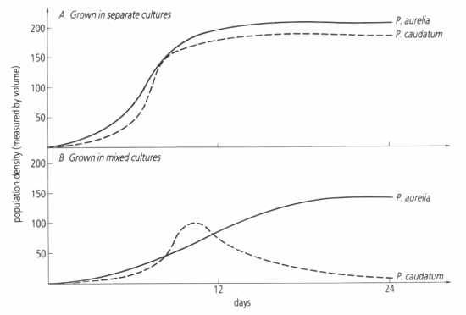
The Competitive Exclusion Principle.
The graphs here show the results of the original 1930s Gause experiment where two single-celled paramecium species were grown in a media solution.
When two species that occupy the same niche are grown in separate optimal conditions, they will both thrive (top).
However, when those same species occupy the same optimal conditions, they will compete with each other, with one species becoming eliminated (bottom).
Source: lungtp.com

Slide 10
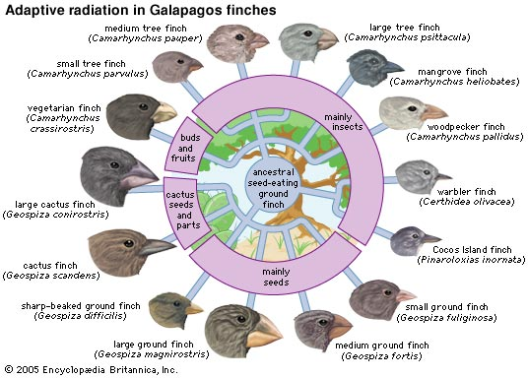
Habitat Extinctions
Specialist-niches occur because of the competitive exclusion principle – if a species cannot specialize, they may be outcompeted by another species occupying the same niche.
An example of this are Darwin’s finches – those finches that survived did so because they were able to adapt to a specific food source.
Some species are able to adapt to many different environments. A species that can adapt to many different conditions is called a habitat generalist.
If a habitat generalist is introduced by human activity to a new habitat, the introduced species may eliminate an existing species from its niche.
Source: www.avibushistoriae.com

Slide 11
Habitat Loss = Increase in Extinctions via CEP
As habitats become smaller and more sparse, the impact of the Competitive Exclusion Principle increases.
As habitat is lost around the world, more species will compete for fewer resources, resulting in an increase in habitat-specific extinctions.
As species become more scarce, the impact of the Competitive Exclusion Principle increases.
When resources are abundant due to high biodiversity, the effects of competition are less pronounced.
However, as biodiversity decreases and as ecosystem services become more scarce, the impact of the CEP is more likely to be observed.
This effect becomes even more observable with the introduction of non-native species who compete to occupy the same niche.
Source: en.wikipedia.org

Slide 12
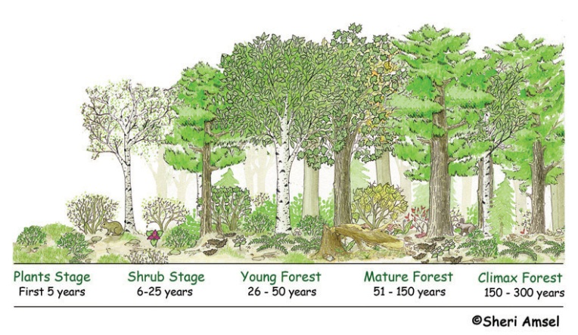
Succession
Succession is the natural process of change and transition in a habitat
E.g. a pond will eventually fill in with sediment to become a marsh. The marsh will eventually dry into a meadow. The meadow will become scattered with shrubs and then trees.
Eventually a full forest will occupy the same area and may remain until it is destroyed by a major natural process (fire, flood, glacier, volcano, etc.)
Succession occurs over thousands of years
It is a slow process that spans many generations of living species.

Slide 13
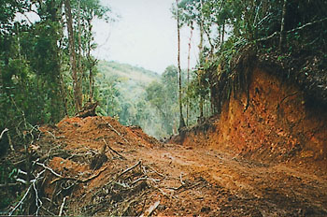
Succession vs. Disturbance
A habitat disturbance is when the normal function of a habitat is disrupted by an outside force.
This could be human-caused or could be the result of a natural disaster such as a tornado or fire.
Succession is very different from human disturbance.
Succession is slow and enables populations to move over time to new habitats that are more suitable.
Disturbances reverse the process of succession, causing an ecosystem to revert to an earlier successional stage or even causing an ecosystem to change into a different type.
Habitat destruction is the greatest cause of extinction.
The more disturbances to a habitat, the greater the likelihood of extinctions to living species.
worldtwitch.com

Slide 14
Positive Effects of Disturbances
Disturbances are a part of the natural cycle of a habitat.
Naturally-occurring disturbances are often a way to “re-set” the succession of a habitat.
For example, aspen trees rely on disturbances for their shade-intolerant seedlings to be able to compete for sunlight and nutrients.
Jack Pine trees depend on forest fires for their seed cones to open and disperse.
Human disturbances tend to differ from natural disturbances largely on the basis of their length of impact.
While a forest fire or tornado causes damage, this damage tends to be rapid and temporary.
On the other hand, human-based disturbances such as pollution, invasive species, or outright habitat destruction (such as building a road or urban sprawl) tend to last much longer.
The prevents the eventual return of species that otherwise would have re-populated the habitat.

Slide 15
Disturbances & Human Activity
Disturbance is a natural part of all systems.
All ecosystems undergo continuous pressures to change – a disturbance is simply an impact that delays or partially reverses the process of succession.
The disturbance may be very small (e.g. only affecting a small clump of trees) or large (e.g. a fire or tornado that destroys a large tract of forested area).
It is important to understand succession & disturbances from a “resilience perspective”.
Resilience is the ability of a habitat to return to its previous state after a disturbance occurs.
The greater the diversity of species and ecological processes, the more likely a system is to return into the type of system it was after it experiences a disturbance.
If native species and processes are lost, a landscape will be more likely to change into a different ecosystem as the result of a disturbance.
When biodiversity is lost, habitats become less able to recover from disturbances.
Human activity can both increase the number of disturbances to an ecosystem as well as increase the damage to a habitat from each disturbance.

Slide 16
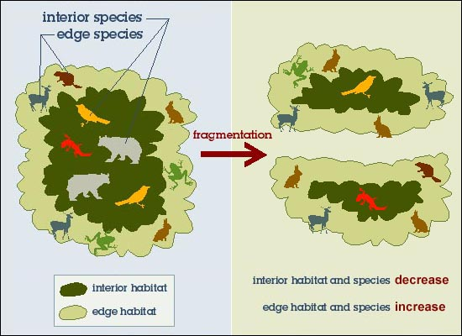
Measures of Habitat Health
One of the most direct indicators of whether a habitat is being negatively affected by a disturbance is biodiversity.
The greater the biodiversity, the healthier and more resilient a habitat tends to be.
Another method for measuring overall habitat health is fragmentation.
Habitat fragmentation is when a large habitat is broken into multiple smaller isolated habitats.
Biodiversity is maximized when habitat size is maximized. As habitats are reduced in size, biodiversity is also reduced.
Habitat fragmentation has two components:
Patchiness – how many ‘pieces’ the habitat is broken into (fewer pieces are better than more).
Edge – how much border a habitat has (less edge for the same area is better than more).
Source: terrienterritory.blogspot.com

Slide 17
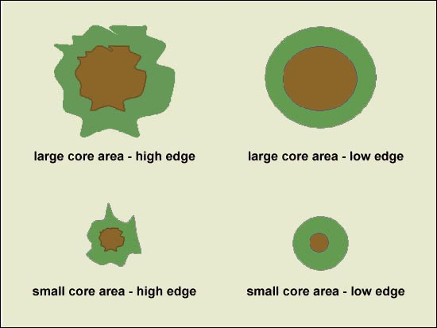
Detrimental Edge
The habitat edge is usually the most altered and damaged portion of a habitat. For example…
Edge is the most likely to be affected by disease. E.g. Emerald Ash Borer
The edge has the greatest temperature changes
Edge has the most invasive species
E.g. Buckthorn and Garlic Mustard prevalence
Edge is the most affected by pollution
Edge is the most damaged in storms
Edge is the most likely to be lost in fire

Slide 18
Mossy Rock
For example, an experiment by Gonzalez, et. al. in 1998 (published in the research journal Science) sought to demonstrate the effects of edge and patchiness in fragmentation.
Gonzales’ research team used mossy rocks to simulate what happens to habitats when they are fragmented.
These rocks served as a habitat for bacteria, fungi, algae, and insects.
The mossy rocks were sort of like micro-habitats but were affected by the same principles as much larger habitats (while being much easier to study).
Before beginning the treatment, species richness and abundance were measured on different moss-covered rocks. Moss was then scraped off in one of four ways:
A) A large area of moss was left as one solid piece (this was the control).
B) The moss habitat was broken into smaller individual pieces.
C) The same area of moss was broken into smaller individual pieces connected by small corridors (a corridor is a strip that connects two habitats).
D) The same area of moss was broken into smaller individual pieces connected by small broken corridors.
Source: Gonzalez, et. al. 1998. Meta-population dynamics, abundance, and distribution in a microecosystem. Science 281:2045-2047.

Slide 19
Mossy Rock
After 6 months, species in the large fragments remained largely unaffected.
However, 41% of the species in the isolated patches and patches with broken corridors went extinct.
In the habitats with continuous corridors, only 14.5% of the species went extinct.
Gonzalez’s experiment showed that habitat fragmentation results in a nearly universal decline in the number of species in a habitat and in the populations of those species.
Even if the same amount of habitat is available, if that habitat is broken into pieces through fragmentation, native species will most likely go extinct.
Source: http://bcs.whfreeman.com/thelifewire/content/chp54/5402004.html

Slide 20
Problems Created by Fragmentation
Populations decrease: because there is less habitat available, the habitats have a lower carrying capacity.
Inbreeding: because populations are isolated from each other, the availability of breeding mates is reduced, increasing the risk of inbreeding and loss of genetic biodiversity.
Increases of predators, parasites, and competitors: as the amount of edge in a habitat increases, so does the exposure to species that reduce native populations.
Changes to the physical environment: increases in edge also change the temperature, exposure to wind, rate of water loss, etc. of a habitat.
Elimination of species with large spatial requirements: e.g. wolves and grizzly bears tend to depend on large tracts of unobstructed habitat.
Increased risk of extinctions: all of these factors together contribute to an increased likelihood that species will be lost.

Slide 21
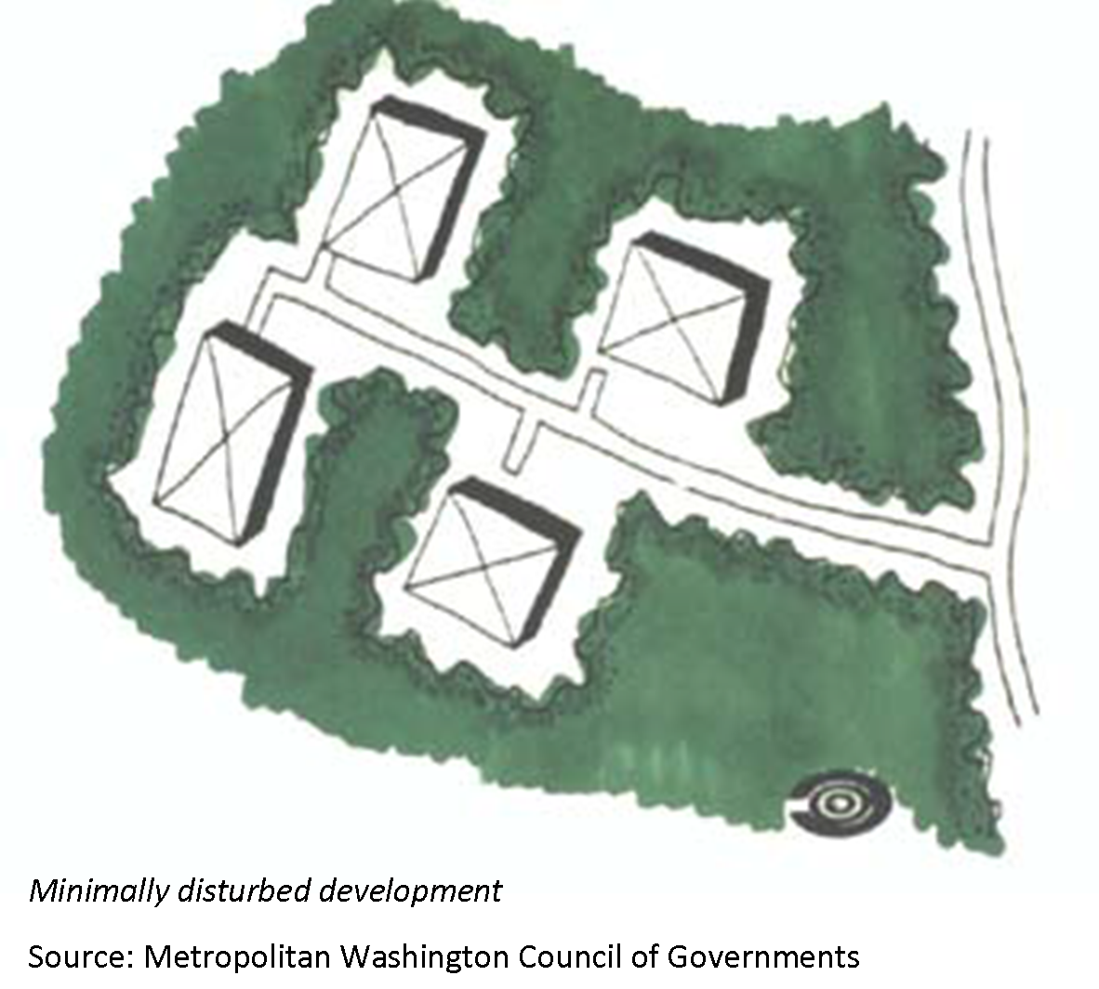
Causes of Habitat Fragmentation
Human Development: urban sprawl replaces habitats and corridors with houses and parking lots, but can also change the niche of a species.
For example, as human populations encroach on habitat in North America, species like deer and bear are more likely to become dependent on human activity for food.
Road-building: roads affect biodiversity in the following ways:
They create barriers to movement of species, isolating breeding populations.
The create easier access to populations by predators.
They increase the spread of disease and invasive species.
They increase the likelihood of species loss by vehicle collision.
Areas the supply different needs to a species may be separated by the road (e.g. if a breeding ground and a feeding area are separated by a road, a species may be lost in that area).

Slide 22
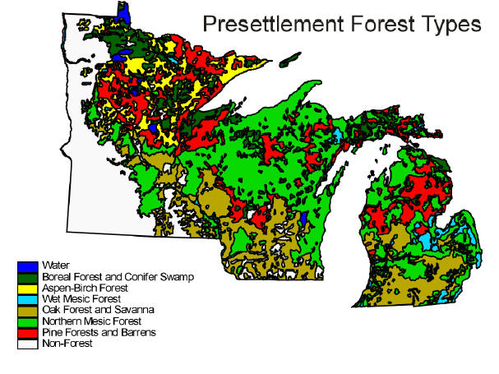
Causes of Habitat Fragmentation
Deforestation: when logging is performed by poorly-planned clear-cutting (especially if corridors are not provided), it can increase patchiness and edge while giving invasive species a chance to become established.
Conversion: when natural habitats are converted for non-natural uses (including agriculture, pasture, developed parks, etc.).
For example, over 99% of North American prairies were lost since European settlement.
Most of this was converted to monocultural fields.
Source: www.uwmc.uwc.edu

Slide 23
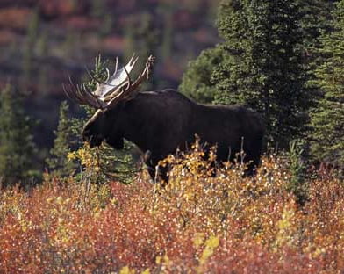
Structure & Habitat Health
Habitat health is not just a matter of size but also quality
For example, moose populations in eastern Canada were wiped out by clear-cut forestry.
Research found that moose could not tolerate the loss of more than 0.5 square miles of their habitat (Peek).
However, even the loss of a specific kind of species (without removing the rest of the vegetation) could cause losses in moose populations.
E.g. only removing coniferous trees was still harmful.
The greater the size of a habitat and the greater the biodiversity, the healthier a habitat will tend to be.
The most effective ways to manage a habitat are to increase the size of the habitat and minimize native species losses.
hickerphoto.com

