Slide 1
Pollution
By C. Kohn, Agricultural Sciences
Waterford, WI

Slide 2
What is Pollution
Pollution is any form of waste (usually, but not always, from human activity) that interferes with an ecosystem function or service.
  Waste is material, resource, or energy that is not being used efficiently or is produced in excess.
  Waste is usually human-specific (as very few things are wasted in nature; e.g. most animal waste serves as fertilizer and food for other organisms such as decomposers and plants).
For example, most water pollution is the result of nutrient runoff.
  Instead of staying in fields and on yards to fertilize crops and lawns, concentrated nutrients are being carried by rainwater into lakes, rivers and streams where they interfere with the normal function of an aquatic ecosystem.
Most people think of litter or garbage when they think about pollution.
  However, the kinds of pollution that tend to be the most harmful may not even be
  visible to the human eye.
  These can include excessive nutrient levels, heavy metals, carcinogens, and even
  carbon dioxide.

Slide 3
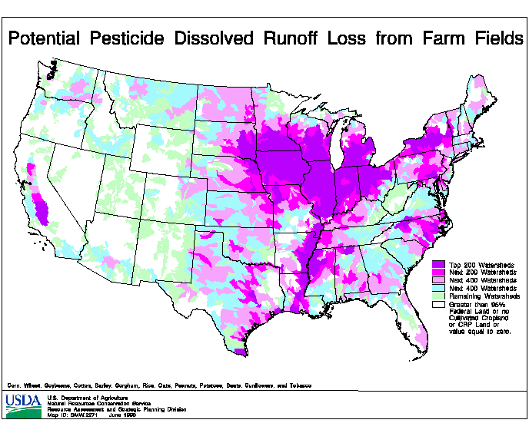
Pollution Costs Money
Pollution prevention is about identifying the practices or processes that create the waste that interferes with normal ecosystem functions and services.
  This can involve improving the efficiency of a process, reducing the amount of energy needed for a practice, substituting less toxic, biodegradable ingredients for current sources of toxic pollutants, and reducing the amount of natural resources needed for a person’s lifestyle.
While pollution can be devastating to ecosystems and is one
of the four major causes of extinction, it is also expensive.
  Because pollution is waste, by existing it causes money.
  For example, the nutrients that run off a field/yard into a waterway had to
  be purchased by a farmer or homeowner, but also are not supporting the
  plants they are growing.
However, it also costs money to clean up pollution.
  Pollution hurts people economically both by causing the loss of purchased
  resources, but also by requiring later cleanup.
  The only economical way to deal with pollution is to prevent it from occurring.
Source: www.nrcs.usda.gov

Slide 4
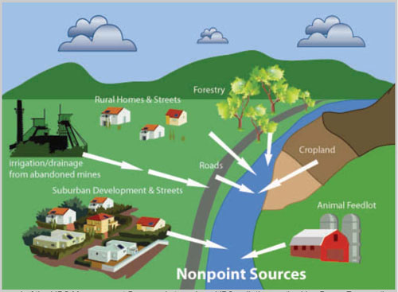
Categories of Pollution
All sources of pollution can be grouped into one of two categories: point or nonpoint.
Point pollution comes from a single source, such as a factory or large farm.
  Point pollution is easier to eliminate because it comes from one place.
  If a source of point pollution is identified, state and federal regulators can take legal action to stop the introduction of a source of pollution.
Nonpoint pollution comes from many sources.
  For example, if many residents of a city over-fertilize their yards, it is impossible to
  go to only one place to stop the introduction of pollutants.
  For this reason, nonpoint pollution is much harder to treat.
  Common nonpoint pollutants include fertilizers, motor oil, and household chemicals.
  Automobile exhaust could also be considered a source of nonpoint air pollution.
From here, we can recognize six kinds of pollution. Each kind of
pollution consists of both point and nonpoint pollution.
Source: www.nptwaterresources.org

Slide 5
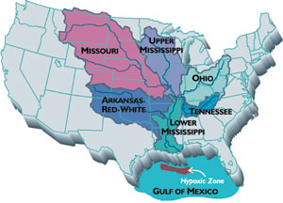
Kinds of Pollution
Air Pollution: this can include anything that is not nitrogen, oxygen, water, or water vapor.
  A major cause of air pollution are partial hydrocarbons – when fossil fuels are burned, the fossil fuel molecule (the hydrocarbon) may not be completely broken down (e.g. soot is a partial hydrocarbon).
  Partial hydrocarbons are very reactive and are known to cause health problems, including cancer, when people are routinely exposed to them.
  Sulfur dioxide and nitrogen oxide (which occur when fossil fuels are burned) are also major
  contributors to air pollution and when they mix with water vapor they form acid rain.
  Excess carbon dioxide production results in increased heat retention in the atmosphere.
  This can change weather patterns, increase global surface temperatures, and alter natural
  ecosystem functions and services.
Water Pollution: common sources are synthetically-produced chemicals, sewage,
pesticides, heavy metals, and fertilizers.
  Many synthetic chemicals can become toxic while sewage and nutrient pollution cause aquatic oxygen levels to drop.
  The Mississippi River carries an estimated 1.5 million tons of nitrogen pollution into the Gulf of Mexico each year, resulting in a Dead Zone the size of New Jersey each summer.
  40% of rivers and 46% of lakes in the US are too polluted for fishing, swimming or aquatic life.
Source: insideclimatenews.org

Slide 6
Kinds of Pollution
Land Pollution: this can include industrial waste but it can also include household garbage.
  According to the EPA, the average American produces 4.3 lbs. of waste per day.
  Of this, over half becomes part of a landfill while roughly only a third is recycled.
  While oil and chemical refining are major contributors to land pollution, so are household wastes such as paints, solvents, motor oil, fluorescent lights, aerosol cans, and ammunition.
Noise Pollution: while we can’t see or smell it, excess levels of noise has been shown to cause environmental harm.
  In human populations, excess noise increases the risk of stress-related illness, high blood pressure, and hearing loss.
  In aquatic ecosystems, excess noise has been shown to upset the navigation of whales and even kill other species.
  The EPA classifies noise as a form of air pollution and has jurisdiction to regulate it as a pollutant.
Light Pollution: when artificial lighting is exposed to natural ecosystems, problems can occur.
  Longer feeding times from birds who are active for longer periods of time have been shown to alter migration patterns.
  Streetlights have been shown to confuse newly hatched sea turtles, who use starlight reflected off waves as an indicator of which direction to move after hatching.

Slide 7
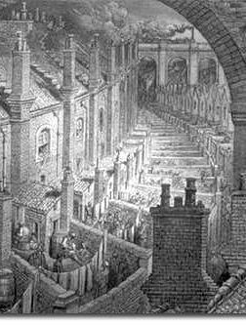
History of Pollution
Pollution is not a new phenomenon.
  By the 1800s, people began to connect unsanitary living conditions and the spread of disease and plagues (such as the Black Plague, which was able to develop in dense urban areas where human waste and garbage accumulated quickly) as the result of the work of scientists such as Louis Pasteur.
  By the 1850s, Chicago became the first major US city to develop a major sewage-treatment system.
  As the US and other nations became more industrialized, the limits to the ability of the environment to process and eliminate waste became more and more apparent.
As the Industrial Revolution changed cities across the world by the
early 1900s, waste from industries and factories became much more
evident, replacing human waste as the primary pollutant.
  Increasingly, waterways near cities became visibly affected by sulfuric acid,
  soda ash, dyes, wood pulp, animal byproducts, and other waste products of
  industrialization.
Source: permaculturenews.org

Slide 8
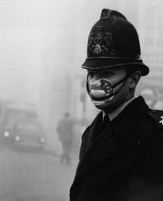
Pollution Nightmares
In Cleveland, the Cuyahoga River became so polluted that it caught fire in 1936, when a spark ignited floating pollutants.
  The river caught fire several more times in the following decades.
Air pollution also became increasingly apparent.
  In the 1800s, smog caused many deaths in large cities like
  New York and London.
  In October 1948, 20 people in Donora, PA died as the result
  of severe air pollution and thousands more were severely sickened.
  In 1952, an event now called “The Great Smog” killed 4000 people
  in London and sickened over 100,000 as airborne pollutants and
  smoke from coal burning mixed with heavy fog and windless
  conditions.
Source: blog.iso50.com

Slide 9
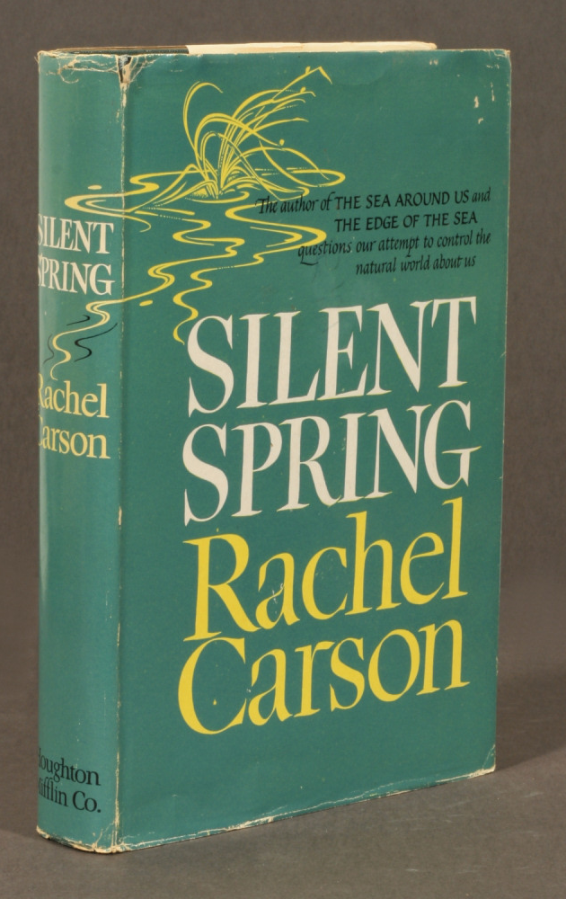
Pollution Nightmares
In addition to outright signs of air and water pollution, wildlife were
showing signs of impact from pollutants as well.
  One of the most famous examples of this was highlighted in Rachel Carson’s
  Silent Spring.
  This 1962 book exposed the impact of the pesticide DDT on large bird kills.
  DDT was a widely popular pesticide in the US, and Carson’s efforts to expose
  its effects faced widespread criticism.
Silent Spring was written after four years of meticulous research.
  In this book, Carson described how DDT accumulated in the tissues of living
  organisms and became more concentrated as it worked its way up the food chain.
  Carson concluded that even one application of DDT remained in the environment
  for long periods of time.
  Once in the environment it could cause cancer and genetic damage, and weakened
  the egg shells of many species of birds which prematurely killed the chicks.
Source: www.everseradio.com

Slide 10
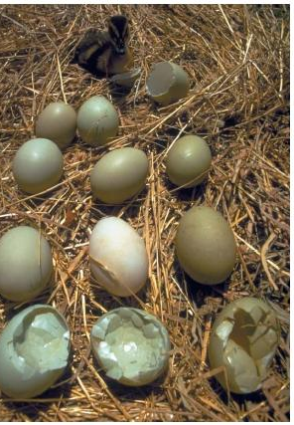
Bald Eagles & DDT
Bald eagles became a prominent victim of DDT.
  After rain, DDT residues would accumulate in lakes and rivers, where it
  was absorbed by aquatic plants and fish.
  Bald eagles would be poisoned by DDT when they consumed those fish.
  The poisoned bald eagles then laid eggs with weakened shells that would
  later fail to hatch.
The use of DDT, in combination with other factors including
hunting, mercury and lead poisoning, and habitat loss decimated
the bald eagle population.
  By 1963, only 487 pairs of bald eagles remained.
  Wisconsin became the first state in the nation to ban DDT in 1970, and a
  federal ban on DDT was established in 1972.
  Today there are nearly 10,000 breeding pairs of eagles in the US, down
  from an estimated 100,000 when it was adopted as the national symbol in 1782.
Source: www.scienceclarified.com

Slide 11
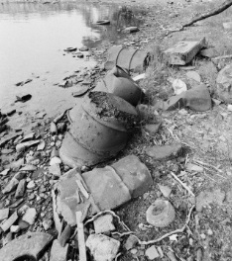
Love Canal
Americans became aware of the damage that the waste from modern life could have on the environment after the Love Canal tragedy.
  The Love Canal was a short canal that connected the upper and lower Niagara Rivers in Niagara Falls, NY.
  After a failed attempt at creating a power station on the site, the canal became an industrial chemical dumpsite in the 1920s.
  In 1953, Hooker Chemical Company filled in the canal/dumpsite with dirt and sold it to the city for $1.
Roughly 100 homes and a school were built on top of this site after it was
sold to the city.
  In 1978, the chemicals underneath the school and homes mixed with heavy rainwater and
  caused an explosion.
  Corroded waste drums leeched dangerous toxins and backyards were littered with puddles
  of noxious chemicals.
  The NY State Health Department reported that high rates of miscarriages and birth defects,
  and large percentages of the residents showed early signs of leukemia.
The EPA estimated that there were hundreds of similar dumpsites across the US.
Source: www.corbisimages.com

Slide 12

Federal Legislation
As a result of these incidents, many governments passed legislation to reduce pollution and improve the environment. In the US, major acts included:
  Clean Air Act of 1963, which established federal air quality standards.
  Clean Water Act of 1964 (Amended 1972 and 1977), which created federal action to restore US waterways. The ’72 and ’77 amendments regulated the discharge of pollutants into waterway, gave the EPA power to implement pollution control programs, set water quality standards, and funded the construction of sewage treatment plants.
  Clean Air Act of 1970, which stated that air was a resource that could be protected from pollution.
  It also established air quality standards to protect human health and amendments in 1990 added
  acid rain, ground-level ozone, and the hole in the ozone layers as issues to address.
  Federal Pesticides Control Act of 1972, which mandated that all pesticides in use be registered
  and tested before approval.

Slide 13
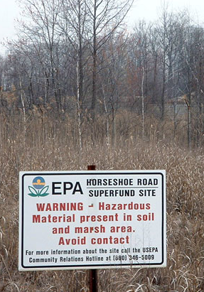
Federal Legislation
  Ocean Dumping Act of 1972, which prohibited the dumping of sewage and industrial waste into oceans.
  Safe Drinking Water Act of 1974, which set standards and regulated public drinking water.
  Toxic Substances Control Act of 1976, which regulated toxic substances.
  Resource Conservation and Recovery Act of 1976, which required the federal
  tracking of hazardous wastes and mandated that states establish hazardous
  waste management plans.
  The Comprehensive Environmental Response, Compensation, and Liability
  Act of 1980, which used the Superfund to clean up hazardous waste sites.
    Superfund is the name for the federal program to clean up abandoned hazardous
    waste sites and compelled responsible parties to either conduct the cleanup
    themselves or reimburse the federal government.
Source: www.earthyreport.com

Slide 14
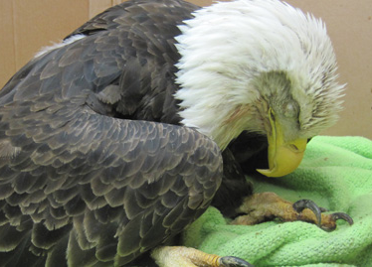
Pollution Today
Despite the large amount of federal legislation that was passed in the 1960s and 1970s, pollution still remains a major issue today. Major sources of pollution today include:
Lead: a metal found in many ores. Lead is widely used because it is dense, does not corrode, and is malleable.
  When humans or animals are exposed to lead, it moves to the brain, kidneys, and bones, causing neurological, gastrointestinal, and cardiovascular problems.
  Because lead is an atomic element, it cannot be degraded and can move
  throughout the body – lead will remain in the body with continued exposure.
  Lead exposure during pregnancy can lead to miscarriage, stillbirth, low birth
  weights, premature births and birth defects.
        Source: Mils-Knapp, Sara, et. al. 2008. The World’s Worst Pollution Problems.
        Blacksmith Institute. New York, NY.
Eagle w/ Lead Poisoning.
Source: www.abcbirds.org

Slide 15
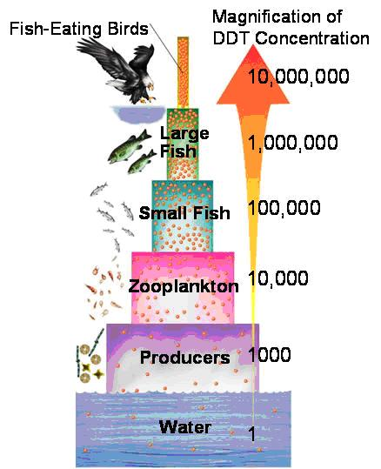
Lead & Bioaccumulation/Biomagnification
Lead, like many heavy metals such as mercury and copper, has the potential to bioaccumulate and biomagnify.
  Bioaccumulation is the process in which a substance can move from the environment into a food chain.
  Biomagnification is the process in which a substance can move from the base to the top of the food chain.
In order for a substance to biomagnify, it must have the following properties:
  It must be long-lived an not break down in the environment.
  It must be mobile (e.g. able to be blown in the wind or carried by water).
  It must be fat-soluble (if not, it will be eliminated with the organism’s waste).
  It must be biologically active (i.e. it affects an organism’s bodily function).
Substances that can biomagnify are a concern because even small
concentrations of chemicals in the environment may cause toxicity
in predators as concentrations of the substance increase in the food chain.
Source: www.goldiesroom.org

Slide 16
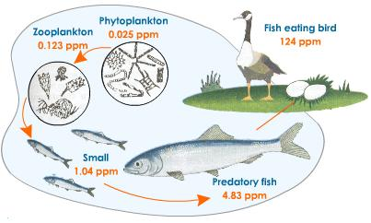
DDT & Biomagnification
Like lead, DDT can also bioaccumulate and biomagnify.
  DDT is fat soluble, mobile, long-lived, and reacts with an organism when ingested.
  A 1967 Long Island study showed the following changes –
    Zooplankton at the base of the food chain absorbed 800x more DDT than the water around them. When small fish ate those zooplankton, they accumulated 31x more DDT than the zooplankton, which resulted in a bodily concentration of DDT that was 24,800x greater than the water.
    When predator fish consumed the smaller fish, they had a 1.7x greater concentration than their prey, which was 42,160x greater than the water. When birds consumed the predator fish, they increased the DDT concentration by 4.8x, resulting in a bodily concentration that was over 200,000x greater than the environment.
As a result of bioaccumulation and biomagnification, as a pollutant
proceeds up the food chain, it accumulates in each organism
  DDT, heavy metals, and other substances have greater concentrations as you
  move up the food chain.
  While concentrations of a biomagnifiable pollutant may be low in the environment itself, these concentrations will be hundreds of thousands times greater in the tissue of top predators like eagles, bears, sharks, and humans.
Source: www.tutorvista.com

Slide 17
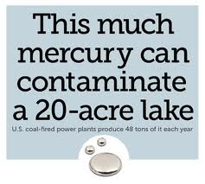
Pollutants Today
Other biomagnifiable metals include mercury and chromium.
Chromium-6: a metal used in steel, dyes, plastics, and leather.
  While chromium-3 is naturally found in the human diet, the version used for industrial processes (chromium-6) is not.
  Chromium-6 is a known carcinogen and has been shown to cause lung cancer in humans when inhaled.
Mercury: a metal element that is liquid at room temperature.
  Emissions from burning coal are the primary source of mercury in the US. Mining
  (especially coal and gold) and chemical manufacturing are also key sources.
  Mercury is known to cause kidney failure, immune system impairment, brain &
  spinal cord damage, and can alter the function of enzymes and DNA.
        Source: Mils-Knapp, Sara, et. al. 2008. The World’s Worst Pollution Problems.
        Blacksmith Institute. New York, NY.
Source: thearrowsoftruth.com

Slide 18
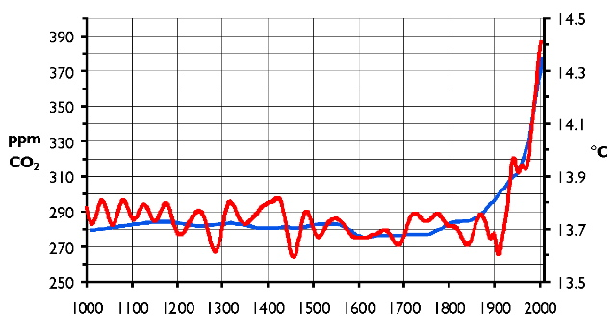
Carbon Dioxide
Heavy metals are not the only pollutants that affect ecosystems today. Others include:
Carbon Dioxide: while CO₂ is a naturally occurring waste product of cellular respiration, decomposition, and combustion, this gas can be considered a pollutant today because of its current rate of production.
  Prior to the Industrial Revolution, CO₂ was produced and absorbed
  (through photosynthesis) in roughly the same rates.
  For over 500,000 years, the levels of CO₂ in the atmosphere hovered
  around 200-300 ppm.
  Today CO₂ levels are much higher at 400 ppm, causing shifts in ecological
  processes such as surface heat retention, the acidity of aquatic ecosystems,
  and global weather patterns.
  Today’s rate of increase of both CO₂ levels and average global temperature
  have never been seen in any natural cycles, and because they coincide exactly
  with the use of fossil fuels, we know that human activity is primarily to blame.
Source: www.art.ccsu.edu

Slide 19
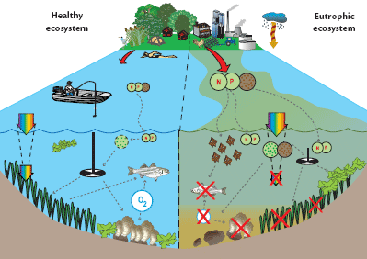
Nitrogen & Phosphorus
Nitrogen and phosphorus are the primary causes of eutrophication.
  Eutrophication: the process in which levels of dissolved oxygen in aquatic ecosystems are reduced due to excessively high nutrient levels.
  As oxygen levels decrease, the ability of an aquatic ecosystem to support native species and function also decreases.
Eutrophication begins when nutrients move from fields
and yards into surface water (lakes, rivers, and streams).
  This is usually the result of runoff from rain or snowmelt.
As nutrients enter freshwater ecosystems, they have the
same effects as they did in a field or yard: they cause
photosynthetic organisms to grow.
  This causes a thick mat of algae to grow on the surface of the water.
Source: beachchairscientist.com

Slide 20
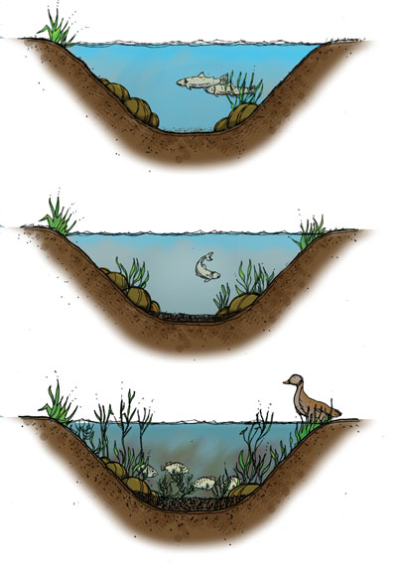
Eutrophication
As algae grows on the surface of the water, it begins to reduce the
amount of light that reaches plants below the water.
  While algae are thriving on the surface of the water, plants beneath begin to shut down.
  Without light to power photosynthesis, underwater plants cannot survive.
  When underwater plants stop photosynthesizing, they also stop the production of oxygen.
As the underwater plants stop photosynthesizing and die,
decomposers break down the plant matter.
  Decomposers use up oxygen as they decompose. More decomposition results in
  even less oxygen.
As oxygen levels continue to decrease from reduced photosynthesis
and increased decomposition, other organisms become starved for oxygen.
  Oxygen-dependent species such as trout and stoneflies are lost or leave, changing the
  aquatic food web and increasing the ability of invasive species to take over.
Source; www.houghtonlakeboard.org

