Slide 1


Sustainability
By C. Kohn
Agricultural Sciences
Waterford, WI

Slide 2
Sustainability
Sustainability refers to choosing practices that allow for needs to be met without compromising future generations.
  For example, fossil fuels are non-renewable and our current usage is not sustainable – we will run out of affordable fossil fuels some day.
  Reducing the use of non-renewable fossil fuels ensures that future generations will have access to this source of energy.
  Eliminating the use of highly-polluting fossil fuels ensures that less damage occurs to other renewable sources such as soil, air, water, and living species.
Sustainability has three components – economic,
ecological, and social.
  Ecological sustainability means that a choice will not
  reduce the ability of an ecosystem to provide renewable
  goods and services.
  Social sustainability means that a choice will be fair,
  equitable, and available to all users without major lifestyle
  or cultural changes.
  Economic sustainability means that a choice will not
  use up an unreasonable amount of a person’s income.
Ecological
Social
Economic

Slide 3

What are sustainable practices?
Examples of sustainability include:
  Minimizing waste at all levels (production, consumption, and disposal).
    E.g. increasing the use of local foods instead of reliance on long-distance sources.
  Utilizing, not fighting, natural cycles and biological systems.
    E.g. enhancing the populations of valuable insects and bacteria rather than killing any and all insects/bacteria.
  Preventing and eliminating pollutants and invasive species.
    “An ounce of prevention is worth a pound of cure” applies here very well.
  Recycling & reusing raw materials as often as possible.
  Composting to return nutrients to a cycle.
    This is a low-energy way to add fertility to soil as
    opposed to energy-intensive synthetic fertilizers.
  Preventing soil erosion/topsoil depletion.
  Minimizing non-renewable energy use.
  Using practices that enhance, not reduce, biodiversity.
    E.g. growing prairie grasses in medians instead of lawns.
  Supporting communities, families, and social structures through
  economic incentives and personal relationships.
    Sustainability does not just apply to wildlife and plants!
Notes:
Examples could include:
Buying from the farmers market instead of corporate chain stores
Formation of cooperatives or employee owned businesses
Banking at local credit unions
Supporting different cultures and traditions - we are losing many of the languages of the world (it would be great to ask your student why this might matter to us).

Slide 4
Common Themes of Sustainability
Stewardship of Natural Resources
  Human beings have a responsibility (economic, moral, etc.) to care for the living things around them.
  This is known as the Land Ethic (among many other terms).
Systems Approaches
  Natural Systems exist for a reason – living species have adapted to take advantage of these systems in order to minimize the energy required for existence.
  Adapting to these systems increases the sustainability of a practice by reducing energy inputs.
Long-term Planning
  Short, quick fixes are rarely sustainable.
  Sustainability requires foresight, planning, investment, and education,
Adaptation to Change
  Living things change. Sustainable systems must benefit from,
  rather than fight ,change.
Sustainability Must be Socially and Economically Justified
  If sustainability comes at the expense of one group of people, it is not sustainable.
  If sustainability is not affordable to a group of people, it is not sustainable.

Slide 5
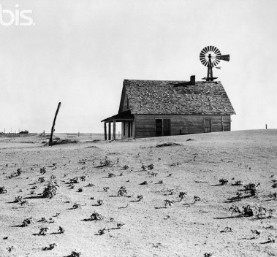
The Dust Bowl
A common example of poor sustainability is the worst man-made ecological disaster on record, the Dust Bowl of the 1930s.
  Widespread and continual plowing of virgin topsoil in North American prairies caused extensive erosion.
Previously, deep-rooted prairie grasses kept the soil in place.
  The deep roots trapped moisture and provided structural support to the thin topsoil in a dry, arid region.
Rapid mechanization of agriculture enable
human populations to completely change
enormous areas of land.
  Small gasoline tractors and the introduction of the
  combine changed how quickly the landscape could
  be changed by agriculture.
Source: tiggernut.com

Slide 6
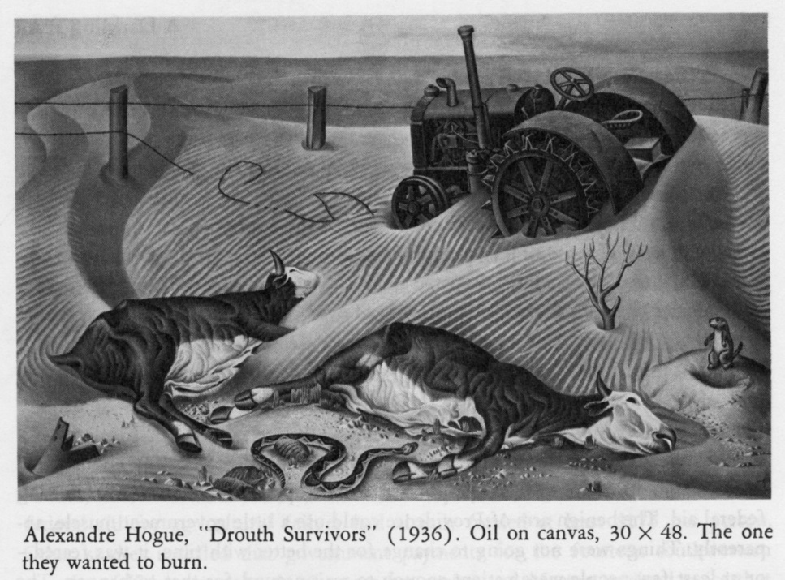
The Dust Bowl
A combination of rapid agricultural mechanization, unprecedented changes to the prairie ecosystems, and a decade-long drought led to the Dust Bowl.
  With no deep-rooted grasses to hold the soil and keep it moist, the topsoil dried out and turned to dust.
  This dust was picked up by the wind, blackening the sky.
  In some cases, these dust clouds reached as far east as New York City and Washington, D.C.
As a result of this, hundreds of
thousands of farm families lost
their income, livelihoods, and
communities and contributed to
the impact of the Great Depression.
  Books like The Grapes of Wrath and Of
  Mice and Men chronicled the personal
  devastation of this ecological disaster.
Source: www.ldeo.columbia.edu

Slide 7
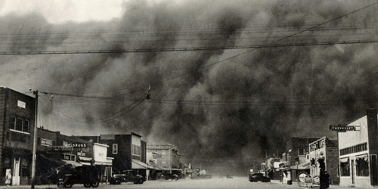
Why Did the Dust Bowl Occur?
The Dust Bowl occurred because of a poor understanding of sustainability. Examples include:
Poor Stewardship of Natural Resources
  Few at the time understood the obligation people have to preservation of ecosystems.
  99.9% of prairie ecosystems have been lost since European settlement in North America (Univ. of Nebraska, 1994).
Lack of Usage of Natural Systems
  The prairie is a natural living thing with its own systems, without which the living components of a landscape cannot survive (just like you cannot survive without a circulatory system).
  When components of this system were lost
  (such as when the deep roots of prairie grasses
  were replaced by the shorter roots of wheat),
  the system that had preserved itself over
  hundreds of thousands of years was lost.
Source: www.popmatters.com

Slide 8
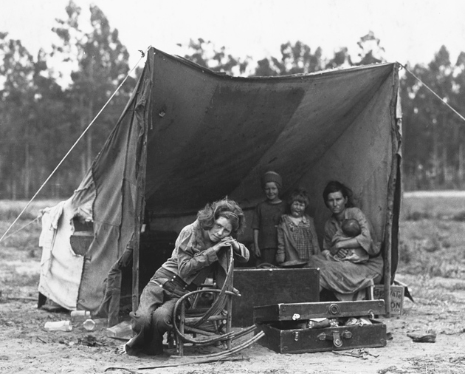
Why Did the Dust Bowl Occur?
No Long-term Planning
  Little to no long-term planning existed in Western agriculture at this point.
  Large tracts of cheap land with fertile soil and a high demand for wheat led to get-rich-quick mentalities in 1800s and 1900s pioneers.
No Adaptability to Change
  Early settlers of the prairies did not anticipate nor plan for changes to the ecosystems on which they depended.
  When those changes did occur, their only remaining option was to leave (e.g. Okies who migrated to California in The Grapes of Wrath).
    Globally-speaking, we do not have the
    option to leave.
No Economic and Social Sustainability
  As a result of little or no sustainable practices,
  entire communities were wiped out, large
  numbers of people had to leave their homes,
  and the worst economic depression in US history
  was made worse.
Source: blogs.kqed.org

Slide 9
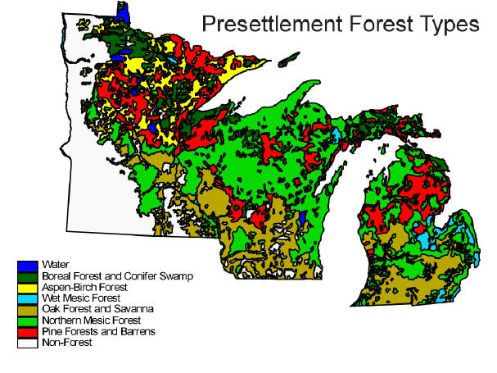
Sustainable Forestry
Forestry is an example of both poor and excellent sustainability.
  Up to the early 1900s, forestry was an epitome of unsustainable usage of a natural resource.
  Modern forestry in North America is now an example of how sustainable use of a resource can be beneficial in all three areas of sustainability – ecological, economical, and social.
After the Northwest Ordinance of 1787 divided the Great Lakes region into townships and sections, a lot of land became the property of railroads and lumber companies.
  America was a rapidly growing nation, and the
  explosive growth of eastern cities created a strong
  demand for building materials.
  White pine made a great building material and
  could easily be transported by floating it down rivers.
  By the 1840s, white pine supplies were largely
  depleted in the East, and so the Great Lakes
  became the next-best source of this natural resource.
Source: uwmc.uwc.edu/geography

Slide 10
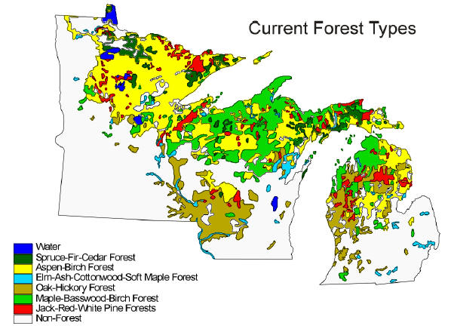
Wisconsin Forest Destruction
By 1867 it was necessary for the Wisconsin Legislature to establish a special commission to study forest destruction.
  Not only were pine forests being completely cleared by lumber companies, but their practices also led to widespread degradation of the natural systems that enabled the forests to grow.
The effects of this unsustainability culminated in 1871 with the Great Peshtigo Fire, which caused the greatest loss of life by a fire in US history.
  Up to 1500-2500 people died in a single day in this fire (Biondich, 2010).
  While the Chicago Fire occurred on the same day, the Peshtigo fire was far more deadly.
  A wall of fire a mile high and five miles wide traveled at speeds up to 100 mph across northern Wisconsin (Lutz, 2003).
Between 1890 and 1910 almost all economic stands of
pine had been cut or burned (Stearns, 2004).
  By the 1920s, much of Wisconsin’s hemlock trees were harvested.
  By the 1900s, loggers had to switch to less-valuable hardwood.
  Clear-cutting remained the dominant mode of logging, and
  widespread forest fires and soil erosion caused major ecological
  damage.
Source: uwmc.uwc.edu/geography

Slide 11
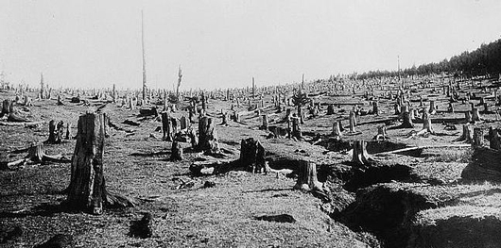
Wisconsin Takes Action
In 1897, the Wisconsin Legislature established the State Forestry Commission.
  The job of the Commission was to find ways to preserve Wisconsin’s forests without impacting the state’s economic development.
  In 1904, E. M. Griffith was made the first State Forester.
  The first State Forest was established in 1925 (the Northern Highland-American Legion State Forest).
As a result of the Great Depression of the 1930s, the state and federal forest services were able to acquire large tracts of forested land.
  Nicolet and Chequamegon National
  Forests were established in 1933.
  Today 28 state forests exist with over
  2 million acres of protected land.
Source: www.dailyyonder.com

Slide 12
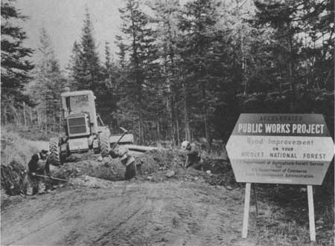
Governance of Wisconsin Forests
“Wisconsin state forests are governed by Wisconsin Statute 28.04.
  This states that "The Department shall assure the practice of sustainable forestry and use it to assume that state forests can provide a full range of benefits for present and future generations."
  Here 'sustainable forestry' is defined as the practice of managing dynamic forest ecosystems to
  provide ecological, economic, social, and
  cultural benefits for present and future
  generations.
          Source: "History of the lake States forests: natural
          and human impacts," by Forest W. Stearns
Source: www.foresthistory.org

Slide 13
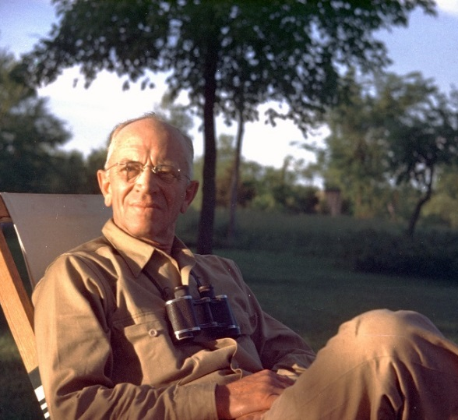
Wisconsin’s Forestry Impact
As a result of the hard-learned lessons on sustainable forestry, Wisconsin and many Great Lakes states contributed to a national change in how sustainability is viewed.
  At the forefront of this movement was Aldo Leopold.
Aldo Leopold is considered the father of the science of Wildlife Management and US wilderness management.
  As a professor at UW-Madison, Leopold published the first textbook on wildlife management in 1933.
  Leopold became the nation’s first academic chair
  of wildlife management in 1934.
  In 1935, Leopold restored the natural landscape
  on a property near Baraboo, WI.
    It was here that Leopold wrote A Sand County
    Almanac, considered to be one of the most
    respected books about the environment ever
    published.
Source: www.prx.org

Slide 14
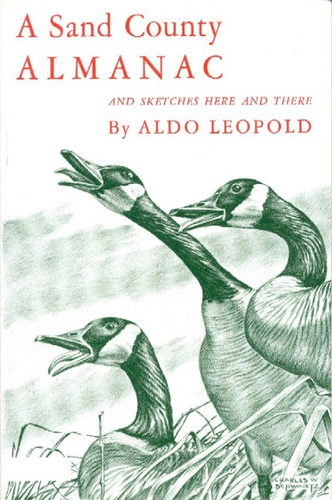
The Land Ethic
Leopold’s ‘Land Ethic’ defined a new relationship between people and nature.
  The “Land Ethic” essay was published in 1949 as the finale to A Sand County Almanac.
  This idea set the stage for the modern conservation movement.
Leopold knew that ethics exist among groups of people for the mutual benefit of all.
  In other words, the more ethically we treat other people,
  the more ethically we will be treated and the better our
  lives will be.
  His idea was that the concept of this ‘community’ should
  be enlarged to include non-human elements.
    This would include soil, waters, plants, and animals.
      Collectively, Leopold considered these elements together to be
      “the land.”
Source: www.artintheage.com

Slide 15
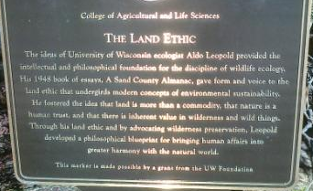
The Land Ethic, Simplified
Leopold’s “Land Ethic” means that we have a moral and ethical obligation to treat natural resources with the same respect and integrity that we would and should treat other people.
  Prior to the Land Ethic, natural resources were only viewed as an economic good.
  Leopold’s philosophy meant that before we consider the economic implications of our use of natural resources, we must consider our moral obligations to ecosystems, living organisms, and future generations.
Leopold’s ideas started a complete
reversal in the way Americans
viewed natural resources.
Source: blogs.scientificamerican.com

Slide 16
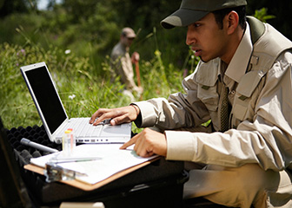
Sustainable Forestry
As a result of the Forestry Commission, Aldo Leopold, and many other influences, forestry in Wisconsin and the US began to become sustainable and ecologically valuable.
  Modern forestry today works under the understanding that in order for logging to be profitable in the long run, it must ensure the permanent existence of healthy forests.
Sustainable forestry necessitates the knowledge of each kind of tree’s unique requirements and adaptations, as well as the threats and opportunities each forest ecosystem provides.
  A trained forester will be able to identify
  opportunities to improve a forest ecosystem’s
  sustainability.
  Foresters do this through careful selection of trees
  to harvest and elimination of threats such as
  disease, insect attacks, and fire.
Source: www.bls.gov

Slide 17
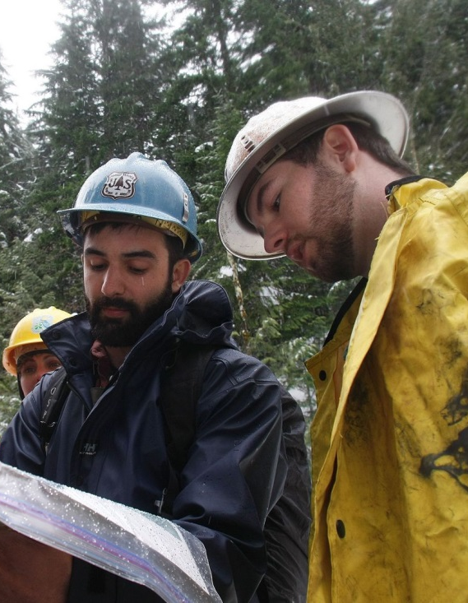
Sustainable Forestry
Sustainable forestry is the harvest of trees at a rate and in a way so that as many or more trees grow to replace those that are lost.
  Sustainable forestry is not just the removal of trees but also the management of the forest itself.
Foresters must…
  Regulate the spread of fire and disease.
  Identify and control harmful insects and pests.
  Prevent harmful plants from crowding out
  beneficial trees.
  Ensure that trees have access to sunlight,
  water, nutrients, and space.
  Prevent water pollution, soil erosion, and
  other harmful potential byproducts of logging.
Source: f2.washington.edu
Notes:
Note: fire is important for many forest ecosystems, so it may be necessary to have controlled burns for a healthy forest.

Slide 18
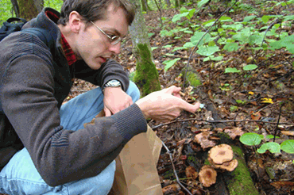
Sustainable Forestry Techniques
Foresters have a range of options to improve a wooded area, including…
  Improvement harvest: removing trees that have poor health so that younger, more vigorous trees can grow in their place.
    The presence of sick or dying trees puts healthy trees at risk.
  Timber Stand Improvement: needed if a forest isn’t ready for a harvest of trees.
    This includes removing weeds, invasive species, and vines; removing cull trees (trees with no usable wood); and pruning (removing excess branches from a tree to allow it to put more of its energy into making wood).
  Diversity improvements: these are practices that encourage forests to have a wide diversity of native species.
    This can even include prescribed clear-cutting so that shade-intolerant species such as aspen can grow.
    It may also include establishing areas that are untouched in order to provide old-growth forest tracts.
  Regeneration: management of a forest that promotes the
  growth and development of new trees.
    This involves supporting and maintaining the growth of
    healthy, valuable, native trees in a forest.
Source: www.careerrelay.com

Slide 19

Final Word
Any sustainable practice should entail the following:
  Meet legitimate human needs for food, fiber, and fuel.
    Examples of fiber include wood, wool, cotton, etc.
  Protect the natural resources that supply food, fiber, and fuel to human populations.
  Protect the natural systems that supply the natural
  resources needed by humans.
  Prevent unnecessary waste of food, fuel, and fiber.
  Support and even use natural biological cycles and
  systems in the production of food, fiber, and fuel.
  Assure the economic, social, and cultural well-being
  of the people who sustainably provide food, fuel
  and fiber.

