Slide 1
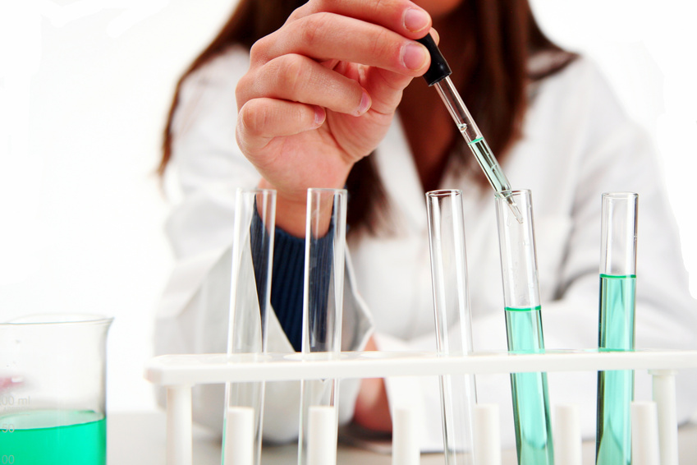
Biotechnology in Agriculture
C. Kohn

Slide 2
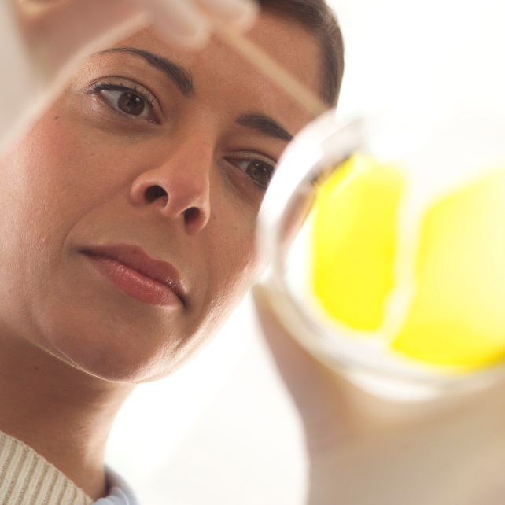
What is Biotechnology?
Biotechnology is the process of changing living species or a biological process to benefit human activity.
  Biotechnology can range from something as simple as artificial selection to something as advanced as cloning or gene splicing.
Biotechnology is central
to agriculture.
  Without changes to living
  species, agriculture could not
  exist.

Slide 3
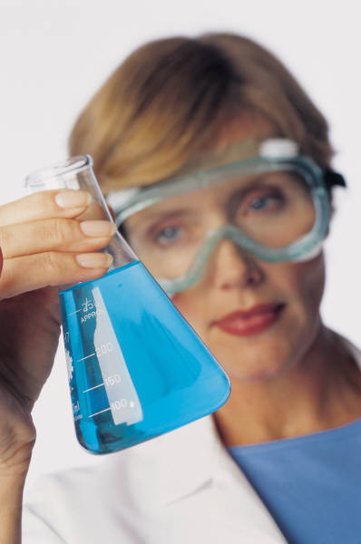
Motivation for Biotechnology
Biotechnology enables humans to change living things in ways never thought possible.
  Scientists can literally re-write the genetic code of living species in order to enable them to produce more valuable products or services.
Through advances in biotechnology, scientists can increase the rate and specificity of the changes made to living species.
  While previous changes to a species
  may have taken hundreds or thousands
  of years, today scientists can create
  entirely new traits within one generation
  of a species.

Slide 4
Biotechnology and Genomes
Biotechnology involves changing the genome of organisms.
  A genome is complete set of genes in the DNA of an organism.
    The genome of a species consists of every chromosome that an individual could possess.
  The ultimate goal of biotechnology is to modify the genomes of living species so that they are more valuable for human purposes such
  as agriculture and the environment
  (green biotechnology), industrial
  applications (white biotechnology),
  and medical science (red
  biotechnology).

Slide 5
Examples of Biotechnology
  Artificial Selection
  Artificial Insemination
  Brewing & Fermentation
  Medicine & Pharmaceuticals
  Gene splicing
  Stem Cells & Tissue Re-generation
  Cloning
  DNA Testing and Genomic Sequencing
  Protein Purification
  Microbial Synthetic Biology (creating a new genome for a species)

Slide 6
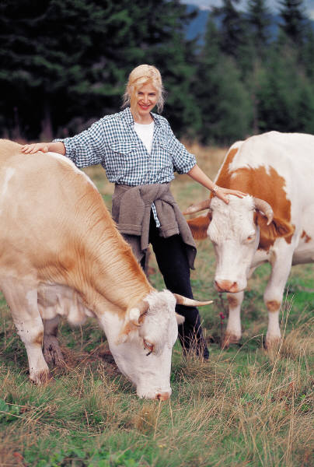
Artificial Selection
Artificial selection is the selection of individuals for breeding that are most valuable to humans.
  This is the oldest form of biotechnology.
  Humans simply chose to breed the individuals of a species that provided the
  most benefits.
  This eventually changed the
  species so that their beneficial
  traits became more common
  and more pronounced.

Slide 7
Artificial Insemination
Artificial insemination is the process in which the semen of one individual is artificially introduced into the reproductive tract of another individual.
  This enables a greater control over the mating and reproduction of that animal, allowing producers to enhance desirable traits in a more specific and functional manner.
  When combined with accurate
  record keeping and measurements
  of heritability for each trait,
  agriculturalists can quickly improve
  and change the traits of a species to
  create a breed with predictable
  characteristics.

Slide 8
Brewing & Fermentation
In brewing and fermentation processes, artificially-selected microorganisms are used to convert food from one form to another.
  For example, cheese is a fermented product produced by bacteria from milk.
    While milk spoils relatively quickly, cheese
    can keep for long periods of time, allowing
    for long-term storage.
  By converting food into
  more usable, storable, or
  valuable forms, agriculturalists
  can ensure a safer and more
  profitable food supply.

Slide 9

Medicine
Biotechnology can be used in medicine to either produce a drug, change disease, or prevent susceptibility to a disease.
  For example, a vaccine is just an artificially weakened form of a disease that enables our body to more easily and safely defeat the pathogen that causes illness.
    E.g. the flu vaccine is just a weakened strain of the influenza virus.
  Biotechnology can also be used to engineer
  treatments such as insulin injections (for
  diabetes patients), antibiotics, and other
  pharmaceutical treatments.
    E.g. Scientists today use E. coli bacteria to produce
    human insulin for injection.
  Biotechnology is also improving medicine
  to the extent where entirely new genes or
  organs could be developed for prevention
  of a disease or disorder.
    Through stem cells and cloning, scientists may
    even be able to re-grow organs and limbs damaged
    by disease or accidents.

Slide 10
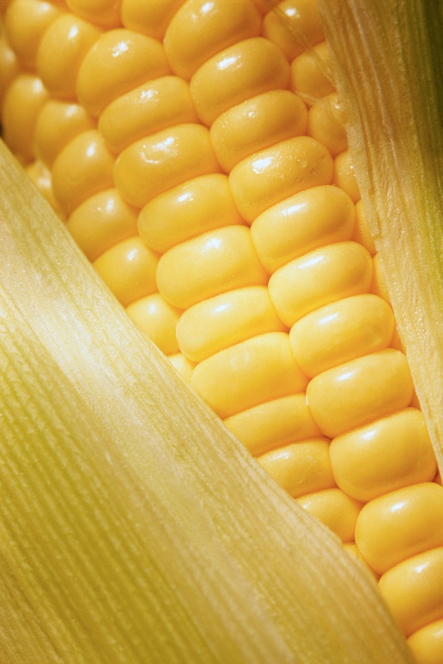
Gene Splicing
Gene splicing is the process in which genes are artificially added to a genome.
  For example, through gene splicing scientists were able to create Bt Corn, a kind of corn that produces its own insecticide.
  Scientists removed the gene for
  a naturally-occurring insecticide
  from bacteria and inserted it into
  the genome of the corn plant.
  A Bt Corn plant produces the
  proteins for the insecticide in the
  same manner it produces any
  other protein.

Slide 11
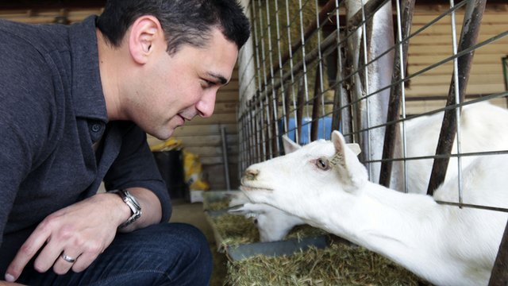
Gene Splicing & Spider Goats
Another example of gene splicing includes Spider Goats.
  Scientists have used gene splicing to add the gene from spiders for spider silk protein to goats.
  These goats produce the spider silk proteins in their milk in the same way they would produce any other kind of milk protein.
  Scientists can filter out the spider silk proteins from the milk and use them to produce spider silk.
    Spider silk is one of the strongest materials found in nature (spider silk the thickness of a
    pencil could stop a jetliner in
    midflight).
    Scientists hope to be able to use
    synthetically-produced spider silk
    to make materials such as bullet-
    proof vests.
Source: www.bbc.co.uk

Slide 12
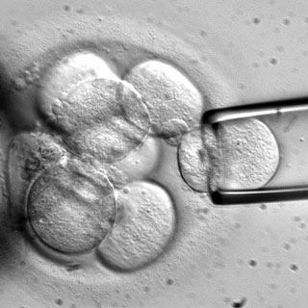
Stem Cells
Stem cells are cells found in the body that can become any kind of tissue.
  When a sperm cell fertilizes an egg cell, this one cell must become every kind of tissue in the body.
    From one individual cell, we can get heart cells, skin cells, bone, blood cells, neurons, etc.
  Scientists are now working
  on methods to grow stem
  cells in order to make tissue
  to replace damaged organs
  due to problems such as heart
  attacks, paralysis, cancer, etc.
    Stem cells could also be used to
    better understand how cells
    function and how diseases occur.
Source: www.scientificamerican.com

Slide 13
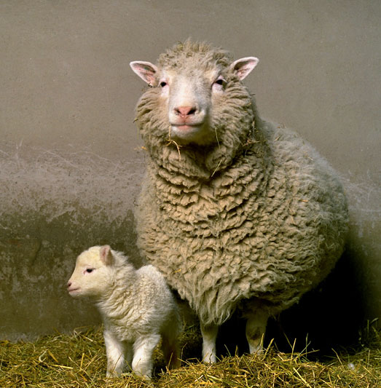
Cloning
Cloning is the process in which a duplicate is made of an individual.
  For example, Dolly the Sheep was the first cloned mammal.
    Dolly had the exact same genome as another sheep.
  When scientists create a clone, they are simply creating a second individual with the same DNA.
    This can occur naturally as well;
    for example, identical twins are
    technically clones of each other.
    Some species can even clone
    themselves; for example bacteria
    can divide in half, creating an identical
    copy of itself with the same genetic
    material.
Source: www.roslin.ed.ac.uk

Slide 14
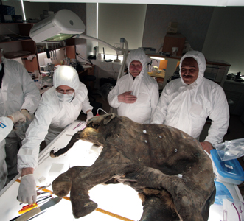
Possibilities of cloning
Through cloning, scientists hope to make the following possible:
  Cloning for models of disease: through cloning, scientists hope to create copies of animals with spliced genes to better understand how the disease occurs and how to treat it.
  Cloning for Stem Cells: creating a stem cell is a very difficult process. Through cloning, scientists hope to be able to develop many more stem cells for medical treatments than are currently available.
  Cloning of Pharm Animals: a pharm animal is an animal created through gene splicing that produces medicine in its milk, eggs, or meat. Through cloning, you could create herds of medicine-
  producing livestock.
  Reviving endangered species: by cloning
  an extinct animal, we could bring back a
  species that recently went extinct.
    Dinosaurs? Probably not. Mammoths? Maybe.
    Passenger pigeons? Probably!
Source: blogs.discovermagazine.com

Slide 15
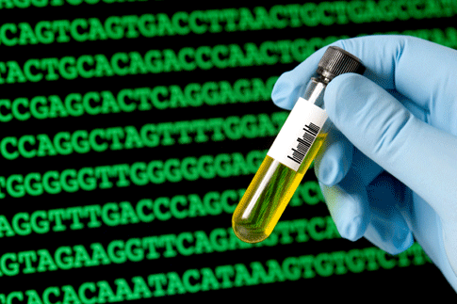
DNA Testing & Genomics
Genomics is the science of reading an individual’s DNA.
  Today we can sequence the DNA of any living organism and read it letter by letter.
  This has enabled scientists to determine which genes are responsible for beneficial or harmful traits.
    For example, genomics has enabled scientists to determine which genes are responsible for valuable traits in cows such as high milk production or high butterfat.
    Genomics has also allowed scientists to identify genes that may cause genetic diseases such as cancer.
  Through genomic science, we now
  have tests that can tell us if an
  individual possesses a specific gene.
    This would enable us to tell if an individual
    will get a genetic disease years or even
    decades before it occurs.
Source: culturewav.es

Slide 16
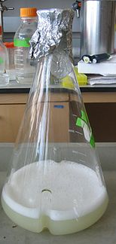
Protein Purification.
Protein Purification is the process in which a single protein is isolated from what is normally a mixture of many, many proteins in the cells of a living organism.
  Analysis of pure proteins can help us to understand the amino acid sequence through which they were created and narrow our search for the gene for a particular protein from billions of bases in an organism’s DNA.
Protein purification also allows for
companies to use specific proteins
for products such as foods or medicine.
  For example, in order to produce insulin
  shots from genetically modified E. coli., we
  must remove the insulin protein from the
  bacterial cells before it can be injected into
  diabetes patients.
Source: en.wikipedia.org

Slide 17
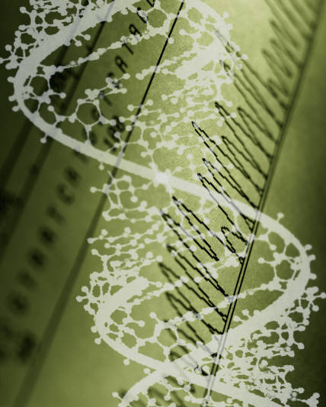
Microbial Synthetic Biology
Microbial Synthetic Biology (or MicroSynBio) is the process of creating artificial species from scratch.
  Through modern genetic science, researchers can actually build species that never existed before by creating synthetic strands of DNA.
    This synthetic DNA can be injected into a bacterial cell after its own genetic material was removed.
    This modified bacteria will now become the species designed by scientists in a laboratory.
  Through microsynbio, scientists can
  create species designed for specific
  purposes, such as biofuel production
  or oil spill cleanup.
    Because these species do not naturally exist,
    microsynbio is the only feasible way to develop
    organisms for these jobs.

