Slide 1
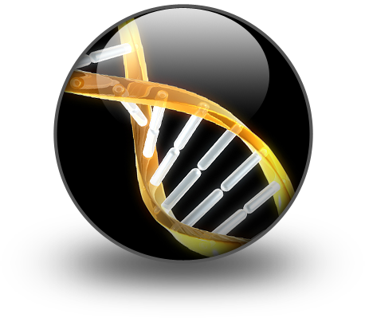

DNA
By C. Kohn
Agricultural Science
Waterford, WI

Slide 2
What is DNA?
DNA is deoxyribonucleic acid.
  It is kept in the nucleus of a cell to protect it.
DNA = Instructions for making cellular proteins.
  Proteins are the functional molecules in an organism’s cells.
    Proteins are like molecular machines.
DNA tells a cell what ingredients it needs to make a protein.
  Those ingredients are also what give the protein its shape.
    The shape of the protein determines its function.
  The ingredients of proteins are amino acids.
    Amino acids are the building blocks of protein.
    Just like a necklace can be made out of pearls,
    a protein is made out of amino acids.

Slide 3
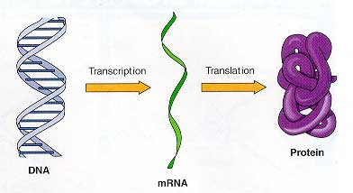
What is DNA?
Each section of DNA that codes for a specific protein is called a gene.
  A gene is just a length of DNA that codes for a protein.
    For example, the protein that gives your eyes its color is made from a specific stretch of DNA.
  Just like a sentence is a portion of a paragraph, a gene is just a portion of DNA.
DNA is responsible for the functions of all living things.
  Proteins are the molecules that make the cells of all living things work.
  The information needed
  to create a protein
  is ‘written’ in DNA.
  Without DNA, a cell could
  not create proteins.
    Without proteins, a cell could
    not function.
Source: www.katiephd.com

Slide 4
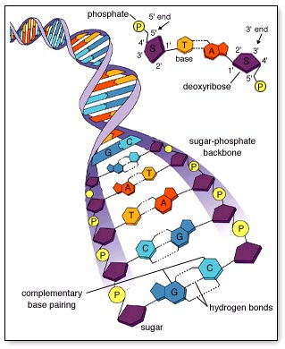
What is DNA made from?
DNA is made from 3 key ingredients
  1. A nitrogen-based molecule (or base): there are four kinds of bases
    Adenine, Guanine, Cytosine, and Thymine
    The order and combination of these bases in DNA determines how a protein is created by the cell
  2. Sugar molecules
  3. Phosphate molecules
Sugar and phosphate together
form the “skeleton” of the DNA
molecule and hold the bases in place.
  Sugar and phosphate do not encode
  any information – they just hold the information in place.
Source: www.mhhe.com

Slide 5
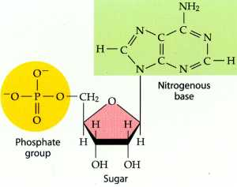
Nucleotides
A nucleotide is a subunit (or building block) of DNA consisting of a base, a phosphate, and a ribose sugar.
Nucleotide

Slide 6
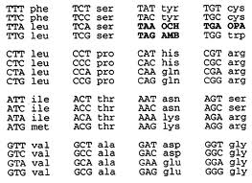
Bases
The bases in DNA are the molecules that actually create the code a cell reads in order to create a protein.
There are 4 kinds of bases in DNA: guanine, cytosine, adenine, and thymine.
  The 4 bases are typically just abbreviated by their first letter: G, C, A, & T
The combinations of these
four bases are what create
the genetic code.
Image Source: chemistry.gravitywaves.com

Slide 7
Rules of DNA
Rule #1: DNA is formed of two sugar-phosphate chains on the outside and two bases on the inside.
  This closely resembles a
  ladder that twists.
Rule #2: Inside that ladder,
A must always pair with T
and G must always pair
with C
  This occurs for two reasons:
    They wouldn’t fit any other way.
    A & T have two bonding sites;
    G and C have 3 bonding sites
  Great Combinations are Always Together
Source: www.mhhe.com

Slide 8
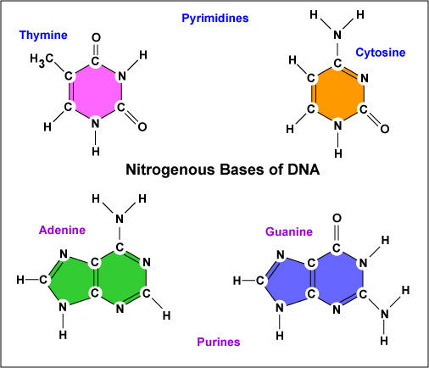
Too Big, Too Small, Just Right
Thymine and Cytosine would be too small to fit inside the structure of DNA.
  These are the smallest of the 4 bases.
Guanine and Adenine would be too big to fit inside the structure of DNA.
Too small
Too big

Slide 9
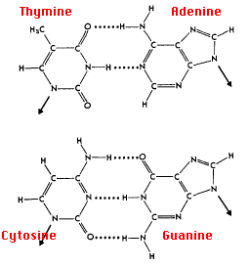
Base Bonding
C-G and T-A combinations are also necessary because of binding sites
  A and T have 2 binding sites (AT=2)
  C and G have 3 binding sites (GC=3)
    They wouldn’t match up any other way

Slide 10
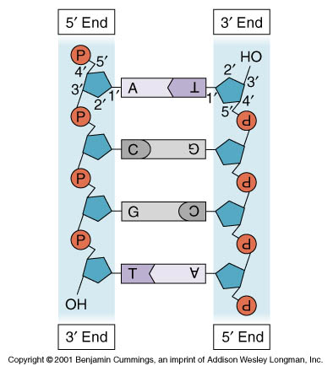
Rules of DNA
Rule #3: DNA is always read in a 5’ → 3’ direction
  5’ and 3’ refer to how the carbon atoms in the sugar molecule are numbered.
  DNA is always read from the 5th carbon atom to the 3rd carbon atom by the cell.
  There is no up/down/ left/right in a cell – this is the only way to give the cell a sense of direction.
Image Source: celebrityhollywoodcool.blogspot.com

Slide 11
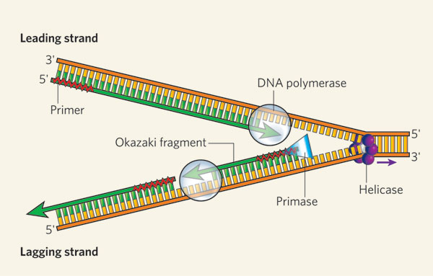
How DNA Works
When the cell needs the information for making a protein, it will need to open up the DNA to read it.
  When DNA is in its “ladder” version, it is not able to be read.
  The DNA must first be opened in order to read it.
The cell opens DNA using DNA Helicase
  DNA Helicase is a protein that opens DNA in the same way that your zipper tab opens a zipper.
Once DNA is opened, it can be duplicated.
  Each cell has only one copy of its directions.
  It would be far too dangerous to risk damaging or losing the only source of
  information a cell has!
  Because of this, a cell
  will make a copy
  of the DNA – mRNA.
mRNA
Image Source: www.nature.com

Slide 12
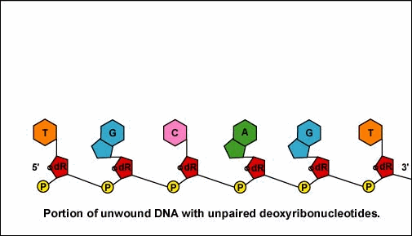
How DNA Works
mRNA is a copy of DNA
  mRNA is similar to DNA except that it is single stranded and uses Uracil (U) instead of Thymine (T)
    RNA is a more evolutionary-primitive version of genetic material.
    Through natural selection, uracil was eventually replaced by thymine because uracil was more prone to mistakes and mutations.
Polymerase is the protein that copies DNA and makes mRNA.
  Polymerase proteins read
  DNA in a 5→ 3 direction.
  For every G, it puts a C.
  For every C, it puts a G.
  For every T, it puts an A.
  For every A, it puts a U
  (because RNA uses U
  instead of T).
Image Source: faculty.ccbcmd.edu

Slide 13
Transcription Animation
Helicase
C
G
A
T
C
G
A
T
C
G
A
T
G
C
T
A
G
C
T
A
G
C
T
A
Polyermase
C
G
A
U
C
G
A
U
C
G
A
U
Step 1: Helicase opens and unwinds the DNA strand
Step 2: Polymerase adds a complementary base for each nucleotide
Step 3: The newly created mRNA strand goes to a ribosome to be read
Step 4: The DNA strand is closed and re-wound

Slide 14
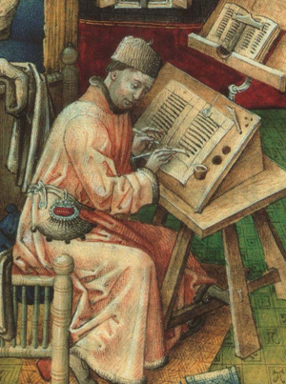
Transcription
The process in which DNA is read and copied so that a copy mRNA strand is created is called transcription.
  Analogy 1: Just a like a ‘transcript’ is a copy of a television program, transcription is the process in which DNA is copied.
  Analogy 2: In medieval times, a ‘scribe’
  recorded all the decisions of a king and
  copied them in a book.
    Polymerase is the ‘scribe’ for King DNA and
    makes copies in the form of mRNA.
Image Source: www.womanofgor.com

Slide 15
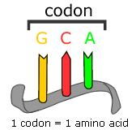
Translation
After detaching from DNA, mRNA leaves the nucleus and travels to a ribosome.
  A ribosome is a protein factory.
    A ribosome is made out of rRNA.
  The mRNA is read by a ribosome in a 5 → 3 direction.
The bases in mRNA are read in
groups of 3.
  Each group of 3 is called a codon.
  Every codon (group of 3 bases)
  codes for a specific amino acid.
  Amino acids are the building blocks
  of proteins.
The process of reading mRNA and
creating proteins is called Translation.

Slide 16
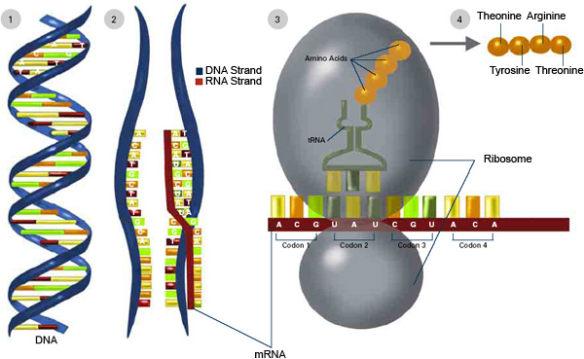
tRNA
A ribosome will read a codon in mRNA and tell tRNA what amino acids to bring to make a protein.
  tRNA will deliver the needed amino acid to the ribosome based on the codon being read.
    tRNA is the molecule that delivers amino acids.

Slide 17
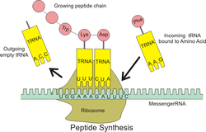
How tRNA ‘knows’
tRNA ‘knows’ what amino acid to bring because it has the complementary RNA sequence.
  For example, if the codon is GCG, the tRNA carrying the correct amino acid will have the CGC codon.
  Because it has the complementary RNA sequence, the tRNA will bond to the mRNA and then release its amino acid.
  The ribosome will add this
  amino acid to the chain that
  forms the protein as the
  tRNA leaves.
  The process will be repeated
  for the next codon.
Image Source: en.wikipedia.org

Slide 18
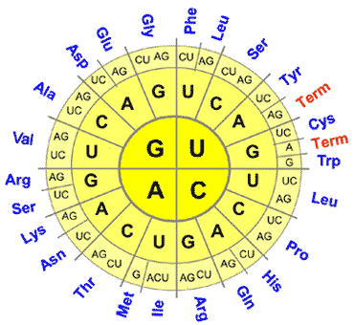
Codons and Amino Acids
Every amino acid has at least one codon.
  If mRNA shows this codon to the ribosome, tRNA will deliver that amino acid.
  Once delivered by tRNA, that amino acid will be added to the growing protein chain.
  In this chart, you can see all
  of the codon combinations that
  code for each amino acid.
    E.g. CUU would be Leu, or
    Leucine.
    UAC would be Tyrosibe.

Slide 19
Translation Animation
Arginine
Arg
C
G
A
U
C
G
A
U
C
G
A
U
Protein
Serine
Ser
Iso
Isoleucine
Asp
Asparagine

Slide 20
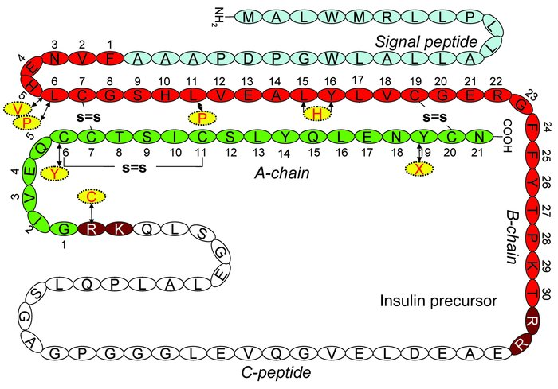
Amino Acids → Proteins
A protein is a long string of amino acids.
  The type of amino acids in a protein, and their order, determine the function of the protein
    For example,
    insulin is shown
    here at the right
    As you can see, it
    is simply a long
    chain of amino acids

Slide 21
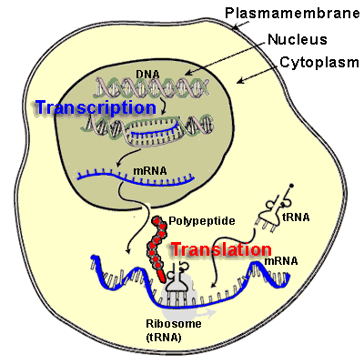
Transcription occurs in the nucleus. Translation occurs in the ribosomes.
Transcription involves making the mRNA copy of DNA.
DNA and mRNA are a part of transcription. mRNA, rRNA, and tRNA are a part of translation.
Translation involves using the mRNA copy to make a functional protein out of amino acids in the ribosome.

Slide 22
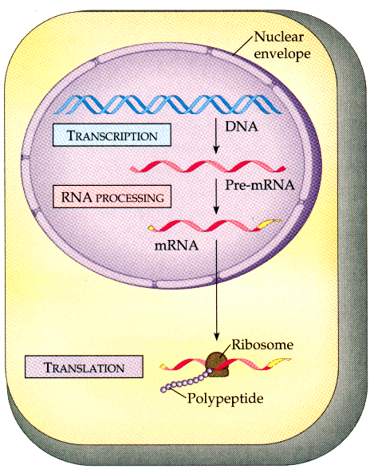
How to Make a Protein
To make a protein, a cell must undergo a few steps.
  A mRNA copy of DNA must be made in a process called transcription.
    In transcription, helicase opens DNA so that polymerase can make a mRNA copy.
    That copy will be made using complementary bases (e.g. T → A; G → C; A → U).
  The mRNA copy travels out of the nucleus to the ribosomes to undergo translation.
    The ribosome reads the mRNA copy in groups of three bases (or codons).
    For each codon, tRNA delivers the appropriate amino acid.
  Each amino acid that is delivered by tRNA is assembled in a long chain.
    That chain of amino acids is what becomes the protein (or polypeptide).
Image Source: godlessliberal.xanga.com

Slide 23
Why do we care about DNA?
In agriculture, DNA is everything!
  In order to change living species in order to domesticate them and make them productive, we had to change their DNA.
  Prior to the mid-20th, no one knew what DNA was, but through selective breeding, we have been changing the DNA of species for 10,000 years.
  Because we understand DNA today, these changes can occur much more efficiently and rapidly.
DNA is the future.
  Knowing how DNA works enables scientists to change DNA in a much more controlled manner.
  As the world’s population grows larger and
  resources available for agriculture grow scarcer,
  it will be more and more important to understand
  DNA and how to use it for production in order to
  produce enough food, fuel, and fiber to take care of
  the entire world.

Slide 24

Why do we care about DNA?
DNA gives us options.
  By known how DNA works and how to change it, we can create more opportunities, including…
    Production of clean, renewable energy
    Production of pharmaceuticals from plants, animals, and other organisms
    Replacement of diseased or damaged organs (such as hearts or spinal cords)
    And many more!
  The greater our understanding of
  DNA, the more potential we can create
  for society

