Slide 1

The National FFA Organization
By C. Kohn
Waterford Agricultural Sciences

Slide 2

What is the FFA?
The National FFA Organization used to be know as Future Farmers of America.
  When it was originally created in 1928, the FFA existed to prepare students for careers primarily in production agriculture.
  Agriculture had changed rapidly in the early 1900s – horses were replaced by machinery, electricity was rapidly changing production practices, and modern science was becoming a standard part of farming.
    An organization was needed to prepare students in high school for the rapidly modernizing world of agriculture.
Today, almost ¾’s of FFA members do not
live on a farm, and even fewer intend to become
farmers. Source: https://www.ffa.org/documents/ffa_key_messages.pdff
  Obviously “Future Farmers” is not descriptive of
  most FFA members!
  So why does the FFA exist today?

Slide 3
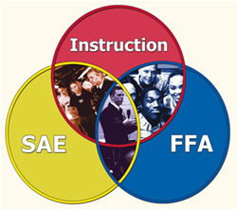
What is the FFA?
The National FFA Organization is a dynamic youth organization that changes lives and prepares students for:
  Premier leadership,
  Personal growth, and…
  Career success through agricultural education.
An example of what works well in education, FFA is an intracurricular organization that implements the three-circle model of education
  Classroom instruction
  Hands-on learning
  Leadership development through
  FFA programs.
  Source: https://www.ffa.org/Donate/Foundation/Pages/Foundation-FAQs.aspx
Source: www.ffa.org

Slide 4

It’s “Intracurricular”
The FFA is an intracurricular organization.
  This means that it combines classroom education with hands-on lab experiences and out-of-class activities to best prepare students for the life they want to have after high school.
  By combining classroom education with real-world experience, you will be best prepared to get into the college of your choice and obtain a fulfilling and rewarding career in a field that interests you.
The FFA is not a club!
  Not just anyone can be an FFA member –
  you have to be a part of a high school that
  offers agricultural education.
  Not just anyone can be an FFA Advisor –
  you have to have a license to teach agriculture!

Slide 5

Why Join FFA?
Members join FFA to prepare themselves for the careers they want to have after high school.
  Most people do not take multiple choice exams or write essays as part of their day-to-day jobs!
  To be prepared for the best jobs out there, you need to have real-world skills and the ability to apply the things you learn in high school to job-related circumstances.
The FFA exists to connect students to careers in agriculture, science, medicine, business, and over 300 other career paths!
  If you think the FFA is about creating future
  farmers, you are ignoring the other 299
  options available!
  While FFA members could become farmers,
  they could also become business owners,
  medical professionals, researchers, ecologists,
  marketers, statiticians, engineers, and more!

Slide 6

How It’s Done
So how does the FFA prepare students for the careers and colleges of their choice?
  The FFA offers a wide range of activities over the course of the entire year in order to ensure that students have the training and skills needed to advance their education and obtain that perfect career.
Key Career Preparatory Activities Offered by the FFA
  Supervised Agricultural Experiences & Proficiency Applications
  Career Development Events
  Speaking Contests
  Agriscience Fair
  Leadership Development
  Community Service
  Scholarships
  Agricultural Courses

Slide 7
Supervised Agricultural Experiences (SAE’S)
Supervised Agricultural Experiences (SAEs) are any experience you might have outside the classroom related to agriculture, science, the environment, business, and technology.
  As part of your FFA experience, you should seek to get career experience before you leave high school.
  SAEs are just experiences you have outside the classroom that help you to gain real-world career skills.
  This could be a part-time job, shadowing a
  professional, a research experience, starting a
  small business, volunteer work or other
  career-related activities.
SAEs help you to gain marketable skills
that will help you to become more hirable
and prepared for a future career.
  SAEs help you to get the job you want some day
  by getting experience in that job today.

Slide 8
Proficiency Applications
If you have a great SAE, you can compete against other FFA members using a form called a Proficiency Application.
  Proficiency applications are a way for you to keep track of your experiences, skills, and income.
  These applications enable you to show the progress you are making in becoming prepared for a career of your choice.
  By submitting these applications at the local, state, and national level, you can compete against other FFA members for recognition and scholarships while building your own skills and abilities.
  Through proficiency applications, you can
  gain career skills while gaining recognition
  and awards, all of which can improve your
  likelihood for college acceptance.

Slide 9

Career Development Events
Career Development Events (CDEs) are another FFA competition that allows you compete and gain recognition and awards while preparing for a future career.
  CDEs (or Judging Teams, as they are sometimes known) are team-based events in which you compete against other students in competitions related to careers.
  A Career Development Event (CDE) is basically a contest, based on current industry standards, where FFA members can demonstrate the knowledge and skills gained from 1) classroom instruction, 2) their SAE and 3) FFA activities.
  Source: https://sites.google.com/site/wisconsinffacdepage/
  In Wisconsin, you can compete in over
  25 different competitions related to
  many different career fields.

Slide 10
Speaking Contests
FFA Speaking Contests are a specific kind of Career Development Event.
  In the FFA Speaking Contests, you can compete in several different kinds of events in order to improve your communication skills.
  Today, excellent communication is absolutely vital to any career path – the stronger your communication skills, the greater your likelihood of obtaining a well-paying job.
  Involvement in a FFA Speaking Contest proves to employers that you have the communication skills needed to be an effective employee.
Contest options include 1) Prepared Speaking,
2) Extemporaneous Speaking, 3) Creed
Speaking, 4) Job Interview, 5) Parliamentary
Procedure, 6) Discussion, and 7) Quiz Bowl.

Slide 11

Agriscience Fair
Agriscience Fair is a competition in which students present the findings from actual research projects related to one of the following categories:
  1) Animal systems – animal growth and performance; medicine
  2) Environmental science – natural resources and ecology
  3) Plant systems – function, structure, and reproduction of plants and plant cells
  4) Power, structures, and technology (engineering) –
  engine performance, renewable energy, product
  performance, etc.
  5) Social sciences (behaviors and decisions of people
  in business and society) – polling of groups of people,
  effective practices, etc.
  6) Food products and processing – product
  development, food safety, sales, and product quality

Slide 12

State Leadership Development
Leadership is a central part of the FFA’s mission. Students in this area can partake in the following leadership development events:
  Sectional Leadership Workshop – hosted by the State FFA Officers in each of the state’s ten sections each September.
  FIRE Conference – for FFA members in grades 7-9; held at UW-Madison each October.
  212 Leadership Conference – this is a National FFA Conference held in March of each year for FFA members grades 9-10.
  Halftime Leadership Conference – this is for two upperclassmen-members of FFA from each chapter in the state.
  State FFA Convention – held in Madison each June.
  National FFA Convention – held in Louisville, KY

Slide 13

Local Leadership Development
FFA Members can also develop their leadership skills through involvement at the local level.
  By running for an Officer Position, FFA members can gain real-world leadership experience by managing one of the largest chapters in the state and thousands of dollars of funding and expenses.
    The Waterford FFA has the following officers annually: President, Vice President, Secretary, Treasurer, Sentinel, and Reporter.
  You can also get leadership experience by applying to be a Manager.
    Managers oversee the day-to-day operations of the following facilities: the Greenhouse, the Research Field, and the FFA Fruit Sale.
    These are paid positions and are hired by the officers and advisors.
  From time to time, members can also serve as
  Chairpersons for various events.
    For example, we may need chairpersons to run
    food drives, FFA week, the banquet, and other events.

Slide 14

Leadership & FFA Degrees
The FFA also offers degrees to its members who show leadership development and personal growth.
  These degrees recognize individual achievement in the FFA in leadership and career preparation.
The FFA offers the following degrees:
  Greenhand – offered to new members who demonstrate a
  basic understanding of the FFA, show leadership potential,
  and have plans for an SAE and career preparation.
  Chapter – offered to members who are established, proven
  leaders and have shown progress with their SAE and career
  preparation.
  State – the highest degree offered in the state; it is awarded
  to the most elite FFA members in the state.
  American – this degree is the highest degree awarded to
  FFA members and is only awarded to the most exceptional
  members who have shown the greatest accomplishment in
  leadership, personal growth, and career preparation.
Source: karenthefarmersdaughter.wordpress.com

Slide 15
Community Service
As part of its mission to foster the personal growth of its members, the FFA heavily emphasizes community service.
  You cannot be a well-rounded and well-prepared individual unless you can appreciate the value and benefits of serving your community and nation.
In Waterford, we annually conduct the following service events:
  Adopt a Highway (Hwy 20 westbound)
  Adopt a Family during Christmas
  Environmental service (e.g. Invasive Species
  Removal & Fox River Water Monitoring)
  Food Donations & Drives to Love Inc.
  Volunteer work at Levi Barnes retirement home

Slide 16
Scholarships
Many, many scholarships are available through the FFA.
  To date, more than $34 million has been provided by the National FFA for higher education scholarships.
  More scholarships are also available at the state and local level.
  Scholarships are also awarded on a cash basis to State Proficiency Winners and CDE National Winners.
The Summer Research Scholars program is one of our top local scholarships.
  Through the SRS program, you can receive a $2500 scholarship for a long-term research project through a grant from Runzheimer, Intl.
You can also make money through FFA Membership!
  Your SAE can be a part-time job in which you make money.
  You can receive money back from fruit sale.
  FFA Managers are paid to do their jobs.

Slide 17
Ag Courses
While not specifically part of the FFA, ag courses are definitely a part of the 3-circle model of ag education!
  Continued enrollment in ag courses is one of the most sure-fire ways of ensuring your continued personal development and career preparation.
  Career skills, resumes, cover letters, and job interviews are regular components of higher-level ag courses at Waterford.
Students who are most successful at Waterford in ag ed are those who take part in at least one course each year while staying actively involved in the FFA and their own personal SAE.
  These experiences will pay off for you personally…. literally!

Slide 18

Courses
Courses available in Waterford Agricultural Sciences –
  Agriscience
  Veterinary Pet Care
  Large Animal Veterinary Science
  Natural Resources
  Biotechnology and Bioenergy
  Home Gardening & Horticulture
  Landscape Design
  Greenhouse Management
  Agribusiness & Marketing
  Advanced Leadership
  Ag Coop
  Summer Research Scholars
  Personal Preparation for Careers

Slide 19

FFA Traditions

Slide 20

The National FFA Organization
The National FFA is the largest student-run organization in the United States with our 500,000 members annually in middle school, high school, and college.
The FFA was created in 1928.
  Waterford has the 3rd oldest chapter in Wisconsin and was started in 1929.
It is a federated system of state associations, located in all 50 states, Puerto Rico, the Virgin Islands and Guam.
  Each state is typically divided into districts or
  regions and each made up of numerous local
  chapters.
  FFA members engage in the FFA on a local level
  and have opportunities to engage on a regional,
  state and national level for more advanced
  leadership and competition activities.

Slide 21

How It’s Governed
Each school’s program is called a Chapter.
  FFA Chapters are run by an elected FFA President,
  an Officer Team, and advisors.
  Your Advisors are Mr. Kohn and Mr. Wolf.
  Your President is Hannah Waldron.
Each state association also has an officer team and advisors.
  Our State Association is divided into 10 Sections. Your Sectional State Officer is Emily Watson. Each state officer serves a 1-year term.
  Your State President is Kayla Hack.
  Your State Advisor is Jeff Hicken. The State Executive Director is Cheryl Zimmerman. http://www.wisconsinffa.org/pg-officers.php
The National FFA is governed by 5 elected National Officers who serve 1-year terms. https://www.ffa.org/About/nationalffa/nationalofficers/Pages/default.aspx

Slide 22
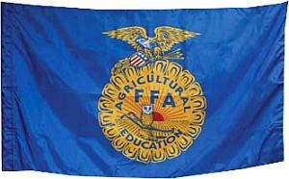
FFA Mission
FFA Mission Statement: FFA makes a positive difference in the lives of students by developing their potential for premier leadership, personal growth, and career success through agricultural education.
FFA Motto: Learning To Do, Doing
to Learn, Earning to Live, Living to Serve
FFA Colors: National Blue and Corn Gold.
  These represent national unity and pride.
The FFA Salute is the Pledge of Allegiance.

Slide 23
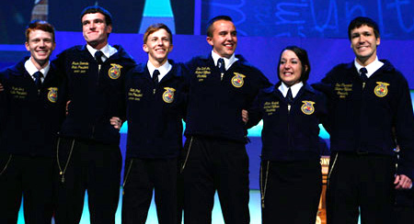
FFA Official Dress
Official Dress is the term for the ‘uniform’ of FFA members. Official Dress consists of:
  A FFA Jacket
  A white collared shirt or blouse
  A FFA Tie or Scarf
  Black dress pants or a black skirt
  Black socks or nylons
  Black shoes or heels.
Like a military uniform, FFA Official Dress should only be worn for proper FFA events and should only be worn if all items listed above are present.
  You would never wear part of a military uniform because it would be disrespectful to that branch.
  The same is true for FFA Official Dress.

Slide 24
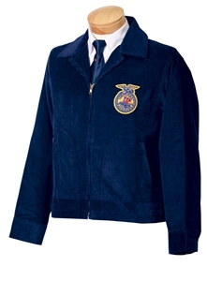
Official Dress Rules
The jacket is to be worn only by members
The jacket should be kept clean and neat
The back of the jacket should have only:
  A large official emblem
  The name of the state association (Wisconsin)
  Name of the local chapter
The Front of the jacket should only have
  A small official emblem
  The name of the individual
  One office or honor
  The year of that office or honor

Slide 25
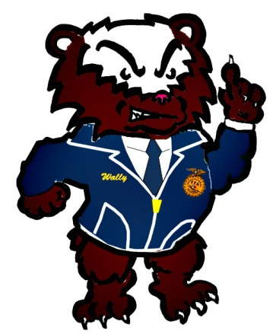
Official Dress Rules
The collar should be turned down and the cuffs buttoned.
The FFA Jacket should only be worn during appropriate occasions and at appropriate places. A member should act professionally when wearing the official FFA jacket
Members should refrain from use of tobacco and alcohol.
  In addition, members should exhibit their leadership qualities when they encounter substances including tobacco and alcohol and serve to discourage others from inappropriate behavior.
All chapter degree, officer, and award medals should be worn beneath the name on the right side of the jacket. No more than 3 medals should be worn on the jacket. These should represent:
  1 The highest degree earned
  2. The highest office held
  3. The highest award earned by the member

Slide 26
FFA History

Slide 27
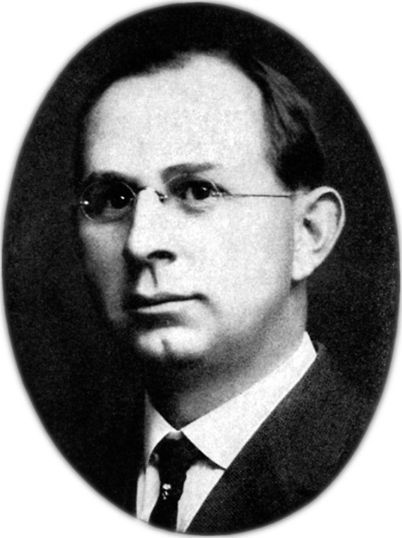
Early Years
1917 - President Woodrow Wilson signs into law the Smith Hughes Act , establishing Agricultural Education as a high school subject.
  This allows state and federal funding to be used to support vocational education to prepare students for future careers.
1925 - Henry Groseclose, an instructor
at Virginia Tech, creates the Future
Farmers of Virginia
  The FFV becomes the basis on which the
  FFA is created
1928 - At a meeting in Kansas City, MO, the FFA is created.
  The first National FFA Convention is held; 33 delegates from 18 states attend.

Slide 28
Early Years
1930 - The FFA Creed, written by E.M. Tiffany of UW-Madison, is adopted at the 3rd National FFA Convention
1933 - The iconic blue corduroy jacket
is officially adopted as the FFA Jacket.
  This jacket has remained largely unchanged
  and serves as the official “uniform” of FFA
  members, representing unwavering
  commitment to key principles and ideals.
1933 - A group of FFA Members are also greeted on the White House lawn by President Roosevelt.

Slide 29
NFA, FFA Week, and Presidents
1935 - New Farmers of America is established in Tuskegee, AL. This was the African-American version of the FFA.
  This was necessary because school segregation was still legal
  NFA would remain in existence until 1965 when it was merged with the FFA after Brown v. Board of Education
1948 - FFA Week is established as
the last week of February.
  This week was chosen in honor of George
  Washington’s birthday
1953 - President Eisenhower becomes the first of many US Presidents to speak at the National FFA Convention
  Later, Presidents Truman, Nixon, Ford, Carter, Bush, and George W. Bush would also speak at the National FFA Convention

Slide 30
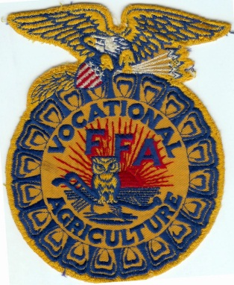

1988 – FFA became FFA
1988 - Future Farmers of America changes its name to National FFA Organization to better reflect the expanded agricultural opportunities encompassing science, business and technology, in addition to production farming.
  FFA members are as likely to be future veterinarians, future scientists, future business owners, future marketers, etc. as they are to be future farmers.
  This meant a new name was needed.
    FFA was kept because it was familiar but
    does not stand for Future Farmers of America
    (kind of like KFC no longer stands for Kentucky
    Fried Chicken – KFC now sells other kinds of
    meals as well).

Slide 31
2013
Today, there are 557,318 FFA members, aged 12‒21, in 7,498 chapters in all 50 states, Puerto Rico and the U.S. Virgin Islands.
44% of FFA members are female; women hold approximately 50% of state leadership positions.
73% of our membership is White; 15% is Hispanic/Latino; 7% is Black/African-American; 5% is American Indian, Asian or Pacific Islander.
FFA chapters are in 18 of the 20 largest U.S. cities, including New York, Chicago, Philadelphia, and Milwaukee.
The 2012 National FFA Convention was host to 56,167 members, FFA advisors and FFA supporters.
23% of teachers have five or fewer years of teaching experience. The shortage of qualified agriculture teachers is the greatest challenge facing FFA and agricultural education
Collectively, FFA members earn more than $4 billion annually through their hands-on work experience.
In 2011, 129 sponsors provided 1,590 individual scholarships worth over $1.9 million through the National FFA Organization.
To date, more than $34 million in FFA collegiate scholarships have been awarded to students pursuing higher education.

