Slide 1
Elements of Landscape Design
By C. Kohn
Agricultural Sciences
Waterford WI

Slide 2
Elements of Design
The elements of design are the components and characteristics of a landscape that add harmony, visual appeal, and functionality to that landscape.
Beauty is in the eye of the beholder, but ‘ugly’ is universal – in other words, we may all have different preferences but poorly designed landscapes are generally recognized universally as poor designs.
It is easy to spot poor designs because people have come to expect certain functions and services from every designed landscape.

Slide 3
Elements of Design
The elements of design are the considerations that must be taken into account for a design before any other work can begin.
If even one of the elements if misused or overlooked, the entire landscape will generally be viewed as a failure by anyone who sees it.
Elements of design are common to any and all forms of art – while these will be used in application to landscape design, they also apply to building design, fashion, interior decorating, and more.

Slide 4
Elements of Design
Landscaping Forms Special Creations Through Vision
The elements of design are:
Line – how is the eye guided?
Form – what shapes are found?
Space – does the design seem three dimensional? Does the design ‘pull you in’ and catch your eye?
Color – how is consistency and variety created via color? What mood does it create?
Texture – how do the visual surfaces of the design components create a functional landscape?
Value – how is contrast used to support the intent of the design?

Slide 5
Additional Elements
Additional elements to consider (but are not an element by themselves due to the fact that they are a combination of different elements) are:
Pattern – Combination of line, form, color, texture, and space
Size – Combination of line, form, and space.

Slide 6
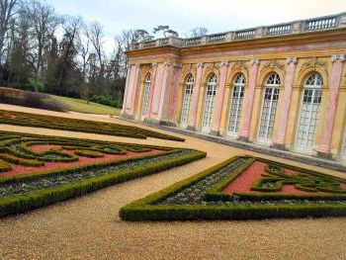
Line
Line: Line is the element that guides a viewer’s eye through a design and adds visual structure to a design. This means that line…
Tells your eyes where to look.
A poor design will create visual confusion – we take it for granted that our eyes will go to one spot when we look at a design.
A good design will cause your eyes to focus on a specific spot (or spots) the moment you glance at a design.
Source: www.landscape-design-advisor.com

Slide 7
Line
Line tells your eyes where the design begins and ends.
A poor design will seem “blurry” – it will be unclear where the boundaries of each part of the design exist.
A strong design will have clear boundaries that separate and unit different components of the landscape.
Landscapes are like cartoon characters. Mickey Mouse and Bugs Bunny had clear, distinct lines that separated the edges of their body from the space around them. Landscapes should be the same.

Slide 8
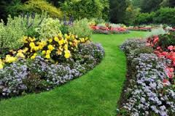
Line
Line can be created by many different components of the landscape. This could include…
Vegetation – contrasting colors or types of vegetation can create specific borders because of this contrast.
For example, dark hedges on light grass automatically create a line that your yee can follow.
Natural elements – a flowing river gives your eye a natural line to follow; a ridge of a hill or a distant skyline guides your eye through your landscape if it is well-designed.
Human elements – a meandering path, a brick wall, and even a sidewalk or street add lines that can complement or enhance your design.
Source: newtampalandscapeservice.com

Slide 9
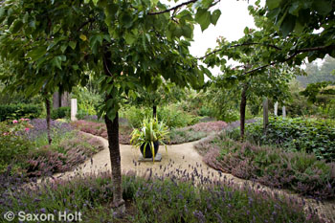
Line
Line is used effectively when it is used to draw the viewers’ eyes to points of interest in the landscape (a.k.a. the focal point), emphasize the ‘structural’ lines that give shape to the landscape, and highlight or accentuate lines in nature that may already exist.
For example, if a landscape is designed around a historical statue or monument, the lines in that landscape should effortlessly guide the viewers’ eyes to that structure.
Lines may also separate the edge of a landscape from the space around the landscape, or separate different parts of the landscape from each other.
Lines may also be used to make already-existing lines “bolder”.
For example, if a river exists as a line, plantings along the edge of the river add additional emphasis to make that line have more impact.
Source: www.gardeninggonewild.com

Slide 10
Form
Form: in its simplest definition, form is the shape of the landscape and/or the objects in that landscape.
Examples of form include cubes, spheres, pyramids, cylinders, cones, or a combination of any of these shapes.
Form is used by our brain in order to logically analyze a visual image.
In other words, our brain instinctively breaks every visual image into a collection of cubes, spheres, pyramids, cylinders, and cones.
By doing this, our brains have to do less work to process what our eyes are seeing.
A good designer will use form to aid the brain, reduce the strain needed to process a visual image, and enhance the brain’s ability to focus, relax, and become calm.

Slide 11
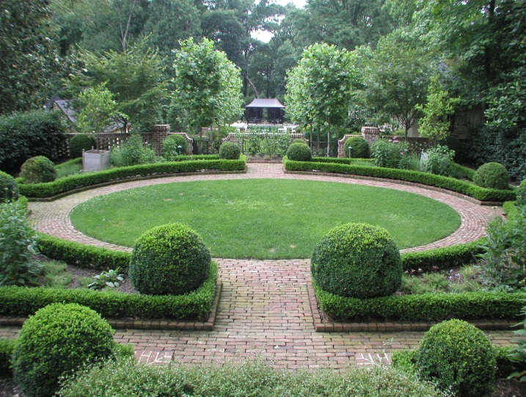
Form
Form matters because it prevents a landscape from being too “busy” and “messy”.
The same kinds of forms, when used repeatedly, create a “visual theme” that provides consistency, harmony, and order in the landscape.
Good landscapes use form consistently in order to make the landscape seem designed and intentional instead of haphazard and unpredictable.
Our brains like predictability, logic, and order. Good landscapes should supply this through the proper use of form.
Source: http://dargan.com/about/images/0696Walden.jpg

Slide 12
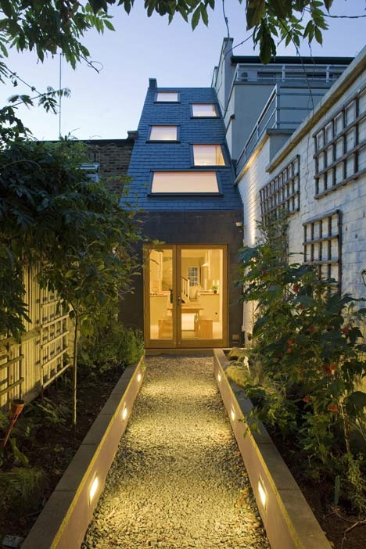
Space
Space: Space is the sense that a design is three-dimensional and has depth, or the sense that the landscape extends into the distance and is not two-dimensional.
A landscape that lacks depth will appear as if it has width and height but very little depth.
A well-designed landscape will appear to extend into the distance (when possible) draw the viewer gets “deeper” into the landscape.
This can be accomplished through changes as the landscape moves deeper into the distance, or by repeated use of the same form, plantings, textures, etc., or both.
Source: www.dezeen.com

Slide 13
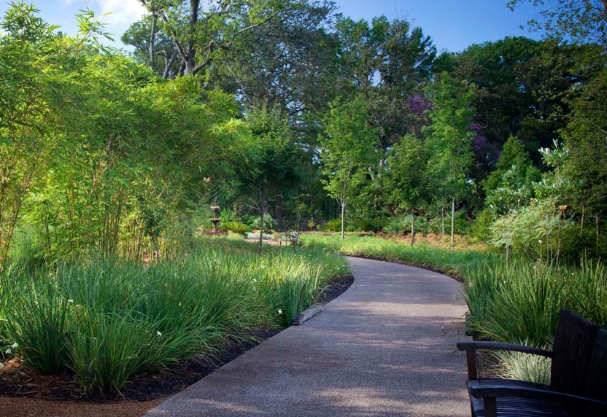
Space
A sense of space can be created in multiple ways, including…
Appropriate combinations of open and closed spaces (e.g. open spaces that proceed into the distance with layered borders on either side).
Using the same kinds of forms and shapes repeatedly, so that their perceived decrease in size as they move into the distance creates a sense of distance.
Creating ceilings and walls using vegetation. This creates a sense of intimacy and security when scaled properly, enabling viewers to feel secure and sheltered in that space.
Source: www.asla.org

Slide 14
Color
Color: Color is one of the most prominent elements in landscape design.
Color helps to emphasize, complement, heighten the effect of, or disguise other aspects of a landscape’s design.
Color also unifies the landscape and creates consistency (which our brains like) throughout the entire design.
Color has three properties:
Hue – the ‘name on the crayon’ – e.g. red, blue, green, etc.
Value – how dark or light the hue is (e.g. dark blue, light green)
Intensity – how ‘strong’ the color is, i.e. the brightness and pureness of a color (is it faint and dull or strong and bright?).

Slide 15
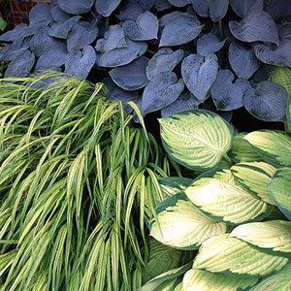
Texture
Texture: texture refers to how the appearance of an object ‘feels’ to the viewer.
For example, a palm tree with large distinct leaves visually ‘feels’ rough and coarse.
A golf course with consistently uniform green grass cut short looks smooth and velvety.
Source: capecodgolfvacations.com
Source: rol.vn

Slide 16
Texture
Texture can be used for many functions, including…
It enables certain emotions by the viewer (e.g. soft textures create a sense of comfort, while rough textures add excitement and heighten attention).
It creates a sense of space and depth (when rough textures are placed in front and soft textures are found in the distance, the landscape appears larger).
It provides contrast to emphasize or highlight parts of the landscape (e.g. a soft lawn leading up to the course texture of a pillared-building of a university or capitol).
It can create lines (e.g. if a soft lawn is bordered by a course-textured hedge, it creates a distinct line for the eye to follow).

Slide 17
Value
Value: Value is the measure of lightness or darkness usually in regards to color.
However, value can also affect the perception of other elements such as line, space, and texture.
Value is measured from lightest (white) to darkest (black), with mid-gray being the halfway value.
Value is necessary to create contrast, or the difference between adjacent light and dark values.
For example, a white line on a black shape has high contrast and ‘stands out’.
Source: mhsart1.wikispaces.com

Slide 18
Contrast
Contrast is created when opposite-values are adjacent to each other; in other words, when light values are next to dark values, distinct contrast is created.
Contrast is necessary to create lines for the eye to follow, to establish a sense of distance to create space, to highlight the forms (3D shapes) that help the brain analyze the landscape, and provide variety and consistency to the landscape.
Contrast is necessary to highlight the focal point that your eye is drawn to because of the lines in that landscape.
Without the combination of contrasting values and bold lines, your eyes will not be able to figure out where they need to go.
Source: www.imageflora.com

Slide 19
Misuse
When an element is missing to an appreciable extent, every viewer will be dissatisfied with a landscape.
If line is missing, a viewer will not know where to look. Their eyes will wander, and this creates unease to the viewer.
If form is misused, the brain will be unable to logically examine and analyze a landscape. Our brains use forms to make a landscape “make sense”. Misuse of form creates visual confusion and unease.
If space is improperly applied, a landscape will appear ‘shallow’ and two-dimensional. It will lack depth and the eye will not be ‘drawn into’ the landscape.
If color and texture are not appropriately applied, there will be no visual consistency, the sense of space and depth will be diminished, and the landscape will seem either boring or too busy.
Without value and contrast, the lines lose their distinctness, the emphasis of the focal point is lost, and the landscape will lack depth and variety. It will appear ‘bland’.

Slide 20
Proper Use
However, when appropriately applied, the elements of design will create the following:
Lines will guide your eye to a specific point or points. Within a second of glancing at the landscape, your eye will be drawn into the landscape and allow you to take in everything in an instant.
The forms used in the landscape will add visual order; it is easy for the brain to logically analyze its visual elements. A sense of order will be felt when the landscape is viewed, creating a sense of ease and satisfaction.
The use of space will create dynamic landscapes that seem larger than their physical size, offer a sense of grandeur, add emphasis to structural elements and buildings, and draw the viewers’ eye deeper and deeper into the design.
The use of color and texture will simultaneously add variety and consistency to the landscape, preventing it from seeming too busy or too boring. The color will highlight the focal points, lines, and forms found in the landscape and will allow the viewer to feel the intended mood the designer wanted the viewer to feel.

Slide 21
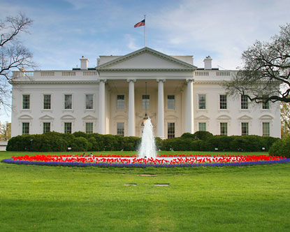
Can you find…
Line
Form
Space
Color
Texture
Value
Source: http://www.destination360.com/north-america/us/washington-dc/images/white-house-photo.jpg

