Slide 1

Statistics
By C Kohn, L Hitsman, Waterford WI

Slide 2
Statistics
Statistics is the collection, analysis, and interpretation of the data in order to determine the specific outcome of an experiment or survey.
  Scientists use statistics to determine whether or not their experimental results are reliable and repeatable.
  Scientists also use statistics to determine whether or not they can trust the accuracy of their results.
Knowing whether the trends of an experiment are a one-time occurrence or will occur every time is critical in determining the dependability of an experiment.
  An experiment with results that vary each time is not dependable.
  A dependable experiment is one that gets similar results each time it is performed.

Slide 3

Reliability = similarity
Two factors affect whether or not the results of an experiment will be similar each time.
  Amount of Data: the more data we have, the more likely we will have similar averages from our experiments each time it is performed.
  Similarity of Data: the more alike our data, the more likely the experiment will have similar results each time.
Scientists use data to answer to
key questions:
  1. How do I know that I am not wrong?
  2. How do I know that I will be right
  every time?
opticalres.com

Slide 4
Statistics
Data in research is sort of like target practice.
  When you are shooting at a target, you want all of your shots to be close together.
    The closer your shots are to each other, the better.
  You also need to have lots of shots to ensure that a shooter is accurate and not just “lucky”.
    If a shooter only takes one shot and they hit a bulls-eye, it might be accuracy or it might be luck.
    If a shooter takes lots of shots and all are on the bulls-eye, we know that the shooter is accurate.
Statistics are similar to target practice: the more numbers we have, and the more similar each number is to each other, the better.
  An archer wants lots of arrows all close
  together on the target.
  A researcher wants a large amount of
  measurements, and they want those
  measurements to be as similar to each
  other as possible.

Slide 5

Reliable vs. Unreliable
An experiment with very little data and/or data that varies a lot will have results that are unreliable.
  If we don’t have a lot of data, or if that data varies a lot, we will be unable to predict how that experiment would turn out even if we repeated it under the exact same conditions.
However, if an experiment has lots of data AND that data is very similar, it is likely that the experiment will have reliable results if performed again.
  This tells a researcher that their experimental results will be similar and predictable every time their experiment is repeated.
  These results are then considered reliable.
Somewhat Reliable More Reliable Most Reliable
Source: topendsports.com

Slide 6

Averages
In an experiment, the most important kind of statistic is the mean (or average) of the data.
  Mean is the same as average.
  It is calculated by dividing the sum of the numbers by the sample size.
    Mean = (Sum of Data)/(Sample Size)
    The mean of 1, 2, & 3 would be (1+2+3)/3 = 2. The mean is 2.
The mean is important because provides
information about every measurement in a
single number.
  For example, a teacher would know if their class
  understood the material in a unit by the average
  score from the unit quiz.

Slide 7

Averages continued
If the average score of a quiz is high, a teacher does not have to look at each score individually to see if the class did well.
  A teacher can look at the average quiz score and assume that the class as a whole understood the material if the average is high.
  While a couple students might need to relearn the material and retake the quiz, a teacher can assume they can move on to the next unit with a high average.
On the other hand, if the average quiz score is low, a teacher knows they should re-teach that unit (even if a couple students scored pretty well).
  Because they have the mean quiz score, a teacher can focus primarily on this number (the mean) to determine if their teaching was effective.

Slide 8
Averages Can change
When we take the average of something, we are using a number that can change as our data changes.
  For example, if we wanted to know the mean height of this class. We would…
    Record each person’s height.
    Add all the heights together.
    Divide by the number of students we have.
However, the mean height of class can change.
  If we gained or lost a student, the mean or average
  height would be a new number.
  If a student had a growth-spurt, their new height
  would change the average height if it was
  calculated a few months later.
  The “average height” is not one number; it can
  change each time it is measured!

Slide 9

Class average
If our class did not have very many students, the addition of one more person’s height would have a big impact on the calculated average.
  On the other hand, if we had 1000 students in our class, the addition of one more person’s height would hardly change the calculated average.
If a new person’s height was very similar
to the average, our calculated average
would not change much.
  On the other hand, if they were 6’7”, our
  calculated average would change a lot more.
www.presentermedia.com

Slide 10
Variability
Whether or not the numbers in data are similar to each other (or vary widely) is known as variability.
  Variability is the opposite of similarity in data.
The more similar our data, the less variable it is. The less variable the data, the more reliable it is.
  Just like an archer wants all of their arrows to be close together, we want the numbers in our data to be as similar as possible.
  In other words, we want our data to have low variability.
More Variable Less Variable
Source: topendsports.com

Slide 11
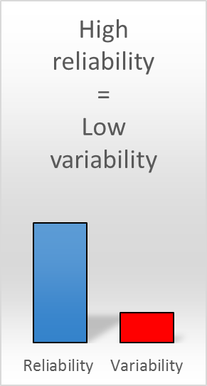
Variability
The less similar our data, the more variable it is. The more variable the data, the less reliable it is.
  We know that if an archer has arrows all over the target, they are not a reliable shooter.
  Similarly, if the numbers in our data are highly variable and very dissimilar, our experiment does not have reliable results.
The lower the variability of our data, and the greater the amount of data that we have, the more reliable and repeatable our data.
  An experiment with large amounts of data and with minimal variability is a reliable experiment.
  An experiment with little data and/or data with lots of variability is not a reliable experiment.

Slide 12




Standard Deviation
Variability can be measured using a statistical method known as Standard Deviation.
  Standard deviation is the “average variability”.
  Standard deviation is a measurement of how similar or dissimilar the numbers from an experiment are to each other.
A low SD score means your data is all very similar.
  These corn plants would have low SD
A high SD score means your data is very dissimilar.
  These corn plants would have high SD
More reliable data
Less reliable data

Slide 13
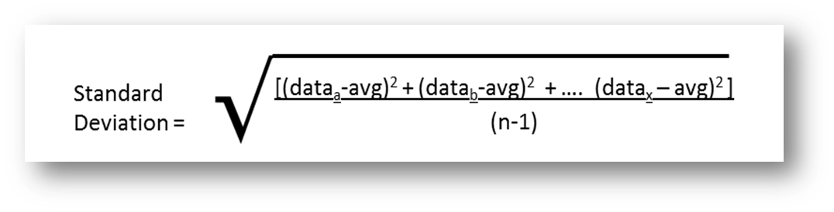
Standard Deviation
Standard deviation is calculated by measuring the difference between the average and each individual measurement and taking the average of these differences.
  The lower the standard deviation value, the more reliable the data.
  The greater the standard deviation value, the less reliable the data.

Slide 14
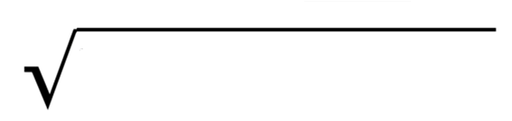
Standard Deviation
To calculate standard deviation, we have to determine the average difference between each number and the mean of the data and divide by the amount of data minus 1.
  Don’t worry about knowing the specific formula; just focus on knowing what standard deviation values indicate.
For example, if we had radish height measurements of 7, 10, and 13 cm, our average height would be 10 cm.
  SD = [(7-10)² + (10-10)² + (13-10)²] = 3
  (3-1)
  Our standard deviation in this case is 3 cm.
  This indicates that on average each measured height varies by 3 cm from the mean.

Slide 15
Standard error
Standard error is another statistical equation that can be used to calculate the reliability of data from an experiment.
  Standard error is very similar to standard deviation.
  While standard deviation uses the “average variance” to calculate the reliability of data, standard error uses both variability and the size of the sample to calculate reliability.
Standard error is calculated by dividing the standard deviation value by the square root of the amount of data that you have.
  For example, if your mean was 10, if your standard deviation was 3, and your sample size was 9, your standard error would be 3/√9 = 3/3 = 1.
  In this case, our standard error value is 1.

Slide 16
Standard Error
Because standard error incorporates both the sample size and the variability of the data, it is more valuable than standard deviation for calculating reliability.
  The lower the standard error value, the more reliable the data.
  The greater the standard error value, the less reliable the data.
Standard error can be used to calculate the margin of error.
  Margin of error shows the range in which our mean (average) would be found any time we repeated an experiment under the same conditions.
  The smaller the margin of error, the more reliable the results.

Slide 17
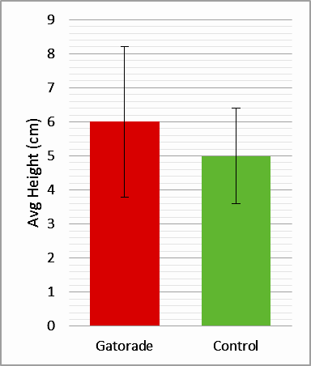
Margin of error
The margin of error is the range in which we would find the new results if the experiment was repeated under the same conditions.
  For example, if we repeated the Gatorade-radish experiment under the same conditions, the margin of error tells us the range in which we would find the average height for the second experiment.
  This helps a scientist to determine how similar and predictable their results will be each time an experiment is performed.
Margin of Error

Slide 18
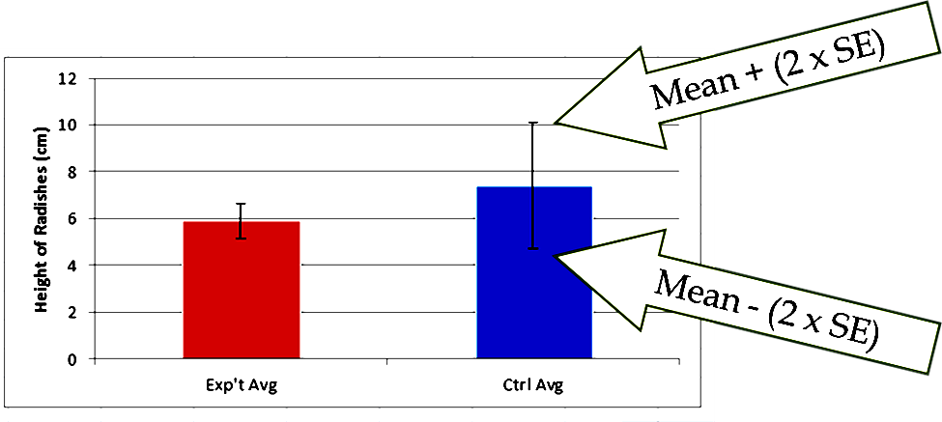
Margin of Error Continued…
Typically the margin of error is equal to: Mean +/- (2 x Standard Error).
  For example, in our previous example, the mean was 10 cm and the standard error value is 1 cm.
  This would mean that our margin of error would be 12 to 8 cm.
    [10 +/- (2 x 1)] = 12 or 8
If margin of error is calculated by doubling the standard error value, it provides over a 95% confidence interval.
  This means that there is over a 95% chance if an experiment were repeated under the same conditions, the new results would be inside the margin of error.

Slide 19
Error bars
Standard Error and the Margin of Error are used to create Error Bars.
  Error bars are a visual depiction of your Margin of Error.
Both margin of error and error bars enable us to visually determine if two averages have a statistically significant difference.
  In other words, the error bars show whether or not two groups are different enough to always be different (if we repeated the same experiment under the same conditions).
If the error bars and margin of error do not overlap, then the average of one group will always be greater than the average of another group.
  Error bars do not overlap if the greatest error bar value of one group is less than the lowest error bar value of another group.
  Visually, this would mean that the top of one error bar is beneath the bottom of another error bar.

Slide 20
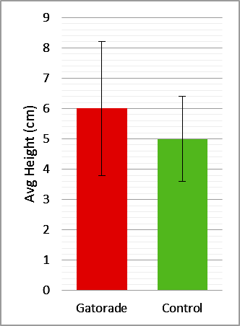
Error bars & margin of error
If the error bars and margin of error DO overlap, this means that the two groups are too similar to say that there is any real difference.
  This would occur when the top of one error bar is above the bottom of another error bar.
  This means that if an experiment were repeated, it would be impossible to predict which group would have the greatest average value in the second experimental trial.
For example, if radishes treated with Gatorade had an average height whose margin of error/error bars overlapped with that of the control, this would mean that…
  There is no significant difference between average height of the Gatorade-treated radishes and the average height of the control radishes.
  If we were to repeat the experiment under the same conditions, we would be unable to predict whether the Gatorade-radishes or the control radishes would be taller on average.

Slide 21
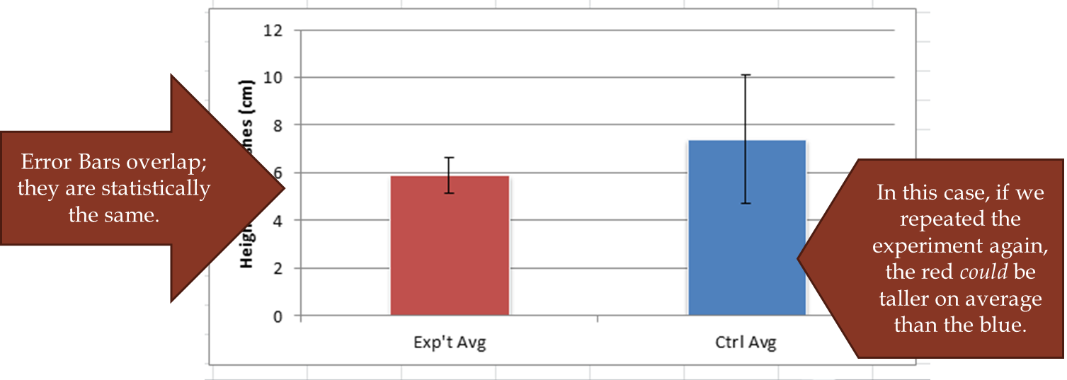
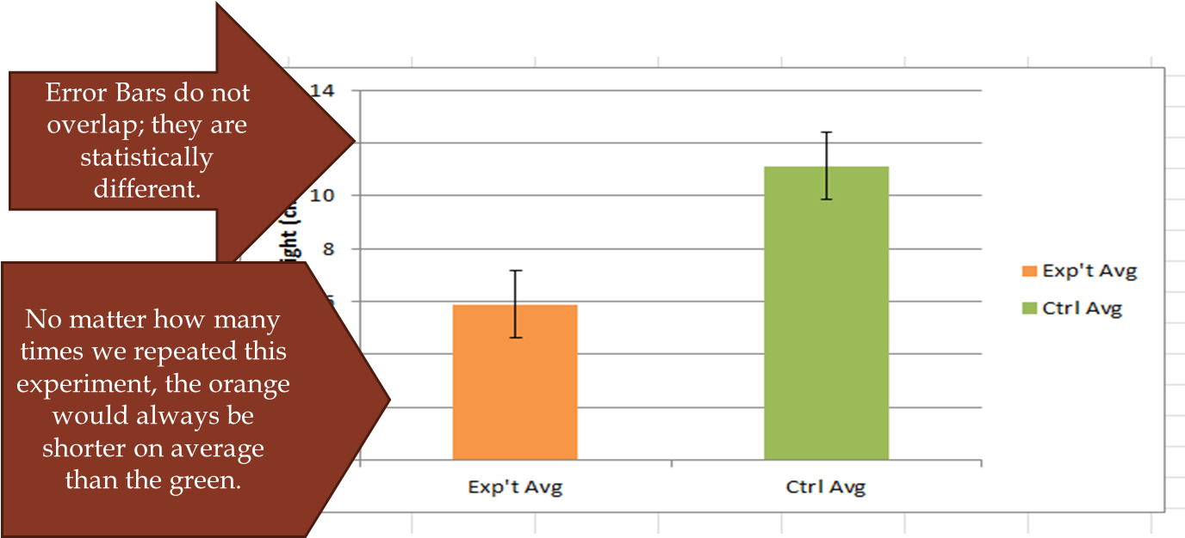

Slide 22
What to test?
Null Hypothesis is the statement that you want to test.
  It is the hypothesis that the researcher tries to disprove, reject, or nullify.
  The null hypothesis may represent an existing hypothesis that has not been proven correct or incorrect.
For example, if we were testing whether or not radishes that were treated with Gatorade would grow taller, our null hypothesis would be:
  “There is no difference between the height of radishes given Gatorade and the height of the control radishes.”
The alternative hypothesis is what we are attempting to prove or demonstrate.
  Alternative hypothesis is what you accept if the null hypothesis is rejected.
For example, our alternative hypothesis in the earlier situation would be:
  “Radishes treated with Gatorade will grow taller than the control radishes.”

Slide 23
significance of your results
P-value: this measurement enables you to determine whether or not you can accept or reject the null hypothesis.
  P-value is a number between 0 and 1 and is interpreted in the following way:
Small p-value (lower than 0.05) = STRONG evidence against the null hypothesis.
  A p-value under 0.05 means you would reject the null hypothesis and accept the alternative hypothesis.
Large p-value (over 0.05) indicates that you have WEAK evidence against the null hypothesis.
  If p-value greater than 0.05, you cannot reject the null hypothesis.
A p-value above 0.05 does not indicate anything about your alternative hypothesis.
  It only means that we cannot prove that the null hypothesis is incorrect.

Slide 24
Summary of concepts terms:
Most Important – Reliability of data depends on two factors:
  1) How much data we have. More data is more reliable.
  2) How similar the measurements are to each other. More similar data is more reliable.
Mean: the average of the data.
  The mean is found by adding up all the measurements and dividing by the number of measurements that you have.
  Whether or not a mean (average) is reliable depends on how much data was used to create the mean and how similar the measurements are to each other.
Variability: this is the measure of how much your measurements are different from each other.
  The more similar your measurements, the lower your variability.
  The less similar your measurements, the greater your variability.

Slide 25
Summary of concepts terms:
Standard Deviation: this is the measurement of how much variability you have.
  Standard Deviation tells us how much each measurement differs from the mean on average. The lower the standard deviation, the lower the variance, the more reliable the results.
Standard Error: this is a measurement of the reliability of data that includes both variability and the amount of data in an experiment.
  Standard Error is a more valuable measurement of the reliability of data because it includes both size and variance. The lower the SE, the more reliable the results.
Margin of Error: the range in which we would almost always find the mean if we repeated the experiment under the same conditions.
  Margin of Error is equal to: Mean +/- (2 x Standard Error).
  This gives us over a 95% likelihood of finding an accurate margin of error.
Error Bars: a visual depiction of margin of error on a graph.
  Error bars are drawn on a graph based on the margin of error.

Slide 26
Summary of concepts terms:
Statistically significant difference: this means that two means (averages) are different enough that they will always be different.
  Two groups are significantly different if their error bars do not overlap.
  This means that the highest value in the margin of error of one group’s average does not overlap with the lowest value of the other group average’s margin of error.
Null Hypothesis: this is the hypothesis you are trying to disprove.
Alternative Hypothesis: this is the hypothesis that you are trying to prove is correct by disproving the null hypothesis.
P-value: this tells us whether or not we can reject the null hypothesis and accept the alternative hypothesis.
  If the p-value is below 0.05, we can reject the null hypothesis and accept the alternative hypothesis.
  If the p-value is above 0.05, we cannot reject the null hypothesis.

