Slide 1
Pathogens
By C. Kohn
Agricultural Sciences
Waterford, WI

Slide 2
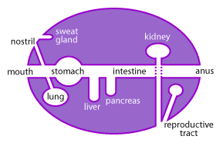
Pathogens
Any organism that is capable of causing a disease is called a pathogen.
Most pathogens are microorganisms (bacterium, virus, or fungus) but most microorganisms do NOT cause disease.
Many microorganisms even provide some protection from infectious pathogens by slowing their growth through competition.
In order to cause disease a pathogen must be able to get entrance into a host (the affected organism), adhere to the host’s tissue, and cause damage.
A pathogen most commonly gains entrance into an animal via the mucus membranes, including the mouth, eyes, nostrils, and genitals.
Cuts or openings in the skin can also lead to infection.
Source: http://www.scq.ubc.ca/mucosal-immunity-and-vaccines/

Slide 3
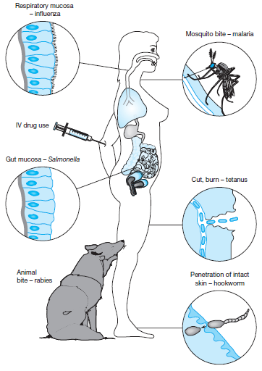
Pathogens are Specific
Most pathogens attack a specific kind of tissue.
While a pathogen can invade the tissue where they gained entrance into the host, most often a pathogen focuses on attacking a specific kind of tissue in the host (such as respiratory cells, intestinal tissue, or other specific kinds of cells).
While the growth and reproduction of a pathogen can cause problems inside the host’s body, damage is more often due to the production of toxins or destructive enzymes by the pathogen.
These toxins or enzymes are often used to enable the pathogen to further invade the host’s tissues and/or to more easily acquire energy or nutrition from the host.
For example, some ‘flesh-eating’ diseases produce enzymes that break down tissue and dissolve fibrin blot clots in order to enable the pathogen to invade even more tissue in the host.
Source: onlineimmunology.blogspot.com

Slide 4
Categories of Pathogens
There are six major kinds of pathogens that can cause infectious disease:
Bacteria: single-celled organisms that lack cellular organelles and divide by fission (splitting in two).
Viruses: non-living nucleic acid surrounded by a protein coat that uses living cells to reproduce.
Fungi: eukaryotic (has organelles) organisms that reproduce by forming spores, can be unicellular or multicellular, and are common decomposers.
Protozoa: single-celled eukaryotic organisms that are mobile and feed off other organisms.
Helminths (worms): simple multi-celled invertebrates that often have multi-staged reproductive cycles.
Prions: non-living infectious proteins that most commonly affect the nervous system of the host.
Source: www.riversideonline.com

Slide 5
Bacteria (Prokaryotes)
Bacteria are unicellular (single-celled) organisms.
Bacteria are prokaryotes, meaning they lack a nuclei, mitochondria, or other cellular organelles. (Conversely, eukaryotes have organelles like a nuclei or mitochondria.)
They have circular, double-stranded DNA.
They also have small additional ‘packets’ of DNA called plasmids.
Most bacteria reproduce by growing and then dividing into two cells in a process called binary fission.
Bacteria are typically classified by their shape.
Bacteria are most commonly classified as either bacillus (rodshaped), coccus (spherical), or spirillum (helical rods).
Bacteria can also be classified by how they obtain their energy.
Some bacteria are photosynthetic, some oxidize inorganic compounds, and some break down organic compounds (such as sugar and amino acids).
Bacteria can also be classified as aerobes (need oxygen), anaerobes (can only live in the absence of oxygen) or facultative anaerobes (can live with or without oxygen).
Source: http://evolution.berkeley.edu/evolibrary/images/endosymbiosis/cells.gif

Slide 6
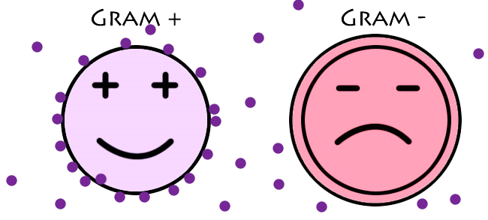
Gram Neg vs. Gram Pos
In regards to disease, bacteria are most commonly classified as Gram Positive or Gram Negative based on the presence or absence of an outer cell membrane.
Both kinds of bacteria are very similar internally.
The main difference between a gram negative and a gram positive bacteria is based on their cell walls.
Gram positive and gram negative bacteria can be identified using a laboratory stain.
When a gram stain is applied, gram positive bacteria turn purple and gram negative bacteria turn red.
Source: http://www.dbriers.com/tutorials/wp-content/uploads/2012/12/GramPositiveNegative21.jpg

Slide 7
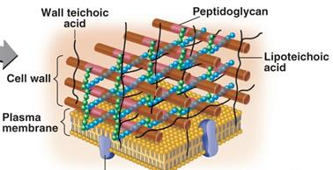
Gram Positive Bacteria
A gram positive bacteria has a cell wall made mainly of peptidoglycan.
Peptidoglycan is a mesh-like substance in the cell wall and is similar to that of the exoskeleton of an insect.
Because the peptidoglycan cell wall is mesh-like, this means that substances can diffuse across the membrane and enter the inside of the bacterial cell.
This makes gram positive bacteria susceptible to most antibiotics, and this makes it easier to treat a gram positive bacterial infection than it is to treat a gram negative bacterial infection.
Peptidoglycan can also be broken down by lysozyme enzymes produced by animal cells.
Source: studydroid.com

Slide 8
Gram Negative Bacteria
Gram negative bacteria have an extra layer of protection due to the presence of an outer membrane on the outside of their cell wall.
This outer membrane is like a stiff canvas sack and blocks larger molecules including antibiotics and lysozymes.
The outer membrane is like a bulletproof shield for gram negative bacteria, repelling most molecules that would otherwise harm the bacterial cell.
The outer membrane also protects gram negative from drying and from harsh environments including the stomach acid of animals and engulfment by white blood cells.
Finally, the outer membrane can enable some species of gram negative bacteria to adhere (or ‘stick’) to the cells of their hosts to increase their likelihood of invasion and infection.
Source: http://biology-forums.com/index.php?action=gallery;sa=view;id=752

Slide 9
Toxins
Gram negative bacteria contain endotoxins in their cell wall and outer membrane.
Endotoxins are toxins found inside bacterial cells and are mostly only released if the cell if broken down.
This is different from an exotoxin, which is a toxin released by a bacterial cell while it is still alive.
Exotoxins are much more common in gram positive bacteria, whereas endotoxins are more common in gram negative bacteria.
If the outer membrane and cell wall of gram negative bacteria are broken down, these endotoxins will be released into the body of the host.
Endotoxins are very resilient and can remain intact even after 30 minutes of boiling temperatures.
These endotoxins cause an inflammatory response in animal hosts.
Source: www.ib.bioninja.com.au

Slide 10
Septic Shock
The inflammatory response due to the presence of toxins from bacteria can lead to septic shock and even death.
When a toxin is sensed by an animal’s body, it causes a systemic (body-wide) inflammatory response.
This means that all the blood vessels in the body expand.
As vasodilation (expansion of the blood vessels) occurs, the blood pressure of the animal drops. This drop in blood pressure is known as hypotension.
The heart will weaken as it works harder to compensate for the hypotension.
As a result of this hypotension, organs will not receive adequate oxygen or nutrients due to impaired blood flow (hypoperfusion), and organ systems will begin to shut down.
The kidneys will be unable to eliminate waste, allowing it to accumulate in the blood.
The respiratory system will begin to fail, resulting in even less oxygen flow to the body’s organs and an increased rate of organ shut-down.
When an infection causes life-threatening low blood pressure, this is known as septic shock.

Slide 11
Stages of Septic Shock
Infection & Bacteremia
Septic shock has the following stages:
Infection: presence of bacteria in what is normally sterile bodily tissue.
Bacteremia: presence of bacteria in the blood.
Systemic Inflammatory Response (SIRS): when blood vessel dilate (vasodilation) due to bacteremia, causing hypotension (drop in blood pressure) and hypoperfusion (lack of blood flow through an organ).
Sepsis: when inflammatory responses occur in tissues that are remote from the infection.
Sepsis becomes septic shock if the systemic inflammatory response leads to dangerously low blood pressure, and organ systems begin to fail as a result.
SIRS
Sepsis
Septic Shock
Death

Slide 12
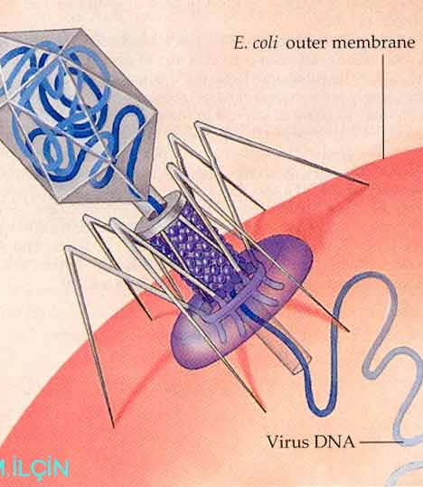
Viruses
The second category of disease-causing pathogens are viruses.
A virus consists of genetic material surrounded by a protein coat.
Viral genomes can be double or single stranded and can be DNA or RNA
Viruses are non-living. They cannot reproduce on their own and they do not metabolize food for energy.
Because a virus is not alive, it will not respond to an antibiotic.
To reproduce, a virus must hijack a cell and manipulate the cell so that it produces viral proteins instead of its normal cellular proteins.
To do this, the virus inserts its genome into the host cell, and forces the cell to reproduce its own genome.
The cell then makes mRNA and tRNA in order to produce more viral proteins.
The cell assembles the viral proteins and genomes into new viruses.
These newly-assembled viruses are released from the cell and then infect other cells, repeating the process over and over.
Source: learningon.theloop.school.nz

Slide 13
Retroviruses
Retroviruses are a kind of virus with the ability to insert their own genetic material into the genome of a cell.
Retroviruses have a unique enzyme called reverse transcriptase that allows them to copy their RNA into the cell’s genome.
As the host’s cells divide, they reproduce the viral DNA, making retroviruses difficult to eliminate from a host.
Retroviruses also tend to have long latent periods (the time between infection and the exhibition of symptoms) which means that the disease often goes unnoticed and can more easily spread.
HIV is an example of a retrovirus.
All viruses cause their respective diseases by interrupting normal cellular function.
Some viruses use their own proteins to stop the creation of the host cell’s proteins.
Some viruses cause the cell membrane to break open and rupture.
Some viral proteins are toxins.
The presence of some proteins causes the host’s own immune system to attack and destroy its own cells to eliminate the virus.

Slide 14
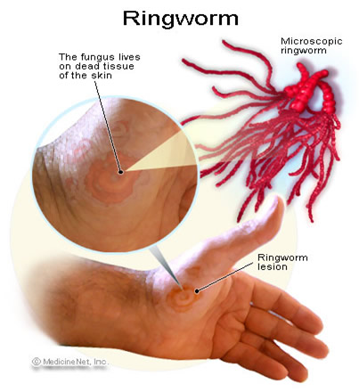
Fungi
The third category of pathogens are fungi.
Fungi, like animals and plants, are classified as their own kingdom of life.
Like animals and plants, fungi are eukaryotic, meaning they have cellular organelle.
Fungi can be either unicellular (such as yeast) or multicellular (such as mushrooms).
With bacteria, fungi are the main decomposers in the environment.
Ringworm in livestock is a well-known example of a disease caused by a fungal pathogen.
Source: http://www.scabies-killer.com/images/ringworm.jpg

Slide 15
Protozoa
Protozoa are the fourth category of pathogens.
Protozoa are single-celled eukaryotes (they have cellular organelles).
The amoebas and paramecium are common examples.
Protozoa lack cell walls, which make them flexible and capable of quick movements.
Protozoa often invade the tissue of their hosts, causing tissue erosion and degradation.
Other protozoa, including Giardia, cause infection of the large intestine, causing it to swell which prevents nutrient absorption and causes diarrhea, gas, and cramping.
Malaria is caused by the Plasmodium protozoa; when Plasmodium gets into the blood, it destroys red blood cells and causes anemia, alternating fever & chills, exhaustion, and often death.
Source: http://thumbs.dreamstime.com/z/protozoa-22943129.jpg

Slide 16
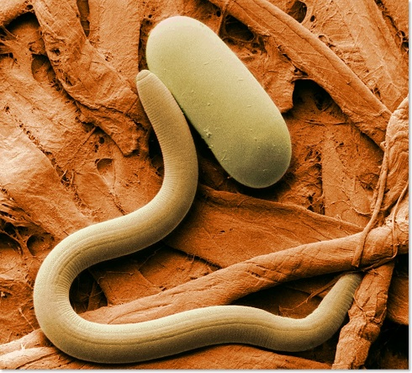
Helminths
Helminths, or parasitic worms, comprise the fifth category of pathogens.
Helminths are multicellular eukaryotes with tube-like bodies.
There are three main classes of helminthes: nematodes (roundworms), cestodes (tapeworms), and trematodes (flukes).
Helminths are unique because they do not proliferate inside their hosts; their offspring will usually be passed in fecal matter from animal hosts so that they can infect other animals.
Most helminths develop slowly inside their hosts, and usually symptoms are mild and have a slow onset.
Helminths can affect their hosts in a variety of ways.
Both adults and larva can cause diseases depending on the species.
The severity of the symptoms depends on the concentration of helminths inside the host.
Helminths affect the host’s tissue in a number of ways, but typically they cause disruption either by physically disrupting the tissue of the host or by taking nutrients from the host’s body.
Source: http://bingsti.ru/styled/files/044004380441-1.jpg

Slide 17
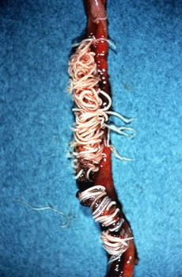
Examples of Helminths
Examples of helminth diseases include the following:
Hookworms are a kind of helminth and cause anemia (lack of red blood cells) and malnutrition.
Some helminths burrow into the skin or eyes causing itching, infection, and inflammation.
Cysticercosis is caused by a pork tapeworm and causes bumps to develop in the skin and muscles as well as neurological problems.
Echinococcus tapeworms cause liver failure, lung disease, and brain abnormalities.
Source: http://www.poultryhub.org/wp-content/uploads/2012/05/Helminths-Ascaridia-galli-in-SI.jpg

Slide 18
Prions
Prions are the most-recently discovered class of pathogens.
Prions are infectious proteins. They are not alive and are not a kind of living species.
Prions affect their host by causing abnormal folding of the host’s proteins.
Like a key for a lock, the function of a protein depends on its shape.
When a prion alters the shape of a protein, it changes its function and makes it useless (much like if you bent a key at an angle, it would not work in a lock).
The abnormal folding or proteins leads to tissue loss in the brain of the host, leading to literal holes in the brain.
Bovine Spongiform Encephalopathy (BSE, or Mad Cow), Chronic Wasting Disease (CWD, common in deer and elk), and scrapie (common in sheep) are common forms of animal prion diseases.
Humans prion diseases include Creutzfeldt-Jakob Disease (CJD) and Kuru.

Slide 19
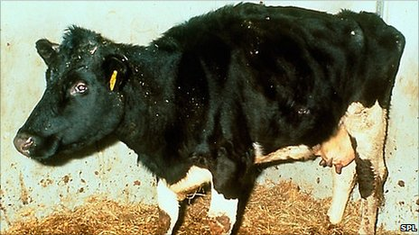
Prion Diseases
Prion diseases are most commonly spread through ingestion of infected materials.
For example, scrapie and mad cow disease (below) were transmitted to animals when they were fed rendered animal protein supplements from previously-infected animals.
Kuru was spread among the Fore people of New Guinea because of a practice of ritualized cannibalism.
CWD seems to be spread by saliva, urine, and feces and may have a correlation to populations of deer and elk that have high concentrations around a feeding area.
As of this time, there is no known treatment for any prion diseases.
Source: news.bbcimg.co.uk/media/images
Source: quizlet.com

Slide 20
Works Cited
http://micro.digitalproteus.com/morphology2.php
http://www.path.cam.ac.uk/~schisto/general_parasitology/parasitology_general_pathology.html
http://www.merckmanuals.com/home/infections/bacteremia_sepsis_and_septic_shock/sepsis_and_septic_shock.html
http://www.cdc.gov/ncidod/dvrd/prions/
http://www.ninds.nih.gov/disorders/kuru/kuru.htm
http://www.cwd-info.org/index.php/fuseaction/about.faqDetail/ID/209ea1b39c93f85dde9a5a4261400ea2
https://science.education.nih.gov/supplements/nih1/diseases/guide/understanding1.htm
https://www.softchalk.com/lessonchallenge09/lesson/ImmuneSystems/BloodLymphaticandImmuneSystems_print.html

