Slide 1
Vaccines & Antibiotics
By C. Kohn
Agricultural Sciences
Waterford, WI

Slide 2
Homeostasis & Pathogens
Homeostasis is the maintenance of a constant internal environment inside of the body.
Because an animal’s body must maintain a constant internal environment, infections by pathogens are an obvious threat.
Blood and lymph, which serve as the two liquid tissues of the body, help to ensure a constant internal environment.
The blood and lymph combine with the immune system to protect the body from pathogens in order to maintain homeostasis.
The immune system is composed of organs, tissues, cells, and chemical messengers that protect the body from foreign pathogens and from its own infected cells.
The immune system has multiple levels of defense to protect the body from pathogens and to maintain homeostasis.
A pathogen seeks to gain entry to the body, reproduce, and utilize the body to obtain energy and continue the process of infection.
The immune system works to negate pathogens in each of these tasks.

Slide 3
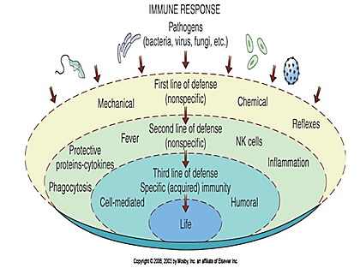
The Immune Response Levels
Source: https://www.softchalk.com/lessonchallenge09/lesson/ImmuneSystems/BloodLymphaticandImmuneSystems_print.html

Slide 4
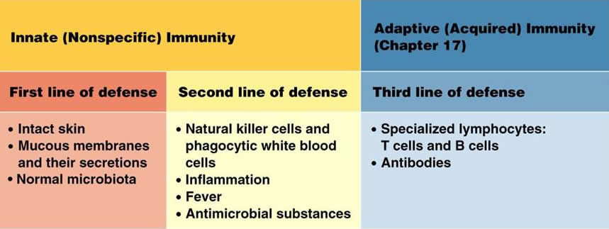
The Immune System
The immune system recognizes which cells belong to the body and which cells do not.
Cells that are not part of the body (including bacteria and fungi) are eliminated by the immune system.
The immune system can also attack the body’s own cells if they are infected by a virus or other pathogen and even has a limited ability to destroy and slow the growth of cancerous cells.
The immune system’s first line of defense is nonspecific immunity; this refers to the various ways in which the body protects itself from pathogens without having to ‘recognize’ them.
Continual forms of nonspecific immunity can be mechanical, physical, and chemical.
Mechanical nonspecific immunity includes physical barriers to pathogens, including the skin and hair.
Physical nonspecific immunity includes coughing, sneezing, vomiting, and diarrhea.
Chemical nonspecific immunity includes tears, saliva, and perspiration, which contain lysozymes that can break down some pathogens; chemical nonspecific immunity can also include the stomach’s acid.
Source: classes.midlandstech.edu

Slide 5
Nonspecific Immunity
If a pathogen is not destroyed by continual forms of nonspecific immunity, an animal’s body can employ selective forms of nonspecific immunity that are only used during a serious infection as a second line of defense.
These include phagocytosis, inflammation, pyrexia, protective proteins, and NK cells.
Phagocytosis is the process in which a pathogen is consumed and broken down by specific kinds of white blood cells (neutrophils and monocytes).
Inflammation is caused by vasodilation (widening) of blood vessels.
This enables more phagocytic white blood cells to access the site of infection.
Source: cnx.org

Slide 6
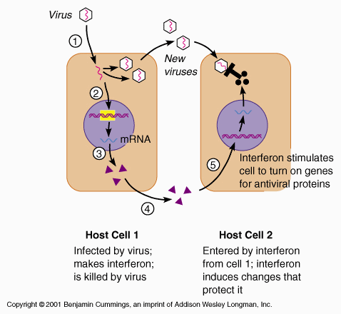
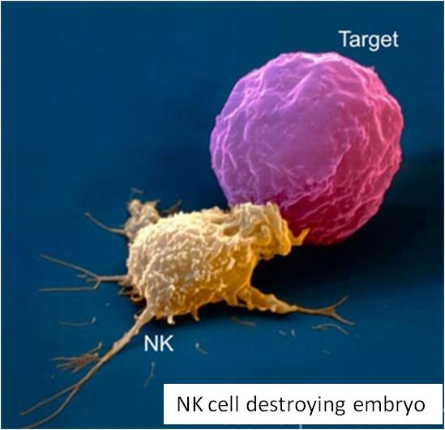
Nonspecific Immunity (cont.)
Pyrexia, or fever, can also be used by an animal’s body if a pathogen is detected.
Because an animal’s cells can withstand slightly higher temperatures than bacteria, it ‘cooks out’ the pathogen.
Protective proteins include:
Interferons, which interfere with viral replication and limit a viruses growth and damage.
Complement proteins, which are activated by the presence of bacteria and lyse the bacteria.
NK (or Natural Killer) cells are a kind of white blood cell that destroy infected or cancerous cells in an animal’s body.
Source: legacy.owensboro.kctcs.edu
Source: www.notesformedicalstudents.com

Slide 7
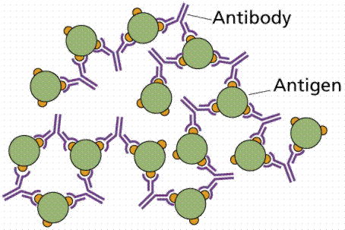
Specific Immunity
If a pathogen is still present after all forms of nonspecific immunity have been utilized, an animal’s body will utilize specific immunity as the third and final line of defense.
Specific immunity is a kind of immunity that depends on an antigen-antibody response to eliminate a specific pathogen known from prior exposure.
An antibody is a substance produced by an animal’s body that recognize and neutralize foreign substances.
An antigen is the foreign substance that is recognized and destroyed by the antibody. Antigen is short for “antibody generator”.
Antibodies and antigens physically fit together like a lock and key.
If an antibody fits on an antigen, the animal’s body knows to destroy the antigen due to a previously harmful experience from which the antibody was developed.
Source: www2.estrellamountain.edu

Slide 8
Active & passive Specific Immunity
Specific immunity can either be genetic or acquired.
Genetic specific immunity is an inherited ability to resist disease received from an animal’s parents.
Acquired specific immunity is developed after an animal has contracted and recovered from a disease.
Acquired immunity can be either active or passive.
Active acquired immunity is due to development of memory white blood cells that recognize pathogens as the result of having the disease or a vaccination for a disease at a prior time; the white blood cells will destroy the pathogen once its recognized to prevent it from reproducing and re-infecting the animal.
Active immunity is typically permanent and will usually last the entire life of the animal. However, in some cases it can become ineffective against a disease over time.
Passive acquired immunity is when an animal receives antibodies through milk, blood, or placental transfer in the womb. It is called passive immunity because the work to produce the antibodies was performed in another animal’s body.
Passive immunity is temporary and will only last a short while.

Slide 9
Immunity: ability to prevent or stop an infection from a pathogen.
Nonspecific immunity: general responses of the body not specific to a pathogen.
Specific Immunity: antibody/antigen response specific to a particular pathogen.
Selective: phagocytosis, inflammation, pyrexia, protective proteins, and NK cells
Continual: skin, hair physical (coughing, sneezing), chemical (lysozymes).
Acquired Specific Immunity: immunity that is acquired after birth.
Genetic Specific Immunity: present at birth due to genetic inheritance.
Active Acquired Immunity: Occurs by actually having the disease or by vaccination
Passive Acquired Immunity: Occurs from a blood transfusion, placental transfer, or colostrum.

Slide 10
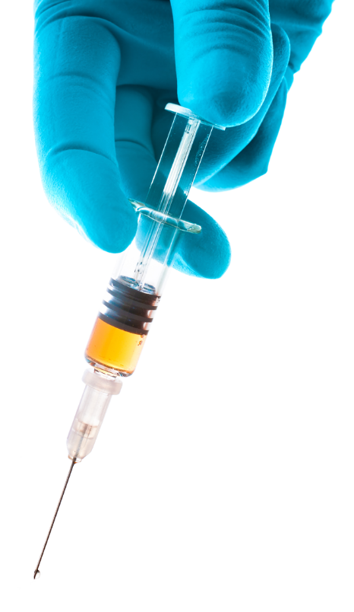
Vaccines
A vaccine is a substance used to stimulate the production of antibodies in an animal that will recognize and destroy a pathogen in order to prevent a second reoccurrence of a disease.
A vaccine consists of a small dose of a disease in a format that does not enable the disease to occur but does enable the body to develop an immune response to the disease.
The immune system of the vaccinated animal will “learn” to recognize the disease and destroy the disease the moment it is able to gain access to the body.
This either prevents the animal from acquiring the disease or, at minimum, keeps the disease from becoming too severe for the animal to fight it on its own.
There are four kinds of vaccinations:
A live virus vaccine uses a weakened form of the disease that the body can more easily overcome.
A killed (or inactivated) vaccine uses proteins or small particles from a pathogen to stimulate the production of antibodies in an animal.
Toxoid vaccines contain a toxin produced by a pathogen which makes the animal immune to the toxins produced by the pathogen but not immune to the pathogen itself.
Biosynthetic vaccines use artificially-reproduced substances that are similar to what the pathogen would contain.
Source: humansarefree.com

Slide 11
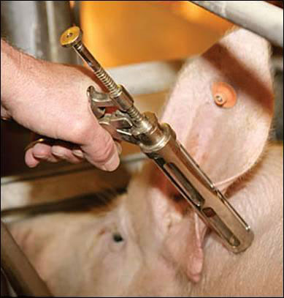
Vaccinations & Animal Safety
Vaccinations are a necessary aspect of ensuring the safety and wellbeing of production animals in agriculture.
Calves, piglets, chicks, and other baby livestock animals are born with passive immunity inherited from the mother and from a mammalian mother’s milk immediately after birth.
Milk that is produced immediately after birth is called colostrum, and is richer and has a higher content of antibodies.
After a short period of time, this passive immunity will wear off.
Because a young animal has less exposure to disease due to its age (meaning less antibodies to fight disease) and because young animals are generally more susceptible to disease, farms depend on vaccinations to prevent the widespread disease of confinement animals.
Vaccinations are not only used for young livestock. Vaccinations are also important for adult livestock.
For example, leptospirosis is a disease that can cause abortions in swine.
A sow should be vaccinated for Leptospira bacteria before she is bred.
Most “lepto” vaccines require a pig to vaccinated twice as a gilt (young female) and then receive a booster shot after each litter has been weaned off her milk to ensure that the sow has a sufficient supply of antibodies to fight this disease.
Source: www.morrisvetcenter.com

Slide 12
Health Management Plans
Vaccinations are part of an effective health management plan for all production animal operations.
Healthier animals grow more quickly, efficiently, and with fewer expenses. A health management plan ensures that animals remain healthy.
A health management plan for a farm should include a strong vet/client/patient relationship (or VCPR) in which a veterinarian is familiar with a farm, its animals, and the farmer and can make sound medical judgments because of this prior knowledge.
Herd health management should also include a herd health plan that includes when vaccinations should be administered as well as periodic checks of herd health.
A farm’s health management plan should also address biosecurity measures, including how diseases will be prevented through sanitation measures, how diseases will be contained so that they don’t spread through quarantine, and how vectors of disease (animals that introduce diseases such as rodents and pests) will be controlled and eliminated.
Finally, a farm should develop an emergency management plan in the event of a disease outbreak or a possible agroterrorist attack.
Source; www.swineimprovement.com

Slide 13
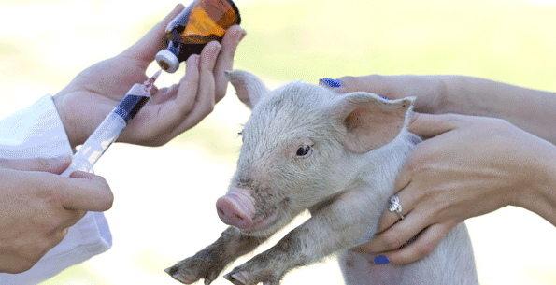
Responsible Use of Antibiotics
Responsible use of antibiotics should be part of a farm’s health management plan.
Antibiotics are medicines that kill or inhibit the growth of bacteria.
Examples include penicillin and ampicillin.
While vaccines are used to prevent diseases, antibiotics are primarily used for infections that have already begun.
Antibiotics are primarily for bacterial infections; they have no impact on viral infections.
Antibiotics are used on farms for three kinds of purposes:
Antibiotics can be used to treat an infection that has already occurred. These are usually delivered by injection but could also be delivered by feed or water.
Antibiotics are also commonly used to control or prevent diseases that are either currently detected in the herd or are known to have a high likelihood of an outbreak at certain production stages. These are typically administered via the feed or water of the animals.
Finally, antibiotics can be administered to improve the ability of an animal to convert their feed into food products (particularly in meat animals). These are usually delivered via the feed.
Source; foodandsafety.com.au

Slide 14
How Antibiotics Work
The overuse of antibiotics is related to the decreased efficacy of antibiotics.
Failure to use antibiotics responsibly can worsen antibiotic resistance, a condition in which populations of a microorganism (usually a bacteria) are able to survive and withstand exposure to antibiotic treatments, making the antibiotic less effective or useless.
To understand how antibiotic resistance occurs, you must first understand how an antibiotic works.
Antibiotics typically use one of four mechanisms to destroy bacteria:
Breached cell walls & membranes: bacteria need to protect the inside of their cells from the external environment. Breaking the cell wall or membrane of a bacteria prevent it from maintaining homeostasis, resulting in the death of that bacteria.
Disruption of the ribosomes: some antibiotics prevent the ribosomes of the bacteria from producing the proteins a bacterium needs to function.
Disruption of bacterial metabolism: some antibiotics prevent a bacterium from metabolizing energy or other needed substances. If a bacterium cannot metabolize energy, or if it cannot produce the amino acids needed for its proteins, the cell will die.
Blocked DNA or RNA synthesis: some antibiotics prevent a bacterium from replicating its DNA (which prevents replication) or prevents the bacterium from producing the RNA it needs to produce proteins.

Slide 15
Bacterial Fighting Mechanisms
Bacteria have evolved strategies to fight antibiotics. These include:
Enzymatic inactivation: some bacteria have evolved to have the ability to produce enzymes that inactivate the antibiotic, preventing it from acting on the bacterium.
This is the most common form of antibiotic resistance.
Decreased permeability: some bacterial species, particularly gram negative bacteria, will not absorb the antibiotic. Gram negative bacteria have an outer membrane outside their cell wall that protects them from antibiotics.
Efflux pumps: some bacteria have protein pumps in their cell membrane that literally pumps out the antibiotic from inside the cell.
Altered target sites: some bacteria camouflage the part of their cell targeted by the antibiotic, preventing the antibiotic from binding to and acting on its target inside the cell.
For example, some species of Mycobacterium spp. have modified their ribosomes to prevent an antibiotic from disabling their protein production.
Overproduction of the target: some bacteria overproduce the target of the antibiotic so that if the antibiotic inactivates a part of the bacterial cell, there is a backup to continue cellular function.

Slide 16
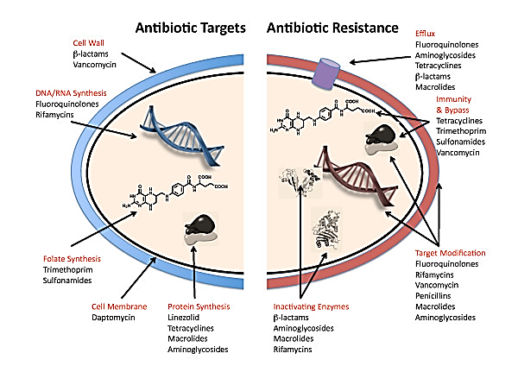
Breached Cell Walls
Efflux Pumps & Decreased Permeability
DNA/RNA Synthesis
Over-production of Target
Bacterial Metabolism
Target Modification
Breached Cell Membrane
Inactivating Enzymes
Protein Synthesis in Ribosomes
Source: www.biomedcentral.com

Slide 17
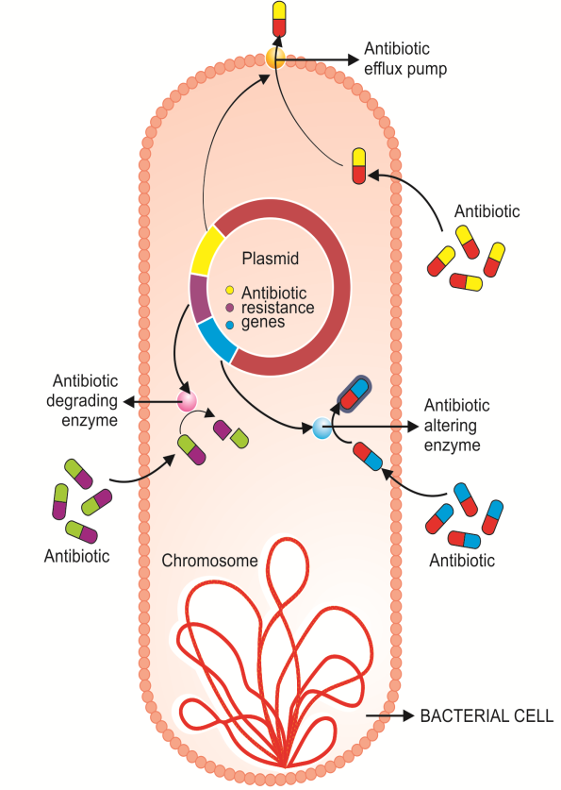
Inherent vs. Acquired Resistance
Antibiotic resistance can be inherent (natural) or acquired.
Inherent resistance occurs mostly because of chance; for example, some bacteria may be unable to absorb an antibiotic because they lack a transport system for it or because they have an additional membrane (gram negative bacteria). They may also lack the target of the antibiotic.
Acquired resistance occurs when a bacterium acquires genes for antibiotic resistance that it did not have at an earlier point.
Very rarely, acquired resistance will occur because of a random chance mutation that provides a bacterium with an advantageous trait that makes it unsusceptible to an antibiotic. This is very rare.
More often, acquired resistance is due to uptake of genes from another bacterium that already has resistance to an antibiotic.
When a bacterium gains a trait from another bacterium, this is called horizontal gene transfer.
Unlike eukaryotes, whose genomes remain unchanged in almost all circumstance after conception, bacteria can change their genomes frequently by exchanging plasmids.
Plasmids are small circular “packets” of DNA that can be exchanged among bacteria.
Source: www.intechopen.com

Slide 18
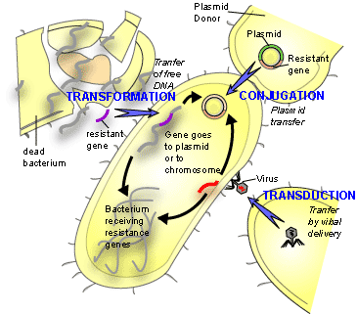
Methods of Acquired Resistance
Acquired bacterial resistance via horizontal gene transfer can happen in four different ways:
Conjugation occurs when bacteria transfer DNA across a small bridge-like appendage called a sex pilus. This is the most common method of horizontal gene transfer.
Transformation occurs when DNA plasmids are absorbed by a bacterium from the environment after the death and lysis of a different bacterium.
Transduction occurs when a virus transfers DNA between two different bacteria (similar to how a mosquito can transfer malaria).
Transposons are “jumping genes”; genes for resistance may leave the primary genome of a bacterium, enter a plasmid, and be transmitted to another cell via conjugation, transformation, or transduction.
The original transposon remains at the original site while its copy is inserted in a plasmid.
Source: textbookofbacteriology.net

Slide 19
Antibiotic Resistance: when bacteria develop the ability to overcome antibiotics.
Inherent Resistance: a bacterium lacks the target of the antibiotic or cannot absorb the antibiotic.
Acquired Resistance: a bacterium gains a trait it did not have before.
Horizontal Gene Transfer: a bacterium receives a plasmid from another bacterium that has the beneficial trait.
Random Mutation: a bacterium receives a mutation that provides a beneficial trait (rare).
Transposons: “jumping genes”
Transduction: plasmids are transferred by virus.
Transformation: plasmids are absorbed from dead bacteria.
Conjugation: plasmids are transferred via a pilus.

Slide 20
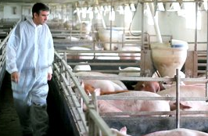
Preventing Resistance
Antibiotic resistance can be prevented by adopting the following practices:
Antibiotics should only be used if necessary, and only if they will be effective against a pathogen that is susceptible to the antibiotic.
Antibiotics should only be used if alternative measures (including vaccinations, health management plans, biosecurity, etc.) are not enough to prevent and/or control a pathogen.
Antibiotics should be used for treatment only when there is an appropriate clinical diagnosis; administration of antibiotics should be limited only to ill or at-risk animals (the fewer animals treated with antibiotics, the better).
Farmers should keep and maintain a strong working relationship with a veterinarian (VCPR) in order to ensure that antibiotics are only being used when necessary.
Farmers should never practice off-label usage, or the usage of a drug in a manner not prescribed by either the manufacturer or a medical professional.
A veterinarian can prescribe extra-label usage, or the use of a drug in a manner that differs from the manufacturer’s instruction but has been deemed acceptable and necessary by a veterinarian (within the constraints of FDA regulation).
Source: www.shutterstock.com

Slide 21
Medical Record Keeping
After the administration of an antibiotic, a producer should develop a plan to identify treated animals. This plan needs to include:
The premise ID (from the USDA).
The animal identification (ear tag, breed registration, ear notches, tattoos, etc.).
A record of where the animal has been moved to (pen, facility, or other pertinent information).
Dates of administration of antibiotics, as well as dates of any movement of the animal.
In addition to identification of treated animals, records should be kept of all medications that have been administered on a farm.
Animal medication record should include the date of administration, the animals treated, the drugs administered, the method of administration (injection, oral, etc.), the person who administered the drug, the amount of drug administered, and the withdrawal time needed for the drug to be eliminated from the animal’s body.
Source: http://www.pork.org/filelibrary/PQAPlus/PQAPlusEdBook.pdf

Slide 22
Withdrawal Times
While there are many reasons to keep accurate animal medication records, the primary reason is to ensure that withdrawal times have elapsed before the animal is used for food.
A withdrawal time is the required for the medication to be completely eliminated from the body of the treated animal.
If a drug has a withdrawal time, it will be on the label, package, or insert of the medication.
If a drug has been administered in an extra-label manner, the veterinarian prescribing the drug will determine the withdrawal time.
Most medications will list the withdrawal time in days.
A day is a full 24 hours from the time of the injection, or when the animal has last had access to medicated feed or water.
If a pig was treated at 9 am on a Friday, and the drug has a 5-day withdrawal time, that pig could not be sold for slaughter until after 9 am the next Wednesday.
If an animal will be sold as food (or produces milk, eggs, or other food products that will be sold) within the withdrawal time of a medication, that medication should not be administered or the animal should not be sold.

Slide 23
Works Cited
https://www.softchalk.com/lessonchallenge09/lesson/ImmuneSystems/BloodLymphaticandImmuneSystems_print.html
http://amrls.cvm.msu.edu/microbiology/bacterial-resistance-strategies/target-modification
http://textbookofbacteriology.net/resantimicrobial_3.html
http://www.pork.org/filelibrary/PQAPlus/PQAPlusEdBook.pdf

