Slide 1
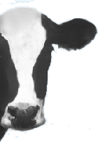
Reproductive Anatomy
By C. Kohn
Agricultural Sciences
Waterford, WI
Image source: www.chasesorganicdairy.com

Slide 2
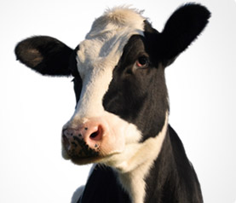
Importance of Reproduction
Reproduction is absolutely essential for a farm to be successful and profitable.
Reproduction ensures that a farm has a plentiful supply of animals from which to obtain the products being sold.
In the dairy industry, reproduction is necessary because it is also what enables a cow to lactate and produce milk.
Rates of reproduction are a major determinant of the profitability of a farm.
In most cases, the faster the rate at which an animal can reproduce, the greater the productivity of that animal.
Reproductive failure is one of the most significant factors that limit animal productivity and profitability and result in millions of dollars in lost profits annually.
A major challenge facing many producers is finding practical, cost-effective ways to improve reproductive performance without compromising the production of safe, high quality meat, milk, and egg products.
Source: http://www.csrees.usda.gov/ProgViewOverview.cfm?prnum=18413
Source: dairy.merial.us

Slide 3
Factors That Reduce Fertility
Inefficient reproduction in livestock may be caused by numerous factors including:
Abnormal or absent reproductive cycles.
Failure to show estrus (aka heat, meaning signs of sexual receptiveness).
Embryonic and fetal loss during the pregnancy.
Failure to reach puberty at an optimum age or an inability of young females to conceive early in the breeding season.
Environmental stressors such as temperature extremes or changes in photoperiod (day and night cycle).
Production of sperm with a low potential for fertilization.
Breeding programs designed to select for milk or meat traits have had negative effects on reproductive performance in some species.
In dairy cattle, intense genetic selection for increased milk production has resulted in significant reductions in fertility.
Similarly, in broiler breeders (chickens bred specifically for meat production) reproductive ability decreases as body weight (meat production) increases.
Source: http://www.csrees.usda.gov/ProgViewOverview.cfm?prnum=18413
Image source: www.chasesorganicdairy.com

Slide 4
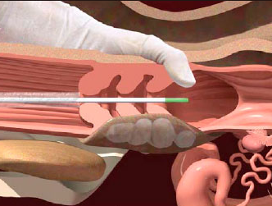
Artificial Insemination
Balancing maximal reproductive performance with animal performance can become more challenging as a livestock species becomes genetically selected for specific traits.
In order to ensure profitability, modern agriculturalists must adopt advanced scientific strategies that incorporate knowledge of reproductive anatomy and endocrinology (the branch of physiology and medicine concerned with endocrine glands and hormones).
This has become especially true due to widespread adoption of artificial insemination in many fields of animal agriculture.
Artificial Insemination is the process in which semen is collected from a male, packaged into straws, and frozen and shipped to individual farms so that it can be artificially inserted into a female animal’s reproductive tract.
This is different from natural insemination (e.g. when a bull directly breeds a cow).
AI enables one male to inseminate thousands of females, reducing the need for males on every farm.
Instead of only having access to bulls, boars, or stallions in your particular area, you could improve your herd’s genetics by introducing high quality genetics from across the world.
Source: en.engormix.co

Slide 5
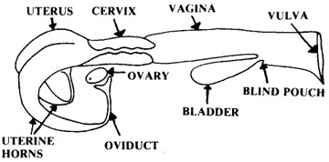
Reproductive Anatomy
Successful artificial insemination programs are based on a clear understanding of anatomy and physiology.
To breed an animal using AI, you must understand and be able to picture the reproductive tract of that animal in order to deposit the semen in the correct location.
To determine when to breed an animal, you must understand its hormone cycles in order to recognize the signs that she can be successfully bred.
The parts of the reproductive tract of cattle include:
Two ovaries.
Two oviducts.
Two uterine horns.
A uterine body.
A cervix.
A vagina.
A vulva.
Source: extension.missouri.edu

Slide 6
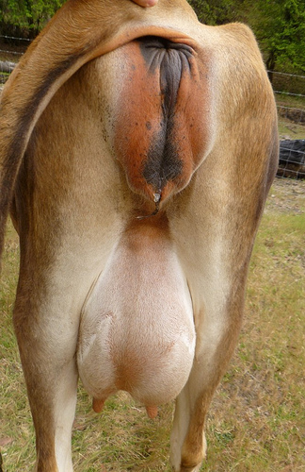
The Vulva
The vulva is the entrance to the reproductive tract and has four main functions:
1. Passage of urine.
2. Opening for mating.
3. Exists as part of the birth canal.
4. The vulva also plays a small protective role, serving as gate between the reproductive tract and the outside environment.
The vulva is primarily composed of the labia, or outer and inner folds.
The labia of the vulva will appear wrinkled and dry when the cow is not in estrus (In a period of sexual receptivity; aka “in heat”).
As the cow enters estrus (goes into heat), the labia will redden and will become moist and swollen.
Mucus from the vagina will also be noticeable on the vulva during estrus.
Source: familycow.proboards.com

Slide 7
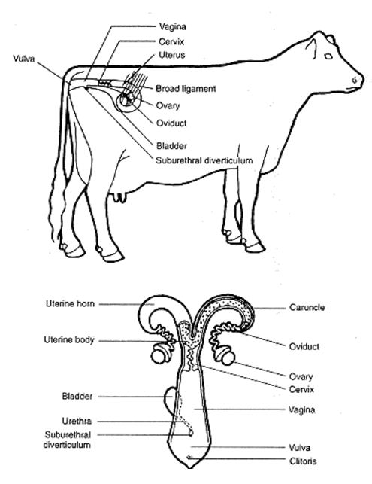
The Vagina
The bovine vagina is a flattened tube behind the vulva and in front of the cervix, and it extends about 6-12 inches into the cow.
This is the site in which semen is deposited during natural insemination by a bull.
The vagina is also part of the birth canal, through which a calf will pass.
The vagina produces mucus that will flush out foreign irritants and pathogens, particularly during estrus.
During artificial insemination, it is a passageway for instruments.
Because the vulva is an imperfect barrier against the outside world, the vagina can be a common site of infection.
The vagina also expels urine.
Source: www.infonet-biovision.org

Slide 8
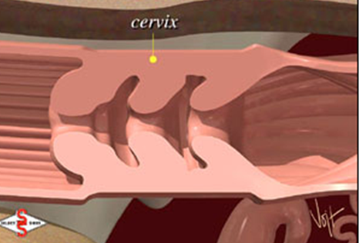
The Cervix & Fornix
The cervix is a thick, muscular barrier 4-5 inches long between the vagina and the uterus.
It is composed of dense connective tissue and muscle.
This tissue forms 3-4 dense folds called annular rings with ‘dead ends’ that slow/trap pathogens to prevent an infection of the uterus.
Most of the time, the cervix is tightly closed.
Because bacteria would reproduce rapidly in the uterus, it is vital that the cervix prevent the entrance of any pathogens.
The cervix will only open at two times: estrus and birthing.
When a cow is pregnant, the cervix will form a thick mucus plug to “glue” the cervix shut.
The opening of the cervix protrudes backwards into the vagina.
This forms a sort of donut- shaped end to the vagina called the fornix.
Source: www.infovets.com

Slide 9
The Uterus
After the cervix is the uterus of a cow.
The uterus consists of the uterine body and the uterine horns.
The main function of the uterus is to provide a suitable environment in which the fetus can develop and mature.
The uterus has three layers:
The perimetrium is the outermost epidermal layer of the uterus.
The myometrium is the middle muscular layer.
The endometrium is the innermost mucosal layer.
During artificial insemination, the uterus is the site of semen deposition.
The uterus myometrium (muscular layer) will be stimulated by hormones to contract rhythmically to enable sperm movement towards the uterine horns and oviduct.
At the end of the pregnancy, the contractions of the myometrium are important for fetal expulsion.
Source: instruction.cvhs.okstate.edu

Slide 10
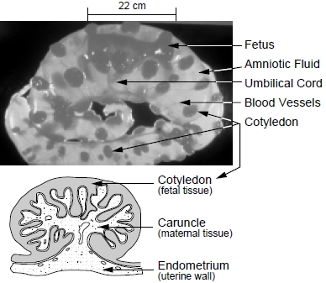
The Uterus & Oviducts
During pregnancy, a cow’s uterine body and uterine horns will grow to hold up to 200 lbs. of weight.
After a successful insemination, the fertilized embryo will attach to the uterine wall, which will form caruncles, or fleshy lumps, where the placenta of the calf will attach to enable transfer of nutrients to the calf as it grows.
Caruncles will form on the endometrium (mucus membrane) of the uterus; endometrium secretions also support the fertilized embryo before it implants onto the uterine wall.
After the uterine horns are the oviducts.
The oviducts enable the movement of ova (eggs) as well as sperm.
The oviducts are also known as the fallopian tubes.
Source: bizplan-uz.com

Slide 11
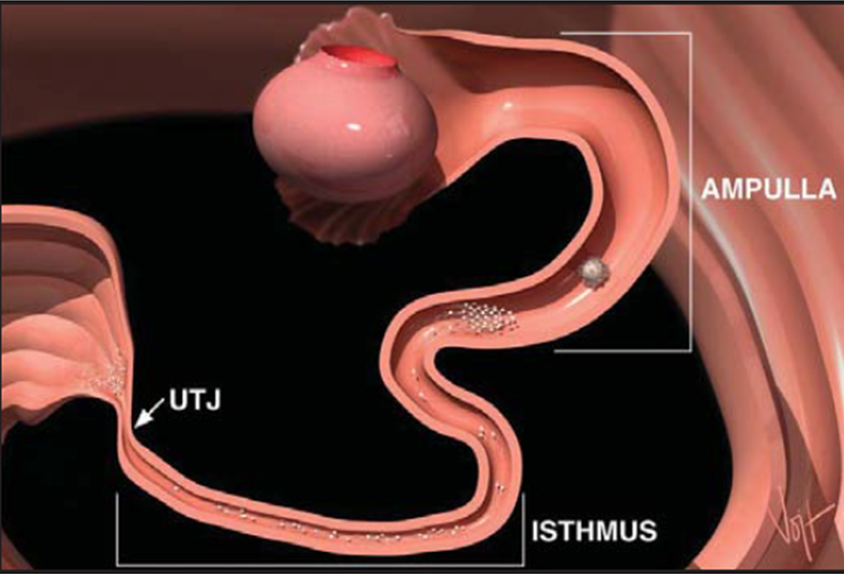
The UTJ, Isthmus, and Ampulla
The oviduct has three key regions with distinct functions.
Attached to the uterine horn is the utero-tubal junction (or UTJ); this region filters abnormal sperm and prevents it from reaching the egg.
The next segment is called the isthmus; the isthmus is a reservoir for healthy sperm.
Here, healthy sperm attach to the walls of the oviduct.
This changes the membrane of the sperm in a process called capacitation, which is a critical process that allows the changes to sperm necessary for fertilization.
The last portion of the oviduct closest to the ovary is called the ampulla. This is the site of fertilization where healthy sperm meet the egg.
A chemical signal released during ovulation ends capacitation and causes the sperm to detach from the wall of the isthmus so that they can move towards the egg.
Source: http://www.selectsires.com/resources/fertilitydocs/reproductive_anatomy.pdf

Slide 12
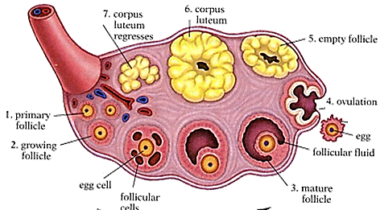
The Infundibulum and Ovary
The large funnel-like structure that extends from the end of the oviduct around the ovary is called the infundibulum.
The infundibulum prevents the ova (eggs) from missing the oviduct and falling into the body.
The infundibulum and ampulla have cilia (hair-like structures) that move ova down the oviduct for fertilization.
The two ovaries of a cow sit within each infundibulum and are the primary reproductive organ.
The ovaries have two functions: production of ova (eggs) and hormone production (primarily estrogen and progesterone).
The surface of the ovary contains two types of structures.
1. Follicles are fluid-filled structures similar to a blister. These contain the developing eggs. (see #1 above)
2. The corpus luteum is a Cheerio-like structure formed from a follicle that released its eggs in the previous estrus cycle. The corpus luteum causes the release of hormones needed to support the ovulated egg through pregnancy (if fertilized) or until the next estrus cycle (if not fertilized). (see #2 above)
2
1
Image Source: biology.clc.uc.edu

Slide 13
The Ova (egg cells)
The outside of the ovary is covered by a layer of cells that surround the immature egg cells.
The eggs cells in the ovary all initially formed before the animal was born.
An animal will not produce any additional egg cells after birth.
These immature egg cells are each surrounded by a hollow ball of cells that will eventually form the follicle as the egg matures and is ready to be released.
The ovum (egg cell) is the reproductive cell of the female tract.
Unlike the sperm cells, the egg cell is unable to move on its own.
Unlike the sperm cells, the ovum is much larger and is visible to the naked eye.
The ovum forms during meiosis and is haploid, meaning it has only one copy of each gene.
This is necessary so that when the egg is fertilized, it has two copies of every gene in every generation.
If the egg were not haploid, the number of genes would double during every generation.

Slide 14
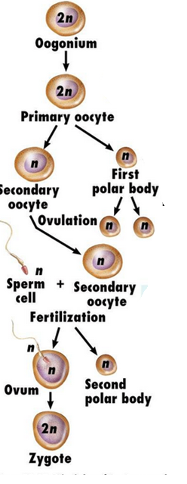
Maturation and Release of Ova
Hormones released from the pituitary gland cause the immature egg cells to undergo oogenesis (the maturation process).
The cells that comprise the follicle will divide, increasing the size of the follicle and making the blister-like structure grow and swell with fluid in order to keep the egg moist.
A follicle stimulating hormone (or FSH) causes the egg cell to mature.
Once mature, another hormone called the luteinizing hormone will be released and will cause the follicle to rupture and release the mature egg into the ampulla of the oviduct for potential fertilization.
If the egg is not fertilized within 24 hours, it will begin to degenerate.
Source: www.studyblue.com

Slide 15
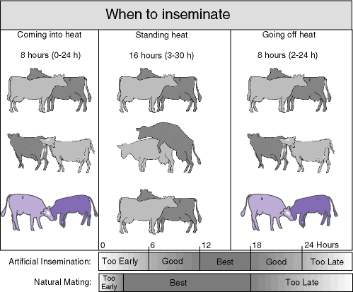
Summary of Changes During Estrus
Recognition of the signs of estrus is vital for successful reproduction.
A female can only be bred by artificial insemination if the producer can recognize when she will be receptive to breeding (i.e. estrus, or “in heat”).
If the breeder inseminates a cow outside of estrus, the animal will not be impregnated and the semen will be wasted.
Signs of estrus in a cow include the following:
Increased nervousness and restlessness.
Will stand still if mounted by another cow.
Will often try to mount other cows.
Excess nudging, licking, and sniffing.
Swollen vulva, possibly with excess mucus.
Possible reduction in feed intake.
Source: babcock.wisc.edu

Slide 16
Changes During Estrus
The cow’s reproductive tract will undergo the following changes during estrus:
Vulva: swollen and red, covered in mucus.
Vagina: excess mucus production.
Cervix: opens to allow acceptance of semen.
Oviducts: open to allow ovulation and fertilization.
Ovaries: an egg (ovum) will be released from an ovary into the ampulla of the oviduct.
In addition to being able to detect signs of estrus, it is also vital for a producer to be able to detect signs of reproductive disorders.
The following slides contain descriptions of common reproductive disorders in cattle and symptoms of these disorders.
Source: www.dairyfarmguide.com

Slide 17
Reproductive Disorders in Cattle
Ovarian Cysts
Description: appearance of a fluid-filled structure on the ovaries.
Cause: often due to a follicle that failed to ovulate.
Symptoms: lack of estrus, possible elevated tailhead, abrupt changes to milk production.
Anestrus
Description: when estrus does not occur or cannot be detected.
Cause: it could be due to an inability to detect or express estrus (e.g. farmer-error or injury in the animal), or estrus may be unable to occur because of energy deficiency, anemia, nutrient deficiency, infection, ovarian cyst, or an existing pregnancy.
Symptoms: cow does not go into heat when predicted.
Repeat Breeding
Description: when a cow requires three or more attempts to be inseminated.
Cause: improper technique or timing of breeding, infection, toxins, nutritional imbalance, hormonal imbalance, anemia, poor choice of sire (bull), improper use of reproductive pharmaceuticals, ovarian cyst, over-conditioning (excess fat).

Slide 18
Reproductive Disorders in Cattle
Abortion
Description: when a calf dies before birth between 50-270 days of gestation.
Cause: infection (especially vibriosis, trichomoniasis, IBR, and BVD), high fever or heat stress, toxins (e.g. silo gas, pine needles, fungal toxins), selenium/Vit. A & E deficiency, genetic disorder,
Signs: lack of signs of pregnancy after breeding, signs of estrus during gestation period, fetal membranes hanging from vulva, aborted calf.
Freemartin
Description: when a heifer (female calf) is infertile when born, has non-functional ovaries, may have a closed cervix, and has masculinized features.
Cause: exposure to male hormones due to shared blood circulation with a male twin during gestation.
Signs: presence of a Y-chromosome in some white blood cells. Presence of a shortened vagina or closed cervix (as detected through a physical exam).
Blind/Closed Cervix
Description: when the cervix does not allow for the passage of semen or AI instruments into the uterus, causing sterility.
Cause: most often due to presence of male hormones (especially in freemartin heifers).
Signs: when an instrument can only be inserted 2-3 inches into the vagina.

Slide 19
Reproductive Disorders in Cattle
Dystocia
Description: difficulty in calving.
Cause: oversized calf, lack of exercise, malnutrition, nutritional disorders, fetal abnormalities, malpresentation of calf (backwards, etc.).
Signs: Extended calving (8+ hours), malpresented calf (calf is not coming nose-forward with both front feet forward).
Endometritis, Metritis, and Pyometra
Description: infection of the uterus.
Cause: usually the cause is an injury or infection due to calving, most often because of a retained placenta. Abortions can also be a cause, as can a nutrient deficiency (especially Vitamine E as well as selenium).
Symptoms: enlarged uterus, watery brownish-red discharge from the vulva, possible increased rectal temperature (40% of cases), changed attitude of cow.
Retained Placenta
Description: when the placenta from a calf remains in the uterus (rather than is expelled), causing a fever, lack of appetite, and a very foul odor.
Cause: difficulty calving (dystocia), hypocalcemia (low bodily levels of calcium), and infection.
Symptoms: placenta that is still attached after 12 hours; cow will have a fever, act sick, and have a reduced appetite.

Slide 20
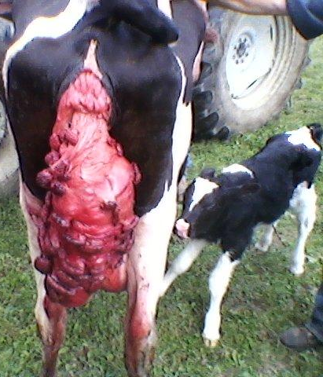
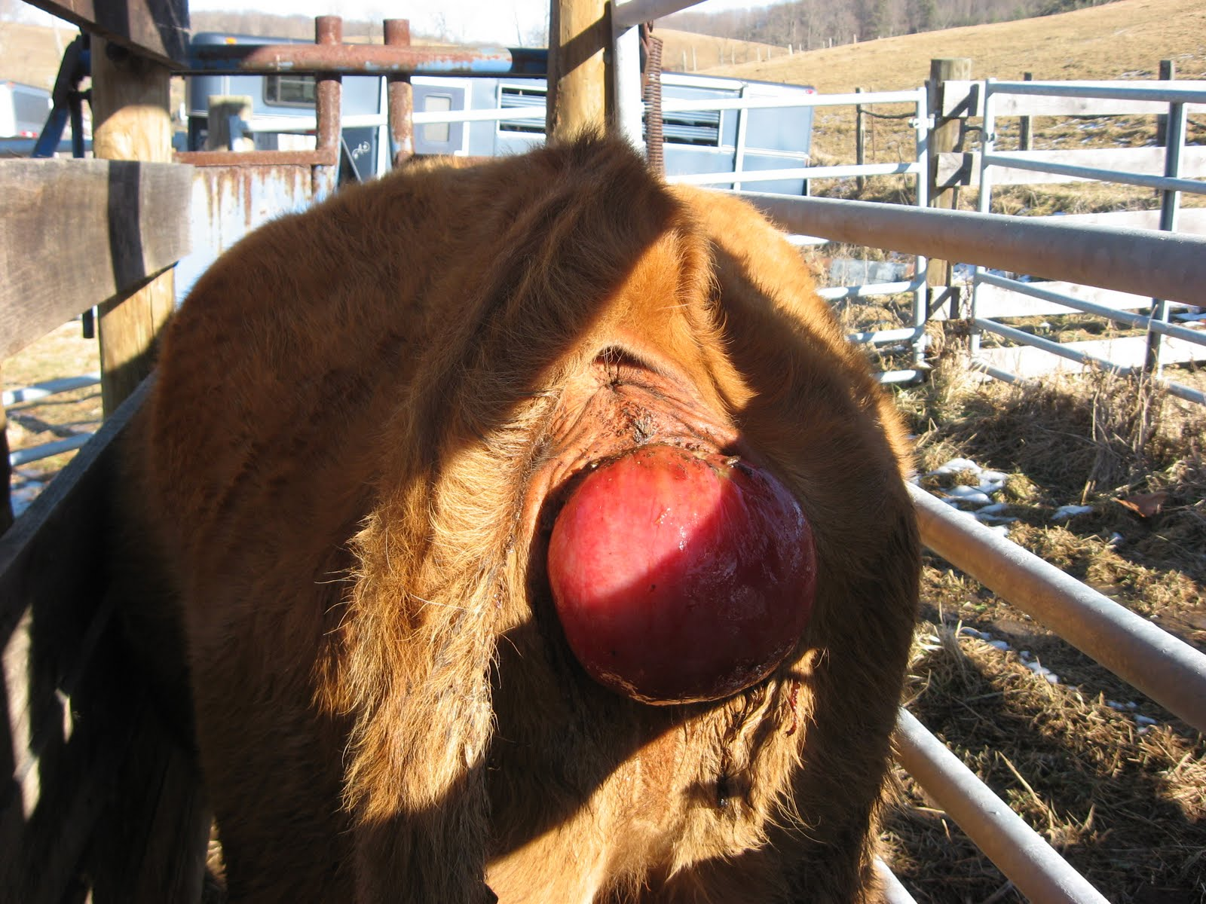
Reproductive Disorders in Cattle
Uterine Prolapse
Description: when the uterus is pushed outside of the cow’s body (an immediate life-threatening emergency).
Cause: dystocia (difficult calving), severe straining, excessive force used during assisted calving, hypocalcemia, and low body fat. Signs: the prolapsed uterus will resemble a pink garbage bag hanging down to the mid-leg of the cow. Caruncles will be visible and will resemble “buttons”.
Vaginal Prolapse
Description: when the vaginal tissue is found outside of the cow’s body, creating a high risk for infection.
Cause: this is most commonly caused by excess pressure from the abdominal cavity as the calf increases in size. Signs: it resembles a pink mass of tissue about the size of a large grapefruit or volleyball.
Source: cowdoc1981.blogspot.com
Source: imgarcade.com

Slide 21
Works Cited
http://www.selectsires.com/resources/fertilitydocs/reproductive_anatomy.pdf
http://www.infovets.com/books/smrm/F/F710.htm
http://extension.psu.edu/animals/dairy/health/reproduction/infertility/trouble-shooting-infertility-problems-in-cattle
http://dairy.ifas.ufl.edu/dpc/2011/Galvao.pdf
http://www.merckmanuals.com/vet/reproductive_system/abortion_in_large_animals/abortion_in_cattle.html
http://pubs.ext.vt.edu/404/404-289/404-289.html
http://www.nadis.org.uk/bulletins/fertility-in-dairy-herds/part-6-dealing-with-abortion.aspx
http://www.ansci.wisc.edu/jjp1/ansci_repro/misc/project_websites_07/wed07/Freemartin/genetic_aspects_of_freemartins%20-%20Freemartin%20Diagnosis.htm
http://www.wvu.edu/~agexten/forglvst/Dairy/dirm20.pdf
Dairy Cattle Fertility & Sterility by Hoard's Dairyman
Reproductive Anatomy and Physiology of Cattle, Select Sires
Reproductive Prolapses of Cattle, Univ. of Arkansas

