Slide 1
Agriscience teaches students why science matters, how it is used to solve problems, and how it affects our every-day lives.
Agriscience is a class designed for students who like hands-on exploration, regular lab sessions, and student-led learning.

Slide 2
Students in Agriscience tend to receive better grades in other science courses because of the strong background they gain in science, especially biology, chemistry, and environmental science.
Agriscience is course design to raise your grades in many other courses.
Besides science, Agriscience also improves math and communication skills and creates students with strong critical thinking.

Slide 3
Students in Agriscience only spend part of their time in the classroom. They also regularly have access to a fully-operational laboratory, a professional-grade greenhouse, an office, and the environmental center.

Slide 4
Agriscience actively teaches students how to work in teams, modeling real-world situations that occur in jobs and careers.
Students who complete Agriscience are among the most prepared at WUHS for the demands of college and careers.

Slide 5
Agriscience is a class that teaches students how to be scientists, doctors, engineers, agriculturalists, ecologists, and more.
Agriscience is a real-world science course, using actual scenarios to teach students to think critically, analyze data, and form accurate conclusions.

Slide 6
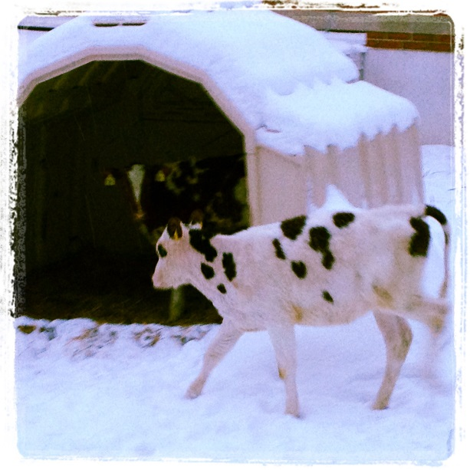
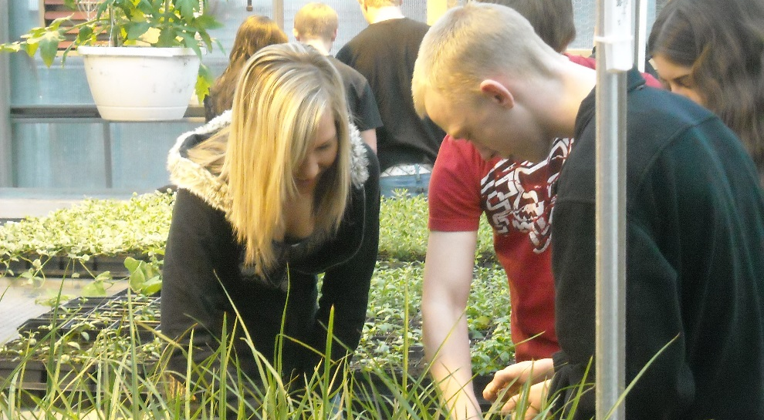
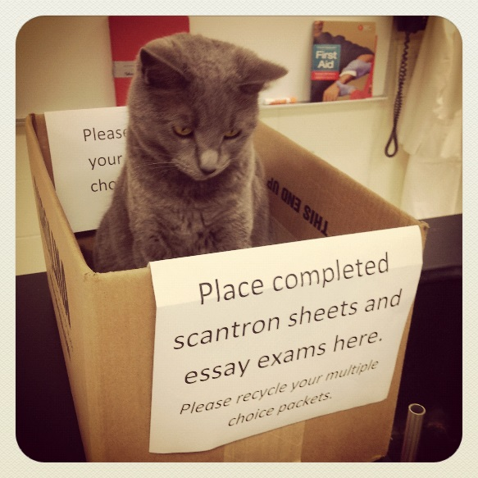
Agriscience uses a wide variety of living organisms to teach advanced concepts, including Tiffany the cat, cattle, chickens, radishes, yeast, mice, and many other living species.

