Slide 1
Genetics Jeopardy!
Waterford Union High School

Slide 2
Rules
Each team sends one person per turn. They cannot get help from their team
First to “buzz” in gets 15 seconds to answer.
If the first person to buzz cannot get the answer, the second team can buzz in. Once they buzz in, they too have 15 seconds. They also cannot get help.
You either gain or lose points on each turn.
If no team buzzes within 10 seconds, the question ends and the answer is given.
All answers must be given in question form (What is…)

Slide 3
Termin-ology
Heteroz or Homoz.?
Future Babies
Fill in the Punnet
Ratios
Misc
$100
$100
$100
$100
$100
$100
$200
$200
$200
$200
$200
$200
$300
$300
$300
$300
$300
$300
$400
$400
$400
$400
$400
$400
$500
$500
$500
$500
$500
$500

Slide 4
Terminology
This is the term for an animal that has both recessive alleles.
Homozygous Recessive

Slide 5
Terminology
This is the term for an animal who has both dominant alleles
Homozygous Dominant

Slide 6
Terminology
This is the term for an animal that has both dominant and recessive alleles
Heterozygous

Slide 7
Terminology
This is the term two genes that are equally dominant; both genes are expressed completely
Co-dominant

Slide 8
Terminology
This is the term for traits that are a blend of two genes because neither is completely dominant.
Incomplete Dominance

Slide 9
Heterozygous or Homozygous Dominant or Homozygous Recessive?
What is the genotype of the parent on the right?
Homozygous recessive

Slide 10
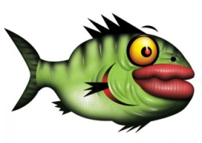
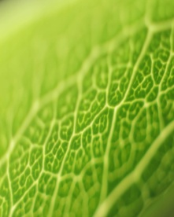
Heterozygous or Homozygous Dominant or Homozygous Recessive?
What is the genotype for color of this fish?
Homozygous recessive

Slide 11
Heterozygous or Homozygous Dominant or Homozygous Recessive?
If green is recessive, what is the genotype of the parent on the left?
Heterozygous

Slide 12
Heterozygous or Homozygous Dominant or Homozygous Recessive?
This is the genotype of all the flower offspring
Heterozygous

Slide 13
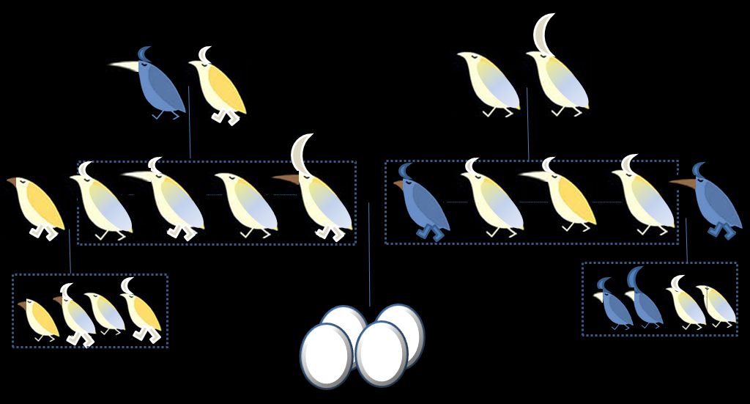
Heterozygous or Homozygous Dominant or Homozygous Recessive?
Body color of both birds in the top right?
Heterozygous

Slide 14
Future Babies
What would a cross between this couple look like?
Mother – RR
Father – rr
R – green allele; r – blue
All offspring will be Green

Slide 15
Future Babies
What is the likelihood of having attached earlobes in this couple’s first child?
Mother – Rr
Father – Rr
R – Unattached earlobes; r – attached earlobes
25% or 1 /4

Slide 16
Future Babies
What will the feet look like on the birds in the unhatched eggs?
All big

Slide 17
Future Babies
What will be the color of the beaks in the unhatched babies?
All orange

Slide 18
Future Babies
If we crossed these two fish, what is the likelihood of having a red baby?
50% or 2/4

Slide 19
Fill in the Punnet
 | R | R
r
r
?
Rr

Slide 20
Fill in the Punnet
? ?
 | RR | Rr
 | Rr | rr
Rr

Slide 21
Fill in the Punnet
? ?
 | Rr | Rr
 | rr | rr
rr

Slide 22
Fill in the Punnet
? ?
 | RR | RR
 | Rr | Rr
RR

Slide 23
Fill in the Punnet
? ?
 | Rr | rr
 | Rr | rr
Rr

Slide 24
Ratios
A 3:1 ration of dominant to recessive traits indicates that the parents have what genotypes?
Bb and Bb

Slide 25
Ratios
If the offspring are half dominant phenotypes and half recessive phenotypes, what must the parents’ genotypes be?
Bb : bb

Slide 26
Ratios
If all of the offspring have the recessive phenotype, what must be the genotypes of the parents?
bb and bb

Slide 27
Ratios
What are the possible genotype combinations that would enable the offspring to have all dominant phenotypes?
Hint – there are 3
BB:BB
BB:Bb
BB:bb

Slide 28
Ratios
A cow and a bull are heterozygous for color
Black is dominant; red is recessive
They have had 3 calves, all of which are black
What are the odds that they will have a red calf the fourth time?
25% or 1/4

Slide 29
Miscellaneous
This is the term for a version of a gene.
Allele

Slide 30
Miscellaneous
This is the term for a trait controlled by multiple genes.
Polygene

Slide 31
Miscellaneous
This is the term for a gene that affects multiple unrelated traits.
Pleiotropy

Slide 32
Miscellaneous
This is the term for the circumstance in which an individual may have a gene but will not express it because of a different gene.
Epistasis.

Slide 33
Miscellaneous
This is the term for the physical characteristics created by a combination of genes.
Phenotype.

Slide 34
FINAL JEOPARDY
What is the body and wing color of the unhatched eggs?

