Slide 1
Site Work
Analysis, Prep, and Instillation

Slide 2
Site Analysis

Slide 3
What is Site Analysis?
When we look at an area that we will be landscaping
Evaluating the site, and surrounding area
Gather information for the client
Remember, in the end it is all about what the client wants not what you want.

Slide 4
Info from the Client
First you will want to sit down with the client and gather some information.
What do they plan to use the area for?
Who is going to use it?
Open areas for recreation?
Gardening?
Etc.

Slide 5
Info from the Client (con’t)
How much maintenance are they willing to do or pay for?
Do they want something hands on, or are they looking for something they can not touch all summer?
How elaborate of a landscape do they want?
Sometimes simplicity best

Slide 6
Checking out the area
Does there seem to be a theme with the landscapes in the area?
Does the client want to match that or not?
What type of architecture is in the area?
What views or potential views are there from the property?
How can the landscape utilize/highlight those views?

Slide 7
What is already there?
What plants and hardscapes are there?
Which of those are staying, going, or not sure yet?
Especially if working with a tight budget, think about creative ways to incorporate existing landscape.
But make sure it does not detract from the new landscape
What equipment is there?
Gas and water pipes, air conditioners, etc.
What is good about the existing landscape?
And what could be better?

Slide 8
Topography
One important factor is the topography of the property.
This is looking at the elevation of the land
Is it relatively flat or does the terrain vary?
How will it effect drainage of rain water?
Will it lead to standing water or erosion
Are there downspouts? How will they effect your plan?
Different elevations can be used to separate areas or create variation.

Slide 9
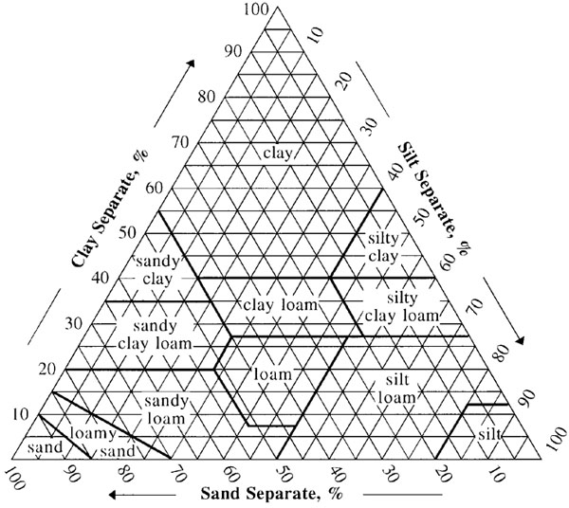
Soil
Soil texture is looking at the ratio of sand silt and clay that make up the soil.
Once you determine the percent of each of the three components, you can use a soil triangle ---------->

Slide 10
Soil (con’t)
To use the soil triangle, start with one compensate, find the percentage on that side, and find where that line meets the line of your second compensate.
If done correctly the line for your third compensate should also meet there, double check.
The type soil will effect other important factors including drainage.

Slide 11
Soil (con’t)
Read Clay
Read Silt
Read Sand

Slide 12
Soil (con’t)
Another factor that you will need to consider is soil pH.
This may effect what plants you can plant because some plants can not survive if the soil is too acidic or basic. Ex: Blueberries love acidic soil.
You may also want to add a material to help adjust the soil pH if needed.
Lime stone can increase the pH, and Sulfur can lower the pH (increase acidity).
The third aspect you will want to consider is the soil’s fertility.
This is looking at the levels of key nutrients .
This corresponds to the soil’s ability to support life.

Slide 13
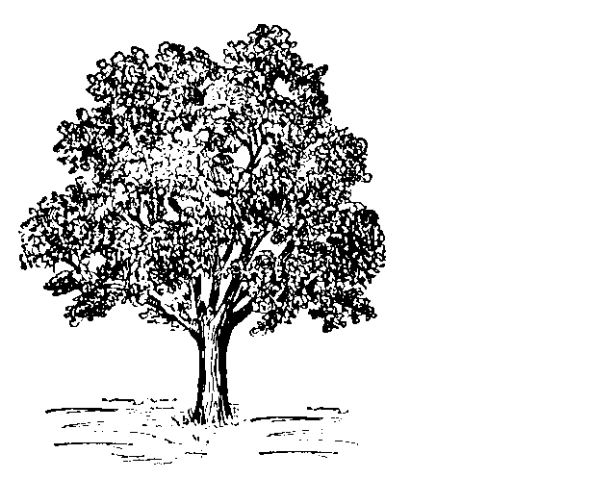
Microclimate
This refers to what specific conditions your landscape will likely experience.
Looking at things such as sun/shade patterns, prevailing winds, etc.
Different plants need certain conditions, specially in terms of light to survive.
Not enough, they starve
Too much, they dry out and die
Summer sun
Winter sun
window

Slide 14
Microclimate: Light Requirement
Full Shade
No direct sun, but on North side of buildings
Partial Shade
Areas with morning or afternoon sun, avoid sun midday (10am-2pm), East or west side of buildings
Light Shade
These plants do best under a tree canopy, always having a little shade
Partial Sun
Similar to partial shade, but can tolerate midday sun
Full Sun
Needs 6 or more hours of sun a day including some midday sun

Slide 15
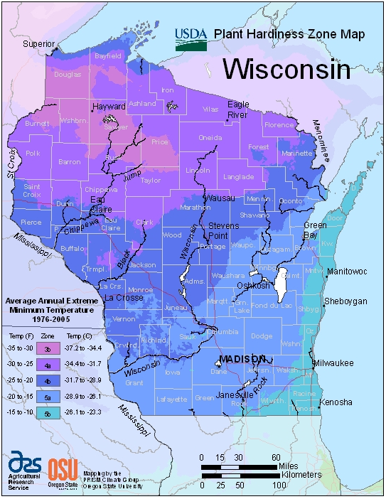
Macroclimate
When looking at a site you will also want to look up what zone your client is in.
Zones refer to the average min. temp the area experience.
Most perennials will indicate what zones the plant is suitable for.

Slide 16
Macroclimate
Waterford is in 5b
If you select plants which minimum zone is higher then 5, they will likely not survive the winter.
Ex: If a perennial flower had a zone rage of 7-9, it would like be an “annual” in WI

Slide 17
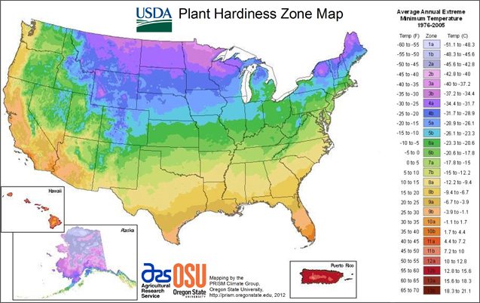

Slide 18
Site Preparation and Installation

Slide 19
Remove Existing Material
First step is to define the borders for where you are working, whether it is a flower bed or the property line, you should know where your limits are.
When you are going to do any major landscaping, you want to remove what is there .
Keeping what you plan to keep in the landscape, making sure not to damage it as you work.
If you plan to reuse some of the mulch or keep/transplant any of the plants, keep that in mind as you clear the area.

Slide 20
Remove Existing Material
Once you have the bulk of the material removed, you will want to make sure you remove any remaining plants (especially weeds).
Do not just break them off at surface level, make sure to dig down and pull out the roots as well.
If roots are left in the soil, especially weeds, they will likely become a problem in the future.

Slide 21
Remove Existing Material
You will often want to get down to the bare soil, if you can, you may leave some areas less disturbed.
If there was landscape fabric in place, evaluate it, it will most likely need to be replaced, but you can keep the fabric pins.
You will want to make sure to pick up all of the mulch or plant material from the soil.
This may seem tedious at first, but it will save you problems down the line.

Slide 22
Soil
Once you have bare soil you will want to begin to break up any clumps and fill in any hole from where you pulled out plants.
You will also want to look at the topography of the area and surroundings.
Do you need to adjust it to improve drainage?
The ideal drainage for residential lawns would be ¼” drop for every foot or about 2’ for every 100’.
This allows for adequate drainage without causing erosion.

Slide 23
Soil
This is also the time to apply any additives to the soil if you need to improve/adjust the texture, pH, or fertility.
Keep in mind that it is difficult to significantly change the soil texture .
Because each situation is difference it is advised to do the needed research or discuss your options with an expert.
Finally you will want to smooth out the soil so that it is ready for the next step.

Slide 24
Weed Barrier
It is important to use some sort of weed barrier, covering the soil to prevent weeds from growing into your landscape.
Of course this does not apply to grassy areas if you are doing a large area.
One of the most effective options is using landscaping fabric, with a organic or inorganic mulch over it.

Slide 25
Weed Barrier
When putting down landscaping fabric it is important that the soil is clean and flat to prevent any rips.
When more than one row of fabric is needed, be sure to overlap the rows (at least 3 inches) to prevent weeds from coming up between the rows.

Slide 26
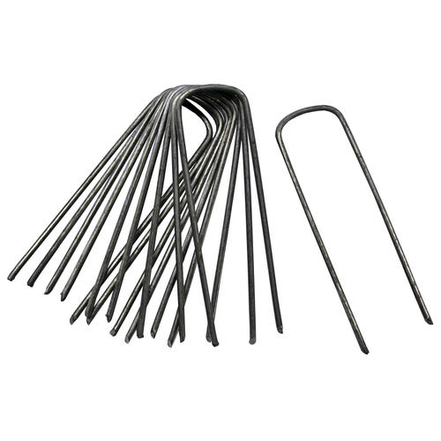
Weed Barrier
After you have laid the fabric you should secure it using landscaping fabric pins.
Then cut an “X” slit in the fabric, just big enough to allow you to put the given plant that will go there down.

Slide 27
Plants
Finally, you get to the accrual planting of the landscape!
You should already have slits cut in the landscape fabric, so dig out a hole in the soil and set your plant’s root ball in the hole.
Making sure that where the soil line was on the plant, is where it will be in the ground.
Then use the soil you dug out to fill in the extra space in the hole.

Slide 28
Structures/hardscape
After you get the plants down, you want to put in any structures that will be part of your landscaping.
Whether it is some sort of a statue, birdbath, path, etc. you want to place it correctly and make sure it is stable and level before moving on.
Although this seems simple, if not done right, it can ruin the whole landscape.

Slide 29
Cover
Once everything else is installed in the landscape you want to add the finishing touch.
Applying a cover serves many purposes including:
Providing an additional weed barrier
Varying the texture, separating the area
Unify areas around the landscape

Slide 30
Cover
One thing to keep in mind is how deep you want your cover to be.
Most recommendations say 2”-4” which is important to remember when ordering supplies.
Be sure that the entire area has a good even cover.
When applying the much, be sure to be careful around your plants, but still get the much in close, to prevent weeds from coming up.

Slide 31
Cover Types
There are many options that can be used
One category of cover is Organic Mulches
One advantage is the natural look and generally minimal heat absorbance
On the other hand, they also decompose over time and weeds can take root in them
The most common type is woodchips
The other category is Inorganic Mulches
Although they do not decompose they can collect trimmings and debris, allowing weeds to grow, also they often will absorb more heat
Rocks are a common inorganic mulch

Slide 32
Finishing Touches
After applying you mulch, you will put down the final touches.
Make any final minor adjustments to the landscape.
If you are going to put in some sort of an edging you can put that in now.
It can also be done before the putting down the mulch
Finally, clean up the area!

Slide 33
Quiz Objectives
At the end of this unit, student will be able to…
Evaluate an existing landscape an see any existing problems
Simulate an client interview, asking the appropriate questions
Explain the importance of understanding the maintenance requirements of a landscape
State the importance of Topography and its’ relationship to drainage
Discus the factors that affect soil and their importance
Explain the differences between Micro- and Macro- Climates and identify them in a landscape
Describe what needs to be done when removing excising material form a landscape
State how to prepare the soil of a landscape site
Describe the importance of a weed barrier and how to install one
Explain what must be done when installing plants and hardscape
Describe the different types of cover and their advantages and disadvantages
Explain how to put down a cover

