Slide 1
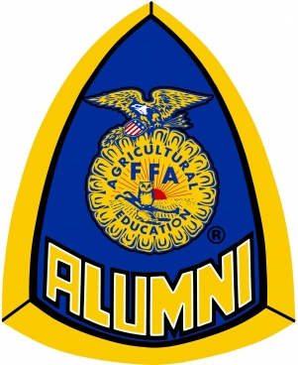
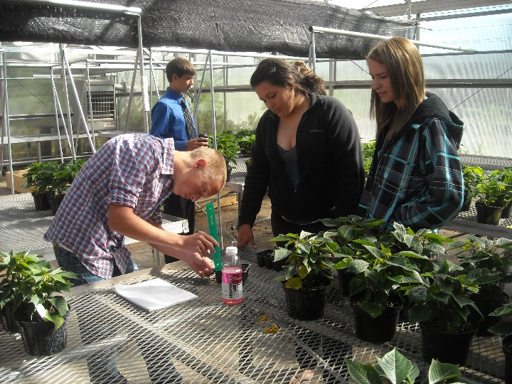
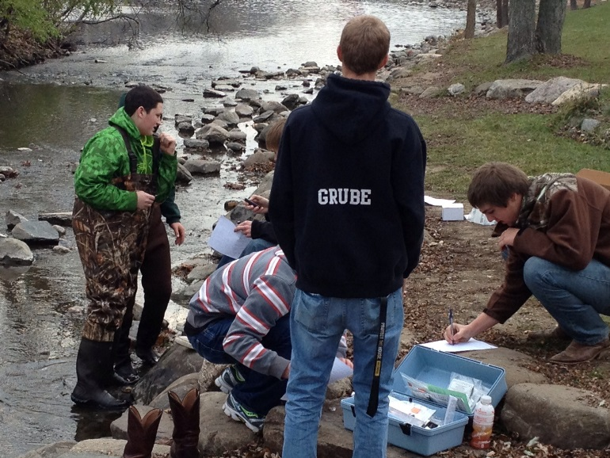
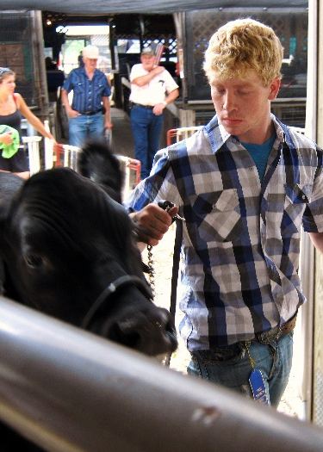
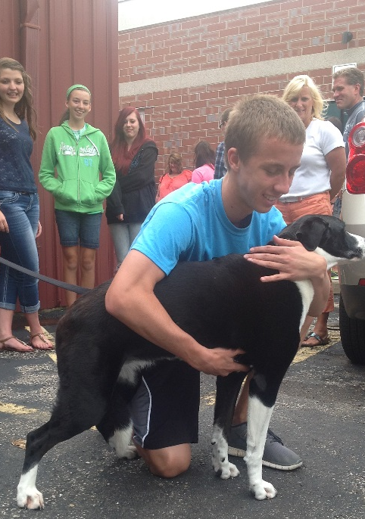
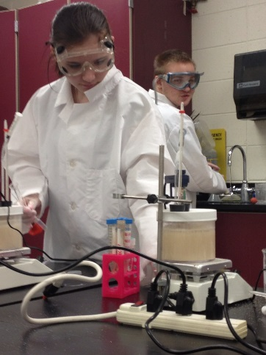
The Waterford FFA Alumni is a group of dedicated parents, community members, and former FFA members who work to improve the opportunities available to students for personal development, college preparation, and career training through the Waterford FFA and Agricultural Sciences Programs.
The money raised by the Alumni helps to fund activities such as leadership conferences, travel expenses, competitions, classroom instruction, and students’ personal expenses from college and career training.
Anyone who wants to maximize the college- and career-preparation of students is welcome to join the FFA Alumni. Meetings are held on the first Wednesday of every month at 7:30 PM at Waterford Union High School.
FFA Alumni – Ensuring student success through support and dedication.

Slide 2
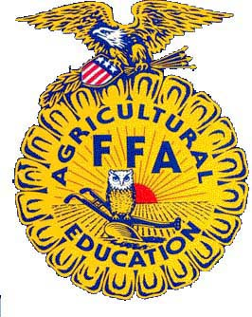
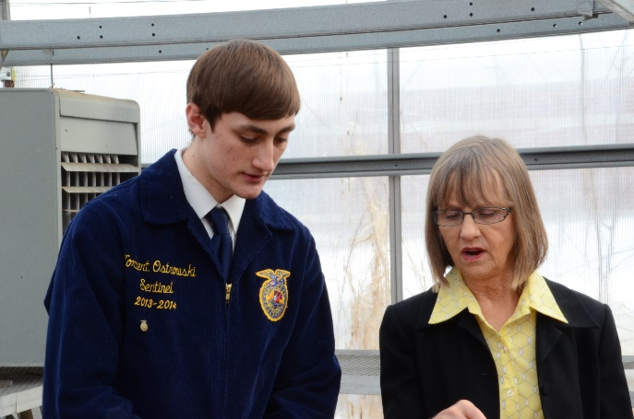
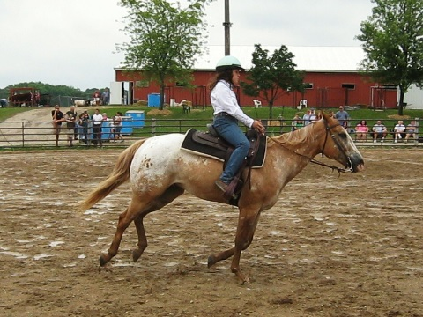
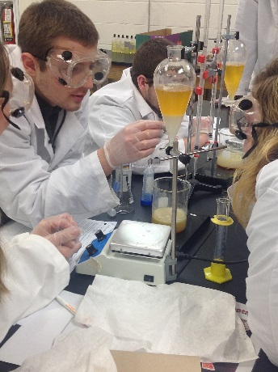
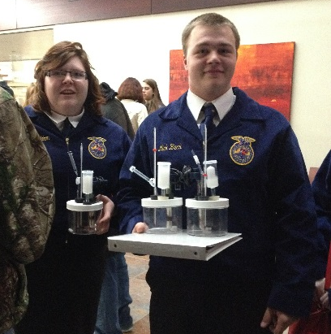
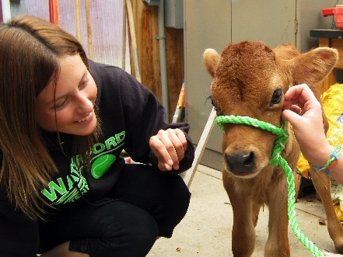
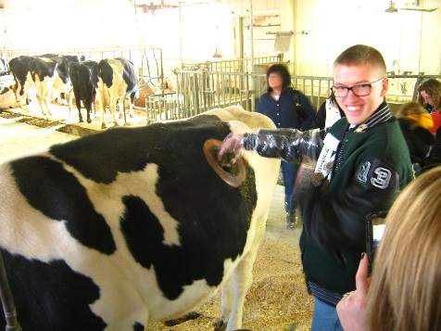
The Waterford FFA is an intracurricular college preparatory program designed to maximize student readiness for any career.
Formerly known as Future Farmers of America, today the National FFA is the largest student-run organization in the United States, preparing its members for over 300 different career paths in areas that include science, medicine, ecology, engineering, business, technology, law, and communication.
FFA Members gain a rigorous education inside and outside of the classroom that is backed by real-world career experiences in the fields of their choice and is enhanced by competitions, travel, social events, and personal development.
FFA Members graduate with an increased likelihood of attending college and an improved ability to acquire the career of their choice.
FFA – Premier Leadership, Personal Growth, and Career Success.

Slide 3
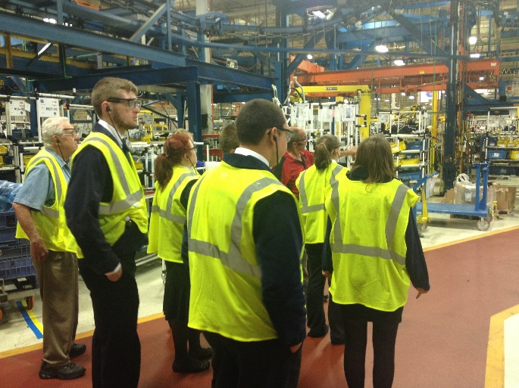
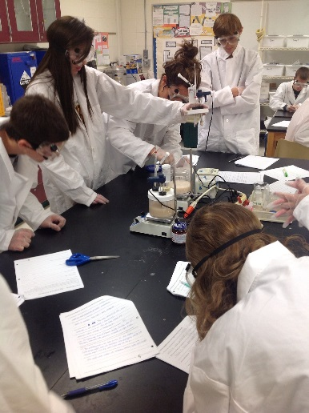
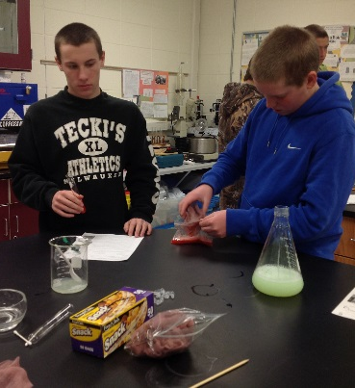
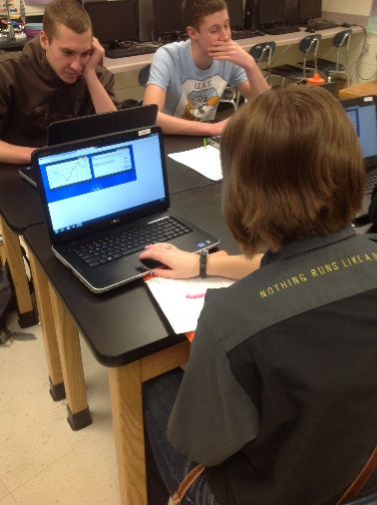
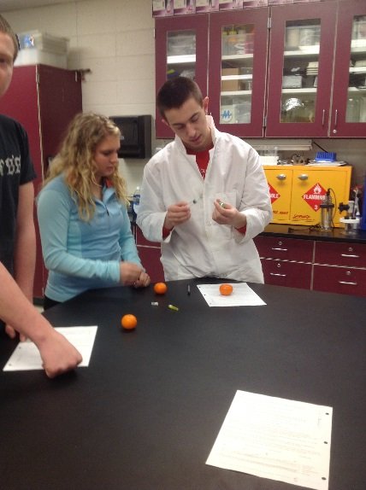
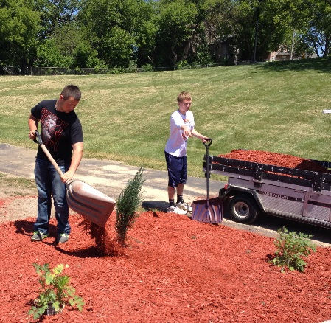
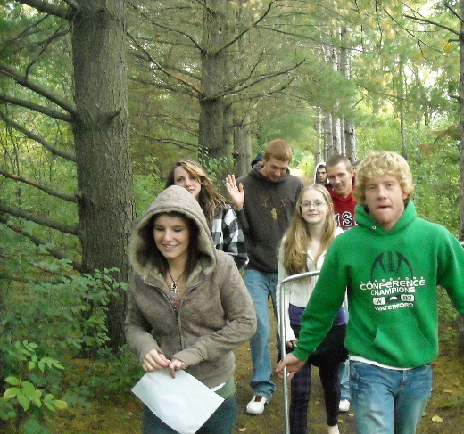
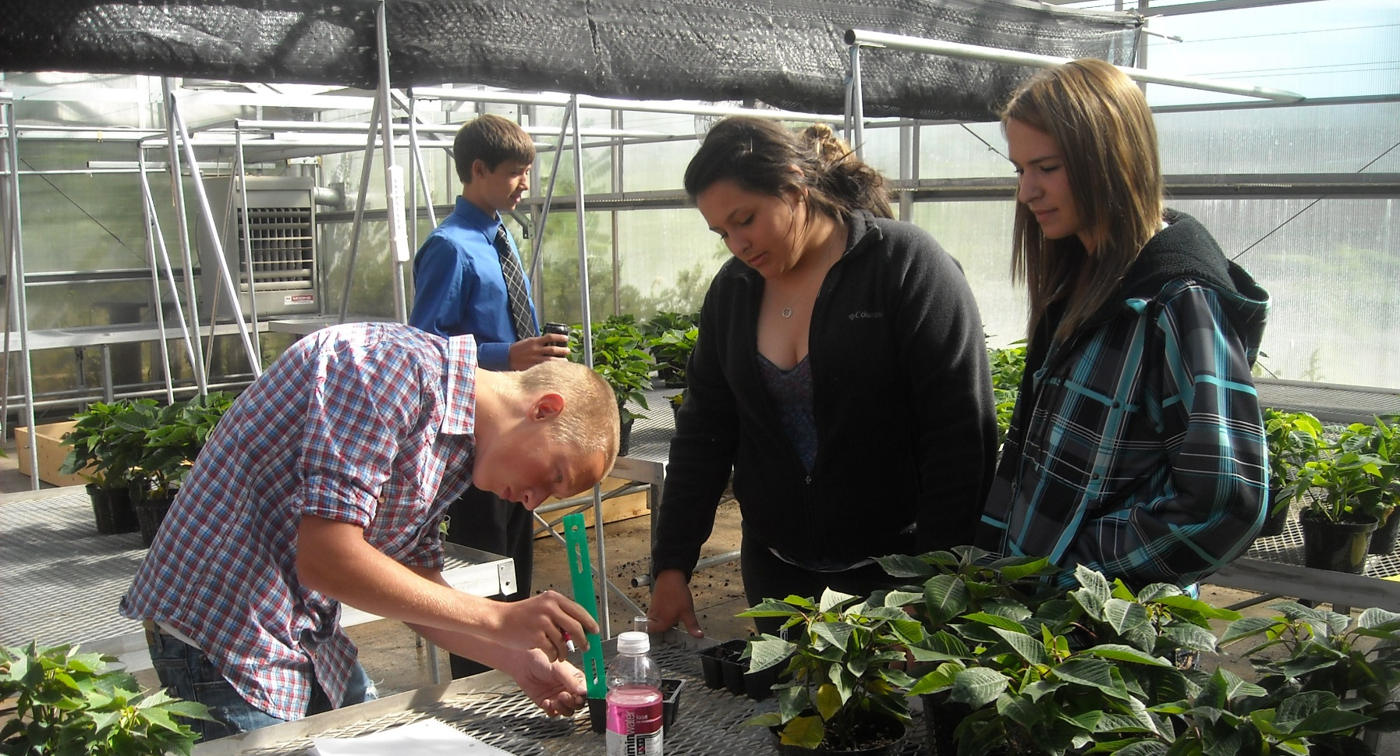
Waterford Agricultural Sciences is both an academic department within Waterford Union High School as well as a collection of extracurricular programs that maximize student readiness for college and for careers.
As a department, Agricultural Sciences encompasses 13 different college preparatory courses in the areas of animal science and veterinary medicine, horticulture, ecology and natural resources, business and leadership, biotechnology and renewable energy, career preparation, and scientific experimentation.
The program also provides internship and research opportunities and prepares students for over 300 careers options through job shadowing and managerial positions. Students who take an agricultural course have maximal preparation for college and careers and are better able to succeed in science, math, business, and technology courses.
Agricultural Sciences – Maximizing Student Readiness for College & Careers

