Slide 1
Invasive Species
By C Kohn, L Hitsman, Waterford WI

Slide 2
Invasive Species
Invasive species: are living species (plants, animals, fungi, or microorganisms) that spread rapidly and cause harm to other species by preventing them from being able to obtain nutrition, reproduce, and/or perform natural functions at a normal rate.
Invasive species (or “invasives”) can go by many other names, including introduced species, nonindigenous species, alien species, exotic species, weeds, and pests.
Usually invasive species are an introduced (or non-native) species.
For example, Asian Carp and Common Buckthorn are two well-known invasive species. Asian Carp are native to Southeast Asia and Common Buckthorn are native to Europe.
While invasive species are usually introduced, native species can behave like an invasive species under some conditions.
For example, whitetail deer are native to the US, but can behave like an invasive species when their population surpasses a sustainable level.
When there are too many deer in an ecosystem, understory plants in forests begin to disappear. This not only threatens those species of understory plants, but also the other animals that depend on these plants for food.

Slide 3
Invasives and Habitat Function
Invasive species lower the carrying capacity of a habitat.
The more a habitat is affected by invasive species, the fewer species that habitat can support.
In order to enable as many species and individuals as possible to live in an ecosystem, invasive species need to be eliminated as much as possible.
The more prevalent an invasive species, the lower the opportunities for kinds of outdoor recreation such as hunting, fishing, and wildlife photography.
When invasive species are introduced into an ecosystem, they disrupt the natural order of that ecosystem.
The invasive takes a niche that once belonged to another species.
Because invasive species usually have no natural predator, they are able to completely occupy a niche over time because they do not face the same kind of limiting pressures of predation that native species face.
Invasives can completely dominate a habitat.
Source: www.fws.gov

Slide 4
Invasives and Ecosystem Services
Invasive species are introduced.
Invasive species reduce the ability of a habitat to provide ecosystem services.
The more a habitat is affected by invasive species, the lower the ecosystem services that the habitat can provide.
Invasive species interfere with a habitat’s ability to cycle nutrients, disrupt food webs, and reduce the ability of an ecosystem to remove and purify waste and pollutants.
Ecosystems affected by invasive species are likely to have…
An imbalance between producer and consumer species.
Unfilled or overfilled species niches,
Incorrect soil or water chemistry (e.g. a pH that is too high or too low).
Unbalanced levels of decomposition (too much or too little).
Increased risks of erosion.
Increased risk for fire or other ecological disruption.
Any combination of the factors above.
Biodiversity is reduced.
Ecosystem services (nutrient cycling, waste removal, reproduction) are reduced.
Ecosystems are at greater risk for more invasions.

Slide 5
Introduced Species are not necessarily Invasive Species.
Of introduced species, only about 10% can survive in the wild.
Often “invasive” and “introduced” are used interchangeably.
Not all introduced species are invasive. Introduced species are not always bad.
Introduced species only become invasive when they displace native species and disrupt ecosystem services.
Some introduced species can be very helpful or valuable. For example, 98% of the US food supply comes from introduced plants and animals including wheat, rice, cattle, and poultry.
Not all introduced species become invasive.
Of every 100 exotic species introduced to North America, only about 10 are able to survive without the planting or assistance of humans.
Of the 10 in 100 that can survive without humans, only about 1 of these will cause serious ecological problems.
Approximately only 1% of introduced species become invasive.
10%
1%
Of that 10%, only 1/10 become invasive.

Slide 6
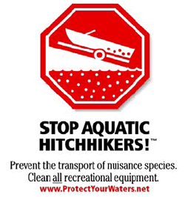
That 1% Causes…
Ecosystem:
Invasive species, when combined with habitat loss, are the biggest cause of extinction of native species (WWF, 2014).
About 42 percent of the species on the federal threatened or endangered species lists are at risk primarily because of invasive species and the loss of biodiversity (Nature Conservancy, 1996).
Economics:
In the United States, expenses associated with ecological damage and control of invasive species is estimated at $138 billion per year and increasing.
Control of buckthorn has been estimated at $500-$2,000 per acre over multiple years.
Zebra mussels have caused an estimated $3 billion in damage to the Great Lakes.
The US Bureau of Land Management spends $22 million annually to prevent overgrazing by wild introduced horses.
Feral dogs cause roughly $10 million in losses to the cattle and sheep industries.
Feral cats cause an estimated $14 billion in losses per year.
Rats cause $19 billion in losses to the grain industry each year.
Source: http://lib.colostate.edu/research/agnic/impacts.html
Source: www.lake-link.com

Slide 7
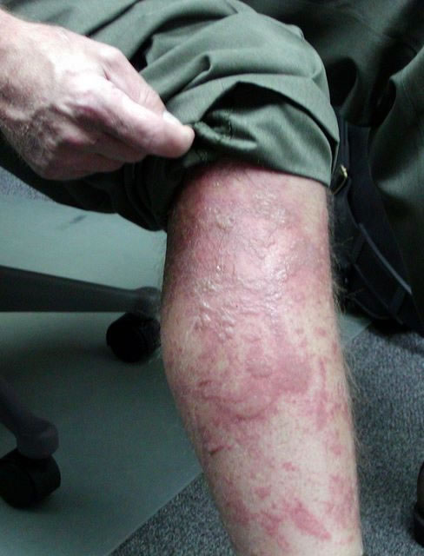
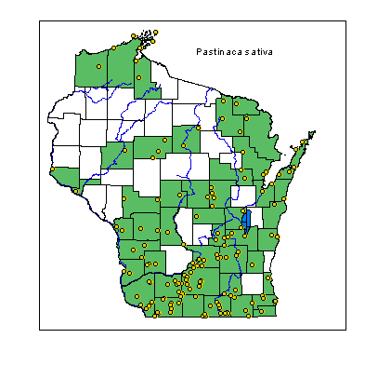
That 1% Causes…
Health:
Invasive species are commonly associated with the spread of disease.
Avian pox and avian malaria were introduced to Hawaii by introduced Asian songbirds.
Rats and mice act as global vectors of salmonellosis, leptospirosis, plague and murine typhus.
Feral pigs spread brucellosis, pseudorabies, and trichinosis.
Simply rubbing against invasive wild parsnip with bare skin can cause burned and blistered arms and legs.
This plant is now spreading rapidly throughout Wisconsin.
Wild Parsnip can cause serious burns to the skin.
Source: https://www.uwgb.edu/Biodiversity/herbarium/invasive_species/passat_map01.gif
Source: invasiveplantsmi.org

Slide 8
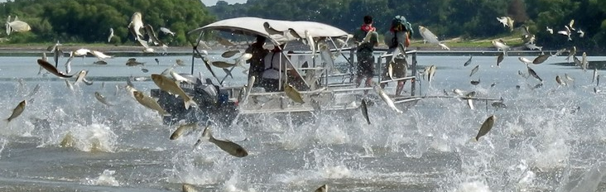
That 1% Causes…
Recreation:
Invasives can also alter recreational activities by altering ecosystem function.
Outdoor recreational opportunities are often limited or even eliminated by invasive species due to their impact on vegetation, on wildlife, and even on the chemistry and geography of a landscape.
Invasive plants may prevent outdoor hobbies including hunting, fishing, and the use of recreational vehicles by physically taking over a landscape.
Invasive animals may prey upon or displace native species such as fish and game animals.
Asian carp jumping in response to a boat.
Source: capitolchat.areavoices.com

Slide 9
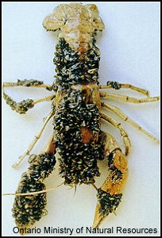
How can they cause so much damage?
Invasive species are successful invaders and usually have at least a few, if not most, of the following characteristics:
They grow rapidly and compete with other plants or animals.
They produce large numbers of seeds/ offspring at a young age.
Their seeds/eggs can survive a long time before sprouting.
They can travel long distances.
They have few if any predators.
Their native region has a climate similar to the affected area of the US.
They have multiple reproductive strategies.
They have few, if any, specific needs.
Zebra mussels enveloping a crayfish.
http://dnr.wi.gov/org/caer/ce/eek/critter/invert/images/zmussel2.jpg

Slide 10
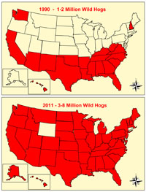
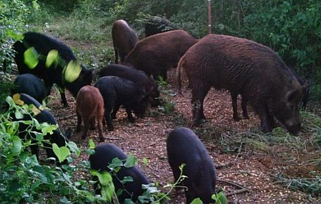
Habitat Generalists
The spread of feral pigs over 21 years.
Invasive species are often “habitat generalists”
Invasives spread well because they don’t have specific needs and most kinds of habitat can fill those needs.
Invasive species are often able to produce or obtain their food using a variety of strategies.
Because invasive species can adapt to many kinds of habitats, they can spread to many different ecosystems.
Unlike most native species that depend on specific conditions for nutrition, reproduction, and other needs, invasive species can meet their needs in almost any kind of habitat.
Image Sources: www.clemson.edu, woodwayhoa.com

Slide 11
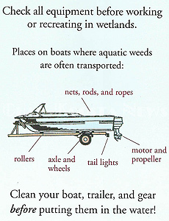
Invasives: Step 1
Invasive species rarely become established in an ecosystem unless they are aided by human activity.
Human activity can aid the establishment of invasive species in two main steps:
Step One: Transportation
Step Two: Habitat Disturbances
Step 1: Transportation -Transporting invasives allows them to gain access to ecosystems to which they otherwise would never gain access.
Transporting of invasives can occur by shipping, vehicles, railroads, and even boats, clothing, and pets.
Without transportation, invasives would likely not spread beyond their native ecosystem.
Source: www.charkoosta.com

Slide 12
Invasives: Step 2
Step 2: A habitat disturbance is when the normal function of a habitat is disrupted by an outside force.
Habitat disturbances enable a newly-transported invasive species to displace native species; without the disturbance, it is possible that the invasive species would be unable to become established.
Habitat disturbances can be natural; for example, if a forest fire, tornado, or volcano disrupts an ecosystem, a newly-introduced invasive plant may be the first to take over that ecosystem.
Habitat disturbances can also be manmade; for example, the building of roads, conversion of habitat into agricultural land, or suburban sprawl may allow an invasive species to become established in an area that previously was dominated by native species.
Step 2.1: Additional human disturbances can continue to occur long after the initial disturbance that allowed the invasive species to become established.
For example, after house development is built on an area that previously had habitat, disturbances may continue to occur from the repeated mowing and spraying of herbicides by homeowners.
This kind of activity makes native species less competitive.
Equipment, people, and introduced animals will help spread the seeds of invasive plants.

Slide 13
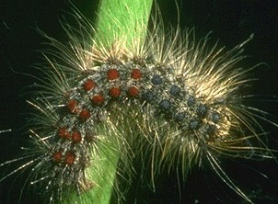
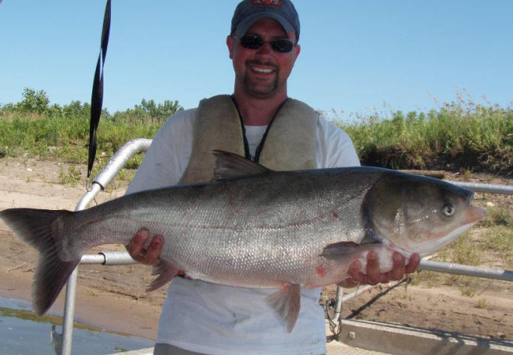
Invasive Species problems in the US
Invasive Species are a problem within the US. A few well-known examples include…
Gypsy Moth: A fast-spreading moth that voraciously eats deciduous leaves with economic cost of about $30 million a year for the past 20 years.
Emerald Ash Borer a small green beetle that bores under the bark of trees, disrupting the flow of sap and sugars in the tree and slowing starving the tree’s cells. So far it has killed 17 million ash trees at an estimated cost of $10.7 billion
Asian Carp: a large fish (30-100 lbs) that crowds out almost all other fish in an ecosystem and depletes an aquatic habitat by consuming plankton, the base of the aquatic food chain.
Buckthorn: a landscaping tree introduced in the 1800s that is now overtaking many US wooded areas.
Source: www.fs.fed.us
Source: www.hungrypests.com
Source: www.activistangler.com
Source: www.lapisandgold.com

Slide 14
Gypsy Moth
The gypsy moth is an invasive forest pest from Europe that is one of the most damaging tree defoliators currently in the U.S.
The gypsy moth is a tree defoliator, meaning it strips the trees of their leaves.
The caterpillar state of the gypsy life cycle is when the damaging effects occur. When full grown the gypsy moth only live 1-2 weeks to reproduce and then die.
Each female can lay an egg mass with 400-600 eggs in each mass. The eggs are laid in July and hatch into caterpillars the following year in April.
Gypsy moths feed off of 500 different tree species, allowing them to consume entire stands of forests. The problem is amount of defoliation, or loss of the tree’s leaves, the caterpillars cause.
Light defoliation is defined as 0 to 30% loss of foliage and has minimal impact of the trees livelihood. . Defoliation is barely detectable.
Moderate defoliation is defined as 31 to 50% loss of foliage. At this level of loss, trees have enough foliage to live,
Heavy defoliation is when 51% or more of the foliage is removed from a tree. Many trees can withstand one year with heavy defoliation; however if they experience it in consecutive years the trees have a higher rate of mortality.
Around the 50% defoliation level, many trees produce new growth of leaves. When trees produce new growth or refoliate within the same year, they are put under more stress and increases the risk of the life of the tree.
Source: animals.howstuffworks.com

Slide 15
Management of the Gypsy Moth
The Gypsy Moth can be controlled in four ways…
Natural Management- Air temperatures of minus 20°F or colder during the winter will destroy exposed eggs. Freezing temperatures in early May, after hatch, may also kill many larvae.
Nonchemical or Mechanical Management- When the caterpillars are half-grown, many of them feed at night and crawl down the tree in the morning to seek shelter during the day. Tree trunks may be encircled with a piece of burlap or similar material. This burlap apron provides a place under which larvae rest and can later be killed.
Biological Control Management- There are some native predators and parasitoids that attack life stages of this key pest. However, the parasitoids and predators do not provide an immediate solution to an infestation.
Chemical Management- Several insecticides are registered for effective management of this pest. Applications should be made according to label directions. To maintain good plant health, applications should made before serious defoliation occurs.
Source: animals.howstuffworks.com

Slide 16
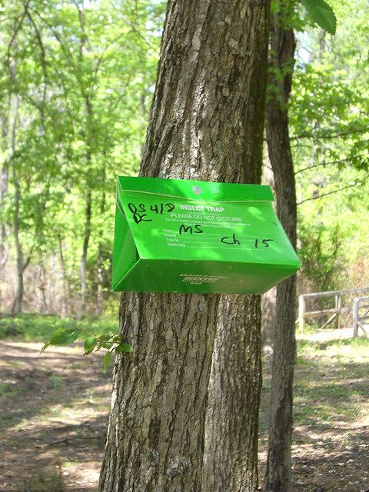
General Strategies for the Control of Invasive Species
There are four different categories conservationists use in order to better manage invasive species.
Natural Management- when a natural system makes an impact on an invasive species’ life cycle
EX) When there is a late frost and the temperature drops, that change can be severe enough to kill exposed eggs or larvae.
Nonchemical or Mechanical Management- when the physical removal of the invasive occurs.
EX) Such as when a land owner physically pulls out invasive species to remove it from their land.
Biological Management- when a predator of the invasive species is introduced to the infected area in efforts to bring the population down.
EX) When Alligator weed flea beetles were introduced to help control the spread of alligator weed in Florida.
Chemical Management- when a chemical is used to prevent an invasive species from reproducing or to kill an invasive species.
EX) The use herbicides or insecticides to kill off invasive species.
Source: www.cdfa.ca.gov
Source; www.flickr.com

Slide 17
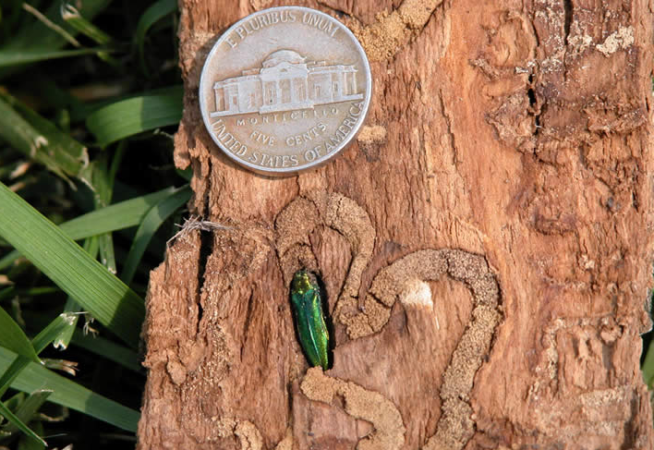
Emerald Ash Borer
Emerald Ash Borer (EAB) is an invasive, wood boring beetle.
EAB kills ash trees by eating the tissues under the bark.
The Emerald ash borer is an exotic beetle that was introduced to the US in 2002 and in Wisconsin in 2008.
Wisconsin forests contain more than 770 million ash trees, and ash trees comprise nearly 7 percent of the WI tree population.
In urban areas, it’s estimated that, on average, 5.2 million trees are ash.
The larvae (the immature stage) feed on the inner bark of ash trees, disrupting the tree's ability to transport water and nutrients.
A female can lay 60-90 eggs that will be fully mature in 1-2 years.
A tree that has been attacked by EAB can die within 2-4 years.
It is estimated that more than 50 million ash trees are dead or dying in the Midwest because of this insect.
Source; www.stcroixtreeservice.com

Slide 18
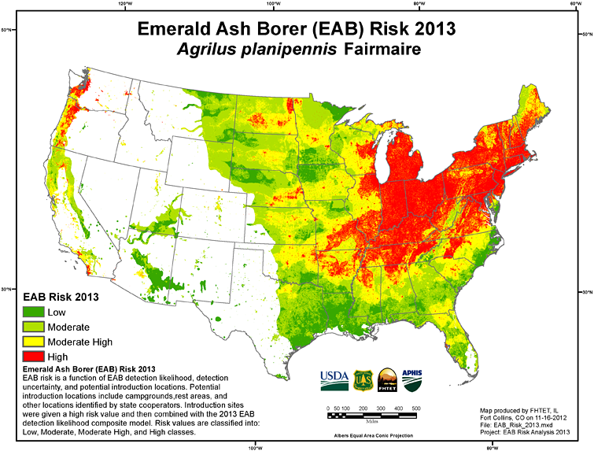
Management of the Emerald ash borer
Unlike most invasive species that need both introduction and habitat disturbance, EAB only needs to be introduced to spread throughout an ecosystem.
Even without a disruption to the ecosystem, it can still infest ash trees.
Because of this, it is vital that everyone practices preventative strategies, such as not moving firewood outside of its original area.
The Emerald ash borer can be managed using several methods including…
DO NOT move firewood from its region. Buy locally within 25 miles of site, because the larvae can still be alive within your firewood.
Biological Control Management- a fungal pathogen and three species of nonstinging parasitic wasps were imported as biocontrol agents from Northeast Asia (the beetle’s original home) to control EAB.
Chemical Management- there are 13 insecticides that are effective for management of this key pest.
Source: osumg.blogspot.com

Slide 19
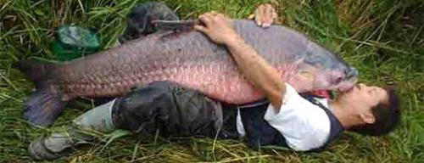
Asian Carp
Asian carp is an invasive aquatic species that was originally imported from Southeast Asia to help keep retention ponds clean of algae.
Flooding allowed these fish to escape into the Mississippi River system and migrate into the Missouri and Illinois rivers.
Even though safeguards were in place to prevent the spread of Asian carp, unexpected levels of flooding enabled this species to spread rapidly.
This is evidence that even with safeguards in place, it is always dangerous to import a species outside of its native region.
Asian carp species are a serious concern because they can aggressively compete with native commercial and sport fish for food and can potentially disrupt entire ecosystems.
They are voracious eaters, capable of eating 5-20 percent of their body weight each day.
They consume plankton, stripping the food web of the key source of food for small and big fish.
Source: www.clevescene.com

Slide 20
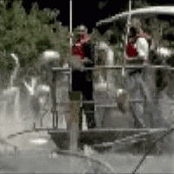
Asian Carp
Asian carp are able to completely fill ecosystem niches because they lack a natural predator.
Asian carp fill a niche that is normally occupied by native species by outcompeting those native species.
Asian carp can also cause physical harm to boaters.
When Asian carp are startled (such as by a boat motor), they can jump up to10 feet out of the water.
Asian carp can grow to large sizes: average size is around 30-40 pounds, and some grow as large as 110 pounds.
There is no proven method to manage or eliminate Asian carp once they are established in an aquatic ecosystem.
If Asian Carp are introduced to the Great Lakes, it would threaten the $7 billion fishing industry.
Source peswiki.com

Slide 21
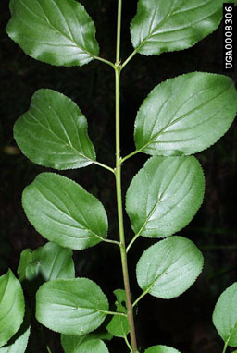
Common Buckthorn
Common buckthorn was originally brought from Europe in the mid-1800s as a hedging material for landscaping.
Shortly after its introduction here, it was found to be quite invasive and quickly invaded natural areas.
The nursery industry stopped selling it in the 1930s.
Common buckthorn can thrive in a wide variety of habitats.
Because it forms leaves early in the spring and sheds them later than most native plants, it can grow for longer periods of time each year, giving it a competitive advantage over other plants.
Buckthorn as it matures it creates dense shade, which eliminates the regeneration of tree seedlings and understory species.
When grown, it forms dense, and tangled thickets that impede hunters, hikers, and wildlife from walking.
Buckthorn also serves as a host to other pests, such as crown rust fungus and soybean aphid.
Source: threatsummary.forestthreats.org
Source: www.lapisandgold.com

Slide 22
“An ounce of prevention is worth a pound of cure”
Invasive species can be prevented or reduced by utilizing the following strategies:
Maintain a habitat’s biodiversity and health to reduce potential for invasion.
When transporting natural materials (such as soil, mulch, firewood, etc.) check them for invasive species.
Clean your equipment, gear, and clothing before leaving areas where invasive plants may be present.
When landscaping, use certified seed to decrease the likelihood of having unwanted invasive plant seed.
In forested areas, maintain a dense leaf litter & canopy layer by utilizing low impact timber harvest and trail maintenance.
Improve the plant diversity by minimizing human disturbances and by management of wildlife.
Continue to monitor your recreational areas to detect new invasive species as soon as they are introduced.

Slide 23
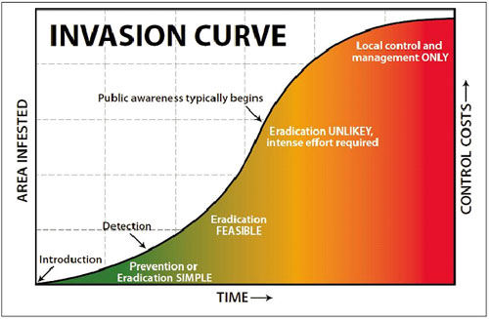
The biological invasion curve shows that prevention is the cheapest and most effective strategy to eliminate invasives.
It also shows that most awareness of an invasive species comes only after eradication is basically impossible.
The only way to completely eliminate an invasive species is to prevent them from being introduced.
Once an invasive species is introduced, elimination is nearly impossible and costly expenses are unavoidable.

