Slide 1
Proteins
By C. Kohn, Waterford, WI

Slide 2
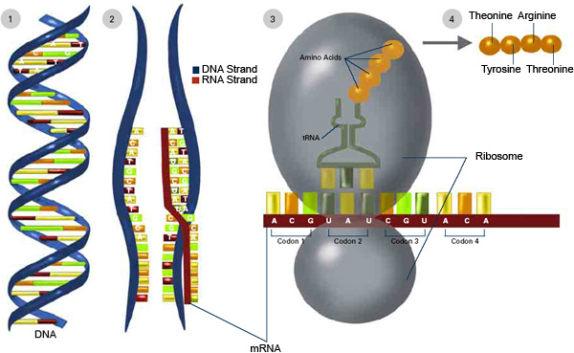
Review – Central Dogma of Molecular Biology
DNA is copied by mRNA in a 5 → 3 direction
mRNA is read in groups of three (codons) by a ribosome
Each codon codes for a specific amino acid
That particular amino
acid is delivered by
tRNA
A string of amino
acids creates a
polypeptide, and
polypeptides join to
form a protein.

Slide 3
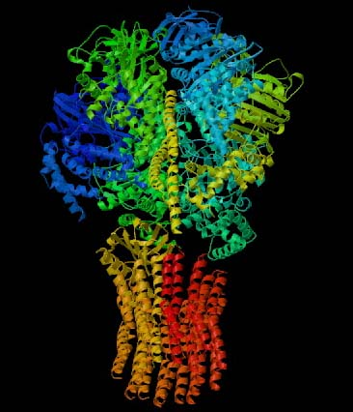
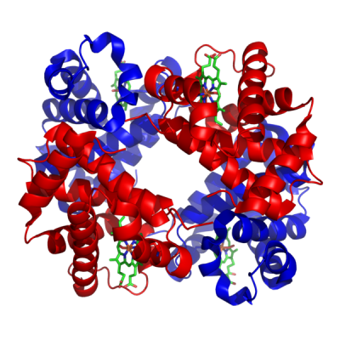
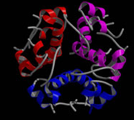
Shape of Proteins
Shown here are three examples of proteins.
  At the top is ATP Synthase.
  In the middle is hemoglobin.
  At the bottom is insulin.
  Each has a unique shape.
We learned earlier that the shape of a protein determines its function.
  So how does a protein get its shape?
  How does it know what shape to take and what to do?
  What “shapes” a protein?

Slide 4
Shape Determines Function
The shape of a protein comes from its amino acids, and this shape determines its function.
  The amino acids that are used depends directly on the codons in mRNA copied from DNA.
Proteins are made from 20-22 amino acids.
  Each species may use a different number of amino acids.
  Humans use 20. Cattle and dogs use 22.
Each amino acid has a specific set of properties that help create the shape of the protein
  For example, some amino acids are negative charged; some are positively charged. Some are neutral
  Some like water; some hate it
  Some really like other amino acids that are the similar. Some are repelled by similar amino acids.

Slide 5
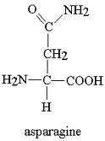
Amino Acid Terminology
Amino acids are molecules that either occur naturally or are produced by an organism’s cells.
  Amino acids our bodies can produce are nonessential amino acids.
  Amino acids we must consume from other sources are essential amino acids.
Different kinds of amino acids can be
written in a number of ways.
  1. You can write the full name of the amino acids.
    E.g. The first amino acid discovered was asparagine
  2. You can just write the abbreviation
  (such as ‘asp’ for asparagine).
  3. You could write the assigned one letter code.
      E.g Asparagine can be written as just the letter ‘N’
      Why N? Because we already used A for Alanine
    Each amino acid has its own one-letter code (just like each atomic element has a one- or two letter code; e.g. Oxygen is O, Carbon is C, Gold is Au)
Image Source: groups.molbiosci.northwestern.edu

Slide 6
Amino Acids → Polypeptides → Proteins
Proteins are typically composed of multiple amino acid chains.
  Just like a machine usually consists of multiple parts, a protein consists of multiple chains of amino acids.
Each chain of amino acids will form a polypeptide.
  Multiple polypeptides together will form a protein.
In a few cases, the entire protein may
be only one polypeptide.
    However, most proteins are made of
    multiple polypeptides.
    For example, in the ATP Synthase
    shown here, each color is a different
    polypeptide.

Slide 7
Rules of Protein Folding
When amino acids are assembled in a line to make a protein, they do not stay in an even, straight line.
  Different properties of different amino acids result in changes to the shape of the chain of amino acids.
This is similar to a line at lunch sometimes…
  A couple might move closer to each other without leaving the line
  Two friends fighting might move away from each other
  That one kid who really likes pizza might move on one side of the line or the other
  That other kid who ate too much
  raw cookie dough might move to
  the side of the line with the trash
  can
    Everyone else would probably move to
    the opposite side!

Slide 8
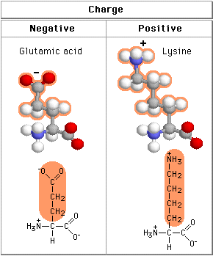
Amino Acid Charge
Three factors affect how amino acids fold into polypeptides and then into proteins.
The first of these factors is charge. An amino acid can be negatively charged, positively charged, or neutral (no charge).
  Opposite charges attract.
    A negative will move closer to a positive
    charge and form a bond.
  Similar charges repel each other; two
  positive charges will move away from
  each other.
    Ditto for two negative charges.
Source: www.phschool.com

Slide 9
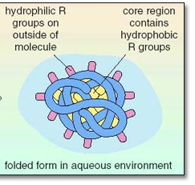
Amino Acid Hydrophobicity
The second property is hydrophobicity.
Hydrophobicity simply means whether or not a molecule is attracted to or repelled by water
  For example, oil is hydrophobic – it does not mix with water
  Salt is hydrophilic – it easily dissolves in water
  Hydrophobic – water hating (it has a ‘phobia’ of water)
  Hydrophilic – loves water (Philadelphia is the city of Brotherly Love)
Hydrophobic amino acids will move
to the inside to get away from water
Hydrophilic amino acids will move
to the outside to move towards water
Source: labspace.open.ac.uk -

Slide 10
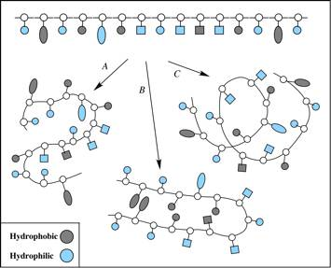

Slide 11
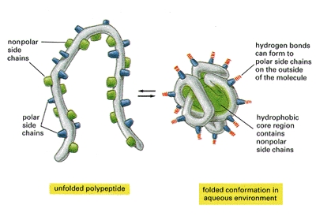

Slide 12
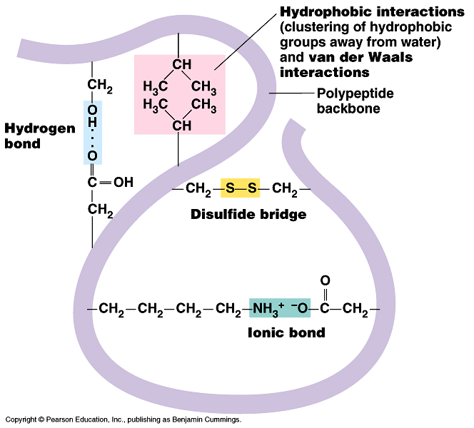
Cysteine Bonds
Cysteines are one of the 20 amino acids
  Cysteines are like the obnoxious couples that are always together – they can’t stand to be apart
  Two cysteines will always move closer to each other
When they move close,
they will form what is
called a “disulfide bond”
or “disulfide bridge”.

Slide 14
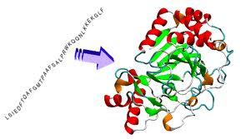
Summary
So, three major factors affect how amino acids change from a straight line to a 3D protein
  Charge – like charges repel, opposite charges attract
  Hydrophobicity – some amino acids are attracted to water and move to the outside; others are repelled by water and move to the inside
  Cysteine bonds – two cysteine
  amino acids will form a disulfide
  bond together
Image Source: people.sissa.it

Slide 15
cys
-
-
-
+
Hydrophilic Amino Acids on the Outside
Hydrophobic Amino Acids on the Inside
-
Disulfide Bond between Cys
+
cys
Neg & Pos attraction
Note: this is an animation that can only be seen on the PowerPoint version.

Slide 16
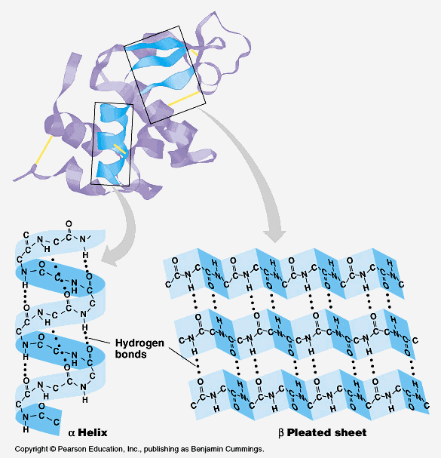
Shapes of Proteins
There are two kinds of shapes that can result because of the factors that affect protein shapes
  α helix (pronounced “alpha helix”)
  β sheet (pronounced “beta sheet”)

Slide 17
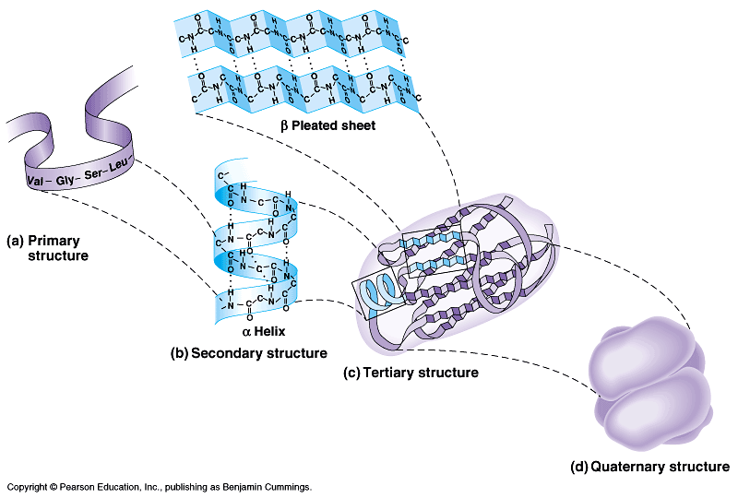
Levels of Protein
Organization
The primary level of protein organization is the order of amino acids as determined by mRNA and DNA
The secondary level of protein organization is the shape created by these amino acids.
  Only two shapes occur - α helix or β sheet
The tertiary level is the overall shape of the polypeptide created by the mix
of α helixes and β sheets.
The quaternary level, is
the mixture of polypeptide
subunits to create a
functional protein.

Slide 19
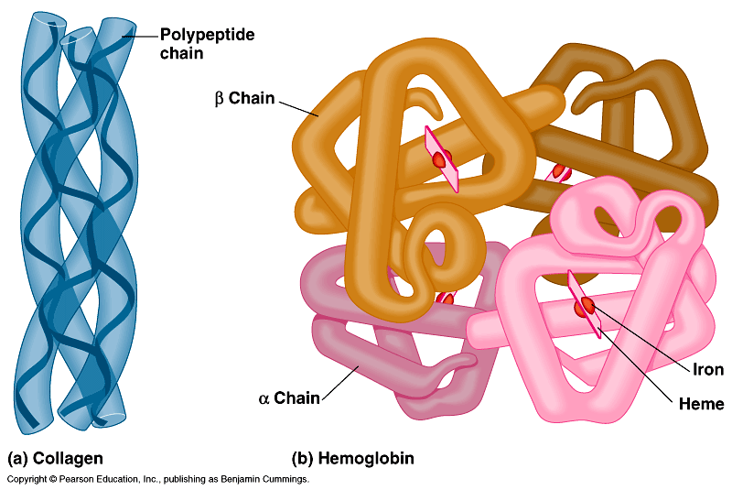

Slide 20
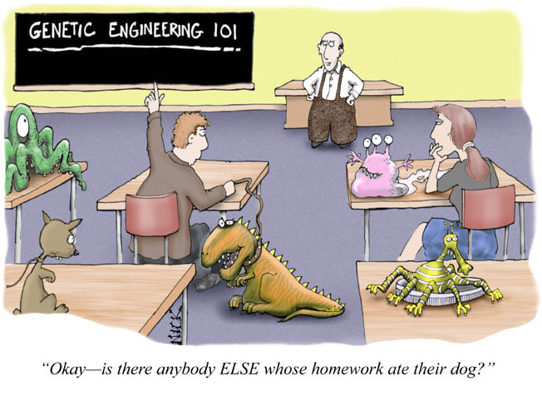
The Impact of Mutations
Source: gcsebiologyblog.blogspot.com
By C. Kohn, Waterford, WI

Slide 21

Mutations
Any change to the DNA is called a mutation
  The effect of a mutation is usually harmful, but it can also be beneficial or even have no impact whatsoever
  Whether or not a mutation is helpful, harmful, or neither depends on how the protein created from that gene is affected.
Mutations are responsible for genetic diseases such as cancer and inheritable disorders.
  While genetic mutations can be bad, they can also be good and are responsible for all of the
  diversity we see in living organisms
  Mutations drive both evolution by
  natural selection in nature as well
  as improvements by artificial
  selection in agriculture

Slide 22
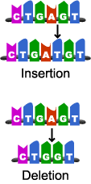
Types of Mutations
Different types of mutations exist
Insertion mutations occur when a base is added
  E.g. GATCTA might become GATACTA
Deletion mutations occur when a base is completely lost from DNA
  E.g. GATCTA might become GATTA
Image Source: learn.genetics.utah.edu

Slide 23
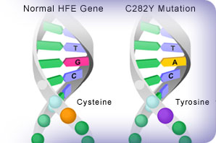
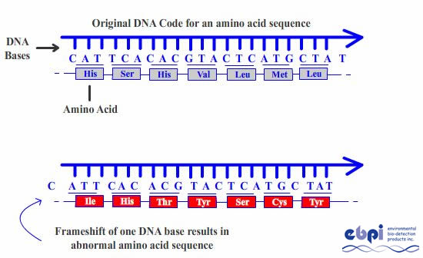
Types of Mutations
Substitution mutations occur
when one base is switched for another
  E.g. GATCTA might become TATCTA
If a mutation causes all of the bases downstream to change, it is called a Frameshift Mutation
  Deletion and Insertion
  mutations are frameshift
  mutations
Source: www.cdc.gov

Slide 24
Impact on Proteins
So how does a mutation affect a living organism?
  First, a mutation may cause a dramatic change to the codons (groups of 3 bases)
  For example, a deletion mutation in
  5’-GAT-TAC-CTA-TAT-GGA-3’
  would turn it into
  5’-ATT-ACC-TAT-ATG-GA…3’
Entirely new amino acids would be added to make a protein because each codon was changed downstream of the mutation
  This again would be a frameshift mutation

Slide 25
Normal mRNA Strand
Arginine
Arg
C
G
A
U
C
G
A
U
C
G
A
U
Ser
Protein
Serine
Iso
Isoleucine
Asp
Asparagine

Slide 26
Mutated mRNA Strand (Frameshift)
Arginine
Arg
C
G
A
C
G
A
U
C
G
A
U
Arg
Arginine
Ser
Serine
-----

Slide 27
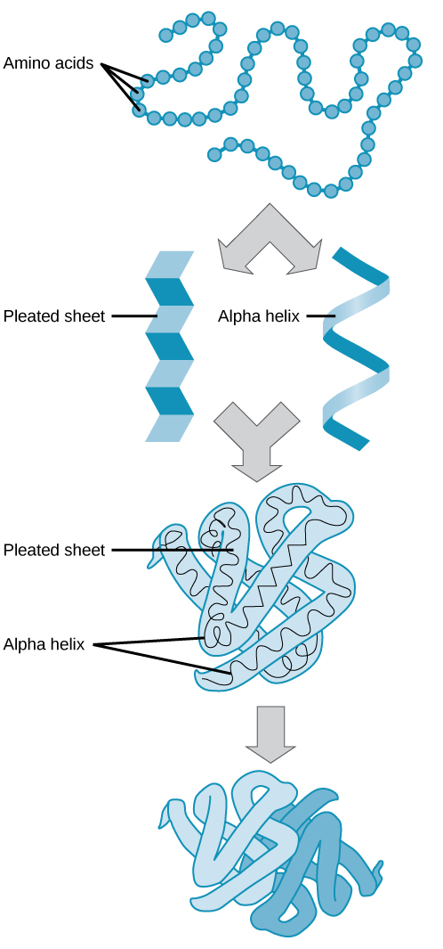
Impact of Mutations at
Each Level
At the primary level of protein organization, the order of amino acids will change, and possibly most or all of the amino acids will be different.
  This will cause a major shift in the shape of the protein
At the secondary level, the arrangement of α helixes and β sheets will be different.
At the tertiary level, the final look of the
polypeptide subunit will be completely different.
At the quaternary level, the protein will have a completely different shape and will not be able to perform its original function.
  This can all happen because of one change in one base!
Image Source: cnx.org

Slide 28
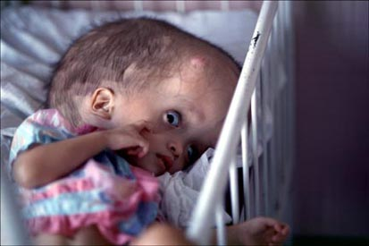
Frameshift Mutations
Frameshift mutations (insertion or deletion mutations) are especially harmful because they cause every codon to change after the mutation.
  This means that almost every amino acid will be different, causing the polypeptide and protein to have an entirely new shape and function.
  Oftentimes, a codon will change from an amino acid to a TERM command, cutting the amino acid chain short.
The result of a frameshift mutation
can be devastating to an organism.
  For example, the herbicide Agent
  Orange caused numerous birth defects
  due to the frameshift mutations it caused
  in the baby’s DNA as it developed.
Image Source: www.steveraymer.com

Slide 29
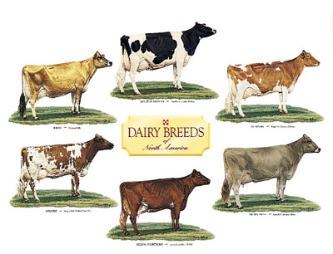
Mutations Aren’t Always Bad!
Most of the time, mutations will cause the entire protein to be misshaped and malfunction (if the protein is even able to be created).
  A mutation that harms an organism is known as a deleterious mutation.
  A mutation can also have no impact on an organism whatsoever. These are neutral mutations.
Very rarely a mutation will be beneficial (or advantageous) and lead to a positive new trait for that organism.
  The differences between breeds of livestock and in strains of crops resulted from random mutations that were beneficial.
  When these productive mutations occur,
  farmers and geneticists will work to ensure
  that these traits are selected for when
  breeding.
    This ensure that the productive trait
    becomes more common and widespread.

Slide 30
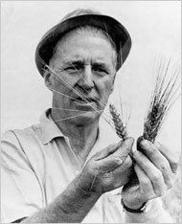
Norman Borlaug
Norman Borlaug was an agricultural researcher who developed strains of wheat that were more productive, more disease-resistant, and more tolerant to temperature extremes.
  He did this by selecting for randomly-occurring traits that were the result of mutations in the wheat crop.
  This selection for beneficial mutations increased wheat yields in his strains by 150%!
For his work, Borlaug became known
as the “Father of the Green Revolution”
and saved countless lives by developing
crops that could feed more people.
  Because he helped so many people,
  Borlaug was awarded the Nobel
  Peace Prize in 1970.
Source: www.nytimes.com

