Slide 1
Concepts of Health and Disease
By C. Kohn, Waterford WI
Based on W. Kirkham’s Animal Health and Management and Clark’s Genes, Germs, and Civilization

Slide 2
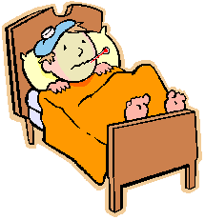
What is “Health”?
Health is a state of an individual living in complete harmony with its environment.
It is not fighting unusual circumstances to maintain a physiological normal state of being
Simply put, it is functioning as it would normally function
It is “normal”
What is normal?
Normal here is defined as measures of health that fall within predictable routine ranges
It is where your temp, HR, breathing, etc. would fall on average for that species under regular circumstances
For example, a normal temperature for humans is 98.6º F
However, some people fall out of the “normal” range where most people lie.
Their “normal” is abnormal; so long as their vitals are within their normal range, they are healthy.
Source: catawbaschools.net

Slide 3
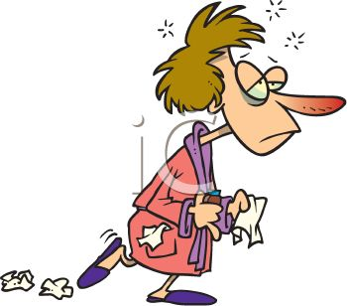
What is “disease”?
Disease is a condition in the individual animal overtly shows bodily changes that are outside the normal range for that species.
The changes that mark the disease are known as symptoms.
Symptoms are not disease; they are just an indication that a disease is occurring.
For example, a cold does not cause a stuffy nose; your body stuffs up your nose because of the cold.
A stuffy nose is not a cold, just a symptom
Source: getridofastuffynose.com

Slide 4
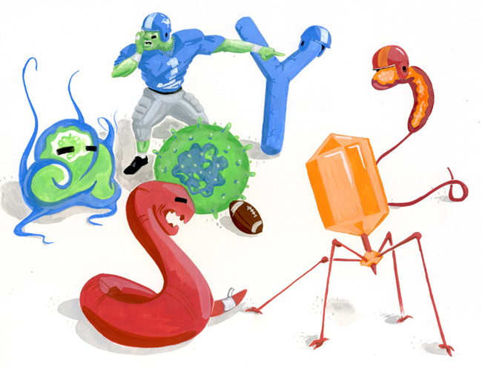
Disease Categories
Disease can be broken down into two categories:
Noninfectious Disease: results from injury, improper nutrition, genetic abnormality, unfavorable environmental conditions (heat, cold), or exposure to toxic materials.
Infectious Disease: a disease caused by microorganisms (bacteria, fungi, viruses, etc.)
The organism that causes an infectious disease is a pathogen.
The organism affected by infectious disease is called the host.
Source: mikecostelloe.com

Slide 5
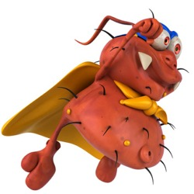
Virulence
Virulence: the ability of a pathogen to overcome the resistance of the host defenses
Microbes are constantly invading the human body but few make it past the human defense system.
Levels of virulence depend on the mode of transmission, and how plentiful, crowded, and unhygienic the hosts are.
The virulence of a disease can change based on the both the pathogen and the host.
E.g. keeping animals cleaner and well-fed reduces the virulence of the pathogen by comparison.
E.g. Some diseases become less virulent over time due to changes in the pathogen or to the resistance of the host organism.
Source: gaia-health.com

Slide 6
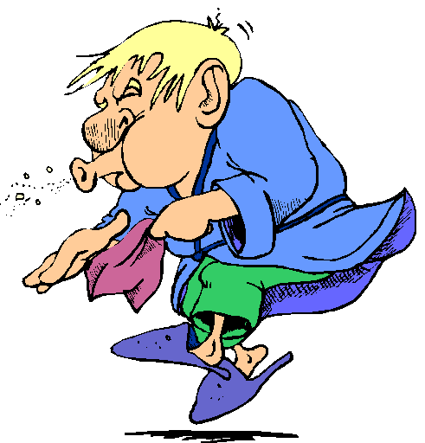
Infectious vs. Contagious
Infectious diseases are contagious if they are transmitted by being passed from animal to animal
For example, tetanus is infectious but not contagious; it is not spread from animal to animal but acquired from soil-borne organisms in the ground and on rusty nails
Ringworm and the flu are diseases that are contagious because they are spread from animal to animal by contact.
Source: marshmassage.blogspot.com

Slide 7
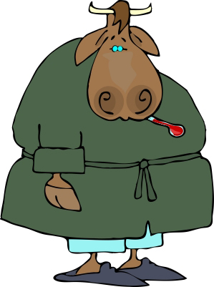
Disease Transmission
Microbes gain entrance into the body in many ways.
Many types enter through breaks in the skin or direct openings into the body including mucus membranes such as the nose, eyes, teats, and vaginal area
Contaminated feed and water are a possible source.
Source: hypnosishealthinfo.com

Slide 8
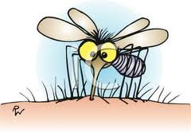
Vectors
Vectors can also spread disease
A vector is an organism that introduces the pathogen that causes a disease
For example, mosquitoes are vectors for malaria; ticks are vectors for Lyme disease
Diseases that are spread by vectors tend to be more severe because they do not need the host to live in order to be spread.
E.g. the Bubonic plague and malaria are both examples of severe diseases transmitted by vectors.
Source: best-of-web.com

Slide 9
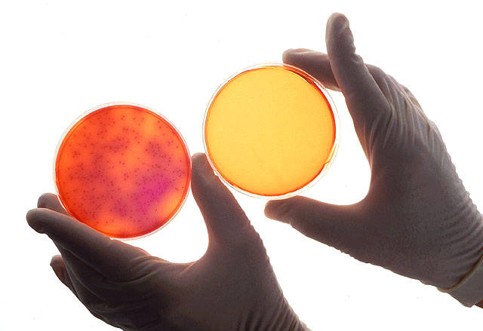
Disease Transmission
Most pathogens have a preferred tissue in which they are most effective given their genetic adaptations
For example, the rabies organism prefers and is most effective in nervous tissue
Salmonella has the most virulence in the digestive tract
Source: chemistry.about.com

Slide 10
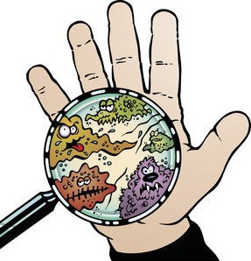
Preventative Strategies
Natural selection has provided livestock and other animals with strategies to prevent, reduce, or minimize the transmission of disease
Skin, hair, and feathers provide a first line of defense
Mucous membranes provide protection by “trapping” airborne microbes
Lysozymes in saliva, gastric acid, and bile also help to break down harmful bacteria
Mucus excreted in the respiratory tract and hair-like cilia help to trap and expel microbes
Source: buzzle.com

Slide 11
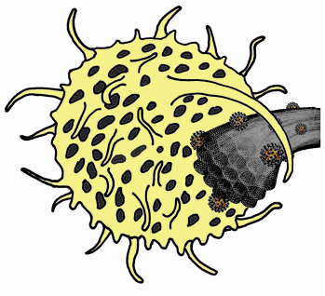
Immunity vs. Resistance
Hosts have two internal strategies for reducing the impact of a disease – immunity and resistance.
Resistance refers to a lack of genetic susceptibility to a pathogen.
The animal does not get sick when exposed to the microbe in question because of an inheritable trait.
E.g. people with one copy of the gene for sickle cell anemia have resistance to malaria.
Resistance is inherited – it is a genetic trait
Immunity is the ability of white blood cells to fight a pathogen and is created by actually having the disease.
Immunity is where the immune system “remembers” the pathogen and how to destroy it.
Source: esrf.eu

Slide 12
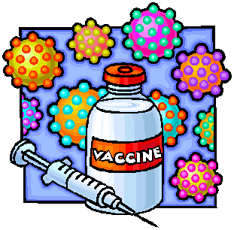
Active vs. Passive Immunity
Active immunity is acquired by the animal as a result of an infection (or vaccination) followed by full recovery.
The animal’s body “remembers” the pathogen and produces antibodies for that disease (see later slide).
Passive immunity is transferred from another animal that has active immunity.
The transfer may be caused by ingestion of colostrum (antibody-rich milk produced immediately after calving), transfusion of blood, through the shell of an egg to a newly hatched bird, or through the placenta to the unborn offspring
Active immunity is permanent; passive immunity is temporary (usually)
Source: salmonellablog.com

Slide 13
Immunity
Active Immunity can be natural or artificially acquired
Natural immunity - acquired due to infection
Artificial or Acquired immunity – acquired due to vaccination
Herd immunity refers to when the majority of a population are immune and/or resistant to a disease and protect the minority of the population who are not immune or resistant.
This requires 75% or more of the population to be vaccinated.

Slide 14
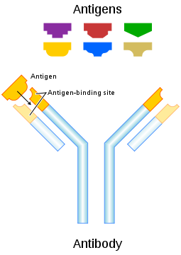
Antibodies
Antibodies are created by the host’s body in response to the presence of an attacking pathogen.
An antibody is a serum blood protein that is produced by the body to fight the pathogen.
Antibodies can serve different functions depending on their type.
These functions can include detection of the pathogen, breakdown, elimination, and recovery
Source: en.wikipedia.org

Slide 15
Antigen
An antigen is short for “Antibody Generator”.
An antigen is the pathogen or part of the pathogen that caused the formation of an antibody.
Common antigens are microbes, venom, toxins, and proteins.
The presence of an antigen in the host’s body causes an immune response; this response enables the body to kill off the invading pathogen.
Source: en.wikipedia.org

Slide 16
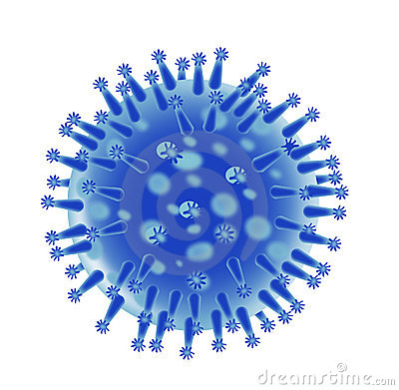
How does a Pathogen Become Virulent?
Many pathogens came from formerly harmless microbes that did not cause disease.
As they acquired mutations, changes to their function were created.
Most of these changes were not helpful to the microbe.
Sometimes, however, a change may enable the microbe to produce a protein that aids in its ability to attack a host.
The changed protein often becomes the antigen that is recognized by the immune system in immune hosts.
The less genetic material a microbe has, the faster it can mutate and form pathogenic forms.
E.g. the flu virus will change from year to year and even month to month.
Bacterial diseases change less quickly because they have more genetic material.

Slide 17
Disease Triangles
In order for a disease to occur, three elements must be present
1. A host to become infected
2. A pathogen to cause infection
3. An environment conducive to the transmission of the pathogen into the host’s body

Slide 18
How a Disease Occurs
In order for a disease to occur, we must have three factors present:
1. A pathogen must be present and thriving in the environment of the host.
If there is no pathogen, there is nothing that can cause the disease. If the pathogen cannot survive in the environment for very long, it is less likely to cause a disease.
2. The pathogen must be virulent
Microbes are constantly invading the human body but few make it past the human defense system
A microbe must be virulent enough to overcome the host’s immune system.
3. The host must be susceptible.
The host must have either an immune system that cannot destroy the pathogen on contact, allowing that pathogen to invade its tissue.

Slide 19
Other Factors
Many factors affect the spread of disease by affecting the host, the environment, the pathogen, or all of the above.
These include:
Crowding – the more individuals in an area, the more a disease can occur and spread.
Weather – some conditions favor the growth and reproduction of a pathogen (usually warm and wet environments cause diseases to grow more quickly)
Hygiene – the less sterile and less clean an environment, the more that disease can spread.
Vectors – the presence of mice, mosquitoes, flies, and other common vectors increases the spread of disease.

Slide 20
Preventing a Disease
Many methods exist to prevent a pathogen from causing a disease, including:
Health – healthy individuals are less susceptible and better capable of fighting off pathogens. Proper diet, nutrition, adequate levels of sleep, proper temperature, and minimal stress will aid the immune systems of individuals.
Immunization – if 75% or more of a population is vaccinated against a disease, a disease usually cannot spread.
Sanitation – clean environments are not favorable for the spread of disease.
Low population densities – the less densely populated an area, the lower the chance of a disease epidemic.

Slide 21
Sanitation
A disease cannot occur if the pathogen that causes the disease is not present
For example, no one in this school has small pox right now because no one is exposed to the small pox virus.
Sanitation & hygiene reduces the impact of the environment in causing disease by reducing the ability of the pathogenic microbe to reproduce and transmit.
Reducing dirt, moisture, pests, and other pathogen-supporting elements from the environment reduces the likelihood of a disease from occurring.

Slide 22
Sanitation Measures
Dead animals, waste, and refuse should be removed quickly from an agricultural operation.
Carcasses should be buried with at least 6 feet of soil; removal from the property is preferred
Low areas or mud holes should be filled or fenced off; these are areas ripe for disease transmission
Water supplies should be regularly refreshed and contain cool, clean water
Stagnant water is a common transmission and growing stage for disease-causing pathogens

Slide 23
Sanitation Measures
Pens and holding areas should be cleaned daily
Bedding packs should have minimal moisture
Sunlight is an effective killer of microbes; facilities should be well-lighted and have access to fresh air flow
Pasture rotation can help minimize the harboring of disease in the soil

Slide 24
Disease Epidemics
Sanitation & hygiene measures on a farm are vital in order to prevent a disease epidemic.
An epidemic is an increase in the number of cases of a particular disease that would normally occur in a given population.
Usually an epidemic is a sudden, unanticipated event.
An epidemic can also be known as an outbreak.
Epidemics are cases of disease that exceed the endemic level of that disease.
Endemic refers to the usual amount of a disease found in a given population.
An epidemic that gets out of control can lead to a pandemic, a situation in which a disease spreads over multiple countries or even continents.

Slide 25
Causes of EPidemics
Epidemics can be caused by a variety of factors. Some common causes of epidemics include:
A change to a pathogen that makes it more virulent.
Introduction of a pathogen to a place where it did not previously exist.
Crowding of individuals in a population in a manner that increases the rate of exposure and transmission o to the pathogen.
Conditions that weaken the immune systems of an entire population (such as weather, disasters, poor nutrition, etc.).
One of the most recent veterinary pandemics occurred in 2013 in the United States: PEDv
PEDv began as a disease that was endemic to Europe in the 1970s. It eventually became an epidemic in Europe, and then a pandemic that spread to Asia in the 1980s and then America in 2013.

Slide 26
Porcine Epidemic Diarrhea Virus (PEDv)
Porcine Epidemic Diarrhea (PED) virus was first observed in the US in spring of 2013.
PEDv is caused by a virus that infects the intestinal tissue and causes a 50-100% death rate among infected piglets.
Adult pigs can be infected but rarely die.
PEDv is spread by oral contact between pigs and by contact with infected feces.
As of 2016, PEDv has been found in at least 27 states.
At least 1 million US pigs have died from this disease so far.
PEDv was common in Asia and Europe since the 1970s.
Since the late 1990s, vaccine development and usage reduced the endemic levels of this disease in Asia.

Slide 27
The Spread of PEDv
Why did the PEDv endemic spread so quickly?
Part of the cause was that PEDv was largely not found in the US prior to 2013.
As a result, there were no vaccination or biosecurity protocols in place in America to prevent its spread, and US pigs had no chance to develop immunity to this disease through regular exposure.
The swine industry also relies on regular transportation to move animals to slaughter, which offered a rapid means of transport for the virus.
These modes of transportation are not usually disinfected between trips, mostly because disinfection are largely unnecessary until recently.
For most producers, the cost of cleaning and disinfecting transport vehicles was greater than the risk of infection until 2013.

Slide 28
The Spread of PEDv
As a result, US pigs became highly susceptible to PEDv because…
It was a disease that was new, and few if any pigs had any immunity to it.
Because the disease was not endemic to the US, there were not widespread vaccination programs to prevent its transmission.
Pigs are kept in facilities where they have more individual contact with other pigs than other species of livestock, allowing easy transmission by the fecal and oral routes.

Slide 29
Human Safety
Fortunately, PEDv is not a zoonotic disease.
A zoonotic disease is one that can be passed from animals to humans.
Examples of zoonotic diseases include rabies, Ebola, influenza, and tuberculosis.

