Slide 1
Proteins
By C. Kohn
Agricultural Sciences
Waterford, WI

Slide 2
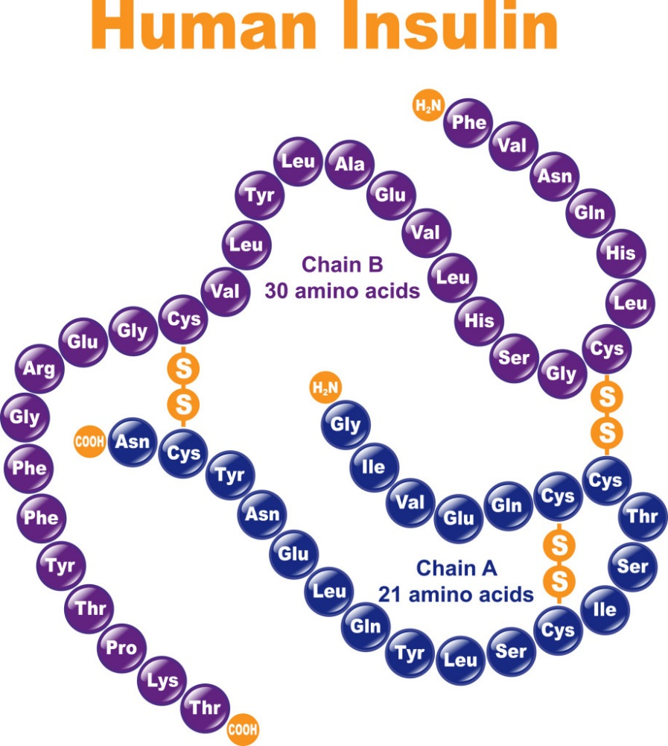
Proteins
You have probably heard about proteins all throughout your life.
They are a major part of our diet.
You probably know that foods like meat, dairy, and some kinds of plants (like beans and nuts) are high in dietary protein.
If you are an athlete, you probably know how important it is to consume protein to support your physical performance.
The proteins in your diet are what eventually become the proteins that help your body to function.
At the molecular level, proteins are the functional part of your body.
Proteins are what do most of the work of your body.
If you eliminated water from your body, proteins would comprise 75% of your body weight.
Source: www.interactive-biology.com

Slide 3
Protein Function
Proteins are the molecules that primarily do the work of running your body. Proteins do all of the following jobs and more:
Proteins in your muscle cells move to allow your muscles to contract and relax.
Proteins can transport substances throughout your cells and throughout your body.
They generate and send electrical signals in your neurons.
Proteins form your joints and connective tissues.
Immune system proteins protect your body from pathogens.
Digestive proteins break down the food you eat into simpler molecules.
Hemoglobin proteins move oxygen in your blood.
ATP Synthase is a protein that produces ATP in your mitochondria.
If something happens in a cell, it's probably because of at least one protein performing that job.

Slide 4
Universality of Proteins
While there are over 10,000 different proteins in your body alone, all proteins are similar in that they are made from chains of amino acids.
The type of protein that is created at any given moment is dependent on the type and order of amino acids from which it is made.
The order in which amino acids are assembled to make a protein is determined by your genes, or stretches of DNA that code for the assembly of specific proteins.
For every protein found in your body, you have a specific section of DNA with instructions explicitly for that particular protein.
Source: online.science.psu.edu

Slide 5
Protein Necessities
If you do not have a gene to make a protein, your body cannot make that protein.
Your body has all 20 amino acids necessary to assemble almost any protein that exists.
However, the ribosomes in the cells of your body cannot make a protein unless it has the genetic instructions in its DNA.
For example, the enzyme lactase is necessary to beak down the sugar lactose (found in milk).
People who are lactose intolerant actually have all the things that they need to make the lactase protein (amino acids, ribosome, tRNA, etc.).
However they cannot produce the lactase protein because their gene with the instructions for this protein is silenced.
Without these instructions for lactase, it cannot make lactase.
Scientists can also enable an organism to produce almost any protein by adding the gene for that protein to their DNA.
For example, scientists can produce pigs that glow in the dark by adding a gene to their DNA from jelly fish or fireflies for a glowing protein.
Source: http://i.kinja-img.com/gawker-media/image/upload/s--mO0gC0AF--/19b05lkw8ck3djpg.jpg

Slide 6
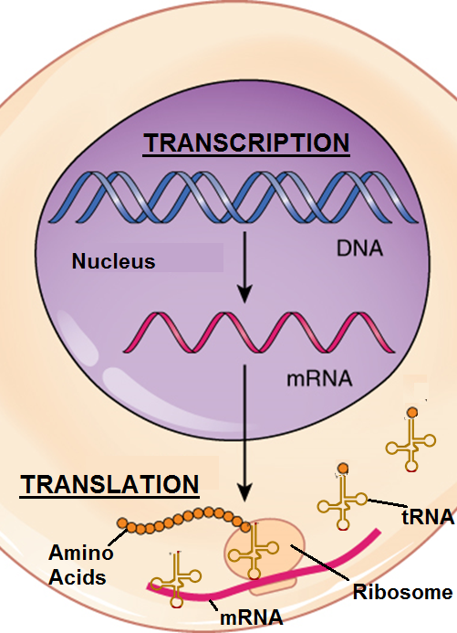
Transcription & Translation
A protein is made as a result of transcription and translation in the cell.
During transcription, DNA is copied by RNA polymerase, which produces a copy of DNA called mRNA.
This mRNA copy then leaves the nucleus and moves to the ribosome.
During translation, the ribosome reads the mRNA in groups of three bases (called codons).
For every codon, a tRNA delivers an amino acid specific to that unique combination of three bases.
As each codon moves through the ribosome, a new amino acid is added to the growing chain of amino acids on the ribosome.
This growing chain of amino acids is what will become the protein.
Source: oerpub.github.io

Slide 7
64 Codons for 20 Amino Acids
tRNA has an anticodon that matches each codon of mRNA that enters the ribosome, ensuring it always brings the correct amino acid.
Every amino acid has at least one 3-letter combination of bases that is specific to that one particular amino acid (and no other).
Because there are four different bases in mRNA (C, G, A and U), there are 64 possible combinations of codons.
However, there are only 20 amino acids used by most living things to assemble their proteins.
As a result, some amino acids have as many as six different 3-letter combinations that code for their delivery by tRNA.
For example, UCU, UCC, UCA, and UCG all code for the same amino acid: Serine.
Most amino acids are coded by multiple codons.
Source: www.slideshare.net

Slide 8
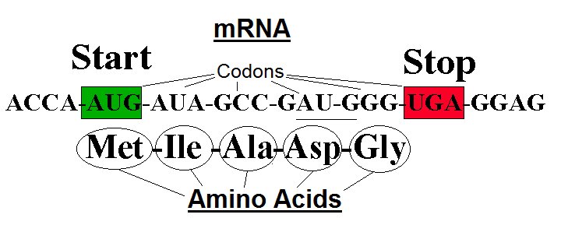
Start & Stop Codons
Four codons are particularly unique and have special importance in the assembly of amino acids into proteins.
AUG is called the “start codon”. It indicates where a ribosome should begin the assembly of a chain of amino acids to make a protein.
UAA, UGA, and UAG are all called “stop codons”. Like a period at the end of a sentence tells you where to stop reading, stop codons tell a ribosome where to stop assembling amino acids into a protein.
The 64 different kinds of codons make up the genetic code.
The genetic code consists of the different arrangements of 3-base combinations and the amino acids that each codon codes for.
Source: www.ucl.ac.uk

Slide 9
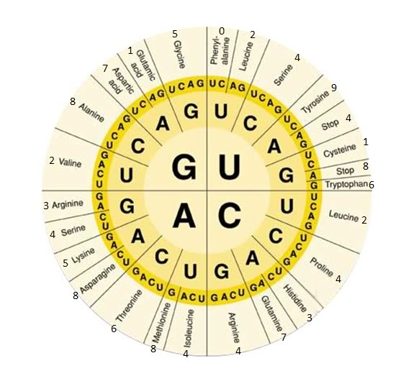
Codon Chart
All 3-base combinations and resulting amino acids that make up the genetic code are able to be determined using a chart. ↓
Begin by finding the first letter in a codon on the very inside of the circle, then find the second letter in the middle ring of bases, and conclude by finding the letter on the outermost ring and the amino acids next to that last base.
For example, CUU would code for Leucine.
AGA would code for Arginine.
UGG would code for tryptophan.
UGA would code for a STOP codon (signaling to stop translation).
Source: www.geocaching.com

Slide 10
Source: http://images.slideplayer.com/25/7815759/slides/slide_17.jpg

Slide 11
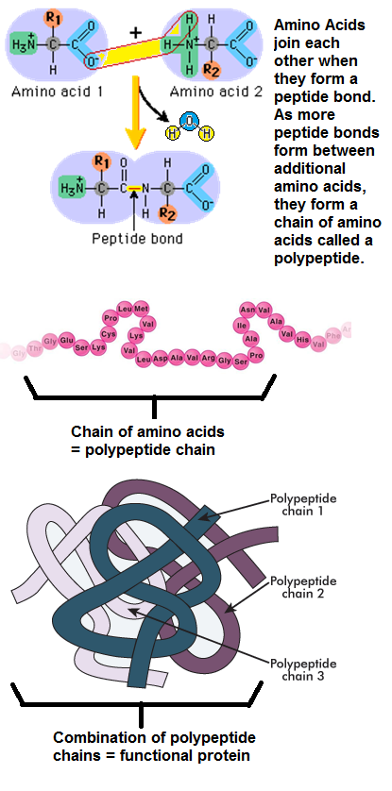
Polypeptides
Source: www.daviddarling.info
Each amino acid is bonded to each other in this chain with a peptide bond.
A peptide bond is what keeps all of the amino acids linked in a chain.
The chain of amino acids that will become a protein is called a polypeptide
Poly- means many, and peptide refers to the peptide bonds.
Sometimes a protein can be made from just one polypeptide but usually multiple polypeptides are needed to make a protein.
In other words, a protein is a macromolecule that is usually made from a combination of multiple chains of amino acids.
Source: www.studyblue.com
Source: tle.westone.wa.gov.au

Slide 12
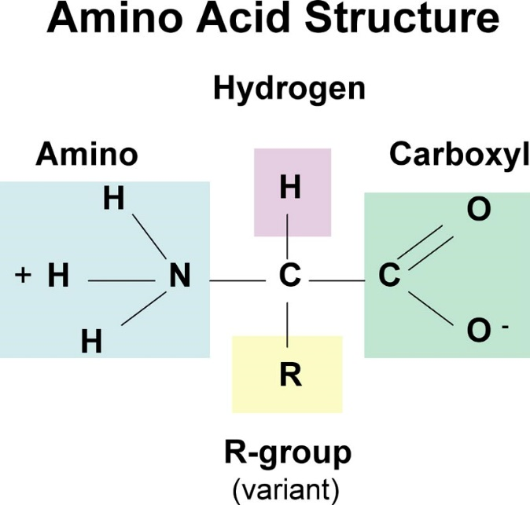
Amino Acids
Source:: www.carlagoldenwellness.com
All amino acids are made of three parts:
1. An amino group (H₃N⁺) made of hydrogen and nitrogen.
2. A carboxyl group (COO⁻) made of oxygen and carbon.
3. A side chain (also called the R group)– the side chain is different in each of the 20 amino acids (see examples →)
While the amino group and carboxyl group are almost the same in all amino acids, the side chains vary widely among amino acids.
The side chain is what determines the properties of the amino acid.
The properties of the amino acid determine the shape of the protein.
The shape of the protein is what determines its function.
Source: cbc.arizona.edu

Slide 13
Amino Acid Properties
A chain of amino acids must fold into a specific shape before the protein can become functional.
Several key properties of each amino acid are necessary to change a straight chain of amino acids into a protein with a specific shape and function.
These properties include:
Charge: amino acids can be positively or negatively charged, or they can be neutral. Oppositely-charged amino acids will be attracted to each other.
Hydrophobicity: some amino acids are attracted to water; other amino acids are repelled by water.
Disulfide Bonds: cysteine amino acids form close bonds with other cysteines; these bonds are called disulfide bonds.
Hydrogen Bonding: positively-charged hydrogen atoms will have a weak attraction to negatively-charged oxygen atoms.

Slide 14
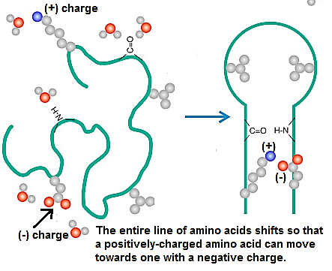
Amino Acid Properties
If a negatively charged amino acid is near another negatively charged amino acid, they will repel each other (just like similar ends of a magnet).
However, if a negatively charged amino acid is near a positively-charged amino acid, it will be attracted and move closer to that positively charged amino acid.
Much of the shape of a protein comes from amino acids moving towards or away from other amino acids because of charge.
Source: scitechconnect.elsevier.com

Slide 15
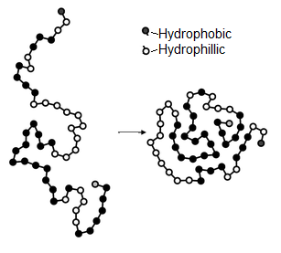
Hydrophillic vs. Hydrophobic
Some amino acids are attracted to water and some amino acids are repelled by water.
The amino acids that are attracted to water are called hydrophillic (hydro- means "water", and phillic- means "loving").
The amino acids that are repelled by water are called hydrophobic (or "water-hating").
Because our bodies (and our cells) are mostly made of water…
Hydrophillic amino acids will move to the outside of a polypeptide chain. ➔
Hydrophobic amino acids will try to hide on the inside. ➔
Source: chemwiki.ucdavis.edu

Slide 16
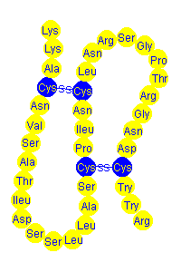
Cysteine Bonds
Some amino acids are attracted to themselves.
The bond between two cysteine amino acids is so strong that they will literally move the whole chain of amino acids just to be together.
Cysteine amino acids are like Romeo and Juliet – they will do anything to be together.
The bond between two cysteine amino acids is called a disulfide bond.
Disulfide bonds are very strong and provide a lot of stability to the protein structure.
Source: www.ausetute.com.au

Slide 17
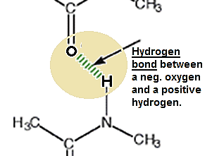
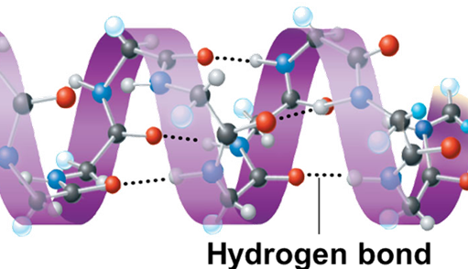
Hydrogen Bonding
Hydrogen Bonds: negatively charged atoms of some molecules will form a weak attraction to the positively charged atoms of other molecules.
The (+) hydrogen atoms on amino acids will be drawn towards (-) oxygen atoms on other amino acids.
Even though they don’t form a covalent bond (a bond in which they share electrons), the attraction between these hydrogen and oxygen atoms will cause the chain of amino acids to twist, bend, or take on other shapes.
The combination of these 4 factors (amino acid charge, hydrophobicity, cysteine bonds, and hydrogen bonding.) are what ultimately influence the shape of a polypeptide chain of amino acids.
The shape of the polypeptide chains are what determine the final shape of each protein, and this shape determines the function of the protein.
Source: doubledecker27.blogspot.com

Slide 18
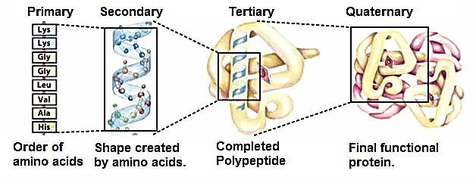
Shape Determines Function
The shape of a protein depends on its amino acids.
The properties of the amino acids create effects over four different levels of protein organization.
These levels of organization are called the Primary, Secondary, Tertiary, and Quaternary Structures.
Source: biochemaholic.wordpress.com

Slide 19
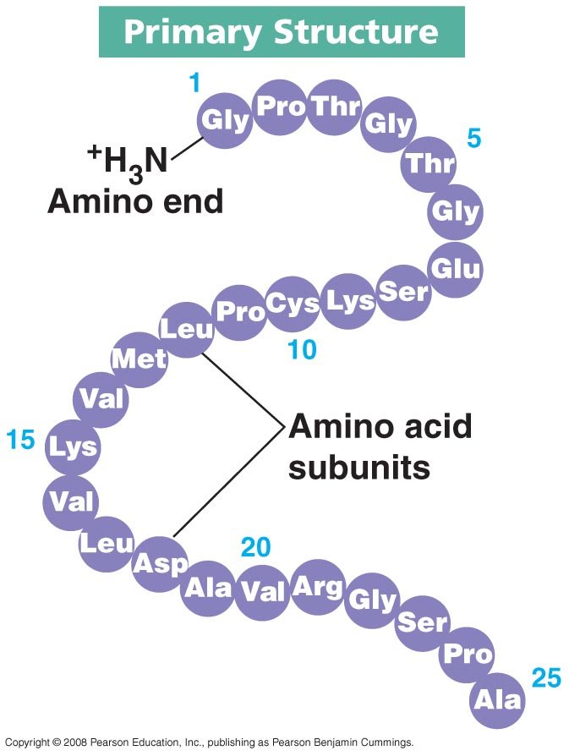
Primary Structure of Organization
The primary structure of protein organization refers to the order of amino acids that make up each polypeptide amino acid chain.
Because each amino acid has unique properties, any change to the order of amino acids at the primary level can have a major impact on the shape of a protein.
Changing just one of the amino acids in the primary structure can completely change the entire shape and function of the protein.
Often this one change can make the protein completely dysfunctional.
Source: https://biochemanics.files.wordpress.com/2013/04/protein_-_primary_structure.jpg

Slide 20
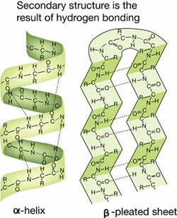
Secondary Structure
The secondary structure of protein organization refers to the shape that results from the order and type of amino acids found in each polypeptide.
Usually there are two major shapes that can result from any arrangement of amino acids – a) a slinky-like spring or b) a what looks like a sheet of paper folded into a zig-zag pattern.
Scientists call the spring shape an alpha-helix, and the zig-zag sheet is called a beta-pleated sheet.
Most polypeptide amino acid chains will be a mix of both alpha-helix springs and beta-sheets.
Source: www.abcte.org

Slide 21
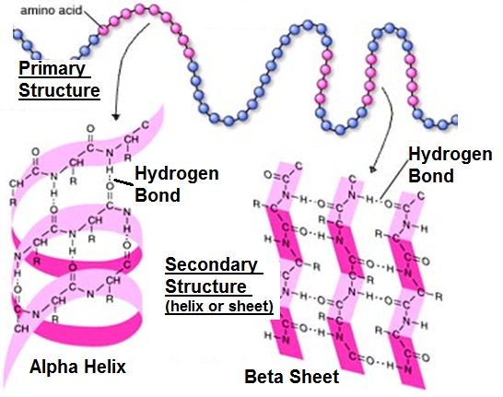
Secondary Structure
Two major factors determine the shape formed by the polypeptide chain of amino acids:
The order of amino acids (primary structure).
The hydrogen bonding between those amino acids.
Source: integrativebiology.okstate.edu

Slide 22
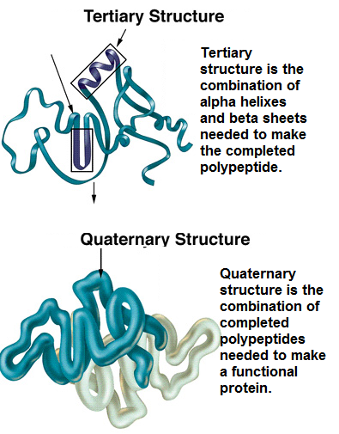
Tertiary/Quaternary Structure
The tertiary (TERSH-ee-airy) structure of protein organization is the overall shape of each polypeptide chain.
In other words, it is the final combination of alpha helixes and beta sheets that make up the polypeptide.
The quaternary structure of protein organization is the final functional protein that results from the combination of different polypeptide chains.

Slide 23
Examples of Protein Organization
Source: www.bio.davidson.edu
For example, ATP Synthase (the spinning wheel in mitochondria that makes ATP) is a complex protein made from many different polypeptide chains.
The functional version of ATP Synthase would be the quaternary level of organization.
The tertiary level of organization would be the shape of each polypeptide subunit of that protein.
The secondary level of organization would be the spring- and zig-zag-shapes in each polypeptide subunit that result from the order of amino acids.
The order of amino acids (as determined by the DNA gene and its mRNA copy) represents the primary level of organization.
Source: oasys2.confex.com
Source: geneexpression27.weebly.com

Slide 24
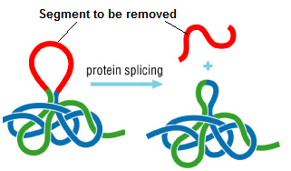
Higher Levels of Protein Assembly
While some proteins do not require any more assembly after the quaternary level, other proteins require additional processing to reach their functional stage.
Many proteins are not ready to be functional until they’ve undergone posttranslational processing.
Posttranslational processing refers to anything that must be done to a protein after it has been assembled and folded in order for it to become functional.
In some cases, entire sections of the amino acid sequence of some proteins need to be removed in order for the protein to become functional.
For example, the protein insulin (which is needed to regulate blood sugar) does not become activated until an internal segment of the polypeptide amino acid chain is removed.
The process of removing some amino acids to activate a protein is called protein splicing. ➔
A protein can also be activated by the addition of other molecules to the protein, such as carbohydrates, phosphate, etc.
Source: faculty.smu.edu

