Slide 1
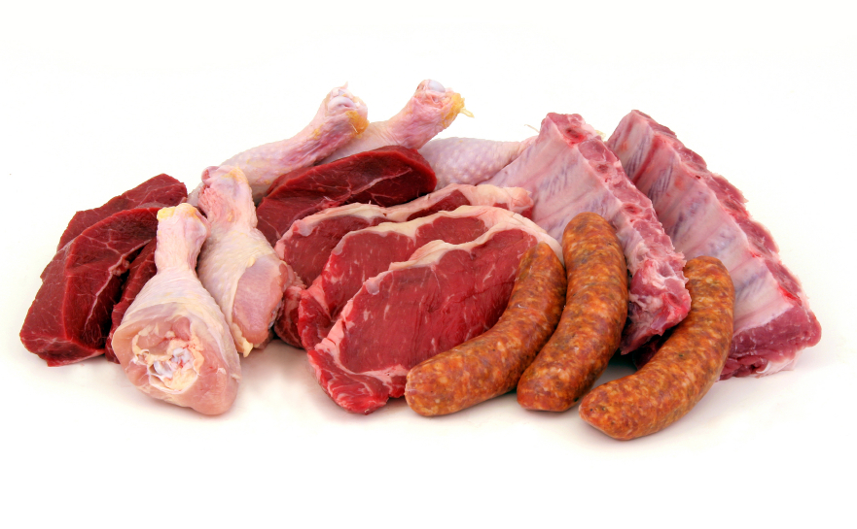
Meat SCience
By C. Kohn
Agricultural Sciences
Waterford, WI
Source: rivesqualitymeats.com

Slide 2
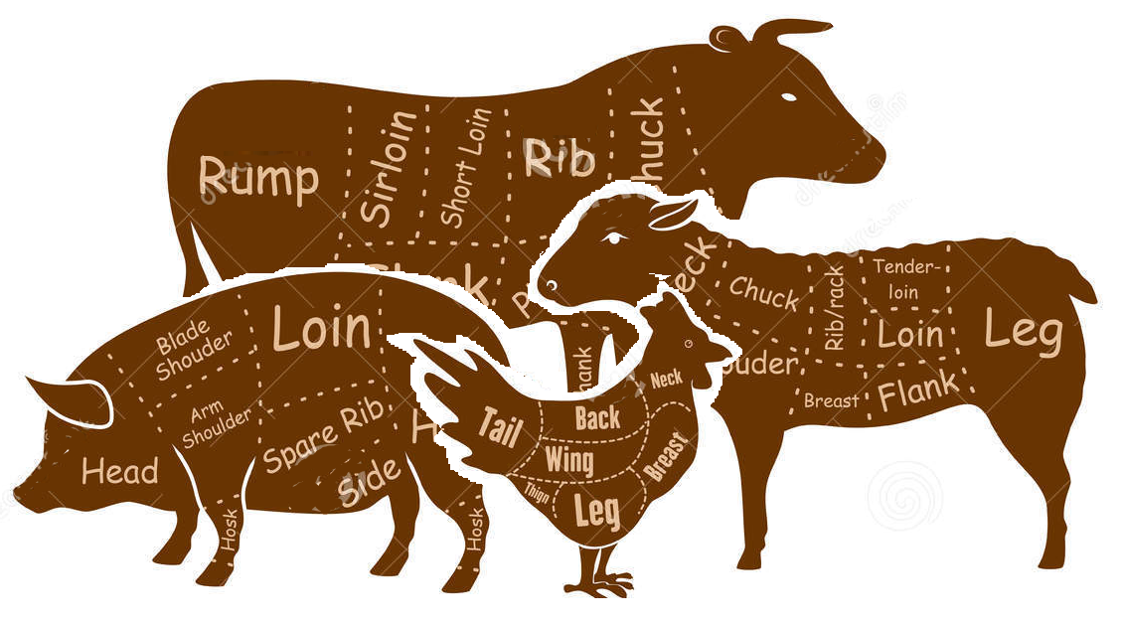
Intro to Meat
Meat is an important component of the diet of many people.
Meat is primarily the muscle tissue of animal that is used for food.
Muscle is a kind of contractile tissue
Tissue is a group of similar kinds of cells that work in unison in an organism.
Tissues are made from cells, and organs are made from tissues.
The factors that determine the quality of meat (its composition, nutritional value, wholesomeness and sustainability) are determined by..
How the animal is cared for and managed before harvest.
How the slaughter of the animal is performed.
How the carcass of the animal is processed into meat.
The ultimate goal of any meat producer is to provide a safe, healthy, humanely-produced product for a reasonably profitable price.
Source: www.dreamstime.com

Slide 3
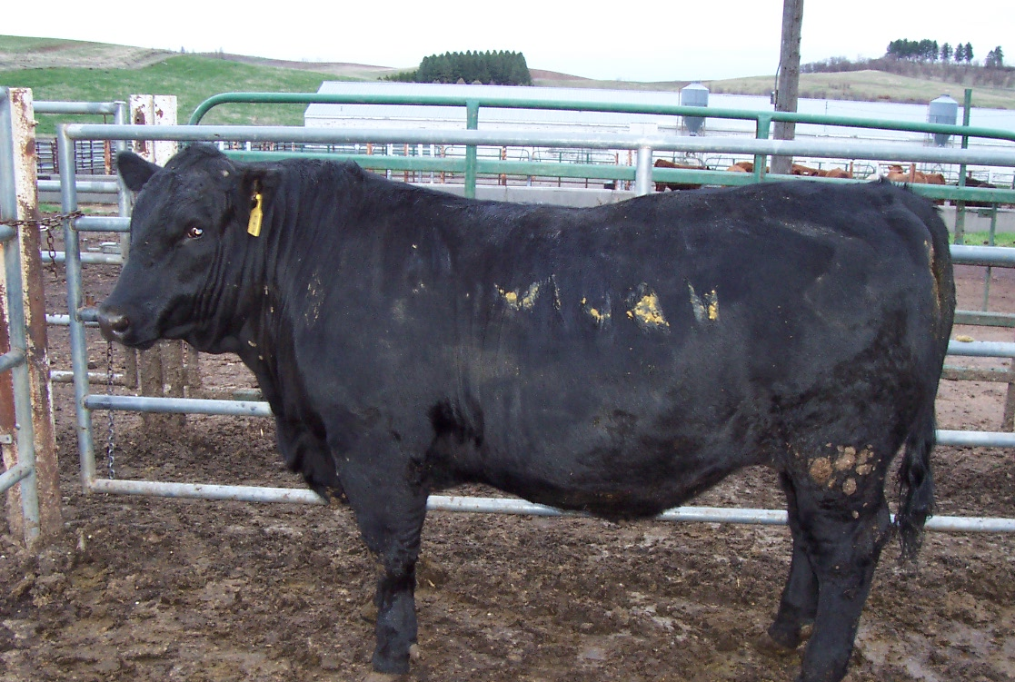
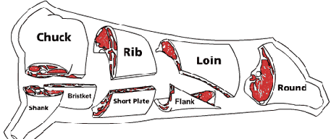
Animal Growth & Composition
How body composition changes as animals grow and mature

Slide 4
ADG & WDA
One of the top concerns of a meat-animal producer is determining live animal performance, carcass characteristics, and profitability.
A producer must be able to assess animals performance in order to maximize their ability to produce a top-quality product for a profitable return.
Two major determinations of this are average daily gain (ADG) and weight per day of age (WDA).
Average daily gain (ADG) is the amount of weight an animal has gained on average for each day in given period of feeding.
The formula for ADG is: [weight gained] ÷ [number of days on feed].
For example, if a pig gained 200 lbs. in a period of 3 ½ months, their ADG would be [200 lbs] ÷ [100 days] = 2 lbs. per day.
Weight per day of age (WDA) is simply the average amount of weight that an animal gained in each day of its life.
The formula for WDA is: [final weight – birth weight] ÷ [age in days].
For example, if a pig weighed 250 lbs., had a birth weight of 3 lbs., and was 150 days old, the WDA would be [250-3] ÷ [150] = 1.65 lbs. per day.

Slide 5
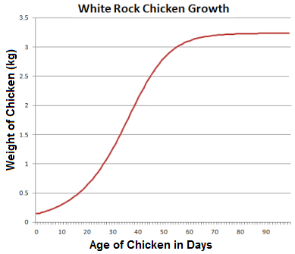
Changes to Weight & Tissue Composition
In order for meat-animal producers to be profitable, they must understand the changes that occur as an animal matures and gains weight.
Body composition in meat animals changes as the animal matures.
Between conception and birth (pre-natal), most of the growth in muscle tissue occurs because of hyperplasia, or the increase in cell numbers due to mitosis (cell division).
However, most post-natal (after birth) growth in muscle tissue occurs because of hypertrophy, or the increase in cell size.
In most meat animals, the muscle fiber formation is completed by birth, and almost all growth in muscle tissue is due to hypertrophy.
After birth, the rate at which an animal gains weight will initially increase as time passes.
However, this increase in the rate of weight gain will eventually stop and the amount of weight gained per day will decrease as time goes on.
The changes to the rate of weight gained per day can be graphed to create what is called the sigmoid-shaped growth curve.
Source: canadiansmallflockers.blogspot.com

Slide 6
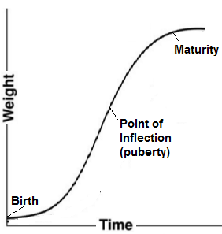
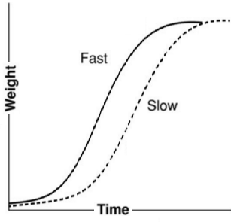
Sigmoid Growth Curves
The point on a sigmoid growth curve at which the gains in body weight begin to decrease is known as the point of inflection.
The point of inflection is where the rate of weight change is most rapid.
The inflection point typically occurs at same time as puberty of the animal.
The rate of weight change can be different even among animals of the same species.
Differences in the rate of growth have major economic implications.
The faster an animal can reach a market weight (the weight at which an animal can be sold for meat), the more profitable that animal tends to be.
Source: The Science of Meat Quality
edited by Chris R. Kerth

Slide 7
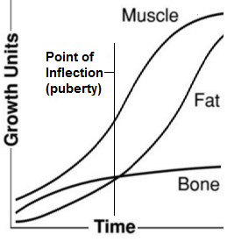
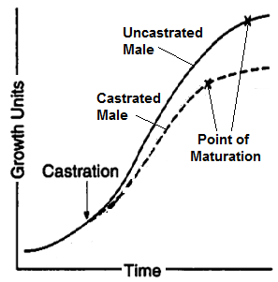
Growth Factors
As meat animals grow and mature, their different bodily tissues grow at different rates.
While the growth in bone tissue will level off shortly after the point of inflection (puberty), muscle tissue will continue to be added (but at a decreasing rate).
Fat will continue to grow on the animal’s body at an increasing rate until maturity.
This is important because it affects the marbling of the meat, which has a major impact on the flavor and texture of the meat.
For most meat animals, slaughter should occur when a enough fat has been acquired to ensure high meat quality.
Gender and castration can also have a major impact on tissue growth.
A castrated male will not grow as large, but it will reach maturity more quickly.
Source: The Science of Meat Quality
edited by Chris R. Kerth

Slide 8
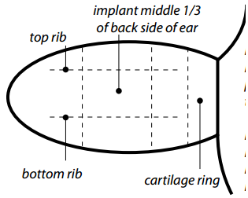
Castration
While castrated animals may not grow as large as intact males, there are many benefits to castration, including:
Safety: intact males are more likely to be aggressive.
Meat Quality: bulls have more muscle and less fat, resulting in meat that is tougher and less flavorful.
Economics: the meat of castrated animals tends to be sold for higher prices (in North America; beef production based on bulls is the norm in most other countries).
Anabolic implants can be used to offset reductions in muscle gain due to castration.
Anabolic implants are pellets that contain steroids and are placed under the skin of the animal (on the backside of the ear).
These implants can result in up to a 30% increase in growth and up to a 10% increase in feed efficiency.
The steroids found in anabolic implants mimic the hormones that would have been produced by the testes of the animal.
The meat of animals treated with anabolic implants has little to no increase in the amount of hormone levels.
Typically implants contain a testosterone-like hormone and estradiol to promote the growth of the animal.
Source: http://www2.ca.uky.edu/agc/pubs/asc/asc25/asc25.pdf

Slide 9
Beta-agonists
Beta-agonists can also be used to improve the growth and efficiency of meat animals.
Beta-agonists stimulate the bodies of cattle and pigs to utilize the feed they consume more for meat production and less for the production of fat.
Often beta-agonists are used in the last few weeks before the animal reaches its market weight due to the decline in the rate at which muscle is produced by the animal’s body.
This allows the animal to produce more meat that is leaner without needing any additional feed.
The beta-agonist compounds break down quickly in the animal’s body and will be excreted before the animal is harvested for meat.
The use of anabolic implants and beta-agonists can result in a more efficient animal that produces more saleable food using fewer resources.
Beta-agonists can increase the average daily gain of cattle by 10-30% and of swine by up to 10%.
Beta-agonists can also reduce the carcass fatness of cattle by up to 30% and of swine by up to 10%.

Slide 10
Dressing Percentages
When an animal is processed for meat, there is a large reduction in weight between the live animal and the packaged cuts of meat.
The slaughter process involves the removal of the animal’s blood, hide (skin), and internal organs.
Dressing percentage refers to the percentage of the live weight that actually becomes the carcass (i.e. carcass weight divided by live weight).
Dressing percentages are not the same for all species and vary among the types of animals (shown below).
The amount of fat, thickness of an animal’s muscling, method of dressing, and how much feed was in an animal’s digestive tract also affect the dressing percentage.
Source: “How Much Meat Will You Take Home?” , Buege & Russell, UW-Madison

Slide 11
Cutting Yields & Losses
The conversion of a carcass to cuts of packaged meat requires the fat to be trimmed and some or all of the bone to be removed.
Cutting yield is the percentage of packaged meat obtained from a carcass.
Cutting yield = Weight of cuts of meat ÷ carcass weight
Cutting loss is the percentage of fat and bone, as well as other kinds of waste that are lost from the carcass as it is processed into retail cuts of meat.
Cutting loss = Weight of fat/bone ÷ carcass weight
Source: “How Much Meat Will You Take Home?” , Buege & Russell, UW-Madison

Slide 12
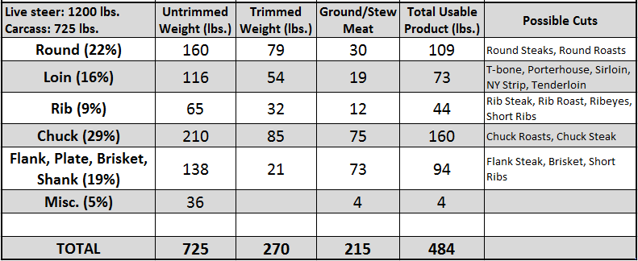
Source: www.certifiedsteakandseafood.com
A steer with a live weight of 1200 lbs. and a carcass weight of 725 lbs. will eventually produce 484 lbs. of saleable meat.
This is 40% of the live weight of the steer.

Slide 13
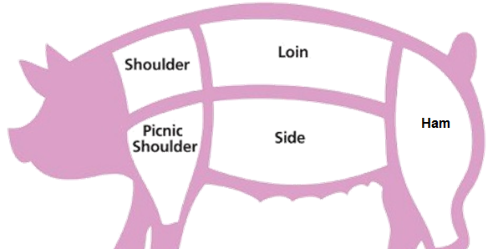
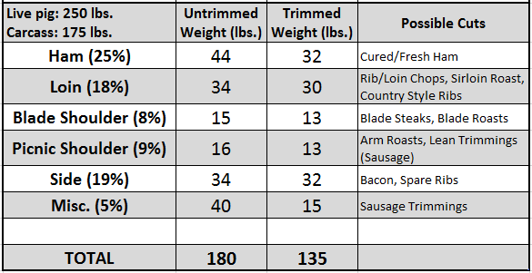
Source: www.idealhomegarden.com
A pig with a live weight of 250 lbs. and a carcass weight of 175 lbs. will eventually produce 135 lbs. of saleable meat.
This is 54% of the live weight of the pig.

Slide 14
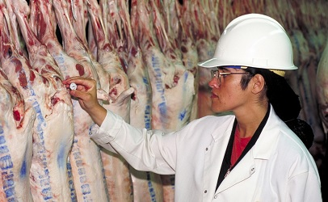
Regulation of the Meat Industry
A History of Reform and Stringent Expectations
Source: www.foodsafetynews.com

Slide 15
Meat Production Regulation
Meat production in the United States is a highly-regulated industry.
This was not always the case; in fact, prior to the 1900s, the meat industry in America was plagued with problems.
For example, an investigation in 1898 indicated that the Armour meat packing company had provided tons of rotten canned beef to US soldiers in the Spanish-American War.
A Senate committee would later find that it was actually common for the five major meat packing companies (called the “Beef Trust” due to their monopolistic practices) to use poisonous substances such as borax and formaldehyde to preserve their meat in that time.
Upton Sinclair’s novel The Jungle would become the most prominent factor in the reform of the meat industry in the early 1900s.
In his 1905 novel, Sinclair vividly described the horrific conditions in Chicago’s meatpacking factories.
While Sinclair’s primary motivation was to expose the atrocious working conditions of the immigrant workforce, most readers were more moved by the descriptions of the unsanitary conditions in which their food was being produced.

Slide 16
Meat Legislation
The Meat Inspection Act and Pure Food and Drug Act were signed into law by President Roosevelt on June 30, 1906.
The Pure Food and Drug Act prevented the sale of adulterated meat and the Meat Inspection Act ensured that livestock were slaughtered and processed under sanitary conditions.
Adulterated meat is any meat that A) contains any poisonous, decomposing, or otherwise unsafe substances, B) has been prepared in unsanitary conditions, C) has valuable component that has been replaced by a lower-value substance, D) has had its inferiority concealed in any way, or E) has had a substance added to make its bulk or weight appear greater than it is.
A key provision of this law mandated that all animals for slaughter are inspected by US Department of Agriculture (USDA) officials both before and after they are processed for human consumption. Key functions of meat inspection include:
Detection of diseased or contaminated meat.
Detection of unsanitary conditions.
Minimization of microbial contamination of meat.
Detection and prevention of adulteration of meat.
Detection and prevention of mislabeling.
Labeling meat as federally inspected.
http://cdn.history.com/sites/2/2016/01/hith-the-jungle-roosevelt-meat-act-AB.jpeg

Slide 17
USDA Inspection
USDA federal inspection requirements do not apply to all meat sold in the United States.
Federal inspection requirements only apply to meat sold across state lines or outside the country. In cases where meat is only sold within the boundaries of a state, state government regulations apply.
However, the Wholesome Meat Act of 1967 stipulated that states must have inspection programs that are equal to or greater than federal standards.
The only exceptions to this are custom slaughterers (such as livestock slaughtered for use on the farm for family and non-paying guests, or game animals slaughtered on behalf of the hunter).
The Humane Slaughter Act of 1958 and the Humane Methods of Slaughter Act of 1978 were passed to ensured the humane treatment of animals used for food.
The Humane Slaughter Act mandated that livestock must be slaughtered in a manner that prevents needless suffering and that all animals used for slaughter must be “rendered insensible to pain” before being cut, shackled, hoisted, etc.
The Humane Methods of Slaughter Act (HMSA) stipulates that an animal may be made unconscious of pain by a single blow, gunshot, electrical, chemical, or any means that is “rapid and effective” as determined by the Secretary of Agriculture.

Slide 18
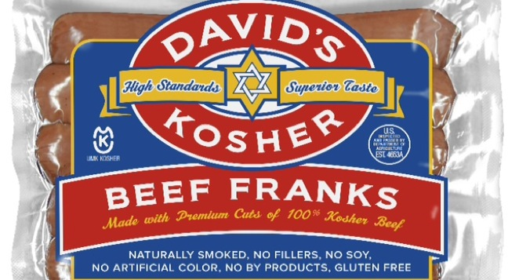
HMSA
HMSA also stipulates that…
Animals must be driven at a normal walking speed to reduce excitement or discomfort.
Animals must have minimal (if any) exposure to tools such as electric prods.
Bans the use of pipes or sharp objects to move animals.
Pens and ramps must provide secure footing, minimize sharp corners, are free from sharp/protruding objects, and must prevent an animal from turning around.
Animals that cannot walk (nonambulatory) must be moved using equipment, or must be stunned and be unconscious before being dragged.
These acts do have exceptions.
HMSA does not apply to animals slaughtered for religious purposes.
HMSA states that slaughter for religious purposes is humane if the animal suffers loss of consciousness due to a severed carotid artery (the artery in the neck) with a sharp instrument.
Source: www.theshelbyreport.com

Slide 19
Facility Inspection
The Food Safety & Inspection Service (FSIS) is the agency within the USDA that ensures that all meat and egg products are safe and are compliant with the Humane Methods of Slaughter Act.
Slaughter facilities are inspected every 12-18 months for humane handling practices by a District Veterinary Medical Specialist (DVMS).
FSIS inspection personnel must be present and inspect each carcass in order for a facility to operate and sell their products across state or national borders.
To receive federal inspection, a facility must receive a Grant of Inspection; this is only granted if a facility has conducted a hazard analysis, has a written standard sanitary operating procedures, developed a Hazard Analysis and Critical Control Point (HACCP) plan, and agreed to all FSIS regulations.
Once a facility obtains a Grant of Inspection, FSIS will conduct a carcass-by-carcass inspection.
If violations are found, the FSIS can issue citations, or even suspend inspections (which means that the product is not federally inspected resulting in a plant shutdown).
Slaughter operations cannot occur if FSIS personnel are not present to inspect each carcass.

Slide 20
Facility Inspection
FSIS inspection is exceptionally thorough and stringent.
Inspection begins before slaughter when live animals arrive. All handling facilities and procedures are checked for compliance with the Humane Methods of Slaughter Act.
All incidents of inhumane handling trigger enforcement actions, up to suspension of inspection (which prevents a facility from operating).
During the antemortem inspection, live animals are viewed for abnormalities and disease.
Animals that show signs of disease or abnormalities are separated; animals that cannot move on their own (non-ambulatory) are euthanized (killed humanely) and are not allowed to be used for food.
Non-ambulatory animals cannot be used for food because of the risk of Bovine Spongiform Encephalopathy (BSE, or Mad Cow Disease), a disease caused by infectious proteins called prions.
For postmortem inspection (after slaughter), FSIS inspectors are stationed at strategic positions throughout the facility.
Only those carcasses with no signs of disease or conditions are allowed to enter the food supply.
All carcasses must be identified and tracked even if they do not enter the food supply.

Slide 21
Facility Inspection
In addition, the FSIS monitors state inspection programs to ensure that they are equivalent to federal standards.
The FSIS also works with other agencies to ensure a safe and wholesome product, including the Food and Drug Administration, the Department of Health and Human Services, and the Environmental Protection Agency.
Meat that has been federally inspected and passed is stamped with a round purple mark.
This mark is made from a food-grade vegetable dye and is not harmful.
The mark is only put on major cuts and may not be visible after trimming in retail cuts.
Meat that has been federally inspected can also be graded.
Unlike inspection, grading is voluntary.
Grading must be requested by and paid for by the facility.
USDA grades are based on uniform federal standards of quality and indicate the comparative value of a particular category of meat.

Slide 22
Meat Grading
Quality grades for beef include:
Prime: the best grade, indicating abundant marbling and is generally sold in restaurants because it is excellent for dry-heat cooking (grilling, etc.).
Choice: high quality but with less marbling and can be cooked with dry heat as long as it is not overcooked.
Select: has less marbling and will not have the juiciness and flavor of the higher grades.
Standard/commercial grade: this is usually sold as ungraded (or ‘store brand’) meat.
Utility/Cutter/Canner grades are used to make processed products such as ground beef.
Source: www.tgfnc.com

Slide 23
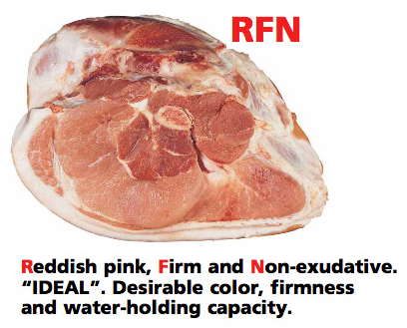
Meat Grading
Source: egashops.directedje.com
Pork is typically not graded by the USDA.
Pigs are sold on the basis of muscle percentage in the carcass.
Tenderness is not an issue in pork to the same extent that it is for beef.
Breeds may be chosen based on their degree of muscling (such as Duroc or Hampshire) or ability to produce highly-marbled meat (such as Berkshire breed).
Poultry is graded as A, B, and C.
Grade A is the highest quality and indicates the cuts are meaty and free from bruises, discoloration, broken bones, tears on the skin, and feathers.
Grades B and C poultry are usually used for cut, chopped, or ground products.
Source: www.slideshare.net

Slide 24
Biological Determinants of Meat Quality
The Molecular Make-up of Muscle and Its Impact on Meat Quality

Slide 25
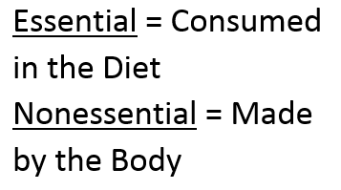
Meat – a complete protein
Meat consists of three kinds of tissue (muscle, fat, and bone), which together create a food source that tends to be high in amino acids, energy, minerals, and other sources of nutrition.
Meat is one of the most complete sources for amino acids (the building blocks of bodily proteins) due to the fact that meat is roughly 20% protein.
Beef can also be an important source of zinc and iron in the human diet.
Meat has both essential and nonessential amino acids.
Essential amino acids cannot be produced by the body, making it essential to consume these every day.
Nonessential amino acids can be synthesized by the body without being directly consumed.
Because it has adequate levels of all essential amino acids, meat is considered a complete protein (dairy products also fit this description).
On the other hand, proteins from plant-based sources are usually considered to be incomplete proteins because they do not contain all of the essential amino acids needed to sustain bodily function.
As a result, plant proteins often need to be consumed in specific combinations in order to acquire all essential amino acids.

Slide 26
Amino Acids & Fat Content
Meat contains higher levels of fat content than many other kinds of food products.
The intramuscular fat that is dispersed within meat muscle (especially red meat) is known as marbling.
Marbling is a major factor that determines the flavor and juiciness of the meat; the greater the marbling, the greater the flavor.
This is largely due to the fact that many of the chemical compounds that impart flavor are hydrophobic (repelled by water), and therefore dissolve in fat.
The amount of fat in meat also affects the moisture content of meat.
As fat content increases, moisture content correspondingly decreases.
Meat with more marbling will be a juicier cut of meat when cooked due to the fact that the fat will melt and lubricate the muscle fibers.
The fat found in a cut of meat also provides a source of the fat soluble vitamins (A,D,E, and K).
The cuts of meat with the highest fat content (such as the chuck of cattle) are used less as whole muscle cuts and more likely as ground beef.
Source: www.tgfnc.com

Slide 27
Maillard Reaction
In addition to marbling, meat also gets much of its flavor from the Maillard Reaction (right).
The Maillard Reaction is the process in which denatured proteins recombine with sugars when heated to 300-500 F.
The Maillard Reaction is also at the basis for many marinades used to cook meat. The acids found in a marinade partially denature the meat’s proteins.
These partially-denatured proteins enable the Maillard Reaction to occur deeper into the meat tissue, where the denatured proteins to combine with sugars to create a more flavorful cut of meat.
Fermentation can also affect the flavor of meat.
For products like sausage, fermentation enables sugars present in meat mixtures to be converted into lactic acid by microbes.
Times and temperatures are carefully controlled to encourage the growth of fermenting bacteria for a time, but thereafter to prevent the growth of harmful bacteria that would cause spoilage.
The fermentation process creates entirely new properties, such as a tangy flavor, a chewy texture, and intense red curing color.
This can also increase the shelf life of the sausage, or the length of time that meat remains usable, fit for consumption, and saleable.
Source: ediblesciencefaire.wordpress.com

Slide 28
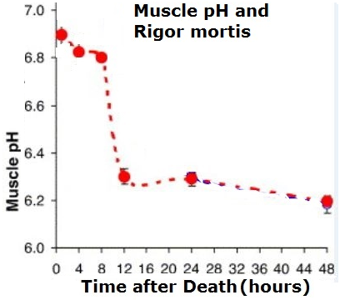
Conversion of Muscle into Meat
Muscle is not the same thing as meat, even though meat comes from muscle.
When an animal is slaughtered and blood circulation has stopped, the oxygen supply in muscle cells will be quickly depleted.
The lack of oxygen will stop the production of ATP through oxidative phosphorylation in the mitochondria of the muscle cells.
The cells will continue to try to produce ATP through anaerobic glycolysis, or the breakdown of sugar without oxygen.
However, instead of sugar, the muscle cells will use a stored version of sugar called glycogen.
Instead of breaking sugars down into CO2 and H2O, the anaerobic muscle cells will break down glycogen into lactic acid.
Because there is no blood flow, the lactic acid will build up, dropping the pH of the muscle tissue from 7.4 to 5.5.
This drop in pH will cause a signal similar to that from a nerve and cause the release of calcium as the pH of the cells becomes more acidic.
The release of calcium will cause muscle length to be fixed, resulting in a condition called rigor mortis, which is the stiffness of muscles that occurs at death.
Source: ulrybio.weebly.co

Slide 29
Tenderness of Meat = Quality of Meat
The pace at which meat is chilled after slaughter will affect the tenderness of the meat (rigor mortis must proceed to completion before freezing occurs).
On the other hand, allowing meat to age in its chilled state will allow these proteins to partially break down, reducing the effects of rigor mortis.
Cooking also causes the denaturation of muscular proteins, reducing the toughness of meat and reducing the amount of chewing needed to digest meat (although excess cooking will cause the meat to lose moisture and become tougher).
Tenderness is one of the main determinants of meat quality. Tenderness is largely determined by…
Age of the animal at the time of harvest (older = less tender).
Proportion of connective tissues (such as collagen) to muscle; the more connective tissue, the less tender the meat.
How stretched the muscle fibers are when rigor mortis sets in (the less stretched the muscle fibers at the time of harvest, the less tender the muscle will be when it becomes meat).
To understand the factors that can cause a cut of meat to be tender or tough, you need to understand the biological components of muscle and how they enable muscle contraction.

Slide 30
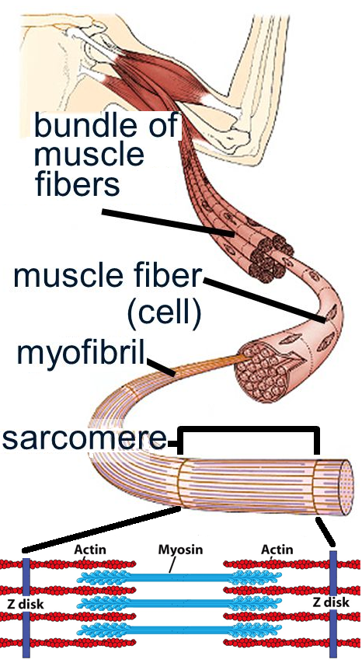
Muscle; Actin & Myosin
Source: http://images.slideplayer.com/1/225629/slides/slide_2.jpg
Muscles are composed of muscle fibers.
These fibers are actually multiple muscle cells that are fused together; they have multiple nuclei as a result.
Each muscle fiber is made from bundles of contractile proteins called myofibrils.
Myofibrils are comprised of smaller units called sarcomeres that consist of overlapping actin and myosin contractile proteins.
Actin and myosin are specialized contractile proteins that work together to convert chemical energy (in the form of ATP) into mechanical energy (the energy of motion).
Actin and myosin are responsible for the movement that occurs during muscle contraction and relaxation.
These proteins also enable non-muscle movement in other cells (such as the movement that occurs in the cell division).
Source: www.bio.miami.edu

Slide 31
Sliding Filament Model
The sarcomere units of actin and myosin can lengthen or shorten, and this is what enables a muscle to contract or relax.
Actin and myosin are able to lengthen or to shorten because they are arranged in parallel lines next to each other in a manner referred to as the Sliding Filament Model.
The actin proteins are anchored to a fixed point called the Z disk (or Z-line).
The myosin proteins are found in between each of the actin proteins.
The myosin proteins have globular heads that can bind and unbind to the actin proteins.
This enables the myosin proteins to “walk” along the actin fibers (in a manner similar to if you pulled your arm along a table by ‘walking’ with your fingers).
A muscle contracts when the myosin heads are ‘walking’ along the actin proteins and a muscle relaxes when the myosin heads unbind and allow the myosin protein to slide down actin away from the Z disk to which the actin is anchored.
Source: www.bio.miami.edu

Slide 32
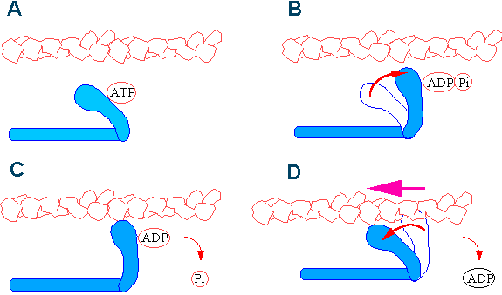
Contraction & ATP
ATP is vital to the contraction of actin and myosin proteins in muscle.
After myosin has bound to actin, ATP is needed to ‘break apart’ myosin from actin.
The binding of ATP to myosin also causes a conformational change to the myosin head that enables the myosin head to ‘walk’ up the actin protein.
Source: http://www.bms.ed.ac.uk/research/others/smaciver/Cycle.gif

Slide 33
Contraction & Calcium
Calcium also plays a major role in the actin-myosin contraction.
Regulatory proteins called troponin and tropomyosin determine when myosin can bind to actin to cause a contraction.
When a skeletal muscle receives a neural signal to contract, calcium is released.
Calcium binds to troponin; this causes tropomyosin to move so that the myosin heads can bind to the actin binding site.
Muscle contraction will continue to occur until the calcium is removed.
Hypocalcemia can cause an animal to be unable to walk due to a lack of calcium and the resulting inability of myosin to bind to actin.
Hypocalcemia (also known as milk fever in dairy cattle) is a condition in which the bodily levels of calcium are too low.
An animal suffering from hypocalcemia will seem like it is drugged and partially paralyzed. An injection of calcium can quickly fix this problem.
Source: www.cscsquestions.com

Slide 34
Ultimate Goals of Meat Production
The ultimate goal of any meat producer is to provide a safe, healthy, humanely-produced product for a reasonably profitable price.
To do so, a producer must understand A) the growth process of meat animals, B) how the muscle of the animal is converted into saleable meat as a result of both the physiology of muscle as well as the chemistry of meat, and C) how the flavor and texture of the meat can be enhanced to best meet the expectations of the customer.
In order to be as valuable as possible to a consumer, a cut of meat must
Be as a tender as possible as a result of A) minimal overlap in contractile proteins at the time of harvest, B) minimal connective tissue, and C) harvesting of animal at the appropriate composition (not lean and not too fat).
Have optimal marbling in order to impart as much flavor and juiciness as possible without excessive caloric content.
Show no signs of spoilage due to harmful bacteria as the result of proper hygiene, refrigeration, and packaging practices.
Be humanely harvested in a manner that reflects humane treatment of animal before and during the time of harvest.
Be sustainably produced so that production practices do not negatively affect the resources involved, consumer or producer’s economic well-being, or the communities on which the producers and consumers depend.
Source: www.dreamstime.com

