Slide 1
Agricultural Genetic Selection
By C. Kohn
Agricultural Sciences
Waterford, WI

Slide 2
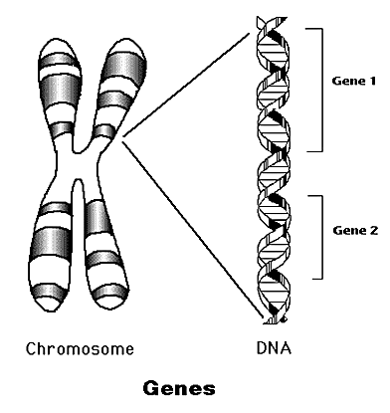
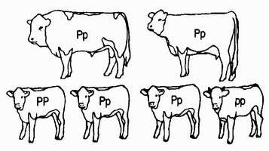
Review
Genes are stretches of DNA that code for specific sequences of amino acids that make the proteins necessary for physical traits.
For example, blue eye color in human beings is due to the presence of lengths of DNA that code for the sequence of amino acids that create the blue pigment in eyes.
The purpose of a gene is to help a cell to make a protein by indicating the order in which to assemble the amino acids needed to make that protein.
Genes can be dominant or recessive.
If one gene for eye color codes for the blue pigment and one gene codes for the brown pigment, then the eyes will be the dominant brown color (even though the individual has genes for both colors).
For some traits, the genes can be co-dominant (both are equally expressed) or incompletely dominant (both traits blend to create a new in-between trait).
Source: www.accessexcellence.org
Horns are recessive in cattle but two hornless heterozygous parents could have a horned calf (25% chance).
Source: www.polledblonde.dk

Slide 3
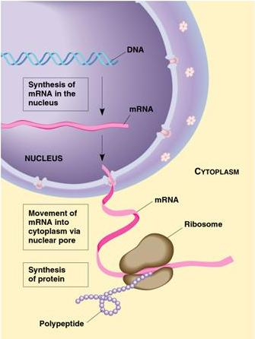
Review
Genes are a part of DNA, which can be packed tightly into packages called chromosomes.
Each chromosome has a portion of all the genes of the body of an organism.
Every plant and animal inherits half of its chromosomes from one parent and half from another parent.
Because every individual has two chromosomes (one from each parent), it also has at least two copies of every gene.
In the case of polygenes, it may have even more genes for a single trait.
For example, skin color in humans is controlled by six genes (three from each parent).
All DNA is kept in the nucleus of each cell.
Every cell’s nucleus contains all the genes found in the body.
Every cell has one copy of the body’s DNA.
To make a protein, DNA must undergo transcription and translation.
Source: hometestingblog.testcountry.com

Slide 4
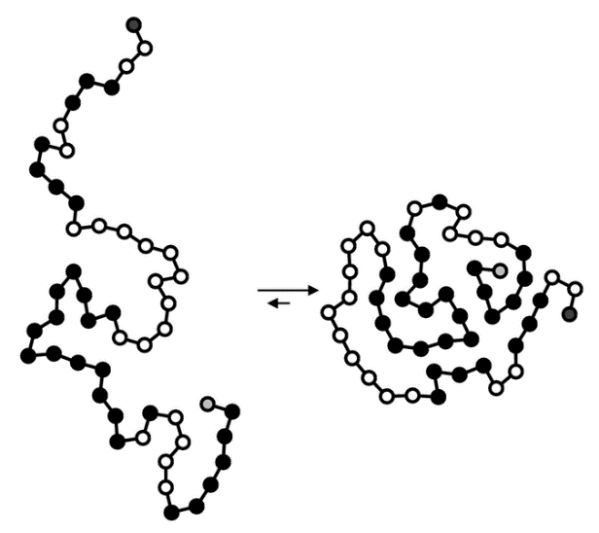
Review
Transcription is when DNA is copied by polymerase, which makes mRNA (the copy).
This is necessary so that DNA can remain in the nucleus and stay protected.
The mRNA copy leaves the nucleus and goes to a ribosome (a protein factory).
The mRNA is read by the ribosome in groups of three called codons.
Each codon has a code for a specific amino acid.
When a codon enters the ribosome, tRNA delivers the appropriate amino acid.
Amino acids are strung together in a specific order to form a protein.
The function of the protein is determined by its shape. The shape of the protein is determined by the order of amino acids and the properties of those amino acids.
Amino acids can have charge, can be hydrophilic or hydrophobic, and can form bonds with other amino acids.
All these properties result in the straight chain of amino acids forming a specific shape which creates a functional protein.
Proteins are what are primarily responsible for the traits seen in an organism.
Source: en.wikipedia.org

Slide 5
Proteins & Agriculture
The more productive the traits of a plant or animal, the more valuable the plant or animal is to an agriculturalist (and to all people in general).
For over 10,000 years, humans have selected the plants and animals that have the most valuable and productive traits, increasing the likelihood that these traits would be passed on to offspring and become more common.
This resulted in major changes to species over time as valuable genes became more common and less valuable genes became less common.
Cattle are a classic example of how domestication can change a species.
All cattle alive today descended from one species called the auroch which is extinct today.
This species was 30% larger than modern cattle and weighed roughly one ton.
These were very aggressive animals that were very difficult to kill (let alone capture).
Unlike modern cattle, males were differently colored than females.
Males were black with a pale stripe down the spine. Females were a reddish color.

Slide 6
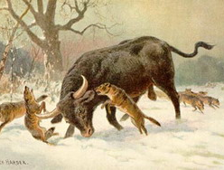
Creation of the Modern Cow
Domestication of the auroch began in 6000 BC.
Early human civilizations were able to identify positive traits (gentleness, high productivity and efficiency, reduced size and aggressiveness) and select captured aurochs for these traits.
Through selection of these positive traits, the auroch species began the dramatic change into the species we know today as the cow.
While modern cows are genetically the same species as the auroch, their physical characteristics and behavior make them far different and nearly unrecognizable from their original ancestors.
As the modern species of cow increased in numbers, it competed with the auroch species for grazing areas, leading to increased hunting and eventual extinction of the non-domesticated ancestor of the cow.
The Aurochs by Heinrich Harder (1858-1935). http://www.petermaas.nl/extinct/ speciesinfo/aurochs.htm

Slide 7
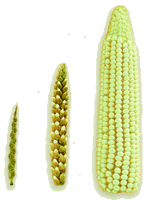
How Domestication Works
Domestication means to selectively breed a plant or animal to change and become more valuable for human needs and purposes.
This is usually done through artificial selection, which is the process in which individuals with beneficial traits are more likely to be bred than those without those traits.
This is different from natural selection, in the fittest individuals with the best traits for survival in their environment are the most likely to reproduce.
Domestication involves changing the genetic makeup of a species by identifying differences among individuals and by breeding the individuals that have the most positive and beneficial differences.
Over time, domestication results in species that are beneficial to humans but also are unable to survive without the constant influence of human care and management.
The improvements in the valuable traits of a species usually result in the loss of other traits that were necessary when the species was undomesticated.
For example, while corn produces 10-100 more kernels than its ancestor, modern corn cannot survive in its environment unless cared for by people.
Source: progressnews.blogspot.com

Slide 8
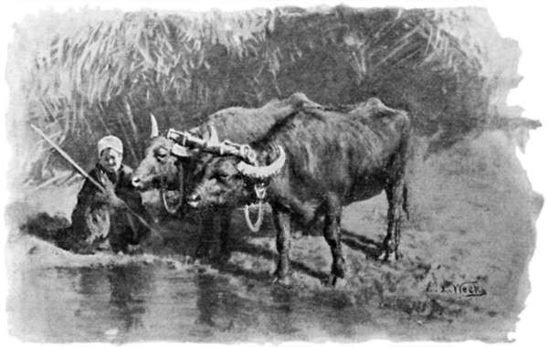
Early Domestication
Early domestication usually occurred in environments that were isolated from other distant places.
Prior to 1900, most agricultural breeding was the result of trial and error, with little understanding of how or why it worked.
Over time, widely different kinds of cattle in an area would become less diverse as some traits were selected more than others.
With little outside interference, the cattle in one village would look more similar to each other and less like cattle from other villages.
As a result of selecting for unique traits suited to specific conditions, specific breeds of cattle began to emerge that were best suited to the conditions in which they were domesticated.
A breed is a specific variety of a species of domesticated animal with similar traits and qualities.
The major breeds of dairy cattle are Holsteins, Jerseys, Brown Swiss, Ayrshire, Guernsey, and Milking Shorthorn.
Source; www.gutenberg.org

Slide 9
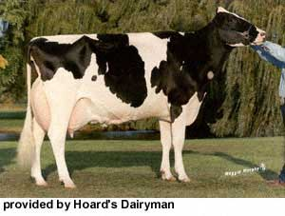
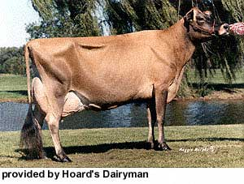
Holsteins & Jerseys
Holsteins are large black and white spotted cows that originated from the Netherlands, where grass was abundant. Holsteins can sometimes be spotted red and white as well.
Holsteins are known for producing the most milk, which is why they are the most common breed of dairy cattle in the US.
Holsteins became outstanding at milk production because they were only bred if they produced large quantities of milk
Jersey cows are small, light brown cows that originated from the islands off of the British coast in the English Channel.
Jerseys were bred to produce the richest milk highest in butterfat and are excellent at grazing.

Slide 10
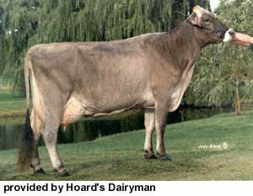
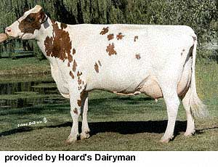
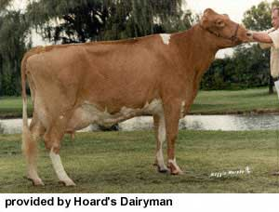
Brown Swiss, Ayrshire, & Guernsey
Brown Swiss cattle are large, rugged, grayish-brown cattle from Switzerland, where they were bred to tolerate the rough, mountainous terrain of the Swiss Alps.
Brown Swiss are hardy cows that can tolerate the severe mountain winters and heavy rainfall common to this area.
Ayrshire cattle are deep-red spotted cattle from Scotland. Guernsey light-red cattle are from islands in the English Channel.
Both are excellent at grazing and can convert low-cost pasture into high-quality milk.

Slide 11
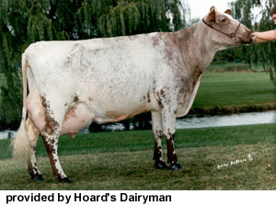
Milking Shorthorns
Milking Shorthorns are one of the oldest breeds of domesticated cattle in the world.
These dark-red cattle originated in England and were bred to be good at producing both meat and milk and could also be used for transportation and labor.
The milking shorthorn was bred to be an ‘everything’ cow that could serve multiple purposes.
As the benefits of selective breeding became better understood, breed associations began to form
Their mission was to support farmers as they developed better, more productive breeds.
They kept track of the performance of different bulls by ‘scoring’ their offspring for different traits.
Organizations such as the National Holstein Association and the American Jersey Cattle Association provided farmers with data on different bulls.
This data allowed individual farmers to select bulls with traits they needed for their herd.

Slide 12
Methods of Genetic Change
Changes in the genetic makeup of species occur both naturally and as the result of human management. There are four ways in which any change to a species can occur.
Mutations are changes to the actual DNA of a species.
Mutations occur when the bases in DNA are lost, when they are substituted for a different base, or when an additional base is randomly added where it didn’t exist before.
Mutations can be positive, negative, or neutral or a species.
Random Drift (or Genetic Drift) is the process in which individuals with one set of genetics are more likely to survive than others simply because of random chance.
Random Drift is completely random – it has nothing to do with the actual likelihood of an individual surviving because of its genetic makeup.
For example, imagine a volcano explodes, killing half of a species on an island.
The population that survives may have more of one trait and less of another than the original population solely because of chance.
Image Source: http://dtc.pima.edu/blc/181

Slide 13
Methods of Genetic Change
Selection is the process that allows one individual to reproduce more than others, resulting in more offspring in the next generation with their traits.
Natural selection causes one individual to reproduce more than others because of the value of its traits in regards to its likelihood of survival.
Artificial selection causes one individual to reproduce more than others because of the value of its traits in regards to the needs of the humans who have domesticated that species.
Crossbreeding (migration) is the process in which individuals from a different population (with different traits) are brought into a new population and bred to those individuals.
The purpose of crossbreeding is to create a generation of individuals with a performance that is greater as a result of their mixed parents than would occur from parents of the same breed.

Slide 14
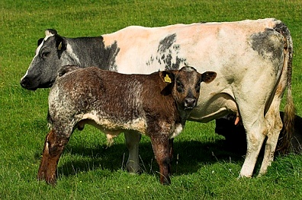
Hybrid Vigor
The increased health, vigor, and reproductive performance that results from crossbred parents is called hybrid vigor.
The first generation from crossbred parents tends to have a higher performance from their parents.
However, the second generation tends to be less productive, making this process less desirable to agriculturalists than pure-breeding (mating only individuals of the same breed).
An agriculturalist cannot control if a mutation happens or if a population changes randomly, but they can control artificial selection and crossbreeding.
This puts added pressure on an agriculturalist to ensure that only the best, most productive matings occur in their animals.
An agriculturalist must be careful to select for the best traits in their animals with each mating.
Source: m.inmagine.com

Slide 15
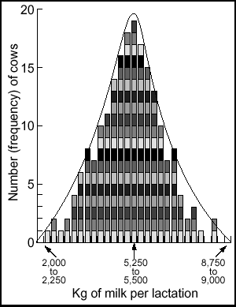
Continuous Traits
Selecting for valuable traits in agriculture becomes more difficult when we deal with a continuous trait.
A continuous trait is one where there are many outcomes possible.
Unlike a discontinuous trait (like eye color) where there are only a small amount of possible outcomes, continuous traits can range widely.
For example, in Holstein cattle, individuals can either be red or black.
This would be a discontinuous trait because there are only two options.
However, milk production is a continuous trait.
In a herd where the annual average milk production is 12,000 lbs., some cows may produce as much as 20,000 lbs of milk whereas others may produce less than 5000 lbs.
We cannot predict the milk production of a cow as easily as we can predict the color of its hair because unlike hair color, milk production is the result of many interacting genes with many possible outcomes.
Source: http://babcock.wisc.edu/node/182

Slide 16
Bell Curves & Histograms
Because continuous traits are widely-variable, the possible outcomes are usually grouped into categories.
A histogram can be used to organize the possible traits that the offspring of an breeding pair can inherit.
A histogram also shows the average for a trait and the likelihood of a desired outcome.
Finally, a histogram shows the bell curve for a trait.
A bell curve is a mathematical concept in which the likelihood of an outcome decreases as you move away from the mean (or average) for a population.
Outliers (extreme values) are less likely to occur than values that are closer to the mean (such as the 2 cows that produced almost 9000 kg of milk on the far right of this histogram).
A histogram showing average milk production (in kg). As production levels move away from the mean (center), they become less prevalent.
Source: http://babcock.wisc.edu/node/182

Slide 17
Heritability
In addition to the fact that many production traits of plants and animals are highly variable (continuous), not all traits are equally affected by genetics.
Heritability is the measure of the amount of variation in a trait specifically due to genetics; it is a measure of how much a trait is affected by genetics and how much the trait is affected by the environment in which the individual exists (known as environmental variance).
For example, the hair color of cattle is almost completely due to genetics; the environment has little to no impact on the color of cattle.
However, milk production is the result of a mixture of genetic and environmental influences.
While we can breed for better-milking cows, we also need to feed them appropriate diets and care for them in order to maximize their milk production.

Slide 18
Heritability
Heritability (or h²) is measured on a scale from 0-1.
Traits with a heritability of 0.1 or less have low heritability, meaning genetics plays almost no role.
Lifespan is an example of a trait with low heritability; most of this trait is determined by how well an animal is cared for.
Traits with a heritability of 0.1-0.3 have moderate heritability, and are slightly influenced by genetic factors.
Milk yield is a trait that has 0.25 heritability, meaning it is mostly affected by the management and care of the cows being milked.
Source: http://babcock.wisc.edu/node/182

Slide 19
Heritability
Traits with a heritability greater than 0.3 have high heritability, and are significantly affected by genetic factors.
In cattle, the quality of the milk (i.e. protein and fat levels) has a heritability of 0.5, meaning that we cannot improve milk quality through management alone; we need to breed for better milk-producing cows.
If we want to improve a trait, we need to determine whether we can best improve it through better breeding or through better management.
While some traits should be selected for even if they have low heritability, a species will improve the fastest if an agriculturalist selects for traits that are highly heritable.
Source: http://babcock.wisc.edu/node/182

Slide 20
Rate of Genetic Change
Agriculturalists want species to improve as quickly as possible. The rate of genetic change is dependent on four factors.
Accuracy: genetic change occurs fastest when we select individuals who are strongest in regards to our desired traits; accurate record keeping is vital in ensuring we have the information needed to improve a species.
The better the records for an animal’s production records, the better the ability of an agriculturalist to improve a species.
Intensity: this is the measure of the quality of animals kept for breeding each year.
The more intense the selection, the more superior the animals that are selected to breed.
Genetic Variation: the less a trait varies, the more likely we are to obtain the trait we desire in the quality at which we want it.
Generation Interval: this refers to the average age of a parent when they reproduce.
The younger the parent at the time of reproduction, the faster the species changes.

Slide 21
Correlation
Selection for one trait may also affect another trait. This is known as correlation, which is related to the concept of pleiotropy.
Pleiotropy is when one gene affected multiple unrelated traits.
For example, milk yield (how much a cow produces) and dairy form (how much a dairy cow actually looks like a dairy cow).
Correlation for traits can either be negative or positive.
Negative correlation means that improving one trait results in a loss of quality in another trait.
For example, as you improve the milk production of a cow, the quality of their milk (such as the amount of protein) tends to decrease.
Positive correlation means that as one trait improves, another trait improves.
Selecting for cows that aren’t “beefy” looking means that you will also improve the average milk production of your cows.

Slide 22
Galton’s Law
It might seem simple to just select the best animals in order to improve a species.
While there is some truth to this, it is also true that the better the individual, the less likely they are to have offspring that are equally productive.
This is known as Galton’s Law.
Galton’s Law means that while we are more likely to have excellent offspring from excellent parents, the better the parents, the less likely the offspring will be as excellent as they are.
While agriculturalists should use the best of their herd (if breeding animals) for mating and reproduction, it is not realistic to expect the best cow in the world to have offspring who are also the best in the world.

Slide 23
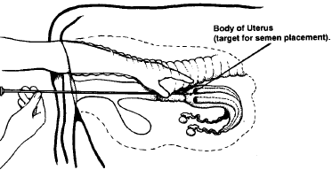
Artificial Insemination
One of the most important reasons why this change has occurred is artificial insemination (AI).
AI is the process in which semen is collected from a bull, packaged into straws, and frozen and shipped to individual farms so that it can be artificially inserted into a cow’s reproductive tract.
This is different from natural insemination (when a bull directly breeds a cow).
AI enables one bull to inseminate thousands of cows, reducing the need for bulls on every farm.
Instead of only having access to bulls in the area, you could improve your herd’s genetics by introducing high quality genetics from across the world.
Source: www.thebeefsite.com

Slide 24
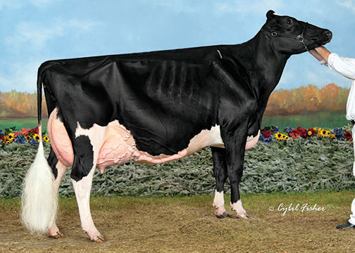
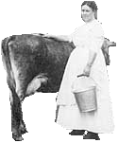
Dairy Cattle & Genetic Change
Dairy cattle are an excellent example of how an understanding of genetics and heritability can create significant changes to species in a relatively short amount of time.
Today the average dairy cow produces over four times as much milk as her ancestors from the early 1900s.
Since 1944, the carbon emissions per gallon of milk produced have shrunk by 63%, with a goal of another 25% reduction by 2020.
These changes have occurred largely because of excellent record keeping and reporting through standardized genetic evaluation.
Shown right is a picture of an adult cow from 1900 in comparison to the much-larger Supreme Champion of the 2013 World Dairy Expo.
Notice the difference in size between the two individuals! This is the power of genetic change in agriculture!
Main Image Source: www.hoards.com
Embedded Image Source: www.wvculture.org

Slide 25
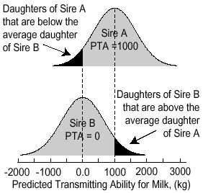
Sire Summaries
Another major tool that has enabled this rapid change is a sire summary.
A sire summary is a report that provides the genetic quality of available bulls for every measured trait.
This information can provide a farmer or breeder with the information they need to select the right bull’s genetics needed to improve the genetic value of their herd.
A sire summary will focus primarily of the Predicted Transmitting Ability (PTA) of each bull’s traits.
Predicted Transmitting Ability is an estimate of how well a bull will transmit improvements to its offspring for milk pounds, fat percent, protein percent, productive life, and other genetic traits.
This information can then be used to determine which bull would be best for mating to a specific cow.
Source; babcock.wisc.edu

Slide 26
PTA’s & STA’s
A PTA score can be expressed as a Standard Transmitting Ability (STA) score.
The STA system maps value of that bull’s traits on a histogram that ranges from -3 to +3 scale, with 0 being average.
These scores are determined by standard deviation from the mean (a mathematical measure of the statistical variability of the data).
An animal with a trait ranked as a +3 would be the best in regards to the trait compared to all other bulls in the breed.
An animal with a -3 would be among the worst animals in the breed for that particular trait.
Most bulls’ traits will fall between -1 and +1.
A bull that scores a +3 on a highly heritable trait could greatly improve the average production of a future herd of cows, and that bull’s genetics would be worth a lot more money as a result.
Images Source: http://www.holsteinusa.com/pdf/print_material/read_sire_%20info.pdf

Slide 27
Dr. Stephen Babcock
A major Wisconsin contribution to genetic advancement of dairy cattle was made by Dr. Stephen Babcock of the University of Wisconsin.
Prior to Babcock’s work, there was no reliable way to test the quality of milk from each cow and from each farm.
This meant that dishonest grocers, dairies, or farmers could dilute their milk with water in order to increase the weight.
It also meant that it was hard to tell if a cow was producing high or low quality milk.
Quality of milk today is mostly determined by the amount of butterfat in the milk.
Babcock’s test not only helped prevent adulteration of milk but provided a basis by which to improve dairy genetics.
It was also the first world-renown scientific achievement at UW-Madison.
This put Wisconsin on the map of the scientific world and spawned a rich tradition of excellence in scientific research.

