Slide 1
Agricultural Genetics
By C. Kohn Agricultural Sciences Waterford, WI

Slide 2
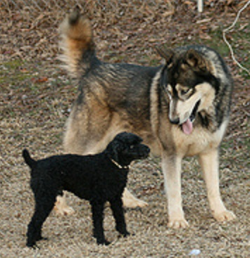
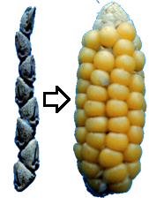
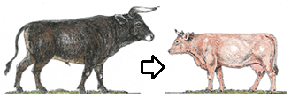
Domestication & Artificial Selection
Artificial selection is the process in which organisms are selected for genetic traits that benefit human needs.
All organisms undergo genetic change at different rates due to random mutations, natural selection, random drift, migration, and artificial selection.
When humans select an organism for beneficial genetic changes to the extent that the organism becomes physiologically different, this is known as domestication.
For example, most domesticated dogs look quite different from their wolf ancestors due to thousands of years of artificial selection. →
Modern stalks of corn look completely different from the teosinte that it originated from before it was domesticated. →
The docile, productive cattle of today were selected from the ferocious and dangerous Auroch. ↘
Even the yeast (Saccharomyces cerevisiae) that is used today to make bread, wine, and beer was artificially selected over thousands of years to provide the benefits that it does today.
Source: retrieverman.net
Source: teosinte.wisc.edu
Source: www.cambridgeblog.org

Slide 3
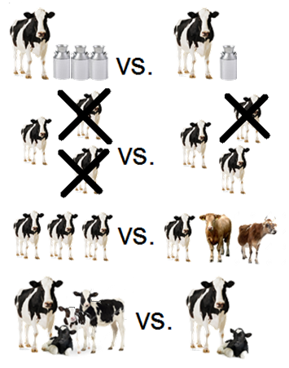
Rate of Genetic Change
The main goal of domestication is to develop the genetic changes in an organism through artificial selection so that the organism’s benefit to humans increases as much as possible at the fastest possible rate.
Four factors affect how quickly and precisely an organism can be changed to benefit human needs through artificial selection. These include:
a. Selection Accuracy: how precisely selected are the organisms that are being mated in regards to their ability to improve the value of what they provide for human needs?
b. Selection Intensity: how many organisms are allowed to breed and how many are prevented from reproducing due to genetic inferiority?
c. Genetic Variation: How much does each individual organism vary in terms of their genotypes and the benefits they provide?
d. Genetic Interval: How quickly are the organisms able to reproduce and have new offspring?

Slide 4
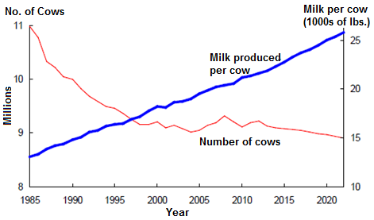
Changes to Dairy Cattle
For example, dairy cattle have changed tremendously over the past century and have become far more productive, efficient, and valuable to human needs.
Between the 1960s and 2000s, the amount of milk produced per cow in America has increased by 7000 lbs. while the greenhouse gas emissions from US dairy cattle have shrunk by 63% since 1944.
This incredible rate of change has been possible because of intense genetic selection by US dairy farmers.
With each passing decade, US dairy farmers have become more accurate in selecting which animals to mate to each other to make sure that the next generation of calves becomes more productive than their parents.
Inferior animals are usually prevented from breeding so that only the best animals can pass on their genes.
The genetic variation among US dairy cattle has decreased as dairy cows continue to genetically improve.
Farmers will breed their cows as soon as they are able to do so.
Source: www.thepoultrysite.com

Slide 5
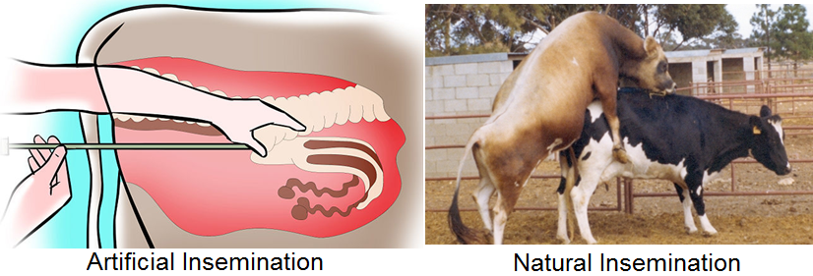
Artificial Insemination
A major factor in this rate of improvement in dairy cattle is the widespread use of artificial insemination in the dairy industry.
Artificial insemination is when a farmer uses specialized equipment to insert the semen of a bull directly into her reproductive tract in order to get the cow pregnant.
This is different from natural insemination, which is when a farmer uses a bull to get a cow pregnant.
Source: ru.wikihow.com
Source: agritech.tnau.ac.i

Slide 6
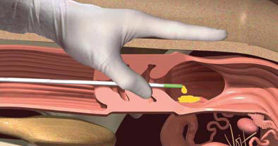
Process of Artificial Insemination
To artificially inseminate a cow, a farmer must purchase the semen of a bull, which is shipped in a sealed plastic straw.
Usually this semen is purchased from a company that chooses and raises bulls based on their genetic value.
The farmer then uses a long, slender rod to insert the semen directly into the cow’s reproductive tract.
Because the farmer does not need to own a bull, they do not have to worry about the cost or danger associated with having a live bull on their farm.
More importantly, a farmer has access to the genetics of thousands of bulls (instead of just a couple on their farm) and can directly control which bull is used to inseminate each cow.
The main advantages of artificial insemination is that it allows a farmer to choose the best bull to mate with each cow in order to maximize the amount of genetic change and the rate of genetic change that occurs in each herd.
Source: www.bairnsley.com

Slide 7
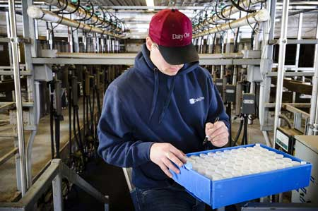
Dairy Data
In order to maximize each farmer’s ability to choose the best bull for each cow, breed associations and dairy herd improvement associations (DHIAs) exist to provide genetic data on cattle.
Breed associations and DHIAs collect enormous amounts of data on the offspring from each bull.
This data is then compiled into a sire summary so that a farmer can know the precise genetic value of each bull for each trait that is measured.
In the United States, about 4 million dairy cows are assessed each year in order to provide this information.
The genetic information of the bulls in a database are reported in a sire summary.
A sire summary can provide a farmer or breeder with the information they need to select the right bull’s genetics needed to improve the genetic value of their herd.
Source: dairyone.com

Slide 8
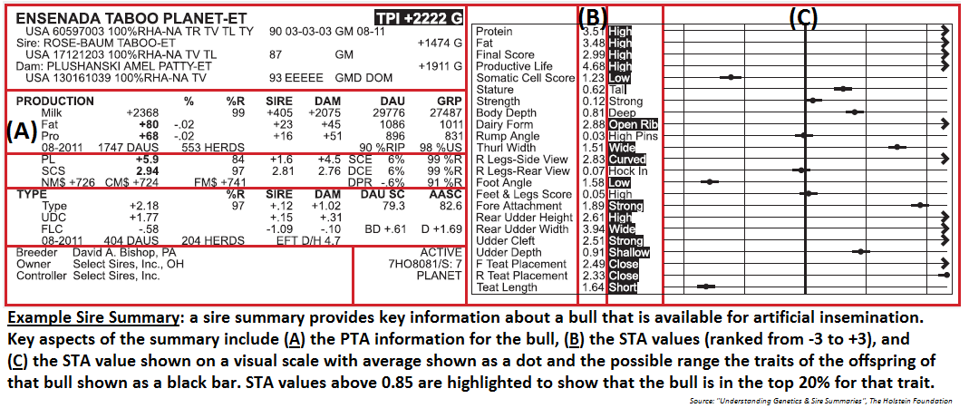
A sire summary provides a farmer with all the information they need in order to determine whether or not a bull would be a good genetic match for a given cow.
By analyzing the data that is provided in sire summaries, a farmer can choose the best bulls to improve the genetic quality of a herd of cows based on the strengths and weaknesses of both the cows and the bulls.

Slide 9
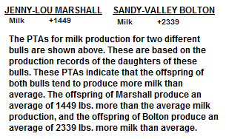
Predicted Transmitting Abilities
The data collected on the offspring of each bull is used to calculate the Predicted Transmitting Ability for the bull for each trait.
Predicted Transmitting Ability (or PTA) is a measurement of how much a bull’s offspring will improve compared to the average for that trait.
For example, if a bull has a PTA value of +1500 lbs. for milk production, this would indicate that the bull’s offspring would produce 1500 lbs. more milk on average than the average milk production of all 4 million cows that were assessed.
On the other hand, if a bull’s offspring had a PTA for milk production of -500 lbs., this would indicate that the bull’s offspring would produce 500 fewer pounds of milk on average.
In dairy cattle, there are PTAs for a wide variety of traits.
In addition to milk production, some of these traits also include how long of a productive life each cow has, how likely they are to have problems when giving birth to a calf, the amount of fat and protein in the milk (more fat and protein = more valuable milk), and even how strong their feet and legs are.

Slide 10
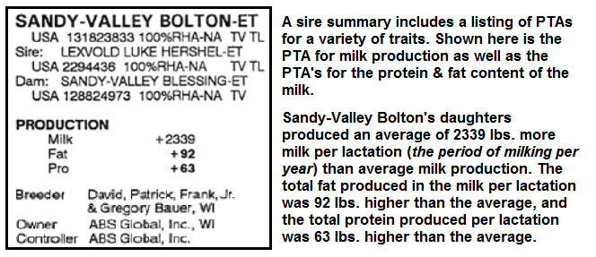
PTA’s and Sire Summaries

Slide 11
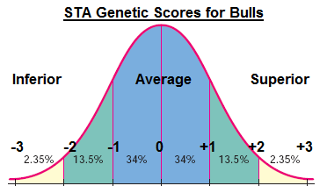
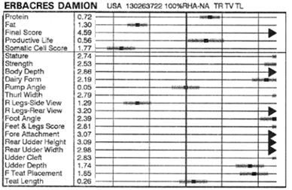
Standard Transmitting Abilities
Because PTAs cover such a wide range of traits, it can be difficult to compare the overall genetic value of different animals.
In order to make it easier to determine the overall genetic value of bull, each PTA can be expressed as a Standard Transmitting Ability, or STA.
An STA reports a bull’s genetic value for a trait in terms of how that bull ranks in comparison to all other bulls.
While the PTA values for milk production would be written in pounds and a PTA for lifespan is written in years, the STA values for these traits would all be reported in terms of how a given bull ranked in comparison to other bulls.
Source: http://www.cri-genetics.de/userfiles/file/PDF/Lernzentrum/Gen_Sire_WKBK.pdf

Slide 12
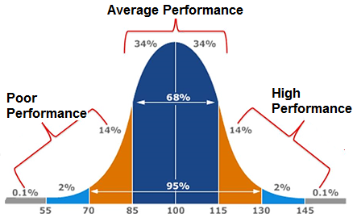
Standard Deviation
To simplify this ranking process for an STA, all the genetic value of these bulls is compared using standard deviation.
Standard deviation is a statistical method used to determine how much the data that has been collected varies.
In a way, standard deviation could also be called “average variance” because it simply measures how much each data point varies in comparison to the mean of the measurements (the mean is the average of the measurements).
Standard deviation can be shown using a bell curve.
A bell curve is visual method of showing the relationship between the range of variations for a specific trait and how common those variations are in a given population (averages are usually much more common than the extremes).
This information can then be used to show what is ‘normal’, what is exceptionally good, and what is exceptionally bad for a given trait.
The individuals that are exceptionally good (or bad) for a trait are called outliers because they have traits that are far outside the normal range.
Source: robert-craven.com

Slide 13
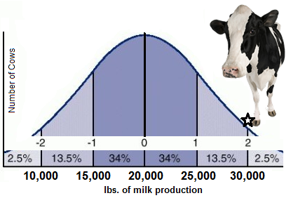
Standard Deviation Example
For example, the average cow in the US produces just over 20,000 lbs. of milk per year.
If the standard deviation value was 5000, this would indicate that, on average, each cow’s production was 5000 lbs. different than the mean value (avg. value).
A cow that produced 30,000 lbs. of milk would then be 2 standard deviations greater than the mean (because she produced 10,000 lbs. more than the average and standard deviation is 5000 lbs.).
If all of a bull’s offspring produced an average of 30,000 lbs. of milk, and if 30,000 is two standard deviation values greater than the mean, then the STA value of this bull for this trait would be +2.
On the other hand, if a different bull’s offspring averaged 5000 lbs. of milk less than the average, then this bull would have an STA value of -1 for that trait (because 5000 is equal to one standard deviation value below the mean).

Slide 14
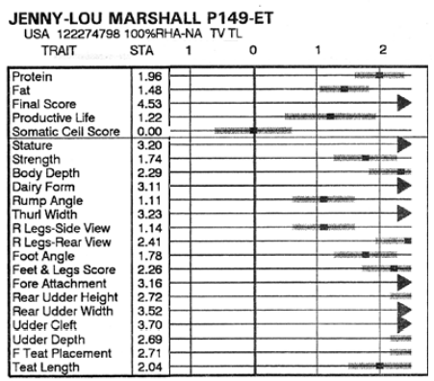
STA Values
While this may sound complicated, the use of STA’s can actually make the comparison of bulls of a lot simpler.
This is because a bull’s scores for all traits are usually on a scale of -3 to +3.
Anything that has an STA score greater than +3 or less than -3 is considered an outlier and is VERY uncommon. (these are shown with a black arrow in the image below).
The more positive STA values that a bull has for each trait, the more genetic value that a given bull has.
The more negative STA values that a bull has, the less genetic value that it has.
If a bull scored a “0” for a certain trait, that particular bull would be completely average for its genetic value for that trait.

Slide 15
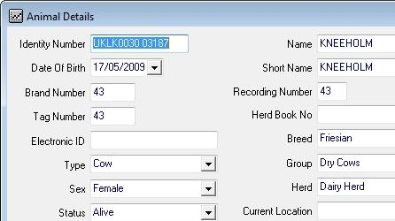
Genetic Evaluation
In order to improve the genetic value of each generation of cows, a farmer has to choose the bulls that score the best for the specific traits that need to be improved in their herd of cows.
This requires the farmer to be skilled in their ability to genetically evaluate their animals, or to determine an animal’s genetic value.
Genetic evaluation can be performed in multiple ways.
One of the easiest methods of genetic evaluation is through record keeping.
Dairy farmers must keep highly-accurate and detailed records of their animals’ performance on their farm.
This includes not just how much milk their cows are producing but also the value of their cows’ milk (based on how much fat and protein is found in the milk), how likely the cow is to have an infection, and many other measurements.
A cow’s likelihood of infection can be determined in part by the cow’s somatic cell count, or SCC, which measures how many white blood cells a cow has in her milk,
Source: www.orchidfarmtech.co.uk

Slide 16
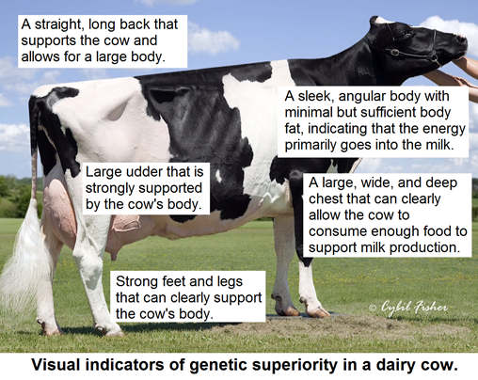
Visual Assessments
A cow can also be genetically evaluated by visually assessing the cow.
A genetically-valuable dairy cow has a large, productive udder that is held high on her body with lots of support.
To support her milk production, she needs to have an ability to consume a large amount of food which is evidenced by a deep, wide chest and long, straight back.
A good dairy cow should also be somewhat thin and angular, because this indicates that the energy she consumes will be used to produce milk and not meat (there are different breeds of cattle that have been bred to produce meat).
A genetically-valuable cow should also have strong feet and legs so that she is able to move to a milking parlor multiple times a day with no difficulty.
Source: holsteinworld.com

Slide 17
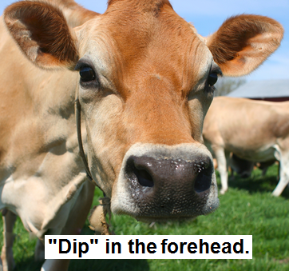
Genetic Correlation
In addition to obvious physical traits such as a large udder and chest and strong feet and legs, a cow can be evaluated for traits that are correlated with high productivity.
Genetic correlation refers to when the presence of one trait indicates an increased or decreased likelihood of the presence of another trait. This is very similar to pleiotropy (when one gene can affect multiple unrelated traits).
For example, farmers have known for many years that cows with a ‘dip’ in their forehead tend to produce more valuable milk and are seen as more genetically valuable because of this.
This would be an example of a positive correlation, or when the presence of one trait indicates an increased likelihood of the presence of another trait.
The dip in the forehead itself does not directly improve the milk production but it does indicate that the cow has a higher likelihood of producing more valuable milk.
Source: prepare-and-protect.net

Slide 18
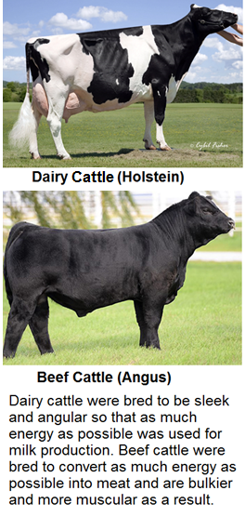
Negative Correlation
On the other hand, a lot of extra loose skin on a cow’s neck has a negative correlation with high milk productivity.
Negative correlation is when the presence of one trait indicates a decreased likelihood of the presence of another trait.
A dairy cow that has a lot of loose skin on her neck is less likely to produce a high volume of quality milk than a cow that has an angular neck with tighter skin.
For this reason, a dairy cow with very little excess skin on her neck has more potential genetic value.
Source: holsteinworld.com
Source: www.harmonyhillcattle.com

Slide 19
Linear Evaluation
A more rigorous visual assessment of a dairy cow’s genetic value that uses a defined measurements is called a linear evaluation.
This is a standardized way to evaluate the genetic value of a cow based on 18 different physical traits that are measured to create a score based on a 50 point scale.
Of this final score…
40% is determined by the physical appearance of the cow’s udder.
25% is determined by the cow’s “dairy strength” (mostly this refers to the size of their chest and the ability of their body to support milk production).
20% is determined by the physical strength of their feet and legs.
The remainder is determined by appearance of the cow’s frame (or skeleton) and it’s ability to support the cow.
Source: www.yourarticlelibrary.com

Slide 20
GEnomics
A cow’s genetic value can also be determined by genomics.
Genomics is the sequencing of some or all of the bases in the DNA of an organism’s genome.
The genome is all of the genetic material present in the cell of an organism.
Genomic testing allows a farmer to more-precisely determine the genetic value of their animals by enabling them to directly read the DNA that codes for the proteins that are responsible for productive traits.
The 25,000 genes that comprise the genome of the cow were sequenced in 2004 (shortly after the Human Genome Project was completed), and now each cow on farm can have its DNA sequenced for as little as $30 an animal.
In 2015, the DNA of over a million dairy cows had been sequenced.
In the US, 94% of bulls used for artificial insemination have had their DNA sequenced.
Source: www.deepgenomics.com

Slide 21
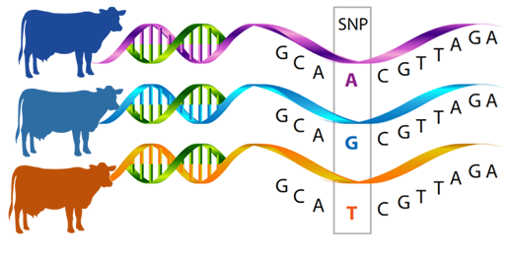
SNPs
A cow’s genome is analyzed by looking for single nucleotide polymorphisms, or SNPs (pronounced “snips”).
A SNP simply refers to the small changes that exist between different genes for the same trait.
Usually a SNP is just a base that was substituted for a different base to create a different protein for the same trait (e.g. a substitution of just one base in the gene for brown eyes can result in a gene that codes for blue eyes instead).
By knowing which SNPs correlate to productive traits, a cow can have its DNA sequenced to determine which particular SNPs it has as a way to determine its overall genetic value.
To perform a genomic assessment of a cow, a farmer needs to submit a hair or blood sample for sequencing.
While some farms may test all of their animals, other may choose to test only their best animals to reduce costs.
Source: biogeniq.ca

Slide 22
Pyrosequencing
Genomics can be very useful for helping a farmer to make informed breeding decisions.
After reviewing a cow’s genomic results and sire summary, a farmer can better determine which particular bull would be the most valuable for mating in a way that is more accurate than can be provided by analyzing just its PTAs.
Genomic information can also assist with the management decisions of a cow.
For example if a genomic test reveals that a cow is likely to have high somatic cell counts (SCC), this would indicate she is more likely to have an infections in her udder and that she should be watched more closely for signs of infection.
Genomic testing might also reveal more effective options for feeding cattle so that they can produce milk or meat more efficiently.
The process of genomic evaluation of cattle is complicated by the fact that most traits in dairy cattle are polygenetic.
Polygenetic means that a trait is controlled by more than one gene.
This means that while a farmer could choose to only have a few thousand SNPs analyzed, more-accurate information will be obtained by using more-expensive tests that analyze 50,000 SNPs or more.

Slide 23
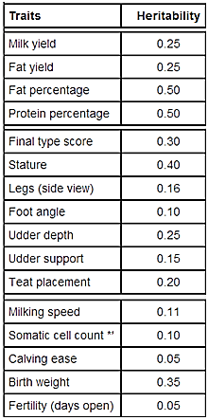
Heritability
Genetic evaluation of cattle is also complicated by the fact that not all traits are completely genetically-based.
Some traits can be partially or entirely affected by the environment of a cow.
For example, the lifespan of a cow is more affected by how well she is cared for by a farmer than by the genes of that cow.
On the other hand, the color of a cow is almost entirely affected by her genes; how the cow is managed is unlikely to change the color of a cow’s hair.
Heritability is the measurement of how much a trait is affected by genetics.
Heritability is measured on a scale of 1.0 to 0.
Source: http://babcock.wisc.edu/node/182

Slide 24
Heritability
A heritability score of 1.0 would mean that a trait is 100% affected by genes, and that the environment of the cow plays no role in how that trait is expressed.
On the other hand, a trait with a heritability score of 0.0 would mean that genes play absolutely no role in that trait and that it is entirely affected by how well the cow is managed.
Heritability values allow a farmer to determine which traits can be changed by genetics and which can be changed by better management practices.
If a farmer needs to improve a highly-heritable trait (one with a score of 0.3 or higher), they would be most likely to be successful if they used bulls that had a very strong PTA/STA/genomic testing result for that trait.
However, for traits with very low heritability (0.1 or less), a farmer is more likely to be successful by focusing on better management of their cattle than better genetics.
Source: http://babcock.wisc.edu/node/182

