Slide 1
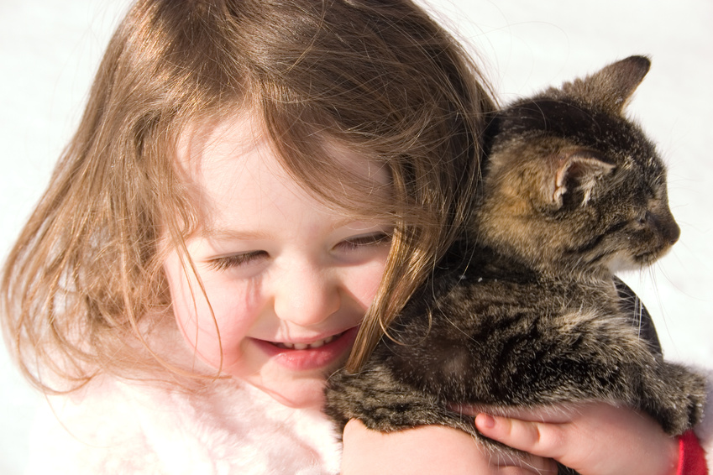
Animal Handling & Care
By C. Kohn
Agricultural Sciences
Waterford, WI

Slide 2
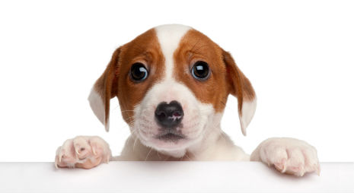
General concepts in animal handling
Always minimize the stress of the animal being treated.
All animals, including properly trained dogs and cats, have an instinct bite, kick, claw, or scratch when stressed, injured, or in trauma.
A hurt or scared animal is a potentially dangerous animal, both to itself, to humans, and to other animals.
First and foremost, do everything possible to calm an animal who has been in an accident or is in a strange or new place (such as a veterinary clinic).
Source: thesanfranciscodogwalker.com

Slide 3
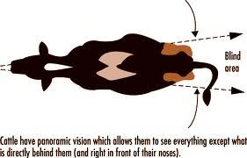
General concepts in animal handling
The stress of an animal can be lowered by
Using a calm, soothing voice continuously and at all times when handling an animal.
Always stay in the field of vision of an animal.
Never go into its blind spot of an animal, or the area it cannot see without shifting its head.
This would be behind the animal outside of its peripheral vision.
Never surprise an animal by coming up from behind – this can be a quick way to get bit/scratched/kicked.
Source: www.extension.org

Slide 4
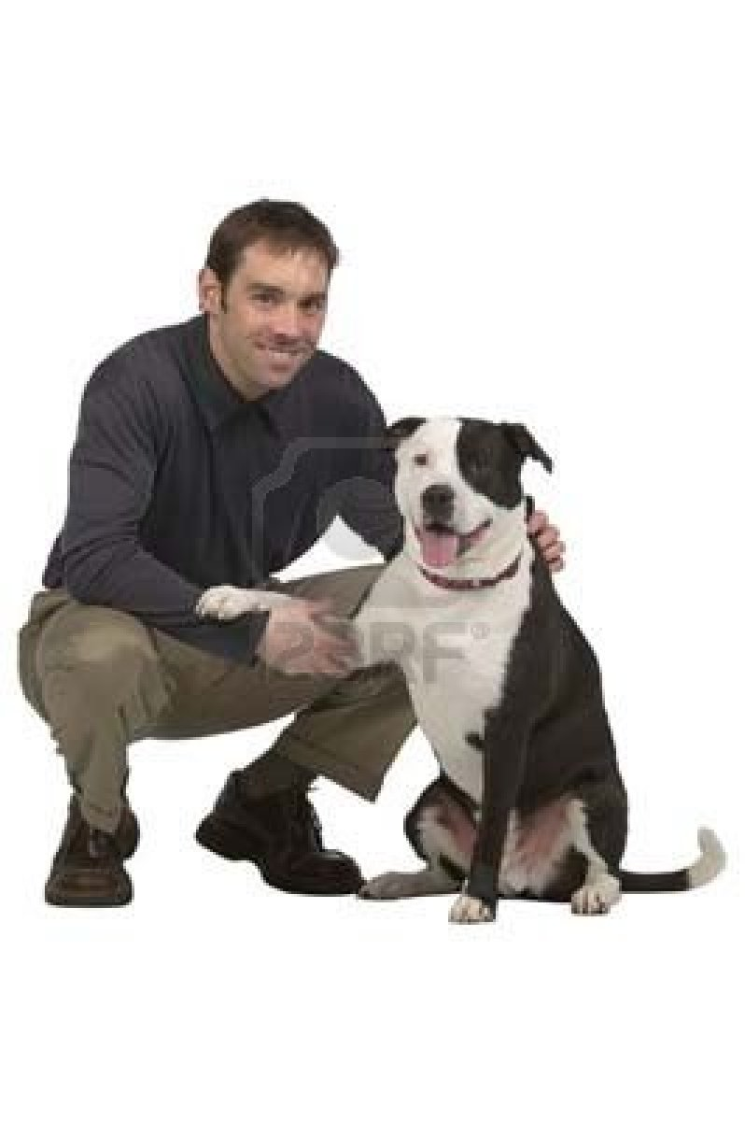
General concepts in animal handling
Before touching or handling an animal, get its attention.
Call the pet by its name and if possible, try to get the animal to come to you.
You can also pat your leg or the ground near you to encourage it to come to you.
Crouch down and try to get at their level.
However, never sit on the ground in case the situation becomes dangerous and you need to escape quickly.
Extend your hand with the palm down and fingers curled slightly inward (to reduce nipping)
Allow the animal to sniff and examine your hand until you sense it is comfortable with your presence.
Source: www.spiderpic.com

Slide 5
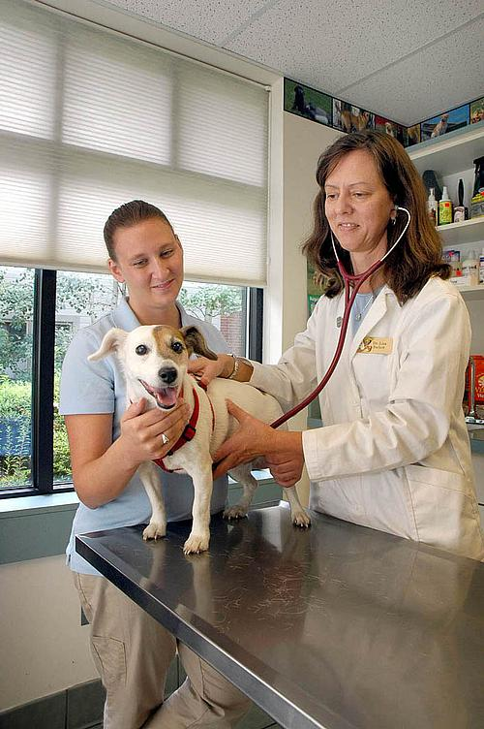
General concepts in animal handling
Small animals (cats, small dogs) should be examined on a table. Large animals should be examined on the floor (dogs) or standing (livestock).
Cats and small dogs should be examined on a table to reduce the likelihood of crushing them and to allow for a closer and more accurate examination.
Large dogs should be examined on the floor – the fall from an examination table could seriously injure the dog. If a large dog must be examined or treated on a table, they need to be properly restrained by another individual.
Livestock and horses should be securely tied using a halter. A chute or stall may also be necessary depending on the temperament of the animal.
Source: www.obeo.com

Slide 6
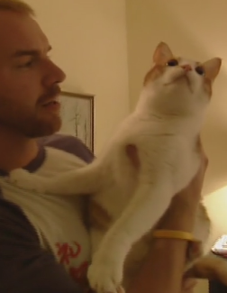
Getting an animal out of a cage or carrier.
Many animals are happy to leave a cage and will do so on their own. However, these animals may pose a risk for running or falling.
To remove these animals, place one hand in front of the animal’s chest and the other behind the rear legs or abdomen to lift them out of the cage.
A cat can also be removed by grasping its scruff; the majority of the cat’s weight should be supported by the other hand holding the cats rear.
Source: www.picstopin.com

Slide 7
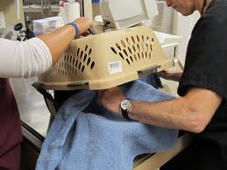
Getting an animal out of a cage or carrier.
Animals that are frightened and that refuse to leave a cage are at greater risk of injury to you or itself.
One option is to put a towel over the head of the animal.
Grasp the scruff of the animal through the towel and lift the rear end to “scoop” them out.
A heavy pair of work gloves can be valuable for an animal that is likely to bite or scratch.
An animal can also be gently “wrapped” in a net or heavy cloth.
Source: halowconsulting.blogspot.com

Slide 8
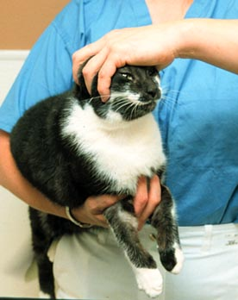
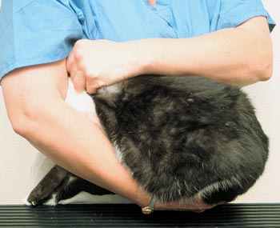
Carrying a Small Dog or Cat
Many owners opt to carry their animal like a baby.
While many animals can be successfully carried this way under normal circumstances, they are also more likely to escape and jump or fall from the carrier’s arms if scared, stressed, or startled.
A more secure way to carry a small animal is to cradle the animal’s rear quarters in your arm while gripping the front legs with the same arm’s hand.
Use the other hand to either a) pet and soothe the animal, or b) grab the scruff of the animal if it tries to jump.
An animal may also try to hide its head if scared.
If this is the case, it can be effective to allow the animal to hide its head in the crook of your arm (or armpit) while grasping the hindquarters with the hand of the same arm and grasp the scruff with the free hand.
Source: www.vetmed.wsu.edu

Slide 9
Restraint
Physical restraint is necessary when an animal is at risk of reacting out of instinct due to stress or injury or general lack of a good temperament.
Restraint provides the following benefits:
Reduces the likelihood of injury to the animal itself, other animals, or other people.
Allows a professional or owner to more accurately examine and treat the animal.
Prevents possible additional injury (such as worsening a broken limb or falling from an examination table).
Reduces the stress of the animal being examined or treated – animal restraint techniques mimic how the animal would have been restrained as a baby (e.g. a cat can be restrained by holding its scruff, which is how it would have been moved by its mother as a kitten).

Slide 10
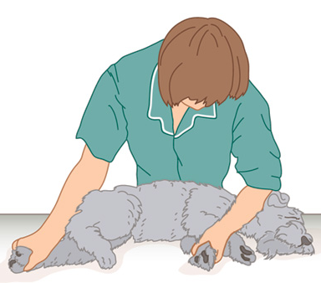
Restraint
The first rule of restraint is to use as little as possible while maintaining control.
The least amount of restraint needed is the best amount (more is not better in this case).
However – do not give up control! Ensure that you are in complete control of the animal at all times.
Once an animal knows it can take control, it is putting itself and others in danger during a treatment or examination.
Animals will sense hesitation and uncertainty – psychological assurance is as necessary as physical control.
Source: www.livingart.org.uk

Slide 11
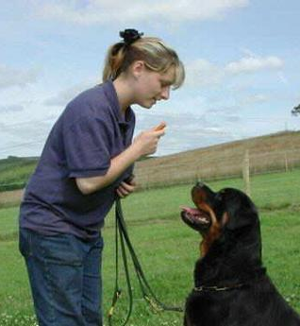
Restraint
Begin with psychological verbal restraint – if possible, use vocal commands to enable an animal to restraint itself.
This is especially true for well-trained dogs.
Commands such as “sit” or “stay” may be enough to allow for a proper examination.
Always use a calm, soothing, cheerful voice.
Never, ever yell – this will increase the likelihood that an animal will cause an injury.
Source: www.petcaregt.com

Slide 12
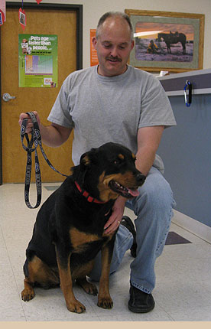
Restraint
If verbal restraint is not a possible option, use a leash or halter if possible.
Animals not restrained by another person or in a transporter should be on a leash during an examination.
Serious injury can result from an animal that runs loose.
Leashes work best for animals accustomed and trained on a leash.
A quick, gentle tug may encourage a hesitant dog to walk.
If an animal starts to struggle, pull, or jerk away when put on the leash, pause and allow the animal to calm down.
Source: elizabethanimalhospital.com

Slide 13
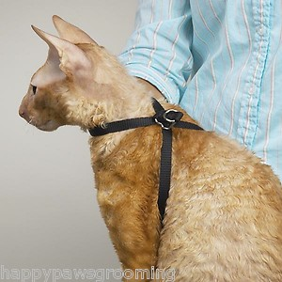
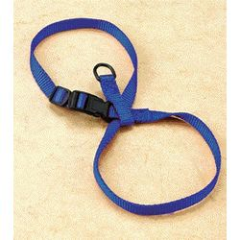
Restraint
Cats can also be restrained by a leash in the event that the animal resists other forms of restraint.
Using a metal ring, form a figure-8 loop with the leash.
The looser loop should be placed behind the cat’s front legs around its chest.
The other loop should go around the animal’s neck.
This may also be used as a preventative measure in case the animal might try to escape.
Source: www.wayfair.com

Slide 14
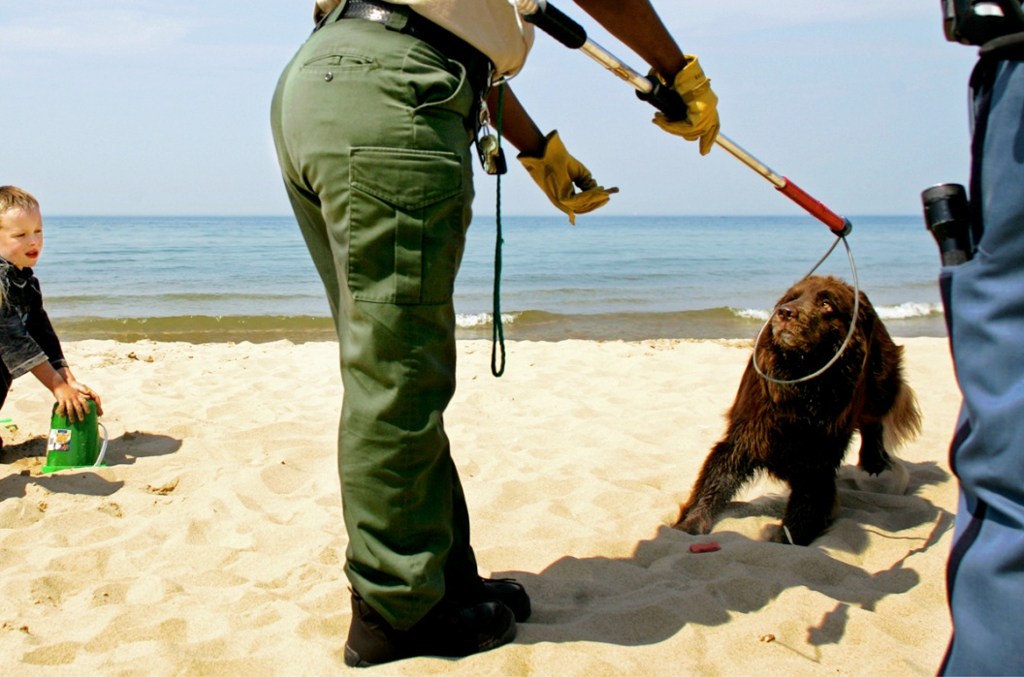
Restraint
Physical restraint is necessary if a halter or leash is not enough to restrain the animal.
Specific restraint procedures are described in the following slides.
If physical restraint techniques are not effective, additional equipment and/or chemical restraint may be necessary.
A come-along pole is required for extremely aggressive dogs.
Only professionals with trained experience should use this tool as it can cause serious injury to the animal.
Nets are often necessary for wildlife and feral cats.
Nets can also cause serious injury to an animal if used improperly and should only be used by trained professionals.
Source: www.anthonysouffle.com

Slide 15
Chemical Restraint
Anesthesia or a sedative (chemical restraint) may be necessary for proper treatment.
Only a veterinary professional can decide whether or not to anesthetize or sedate an animal for treatment.
Both require careful examination of the animal throughout treatment and after the examination has been completed.
Source: www.zimbio.com

Slide 16
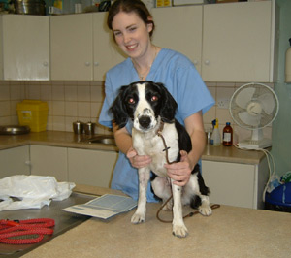
Restraint of Dogs
Types of Restraint of Dogs
Reclining Restraint (or lateral recumbency)
Hugging Restraint
Kneeling Restraint
Sternal Recumbency
Sitting Restraint
Standing Restraint
Source: www.hundarutanhem.se

Slide 17
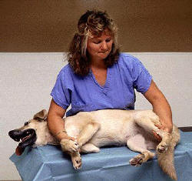
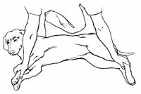
Reclining Restraint
Place your pet on his side, with the injured area facing up.
With one hand, grasp the ankle of the foreleg that’s against the ground while gently pressing your forearm across his shoulders.
With the other hand, grasp the ankle of the hind leg that’s against the ground while pressing that forearm across the hips.
This technique works best for medium-large dogs.
Source: animal.discovery.com
Source: www.vetmed.wsu.edu

Slide 18
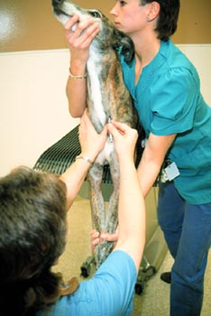
Hugging Restraint
Bring one arm underneath and around your dog’s neck to hug him to your chest.
With the other arm, reach under and around his chest and pull him closer against you.
The dog’s head should be directed away from the restrainer and other people who may be treating or examining the animal.
This technique works best for dogs over 20 lbs. and is most useful when trying to immobilize the abdomen, chest, legs, and back.
Source: www.vetmed.wsu.edu

Slide 19
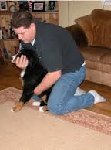
Kneeling Restraint
This restraint works especially well for animals with prominent eyes.
The eyes of some dogs (such as a Chihuahua or Boston terrier) can actually pop out the socket if they experience too much pressure on their head or neck.
To perform, put your dog on the floor between your knees facing away from you as you kneel around it.
Put one hand under the dog’s stomach.
Place the other around or beneath the jaws to steady the head.
Source: www.puppymanners.com

Slide 20
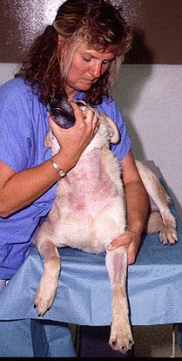
Sternal Recumbency
When a dog is placed on its chest (or sternum), minimal force is needed to restrain the animal, reducing the stress caused by restraint.
Sometimes all that is needed is to securely hold the animal’s head.
To perform this restraint, have the dog lay on its chest on an exam table.
Hold the body of the dog close to your own body.
Hold the muzzle of the animal away from your body and face.
Reach around the back of the animal and grasp their opposite leg. Hold this leg at the elbow.
Source: www.vetmed.wsu.edu

Slide 21
Sitting Restraint
Place one arm under the dog’s neck so that the forearm holds the dog’s head securely against the restrainer's body.
The muzzle should face away from your face.
Place the other arm around the hindquarters.
This will prevent the dog from standing or lying down during the procedure.
Pulling the dog close to the chest allows more control if the animal attempts to move.
Source: www.ruralareavet.org
Source: www.ruralareavet.org

Slide 22
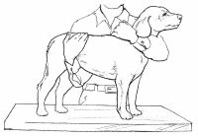
Standing Restraint
Place one arm under the dog’s neck so that the forearm holds the dog’s head securely.
The head should be positioned so that it is impossible for the dog to bite either the holder or the person performing the procedure.
Place the other arm under the abdomen to prevent the dog from sitting or lying down during the procedure.
Pulling the dog close to your body allows more control if the animal attempts to move.
Source: www.ruralareavet.org
Source: animal.discovery.com

Slide 23
Restraint of Cats
Types of Restraint
Stretch Restraint
Restraint bag
Hugging Restraint
Towel Wrap (i.e. Kitty Burrito)

Slide 24
Stretch Restraint
With cats and small dogs, grasp your pet by the loose skin at the back of the neck (scruff) with one hand.
Gently grasp both hind feet with the other hand.
Gently stretch out your pet and hold it against a tabletop.

Slide 25
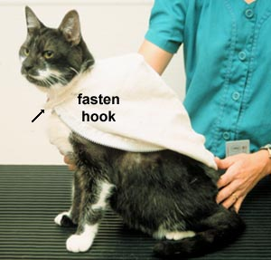
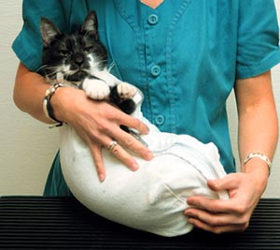
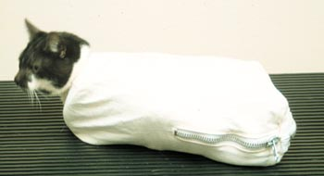
Restraint Bag
A restraint bag made of nylon or canvas can be used to restrain cats.
These bags have hooks, velcro, or other fasteners to contain the cat.
A heavy towel can also be used in lieu of a bag.
To use a restraint bag, drape the opened bag across the cat’s back and fasten around the neck.
Gently flip the cat onto its back and close the bag around the animal’s legs.
Be careful not to catch the fur of the animal in the zipper or fasteners.
If this does not work, you can use the stretch restraint on top of the bag or a towel and close/wrap the bag or towel around the animal.
Source: www.vetmed.wsu.edu

Slide 26
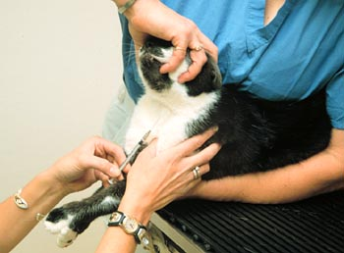
Hugging Restraint
This restraint for cat’s is similar to how a hugging restraint is performed on a dog.
One hand should gently pull the front feet away from the head, and the head should be gently restrained away from the feet.
However, in this case the fingers of the person performing the restraint are placed on the zygomatic arches of the cat and not under the jaw.
The zygomatic arches are on outside of the cat’s eyes near where the jaw meets the skull.
This restraint works best if the cat is also restrained by the arm and body of the person performing the restraint.
Source: www.vetmed.wsu.edu

Slide 27
Towel Wrap (Kitty Burrito)
A towel can also be used if you do not have a restraint bag.
To perform a towel wrap, perform the stretch restraint on top of a towel.
Drape the towel over the cat and quickly (but gently) roll the cat again.
Be careful not to wrap the cat too tightly – the wrap should be tight enough to restrain the cat but loose enough to allow it to breathe easily.
Source: www.vetmed.wsu.edu

Slide 28
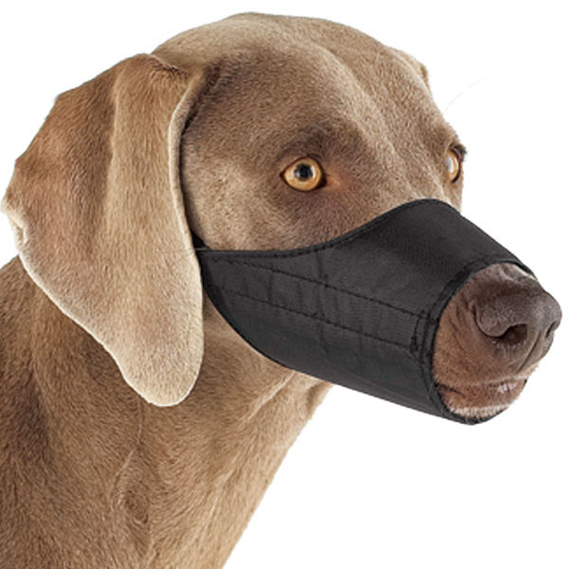
Muzzling
Any pet will bite as a reflex when hurt.
A muzzle is absolutely necessary when examining a stressed or injured animal.
Never leave a muzzled animal unattended.
A muzzle makes it difficult for a dog to pant and lead to overheating.
Dogs can also get toenails caught in their muzzle if they attempt to pull it off.
While commercial muzzles are available, a home-made muzzle can be nearly or equally as effective.
Source: dogstuff4u.com

Slide 29
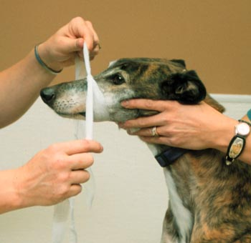
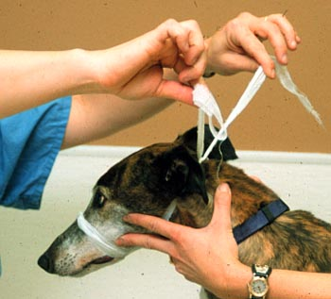
Making a Muzzle
To make a homemade muzzle, you can use any piece of narrow, long material
This could include a necktie, a length of gauze, a panty hose, or a leash
Loop the material around your pet’s jaw and tie it in a single knot (half-hitch) on top of his nose.
Then bring both ends of the tie back down under his jaw and tie another single knot.
Finally, pull the ends behind the base of his neck and tie them in a bow or knot.
Source: www.vetmed.wsu.edu

Slide 30
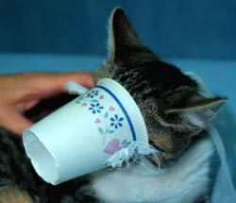
Muzzling Short-nosed Animals
Cats and short-nosed dogs (like pugs) are a concern are a challenge because they do not have enough of a nose to tie shut.
In this case, one of the best muzzles is a pillowcase.
To make a pillow-case muzzle, fit a cloth bag over the pet’s head and gently hold it around the neck.
The fabric will obstruct the animal’s teeth and reduce the risk of biting.
A paper cup with a ribbon can also work as an effective muzzle.
Source: www.vetmed.wsu.edu

Slide 31
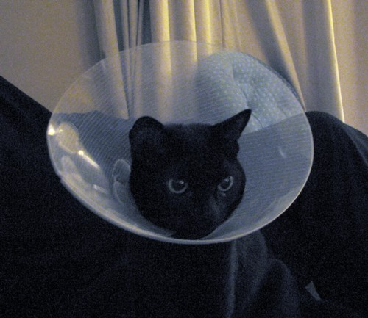
Elizabethan Collars
Elizabethan Collars (or E-collars) prevent dogs and cats from reaching injuries with their teeth.
They also protect facial sores from pawing or scratching.
You can get them at pet-supply stores, catalogs, or from a vet. They can also be home-made.
To make an E-collar, measure the distance from the pet’s nose to their collar.
This is long enough to prevent biting but short enough to allow them to eat and drink.
Also measure the circumference of the pet’s neck (with a little extra to prevent the collar from being too tight).
Multiply this value by 1.3 to determine the size of the inner circle.
Using stiff cardboard or plastic, draw a circle with the circumference of the neck x 1.3. Draw another co-centric circle around the first circle; it should be the distance from the nose to collar away from the first circle.
Cut as shown to the right so that the inside circle matches the size of the pet’s neck.
Secure by tying the cut ends together with yarn or string.

