Slide 1
Bacteriology (and Virology)
By C. Kohn, Waterford, WI

Slide 2
Disease or Symptom?
Typically what we think of as a disease is actually a symptom…
For example, when we think of the common cold, we think of a stuffed up nose, cough, fever, etc.
The thing that actually caused the disease is the organism that infected your body (in the case of the common cold, a virus).
A disease is anything that causes an organism to have abnormal changes to its body.
An infectious disease is most often caused by viruses or bacteria.

Slide 3
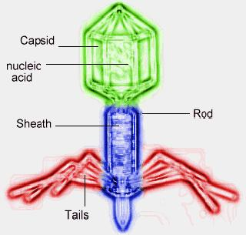
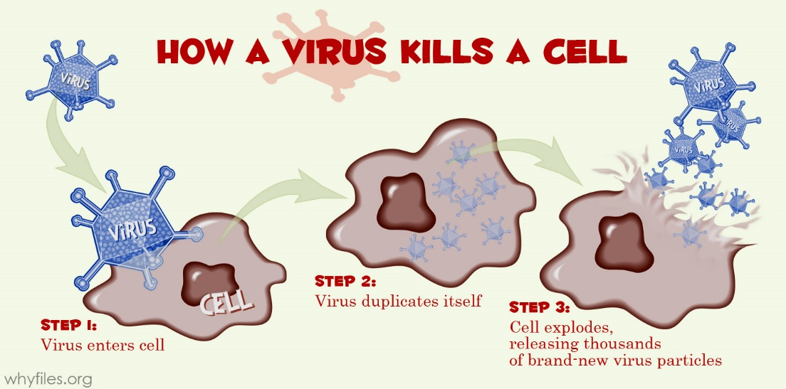
Viruses
Viruses and bacteria are not the same thing.
Viruses are microscopic, non-living crystalline structures that enclose a segment of RNA
Viruses cannot reproduce on their own; they also do not metabolize food for energy.
This is why they are not classified as “living”.
To reproduce, a virus must inject its genetic material into a host cell
This genetic material takes over the cell and forces it to make more viruses instead of the normal cellular proteins.
The cell produces more and more viruses until it literally explodes under the pressure of all the viral particles.
The viruses each go out to infect another cell and replicate the process
Source: http://whyfiles.org/wp-content/uploads/2012/09/diagram_virus_vs_cell.jpg

Slide 4
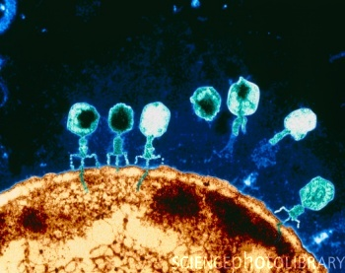
T-bacteriophages on E.coli.
Shown here is a Colored Transmission Electron Micrograph (TEM) of T-bacteriophage viruses attacking a bacterial cell of E. coli.
Four of viruses are "sitting" on the brown bacterial cell and small blue "tails" of genetic material (DNA) are seen being injected into the bacterium.
The virus attaches itself to the cell's wall and, using it's tail as a syringe, injects it's own DNA into the bacterium.
The virus DNA then takes over the bacterial cell, forcing it to produce more viruses.

Slide 5
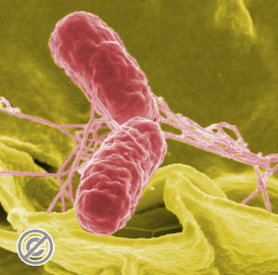
Bacteria, an Overview
Bacteria are…
Single-celled and…
Prokaryotic: they have no nucleus for their genetic material
Prokaryotic (bacterial cells): these are single-celled organisms with no nucleus and no organelles.
Eukaryotic (the cells of plants, animals, etc.): these cells have double-stranded DNA inside a nucleus and have other cellular organelles such as mitochondria.
Bacterial DNA usually is just a single circle of double-stranded DNA.
Bacterial DNA exists in circles of chromosomes rather than the X’s we are more familiar with in plants and animals.

Slide 6
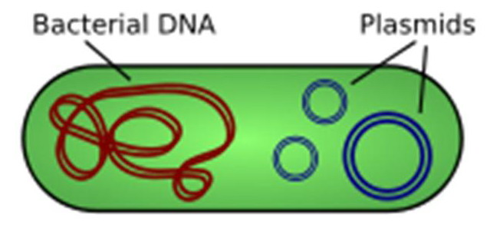
Bacteria
In addition to circular chromosomes, bacterial DNA is also can be found in the form of plasmids.
A plasmid is a smaller circle of DNA adjacent to the circular chromosome.
Genes for antibiotic resistance are often found in these plasmids.
The susceptibility of a bacterial cell to antibiotics is mostly determined by their cellular membrane.
Because bacteria are colorless and mostly invisible under a microscope, we need to stain the bacterial cells to see them.
Source: bacteriasactuaciencia.blogspot.com

Slide 7
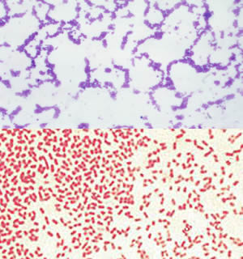
Bacterial Cellular Membranes
The most-used stain is called a Gram stain.
Two kinds of stains are used, one bluish-violet and one red
Bacterial cells that absorb the violet stain will appear blue; those that do not appear red.
1. Gram-stain Blue, or Gram-positive (retains the stain)
I’m ‘positive’ it was stained.
2. Gram-stain Red, or Gram-negative (does not retain the stain).
It tested ‘negative’ for a stain.
Source: kathrynsarajane.pbworks.com

Slide 8
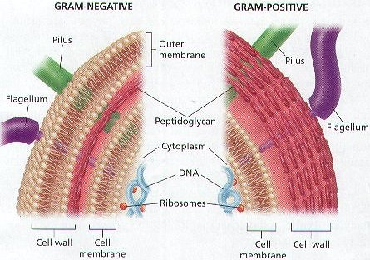
So what?
The differences in stains are the results of differences in the cell walls of the treated bacteria.
Both gram-positive and gram-negative bacterial cells have multiple cellular membranes to protect them from their microscopic environment
However, gram-negative cells have an extra layer.
Gram-negative bacteria have a “shield” – an outer membrane that serves as a ‘third’ layer.
This ‘outer layer’ blocks the entry of substances such as violet dyes, detergents, and antibiotics.
Antibiotics and chemicals that attack these cells are unable to make it past this layer.
Source: americanaquariumproducts.com

Slide 9
Source: http://www.ppdictionary.com/bacteria/gpbac/bacteria_comparison.jpg

Slide 10
Gram Negative – The Batmobile of Bacteria
In the 1990’s Batmobile, there were bullet-proof shields that protected the vehicle from attack.
Like the Batmobile’s shields repelled bullets, Gram (-) outer layers repel chemical attacks, particularly antibiotics.
While a Gram Negative bacterial cell has 3 membranes to protect it, Gram Positive bacteria only have two.
This makes Gram Positive bacteria far more susceptible to medical and veterinary treatments

Slide 11
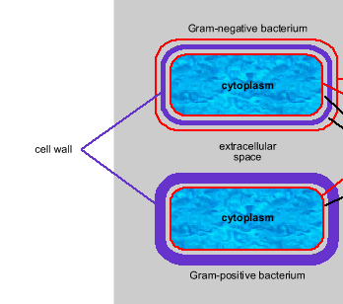
Gram Neg vs Gram Pos
Not only does the Gram (-) third layer reduce or eliminate the effectiveness of antibiotics, but the layer itself is usually toxic to the host.
The outer layer is comprised of Lipid A, which is toxic to most animals and causes fever, diarrhea, and in extreme cases, septic shock.
Because Gram (+) bacteria does not have a third membrane layer with Lipid A, it is not as risky to the host.
Gram (-) infections tend to be more dangerous than Gram (+).
Gram (-) infections are also harder to treat.
Source: http://www.nmpdr.org/FIG/wiki/pub/FIG/CellLocationCode/CellularLocations.png

Slide 12
Toxins
The main concern of bacterial infection are toxins
A toxin is simply a substance that interferes or disrupts a specific cellular function.
Toxins can be broken into two categories –
1. Exotoxins – proteins that are released by gram positive (but to some extent also by gram negative bacteria)
2. Endotoxins – only found in gram negative bacteria*;
They differ from exotoxins in that they are not released, but are a part of the outer membrane
They attack the body when they are released during cell break down.
* exception: Listeria monocytogenes, a gram positive cell

Slide 13
Exotoxins
Exotoxins can interfere with nerve transmission to cause paralysis (tetanus), destroy red blood cells (anemia), block water and ion reuptake in the colon (diarrhea), etc.
Exotoxins: exo- refers to the fact that they have to exit the bacterial cell to be effective.

Slide 14
Endotoxins
Endotoxins: endo- refers the fact that the toxins can be “inside” the structure of the bacterial cell and still effective.
Endotoxins, particularly Lipid A, cause septic shock
While exotoxins can be converted to a toxoid (an inactivated toxin), an endotoxin cannot, making it more dangerous to the host.

Slide 15
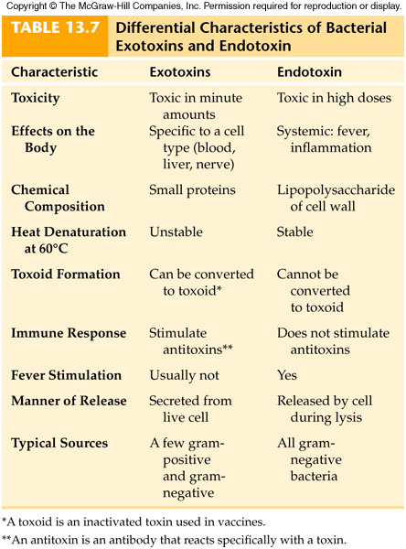

Slide 16
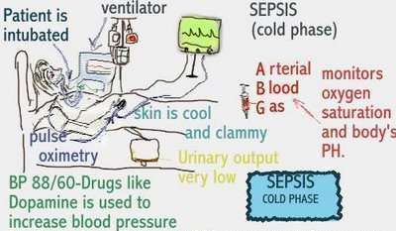
Septic Shock
Septic Shock, or endotoxic shock, can result from both gram-negative and –postive bacterial infections.
Septic shock is the number 1 cause of death in human intensive care units and the 13th most common cause of human death in the US
Septic shock is the result of a number of factors
Source: dearnurses.blogspot.com

Slide 17
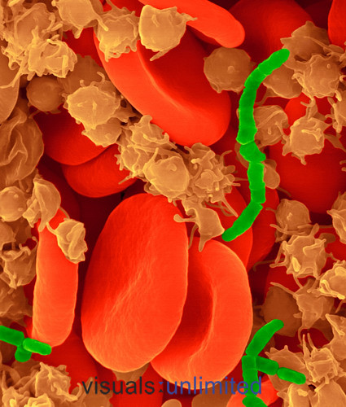
Factors in Septic Shock
Factors that comprise septic shock:
Bacteremia: this term simply refers to the presence of bacteria in the blood stream.
Bacteremia’s effects can vary
For example, brushing your teeth inevitable moves some bacteria into your own blood stream without any noticeable effects.
Bacteremia can also trigger the immune system, resulting in sepsis and even death.
Sepsis: a more severe form of bacteremia in which the immune system is triggered.
Source: audiofilosdr.com

Slide 18
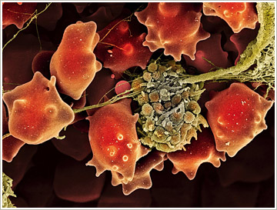
Sepsis
You might wonder why it would be bad thing to trigger the immune system.
After all, the immune system exists to protect us.
During sepsis, the body temperature changes, the white blood cell count is elevated, the breathing and heart rates increase, and symptoms of sickness begin to develop.
If bacteremia increases or if the patient does not improve, sepsis can develop into “septic shock”
Source: dailydiseasesanddisorders.tumblr.com

Slide 19
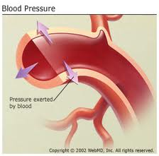
Septic Shock
Sepsis that results in dangerous drops in blood pressure and organ dysfunction is called septic shock.
Usually septic shock causes organ systems to fail one by one
Usually the most affected organ systems are the vascular system and the respiratory system
The vascular system fails because of hypotension – a dangerous drop in blood pressure
The respiratory system fails because of hypoxia – oxygen deficiency caused by physiological measures to correct the deficiency

Slide 20
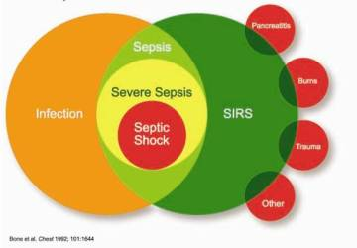
This Venn diagram shows the relationship between a systemic drop in blood pressure (SIRS) and infection.
Blood pressure can systemically drop for many reasons , including trauma, infection, burns, etc.
When blood pressure drops because of an infection, this is referred to as sepsis.
Sepsis can become severe; if the drop in blood pressure is life threatening and organ damage occurs, it becomes septic shock.
SIRS: Systemic Inflammatory Response Syndrome
Source: blogs.scientificamerican.com

Slide 21
Why does Septic Shock occur?
You might wonder why septic shock actually occurs; after all, it might seem as if the body was actually causing more damage than the bacteria.
To some extent, this is true!
To understand why septic shock occurs, we must also understand how the immune system works.
The blood of an animal is its defensive fluid, among other things.
The movement of blood is a critical component of septic shock.

Slide 22
Inflammatory Response
Damaged tissue causes an inflammatory response
Blood vessels dilate, increase their permeability, become red, and swell.
This enables more disease- fighting elements of the body to arrive.
The body then “cooks out” bacterial invaders by fever which denatures viral proteins.
It also sets off the histamine response

Slide 23
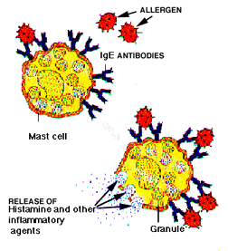
Histamine Response
Chemicals called histamines trigger both more inflammation and increases the permeability of capillaries
Because of inflammation and increased permeability, blood flow increases.
The increased blood flow enhances the delivery of clotting agents (both injury or infection can trigger the inflammation/histamine response).
The increased blood flow also brings more white blood cells to the site of injury/infection.
Normally this response is localized; wherever the injury or infection is, this is where the inflammation occurs
However, severe injury or infection causes a systemic (or body-wide) response.
Source: cityallergy.com

Slide 24
Systemic Response
Systemic Response means that the inflammatory and histamine steps are occurring everywhere in the body
Septic shock occurs when…
Fever is too high
Blood pressure drops too low because of inflammation
Lungs fail – each lung senses it is not being sufficiently oxygenated and shuts down
Organs begin to fail one by one as both blood and oxygen delivery begins to decrease; increased clotting also blocks capillaries that deliver blood and oxygen.

Slide 25
Summary
Summary
Most of the time the body responds to microbial invasion without our awareness.
Bacteremia, the presence of microbes in our body, occurs daily and rarely does much harm.
Bacterial infections can be categorized by the type of bacteria causing the infection
Gram Positive bacteria have only two cellular membranes and are susceptible to antibiotics
Gram Negative bacteria have 3 cellular membranes and resist most forms of chemical attack; the third cellular membrane also has an endotoxin called Lipid A that aggravates the host immune system and can cause septic shock

Slide 26
Summary (Cont.)
Normally, the body’s response to infection is very functional
Various immune system components work to fight invaders and slow or stop their spread
Inflamed blood vessels bring extra macrophages, and increase heat “cooks” bacterial pathogens.
Histamine release further increases the size of this response.
If the infection or injury is too great, a systemic response occurs which can lead to septic shock.

Slide 27
Summary (cont)
Septic Shock occurs as a result of the body over-responding to an infection or injury
If the level of bacteremia is too high, it can cause sepsis (immune response). If sepsis is over-activated, it causes septic shock.
Excessive inflammation causes hypotension (excess drop in BP)
Inflammation reduces blood flow, causing hypoxia and lung failure
Excessive clotting causes blocked capillaries
Organ failure begins with cardiovascular and respiratory failure, followed by additional organ failure.
Bacteremia
Sepsis
Septic Shock

