Slide 1
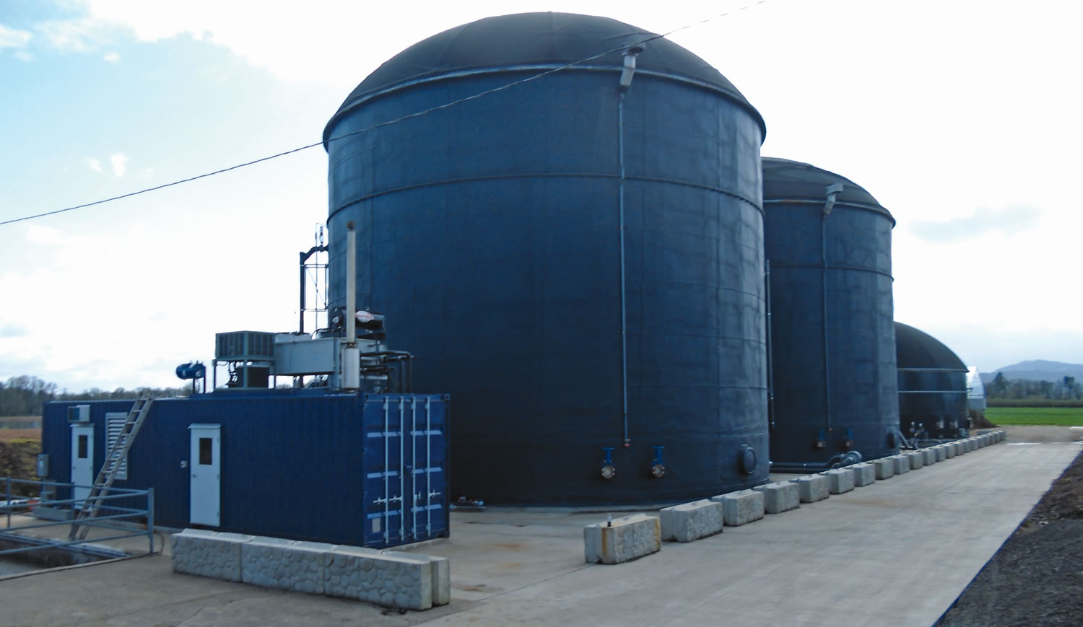
Biogas & Anaerobic Digesters
By C. Kohn
Agricultural Sciences
Waterford, WI
Source: www.biocycle.net

Slide 2
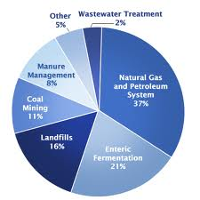
Methane
Methane is the second most prevalent greenhouse gas emitted in the US from human activity.
Methane accounts for 9% of greenhouse gases.
Methane is one of the most potent greenhouse gases with over 20 times the heat-retaining capacity as CO₂.
Methane occurs from decomposition, manure, landfills, and leaky natural gas facilities.
It can also be produced naturally by wetlands, oceans, volcanoes, and other sources.
Natural gas and petroleum production account for the greatest human-caused methane emissions (30%)
Ruminant animals and their waste account for 23% of methane emissions.
Landfills generate the third-most methane at 17% of US emissions.
Source: www.epa.gov

Slide 3
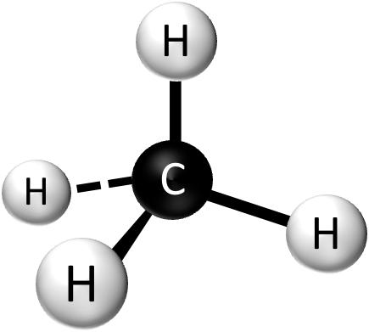
Methane & Biogas
While methane is a potent greenhouse gas, it can be used to produce energy as a biogas.
When methane is burned to produce energy (such as in an electrical generator or an automobile engine), it is released as CO₂ and H₂O.
While CO₂ is also a greenhouse gas, it is far less potent than methane.
The use of anaerobic digesters on farms could drastically reduce the second-leading cause of anthropogenic methane emissions.
Anthropogenic = human-activity related.
This could also provide distinct economic and energy-security benefits to the US.
Source: 1goldenworld.com

Slide 4
Biogas
Biogas is a gaseous fuel (usually methane) that is produced through fermentation of organic matter.
Biogas is produced through a process known as anaerobic digestion, which is decomposition without oxygen.
Biogas can be used to produce electricity or heat or it can be used as a transportation fuel if it is compressed.
Biogas is usually 50-80% methane; the remaining percentage is mostly carbon dioxide with a mixture of trace gases.
Biogas is different from natural gas, which is 70%+ methane with the remainder being other petroleum products (such as propane and butane).
Biogas can be made from sewage, animal byproducts, and from agricultural, industrial, and municipal solid waste.
Agricultural anaerobic digesters hold strong economic potential as a source of biogas.
Source: www.biocycle.net

Slide 5
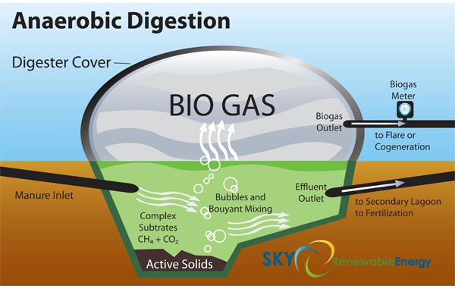
Anaerobic Digesters
Anaerobic digesters (or methane digesters) collect manure and convert the organic molecules in the manure into methane.
This methane can then be used to produce electricity, for heating or cooling processes, or as a transportation fuel (if compressed).
Digesters are usually used to produce electricity due to the near-constant demand (as opposed to heating oil, for example, which has fluctuations in demand).
The biological mechanisms of an anaerobic digester is as follows:
Organic matter (such as manure) is consumed by acid-forming bacteria.
The bacteria break the organic matter into simple organic acids (such as acetic acid, proprionic acid, etc.).
Methane-forming bacteria then consume the organic acids and convert them into methane/biogas.
The biogas is then used to produce electricity (which can be used or sold), to power on-farm needs (such as refrigeration of milk or heating a water heater), or it can be compressed and stored to be used as transportation fuel.
Source: www.skyrenewableenergy.com

Slide 6
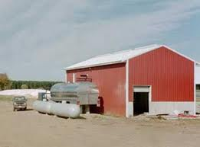
Statistics
A 100 cow dairy farm would need a round tank 18 ft wide and 19 feet tall to process the manure produced by these cows.
A pig farm with 200 sows would need a 24 x 25 tank.
A 1400 lb. dairy cow can produce over 46 cubic feet of biogas per day, resulting in 28,000 BTU’s of energy.
In a digester, this could produce 18,000 BTU’s of net energy (after subtracting the amount of energy needed to power the digester).
This could produce $15.45 per cow per year, or $7725 of additional gross income to a 500-cow dairy farm.
If the biogas were converted into L.P. Gas (for transportation fuel), the average dairy cow could add $41.60 of additional gross income per year to a farm (at $0.58 a gallon).
This equates to $20,800 of additional gross income for a 500 cow farm.
Source: www1.extension.umn.edu

Slide 7
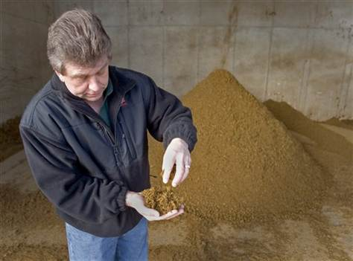
Digester Benefits
Besides additional income, a anaerobic digester provides the following benefits:
On-farm source of energy independent of rising fuel costs, allowing for more constant and predictable energy costs.
Reduced odors – the aspects of manure that cause odor are what are also used to produce methane. When burned, this methane will be odorless, reducing odors from the farm.
High Quality Fertilizer – during anaerobic digestion, organic nitrogen is converted into a more-valuable fertilizer, ammonium.
Reduced Surface and Groundwater Contamination – because it produces a more valuable, more easily-absorbed fertilizer, it reduces the likelihood of water pollution (more nutrients are absorbed by the crop).
Pathogen Reduction – dangerous bacteria is killed off in the manure during the digester process.
Source of bedding – anaerobic digesters produce a solid byproduct that can be used for bedding for cattle.
Source: www.nbcnews.com

Slide 8
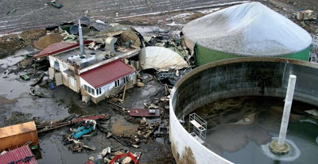
Digester Drawbacks
Anaerobic digesters can also have drawbacks –
Anaerobic digesters require additional skills and access to skilled experts and consultants.
The manure from a farm must be compatible with the digester system (appropriate moisture content, etc.).
Typically farms must have 500 cows or more to have enough waste to feasibly accommodate a digester.
Methane can become explosive if it mixes with air.
Methane leaks are difficult to detect because it is odorless, colorless, and lighter than air.
Logistical considerations – anaerobic digesters require additional work to secure the needs and concerns related to insurance, electrical exchanges, etc. such as licenses, electrical connecting costs, consulting fees, etc.
Source: pinkhamwayincinerator.blogspot.

Slide 9
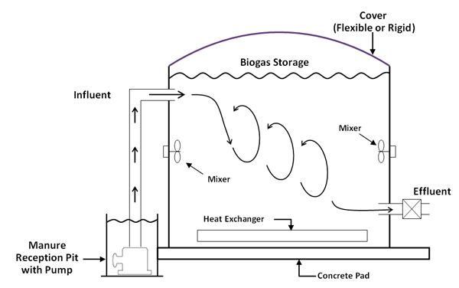
How a Digester Works
Digesters are covered waste storage areas that are air-tight.
They are typically constructed from concrete or steel.
Most digesters require 20-30 days for the bacteria to convert the organic wastes into acids and then methane gas.
Most digesters utilize cogeneration, in which the heat produced by an electric generator is used to heat the digester itself to speed up the reaction time.
The bacteria in a digester are very sensitive, requiring a pH of 7 and a consistent temperature near 35º C.
Every 11 degree change from 35º causes the gas production to be cut in half.
Source: www.epa.gov

Slide 10
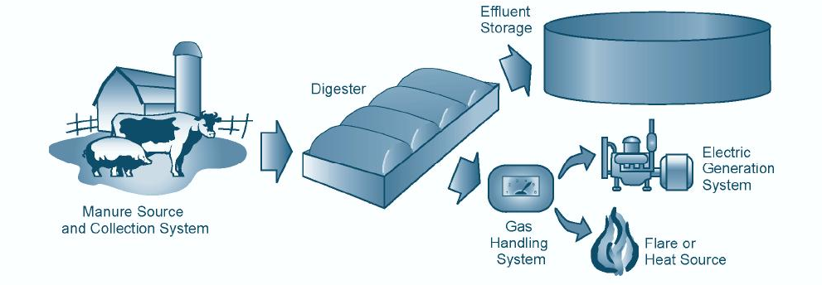
Digester Requirements
Farm anaerobic digesters require the following:
Manure Collection: waste must be delivered to the digester itself.
Anaerobic Digestion: in an air-tight lagoon or tank, bacteria convert the organic waste into acids and then methane.
Biogas Handling: the gas that results from anaerobic digestion is collected from the digester.
Gas-use Device: a device utilizes the gas in order to convert it into a source of power or energy (water heater, refrigeration, electrical generation, or compressed gas for transportation fuel).
Digester Byproduct Removal: the following byproducts must be handled after digestion is completed:
Liquid effluent (sewage) can be used as a high-quality fertilizer
Digested solids: can be used as bedding for cattle or for biodegradable planting pots; it may also hold potential as a building material
Source: climatetechwiki.org

Slide 11
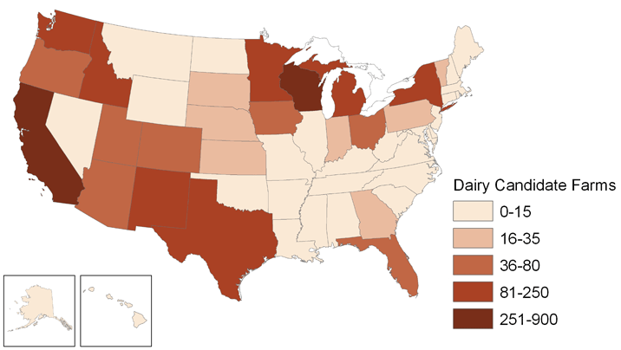
Potential Impact
The US Environmental Protection Agency (EPA) estimates that there are 8200 dairy and swine operations in the United States that could support a methane digester.
Altogether, these farms could generate more than 13 million megawatt-hours of energy.
They could and displace about 1,670 megawatts of fossil fuel-fired generation collectively per year.
A typical coal-fired power plant produces 600-700 megawatts per year, so US agricultural biogas production could eliminate 2-3 coal-fired power plants.
Use of landfill biogas could eliminate even more coal-fired power plants!
Biogas production would reduce dependence on foreign oil and heavily-polluting coal power plants.
Use of anaerobic digestion would provide more income to farmers while reducing air, soil, and water pollution.
Source: www.epa.gov

Slide 12
Sources
http://epa.gov/climatechange/ghgemissions/gases/ch4.html
http://www.afdc.energy.gov/fuels/emerging_biogas.html
http://www.mda.state.mn.us/protecting/conservation/practices/digester.aspx
http://www.ext.colostate.edu/energytalk/ad-works.html
www.epa.gov/agstar/documents/chapter1.pdf
http://www.bae.ncsu.edu/programs/extension/publicat/wqwm/ebae071_80.html

