Slide 1
Bovine Reproductive Anatomy
By C. Kohn, Waterford, WI

Slide 2
BASIC ANATOMY OF THE COWS REPRODUCTIVE SYSTEM
The cow's reproductive system has four basic functions.
To produce ova (eggs) which provides half of the eventual offspring's genetic makeup.
To provide an environment and conditions for the fertilization of those ova.
To provide a place following fertilization for the nourishment and fetal development of the calf.
To provide a mechanism for the birth of the calf.
~

Slide 3
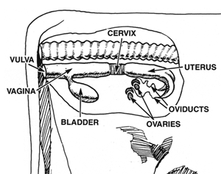
Female Repro Structures
Vulva
Vagina
Cervix
Uterus
Oviducts & Infundibulum
Ovaries
Corpus Luteum
Follicles & Eggs
~ Look at this picture & predict structure function

Slide 5
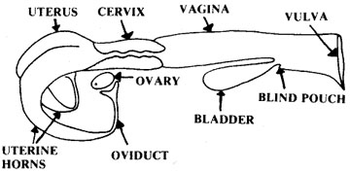
Map of the Bovine Repro Tract

Slide 6
Vulva
“Entranceway” of the female reproductive tract
Only part visible from the outside
Swells and becomes reddish-pink during estrus
Response due to estrogen
~

Slide 7
Vagina
Vagina – flattened tube; passage between the cervix and the vulva
Site of semen deposition during natural insemination
Used as passageway for instruments during AI
Produces mucus (lubricant) - flushes out irritants and infectious agents
Common site of infection
~

Slide 8
Cervix
Cervix – the muscular “valve” or “control gate” between the uterus and the vagina
Made of muscular folds that slow down invading materials
These folds have ‘dead ends’ that trap foreign substances
Completely closed except during estrus and parturition (calving)
During pregnancy, a hard mucus plug “glues” it shut
~

Slide 9
Uterus & Uterine Horns
Uterus – where the fetus grows, a.k.a. womb
Muscular, capable of “enormous expansion”
Has to support up to 80 kg / 177 lbs of weight
Uterine Horns
The extensions on either side of the uterus that lead to the oviducts
Curl like ram horns
~

Slide 10
Oviducts (Fallopian Tubes)
Oviducts– tubes that carry eggs from ovaries to uterus
Kept shut tight except during ovulation and insemination
Where fertilization occurs
Egg moved from the ovaries down the oviduct by cilia (microscopic hairs)
Motile sperm meet the egg in the upper part of the oviduct
Newly formed zygote stays in the oviduct 3-4 days
This time is needed for the uterus to prepare itself
~

Slide 11
Infundibulum
Infundibulum – Latin for “funnel”
The end projection of the oviducts that surrounds, but does not connect to, the ovaries
“Funnels” eggs from ovaries into oviduct.
~

Slide 12
Ovaries
Small walnut-shaped ovals 4-6 cm / 2-3 inches in length
Contain thousands of ova (plural of ovum, or egg cell)
These were created before the birth of the cow
Has a finite supply, as do human females
~

Slide 13
Ovaries (cont.)
Functions:
Produce a mature ovum (egg) every 21 days
Produce/secrete hormones that:
Control growth of egg
Change cow’s behavior (gets her “in the mood”)
Prepare reproductive tract for pregnancy
Start parturition process (birthing)
Prepare mammary glands for lactation
~

Slide 14
Follicles
Follicles – start as cavities (holes) on the ovary
An egg moves to this cavity.
It is surrounded by support cells and nutritive substances
All these things together are the follicle
~

Slide 15
Corpus luteum
The cells that remain in the follicle after the egg is ovulated (expelled into the oviduct) become the corpus luteum (CL)
Corpus luteum translated = yellow body
Produces progesterone, a hormone which sustains the pregnancy (allows pregnancy to “progress”)
Occurs regardless of fertilization
~

Slide 16
Egg (ovum)
Female gamete (reproductive cell)
Haploid - half the number of normal chromosomes
Present prior to birth, but maturation occurs at puberty
Multiple eggs develop during a cycle, but only one matures
~

Slide 17
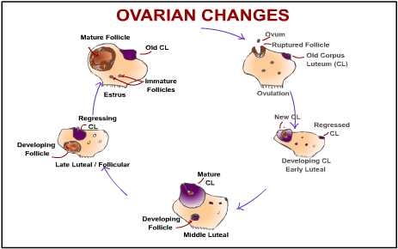

Slide 18
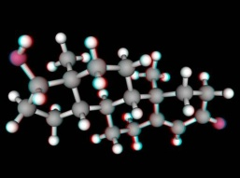
This is an animation – to watch the animation, use a computer or laptop.

Slide 19
How they change during estrus
Vulva: swollen due to estrogen, covered in mucus
Vagina: excess mucus production
Cervix: dilates to allow acceptance of semen (otherwise locked shut with hardened mucus to prevent infection)
Oviducts: open to allow ovulation, fertilization
Ovaries: ovulation – release of the follicle (egg and some supporting cells) from the ovary
number of young that a female can produce at one time is determined by how many eggs are released during ovulation
ovulation usually occurs at the end of a heat/estrus
~ MAKE SURE YOU KNOW THIS!

Slide 20
Anatomical Disorders
Closed Cervix – cervix does not open to allow fert.
Retained Placenta – afterbirth stays in cow
Damaged Oviduct (due to excess palpation)
Freemartins – heifer exposed to male hormones
Cystic ovaries – growth/swelling of ovaries
Infection – varies
Anovulation – lack of ovulation
Metritis – inflammation of lining of the uterus
~

