Slide 1
Bovine Reproductive Endocrinology
By C. Kohn, Waterford, WI

Slide 2
Hormones 101
An animal’s body must have consistency – a body’s physiological variables must be kept within a narrow range
For example, you must always keep blood sugar, dissolved oxygen, the pH, and the salinity of the body’s tissues at a consistent level
When these variables cannot be controlled, a disease will occur
E.g. Diabetes is a disease in which the body cannot control the levels of sugar (glucose) in the blood

Slide 3
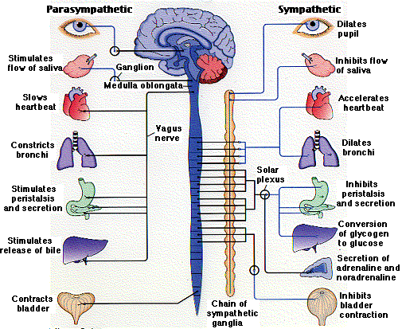
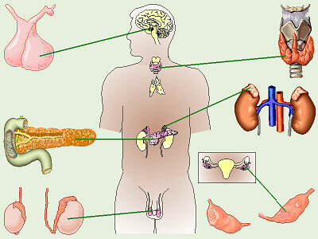
The Body’s Regulators
There are two systems responsible for maintaining homeostasis (homeostasis is maintaining a constant internal environment)
Nervous system – brain, spinal cord, nerves
Endocrine system – endocrine glands (pancreas, thyroid, adrenal glands, ovaries/testicles) and hormones
The nervous system is responsible for quick, split second responses, such as reflexes and reactions.
The endocrine system is responsible for very long-term responses; for example, puberty and sexual maturation occur over a period of years in humans and other animals.
Source: users.rcn.com
Source: biology.clc.uc.edu

Slide 4
The Endocrine vs. Nervous System
The endocrine system coordinates bodily responses with the nervous system, but each works in different ways
The endocrine system functions by releasing chemicals into the blood to change, tweak, or reverse the metabolic activities of a specific group of cells
It works relatively slowly and usually the results are long lasting or even permanent
The nervous system uses electrical signals that travel at lighting fast speeds to alter the activities of muscle, glands, and other structures.
The results are immediate but short-lived

Slide 5
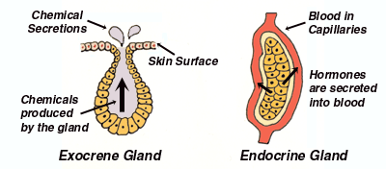
Endocrine Glands
A gland is a type of organ that secretes a substance into another part of the body
E.g. your salivary glands secrete saliva into your mouth
There are two types of glands
Exocrine – releases a substance into an empty space in the body (e.g. the salivary glands releasing saliva into the mouth, or sweat glands onto the surface of the skin)
Endocrine – releases substances called hormones directly into the bloodstream – e.g. your pancreas secretes insulin directly into your blood to control blood sugar levels
Source: commonsensehealth.com

Slide 6
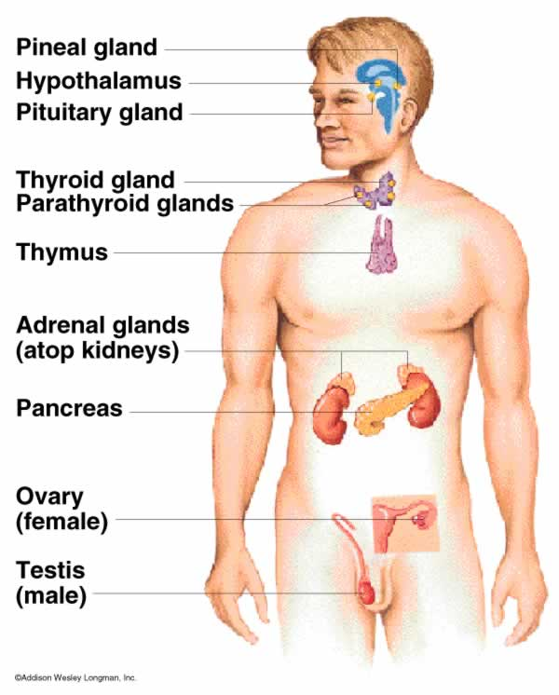
Endocrine Glands
The endocrine glands include
Pineal
Hypothalamus
Pituitary
Thyroid
Parathyroid
Adrenal
Pancreas
Ovaries or Testes
Note that some parts of the brain are considered part of the endocrine system and not the nervous system!

Slide 7
Classes of Hormones
Hormones are created in one of three ways
Amine-hormones are derived from the amino acid tyrosine
For example, epinephrine (adrenalin) is created in this way
Peptide or Protein-based Hormones – these are derived from proteins created by the body
E.g. growth hormone is created from a protein
Steroid hormones – these are created from cholesterol
E.g. testosterone and progesterone are created in this way

Slide 8
Reproductive Hormone Cycles

Slide 9
Hormones in Estrus
During the estrus cycle, hormones control signs of heat, the release of the egg from the ovary, maintain pregnancy, and regulate almost all aspects of reproduction.
they are: chemical messengers secreted by tissue (an endocrine gland) and carried by blood to different tissue (a target tissue) with a direct specific effect.
Endocrine gland – not a specific organ, just an organ that secretes the hormone in the specific case
(just like Air Force One is not a specific plane but the name given to any plane carrying the president)
Endocrine gland and target tissue can even be the same thing
~

Slide 10
Hormones

Slide 11
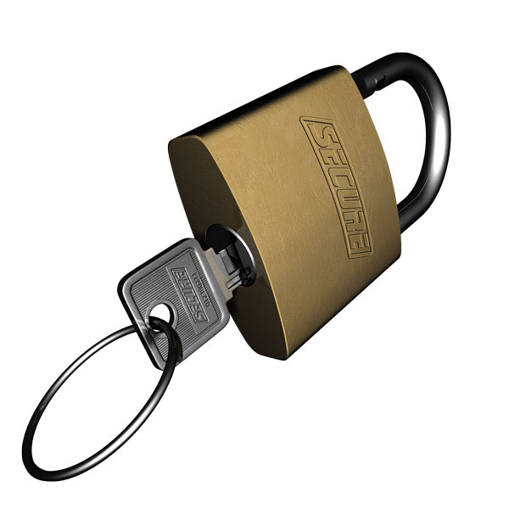
Hormones
Tissue only responds to a hormone if it has a receptor for that particular hormone
works sort of like a lock and key
a hormone is the key, but a key can only work if it has a lock to work on
tissue can have (and usually does have) multiple receptors for multiple organs
Summary: an endocrine gland releases a hormone into the blood, which travels throughout the body and affects tissue with a receptor for that particular hormone with a specific targeted effect.

Slide 12
Hormone Type and Function
GnRH – gonadotropin releasing hormone
Regulates the secretion of FSH
Injections of GnRH cause developing eggs in follicles to be ovulated (released) and stimulates the growth of immature eggs in new follicles ~

Slide 13
Hormone Type and Function
FSH – Follicle Stimulating Hormone
Stimulates growth of eggs in follicles on the ovary
LH – leutenizing hormone
Promotes ovulation (release of eggs from the follicle) ~

Slide 14
Hormone Type and Function
Estrogen – jack of all trades
Causes behavioral changes in the cow
Causes LH surge just prior to release of follicle
Coordinates acceptance of bull and release of follicle
Necessary to ensure that sperm and egg meet
Stimulates muscular contractions that move egg into oviduct and contractions in vagina, cervix, and uterus to move sperm towards oviduct ~

Slide 15
Hormone Type and Function
Progesterone
Prepares uterus for pregnancy
Prevents development of new follicles
Prevents recurrence of estrous cycle during pregnancy ~

Slide 16
Hormone Type and Function
Prostaglandins (PGF_{2α})
In non-pregnant cows, uterus secretes prostaglandins
Cause the corpus luteum to regress and stop producing progesterone
Follicles are no longer inhibited and can grow and develop
In animals with a mature corpus luteum, a heat typically occurs 2-7 days after an injection of prostaglandins ~

Slide 18
Estrus Hormone Cycles
Day 20 and 21 (of previous cycle) – Corpus luteum decays; final maturation of a follicle for the next cycle begins
Day 1 and part of Day 2 (30 hours total): estrus (heat period), the point of sexual receptivity.
The only time that a cow will allow herself to be mounted.
Egg and follicle reach final maturation. ~

Slide 19
Estrus Hormone Cycles
Day 2-5 [Starting 10-14 hours after last sign of estrus]: follicle is expelled from the ovary into the oviduct (a.k.a. ovulation).
Wall of ruptured follicle that remains on the surface of the ovary will become the corpus luteum.
Days 6-16: corpus luteum is large and fully functional.
Some growth of follicles which will not fully mature until current corpus luteum regresses, at which time a dominant follicle will emerge and eventually ovulate in the next cycle. ~

Slide 20
Estrus Hormone Cycles
Days 16-20: Corpus luteum will start to regress. The uterus will begin to try to detect the presence of an embryo.
if no embryo is detected, the uterus will send a signal to the corpus luteum telling it to regress so that a new cycle can begin.
If egg has been fertilized, the cow is pregnant and the corpus luteum will continue to produce hormones (progesterone) that inhibit follicular development.
Day 20 – 21 – Corpus Luteum decays if there is no fertilized egg;
final maturation of a follicle for the next cycle begins. ~

Slide 21
Hormone Therapies

Slide 22
Artificial Hormone Therapies
Knowledge of the physiology and endocrinology of the reproductive tract has resulted in the creation of numerous pharmaceuticals that aid in regulating, adjusting, or terminating the estrus cycle
This can be of great advantage to the producer.
All treatments must be thoroughly researched and extensively tested to determine whether or not they are safe for administration to animals and must show that they cause no harmful effects in humans who consume products from those animals
All of these products available for sale must be FDA approved.

Slide 23
Artificial Regulation of Ovulation
If a producer misses a cow in heat, or if the heats are not easily detectable, profits can quickly be lost if the cow is not bred in a timely fashion.
Research at UW-Madison led to the creation of Ovsynch, a hormone therapy treatment to synchronize ovulation and allow for predictable, timed inseminations.
In short, we can use this treatment to make a cow go into heat at a specific time that is known in advance
This can greatly increase the chances of impregnating the cow
Source: animal.ufl.edu

Slide 24
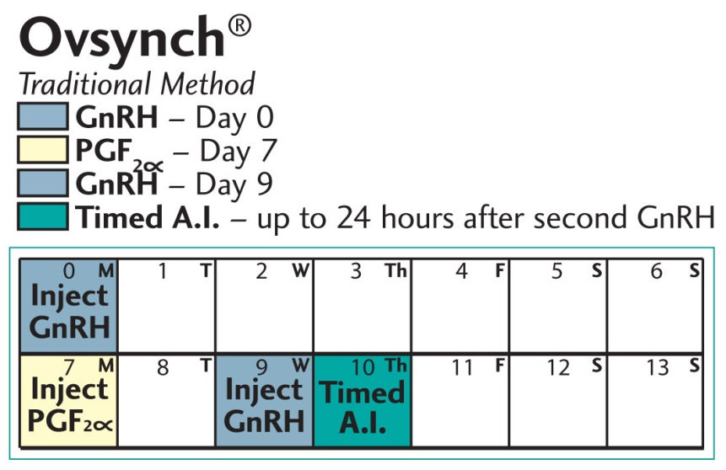
Ovsynch
Ovsynch uses two hormones
PGF_{2α} and GnRH
Ovsynch occurs in three stages
Day 0 - Stage 1: GnRH injection to create a new follicle
Day 7 - Stage 2: PGF_{2α} injection to end the currnet estrus cycle and regress the corpus luteum
Day 9 – Stage 3: Second GnRH injection to cause the new follicle to ovulate and release the egg
All cows will ovulate 24-32 hours after the second GnRH injection
Day 10 – Insemination
Source: genex.crinet.com
Source: animal.ufl.edu

Slide 25
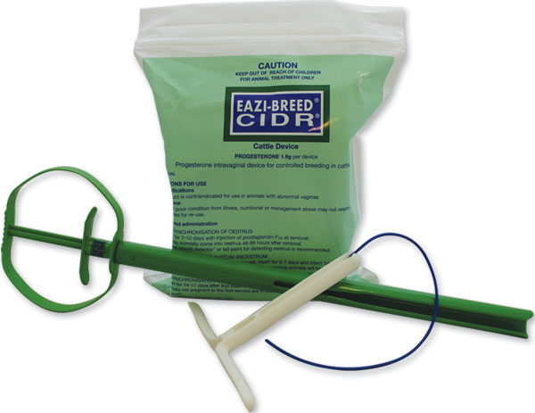
CIDR - Source: ansci.wisc.edu
CIDRs (Controlled Internal Drug Release) are an intravaginal progesterone insert used in the beef cattle, dairy cattle, goat and sheep industries.
The progesterone is released at a controlled rate into the bloodstream after insertion.
In all species, CIDRs are used for the synchronization of estrus.
This can be highly beneficial in large herds because with the synchronization of estrus, groups of cows and heifers can be bred at the same time in a narrow window.
Source: northsbreedingsolutions.com.au

Slide 26
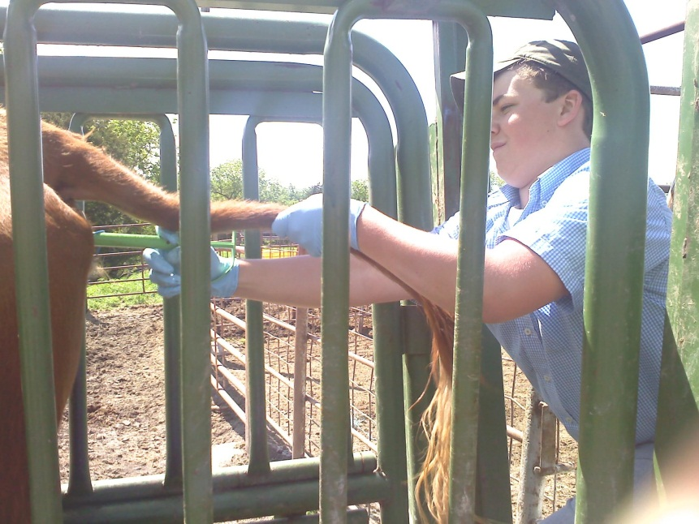
How CIDR Works
CIDRs are coated with progesterone.
In vivo, progestrone functions to ‘progress’ or sustain the pregnancy.
Progesterone will prevent the animal from going into heat.
When the CIDR is removed at the end of a treatment period, the progesterone production also immediately stops
This enables ovulation to occur
Source: ladyofag.wordpress.com

Slide 27
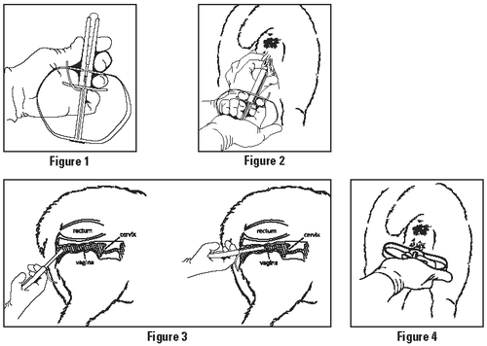
How CIDR Works
All animals on the CIDR treatment will go into heat at the same time, reducing labor costs
The animal will respond to the progesterone from the CIDR in the exact same way it will respond to progesterone from its own body
The two hormones are physiologically indistinguishable
Source: drugs.com

Slide 28
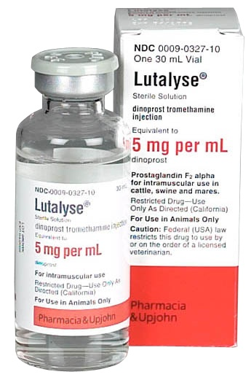
Lutalyse
Lutalyse is a veterinary pharmaceutical brand name
Lutalyse is a PGF_{2α} therapy treatment
If an animal is known to be open (i.e. her ovulated egg was not inseminated), a shot of Lutalyse will end the cycle and start a new one.
Lutalyse/ PGF_{2α} will cause the death of the corpus luteum, resulting in reduced progesterone production.
Pregnant women SHOULD NOT administer shots of Lutalyse; it can cause their bodies to terminate the pregnancy!

Slide 29
Summary
Ovsynch – ends current cycle, and re-starts a new follicular wave at a predictable time
CIDR – a vaginal insert used to delay estrus to a certain time so that all animals in a herd will be able to be bred at the same time
Lutalyse – a PGF_{2α} treatment used to end a cycle in an open, unbred cow

