Slide 1
Cattle Rations
By C Kohn,
Department of Agricultural Sciences
Waterford, WI

Slide 2
Dairy Nutrition Needs
Nutrient requirements of a dairy cow vary with their stage of lactation (milking) and gestation (pregnancy)
Because they are so precise, the nutrient requirements of a dairy cow have helped redefine nutrition in animal agriculture.
For this reason, we’ll use nutrition in the dairy cow as our representative example.

Slide 3
Lactation Cycles
A dairy cow has lactation cycles
Lactation is the period in which a cow is milking
It begins with the birth of her calf and continues until she is “dried up” in order to prepare for the birth of her next calf.
A producing dairy cow has 5 distinct nutritional stages in her lactation cycle.
Early lactation—0 to 70 days (peak milk production) after calving.
Peak DM intake—70 to 140 days (declining milk production)
Mid- and late lactation—140 to 305 days (declining milk production).
Dry period—60 to 14 days before the next calving.
Transition or close-up period—14 days before the next calving (birthing)

Slide 4
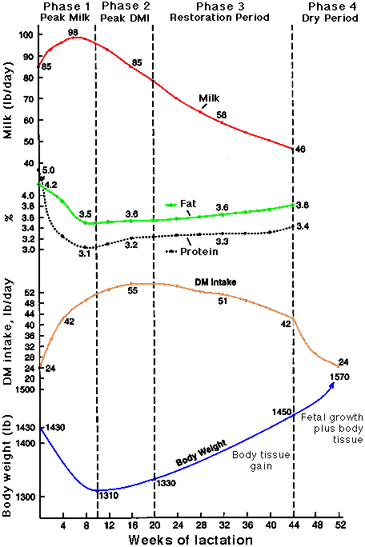
As shown in this graph, the cow’s body undergoes immense changes from the birth of one calf to the next.
These changes include…
An early peak in milk production followed by a steady drop.
A steep drop in fat and protein followed by a slow increase
A sharp increase in dry matter intake (DMI) followed by a slow drop
A sharp drop in body weight followed by a steady increase

Slide 5
Phases of Lactation
Phase 1. Early lactation—0 to 70 days after calving
Milk production increases rapidly, peaking 1.5-2 months after calving
Feed intake cannot match energy demands
This means that every day, the cow will use more energy than she can consume
Energy concentrates (grain) should be increased by about 1 lb.
If grain intake is increased too rapidly or is too high, acidosis and displaced abomasum are possible.
Rumination must also be stimulated – longer fibers will activate the cow’s rumen and papillae activity m

Slide 6
Phases of Lactation
Phase 1. Early lactation—0 to 70 days after calving (cont)
Protein and fat must be fed in adequate amounts more so at this time than any other
Failure to do this can lead to ketosis and low peak milk production (lowering milk production for the rest of the lactation
A loss of 1 pound in peak milk production equates to a 220-pound loss for the lactation.
Disorders are most likely the closest to calving.

Slide 7
Phases of Lactation
Phase 2. Peak DM intake—second 10 weeks after calving.
The goal of this stage is to maintain peak milk production for as long as possible.
This is when feed intake reaches its peak and cows begin to regain lost body weight and tissue
More digestible (finer ground) grains and fibers can be fed if rumen activity is adequate
Potential problems during this period include a rapid drop or decline in milk production, low fat test, silent heat (no observed heat), and ketosis.

Slide 8
Phases of Digestion
Phase 3. Mid- to late lactation—140 to 305 days after calving.
Milk production is declining, the cow is pregnant, and nutrient intake will easily meet or exceed requirements
This phase will be the easiest to manage
Grain feeding should be at a level to meet milk production requirements and begin to replace body weight lost during early lactation.
Young cows should receive additional nutrients for growth
Potential problems during this phase are few.
Milk production should slowly decline at an 8 to 10 percent drop per month.
Avoid over-conditioning cows – an over-conditioned cow with too much body fat is more prone to digestive problems.

Slide 9
Phases of Lactation
Phase 4. Dry period—60 to 14 days before the next calving.
This is the start of the dry period – when a producer stops milking a cow so that she can build up bodily reserves prior to calving
Nutritional programs during this period help a cow reach her maximum during the next lactation and minimize metabolic problems after calving.
A cow in a dry period needs to be fed a different ration than a milking cow due to different physiological needs
Her body is focused on producing a calf instead of milk

Slide 10
Phases of Lactation
Phase 4. Dry period—60 to 14 days before the next calving.
Cows that this point should not be over-conditioned or the risk of metabolic disorders will increase.
Problems such as milk fever, displaced abomasum, retained placenta, fatty liver syndrome, fatty liver formation, and poor appetite, along with other metabolic disorders and diseases, are common in overweight cows at freshening (calving).
Grain consumption should be minimal at this point.
Minerals should be fed to meet their dietary need; however, over-feeding minerals can also cause dietary problems
The cow’s body becomes “accustomed” to excess nutrient levels and fails to adequately utilize its own bodily stores

Slide 11
Phases of Lactation
Phase 5. Transition period—14 days before the next calving.
It is critical at this stage to closely regulate and manage a cow’s ration in order to prevent problems during calving
E.g. mismanagement of the mineral portion of a cow’s diet can lead to milk fever (hypocalcaemia) during or after calving
Some grain, if not previously fed, should be fed starting two weeks before freshening.
Introduction of grain is necessary to begin changing the rumen bacteria population over from an all-forage digestion population to a mixed population of forage and grain digesters
If niacin (to control ketosis) and/or anionic salts (to help prevent milk fever) are going to be used, they should be included in the ration during this period.

Slide 12
Summary of Lactation
Early lactation: disorders are most common during this stage; this is also the stage of peak milk production – failure to maximize peak production can reduce overall milk production by hundreds of pounds. Use of calories exceeds consumption of calories, but grain intake must be limited because of the risk of nutrient disorders.
Peak DM Intake – this begins at peak milk production (6-8 weeks after calving). The producers goal is to maximize the length of peak production for as long as possible.
Mid to late lactation – the easiest stage to manage; nutrient intake easily meets or exceeds usage. Milk production begins to decline.
Dry Period – cow is not milking (dried up); nutritional programs during this time maximize peak milk yield and minimize metabolic disorders. However, nutritional needs should not be fed in excess because they can easily cause metabolic problems.
Transition Period – grain should be fed in increasing levels to stimulate rumen function. Niacin and anionic salts are good respectively for preventing ketosis and milk fever.

Slide 13
Sample Diet Rations
2 year , high producing cows, early lactation – 50 lbs per day per head
Forage
Hay , 2.5 lbs (5%)
Haylage, 7 lbs (14%)
Corn Silage, 14 lbs (28%)
Energy Concentrate
High Moisture Corn, 10.64 lbs (21.3%)
Cottonseed, 3.92 lbs (8%)
Wet Distillers Grain, 2.6 lbs (5%)
Protein
Protein Mix (canola, soy, etc.), 10 lbs (20%)

Slide 14
Sample Diet Rations
Mature cows, early lactation and late lactation high producing cows– 54 lbs per day per head
Forage
Haylage, 10.2 lbs (18.9%)
Corn Silage, 14.7 lbs (27.2%)
Energy Concentrate
High Moisture Corn, 11.5 lbs (21.3%)
Cottonseed, 4.24 lbs (8%)
Wet Distillers Grain, 2.8 lbs (5.2%)
Protein
Protein Mix (canola, soy, etc.), 10.6 lbs (20%)

Slide 15
Sample Diet Rations
Dry cows – 26.5 lbs per day per head
Forage
Grass hay 10 lbs (37.7%)
Corn Silage, 12 lbs (45.3%)
Energy Concentrate
Wet Distillers Grain, 2lbs (7.5%)
Protein
Protein Mix (canola, soy, etc.), 2.5 lbs (9.4%)

