Slide 1
Cell Biology
By C. Kohn
Agricultural Sciences

Slide 2
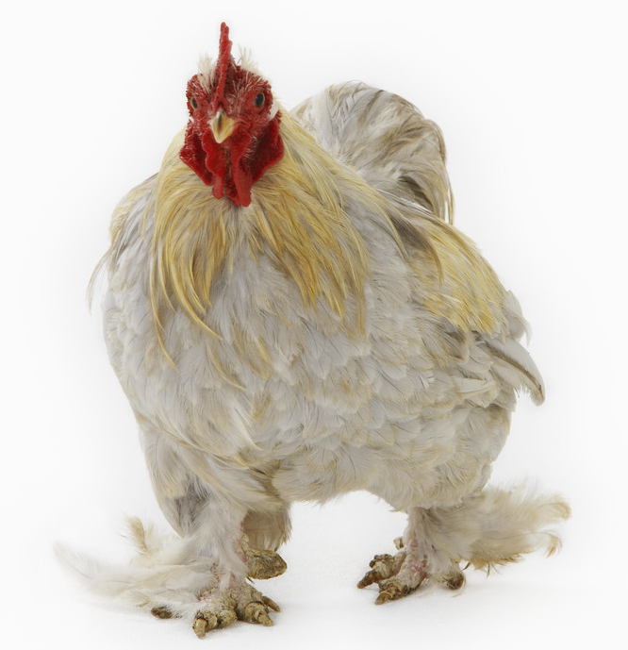
Biology & Agriculture
In order for any agriculturalist to improve the performance of plants or animals, they must understand the biological cellular processes at the heart of food production.
  Any increase in the milk production of a cow, the production of a cob in corn, or the making of any food product depends on processes such as
  cellular respiration, photosynthesis,
  and other cellular processes.
We will focus on three key topics:
  ATP and ATP Synthase
  Cellular Respiration
  Photosynthesis

Slide 3
Sequence of Topics
In this course, we will start with basic concepts of biology, including:
  The requirements for something to be alive
  Components of living organisms
  Cellular sources of energy
  Cellular respiration
  Photosynthesis
As we move through topics, think about the following:
  How could an agricultural scientist use this information to improve the production of plants and animals?
  How have these processes changed as animals became domesticated compared to wild animals?
?

Slide 4
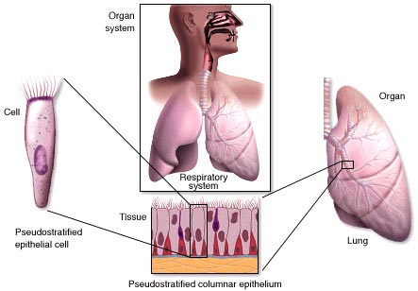
Life 101
Source: mhhe.com
Requirements of life, atoms, molecules, cells, etc.

Slide 5
The requirements of life
To be alive, something...
Must have a cell (or cells) with an inside different from the outside to allow for homeostasis (a constant internal environment)
Must have genetic material that can be passed on through reproduction and can be changed through natural selection and adaptation
Must use energy to power both cellular activity and cell growth and division
Must respond to signals from the environment in order to function in that environment

Slide 6
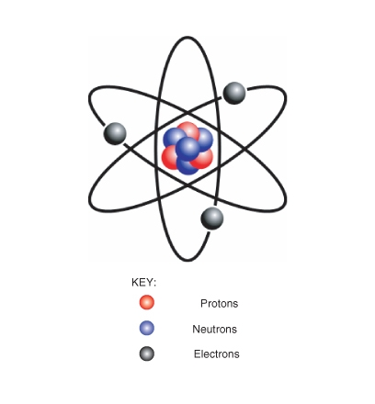
From Atoms to Ecosystems
The smallest indivisible unit of matter is the atom.
  In living things, the most common atoms (or elements) are carbon, oxygen, hydrogen, and nitrogen
    (COHN, sort of like me ☺)
Atoms have parts –
  A nucleus made of a neutral
  neutron and a positive proton.
  Revolving electrons with a
  negative charge
    If an atom were to lose an
    electron, it would have a
    positive charge
    For example, hydrogen atoms can
    lose an electron and become H⁺
  Opposite charges attract;
  similar charges repel (like magnets)
Source: cosbiology.pbworks.com

Slide 7
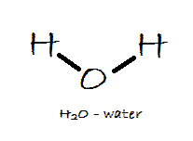
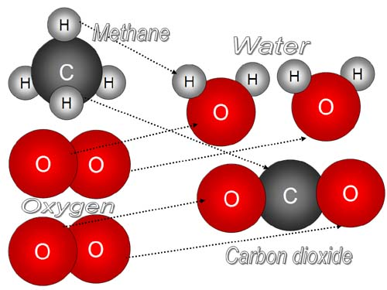
From Atoms to Ecosystems
Atoms group together to form molecules
  For example, water is a molecule because it is made of two hydrogens and an oxygen (H₂O)
  When atoms form molecular bonds, they usually release energy
  To break apart a molecule, you have to use energy
Molecules can bond with
each other to form
macromolecules.
  A macromolecule is made
  of multiple molecules
  bonded together.
Source: chemistryland.com

Slide 8
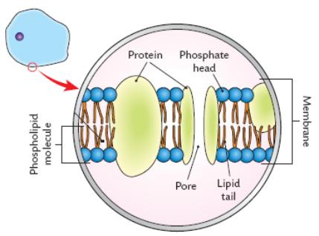
Proteins & Cells
A common example of a macromolecule is a protein.
  At the molecular level proteins are the functional part of
  any living organism.
    Proteins are like tiny, molecular machines that work inside the cell.
  Proteins are just one kind of molecule found in a cell
  (see image to the right).
    Cells are made of many kinds
    of molecules.
Cells are the smallest unit of life
  The smallest that something
  can be and still be alive is a cell
    To be alive, you must have cells
  Cells are made of molecules and
  macromolecules.
Source: leavingbio.net

Slide 9
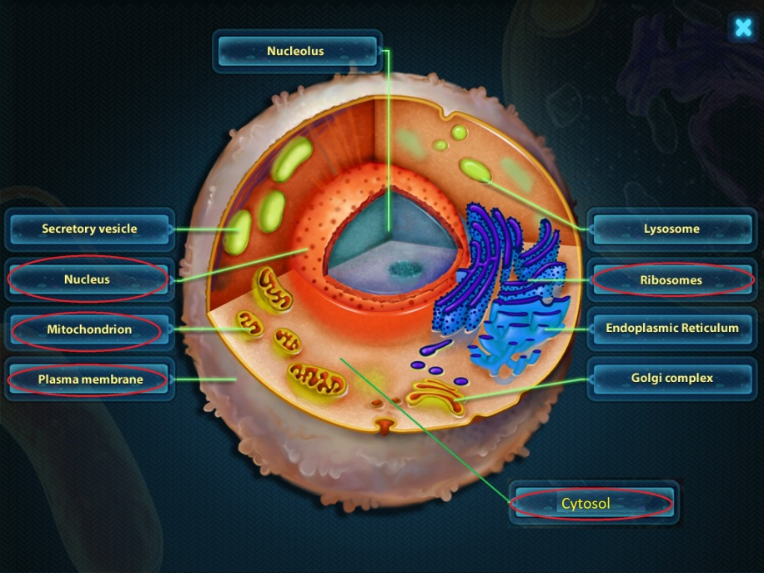
Atoms to Ecosystems
Cells have functional structures called organelles. These include:
  A nucleus, where DNA is stored
  A mitochondria, the
  energy-factory of the cell
  A membrane, the
  protective shell of the cell
  Cytosol, the ‘jelly-filling’
  of the cell
  Ribosomes, the protein
  factories of the cell
  And more!
Source: Cell And Cell Structure 1.0

Slide 10
Atoms to Ecosystems
A group of similar cells that perform the same function is called tissue.
A group of different kinds of tissues that coordinate their actions into a main primary function is called an organ.
A group of organs
and tissues that
work together to
maintain homeostasis
in the body are called
a system.
  There are 11 major
  systems in the human body.
Source: mhhe.com

Slide 11
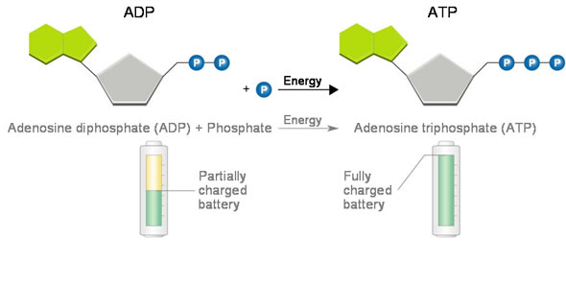
Cellular Energy
ATP, ADP, and ATP Synthase
Source: goldiesroom.org

Slide 12
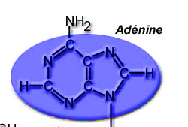
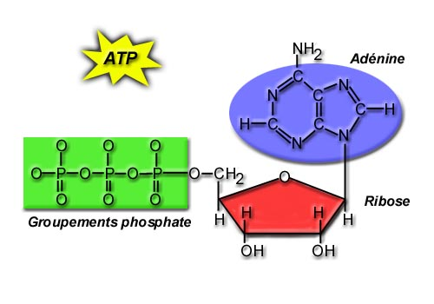
Energy and Life
All living things require energy to be alive
  Cells need energy to perform functions such as
  transport, signaling, contraction, movement, etc.
All living cells use ATP as their
primary source of energy
  ATP is a molecule made of
  an amino acid, a sugar, and
  three phosphate molecules
    ATP = “A Triple Phosphate”
ATP is sort of like a rechargeable
battery
  When ATP powers something in
  a cell, it loses a phosphate and
  becomes the uncharged ADP
    ADP = “A Double Phosphate”
  ATP is the “charged battery”
  version; ADP is the “dead
  battery” version
Source: sugaratoms.tumblr.com
Source: goldiesroom.org

Slide 13
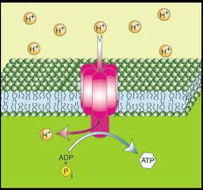
“Re-charging” ATP
Uncharged ADP can be “recharged” back into ATP
  To turn the uncharged ADP back into the charged ATP, we have to add a 3rd phosphate back onto ADP
    3 phosphates = charged; 2 phosphates = uncharged
Just like a rechargeable
battery has a battery charger,
ATP has ATP Synthase to
‘recharge’ it
  ATP Synthase is a large
  macromolecule that
  combines ADP and a
  phosphate molecule
  (P_{i}) back into ATP
  ADP and P_{i} go into ATP
  Synthase; ATP comes out
Source: sparknotes.com

Slide 14
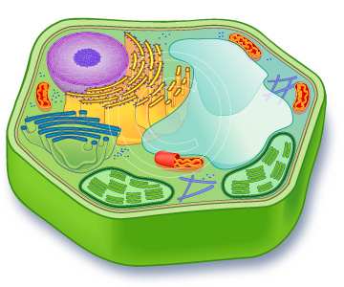
ATP Synthase
ATP Synthase is primarily found in one place – the mitochondria.
  The mitochondria is the “powerhouse” of the cell – it produces the ATP used to run the rest of the cell.
  More mitochondria = more ATP production
ATP Synthase can also be found
in the chloroplasts of plant cells.
  This ATP is used for a very specific
  purpose - to power the assembly
  of a sugar molecule during
  photosynthesis.

Slide 15
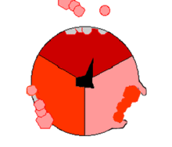
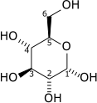
ATP Synthase & Hydrogen
ATP Synthase is like a tiny,
molecular wheel.
  When the ATP Synthase “wheel”
  turns, it combines a single phosphate
  (P_{i}) and ADP into a charged ATP.
Hydrogen is what turns the ATP Synthase “wheel”.
  Like water turning the wheel of a mill at a dam, hydrogen turns the “wheel” of ATP Synthase.
The hydrogen that turns ATP Synthase
comes from the food we eat.
  Foods that are high in energy are
  actually high in hydrogen.
  For example, half of the molecules
  a sugar molecule are hydrogen
  atoms (C₆H₁₂O₆).

Slide 16
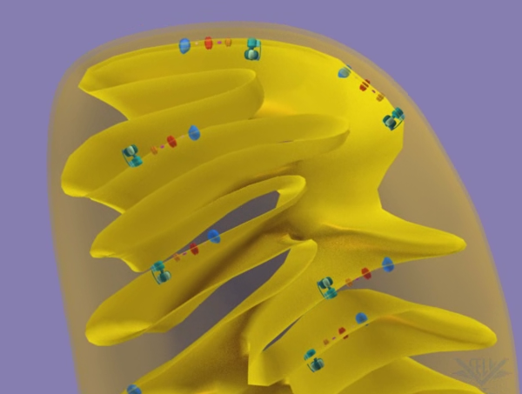
Mitochondrial Outer Membrane
``
Intermembrane Space (w/ Hydrogen atoms)
Flowing Hydrogen
Mitochondrial Inner Membrane
ATP Synthase
Mitochondrial Matrix(inside)
As hydrogen moves past ATP Synthase, it causes it to turn. As ATP Synthase turns, it makes ATP from ADP and P_{i}.

Slide 17
Removal of Hydrogen
After it powers the wheel, each hydrogen atom must be removed from the mitochondria.
  If hydrogen was not continuously removed, it would stop flowing. (Imagine if people stopped inside a revolving door!)
To remove the hydrogen, we breathe in oxygen
  The oxygen binds to two hydrogen molecules to make H₂O
  H₂O and CO₂ are breathed out when we exhale

Slide 18
Summary
To be alive, four things are required:
  1) Must have a cell; 2) must have genetic material; 3) must use energy for cell growth and division; 4) must respond to signals from the environment
The smallest indivisible unit of matter is the atom. Atoms are made of 3 parts:
  A nucleus with a proton and a neutron and revolving electrons.
A group of atoms is a molecule. Combinations of multiple molecules are macromolecules.

Slide 19
Summary (cont.)
Cells are the smallest unit of life – the smallest something can be and be alive is a cell.
Cells have organelles – small structures inside the cell with a specific function. Some examples include:
  Nucleus – where DNA is stored.
  A mitochondria, the energy-factory of the cell
  A membrane, the protective shell of the cell
  Cytosol, the ‘jelly-filling’ of the cell
  Ribosomes, the protein factories of the cell

Slide 20
Summary (cont.)
Groups of similar cells make tissue; multiple kinds of tissue form organs. Organs are part of systems that perform specific functions for a body.
All living things need energy; the primary source of energy used by cells is ATP.
  ATP has a ribose sugar, adenine, and 3 phosphate molecules (P_{i})
After ATP powers a cellular process, it loses a phosphate and becomes ADP.
  ADP can be remade into ATP by adding a phosphate.

Slide 21
Summary (cont.)
ATP Synthase is the protein that turns ADP and P_{i} back into ATP.
ATP Synthase is primarily found in the mitochondria.
  It is also found in the chloroplasts of plant cells.
ATP Synthase has to turn to produce ATP; stored hydrogen in the mitochondria is what enables ATP Synthase to turn.
  This hydrogen comes from the food we eat.
  This hydrogen must be removed by oxygen after it flows through ATP Synthase.

