Slide 1
Cellular Respiration
By C. Kohn
Agricultural Sciences

Slide 2
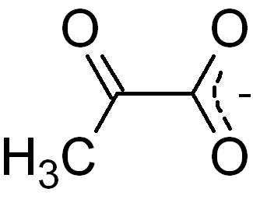
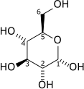
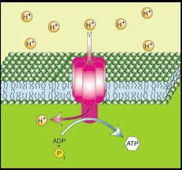
In a nutshell…
Cellular Respiration is a series of chemical reactions in which hydrogen atoms on a glucose molecule are removed so that they can be used to turn ATP Synthase proteins and power the production of ATP (the source of energy for cellular activity).
Key points of Cellular Respiration:
  Hydrogen atoms are
  removed from glucose
  Those hydrogen
  atoms are used
  to turn ATP Synthase
  ATP Synthase makes ATP from ADP
  and P_{i} every time it turns

Slide 3
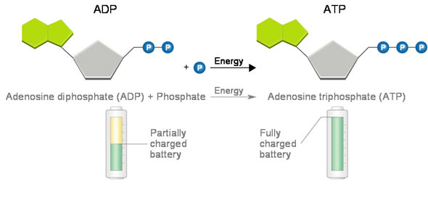
Glucose
Glucose is the simplest carbohydrate
  A carbohydrate is an organic
  molecule that contains carbon,
  oxygen, and hydrogen
  (note: carb-o-hydr-ate).
  Examples include sugars, starches,
  fibers, and cellulose
Glucose is NOT used to power cellular activities.
  Instead, the hydrogen atoms on glucose are used to power the production of cellular energy
  Glucose is the way in which living organisms get hydrogen into their mitochondria
  Those hydrogen atoms are
  used to turn ATP Synthase.
  ATP Synthase is the
  protein that produces
  ATP
  ATP powers cellular activity
Source: goldiesroom.org

Slide 4
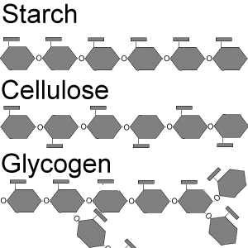
Carbohydrates
Glucose
All carbohydrates are made of chains
of glucose.
  The longer the chain of glucose,
  the more difficult the carbohydrate
  is to break apart and digest.
  E.g. simple sugars break down easily
  in our bodies because they are very
  short chains of glucose
  Fibers break down very slowly because
  they are very long chains of glucose.
All carbohydrates must be broken down into individual glucose molecules when we consume them.
  It is necessary to break carbohydrates into individual glucose molecules so that they can be absorbed into the bloodstream
  A starch or fiber would be way too big to be absorbed across the lining of the intestines and through the membrane of a cell.
Source: bioweb.wku.edu

Slide 5
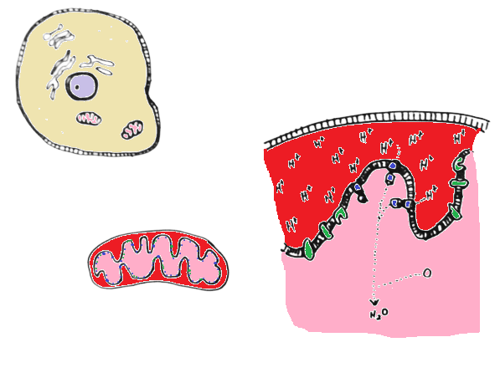
In the cell…
Once absorbed into the bloodstream, cells absorb the glucose from the blood across their cell membrane and into their cytosol.
  The breakdown of sugar and the process of cellular respiration begins in the cytosol of a cell.
When a glucose molecule is absorbed by a cell, it is broken down over a series of steps that each occur in different places. These places include:
  The cytosol: the “jelly filling” of the cell that surrounds the organelles
    Glucose is split in half in the cytosol to form 2 pyruvate molecules.
  The matrix of the mitochondria: this is the innermost middle of the mitochondria
    This is where the pyruvate molecules are completely broken down
←Outer membrane
← Intermembrane Space
←Inner membrane
← Matrix (innermost middle)

Slide 6
Inside the cell (cont.)
  The intermembrane space of the mitochondria: this is the space between the inner and outer membrane of the mitochondria.
    The hydrogen atoms that were taken from glucose are crammed in here so that they can turn ATP Synthase.
  The inner membrane of the mitochondria: this is where we would find ATP Synthase.
    To get out of the intermembrane space, H+ atoms must pass through ATP Synthase proteins, causing them to turn and make ATP.
←Outer membrane
← Intermembrane Space
←Inner membrane
← Matrix

Slide 7
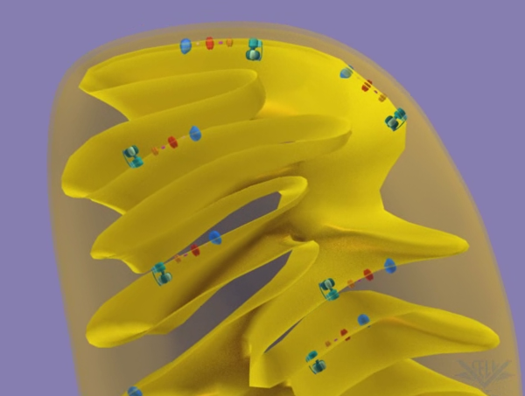
Mitochondrial Outer Membrane
``
Intermembrane Space (w/ Hydrogen atoms)
Flowing Hydrogen
Mitochondrial Inner Membrane
ATP Synthase
Mitochondrial Matrix (inside)
As hydrogen moves past ATP Synthase, it causes it to turn. As ATP Synthase turns, it makes ATP from ADP and P_{i}.

Slide 8
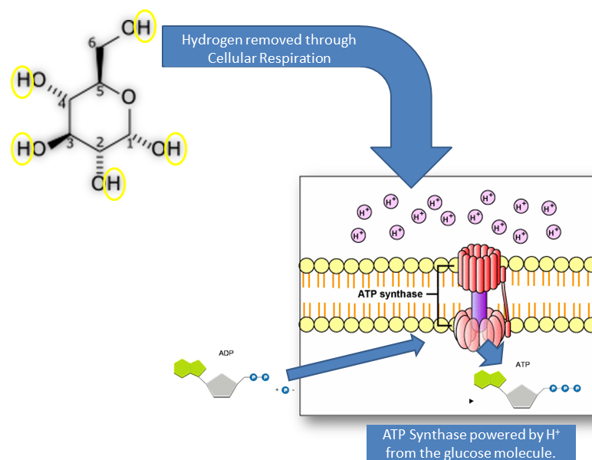
Cellular Respiration
The main point of cellular respiration is to obtain hydrogen atoms in order to power ATP Synthase.
  These H+ atoms primarily come from glucose
    (although fat and other components of food can be used as a source of hydrogen as well).
A series of multiple
chemical reactions
are necessary to break
down glucose in
order to remove the
hydrogen atoms.
  The process of cellular
  respiration can be broken
  into four basic steps
  Each step consists of
  multiple chemical reactions
Source: student.ccbcmd.edu

Slide 9
Steps of Cellular Respiration
1. Glycolysis: glucose is split in half to become 2 pyruvates. This occurs in the cytosol. Some hydrogen is removed.
2 ATP are used, but 4 ATP are produced via Substrate-level Phosphorylation.
2. TCA Cycle: Pyruvates move from the cytosol into the matrix (innermost middle) of the mitochondria. The remaining hydrogen is all removed during the TCA Cycle.
3. Electron Transport System: the hydrogen atoms that were removed from glucose are moved into the intermembrane space between the membranes of the mitochondria.
4. Oxidative phosphorylation: the hydrogen is used to turn ATP Synthase so that ATP can be produced from ADP and P_{i}

Slide 10
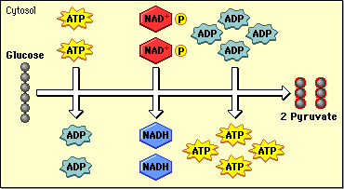
Step 1: Glycolysis
Glycolysis: glucose (C₆H₁₂O₆) becomes 2 pyruvates (C₃H₄O₃) and 4 H⁺ atoms
  ATP transfers energy on a phosphate to split glucose in half.
    Note: only carbons are shown in the image below to simplify it
It takes energy to break apart a glucose molecule:
2 ATP molecules to be exact.
  However, we do
  get 4 ATP back eventually
  Glycolysis has a final gain
  of 2 ATP (-2+4 = +2)
ATP is re-created in Glycolysis
using Substrate Level
Phosphorylation (next slide)
Source: phschool.com

Slide 11
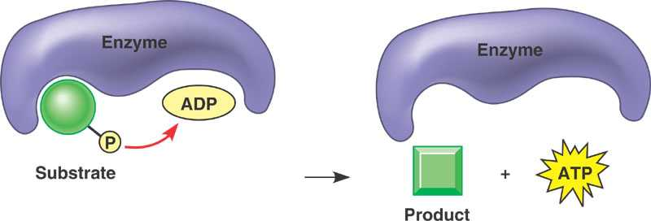
Substrate Level Phosphorylation
ATP production during Glycolysis is slightly different than in the rest of the stages.
  Instead of using ATP Synthase to produce ATP, ATP is produced by an “exchange” kind of chemical reaction.
  Production of ATP using an enzyme
  reaction to transfer a phosphate to ADP
  is called Substrate Level Phosphorylation.
  To “phosphorylate” means to add a phosphate
In glycolysis in the cytosol, an enzyme
moves the phosphate from the halved
glucose onto the ADP .
  This is different than what occurs later in
  the mitochondria, where the phosphate
  (P_{i}) must be added by the “turning
  wheel” of ATP Synthase.

Slide 12
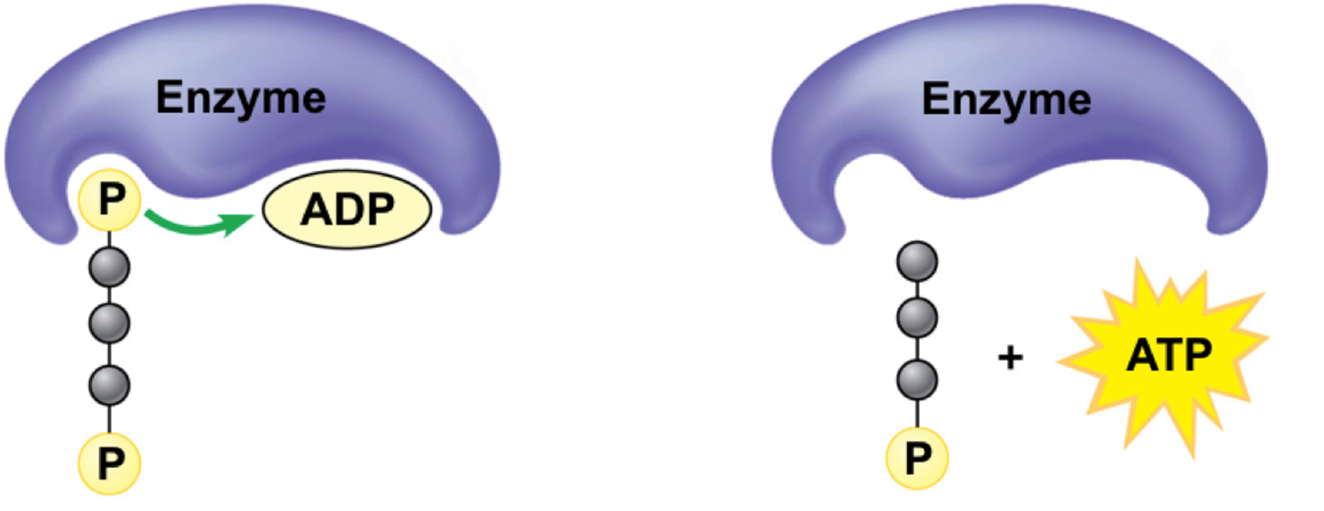
Substrate Level Phosphorylation
Source: www.studyblue.com
This “half” of glucose (with its 2 phosphates), goes into an enzyme with an ADP molecule.
When glucose is split in half by ATP, each half acquires 2 inorganic phosphate molecules (P_{i})
After the enzyme is done, a phosphate will moved from the “glucose half” to ADP to make ATP.

Slide 13
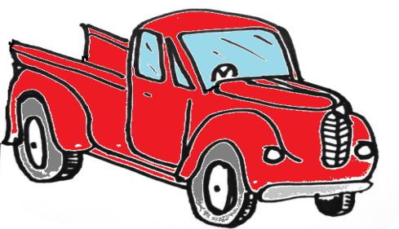
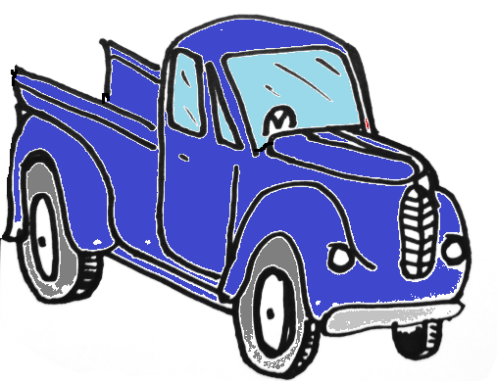
Step 2: TCA Cycle
TCA Cycle: The pyruvate molecules get completely broken down.
  The 2 pyruvate molecules were formed when glucose was split in half.
  The 2 pyruvate molecules leave the cytosol and enter the matrix (the innermost middle) of the mitochondria.
H⁺ atoms are taken off of the disassembled glucose molecule by NAD⁺ and FAD⁺ at different points of the TCA Cycle.
  NAD⁺ and FAD⁺ are sort of like
  molecular pickup trucks for hydrogen.
  When NAD⁺ and FAD⁺ pick up a hydrogen,
  they become NADH and FADH₂.
During glycolysis and the TCA cycle,
6 CO₂ will be produced.
  These are made from the six original
  carbons on glucose (C₆H₁₂O₆)
H⁺
FAD⁺
H⁺
NAD⁺

Slide 14
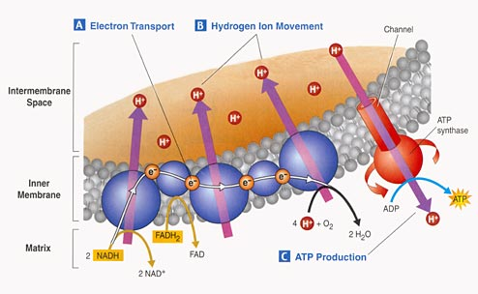
Step 3: The Electron Transport System
Electron Transport System: H⁺ is moved from the matrix to the intermembrane space.
  The inner membrane of the mitochondria has special proteins that get hydrogen from NAD+ and FAD+ in the matrix and cram it into the intermembrane space.
  These proteins are
  powered by electrons
  taken from the
  glucose molecule.
    These electrons
    were removed
    from glucose
    during glycolysis
    and the TCA cycle.
Source: teachersdomain.org

Slide 15
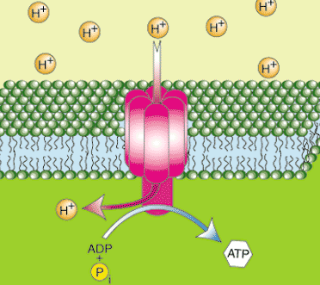
Step 4: Oxidative Phosphorylation
Oxidative Phosphorylation: H⁺ is used to turn ATP Synthase, powering ATP production
  The H⁺ atoms are crammed into the intermembrane space – they want to get out!
  The only way out of the
  intermembrane space is
  through ATP Synthase (like
  a revolving door)
  As hydrogen atoms move
  past ATP Synthase, they
  turn it, powering the
  production of ATP from
  ADP and P_{i}
Source: http://www.sparknotes.com/biology/cellrespiration/oxidativephosphorylation/section3.rhtml

Slide 16
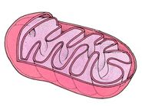
Step 4: Oxidative Phosphorylation
“Phosphorylation” means to gain a phosphorus atom
  ADP is phosphorylated to become ATP – ADP gains a P_{i}
    E.g. “education” is the process of getting educated
  For every H+ delivered by NAD⁺ and FAD⁺ 3 ATPs are created
After hydrogen atoms move
past the ATP Synthase, they
enter the matrix.
  Here, H⁺ atoms must be picked
  up by an oxygen atom.
  When two hydrogen atoms bond
  to an oxygen atom, they form
  H₂O (water).
O₂
Glucose
CO₂
H₂O
Source: www.biologycorner.com

Slide 17
Oxidative Vs. Substrate Level Phosphorylation
During glycolysis in the cytosol, ATP is formed by Substrate Level Phosphorylation
  In this case, ATP is created by an enzyme that “transfers” an inorganic phosphate (P_{i}) from the halved glucose onto ADP.
In the mitochondria, ATP is formed by oxidative phosphorylation (when ATP Synthase protein powered by the H⁺ from glucose makes ATP).
  In oxidative phosphorylation, H⁺ moving through ATP Synthase turns a “wheel” that smashes an inorganic phosphate (P_{i}) onto an ADP to make ATP.

Slide 18
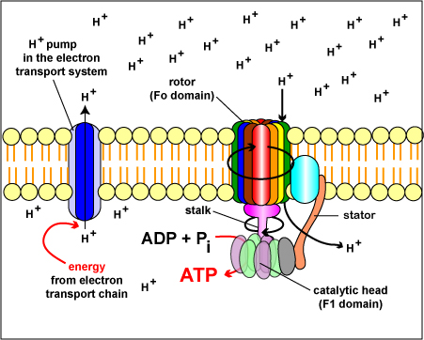
‘Clogged’ ATP Synthase
If hydrogen wasn’t removed from the matrix by oxygen, it would “clog” ATP Synthase.
  This would slow and eventually stop ATP Synthase from turning.
  If ATP Synthase doesn’t turn, ATP isn’t produced.
  If ATP isn’t produced, most cells will eventually shut down because they won’t have enough ATP to power cellular activity.
    Exception: cells that can produce ATP by fermentation.
The lower the concentration of hydrogen in the matrix, the faster ATP Synthase turns and the faster ATP is produced.
  More oxygen in the matrix means faster H⁺ removal
    This is why you breathe more heavily
    during exercise than at rest
    During exercise, you need more oxygen
    to remove more H⁺ to turn ATP Synthase
    faster to make ATP more quickly
  In agriculture, plants & animals that can
  produce more ATP will produce more food.

Slide 19
What if there is no oxygen?
As long as there is oxygen present, it will bind to the hydrogen in the matrix (innermost middle) of the mitochondria.
  Oxygen will continue to go to the matrix to bind with H⁺ to form water and leave the mitochondria.
  Oxidative Phosphorylation produces 36-38 ATP.
However, if there is no oxygen, Oxidative Phosphorylation cannot occur and ATP cannot be made by ATP Synthase in the mitochondria.
  ATP can be made by Substrate-level Phosphorylation in the cytosol.
  However, this kind of phosphorylation only produces 2 net ATP.
This occurs in humans for short periods when not enough oxygen is available (such as when you are sprinting).
  It also occurs in some microorganisms when they ferment.
  Fermentation – the breakdown of glucose into ethanol to produce small amounts of ATP in the absence of oxygen.
    Energy does remain in the ethanol that is excreted.

Slide 20
In a nutshell…
Five ways to maximize Mitochondrial ATP Production
(Note: max ATP = max food production by plants & animals):
Maximize H⁺ in the intermembrane space
Minimize H⁺ in the matrix.
Maximize O₂ in
the matrix
Maximize the
number of ATP
Synthase.
Maximize the
number of total
mitochondria in
an organism’s cells.

Slide 21
Summary of Cellular Respiration
Glucose is consumed, enters the bloodstream, and is absorbed by cells
  Glucose is absorbed by cells because higher concentrations are found in the blood than inside the cells.
Glucose enters the cytosol of the cell and is broken in half into 2 pyruvates
  ATP is produced by substrate-level phosphorylation
The pyruvate molecules enter the matrix (innermost middle) of the mitochondria and are broken down in a series of steps so that hydrogen can be removed
  A total of 6 CO₂ molecules are released during cellular respiration (from the original 6 carbons)

Slide 22
Summary of Cellular Respiration
As glucose is broken down completely, NAD⁺ and FAD⁺ collect hydrogen atoms (like a molecular pickup truck)
The hydrogens are brought to the inner membrane of the mitochondria; there they are crammed into the intermembrane space by protein pumps
  The protein pumps are powered by the electrons taken from the glucose molecule.
The hydrogen atoms that are crammed in the intermembrane space want to leave; the only way out is through ATP Synthase.
As H⁺ atoms move through ATP Synthase, they turn the “revolving door”; when ATP Synthase turns, it makes ATP
  With each H+ atom, 2-3 ATPs are created from ADP and Pi

Slide 23
Review Concepts
List the parts of the mitochondria and where each step of respiration occurs in the cytosol/mitochondria.
State the differences and similarities between substrate-level phosphorylation and oxidative phosphorylation.
Identify the roles of glucose, pyruvate, NAD+/FAD+, the TCA cycle, the Electron Transport System, hydrogen, ATP Synthase, and oxygen.
List 5 ways to increase ATP production
Summarize the 4 steps of respiration: Glycolysis, TCA cycle, Electron Transport System, and Oxidative Phosphorylation.

