Slide 1
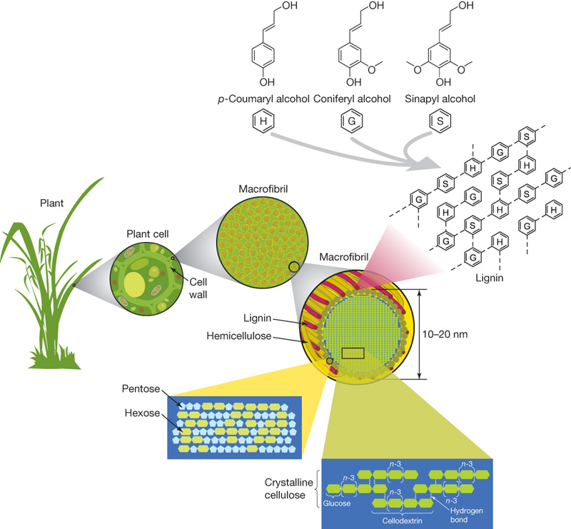
Cellulosic Ethanol
By C. Kohn
Agricultural Sciences
Waterford, WI
Source; www.nature.com

Slide 2
Imperfect Ethanol
Ethanol is still far from a perfect fuel.
The biggest drawback of ethanol is its reduced energy content compared to gasoline.
Per gallon, ethanol contains about 30% less energy than gasoline.
E85 contains about 25% less energy than gasoline.
This means that it would take more gallons of fuel to go the same distance if ethanol is used instead of gasoline.
Ethanol can be more expensive compared to gasoline.
The cost of ethanol and the cost of gasoline fluctuate differently because of different markets, meaning that sometimes ethanol is cheaper, and sometimes gasoline is cheaper.
As prices of gasoline have decreased due to a surplus of shale oil, the price of ethanol compared to gasoline has become less favorable.
As of December 2014, ethanol was $2.40 per gallon versus $1.73 for unleaded gasoline.

Slide 3
Imperfect Ethanol
Ethanol is very corrosive.
While most vehicles made after 2001 can handle ethanol blends, very few vehicles can handle pure ethanol or E85.
This is largely because ethanol is corrosive, and will break down non-metallic parts of the engine over time (particularly hoses, gaskets, and any components made from plastic or rubber).
Ethanol can absorb water and dirt very easily; especially in older engines where these contaminants are not filtered out successfully, they can cause damage and corrosion inside the engine block.
Corn ethanol can only replace a fraction of the transportation energy needs of Americans.
In 2012, biofuels accounted for only 7% of total transportation fuel consumed in the US.
If all of the corn produced in the US were converted into ethanol fuel, it would only displace 25% of the transportation fuel used by Americans.

Slide 4
Imperfect Ethanol
Ethanol can have a very negative environmental impact depending on how its feedstocks are grown.
If large amounts of native habitat are cleared for monoculture crop production, the environmental benefits of ethanol can be outweighed by the environmental damage.
Monoculture crop production is when only one species is grown in a field.
Not only does the clearing of habitat for crop production affect ecological sustainability, but this will also reduce the amount of CO₂ absorbed from the atmosphere.
Because native vegetation tends to absorb more CO₂ for longer periods, replacing native vegetation with crops will offset any reductions in CO₂.
Depending on how it is made, ethanol can require large amounts of fossil fuels.
Because corn production can involve intensive practices that require large amounts of fossil fuels, the method in which corn is grown can greatly affect the sustainability of ethanol.
If corn is produced using large amounts of fossil fuels, the sustainability, energy balance, and CO₂ emissions will be far more harmful than if corn is grown using more low-energy, sustainable methods.

Slide 5
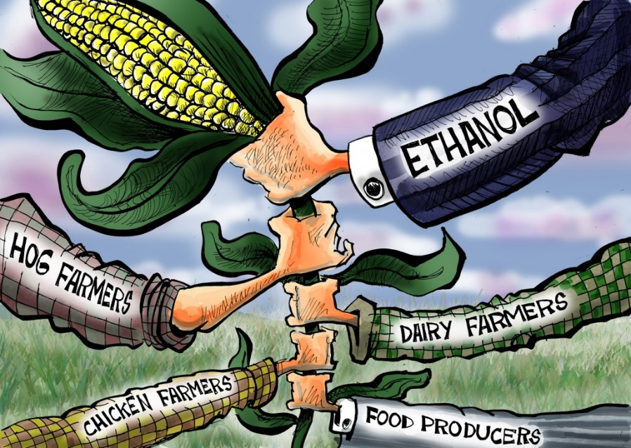
Competition w/ Food
Ethanol production may compete with food production, possibly causing increased food prices.
In 2000, over 90% of the U.S. corn crop went to feed people and livestock; less than 5% was used to produce ethanol.
In 2013, 40% of U.S. corn went to produce ethanol; 60% was used to feed people and livestock.
While ethanol’s competition with corn for food is lessened by the utilization of Distillers Dried Grains (DDGs) as feed for cattle, DDGs account for less than a third of the corn kernel’s weight.
Because the U.S. produces 40% of the world’s corn, how the majority of that corn is used can have major ramifications on food prices.
Source: happyhourforyourbrain.blogspot.com

Slide 6
Why Bother?
If ethanol has so many drawbacks, why even bother with it?
First, it is important to remember why we are seeking an alternative to fossil fuels.
The overdependence on foreign fossil fuels threatens the national and economic security of the United States, as evidenced by the oil embargos of the 1970s.
Secondly, the use of fossil fuels the cause of some of the most harmful effects on the environment and sustainability and is a leading contributor to climate change.
Finally, fossil fuels are limited and will become increasingly limited. While there is a large supply of fossil fuels at the moment due to easy-to-access shale oil, fossil fuels will become increasingly more difficult to obtain and more expensive as a result.
It is important to remember that corn ethanol is not the only kind of biofuel.
Corn ethanol has a positive energy balance, is carbon neutral, and reduces the needs for hundreds of millions of barrels of oil.
However, corn ethanol also has many drawbacks including environmental impacts, limited capacity for production, and the potential to require as much fossil fuel as it displaces for corn production.
Not all ethanol is corn ethanol, and not all biofuels are ethanol.

Slide 7
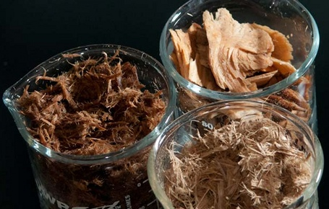
Cellulosic Ethanol
Cellulosic ethanol has the potential to become an even-more valuable fuel than corn ethanol.
Unlike corn, cellulosic ethanol can be produced from a wide variety of sources (including corn).
Because cellulose is the most abundant organic molecule on earth, the potential amount of fuel that is able to be produced from cellulosic ethanol is far greater than what could be produced from corn ethanol alone.
Agricultural and forest residues (such as wood chips, grasses, and corn fodder) could produce enough ethanol (60 billion gallons per year) to displace 30% of US gasoline consumption by 2030 using infrastructure and businesses that are already in existence.
Source: spectrum.ieee.org

Slide 8
Cellulosic Ethanol
Cellulosic ethanol has many potential benefits over corn ethanol, including…
A greater potential supply of cellulosic ethanol that could more effectively reduce our reliance on fossil fuels.
A more positive energy balance than corn ethanol.
Less reliance on fossil fuels during production.
Less likelihood of displacing native habitat.
Greater potential reductions in atmospheric CO₂.
Potential avoidance of monocultural production (e.g. if prairie grass is used as a feedstock).
Generally greater drought tolerance.
Generally reduced need for fertilizers and pesticides.
Most cellulosic feedstocks are perennial crops (regrow every year), whereas corn is an annual crop (it has to be planted every year).

Slide 9
Cellulose – A Difficult Molecule
The greatest drawback of cellulosic ethanol is that it is very difficult to produce ethanol from cellulosic feedstocks.
While cellulose is made of long chains of sugar, these sugars are locked in a complex polymer that resists breakdown.
A polymer is a long repeating chain of a molecule.
In this case, cellulose is a long, repeating chain of glucose.
Cellulose is what comprises the cell wall of plants; because plants depend on the cellulose in their cell walls for structure and rigidity, it is important to the plant that the cellulose is not degraded.
Plants have evolved over hundreds of millions of years to resistant degradation by the weather, bacteria, fungi, insects, etc. As a result, breaking down the cellulose to a point in which it can be fermented into ethanol is extraordinarily challenging.
Source: http://www.facstaff.bucknell.edu/mvigeant/thermo_demos/mathiasmetzmetzler/images/cellulose.gif

Slide 10
Cell Walls – Intricate Networks
Plant cell walls are composed of an intricate combination of cellulose, hemicellulose, lignin, and other molecules.
Most of the mass of the cell wall is made up of cellulose and hemicellulose; hemicellulose is molecule that forms a protective sheath around cellulose and increases the level of protection against degradation.
Lignin is an alcohol polymer that is found alongside cellulose and hemicellulose that adds to the structural strength of cell walls in the cells of plants; it is the ‘fiber’ in food and woody plants.
Source: http://www.intechopen.com/source/html/45623/media/image5.jpeg

Slide 11
Cellulose, like starch, is a complex carbohydrate made up of chains of glucose.
However, the bonds holding the glucose together in cellulose alternate orientation between every individual glucose molecule, meaning that enzymes that can break down simpler carbohydrates are unable to break down cellulose.
To complicate matters even further, the cellulose molecules are packed into tight crystals and then wrapped up in lignin and hemicellulose; the lignin and hemicellulose have to be degraded and broken down before the cellulose can even begin to broken down into individual glucose molecules.
This process is called “pretreatment” and is currently the most expensive part of the conversion process for cellulose ethanol.
Source: http://www.facstaff.bucknell.edu/mvigeant/thermo_demos/mathiasmetzmetzler/images/cellulose.gif

Slide 12
Source: http://www.facstaff.bucknell.edu/mvigeant/thermo_demos/mathiasmetzmetzler/images/cellulose.gif

Slide 13
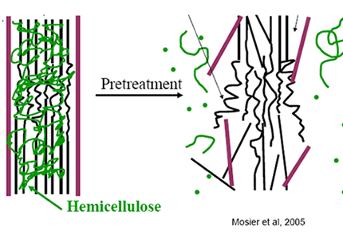
Pretreatment
Production of ethanol from cellulose requires additional steps compared to production ethanol from sugar cane and from corn.
Sugar cane can be directly fermented into ethanol, making it the simplest feedstock for ethanol production. However, sugar does not grow in most of the United States.
Corn must be first treated with heat and/or enzymes before it can be converted into ethanol.
To produce cellulosic ethanol, you must first get past the hemicellulose and lignin that surround the cellulose.
The elimination of the protection by hemicellulose and lignin in order to produce cellulosic ethanol is called pretreatment.
Source: www.purdue.edu

Slide 14
Hydrolysis
Once the cellulosic feedstock has undergone pretreatment, the cellulose molecules must be broken down into individual glucose molecules in a process called hydrolysis.
Hydrolysis is the chemical breakdown of a molecule.
In sense pretreatment is the “unraveling” step and hydrolysis is the “unpacking” of each individual glucose molecule from the cellulose polymer.
Source: www.biotek.com

Slide 15
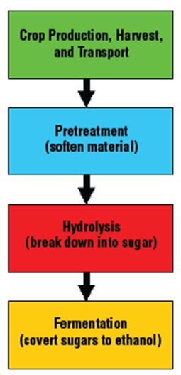
The Most Difficult Steps
Pretreatment and hydrolysis is the primary obstacle standing between now and a future of a plentiful and affordable supply of cellulosic ethanol.
The most common method use to pretreat cellulosic feedstocks is to use a dilute acid raised to a moderately-high temperature and kept under high pressure to disrupt or dissolve the lignin and hydrolyze the hemicellulose.
This then exposes the cellulose for hydrolysis into glucose.
While it is technically feasible to produce cellulose ethanol using this common pretreatment method, the problem is that it makes cellulosic ethanol more expensive than gasoline.
The Department of Energy has determined that in order to be economically viable, the cost of producing cellulosic ethanol has to be reduced to $1.07 or less (in 2002 dollars).
Source: Cellulosic Ethanol—Biofuel Beyond Corn

Slide 16
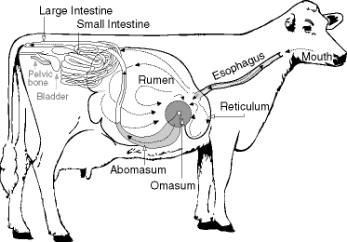
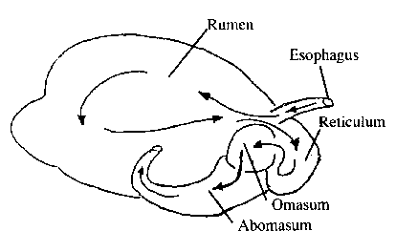
The Models of Success
However, there are reasons to believe that methods will be found to make the production of fuel from cellulose more efficient and cost effective.
The primary reason to believe that cellulose can be used as a primary source of energy is because one species has already succeeded at doing this: the dairy cow.
The processes needed to convert ethanol into a fermentable source of ethanol are the same processes that a dairy cow uses to produce milk from hay, alfalfa, and other sources of ethanol.
Source: babcock.wisc.edu
Source: www.agricultured.org

Slide 17
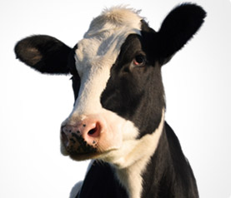
The Steps for a Cow
To convert grasses, hay, or alfalfa into a source of a bodily energy, a cow must undergo the following steps:
First, a cow has to acquire a source of cellulose to consume, bringing that feed into her mouth.
Next, she has to grind the cellulose she has consumed into smaller and smaller particles to make it easier for the enzymes produced in her rumen (first stomach chamber) to more easily break down the cellulose molecules.
Third, enzymes produced by microbes in her rumen break down the lignin and hemicellulose, unraveling it from the cellulose.
Fourth, the cellulose has to be hydrolyzed into glucose by cellulase enzymes produced by other microbes in the cow’s rumen.
Finally, other microbes will ferment the glucose that was unpacked from the cellulose polymers into a source of energy that the cow’s body can use.
Source: dairy.merial.us

Slide 18
The Steps for People
Similar steps exist for the production of ethanol from cellulosic feedstocks.
First, the feedstock has to be harvested and transported to a production facility.
Next, that feedstock has to be ground down into fine particles.
Third, the feedstock has to be pretreated with acids and heat in order to break down the lignin and hemicellulose and expose the cellulose polymers.
Fourth, cellulase enzymes are needed to break down the cellulose into glucose.
Fifth, the glucose has to be fermented into ethanol.
Finally, the ethanol must be distilled (separated from the other non-ethanol components), processed, and shipped to a station where it can be sold as fuel.
Source: Cellulosic Ethanol—Biofuel Beyond Corn

Slide 19
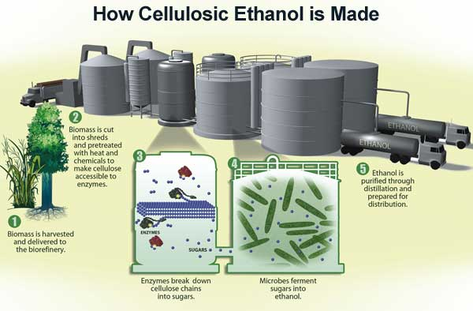
Source: www.csa.com

Slide 20
Millions of Years of Evolution
The reason cows and other ruminant animals can efficiently use cellulose as their primary source of energy is due to millions of years of natural selection and artificial selection (in the case of domesticated animals).
This selection pressure enabled ruminants to develop a hospitable environment in their rumen for microbes that produced the exact right amounts of enzymes needed for the efficient pretreatment and hydrolysis of cellulosic feedstocks.
Scientists are confident that if they can either discover the right kinds of enzymes produced naturally by microbes or synthetically develop and produce synthetic enzymes, they can reduce the difficulty of the steps of pretreatment and hydrolysis.

Slide 21
Hope for the Future
If the pretreatment and hydrolysis steps can be made more efficient and cost effective, this would lower the cost of producing cellulosic ethanol.
Due to the fact that cellulosic feedstocks are already produced through existing agricultural and forestry industries, cellulosic ethanol shows a lot of potential as a future major source of transportation energy that is renewable, widespread, made in the USA, carbon neutral, affordable, and sustainable.
Source: www.technologyreview.com

Slide 22
Works Cited
Works Cited:
https://www.glbrc.org/sites/default/files/Cellulosic_Ethanol.pdf
http://cool.conservation-us.org/byorg/abbey/ap/ap04/ap04-4/ap04-402.html
http://www.c2es.org/technology/factsheet/CellulosicEthanol
https://www.glbrc.org/education/classroom-materials/cb2e-converting-cellulosic-biomass-ethanol
Nathan S. Mosier. 2012. Cellulosic ethanol—Biofuel Beyond Corn. Department of Agricultural and Biological Engineering Purdue University.
Yang, B. Wyman, C. 2008. Pretreatment: the key to unlocking low-cost cellulosic ethanol. Wiley InterScience: DOI:10.1002/bbb.49 Biofuels, Bioprod. Bioref. 2:26–40
NREL. 2007. Research Advances: Cellulosic Ethanol. US Dept. of Energy.

