Slide 1
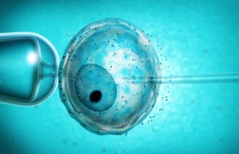
Cloning
By C Kohn
Dept of Agricultural Sciences
Waterford, WI

Slide 2
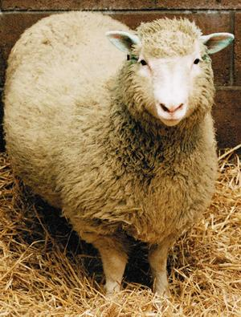
Questions
By taking and planting a leaf cutting, you can create a new plant with identical DNA. Is this cloning? Why or why not?
Could identical twins be considered clones? Why or why not?
If you cloned your dog, would the clone look and behave just like the original?
If someone cloned you, would that clone be any different from you? How so?
Is cloning ethical? Why or why not?

Slide 3
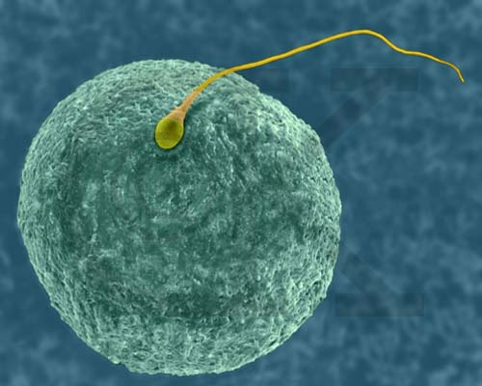
Early Experiments
One of the most complicated questions regarding genes in the early 1900s was how they changed as your cells diversified.
It is clear that when a sperm cell fertilizes an egg to create that first cell (a zygote), that particular cell must have every functional gene in order to become a fully developed adult.
What scientists did not know was whether the genes were ‘lost’ as cells specialized into skin cells, liver cells, nerves, etc., or if these genes were simply “turned off”.
What do you think? TPS

Slide 4
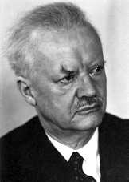
16 Salamanders
One of the first scientists to successfully address this question was the German embryologist Hans Spemann.
Spemann took a newly fertilized salamander zygote (fertilized egg) and tied it in half using a piece of hair.
One half contained the nucleus; the other half contained the rest of the cell.
The nucleus continued to divide, creating 2, then 4, then 8, then 16 individual nuclei.

Slide 5
16 Salamanders
After he allowed the nucleus to divide 4 times, Spemann loosened the hair so that one of the 16 nuclei could move to the other side of the cell.
Spemann then completed cut the cell in half to create 2 individual cells
One cell had 15 nuclei; the other had one nucleus.
Each of the two cells developed into a salamander (Spemann basically created identical twins).
This proved that an early embryo is totipotent, or able to develop into any kind of tissue.
Each of the 16 nuclei could each still become their own salamander at that point.

Slide 6
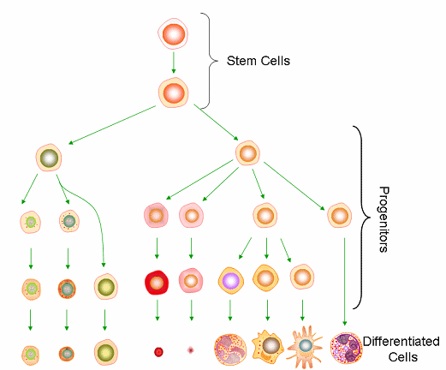
Significance of Spemann
Spemann’s work showed that early in cell division, each cell retained all of its DNA.
This suggested that cells did not “lose” DNA but that genes did become ‘silenced’ as cells differentiated.
Differentiation: when cells become specialized for a particular function.
E.g. skin cells’ genes are specific for the jobs related to being a skin cell.
Opposing hypotheses (that genes were ‘lost’ as cells divided) would not have allowed salamanders to form from the 16 different nuclei.

Slide 7
Briggs & King
Scientists were still unsure of the relationship between the nucleus and the cell.
Some thought that the nucleus had to be with its ‘own’ cell in order to function.
Others thought that the nucleus was like a bus driver and the cell like a bus (i.e. that the nucleus could be switched to any cell and still function).
After Spemann’s work, scientists wondered if cell nuclei could be moved from one species to another.
In 1952, US Scientists Robert Briggs and Thomas King carried out the first successful somatic cell nuclear transfer (SCNT).

Slide 8
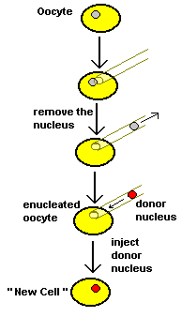
Somatic Cell Nuclear Transfer (SCNT)
SCNT is the process in which DNA from an egg cell is replaced with DNA from an adult or embryonic cell.
Basically, it means we switch the nucleus from one cell to another.
This is what we typically are referring to when we use the generic term “cloning”
Clone: an exact genetic replica of an organism.
Briggs and King removed the nucleus of a frog zygote (fertilized egg) using a pipette and inserted it into an unfertilized frog egg cell.
The re-nucleated egg became a tadpole.
This was the first case of modern animal cloning (In 1952!)

Slide 9
Briggs and King
The work of Briggs and King was significant because it showed that the nucleus of a cell was transferable.
In a way, the cell is like a bus – the bus goes wherever the bus driver drives it. The bus does not affect where it goes – only the driver decides this.
Cells, in a way, are similar – the nucleus is what controls what they become and what they do.

Slide 10
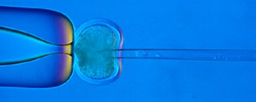
Remaining Questions
Despite these early successes, we still didn’t have a concrete answer to two key questions:
1. Do genes disappear or are they turned off?
2. Can any nucleus control any cell?
The work of a British scientist, John Gurdon, would help answer this question.

Slide 11
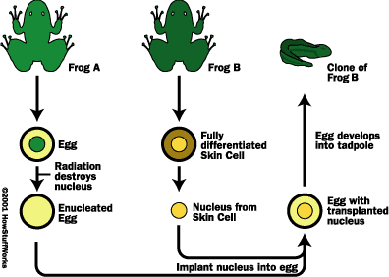
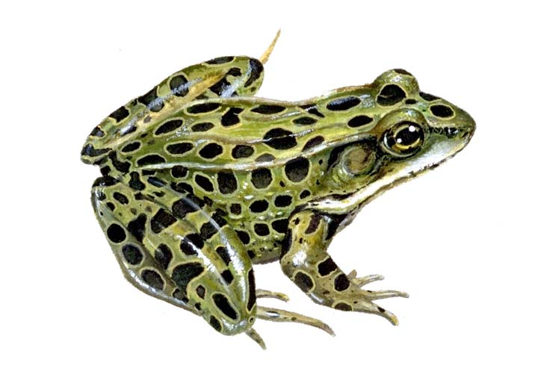
John Gurdon’s Work
Gurdon cloned tadpoles using the nuclei from fully differentiated cells taken from the intestines of adult leopard frogs.
These cells (w/ the nuclei from adult intestinal cells) grew into tadpoles.
Gurdon’s work showed that adult nuclei did not lose genes and still carried all the genetic information to create an entirely new animal.
Gurdon also showed that cell differentiation is reversible and not permanent.
I.e. genes stay the same but can be switched on and off.

Slide 12
Success Rates
Success rates were pretty meager in both the Briggs and King experiments and the Gurdon experiments.
Briggs and King had success in creating tadpole clones from transferred nuclei about 40% of the time.
Gurdon’s success rate was not nearly this high.
This was evidence that ‘reprogramming’ a cell’s genetic information became increasingly difficult as an animal developed and matured.
For decades later, a string of failures in other species led many to believe that the cloning of mammalian cells would never work.

Slide 13
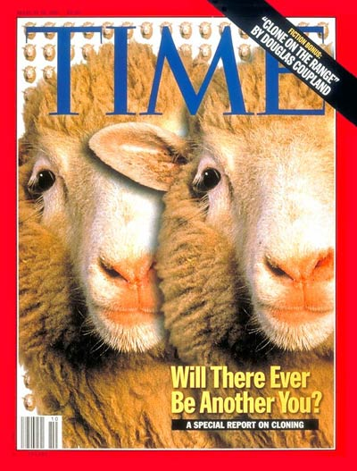
Dolly the Sheep
In 1996, Dolly the Sheep would prove skeptics of mammalian cloning wrong.
Scottish scientists Ian Wilmut and Keith Campbell created Dolly the Sheep by taking the nucleus from the mammary glands of an adult Finn Dorset sheep and put it into an enucleated egg from a different breed (the Scottish Blackface).
In short, they put a white-faced sheep nucleus into a black-faced sheep egg cell with its nucleus removed).

Slide 14
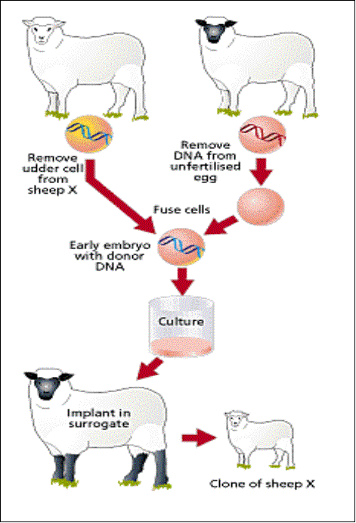
Creating Dolly
Dolly the Sheep was created via the following steps:
1. The nucleus of a Finn Dorset (white-faced) sheep was removed from an adult mammary cell.
2. This nucleus was inserted into an enucleated egg cell of a Scottish Blackface sheep.
3. The re-nucleated egg cell was jolted with electricity to induce the cell to start dividing.
4. The re-nucleated egg was put in the uterus of a Blackface sheep.
5. A few months later, the Blackface mother gave birth to a clone of a white-faced sheep: Dolly

Slide 15
Dolly Success Rates
It took 277 attempts to create Dolly – in other words, Dolly was the first success after 276 failed attempts.
Furthermore, Dolly was put down after 6 years of life due to a lung disease that was more common in older sheep.
When she died, she suffered from not only this lung disorder but also from obesity and arthritis.
It is still not known if her early death was due to her method of creation or because of her pampered lifestyle.
As a whole, cloned animals (the few that are successfully created) suffer from enlarged organs, problematic immune systems, joint problems, liver disease, and obesity.

Slide 16
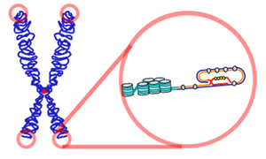
Cellular Age vs. Biological Age
One proposed hypothesis for this increase in physical problems in cloned animals is the difference between an animals actual age and their cellular age.
The age of a cell can be determined by the length of its telomeres.
Telomeres are the protective pieces of DNA at the end of chromosomes
They are sort of like the plastic caps at the end of your shoelaces.
Telomeres become shorter the more times a cell divides.

Slide 17
Cloning and Telomeres
As a cell divides more and more, its telomeres become shorter and shorter.
If telomeres become too short, that cell will not function as well and will stop dividing.
Dolly, like many cloned animals, had unusually short telomeres, a sign that her cells aged too rapidly.
However this is not true of ALL cloned animals – Hawaiian scientists in 2000 showed no signs of shortened telomeres over 6 generations of cloned mice
This showed that not all clones are subject to the telomere problem.
They would have kept going but a foster mouse mother ate the entire 6th generation

Slide 18
Human Cloning
The problems associated with animal cloning (low success rate, enlarged organs, immune failure, rapid cellular aging) easily convinced Congress to ban human cloning in 2001 after only 6 hours of debate.
Any human cloning would likely result in high rates of miscarriage and deformity
Those human clones that would make it to adulthood would likely face lives of great medical and psychological trauma.
This does not mean that everyone is against human cloning, but the majority agree with the ban.

Slide 19
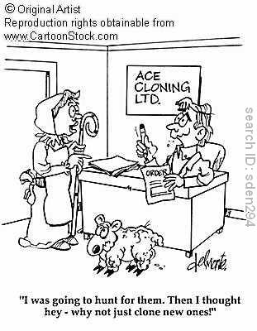
Why Clone?
Most cloning even today is rare and rarely occurs outside of agricultural research and developmental biology labs.
Very few commercial cloning firms exist – but there are some out there.
Given the large failure rate and high likelihood of physical problems, why would anyone want to clone? What practical applications would cloning have? TPS

Slide 20
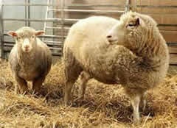
Why Clone
The primary reason for perfecting cloning technology would be so that we could mass-produce animals with useful qualities (like pharm animals).
E.g. The same lab that created Dolly also created the clone Polly (below) – a sheep that was genetically engineered to produce a medicine for hemophilia (blood clotting problem) in her milk.
Creating clones of genetically altered pharm animals would hypothetically be easier, faster, and cheaper than trying to create these same animals through standard breeding practices.
Once standardized, genetically altered nuclei could be grown in lab and inserted into enucleated cells, assembly-line style.

Slide 21
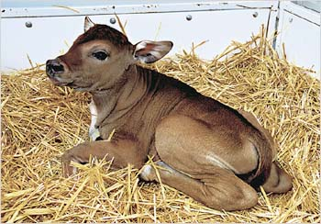
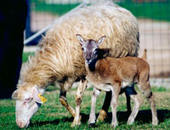
Endangered/Extinct Species
Cloning could also be used to create more of an endangered species.
For example, in 2001 a guar (endangered species of wild ox) was cloned.
Also in 2001, a baby mouflon (wild sheep) was cloned as well (left)
In 2004, a rare breed of cattle, the banteng, was cloned (right).
In 2004 a rare African wildcat was cloned.
Mammoth cloning has also been proposed, but would be far more difficult because the donor enucleated egg would be from a different species.

Slide 22
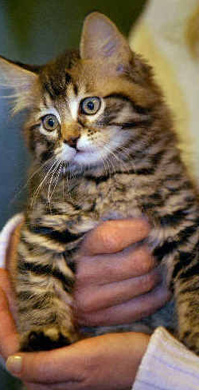
Pets
One of the first commercial applications of cloning was for pets.
In 2004, an airline worker from Dallas paid $50,000 to clone her pet cat Nicky. “Little Nicky” was born in October 2004.
While the owner claimed the clone was just like the original, this is not really true.
For one, not all DNA is found in the nucleus – some is also located in the mitochondria.
Because the enucleated donor egg provides the mitochondria, some DNA will be different.

Slide 23
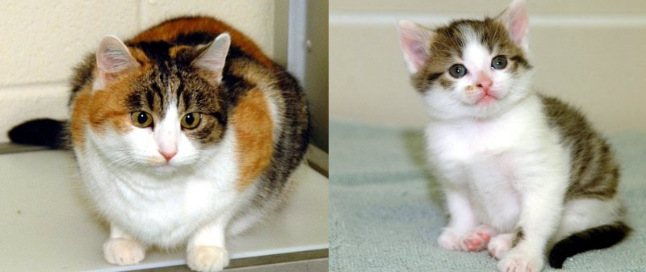
Cloned Cats
The first cloned cat, CC (short for “Carbon Copy”), did not even look like her original, Rainbow.
This is because some genes for hair color in cats are located on the X-chromosome.
Only one X-chromosome is needed for a cell to function; because of this, each cell randomly switches off an X-chromosome (in females, who have two X-chromosomes).
Rainbow (left) had patterns of black and orange – some cells expressed the ‘orange’ X chromosome and some cells expressed the ‘black’ one.
CC (right) was all black, meaning the ‘orange’ X chromosome in the cell nucleus she was cloned from was completely “switched off”.

