Slide 1
Color in Landscaping
By C. Kohn
Agricultural Sciences
Waterford WI

Slide 2
Color
Color is the difference in the visual appearance of objects due to how they reflect light into a person’s eyes.
Different objects appear to have different colors because of the wavelengths of the light they reflect.
In order to be seen, an object must reflect visible light.
Light is actually one of many kinds of electromagnetic radiation.
Radiation is any kind of moving energy.
There are many kinds of electromagnetic radiation, ranging from visible light to AM and FM radios waves, to X-rays and microwaves.

Slide 3
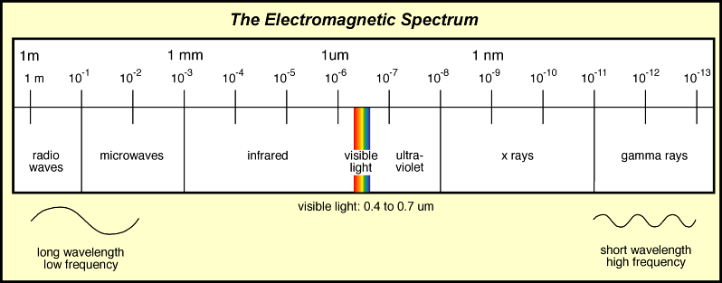
Electromagnetic Radiation
Electromagnetic radiation consists of two properties – the size of the wavelengths and intensity.
The wavelength of radiation (or frequency) is a measure of how are apart the peak of each wave of energy is from the peak o the next wave.
The human eye can detect electromagnetic radiation whose waves are 390-700 nanometers apart.
A nanometer is one billionth of a meter.
Source: http://www.columbia.edu/~vjd1/electromag_spectrum.gif

Slide 4
Electromagnetic Intensity
Electromagnetic intensity is a measure of how much radiation is being emitted from a source.
For example, a 100 watt incandescent light bulb and a 100 watt black light will each emit the same intensity of light.
However, the 100 watt incandescent bulb will appear brighter because it is detectable by our eyes (even though both bulbs are emitting the same intensity of radiation).

Slide 5
Radiation & Color
Color is detectable by our eyes because we have specialized nerves in our eyes called cones.
Cones detect light within specific wavelength ranges.
Most people have three kinds of cones.
Blue cones have maximum stimulation by light with a wavelength of 420 nm, Green cones by light with 530 nm, and Red cones by light with a wavelength of 560 nm.
The color of an object depends on the size of the wavelength it reflects back into the viewer’s eyes.

Slide 6
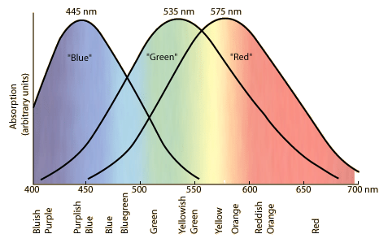
The three kinds of cones in our eyes are each stimulated by different wavelengths of light.
Source: http://hyperphysics.phy-astr.gsu.edu/hbase/vision/colcon.html#c1

Slide 7
Beyond blue, green, and red.
We obviously see more than just blue, green, and red colors.
The wide range of colors that people can detect is a result of which cones are stimulated, and to what extent they are stimulated.
For example, the color yellow is created when both green and red cones are stimulated to almost an equal extent.
Source: http://hyperphysics.phy-astr.gsu.edu/hbase/vision/colcon.html#c1

Slide 8
Undetectable Colors
When the wavelength of electromagnetic radiation is greater than 700 nm or less than 390 nm, our eyes are unable to detect this radiation.
That radiation is still occurring, but our eyes are not able to detect it.
This is similar to a dog whistle – we cannot hear this whistle when it is blowing, but sound is still being produced (as evidenced by the fact that a dog can hear it).
Similarly, if we play the lowest key on a piano, we can hear it but a dog cannot.

Slide 9
Color, Summarized
Color is the result of the different kinds of cones in our eyes becoming stimulated in varying ways by a very specific and narrow band of radiation, resulting in our brain “painting” what we see so as to create the sensation that each of these objects has a different appearance.
In reality, it is our brains that create the color of an object (not the object itself) based on the wavelength of light it reflects.
Things that appear “blue” to us do so because the light reflected from that object stimulated more of our blue cones than our red and green cones.

Slide 10
Properties of Color
Color has multiple properties, including…
Hue – this is the actual color (e.g. green, blue, red, yellow, etc.).
Value – this is how light or dark the color is (e.g. dark green or light red). Value can have shade or tint.
Shade is a hue that has been darkened; e.g. Navy is a shade of blue.
Tint is a hue that has been lightened; e.g. pink is a tint of red.
Tone is created by the addition of gray to create a “dusty appearance”; e.g. country blue is a tone of blue.
Intensity – intensity is how ‘strong’ the color appears to us.
E.g. if gray has been added to a color, it will appear muted and duller than if that hue exists in its purest form (such as ‘fire engine red’).

Slide 11
Originally found at http://www.tigercolor.com/color-lab/color-theory/color-theory-intro.htm#complementary

Slide 12
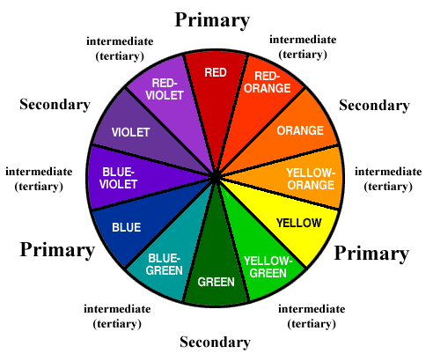
Hue
Hue is the descriptive name of the color (e.g. what you see as the name on the side of the crayon).
Hues are organized by using a color wheel, which consists of twelve hues.
Source: http://cios233.community.uaf.edu/files/2011/10/color_wheel.gif

Slide 13
Color Wheels
The primary colors on a color wheel are red, yellow, and blue.
These colors are spaced equidistantly on the color wheel.
In design, they cannot be created by mixing any other colors.
Source: http://cios233.community.uaf.edu/files/2011/10/color_wheel.gif

Slide 14
Color Wheels
The secondary colors on a color wheel are orange, green, and violet.
These colors are also spaced equidistantly on the color wheel.
These colors are created by mixing two primary colors.
Source: http://cios233.community.uaf.edu/files/2011/10/color_wheel.gif

Slide 15
Color Wheels
The tertiary colors on a color wheel are the colors created by mixing a primary and a secondary color.
These colors are hyphenated and the primary color is always listed first.
E.g. Red-orange and blue-green are examples of tertiary colors.
Source: http://cios233.community.uaf.edu/files/2011/10/color_wheel.gif

Slide 16
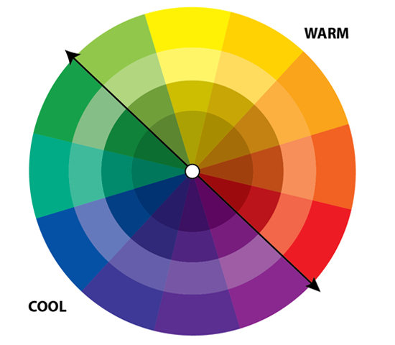
Color wheel categories
The color wheel can be broken into two kinds of categories.
Advancing/Warm Colors are those between red-violet and yellow.
Receding/Cool Colors are those between yellow- green and violet.
Source: http://operationwritehome.org/wp-content/uploads/2013/01/warm-and-cool.jpg

Slide 17
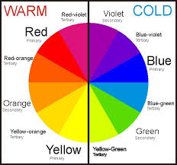
Warm Colors
Advancing/Warm colors appear to move toward the viewer.
A viewer’s brain will associate these colors with warmth, aggression, or excitement.
They can also seem cheerful or happy.
They tend to create a more informal look for a landscape.
Warm colors tend to make an object look larger.
If overused, warm colors can evoke a sense of irritation.
Source: http://www.beautyhows.com/wp-content/uploads/2013/03/How-to-Choose-Eyeshadow-Colors-%E2%80%93-Warm-and-Cool-Colors.jpg

Slide 18
Warm Colors
Receding/Cool colors appear to move toward the viewer.
A viewer’s brain will associate these colors with a sense of passive coolness.
They can also seem restful, peaceful, soothing, and sometimes even melancholy and depressing if overdone.
Cool colors tend to make an object look smaller.
They tend to create a more formal look for a landscape.
Source: http://www.beautyhows.com/wp-content/uploads/2013/03/How-to-Choose-Eyeshadow-Colors-%E2%80%93-Warm-and-Cool-Colors.jpg

Slide 19
Warm Color Scheme
Source: http://ebepp.com/wp-content/uploads/2014/01/small-backyard-landscaping-165.jpg

Slide 20
Cool Color Scheme
Source: http://procutlandscaping.com/blog/wp-content/uploads/2012/06/landscape-design-rockland-county.jpg

Slide 21
Harmony of Color
A color wheel can be used to determine which colors can be grouped together to create a sense of unity and harmony.
Colors that harmonize with each other do not “clash”.
Imagine a well-selected clothing outfit – if you would wear a combination of colors, those are probably colors that harmonize with each other.
Clothing that appears gaudy to a viewer may likely consist of colors that do not harmonize with each other or with the person’s skin tone or hair color.

Slide 22
Color Harmony Groupings
There are multiple kinds of color harmonies:
Achromatic Color Harmony consists of grouping neutral colors without any hues.
This would include black, gray, white, and any colors that do not appear on the color wheel.
Source: http://myworldofcolour.files.wordpress.com/2010/04/all_harmonies-021.jpg

Slide 23
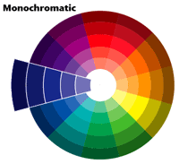
Monochromatic Color
Monochromatic color harmony consists of grouping different values of one hue.
For example, if a color scheme consisted of pink, mauve, red, burgundy, black, white, and gray.
Monochromatic color harmony evokes a sense of formality and professionalism.
Source: http://taylors2ddagnes.files.wordpress.com/2013/05/how-to-choose-eyeshadow-colors-e28093-monochromatic-colors.gif

Slide 24
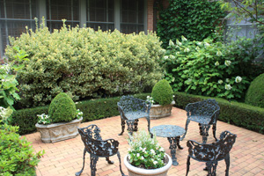
Monochromatic Color Harmony
This landscape consists primarily of values of green hue and neutral colors.
Source: http://www.caes.uga.edu/applications/publications/files/html/B1396/images/Figure%206.JPG

Slide 25
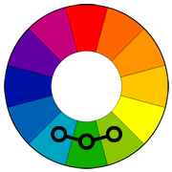
Analogous Color
Analogous color harmony is created when adjacent hues on the color wheel are used.
Analogous color harmony involves only one primary color which dominates the selection.
Analogous color creates a sense of serenity and comfort.
Analogous color schemes require a strong level of contrast and need a third achromatic color (black, white, or gray) to accent the selection.
Source: http://www.tigercolor.com/color-lab/color-theory/color-theory-intro.htm#complementary

Slide 26
Analogous Color
The colors used in the flowers are all red, pink, or red-violet.
Source: http://3.bp.blogspot.com/-PfFpZ6f4bTc/Tar5abRUbJI/AAAAAAAAAE0/Rh5gyAbbhJw/s1600/curb-appeal-1.jpg

Slide 27
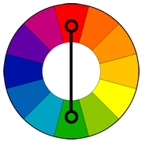
Complementary Color
Complementary Color Harmony is created when hues are used that are opposite from each other on the color wheel.
This could include blue and orange, purple and yellow, or red and green.
Complementary colors create a sense of vibrancy and enthusiasm (which is why they are so often used as collegiate colors and for pro-sports teams).
Source: http://www.tigercolor.com/color-lab/color-theory/color-theory-intro.htm#complementary

Slide 28
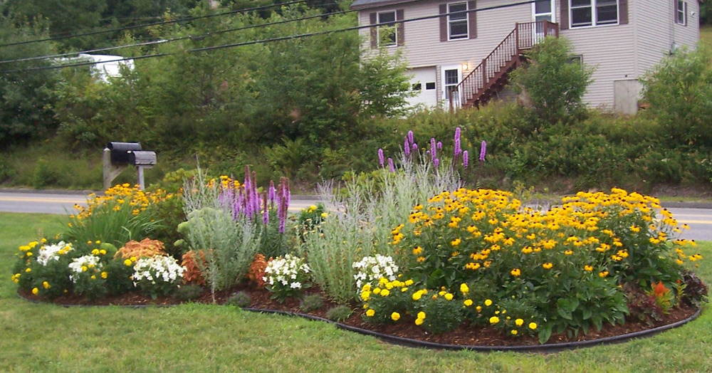
Complementary Color Harmony
This landscape is dominated by yellow and purple hues.
Source: http://www.simplebynaturelandscape.com/wp-content/gallery/residential-landscape-design/flower-landscape-design.jpg

Slide 29
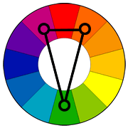
Split-Complementary Color
Split-Complementary Color Harmony consists of a hue and the two hues on either side of the hue opposite this first hue.
For example, red would be paired with yellow-green and blue green.
This harmony creates a strong sense of visual contrast, allowing the colors to stand out.
However, this does not create the same sense of ‘tension’ as the standard complementary color harmony.
This makes it ideal for situations in which a business needs to stand out but appear professional, such as a restaurant.
Split-complementary is a good beginner’s choice because it is difficult to get wrong.
Source: http://www.tigercolor.com/color-lab/color-theory/color-theory-intro.htm#complementary

Slide 30
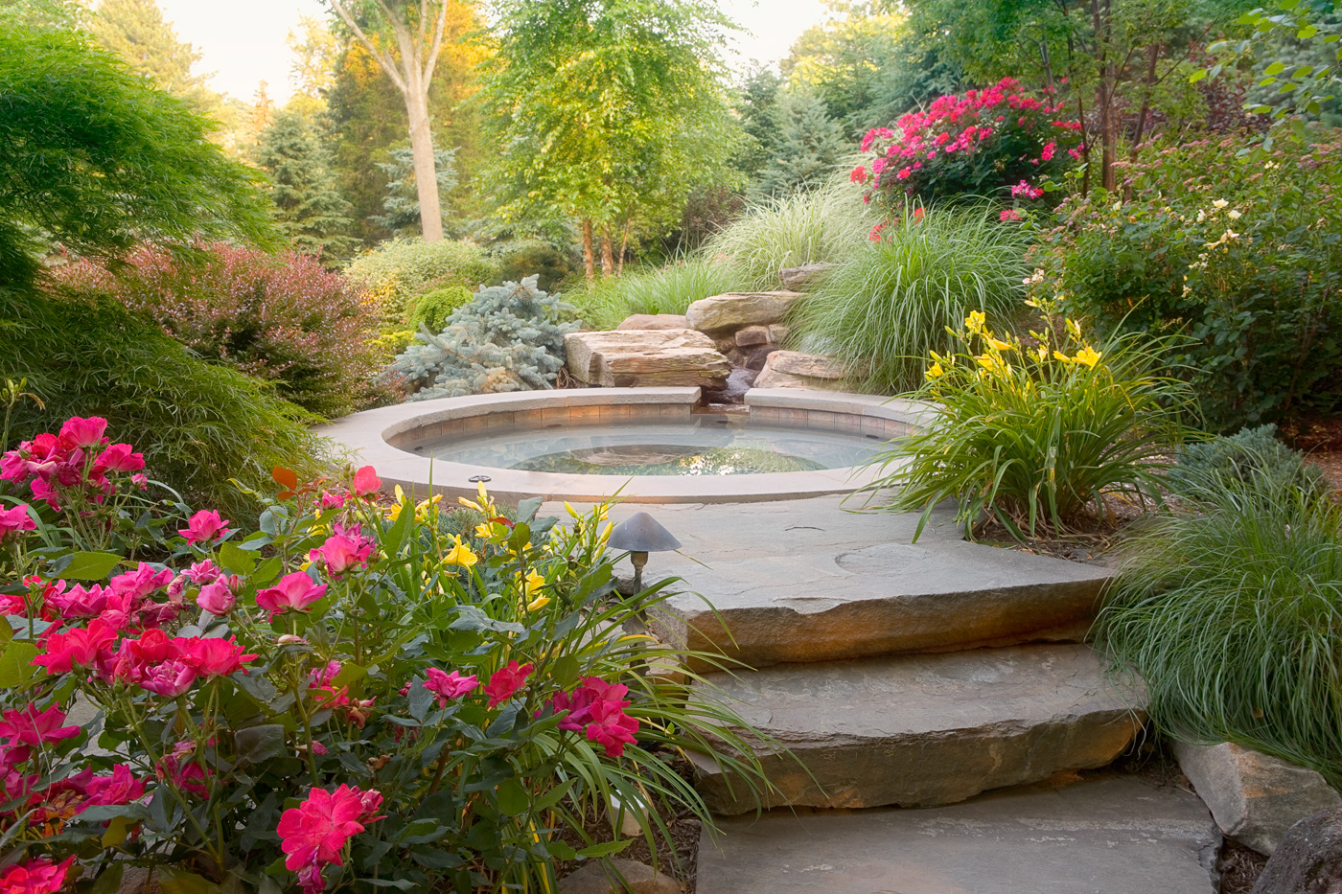
Split-Complementary Color
This landscape is dominated by red, yellow-green, and blue-green values.
Source: cordinglandscape.com

Slide 31
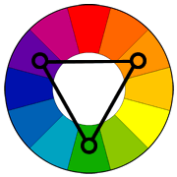
Triadic Color
Triadic color harmony consists of group three hues that are equidistant from each other on the color wheel.
This could be as simple as red, blue, and yellow or more complicated, such as yellow-orange, red-violet, and blue-green.
Triadic color harmonies also create a sense of vibrancy even if pale or unsaturated colors are used.
Source: http://www.tigercolor.com/color-lab/color-theory/color-theory-intro.htm#complementary

Slide 32
Triadic Color Harmony
Source: http://www.pwconsole.com/content/images/complimentary%20orange%20and%20blue.jpg

Slide 33
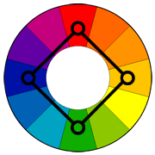
Square Color Harmony
Square color harmony consists of four colors, all equidistant from each other on the color wheel.
For this scheme to work, one color must be dominant over the other three.
Close attention must be used when balancing warm and cool colors.
Source: http://www.tigercolor.com/color-lab/color-theory/color-theory-intro.htm#complementary

Slide 34
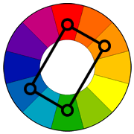
Rectangular Color Harmony
Rectangular color harmony consists of four colors separated by two different distances (e.g. two sets of hues each one color apart separated from the other set by three colors).
This scheme requires more skill and works best if one color is dominant over the other three.
The balance between warm and cool colors must be kept in consideration.
This scheme offers possibility for wide variation.
Source: http://www.tigercolor.com/color-lab/color-theory/color-theory-intro.htm#complementary

Slide 35
Rectangular Color Harmony
This landscape is dominated by yellow, green, red, and violet.
Source: http://qualitylandscapedesign.com/wp-content/uploads/2013/01/Front-Yard-Landscape-Designs.jpg

