Slide 1
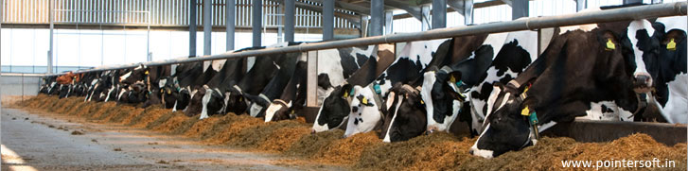
Dairy Herd Management
By C. Kohn
Agricultural Sciences
Waterford, WI
Source: www.pointersoft.in

Slide 2
Management at Birth
Good management of dairy cattle starts the moment that a calf is born.
Calves should be born in a clean area.
Mucus should be cleared from their nasal passageway immediately after birth.
Calves should be given colostrum (the antibody-rich milk produced at the time of calving) for the first three days to boost their immune system.
Their navel should be dipped with a 7% iodine solution.
The cow should be allowed to lick the calf clean once she is able to do so.
The calf should be removed from the mother once it has been licked clean.
This is primarily to ensure the health of the newborn calf because calves are at high risk for infectious disease and other disorders.
Source: agriculturalwithdrlindsay.com

Slide 3
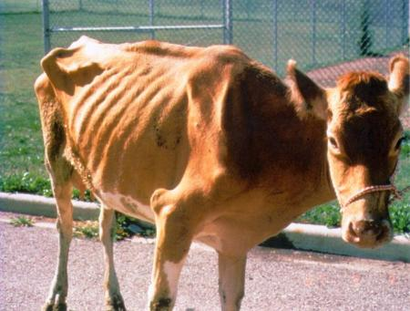
Johne’s Disease
One of the most significant risks to a newborn calf is Johne’s Disease.
Johne’s Disease is a very serious and often fatal illness in which the cow’s intestinal tract becomes infected by the paratuberculosis pathogen.
The signs of the disease (including severe weight loss and diarrhea) only become apparent in the late stages of the disease when the infected animal is unable to adequately absorb nutrients due to a swollen intestinal wall.
When these signs become visible, the animal will usually die within a few weeks.
Calves are most likely to become infected by consuming small particles of infected manure either from the teat of the mother or from the bedding itself.
It is vital for the health of the calf to bottle feed the calf by hand rather than let it drink directly from the teat of the cow (as the teat will be exposed to paratuberculosis pathogens in the environment if the pathogen is present in the pen).
Colostrum that is fed to the calf for the first three days should be tested for the presence of Johne’s disease to ensure that it is free of this pathogen.
Source: www.moredun.org.uk

Slide 4
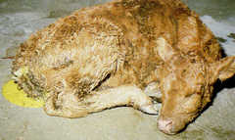
Scours
Scours is another common disease among newborn calves.
Scours is another term for enteritis (an infection of the intestinal tract), which causes severe diarrhea.
Most cases of calf scours occur under one month of age.
Overcrowding and poor sanitation are common causes of scours.
Newborn calves should be housed in individual pens that are free of drafts but provide good ventilation.
Overfeeding milk to the calf can also lead to diarrhea as can the ingestion of dirt or sand.
Calf scours can result in the loss of water and electrolytes from the calf’s body.
Electrolytes are minerals such as sodium and potassium that are necessary for the regulation of fluid levels in the body, and for the transmission of signals in the nervous system.
Source: calfology.com

Slide 5
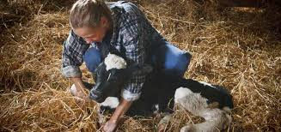
Treating Scours
Signs of scours include watery manure with an abnormal color (such as gray or green).
The stool (manure) may also have flecks or streaks of blood.
The calf’s eyes may become sunken due to dehydration and their skin may become stiffer and will not ‘snap back’ immediately if pinched.
As their condition worsens, a calf may be unable to stand; death may likely occur within a day at this stage without treatment.
Treating a calf with scours consists primarily of fluid and electrolyte therapy.
A calf needs to receive as much fluid and electrolytes as it has lost because of the disease.
Many products exist to restore the fluid and electrolyte balance in sick calves.
These products are usually administered orally by a bottle or by an esophageal feeder (if the calf will not or cannot drink on its own).
Source: www.delaval.com

Slide 6
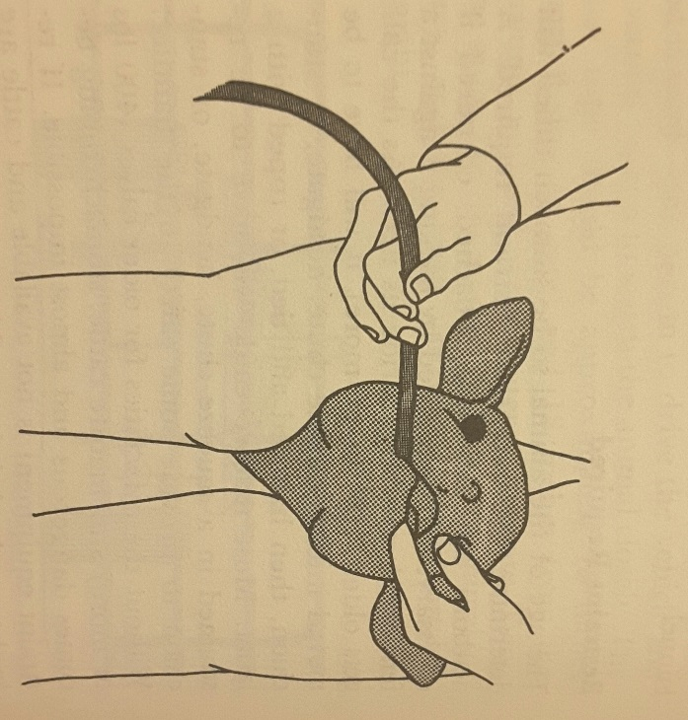
Esophageal Feeders
An esophageal feeder is designed to deliver fluids directly to a calf’s stomach via a tube.
The tube has a bottle or pouch on one end to hold the fluid and a plastic or steel ball at the other end to guide it down the calf’s esophagus.
An esophageal feeder should only be used by those with proper training; without training, it is very easy to accidentally introduce the fluid into the lungs of the calf instead of the stomach.
To administer treatment via an esophageal feeder, detach and moisten the tube of the feeder, and allow the calf to suckle on your finger.
Slowly move the ball of the detached tube to the back of its throat, allowing the calf to start swallowing the tube.
Slowly and gently move the tube down its throat, checking to make sure the ball of the tube cannot be felt in the calf’s ridged trachea (windpipe).
Attach the bottle or pouch and administer the treatment.

Slide 7
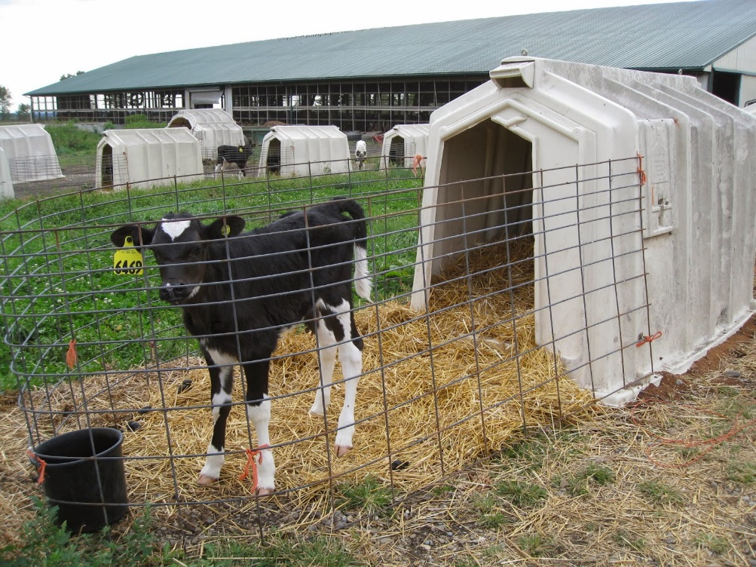
Housing & Feeding Newborn Calves
One of the most common methods of housing newborn calves is the use of hutches.
Calf hutches are small enclosures that are designed to keep calves dry and protected from extreme or uncomfortable environmental conditions.
Calf hutches should prevent calves from being able to make physical contact with other calves and should allow for easy cleaning and sanitation.
Often calf hutches can also include a wire enclosure that allows for the calf to move around outside to get exercise and for feeding.
Calf hutches should be bedded with clean, dry materials, such as straw or sawdust.
Source: thedairymom.blogspot.com

Slide 8
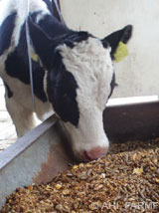
Calf Starter
For the first two weeks of life, calves receive most of their nutrition from milk.
Calves can either be fed whole milk from cows that has been tested to ensure it is free of disease, or a calf can be fed milk replacer.
Milk replacer is a dry milk powder that is reconstituted with water before being fed to the calf.
Calves up to two months of age should be fed milk twice a day, with the amount totaling about 10% of their birth body weight.
One quart of milk weighs about 2 pounds, so a Holstein calf weighing 90 pounds at birth would be fed 2.25 quarts per feeding when fed twice a day.
Calves up to two months of age should also receive calf starter.
Calf starter is a mixture of grains, protein source, minerals, and vitamins.
Calf starter is crucial to help the rumen, reticulum, and omasum (the stomach chambers of a ruminant that break down the plant material in the animal’s diet) to develop and become functional as they grow and mature.
Source: www.thebullvine.com

Slide 9
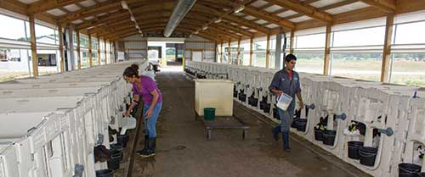
Weaning Calves
Calves should have free access to just a cup of fresh starter per day shortly after birth.
Increase the amount that the calf is fed to match their consumption as they begin to eat the starter.
Newborn calves should also have constant access to water (after they are four days old) in order to stimulate the maturation of their stomach chambers.
After eight weeks of milk, water, and starter, calves can be weaned from milk; at this time their stomach should be capable of digesting hay.
Source: www.hoards.com

Slide 10
Management of Fresh Cows

Slide 11
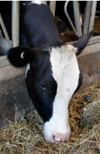
The First Weeks After Calving
How a dairy cow is managed in the first 2 to 4 weeks after calving has a major impact on their health, milk production, and reproductive performance.
Fresh cows (those that just freshened, or had a calf) need to maximize their intake of feed to sustain their high level of milk production.
Milk production is so high immediately after calving that a cow will actually have a negative energy balance (meaning that she will lose more energy in producing her milk than she will be able to consume in her diet).
A fresh cow will have to utilize stores of body fat to meet the high energy demands of this high level of milk production.
Cows will need an adequate (but not excessive) level of energy consumption in order to meet their energy demands without causing metabolic disorders.
Fresh cows should be housed separately from other cows for the first 2-4 weeks after calving.
This allows for them to be fed specialized rations to help meet their high energy demands, and allows for closer observation of each fresh cow in order to spot problems.
Source: agrinutrition.com

Slide 12
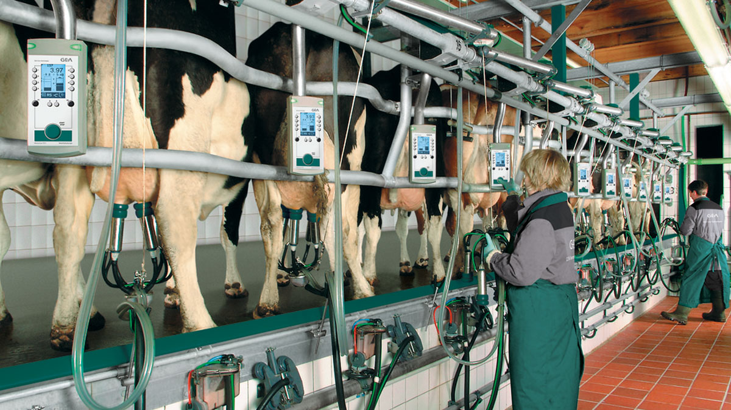
The Milking Process
A proper milking procedure is absolutely vital for the health of a dairy cow as well as the profitability of a dairy farm.
Proper milking procedures reduce the likelihood of infections of the udder (known as mastitis) and ensure that a high-quality food product reaches the consumer.
Proper hygiene and sanitation is absolutely vital to the operation of a milking parlor.
A milking parlor is the area of the dairy farm specifically for the milking of cows. Milking parlors must be cleaned after every milking and kept as sanitary as possible.
All employees and laborers should wear latex, rubber, or vinyl gloves while milking to prevent the spread of pathogens that can be spread in the crevices of the skin on the hands of milkers.
Source: www.gea.com

Slide 13
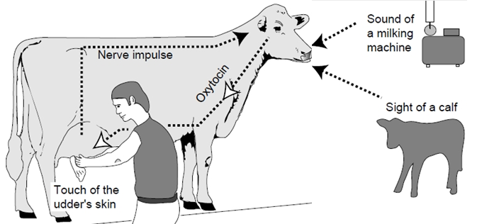
Milk Letdown
The milking process requires several steps, all of which are vital to enabling a cow to let down her milk, reduce the risk of mastitis, and ensure a quality food product can be produced safely, humanely, and profitably.
While a mechanical milking machine (or milking unit) is used to collect the milk using a vacuum, the milk is not just “sucked” from the cow.
Instead, a cow must be stimulated to let down her milk.
Source: bizplan-uz.com

Slide 14
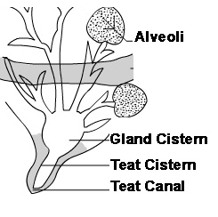
Milk Letdown Reflex
The factors that affect the Milk Letdown Reflex are critical for the milking process.
How well a cow is handled and the process that is used to milk a cow are all vital to ensure that a cow can feel comfortable enough to be properly milked.
To stimulate the Milk Letdown Reflex, the teats of the cow must be mechanically stimulated.
When nerve endings in the teats are stimulated by at least 10 seconds of touching, they will stimulate the brain to release oxytocin into the bloodstream.
Oxytocin is a hormone in mammals that causes the blood vessels in the teats to fill with blood.
This will cause the teats to become erect and allow milk from higher in the udder to fill the inside of the teats.
Oxytocin will also cause muscle cells deep inside the udder to contract and squeeze the milk producing components of the udder (called alveoli) to release the milk into the cistern (the milk-storage area of the udder).
Source: www2.ca.uky.edu

Slide 15
Low-Stress Environments
The Milk Letdown Reflex is also highly dependent on a low-stress environment.
Cows that are frightened or agitated before or during milking will release hormones such as cortisol that interfere with the milk let-down response.
Animals that are rushed, yelled at, in pain, or in an unfamiliar environment will not be able to fully let down their milk because of interference with oxytocin.
On the other hand, cows that are exposed to familiar surroundings, calm demeanors, and respectful humane treatment will have a full milk letdown and faster, more complete milking.
Because both manual stimulation and cleaning of the udder are necessary for proper milking, both can be performed simultaneously.
When milking a cow, all debris should be gently cleaned off of the udder and teats by hand.
A cow should also be stripped prior to applying the milk machine; “stripping a cow” means to remove a few streams of milk from each teat prior.
This not only prepares the udder for the milking machine but also allows the person milking the cow to check for signs of mastitis (infection in the udder).
Signs of mastitis include clumps or flakes in the milk, abnormally watery milk, or tinges of blood.

Slide 16
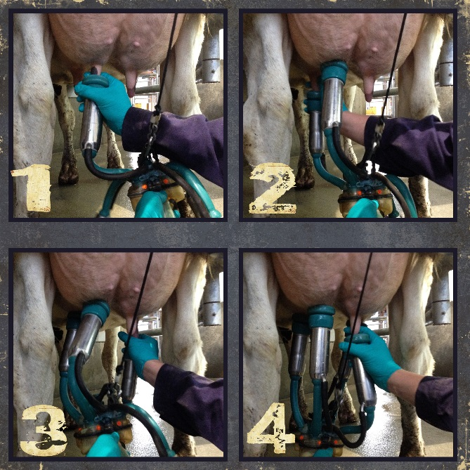
Predip, Applying the Milking Unit
Once the udder has been stimulated and each teat has been stripped, the teats should be washed.
Most cows’ teats are washed with a disinfectant solution (also called predip) using an application cup or a sprinkler cup.
The predip should be allowed to stay on the teats for at least 30 seconds to sufficiently kill any bacteria that could be introduced into the milk.
After 30+ seconds, the predip should be removed using a single-use paper towel (or cloth towel that is washed between milkings and only used once per cow).
Within two minutes of prepping the udder, the vacuum-powered milking machine should be attached one teat at a time.
Once applied, each milking unit should be examined to make sure it is properly applied to each teat.
Signs of improper application include sitting to high or low on the teat, kinking the teat as it was applied, sucking air, and slipping.
Improper application of the milking unit can result in irritation of the teats as well as an increased risk for mastitis.
If a cow is properly milked, no human hands should ever come in contact with milk sold for consumption.
Source: inuddernews.com

Slide 17
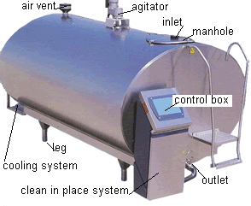
Concluding the Milking
The milking unit should be removed after the last quarter milks out.
A quarter is the portion of the udder that drains into each teat.
Most modern parlors use milking units that will sense when the cow’s udder is sufficiently emptied and automatically remove the milking machine; these units must still be watched to make sure they are correctly sensing the changes to the flow of milk.
Each teat must be covered in a post-dip teat disinfectant product immediately after milking to reduce the risk of mastitis.
The milk should be cooled to under 40º within an hour of milking using a storage container such as a bulk tank with refrigeration.
Any cattle treated with antibiotics or suffering from mastitis should be milked separately and their milk should be dumped instead of being added to the milk for sale in the bulk tank.
Source: en.wikipedia.org

Slide 18
Dairy Herd Genetics

Slide 19
Genetic Improvement
In order for the cow to remain profitable, she must be re-bred as quickly as is reasonably possible.
The reproductive tract of the cow requires at least 30 days to completely recover after a normal calving.
In this time, a producer must determine which genetics he or she intends to use when the cow is re-inseminated.
Genetic improvement to a herd of cows depends on four key factors.
Accuracy of selection: how appropriate is a mating between a cow and a sire (bull) given the strengths and weaknesses of each animal as well as the desired improvements for the herd?
Selection intensity: how many animals are kept for breeding and how many are culled (eliminated from the herd)?
Genetic variation: how much can a trait vary for the animals in question (the traits passed on by the cow and bull can vary, and cross-breeding two different breeds can increase variation).
Generation interval: how quickly are the animals in a herd bred?

Slide 20
Genetic Improvements
A producer that wishes to improve the genetics of a herd must understand which traits can be improved through genetic selection and which traits are more affected by management than genetics.
The measure of how much a trait is affected by genetic factors is called heritability.
Heritability is measured on a scale of 0.0 (completely unaffected by genetics) to 1.0 (entirely due to genetic factors).
Traits with a heritability of 0.1 or less have low heritability, meaning genetics plays almost no role.
Traits with a heritability greater than 0.3 have high heritability, and are significantly affected by genetic factors.
Genetic evaluations are a critical tool for improving the quality of each generation in a herd of cattle.
Genetic evaluations of cattle in the US follows standardized protocols in order to provide producers with performance data in order to make informed insemination decisions.
This information is usually collected and processed by breed associations (such as the US Holstein Association) as well as by Dairy Herd Improvement Associations (DHIA).

Slide 21
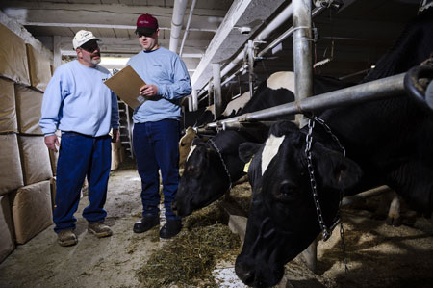
DHIA’s
DHIA’s are usually organized on a state or regional basis.
Producers can choose how often a DHIA representative collects data such as milk production, milk fat, milk protein, and Somatic Cell Count (SCC).
SCC is an indicator of the quality of milk; SCC measures white blood cells in the milk to determine the presence of pathogens – the lower the better.
Currently almost half of the cows in the US (or over 4 million cows) are analyzed by DHIA technicians to generate a national database of genetic information and production practices.
This information is used to determine the overall quality of the animals used for breeding, particularly the bulls used for artificial insemination.
By collecting vast amounts of data on the offspring of a bull, the genetic value of a bull can be determined and can guide a producer’s breeding decisions.
This genetic information is recorded as a Predicted Transmitting Ability, or PTA.
Source: dairyone.com

Slide 22
PTA’s & STA’s
A PTA is an estimation of the level of genetic superiority that a cow or bull will pass on to their offspring in comparison to all other cows in a genetic database.
PTAs are calculated for each individual trait in question; there are different PTA scores for milk, fat, protein, productive life, and other traits for each individual animal that is assessed.
A PTA is also known as an Expected Progeny Difference (EPD) (especially outside the dairy industry).
A PTA is simply a statistical method used to rank bulls.
For example, if a bull has a PTA of 1000 kg of milk, this does not mean that he will have daughters that produce 1000 lbs. more milk than all the other cows in a herd. This simply means that his daughters produced 1000 kg more milk on average than the average of all of the cows from bulls used to comprise the genetic base.
A bull should be selected for a herd by choosing the most important heritable traits and assigning these traits a weight based on their importance.
The better the PTA of a bull for the most desired traits, the more valuable a bull will be for the genetic improvement of a herd.

Slide 23
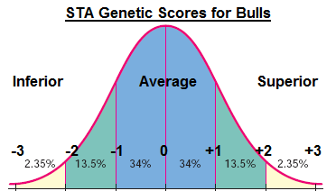
STAs
A PTA can also be expressed as a Standard Transmitting Ability (or STA).
An STA is used to show the PTA of an animal on a statistical bell curve using a scale of -3 to +3, with 0 being average.
Unlike PTAs (in which the numbers are specific to the trait measured, such as kilograms for milk or percentages for fat), all STAs are reported using the same -3 to +3 scale.
This makes it easier to gain an overall idea of the genetic value of a bull.
For example, an animal that scored a +3 for an STA would be one of the top genetic sources in the world for that trait.
A bull that has an STA value of 0.0 would be average for that trait, while a bull with a score of -3.0 would be among the worst in the genetic base.
STA’s rely heavily on statistics.
A bell curve (shown right) is created by calculating the standard deviation (a measurement of how much each data point differs from the average).
Most (68%) of the animals on the bell curve will fall between -1 and +1.
Only about 2% will score above +2.
Source: www.chegg.com

Slide 24
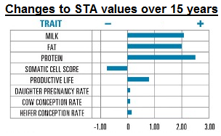
EBV’s
A genetic evaluation can also be expressed as an Estimated Breeding Value (EBV).
An EBV is similar to a PTA in that both measure the performance of an animal for given traits compared to the rest of the animals in the population.
The key difference is that a PTA is the genetic value that is passed on to offspring of an animal, while EBV is used to measure the genetic value of the animal that will be used for breeding.
EBV and PTA basically measure the same thing; however, because the offspring will be affected by two PTA values (the cow and the bull), EBV is always double the value of the PTA.
The PTA, STA, and EBV values are all determined by comparing any given animal to the genetic base.
The genetic base refers to the average of a large population of animals.
In the case of U.S. dairy cattle, this genetic base is updated every 5 years.
This is necessary because dairy cattle continue to change and improve.
Source: genex.crinet.com

Slide 25
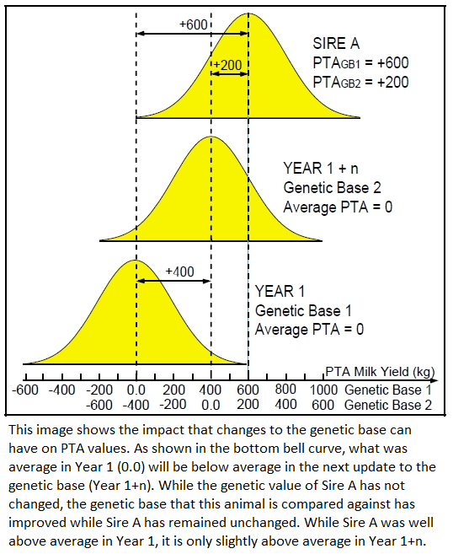
Because the basis of genetic comparison continues to change and improve, an animal’s PTA might actually be lower five years later (even if it did not change) because the average for the genetic base for all traits continues to improve.
In other words, an animal that was slightly above average for a given trait may have be ranked below average when the genetic base data is updated.
Source: http://bizplan-uz.com/learning/course/?COURSE_ID=6&TYPE=Y

Slide 26
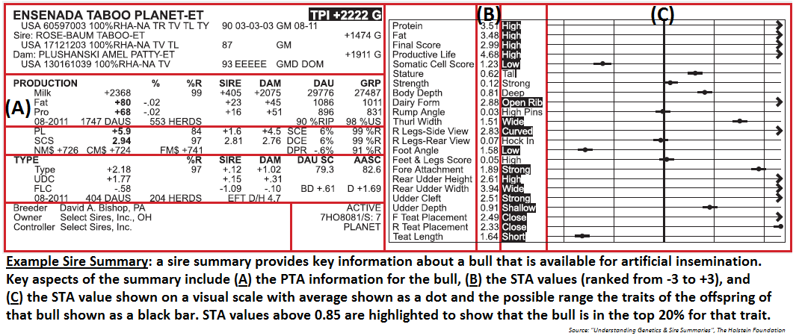
Rapid Genetic Improvement
The genetic information of the bulls in a database are reported in a sire summary; this can provide a farmer or breeder with the information they need to select the right bull’s genetics needed to improve the genetic value of their herd.
When artificial insemination is used with a sire summary, a farmer can improve the genetics of their herd by (A) gaining access to any genetic materials available for sale while also (B) accessing the information needed to choose the genetics of the bull that will result in the greatest improvements for the most needed heritable traits in a herd.

Slide 27
ET, IVF, and Genomics
The following technologies have also enabled rapid genetic improvement in dairy cattle.
Embryo Transfer (ET), also known as “flushing”: in this technique, a cow undergoes hormone therapy to cause her to superovulate, or produce a larger number of eggs than normal for fertilization.
These eggs can then be removed, inseminated, and implanted into the uteruses of donor animals who carry the calf until it is born.
In Vitro Fertilization (IVF): in this technique, fertile eggs are inseminated with sperm outside of the cow’s body in a petri dish (“in vitro” literally means “in the glass”, referring to the glass petri dish).
IVF and ET are usually combined into one technique in order to maximize the reproduction of the most genetically-valuable cows so that as many calves as possible can be produced from these superior genes.
Genomics: in this process, the DNA of an animal can be analyzed directly to determine the genetic value of that animal.
This allows a farmer or breeder to determine whether or not an animal has beneficial traits for production as well as any harmful traits for genetic diseases or other problems as early as possible.
Almost all bulls available for artificial insemination are now genomically sequenced, and an increasing number of female cattle are also being sequenced in order to make highly-accurate breeding predictions.

