Slide 1
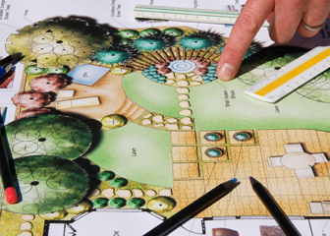
Drafting Techniques in Landscape Design
Source: www.bls.go
By C. Kohn Agricultural Sciences Waterford, WI

Slide 2
Purpose of Drafting
The purpose of drafting is to enable a designer to take an idea in their head and put it on paper.
It may seem obvious, but without the ability to draft your ideas on paper (or using technology), there is no way for a designer to show their customers the ideas they intend to eventually sell to them.
Even for homeowners who are only creating a project for their own needs, drafting enables the designer to better plan their projects, avoid problems and pitfalls, and ensure that their design is appropriate for the space in which it will occur.
Without skills and abilities in regards to drafting, there is a minimal likelihood that you’ll be able to effectively translate the ideas in your head into a reality.
Source: http://thumb10.shutterstock.com/

Slide 3
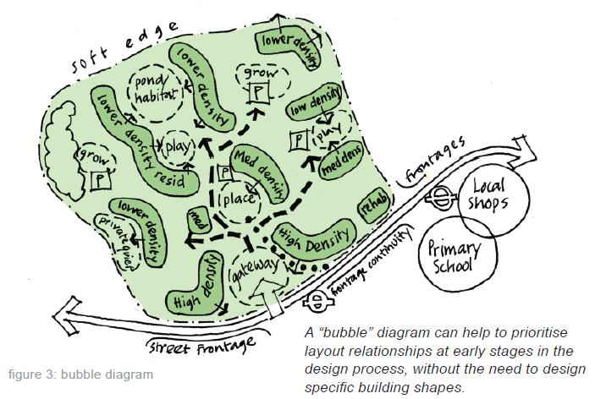
Steps of Drafting
Typically a designer will follow a sequence of steps similar to those below when drafting their ideas.
These include 1) program development, 2) inventory & analysis, 3) design development (including preliminary design and conceptual design), and 4) construction documentation.
The first step of drafting is program development.
This is the phase in which the designer researches their property and its owners/users, and gathers information from owners and other people who will be affected by the project.
The designer is trying to ascertain the specific goals that the users of this site have in mind for the design (and eventual landscape) that is to come later.
The focus is on the facts, attitudes, needs, wants, opportunities, and limitations of this site and primarily consists of discussions with the people who will be most affected by the future design.
Drawings are seldom needed at this stage – this is really just about obtaining the needed facts in order to shape the design planning.
Source: www.hertslink.org

Slide 4
Source: www.hertslink.org

Slide 5
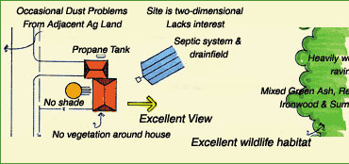
Steps of Drafting
The next step is inventory and analysis.
In this stage, the designer gathers information about the physical characteristics of this site, including property lines, building dimensions, vegetation, topography, soils, views, and other factors.
Inventory involves recording the objective site data (anything involving a number, such as the length and width of the property, the USDA plant hardiness zone, slope, etc.).
Site analysis involves the subjective evaluation, which could include suggestions that the designer has in regards to the opportunities and limitations of that site based on the inventory.
It is in this stage that the designer should start to produce some plan view drawings that explain the existing conditions and provide some rough ideas of the existing conditions.
This is likely a mix of rough sketches (or outlines) as well as written notes on the plan.
Source: web.cals.uidaho.edu

Slide 6
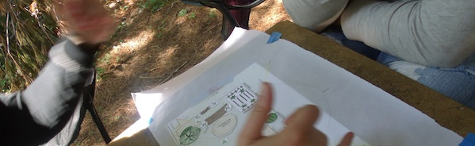
Steps of Drafting - Design
The third step is design development.
Design development tends to entail the largest portion of landscape drafting and can be broken into two steps: conceptual design and preliminary design.
Conceptual design is where the earliest ideas begin to develop in regards to the changes that you’ll be making to this landscape.
These designs are usually very rough and are typically only be meant to be seen by the designer as he or she tries to organize their thoughts and stimulate creativity.
A conceptual design can be very loose; even bubbles with written descriptions can suffice in this stage. The key is that the designer uses the conceptual design to narrow their focus for each individual component of this landscape.
Source: fingerlakespermaculture.org

Slide 7
Preliminary Design
Preliminary design is where the ideas from the conceptual design become refined and shaped by the constraints and unifying themes of the design as they develop.
It is at this stage that the designer begins to choose materials, color schemes, and potential uses and benefits of the new design.
It is typically at the completion of this stage that the designer makers their first presentation of their ideas to their client, if they have one.
The designer should present to the client knowing that they may have to start over from the beginning if their client does not like their ideas or their direction.
Obtaining honest feedback from their client is vital at this stage to prevent costly setbacks should the client not like the landscape as it is being installed (or worse, after it is installed).
Because this is usually the first chance for client feedback, the designer should create a refined drawing for this presentation.
The presentation should be realistic, convincing, colorful, and should include a combination of perspectives (bird’s-eye view, cross-section, etc.).
The presentation should include enough detail and be made with enough effort that the need for text is minimal or nonexistent.

Slide 8
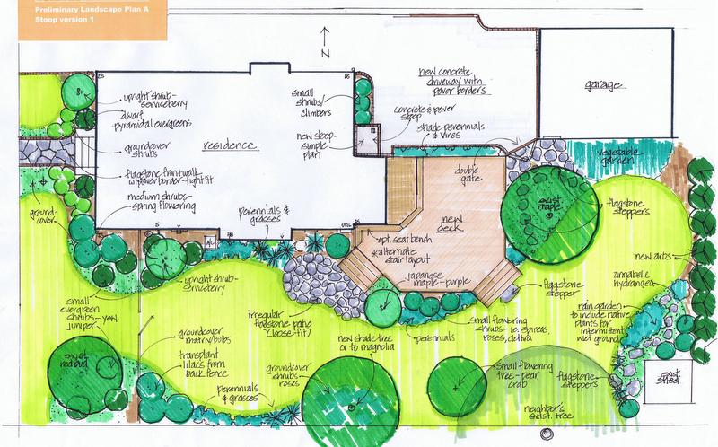
Example Preliminary Design
Source: blog.muddybootslandscaping.com

Slide 9
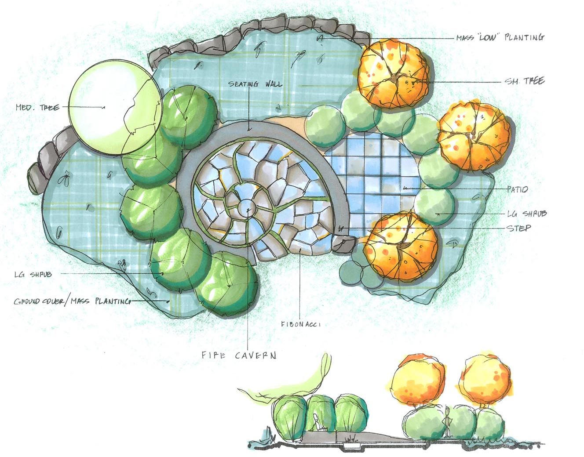
Example Preliminary Design
Source: http://waterfordtilling.com/wp-content/uploads/2014/05/8456271306_a92377cda8_o-1500.jpg

Slide 10
Steps of Drafting
The final step of landscape drafting is construction documentation.
This is where the ideas are finalized into the documents that will provide the specifics necessary for the construction of the landscape.
Once this stage is reached, there should be little if any changes made to the documents; any changes should occur prior to this during the preliminary design.
The purpose of the documents created during the construction documentation is to provide clear, specific instructions to those who will be creating the landscape and should include exact sizes, quantities, locations, and material types.

Slide 11
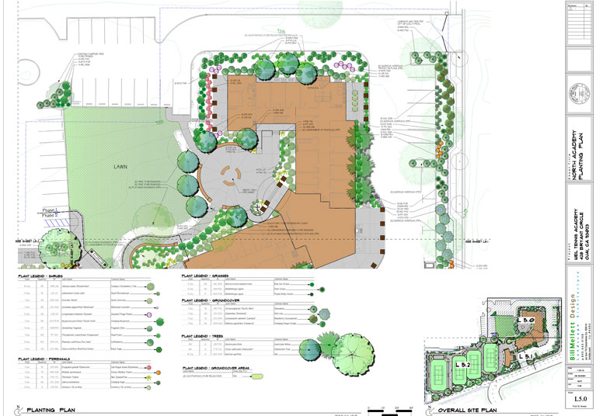
Sample Construction Documentation
Source: bmdla.com

Slide 12
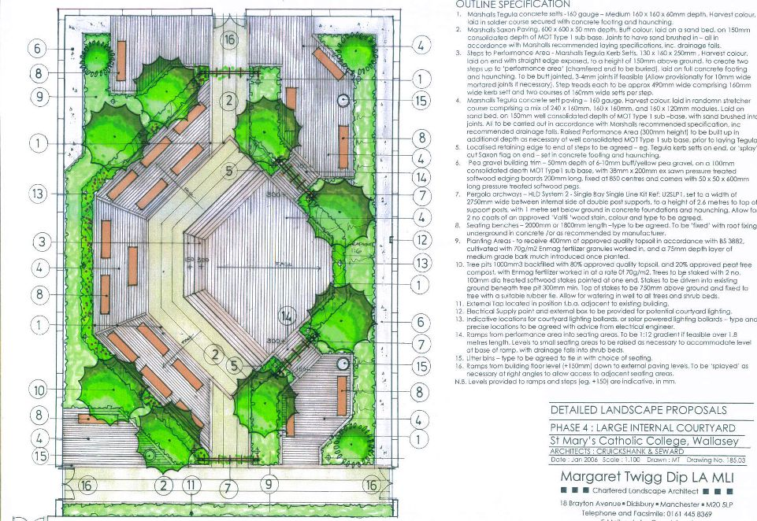
Sample Construction Documentation
Source: www.margarettwigglandscapearchitect.co.uk

Slide 13
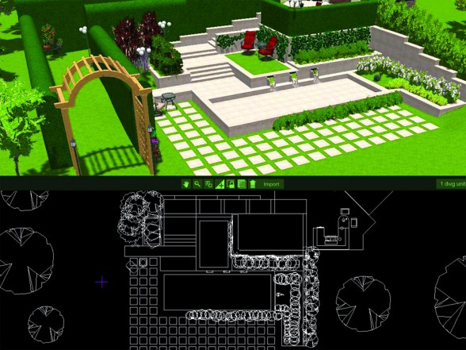
CADD vs. Drafting by Hand
Most preparation of landscape design materials is now completed using modern technology, particularly computer-aided drafting and design (CADD).
While manual drafting skills are now less necessary and less common in the professional landscape architectural field, there is still a need to learn these manual skills for several reasons.
First, most individuals develop landscapes not for professional companies but for their own personal property. While CADD would certainly be a valuable tool for these purposes, it is not necessary to invest in classes and software if you can complete small designs by hand (and it is sometimes faster).
Secondly, manual drafting serves as a valuable means of communicating ideas to clients and coworkers, especially in the initial stages of design.
Finally, manual drafting provides opportunities in regards to artistic development and expressive styles than the more rigid conventions found in CADD technology.
Source: newgardendesigning.blogspot.com

Slide 14
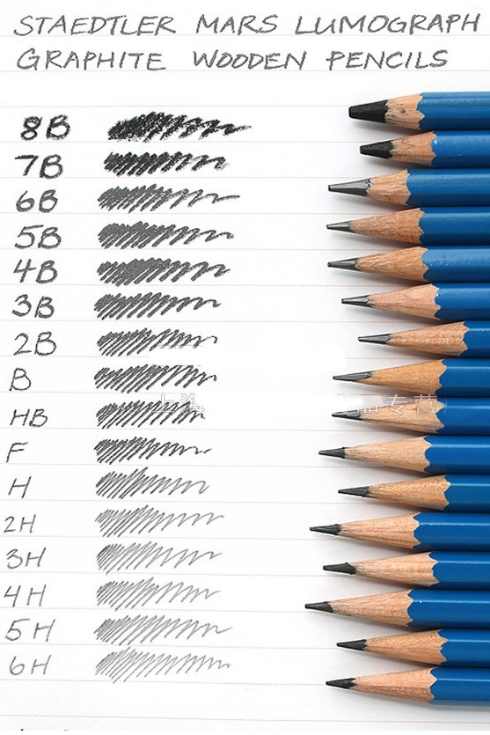
Tools of Drafting
Pencil and paper is still a preferred medium for many designers because it is easy to use, easy to change, and easy to manipulate on paper in order to create depth and dimension.
Most designers will choose a mechanical pencil over a traditional pencil due to its uniformity.
Pencil lead comes in many different hardnesses, including:
HB Soft – for wider, darker lines.
H medium – all purpose lead for a variety of purposes.
2H to medium hard – designed for fine, precision work. Difficult to erase but will not smudge.
4H hard – for any lines that need to be light (such as guidelines).
Source: www.aliexpress.com

Slide 15
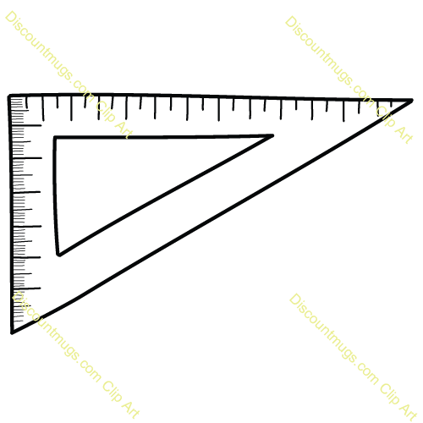
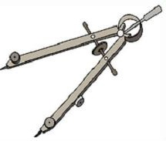
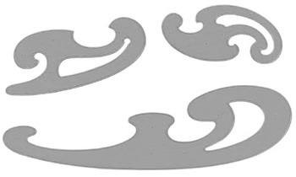
Tools of Drafting
Besides the pencil, a wide variety of tools exist to enable the designer to create their design. These tools include the following:
T-Square – these are long rulers with a perpendicular guide to help the designer draw perfectly parallel lines.
Triangle – these are used to draft straight lines in a variety of directions. Some are adjustable to enable the designer to create lines at any angle.
Compass – these are used to create perfect circles and arcs.
French curve – these are plastic or wooden templates that enable the designer to create curves of any kind of curvature as needed.
Source: etc.usf.edu
Source: www.discountmugs.com
Source: www.allthingsclipart.com
Source: www.spectrumart.co.za

Slide 16
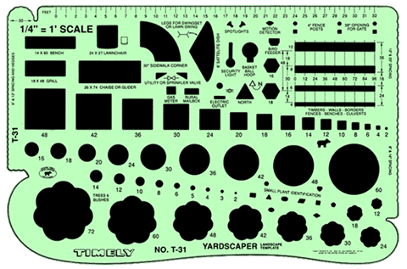
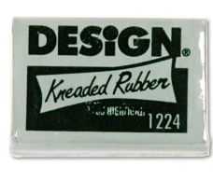
Tools of Drafting
Template – this is a sheet or piece of flat plastic with circles, squares, ovals, and other shapes to guide the designer in drawing these shapes as needed in their design.
Eraser – as most people know, the eraser exists to eliminate mistakes. However, most designers choose to use erasers other than the pink kind common in elementary school. The kneaded eraser is especially valuable for removing pencil marks without smudging.
Source: www.timelytemplates.com
Source: www.amazon.com

Slide 17
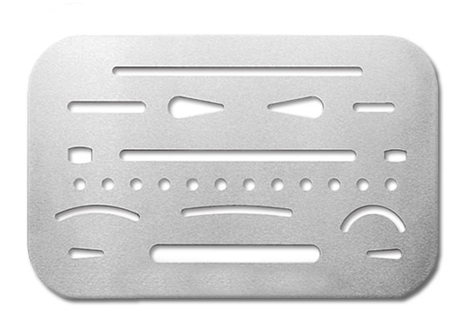
Tools of Drafting
Erasing shield – sometimes it is necessary to erase only a small, specific portion of the design. Erasing shields enable the designer to only remove a specific area of their design in a specific shape without affecting any of the other components.
Drafting brush – with erasing and pencils will come dust, debris, and loose graphite. A brush is necessary to ensure that the designer does not accidently create stray marks on their design when clearing away debris.
Source: davinciartistsupply.com
Source: www.isubookstore.com

Slide 18
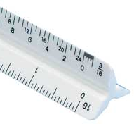
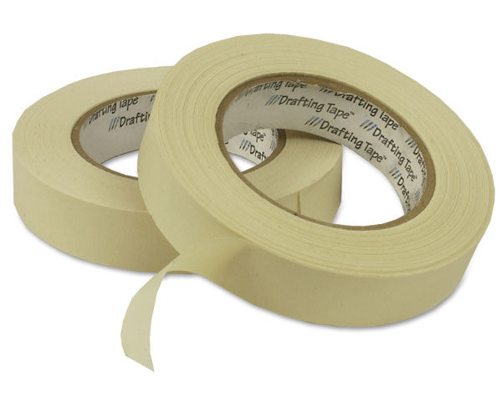
Tools of Drafting
Scales – architects’ scales are specialized rulers with multiple units of length and proportional length increments to enable the designer to draw their entire design using appropriate scale (e.g. 1 inch equals 10 feet, or 1:10). In the US, usually the first number in the units scale is inches and the second is feet.
Drafting tape – this is used to secure the paper on which the design is made so that it does not shift during the creation of the design. The best kinds hold securely but peel off without ripping the paper.
Source: www.draphixdirect.com
Source: www.jerrysartarama.com

Slide 19
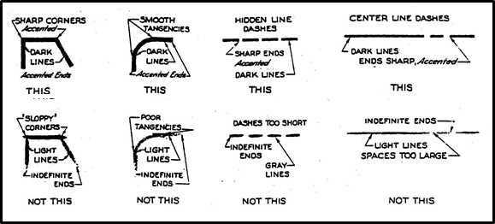
Drawing Lines
Drawing a line may sound pretty simple – you’ve probably been doing since you were age 5.
However, there are 3 keys to creating high quality lines that are necessary for a valuable design drawing.
1. Density (or value) of the line: this depends on the lead of the pencil and the paper (textured paper has more “grip” and will result in a darker line than smoother paper).
2. Width of the line.
3. Consistency of the line.
Source: rvhs-denyer.com

Slide 20
Drawing Lines
Drawing high quality lines in your design requires more focus and technique than most people are used to applying.
Begin by tapping off the very tip of a newly sharpened pencil by tapping it gently on scratch paper. This will ensure that your lines have the appropriate width and consistency.
Next, round the corners by making a few marks on scratch paper while turning the pencil slightly.
Hold your pencil at a slight angle when using it. This will provide more area for the lead to grip the paper; be careful not to angle the pencil too much or the lead will break.
Source www.bilerico.com

Slide 21
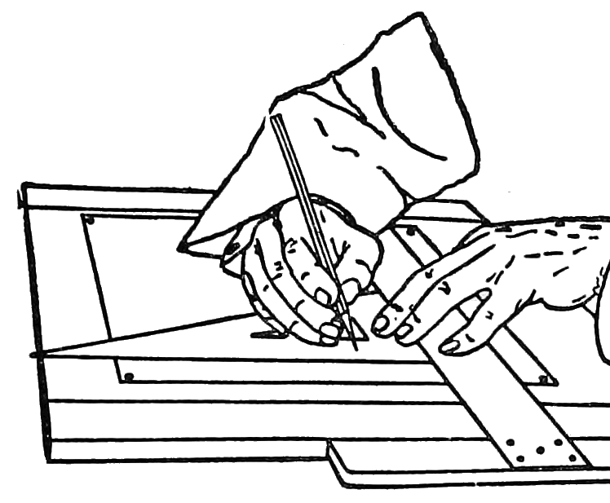
Drawing Lines
When drawing straight lines, be sure to always use a straight edge, particularly a T-square if possible.
Use your non-dominant hand to make sure the straightedge is held firmly against the paper.
Always keep the lead at a 90º angle to the straight edge (but at a slight angle to the paper).
Roll the pencil slightly as you draw to ensure that the lead has even contact with the paper (1/2 roll max).
Source: en.wikisource.org

Slide 22
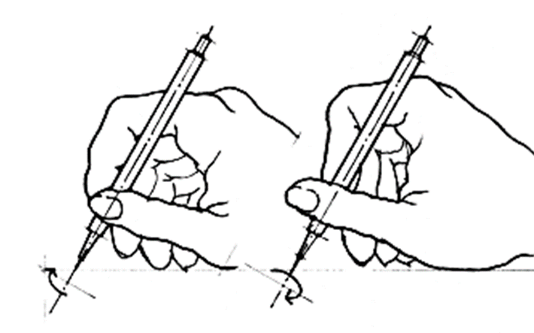
Drawing Lines
Steps of Drawing a Line
1. Tap the pencil on the paper.
2. Round out the lead.
3. Hold at an angle.
4. Use a straightedge.
5. Keep the pencil 90º to the straightedge.
6. Roll the pencil slightly as you draw the line. ↗
Source: Architectural Graphics, Francis D. K. Ching

Slide 23
Drawing Lines
When connecting lines (for example, to make a 90º angle), make sure that your lines touch or have just a slight overlap.
Make sure you have no weak corners (where the lines do not touch) and avoid excessive overlap.
Source: Architectural Graphics, Francis D. K. Ching

Slide 24
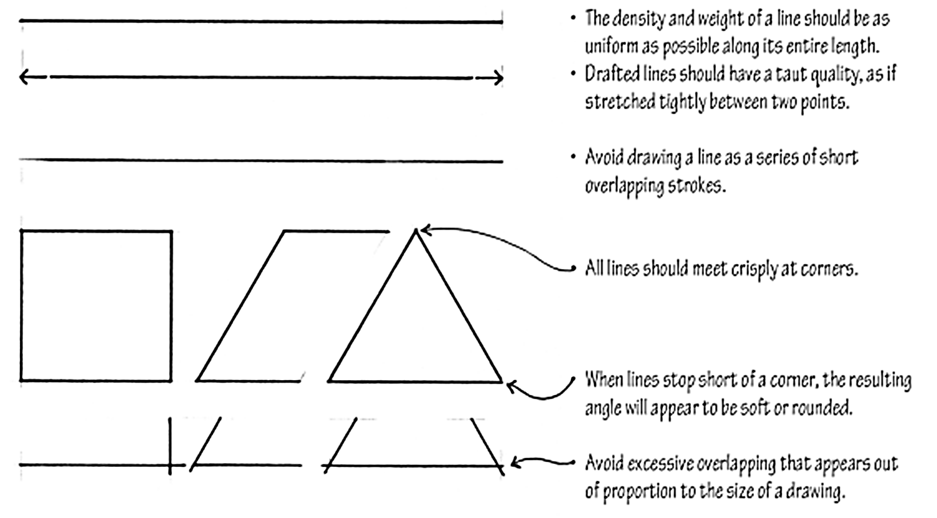
Drawing Lines
Source: Architectural Graphics, Francis D. K. Ching

Slide 25
Drawing Lines
When starting a design, it is best to begin with your arcs and curves and then connect them with straight lines.
Use harder lead (if you have multiple kinds of lead) for the arcs and softer, darker lead for straight lines.
This will allow you to more easily correct mistakes if your arcs are incorrect.
Finally darken your lines once you are sure they are correct and add shading, texture, and other necessary details.
Source: lizzielenard-vintagesewing.blogspot.com

Slide 26
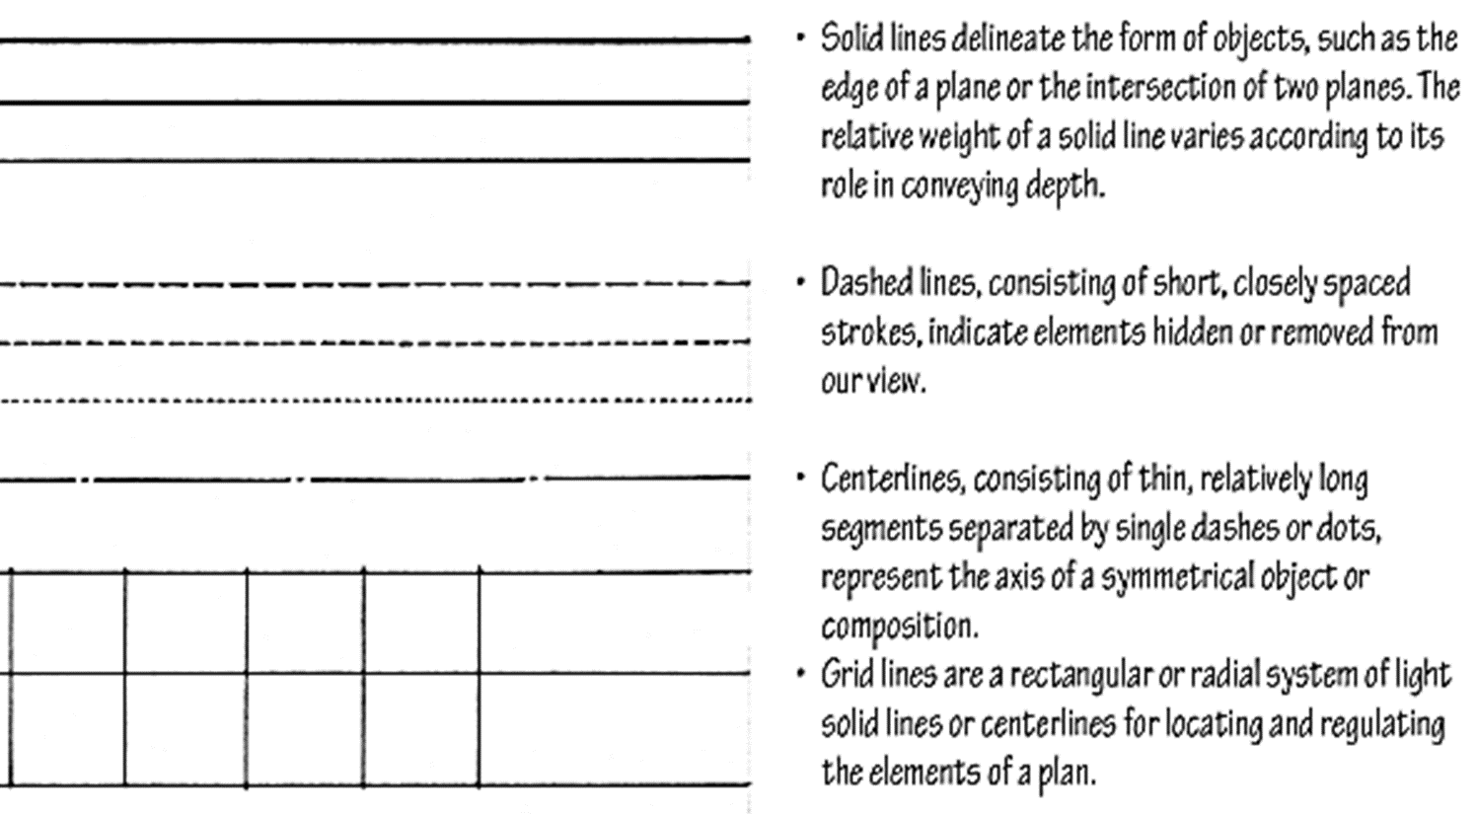
Types of Lines
Source: Architectural Graphics, Francis D. K. Ching

Slide 27
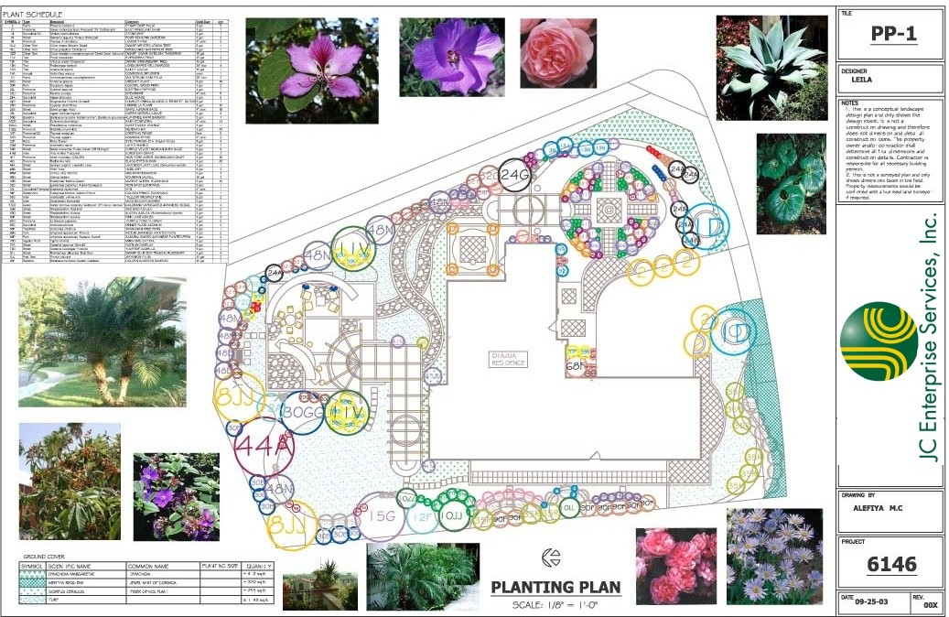
Title Blocks
Source: http://www.uniqueoutdoordesign.com/images2/a2.jpg
Landscape drawings should include title blocks if they will be used in a presentation. →
A title block is a section on the bottom or right edge of the presentation that includes necessary information about the presentation.
This information includes the project name and address, the designer and company, dates, scale, north indicator, and other pertinent information.

Slide 28
North Indicators
North indicators should be included in every landscape plan in order to help the designer and viewer orient their eyes.
North indicators are usually just a large, unmistakable arrow.
While the north indicator is necessary to help the viewer make sense of the drawing, it is also necessary to understand environmental factors such as the position of the sun, wind direction, slope, and other factors.
The north indicator should always be near the scale.
Source: www.gardencad.net

Slide 29
Scale Indicators
Every landscape drawing must include a scale indicator.
This shows the difference in size between the drawing and the actual landscape.
The scale is expressed as either a ratio or an equation (or both).
There are three options for the scale: architects’, engineers’, and metric.
Source: www.fclandscapedesign.com

Slide 30
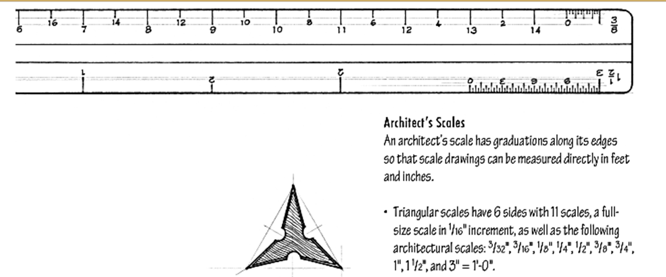
Architect’s Scales
Architects’ scales are written as a fraction with an inch on the left and the feet on the right.
For example, 1/4” = 1’-0” would mean that ¼ of an inch on the drawing equals one foot in real life.
Architects’ scales are always written with a fraction of an inch on the left and a dashed-number on the right.
Source: Architectural Graphics, Francis D. K. Ching

Slide 31
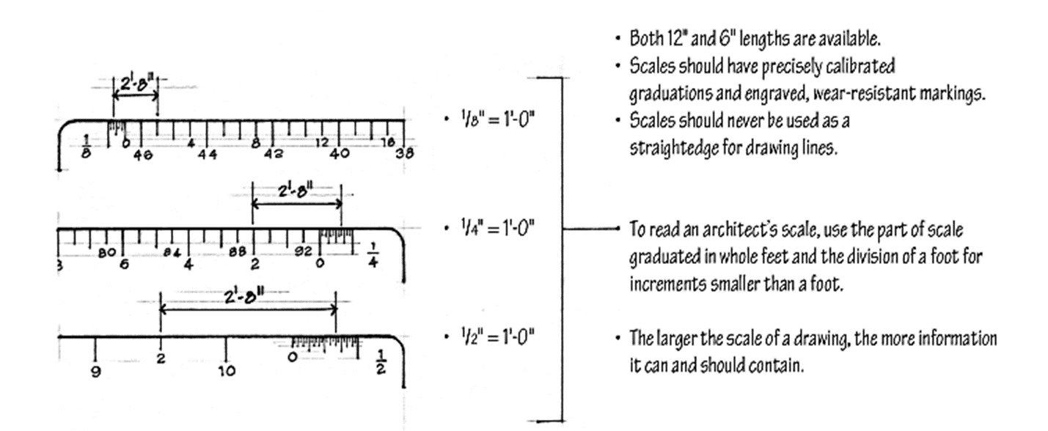
Architect’s Scales
Source: Architectural Graphics, Francis D. K. Ching

Slide 32
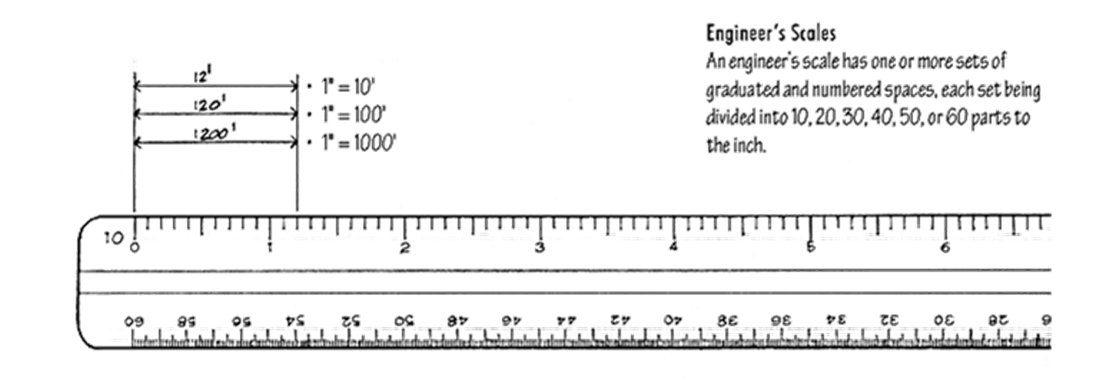
Engineer’s Scales
Engineers’ scales are written with the unit of 1 inch to the left of the “=” sign and multiples of 10 feet on the right side.
For example, 1” = 20’ would mean that 1 inch on the drawing is equivalent to 20 feet at the actual landscaping site.
Engineers’ scales are always written in whole numbers with a multiple of ten on the right.
Source: Architectural Graphics, Francis D. K. Ching

Slide 33
Metric Scale
A design can also use a metric scale, with 1 on the left of a “:” and multiples of ten on the right.
For example, 1:50 means that one meter on the drawing is equivalent to 50 meters in the landscape.
Source: Architectural Graphics, Francis D. K. Ching

