Slide 1
Duck Jeopardy!
Waterford Union High School

Slide 2
Puddles
Double Puddle
Divers
Double Diver
Swans & Stuff
The Sixth One
$100
$100
$100
$100
$100
$100
$200
$200
$200
$200
$200
$200
$300
$300
$300
$300
$300
$300
$400
$400
$400
$400
$400
$400
$500
$500
$500
$500
$500
$500

Slide 3
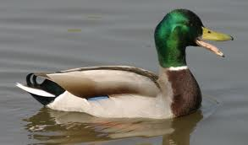
Puddles
Mallard

Slide 4
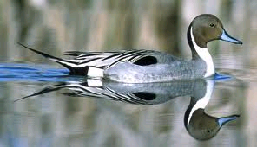
Puddles
Pintail

Slide 5
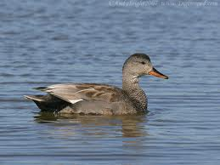
Puddles
Gadwall

Slide 6
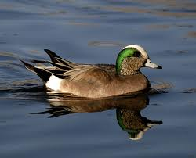
Puddles
American Wigeon

Slide 7
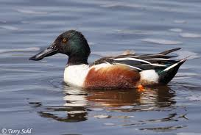
Puddles
Shoveler

Slide 8
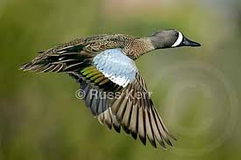
Double Puddle
Blue Winged Teal

Slide 9
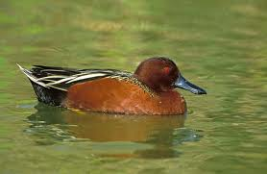
Double Puddle
Cinnamon Teal

Slide 10
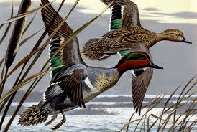
Double Puddle
Green-winged teal

Slide 11
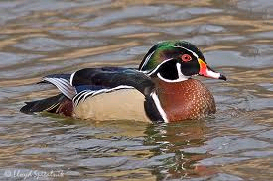
Double Puddle
Wood Duck

Slide 12
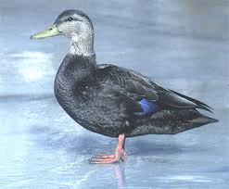
Double Puddle
Black Duck

Slide 13
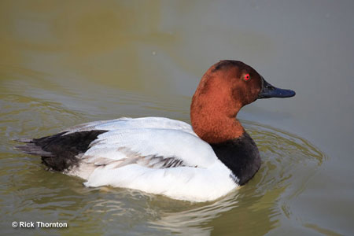
Divers
Canvasback

Slide 14
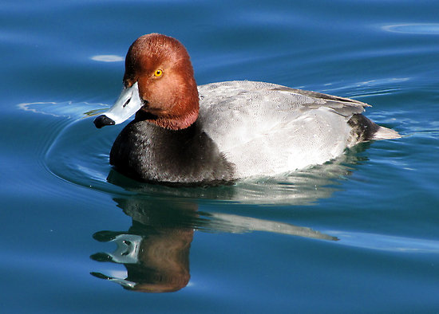
Divers
Redhead

Slide 15
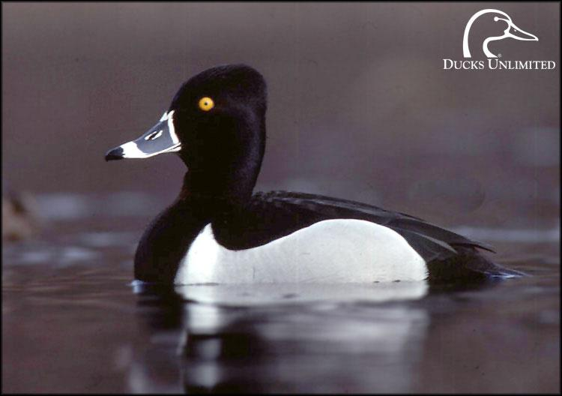
Divers
Ring-neck

Slide 16
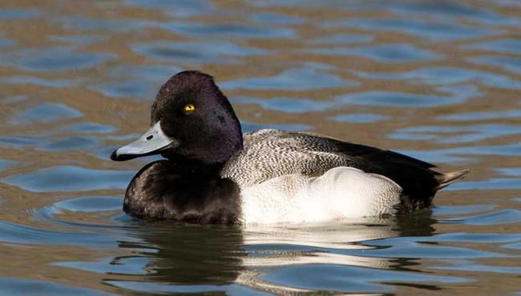
Divers
Lesser Scaup (aka Blue-bill)

Slide 17
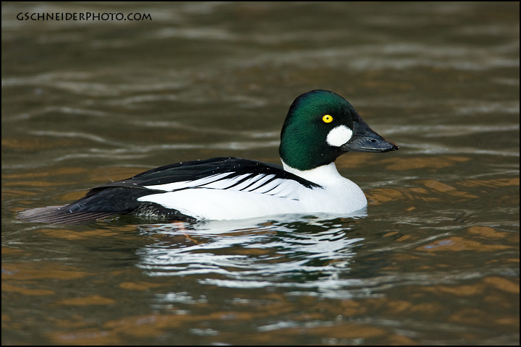
Divers
Goldeneye

Slide 18
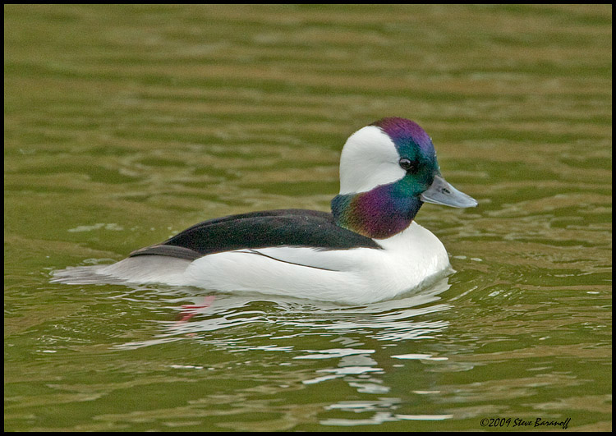
Double Divers
Bufflehead

Slide 19
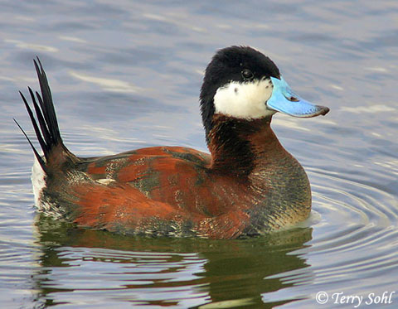
Double Divers
Ruddy Duck

Slide 20
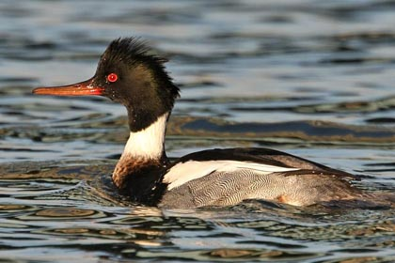
Double Divers
Redbreasted Merganser

Slide 21
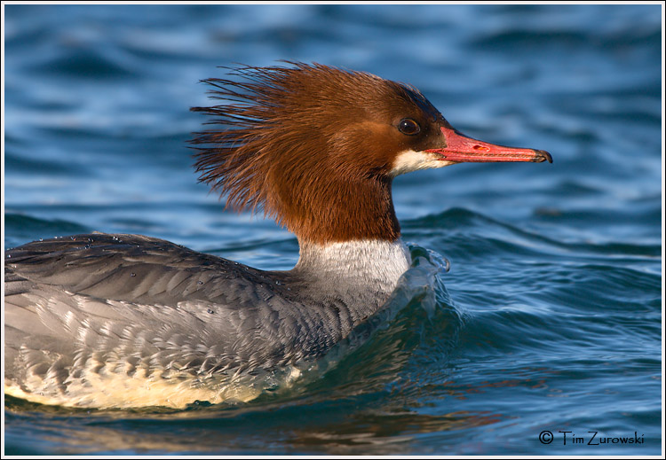
Double Divers
Common Merganser

Slide 22
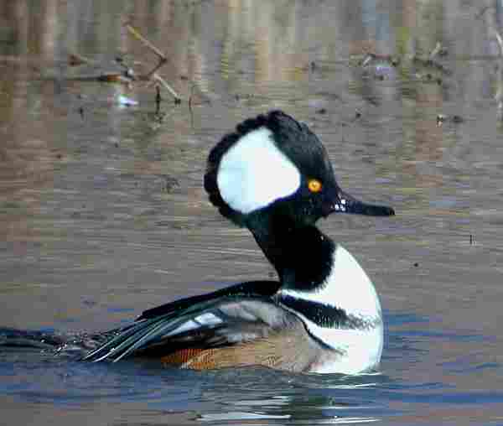
Double Divers
Hooded Merganser

Slide 23
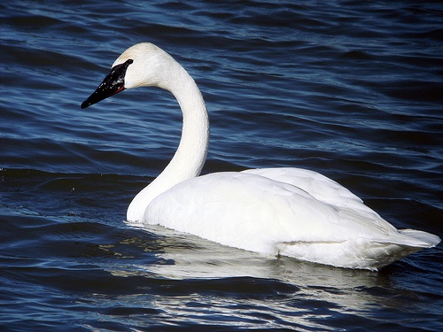
Swans & Stuff
Trumpeter Swan

Slide 24
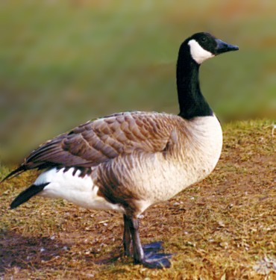
Swans & Stuff
Canada Goose

Slide 25
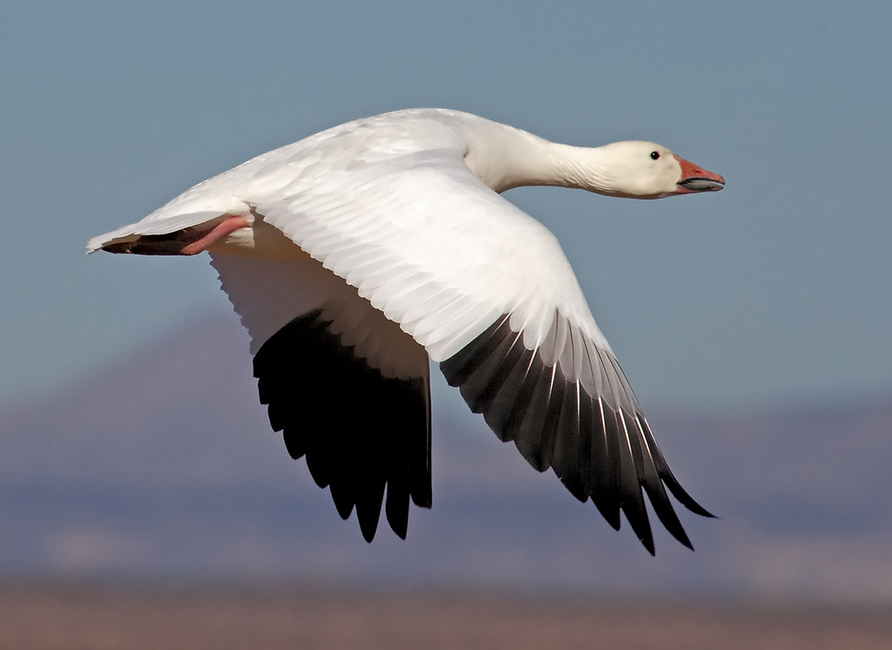
Swans & Stuff
Snow Goose

Slide 26
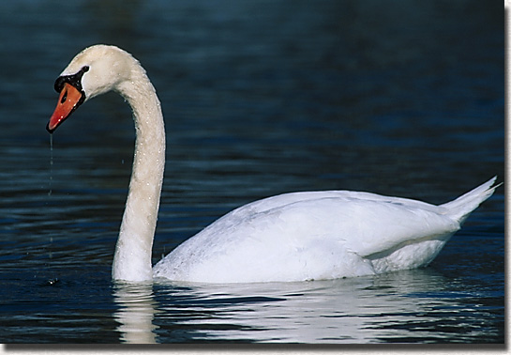
Swans & Stuff
Mute Swan

Slide 27
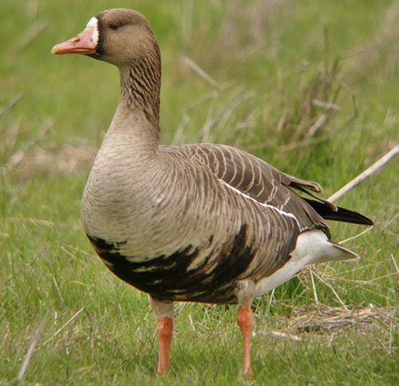
Swans & Stuff
White-fronted Goose

Slide 28
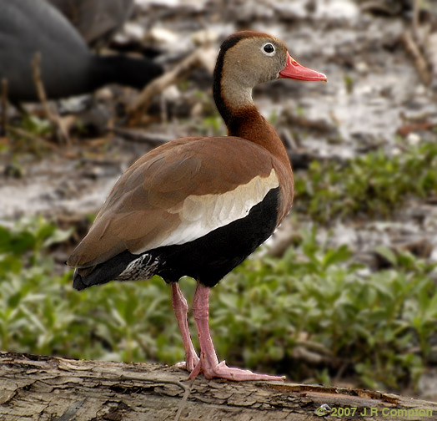
The Sixth One
Whistling Duck

Slide 29
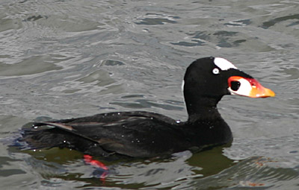
The Sixth One
Scoder
.

Slide 30
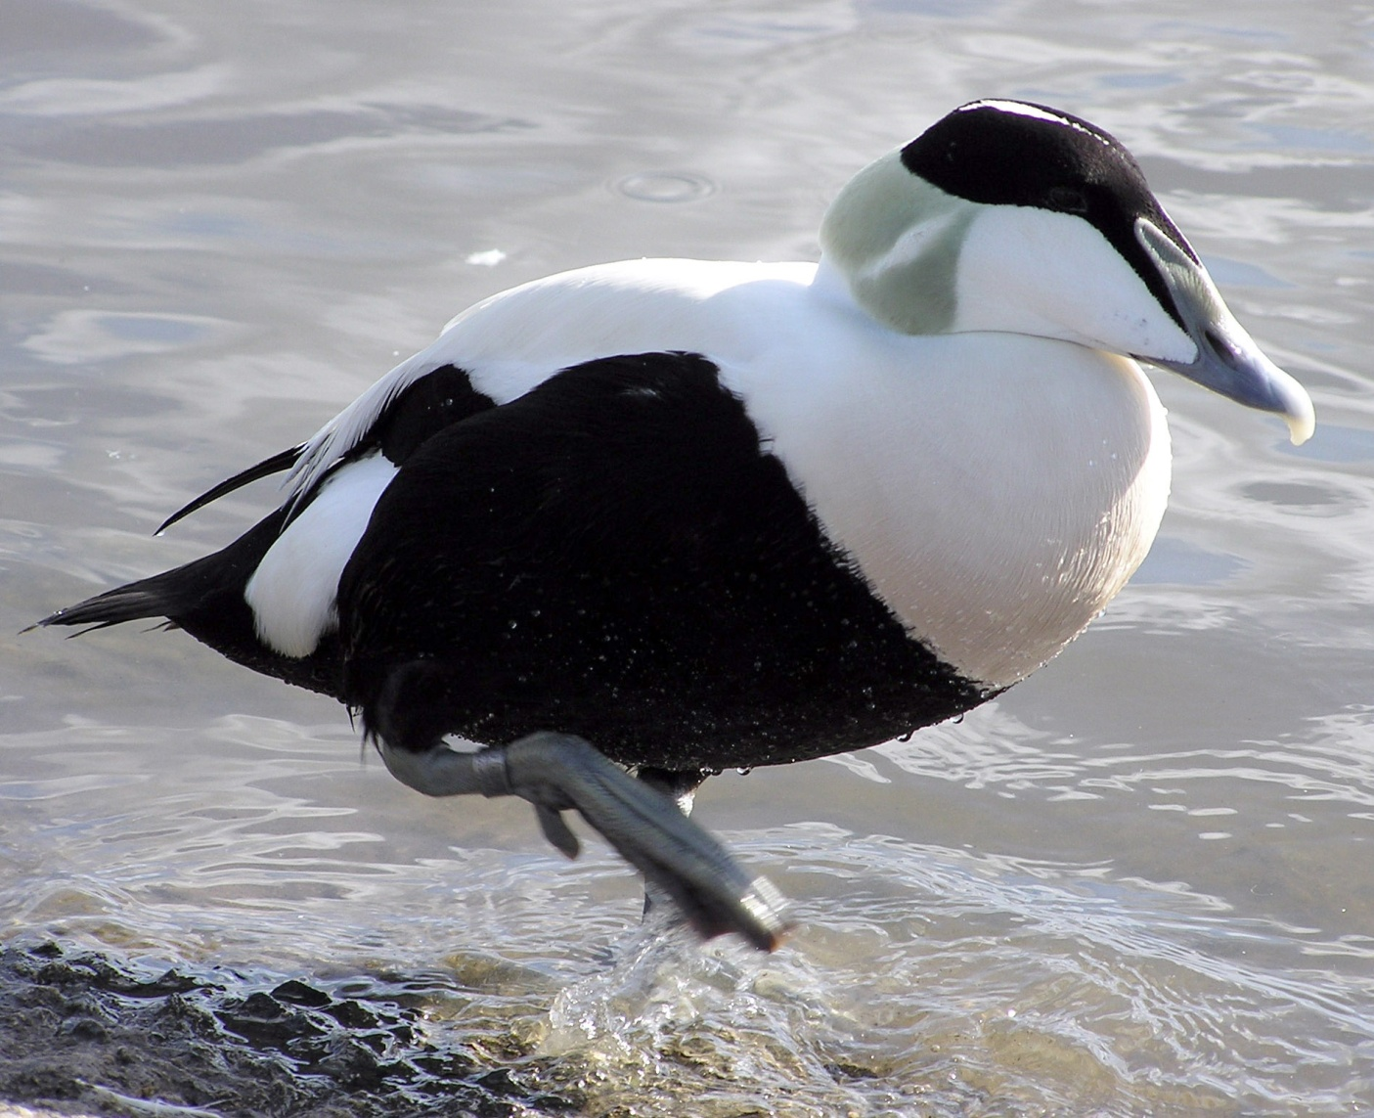
Engine Interest
Common Eider

Slide 31
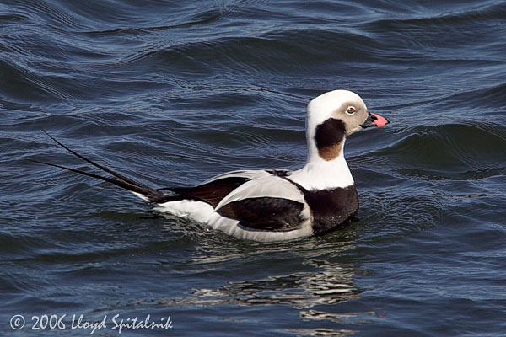
The Sixth One
Old Squaw

Slide 32
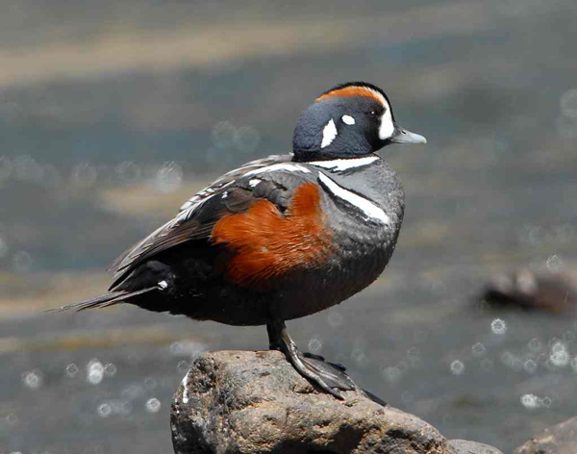
The Sixth One
Harlequin

Slide 33
FINAL JEOPARDY
Name an invasive species of waterfowl.
Mute Swan

