Slide 1
ENR Tools Jeopardy!
Wisconsin FFA Association

Slide 2
Water Quality
Aquatic
Wildlife & Weather
Forestry
This & That
Which is Which?
$100
$100
$100
$100
$100
$100
$200
$200
$200
$200
$200
$200
$300
$300
$300
$300
$300
$300
$400
$400
$400
$400
$400
$400
$500
$500
$500
$500
$500
$500

Slide 3
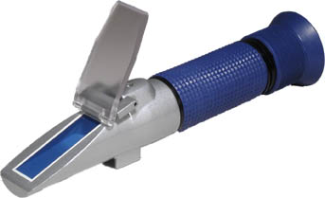
Water Quality
Refractometer

Slide 4
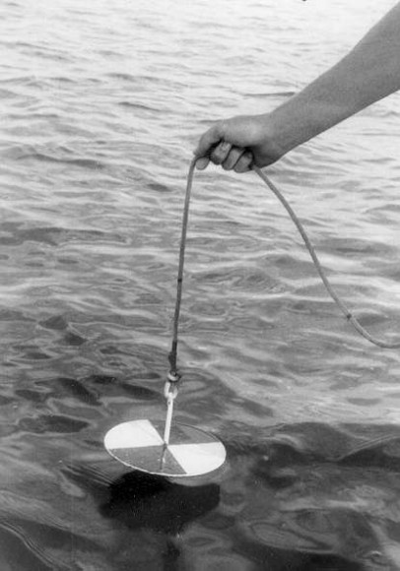
Water Quality
Secchi Disk

Slide 5
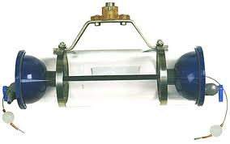
Water Quality
Water Bottle Sampler

Slide 6
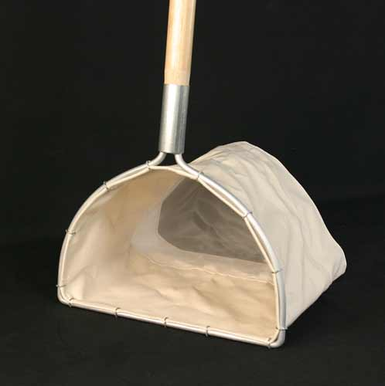
Water Quality
Aquatic Net (D-net)

Slide 7
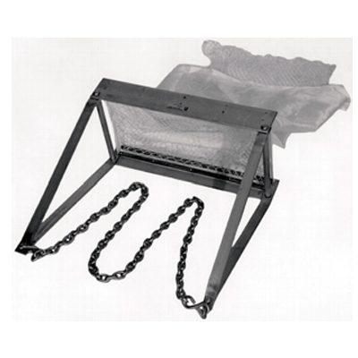
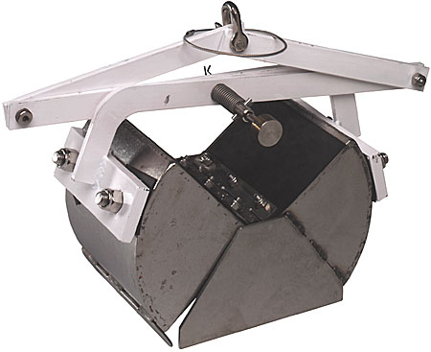
Water Quality
Bottom Dredge

Slide 8
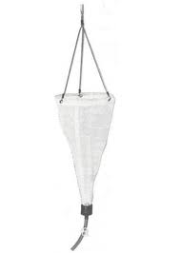
Aquatic
Plankton Net

Slide 9
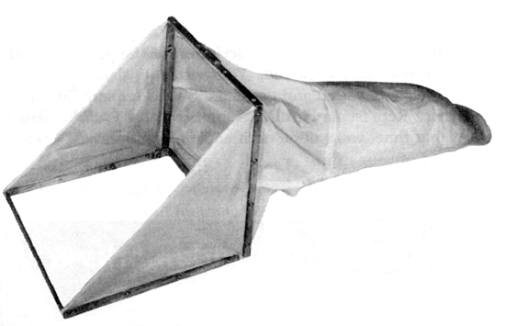
Aquatic
Stream Bottom Sampler

Slide 10
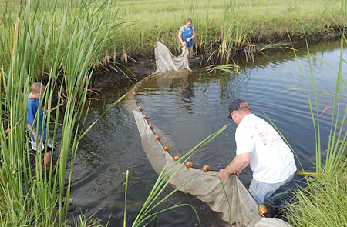
Aquatic
Seine

Slide 11
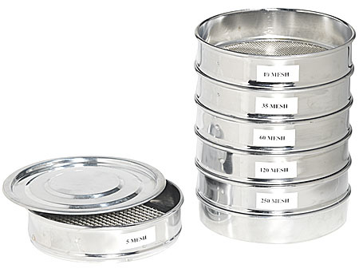
Aquatic
Seive

Slide 12
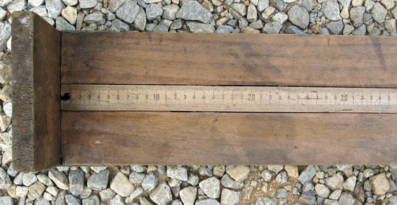
Aquatic
Fish measuring board

Slide 13
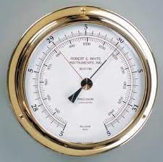
Wildlife & Weather
Barometer

Slide 14
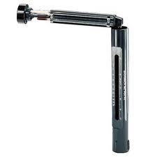
Wildlife & Weather
Sling Psychrometer

Slide 15
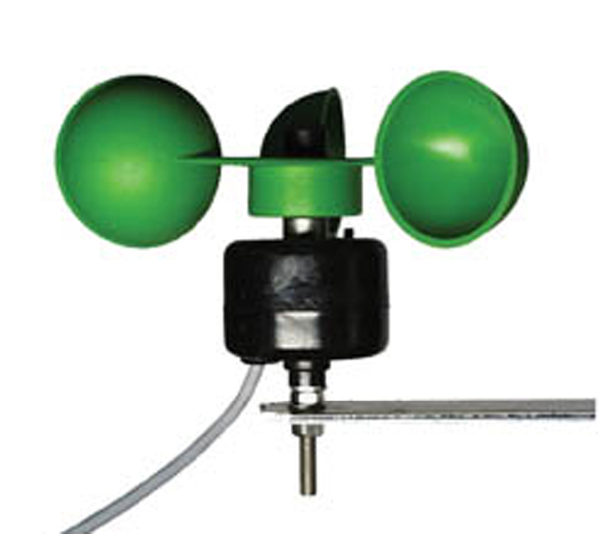
Wildlife & Weather
Windspeed Meter

Slide 16
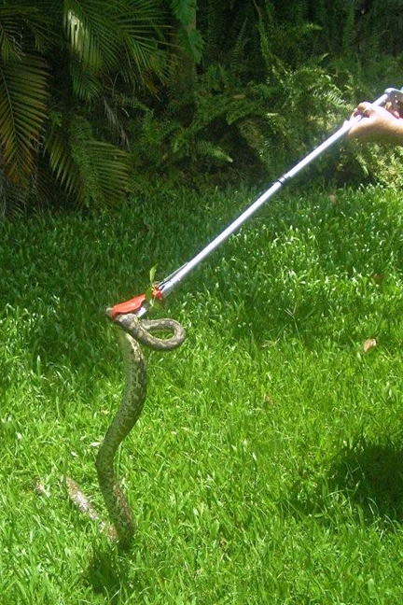
Wildlife & Weather
Snake/Reptile Stick

Slide 17
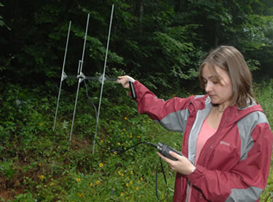
Wildlife & Weather
Radio Telemetry Unit

Slide 18
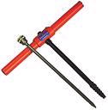
Forestry
Tree Increment Borer

Slide 19
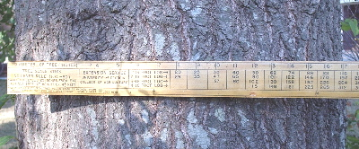
Forestry
Biltmore Stick

Slide 20
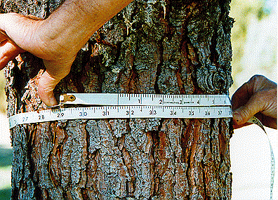
Forestry
Diameter Tape

Slide 21
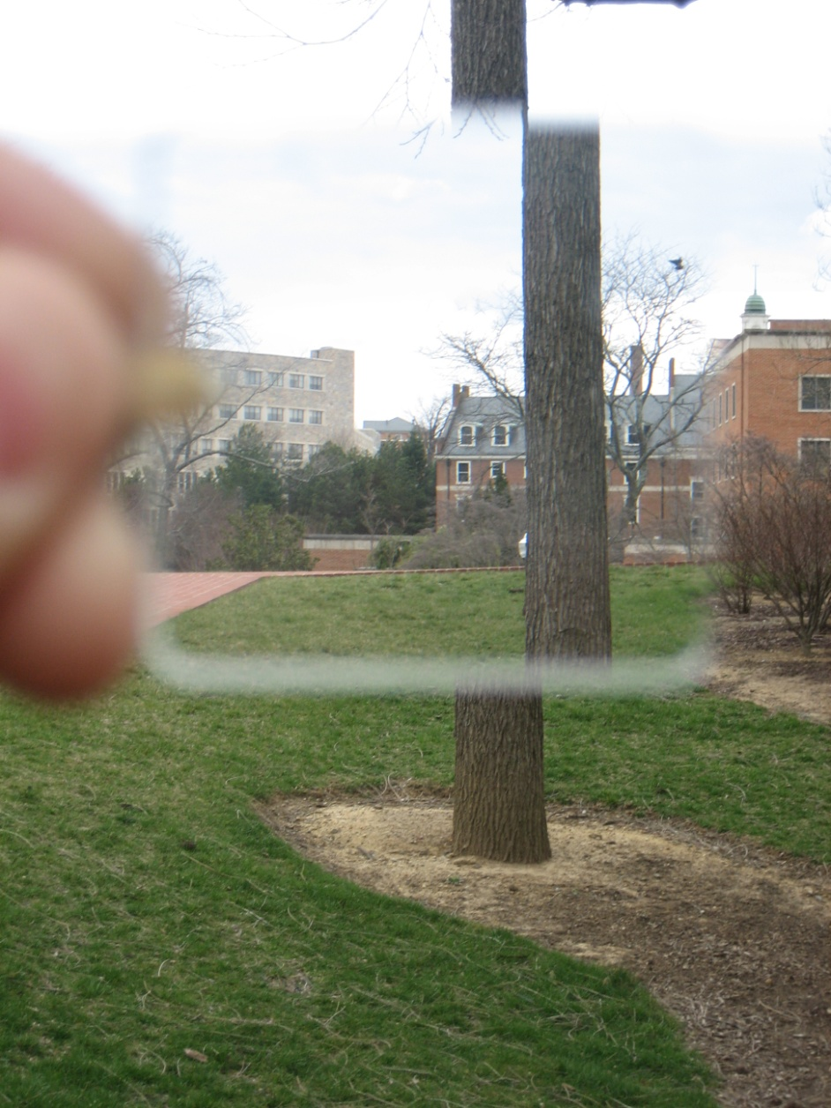
Forestry
Prism

Slide 22
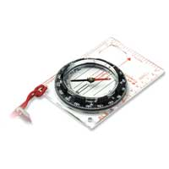
Forestry
Hand-compass

Slide 23
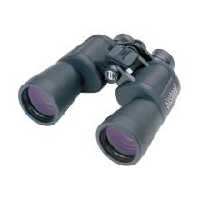
This & That
Binoculars

Slide 24
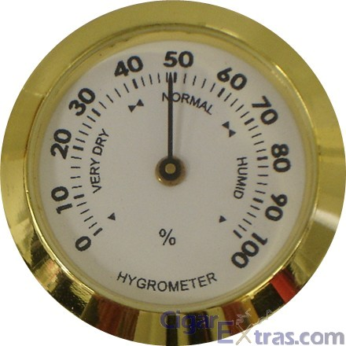
This & That
Hygrometer

Slide 25
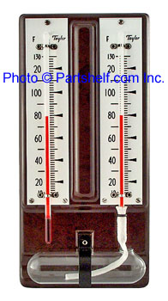
This & That
Wet-bulb thermometer

Slide 26
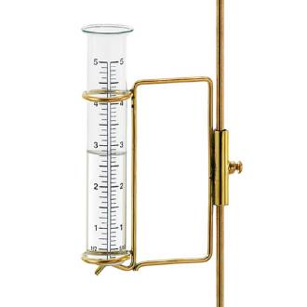
This & That
Rain Gauge

Slide 27
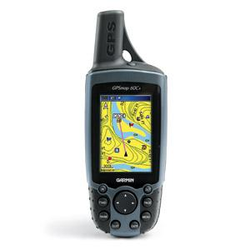
This & That
GPS Unit

Slide 28
Which is Which?
Left or Right? Secchi Disk

Slide 29
Which is Which?
Left or Right? Hygrometer

Slide 30
Which is Which?
Left or Right? Seine

Slide 31
Which is Which?
Left or Right? Refractometer

Slide 32
Which is Which?
Left or Right: Wet Bulb Thermometer

Slide 33
FINAL JEOPARDY
Make your wagers!
What is this? What does this do?
Sling psychrometer: Measures relative humidity

