Slide 1
Enzymes & Bioprospecting
By C. Kohn
Agricultural Sciences
Waterford, WI

Slide 2
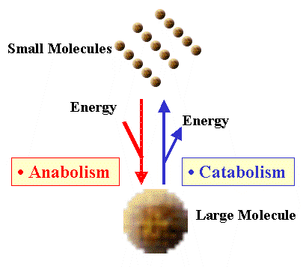
Biochemical Reactions
Life is dependent on chemical reactions.
Life is dependent on both the formation of different molecules into new molecules (anabolism) and on the breaking of one molecule into multiple molecules (catabolism).
For example, all living things depend on plants to combine carbon dioxide and water into sugar during photosynthesis.
All living things break down sugar into carbon dioxide and water, and use this process to generate ATP in order to power cellular activity.
Chemical reactions rarely ‘just happen’.
Most molecules do not just combine with each other. Most molecules do just break apart automatically.
The majority of chemical reactions requires an input of energy and often involves specific conditions and circumstances in order to occur.
Source: general.utpb.edu

Slide 3
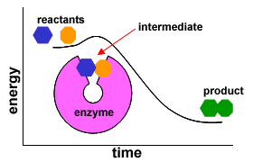
Enzymes
In a chemical reaction, the molecules at the start of a reaction are called the reactants.
The molecules formed as a result of the reaction are called products.
The energy needed to start a reaction is called the activation energy.
Enzymes are protein catalysts that lower the activation energy of a reaction in order to increase the rate of the formation of a product in a biochemical reaction.
Enzymes are needed by living organisms because they increase the rate at which biochemical reactions necessary for life can occur.
Without enzymes, the reactions needed for living organisms to function could not occur at a fast enough rate.
Source: ats.doit.wisc.edu

Slide 4
Enzymes
Enzymes are catalysts, or chemicals that enable a reaction to occur more easily because they lower the activation energy of a reaction.
A certain amount of energy is needed when two molecules react with each other in order to form a product.
If the two molecules that react in a chemical reaction do not contain a sufficient amount of energy, then the reaction cannot occur and no product will be formed.
Enzymes and other kinds of catalysts lower the amount of energy that is needed for a reaction to occur and for a product to be formed from a substrate without being a part of the final product formed in a reaction.
A substrate is a reactant in an enzymatic reaction that an enzyme acts upon to create a product.
The product is the molecule created as a result of a chemical reaction.

Slide 5
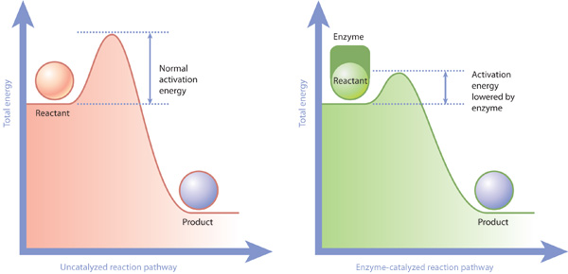
Shrinking the Mountain
Chemical reactions are sort of like a car going up a mountain.
If the car does not have enough gas to get up the mountain, it will roll back to its starting point.
Enzymes in this analogy wouldn’t increase the amount of gas in the car; instead, they would lower the height of the mountain.
In this case, enzymes would be like the excavation equipment that lower the height of the hills so that less energy is needed to reach the top of each hill.
Source: www.nature.com

Slide 6
Review of Proteins
Enzymes are proteins, or nitrogen-based biological macromolecules that are formed through specific combinations of amino acids.
A macromolecule is a molecule that contains a very large number of molecules.
Proteins are essential to the function and existence of every living organism.
In addition to enzymes that lower the activation energy of biochemical reactions, proteins can also work as pumps, serve structural roles, manufacture other molecules (such as ATP), fight pathogens (e.g. antibodies), send messages (e.g. hormones), and play many other roles.
Proteins are often the molecular machines of an organism.
Source: www.ib.bioninja.com.au

Slide 7
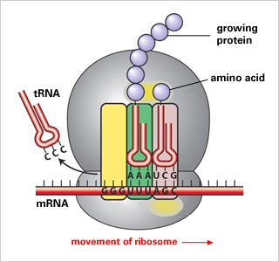
Transcription and Translation
Proteins are formed through transcription and translation.
Transcription is when DNA is copied by mRNA.
Translation is when a ribosome makes a protein using amino acids delivered by tRNA based on the information copied from DNA by mRNA.
As amino acids are delivered to the ribosome, they are assembled into a chain (sort of like pearls on a necklace).
This chain will begin to fold into a specific shape based on the chemical properties of the amino acids.
The shape in which the protein folds will determine the function of the protein.
Shape is very important for enzymes.
Enzymes usually work by providing a specifically-shaped active site in which a specific molecule binds.
Source: www.tokresource.org

Slide 8
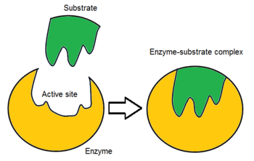
Protein Shapes
The active site of an enzyme is where a substrate binds to the enzyme.
Most of the work of a protein occurs at the active site.
The active site often forms a sort of pocket in which the substrate fits.
The shape of the active site, as well as the chemical properties of the active site, prevents the enzyme from reacting with any other molecules except the target substrate.
An enzyme is sort of like a lock and a substrate is sort of like a key – they must both have a correct shape and structure in order for the combination to work.
Source: en.wikipedia.org

Slide 9
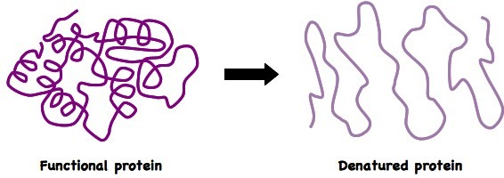
Enzymes & Temperature
Temperature, pH, and concentration are also vital to the function of an enzyme.
The rate of enzyme activity usually doubles with every increase of 10 degrees due to the fact that molecules involved in the reaction will move faster and collide more often as the temperature increases.
However, if temperatures get too high, the enzymes will denature (unfold and lose their shape).
This is why a fever becomes dangerous for a human being when it gets above 104º F.
Source; www.ib.bioninja.com.au

Slide 10
Enzymes & pH
Enzymes also are dependent on a specific pH to function.
If a solution becomes too acidic or basic, an enzyme will become less functional and may even denature under extreme changes to a pH.
Enzymes also depend on a sufficient concentration of both the enzyme and the substrate in order to function.
This is because of the fact that enzymes and substrates must make physical contact in order to function.
As long as there are enzymes with open active sites, an increase in the amount of substrate will increase the amount of enzyme activity.
Source; www.cs.mcgill.ca

Slide 11
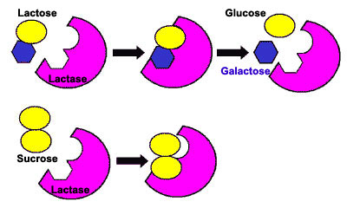
Lactase & Lactose
Lactase is a simple example of how an enzyme functions.
Lactose is the sugar found in milk.
Lactose is hydrolyzed (broken down) into the simpler sugars glucose and galactose when it binds to the active site of the enzyme lactase.
People who are lactose intolerant do not produce enough of the enzyme lactase (or none at all) and cannot break down the lactose sugar.
Without sufficient lactase production, the body cannot break down lactose and this undigested lactose passes through the digestive tract.
When undigested lactose reaches the colon (large intestine), it is fermented by bacteria found there.
This results in the production of gas and subsequent bloating, and attraction of water into the bowels that causes diarrhea.
Source: www.chemicalconnection.org.uk

Slide 12
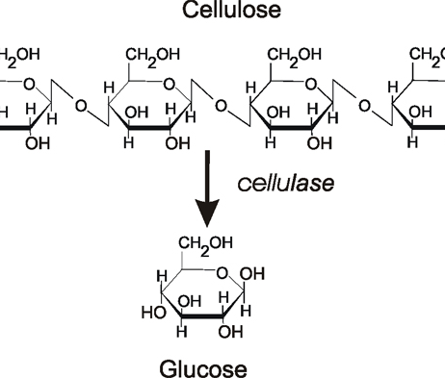
Cellulosic Ethanol
Because cellulose is the most abundant organic molecule on the planet, there is immense interest in the enzyme cellulase.
Cellulose is a polymer (a long, repeating molecular chain) of glucose.
Cellulase is the enzyme that breaks down cellulose into glucose.
Hydrolysis of cellulose into glucose is necessary in order to produce ethanol from cellulosic feedstocks (such as switchgrass or corn stalks).
Most ethanol in the US is produced from corn grain because it is relatively easier to convert its starch molecules into glucose for fermentation.
Cellulose has a dense crystalline structure made from chains of thousands of glucose molecules.
Source: www.biotek.com

Slide 13
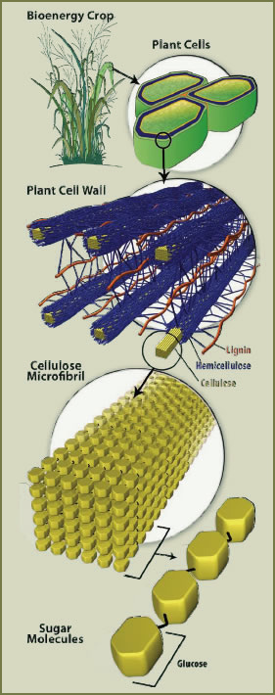
Crystalline Cellulose
A crystalline structure is often very strong and resists break-down because each molecule is also bonded to the molecules around it, forming a dense three-dimensional structure.
Cellulose does not break down easily; it is insoluble in water, most organic solvents, and weak acids and bases.
Without cellulase enzymes, the only other way to convert cellulose into glucose is to use high temperatures, high pressures, and/or strong acids.
All of these require large amounts of energy and may also reduce the sustainability and profitability of the biofuel production process.
Source: glbrc.org

Slide 14
A Difficult Breakdown
Not only does the hydrolysis of cellulose into glucose represent the greatest cost of cellulosic biofuel production, but it can often be the slowest and most limiting step in this process.
Finding more efficient ways of converting cellulose into glucose is necessary to make cellulosic ethanol a viable, sustainable, and profitable potential fuel source.
There are actually many different kinds of cellulase enzymes needed in order to break down cellulose.
Multiple enzymes play different roles in order to break down cellulose together.
What is the product of some enzymes will be the substrate for other enzymes.
Not only are there multiple kinds of cellulase, but other enzymes are also needed to break down the lignin and hemicellulose that protect cellulose from degradation.

Slide 15
Three Kinds of Cellulase
Of the multiple kinds of cellulases, most can be grouped into three categories.
Endoglucanases convert crystalline cellulose into individual molecules of cellulose.
Endoglucanases break the bonds between different cellulose chains in order to break up a ‘block’ of cellulose into its individual ‘chains’ of cellulose.
Endoglucanases are also unique in that they can cleave cellulose at random sites in order to create more ‘open ends’ at which other kinds of cellulase-enzymes can act.

Slide 16
Three Kinds of Cellulase
Exoglucanases convert long chains of cellulose into cellobiose.
Cellobiose is a molecule consisting of two glucose monomers (the individual units of a polymer).
Cellobiose molecules have the same structure as cellulose; they are just much shorter chains of glucose.
Exoglucanases need endoglucanases to ‘cleave’ the crystalline cellulose and create more open ends because exoglucanases can only start at the ends of the cellulose strands.

Slide 17
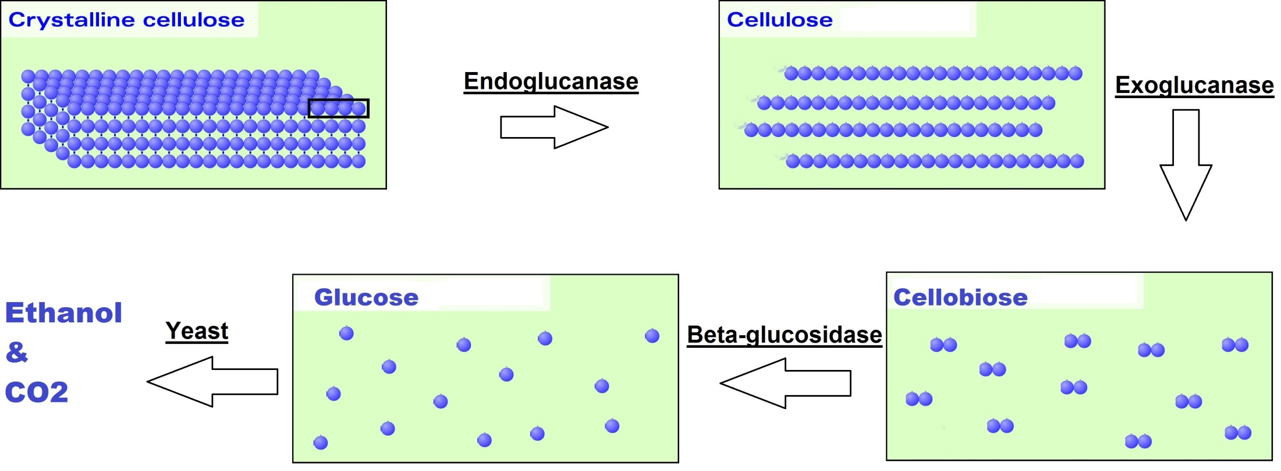
Three Kinds of Cellulase
Beta-glucosidases convert cellobiose into single molecules of glucose, which can be fermented by yeast and other microorganisms into ethanol.
Beta-glucosidases are necessary to convert the short-chains of glucose created by exoglucanase into the single glucose monomers that can be fermented.

Slide 18
Three Kinds of Cellulases
Endoglucanase, exoglucanase, and beta-glucosidease are excellent examples of how enzymes often work together in multiple stages to create a final molecular product, with the product of one enzyme becoming the substrate for the next enzyme.
In this case, crystalline cellulose is converted by endoglucanase into a single strand of cellulose.
Single-stranded cellulose is converted by exoglucanase into cellobiose.
Cellobiose is converted by beta-glucosidase into glucose.
Glucose is fermented by yeast into ethanol.

Slide 19
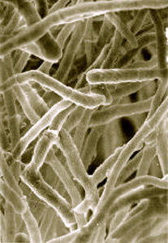
T. reesei
Much of what is currently known about the breakdown of cellulose by cellulase enzymes came from research of living organisms.
The study of the fungus T. reesei in the 1950s provided some of the first major evidence of the complexity and mechanism of cellulose breakdown.
Recent research of T. reesei has moved beyond the examination of what cellulase-enzymes are produced to the genes used to create the protein enzymes.
The T. reesei genome contains 9143 genes, of which 200 code for proteins related to cellulose breakdown.
Furthermore, research has shown that the presence of cellulose as well as lactose induces the expression of these genes.
T. reesei has also been selectively bred so that some industrial strains can produce as much as 100 grams per liter of cellulase enzymes.
Source: en.wikipedia.org

Slide 20
Bioprospecting
Living organisms may provide insights as to how cellulase enzymes can be acquired, utilized, and improved in order to make it more feasible and cost effective to produce ethanol from cellulosic feedstocks.
Bioprospecting is the process of searching for species in nature that can provide valuable products for human purposes.
These products can include chemical compounds, genes, microorganisms, and more.
The research related to the T. reesei fungus provided the insight as to the mechanism in which cellulase enzymes were able to break down cellulose into glucose.
This research represented early work in the field of bioprospecting because it enabled researchers to not only understand the mechanism of these enzymes but also develop industrial strains of this fungus in order to produce larger quantities of the needed enzymes.

Slide 21
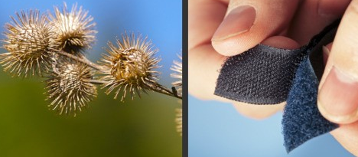
Applications of Bioprospecting
In addition to enzymes for the production of biofuels, the process of bioprospecting can be applied to many different industries and disciplines.
Bioprospecting has many applications in the field of medicine, as a large portion of medical compounds were originally discovered in nature.
For example, aspirin (acetylsalicylic acid) was actually first discovered in willow bark.
A widely-used cancer treatment called Taxol was isolated from the bark of the Pacific yew tree.
Bioprospecting has also yielded materials and inspiration for engineering.
Velcro was inspired by burs that stuck to the clothing of its inventor.
Some current research has focused on spider silk as an inspiration for stronger, lighter industrial materials.
Source: www.mnn.com530 × 267Search by image

Slide 22
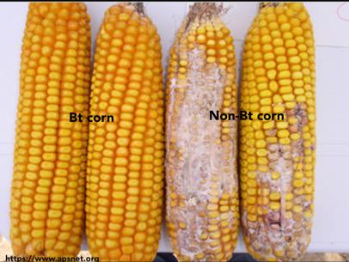
Applications of Bioprospecting
Bioprospecting has also been valuable for agriculture.
For example, Bt Corn is a widely-utilized genetically modified crop that has a gene so that it can produce a naturally-occurring insecticide from a species of bacteria.
Because Bt Corn produces its own insecticide, it significantly reduces the need for spayed applications of synthetic pesticides and greatly reduces the harmful impact on beneficial pollinating insects.
Source: twitter.com

Slide 23
Leaf Cutter Ants
Bioprospecting for more effective versions of cellulase enzymes has broadened far beyond the initial research of T. reesei.
One successful modern example of bioprospecting for cellulase enzymes involves the leaf cutter ant, Atta colubmica.
This leaf cutter ant has developed a symbiotic relationship with a funcus called L. gonglyophorus.
This fungus only grows in the nests of this particular species of leaf cutter ants by breaking down the leaves that are brought to it by the ants themselves.
Source: www.arkive.org

Slide 24
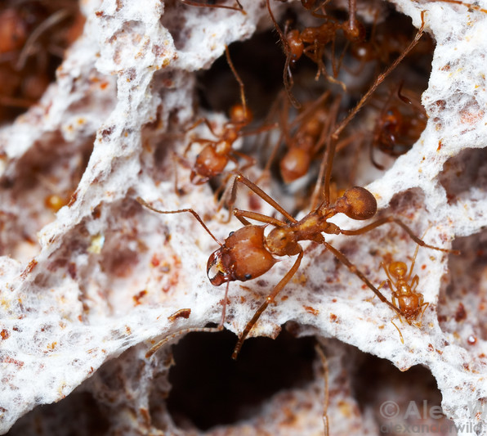
Leaf Cutter Ants as a Model
The leaf cutter ants and fungus that they feed are evidence that complex organisms (like ants and humans) can use a cellulosic source of fuel to meet all of their energy needs.
For 50 million years, these ants have fed cellulosic feedstocks to this fungus and in exchange the fungus provides a mixture of lipids, proteins, and carbohydrates that feed the ants.
This fungus only uses the hemicellulose, leaving behind lignin and cellulose waste that the ants remove and deposit in a ‘dump’ in their colony.
Additional forms of fungi and bacteria further degrade this lignin and cellulose.
Source: www.alexanderwild.com

Slide 25
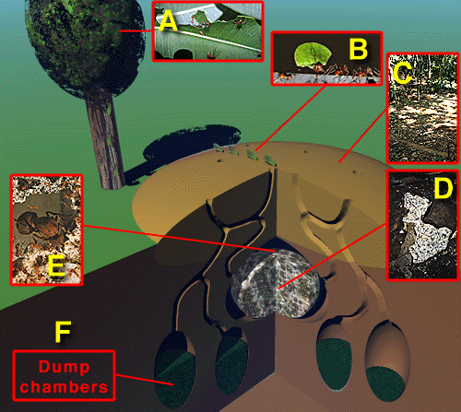
A. Leaves are cut by the ants.
B. The cut leaf parts are carried to the ant’s nest.
C. Specialized workers process the leaves into a mulch.
D. The ants feed the mulched leaves to the fungus. The fungus feeds on the mulch and uses the nutrients to grow and feed the ants.
E. The queen sits among the fungus garden laying her eggs.
F. When the nutrients have been removed from the leaf material, the waste is moved to special dump chambers, where dead ants and dead fungus are also placed.
Source: http://bioold.science.ku.dk/
Source: bioold.science.ku.dk

Slide 26
Resistance to Antibiotic Resistance
Furthermore, the ants have specialized-bacteria that living on their bodies that produce an antibiotic that the ants use to protect the fungus.
The ants have been using these antibiotics for 50 million years with the development of antibiotic resistance (a phenomenon in which an antibiotic loses its effectiveness over time due to overuse).
The fact that humans have only been using antibiotics for several decades and have already had to stop using some because of antibiotic resistance is evidence for the fact that these ant colonies and their symbiotic relationships may yield large amounts of valuable information.
The enzymes that the fungi use to break down the mulched leaves, the bacteria in the dumps of the ants, and the antibiotics used by the ants may all be useful for human purposes in bioenergy, medicine, agriculture, and much more.
Source: acanadiannaturalist.net

Slide 27
Five Phases of Bioprospecting
Bioprospecting generally consists of five phases.
Phase 1: determination of environmental characteristics necessary to support and select for traits sought in target organisms and formation of hypotheses related to where to search for organisms.
For example, if you were seeking cellulase-producing microbes and fungi, you would need an environment that both enables the growth of these organisms (wet and warm) while also selecting for organisms that produce cellulase over other types of organisms (which might occur if cellulose were the only source of energy available in that environment).
Phase 2: on-site collection of samples in areas hypothesized to be supportive and selective for the target organisms.

Slide 28
Five Phases of Bioprospecting
Phase 3: culturing, isolation, and identification of target organisms.
Phase 4: screening of the target organism(s) for their ability to produce the needed compounds.
Phase 5: development and industrial production of the acquired compounds.
This could be developed through selective breeding of the target organism to improve its ability to produce the needed compounds.
This could also occur through identification of the genes associated with the needed compounds and insertion of these genes into other organisms that are easier to grow in a laboratory, agricultural, or industrial setting.
It may also be possible to artificially produce the compound without the use of the organism (as is the case with the acetylsalicylic acid in aspirin).

Slide 29
Works Cited
https://www.glbrc.org/research/publications/saccharification-step-trichoderma-reesei-cellulase-hyper-producer-strains-0
http://www.ejbiotechnology.info/index.php/ejbiotechnology/article/view/v13n5-19/1218
http://large.stanford.edu/courses/2010/ph240/jin2/
http://www.worthington-biochem.com/cel/default.html
http://www.scripps.edu/marletta/research/research5.html

