Slide 1
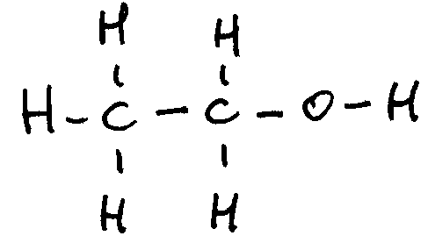
Ethanol
By C. Kohn
Agricultural Sciences
Waterford, WI

Slide 2
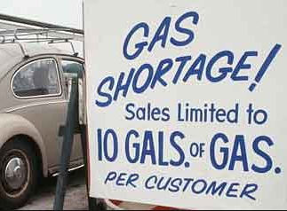
1973 Oil Embargo
In 1973, the future of energy use in America was permanently changed.
As a result of the Arab-Israeli War, Arab countries that were a part of the Organization of Petroleum Exporting Countries (or OPEC) imposed an embargo against the US in retaliation for US support of the Israeli military.
OPEC is an organization that was founded in 1960 that consists of the world’s major oil-exporting nations (except the United States).
OPEC has 12 member countries (including Iran, Iraq, Kuwait and Venezuela), and these countries control 80% of the world’s crude oil reserves and half of the natural gas reserves.
OPEC is a cartel, which is a term for an association of manufacturers (countries or businesses) who determine prices by restricting competition rather than let prices be determined through market forces.
Most prices in a capitalism are determined by supply and demand; prices go up as demand increases and prices go down as demand decreases.
In a cartel, the sellers of a product agree to sell a good at the same price, which is usually higher than what would occur if supply and demand determined the price.
Source: automotivedigest.com

Slide 3
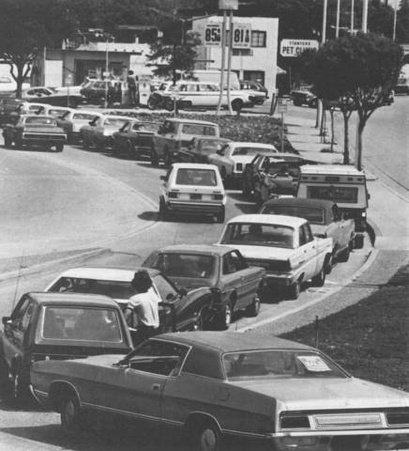
1973 Oil Embargo
The 1973 OPEC Oil Embargo banned petroleum exports to nations that supported Israel, including the US, the Netherlands, Portugal, and South Africa.
As a result of this ban, the US economy underwent severe strain as it had grown increasingly dependent on foreign oil.
The difficulty that President Richard Nixon faced in ending the embargo revealed a significant weakness in US security and foreign relations, namely that the US had become overly dependent on foreign energy for its own national and economic security.
The oil embargo caused dramatic effects on the US.
The price of oil doubled and then quadrupled within a few months, significantly threatening the stability of the world’s largest economy.
The US, having few options as its own domestic supplies of oil dwindled, had to negotiate under harsh economic circumstances that diminished much of its international leverage.
To an extent like never before, it was clear that a supply of sustainable, domestic energy was necessary for even the most powerful economic and military superpowers.
Source: greenthoughts.us

Slide 4
Alternatives to Oil
However, even more historical events would continue to shape the US energy policy.
A second oil embargo occurred in 1979, causing the US government to begin to consider the use of fuels other than petroleum.
As a result of the 1990 Clean Air Act Amendments, it became clear that military and economic security were not the only factors threatened as a result of the use of foreign oil; environmental security was also put at risk by the use of this fuel.
The attacks of 9/11 once again raised concerns about energy security as fuel prices spiked in the wake of the terrorist attacks and national security was once again in jeopardy as the US entered multiple wars in the Mideast.
President George W. Bush announced on March 9, 2007 that the US would form a partnership with Brazil to develop new ethanol policies and technologies.
Brazil and the United States were, and still are the world’s leading producers and exporters of fuel ethanol.
Ethanol (as a fuel) is a fuel produced by fermenting sugars and other carbohydrates into alcohol (see the molecule to the right).
In the United States, ethanol is primarily made from corn.
In Brazil, ethanol is primarily made from sugar cane.

Slide 5
The Brazilian Model
As a result of the energy turmoil that came from the OPEC embargos, Brazil decided to wean itself off of expensive, imported oil and turned to ethanol as its choice of alternatives.
Starting in 1975, Brazil set a goal to produce 3.5 billion liters of ethanol by the year 1980 (a goal which was vastly exceeded).
Brazilian factories built cars that ran completely on biofuel.
Gas stations were created throughout the entire nation to sell ethanol.
Government subsidies were created to encourage the development of sugar cane producers and mills.
In 2003, Brazil introduced flex-fuel cars which could run on either petroleum fuels or biofuels; today almost all cars manufactured in Brazil are flex-fuel vehicles (FFVs).
Source: www.nytimes.com

Slide 6
EISA
The attacks of September 11th prompted the Bush administration to actively pursue alternative energy sources.
In 2005 President Bush noted that Brazil’s transportation energy supply (primarily ethanol from sugar cane) was not only domestically produced but also had cleaner emissions, was less environmentally harmful to produce, and used much less energy for production than petroleum.
The US Congress sent delegations to Brazil to research and observe their methods, infrastructure, and policies that enabled Brazil to be powered by a cleaner, cheaper, renewable alternative fuel that could be completely domestically produced.
President Bush signed the Energy Independence and Security Act (EISA) in 2007. EISA aimed to…
move the United States toward greater energy independence and security;
increase the production of clean renewable fuels;
increase the efficiency of products, buildings, and vehicles;
promote research on and deploy greenhouse gas capture and storage options;
increase U.S. energy security, develop renewable fuel production, and improve vehicle fuel economy.
Source: http://www2.epa.gov/laws-regulations/ summary-energy-independence-and-security-act
Source: nchsapes.pbworks.com

Slide 7
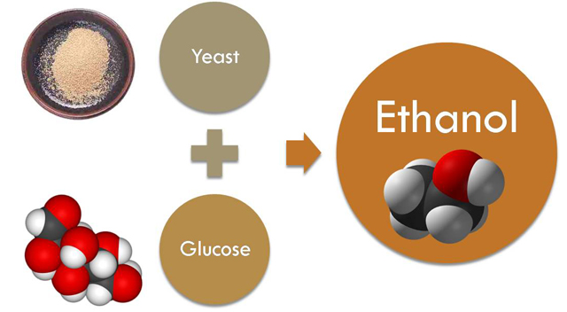
Ethanol
EISA includes provisions to increase the supply of renewable alternative fuel sources by setting a mandatory Renewable Fuel Standard.
The Renewable Fuel Standard requires transportation fuel sold in the United States to contain a minimum of 36 billion gallons of renewable fuels annually by 2022.
The primary renewable fuel used to meet this mandate is ethanol.
Ethanol is a renewable fuel made by fermenting biomass into alcohol.
Biomass is organic matter that was once a part of a living organism. Usually a sugar or a starch is the biomass that is used to make ethanol, but other forms of biomass may also be used (including cellulose).
Fermentation is the chemical breakdown of sugars into alcohol by bacteria, yeasts, or other microorganisms in the absence of oxygen.
Source: fyi.uwex.edu

Slide 8
Production of Ethanol
More than 95% of US gasoline contains ethanol. There are four primary ways in which ethanol can be used as a transportation fuel.
E-10: blended fuel that consists of 90% gasoline and 10% ethanol.
E-15: blended fuel that consists of 85% gasoline and 15% ethanol.
E-85: blended fuel that consists of 15% gasoline and 85% ethanol.
ETBE (or ethyl tert-butyl ether): a gasoline additive in which ethanol is mixed with isobutylene (a gas found in crude oil).
Ethanol and gasoline do not mix well; ETBE prevents separation of the ethanol from the fuel mixture. The downside of ETBE use is that unlike pure ethanol, it is not biodegradable.
There are three primary steps through which ethanol is produced.
First, biomass feedstocks have to be grown, harvested, and transported to an ethanol production facility. (An ethanol feedstock is the plant-based biomass from which ethanol is made.)
Second, the ethanol is fermented from the feedstock at the ethanol production facility and then transported to a fuel supplier.
Finally, ethanol is mixed with gasoline to make E10, E15, ETBE, or E85.

Slide 9
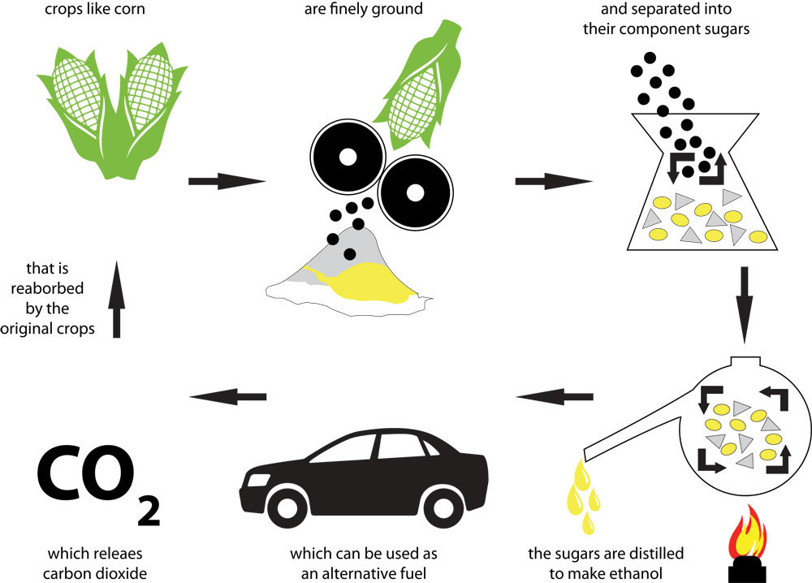
Producing Ethanol
Source: ethanolproducer.com

Slide 10
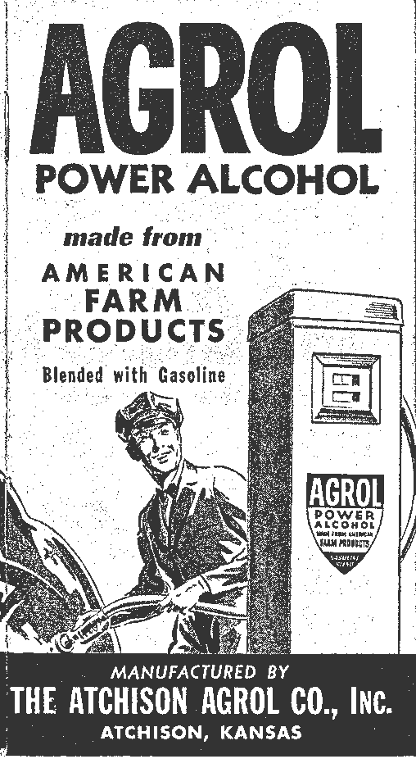
Henry Ford’s Ethanol
The use of ethanol is not a new idea.
In the 1850s, almost 90 million gallons of ethanol were produced to be used as fuel for lamps in the US.
To finance the Civil War, Congress put a $2 per gallon tax on ethanol to finance the war.
This caused people to instead use kerosene from petroleum that had recently been discovered in Pennsylvania.
In 1896, Henry Ford built his first automobile (as well as the first Model T) to run on ethanol.
Henry Ford and other early automakers had assumed that it would be the world’s primary source of transportation fuel.
Due to the end of Prohibition, the need for grain for food in countries ravished by World War I, and large supplies of cheap foreign oil, gasoline became a more cost-effective way to fuel the automobile.
As a result, gasoline became the primary source of transportation energy in the US.
Source: www.environmentalhistory.org

Slide 11
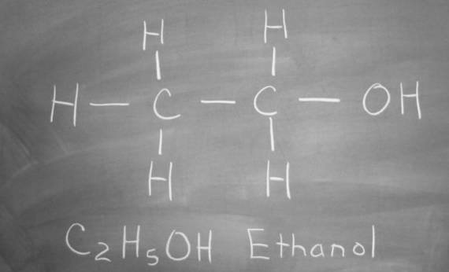
Valuable Properties of Ethanol
Ethanol has many valuable properties as a fuel.
Ethanol is a clear, colorless liquid.
Ethanol has the same molecular structure (CH₃CH₂OH) regardless of if it is produced for consumption or for fuel and regardless of whether it is produced from sugar cane, corn, wood chips, or any other source.
Other names for ethanol include ethyl alcohol, grain alcohol, and EtOH.
Ethanol burns more completely than petroleum.
Incomplete combustion is one of the primary causes of the dangerous byproducts of petroleum combustion.
Gasoline-fueled engines produce three undesirable products due to incomplete combustion: carbon monoxide (CO), nitrogen oxides (NOx), and reactive unburned hydrocarbons (a mixture of unreacted or partially reacted fuel molecules).
In the presence of sunlight, these undesirable products will form smog.
Source: driverlayer.com

Slide 12
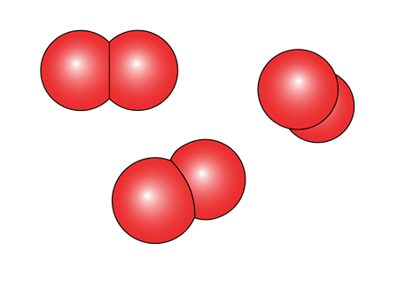
Valuable Properties of Ethanol
Emissions of CO, NOx, and unburned hydrocarbons are lower in ethanol-fueled engines than in engines powered by gasoline.
This is because of the presence of oxygen on the ethanol molecule.
While one molecule of octane (C₈H­₁₈) requires 13 molecules of O₂ for a complete combustion, a molecule of ethanol only requires 3 molecules of O₂ to combust completely.
The presence of oxygen on the ethanol molecule greatly reduces how much additional oxygen is necessary for combustion, ensuring a much greater likelihood of complete combustion.
O2 needed for one molecule of ethanol.
O2 needed for one molecule of octane.

Slide 13
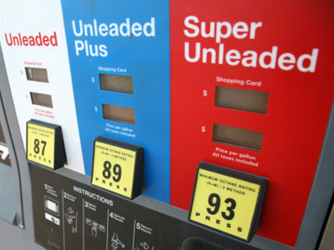
Valuable Properties of Ethanol
Ethanol has a higher octane number than gasoline.
The octane number is the measure of a fuel’s ability to resist knocking or pinging during combustion.
Engine knocking occurs when a fuel detonates prematurely; this causes an explosion outside of the normal combustion sequence in the four-stroke engine.
The greater the octane rating, the less likely that there will be engine knocking.
In older vehicles, higher octane numbers were achieved by adding lead to the fuel.
Due to the environmental damage and toxic biomagnification caused by the use of lead, legislation was passed that required the use of unleaded gasoline.
Today low octane gasoline can be blended with 10% ethanol instead of harmful lead to obtain the standard 87 octane requirement.
Source: auto.howstuffworks.com

Slide 14
Octane Ratings
The octane number is primarily determined by the molecular structure of the fuel.
Smaller fuel molecules have a higher ignition temperature (which is why they require a spark plug instead of just the heat of combustion as is the case with diesel fuel).
If temperatures are high enough, or if enough large fuel molecules are present in a fuel, the fuel will ignite before the spark from the spark plug, creating an ignition at the wrong time in the four stroke cycle.
Octane ratings are determined by how much knocking a fuel causes.
The fuel heptane (C₇H₁₆) combusts with constant engine knocking, resulting in an octane rating of 0.
Iso-octane (C₈H₁₈) combusts without any engine knocking, resulting in an octane rating of 100.
Gasoline with an octane rating of 87 means that it contains 13% heptane fuel.
Pure ethanol has an octane rating of 108.6, meaning that it combusts even more efficiently than pure octane.
Adding ethanol to gasoline improves its performance by raising its octane rating.
Heptane (above) and Iso-Octane (below)
Source: www.chemguide.co.uk

Slide 15
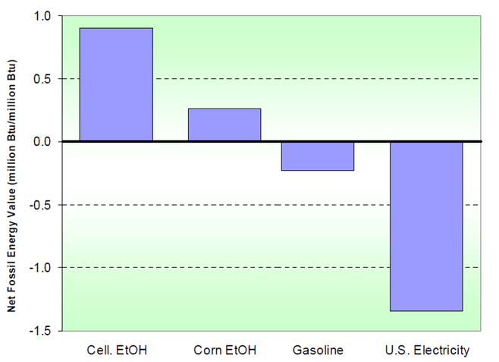
Positive Energy Balance
Ethanol has a positive energy balance.
A fuel with a positive energy balance means that the fuel contains more energy than was used to produce that fuel.
For every BTU of fossil fuel produced, gasoline requires 1.23 BTUs to be produced.
For every BTU of electricity produced in the US, over 2.3 BTUs are needed to produce it.
For every BTU of ethanol produced, it takes 0.78 BTUs of fossil fuel to produce it.
For every BTU of cellulosic ethanol produced, it takes only 0.1-0.2 BTUs of fossil fuel to produce it.

Slide 16
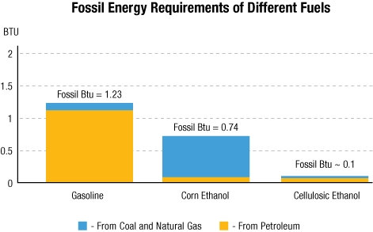
Ethanol’s Energy Balance
Ethanol has a positive energy balance because the majority of the energy found in ethanol originated from solar energy (instead of fossil fuel energy).
Technically, the amount of energy used to make ethanol is greater than the energy that is found in the ethanol fuel.
However, the solar energy that is used to produce ethanol is not taken into account for federal energy balance calculations because it is free, renewable, and has no negative impact on the environment.
Source: www.svtperformance.com

Slide 17
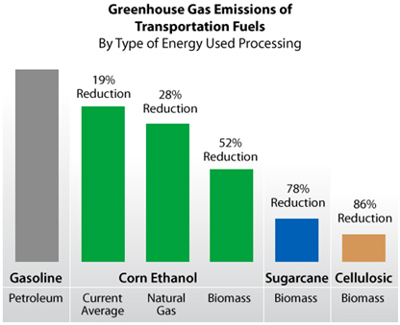
Greenhouse Gases
The use of ethanol reduces greenhouse gas (GHG) emissions.
Corn ethanol could reduce GHG emissions by 18-28% (and even up to 52% with improved technology and methods).
Cellulosic ethanol could reduce GHG emissions by 87%.
Cellulosic ethanol is a biofuel produced from wood, grasses, or the inedible parts of plants.
While corn-based ethanol can achieve moderate reductions in GHG emissions, cellulosic ethanol can produce much greater benefits in regards to a positive energy balance and greenhouse gas reductions.
It could also potentially provide more diverse wildlife habitat, reduced soil erosion, and improved soil fertility.
Source: www.afdc.energy.gov

Slide 18
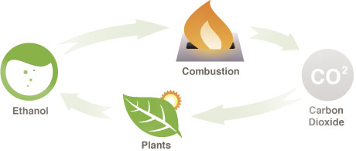
Ethanol and the Environment
Ethanol is a carbon-neutral fuel.
Not only are fewer greenhouse gases emitted when ethanol is burned, but those gases are reabsorbed when ethanol feedstocks are grown.
This makes ethanol a carbon neutral fuel – the carbon dioxide emitted when the fuel is combusted is reabsorbed when the fuel is produced.
This is different from petroleum, in which the greenhouse gases that are emitted increase in the atmosphere over time, resulting in worsening climate change.
Ethanol and Environmental Impact
Ethanol is a non-toxic, biodegradable fuel.
Unlike a major oil spill (like Deepwater Horizon in the Gulf of Mexico, or Exxon-Valdez in Alaska), an ethanol spill will mostly evaporate and would have minimal long-term impact on the environment.
Unlike fossil fuels, ethanol poses no threat to groundwater or surface water.
Source: www.ecosmartfire.com

Slide 19
Economic Benefits
Ethanol also has social and economic benefits.
Ethanol production lowers unemployment and stimulates the economy within the United States.
Ethanol production directly added 87,000 jobs and $44 billion to the US economy in 2013 alone.
Of this $44 billion, over $30 billion went to American households and consumers, an average of roughly an extra $100 per American in increased economic output.
Cellulosic ethanol also offers a future potential of providing two crops from the same field.
Improvements to the production of cellulosic ethanol may make it possible to harvest the stalks and leaves of corn plants for ethanol.
This would mean that almost the entire corn plant could be used to produce products.
Ideally the corn could be used for food or feed, and the stalks and leaves (or fodder) could be used to produce ethanol.

Slide 20
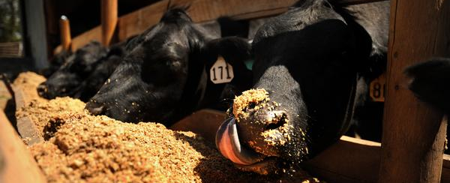
Ethanol and Agriculture
Ethanol also provides a larger market for American agriculture.
Not only does the use of ethanol provide a greater market for US producers of corn, but also provides additional uses for corn.
After corn has been fermented into ethanol, the components of corn that remain after fermentation can be fed to cattle as Distillers Dried Grains (DDG).
Currently 98% of DDGs are due to fuel ethanol production (the remaining 2% come from the fermentation of alcoholic beverages.
DDGs provide a high-quality feed for livestock and poultry that is high in energy, protein, and digestible phosphorus while reducing costs for livestock producers compared to similar feeds.
Source: chamapeak.org

Slide 21
Ethanol can be widely used.
Ethanol-blends can be used is most modern vehicles.
Low-level blends of E10 or less require no special fueling equipment, and they can be used in almost any conventional gasoline vehicle.
Four-stroke vehicles produced after 2007 can safely use E15.
Flex-fuel vehicles and other E85 vehicles are becoming increasingly more common, as are stations that offer E85 for sale.
Source: harvestpublicmedia.org

Slide 22
Works Cited
https://history.state.gov/milestones/1969-1976/oil-embargo
http://www.investopedia.com/terms/o/opec.asp
http://www.washingtonpost.com/world/brazils-ethanol-sector-once-thriving-is-being-buffeted-by-forces-both-man-made-natural/2014/01/01/9587b416-56d7-11e3-bdbf-097ab2a3dc2b_story.html
http://www.clover.okstate.edu/fourh/aitc/lessons/upper/biofuel3.pdf
https://www1.eere.energy.gov/vehiclesandfuels/pdfs/program/ethanol_brochure_color.pdf
http://www.afdc.energy.gov/fuels/ethanol_benefits.html
http://www.chemistryexplained.com/Fe-Ge/Gasoline.html
Chemistry of Fossil Fuels and Biofuels, by Harold Schobert
http://www1.eere.energy.gov/vehiclesandfuels/pdfs/basics/jtb_ethanol.pdf
http://www.academia.edu/3808775/Comparison_of_Ethanol_and_n-Butanol_blends_with_Gasoline_A_Computational_Study
http://www.bioenergywiki.net/ETBE
http://www.ddgs.umn.edu/GenInfo/Overview/index.htm
http://www.student.nvcc.edu/home/pejellendil/ITD110/downside-to-ethanol.htm
www.neo.ne.gov/statshtml/66.html
http://www.ers.usda.gov/data-products/us-bioenergy-statistics.aspx
http://www.forbes.com/sites/jamesconca/2014/04/20/its-final-corn-ethanol-is-of-no-use/

