Slide 1
Fermentation
By C. Kohn Agricultural Sciences Waterford, WI

Slide 2
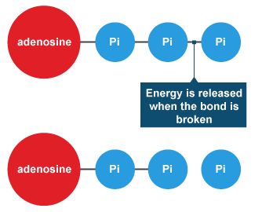
ATP = Cellular Batteries
The cells of all living organisms are powered by a molecule called ATP.
ATP, or adenosine triphosphate, is what powers most activity that occurs in a cell.
After ATP powers a cellular process, it becomes ADP and P_{i} (inorganic phosphate).
To become ‘recharged’, ADP and P_{i} have to be recombined into ATP.
In a way, ATP is like a rechargeable battery.
Like a battery, ATP can provide energy to power a process.
Like a battery, ATP can lose its energy after it powers a process.
Like a rechargeable battery, ATP can be “recharged”.
ATP
ADP
Source: www.bbc.co.uk

Slide 3
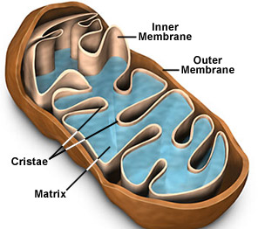
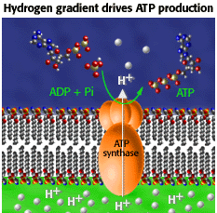
ATP Synthase = Battery Charger
Most eukaryotic organisms (those with cellular organelles) use their mitochondria to produce ATP from ADP and P_{i}.
The mitochondria is the ‘powerhouse’ of the cell and produces most of a cell’s ATP.
ATP is produced by a protein found in the mitochondria called ATP Synthase.
ATP Synthase is sort of like a wheel. As this wheel turns, it combines ADP and P_{i} into ATP.
Like a water turning a turbine in a hydroelectric power plant, ATP Synthase is turned by hydrogen protons (hydrogen atoms lacking an electron).
This hydrogen is acquired from the fats and carbohydrates (sugars, starches, and fiber) in the food that has been consumed by that organism.
Source: micro.magnet.fsu.edu
Source: www.biology.arizona.edu

Slide 4
Oxygen = Molecular Garbage Trucks
The ATP Synthase in the mitochondria of cells depend on oxygen in order to produce ATP.
Hydrogen must constantly flow past ATP Synthase in order for ATP Synthase to turn and produce ATP from ADP and P_{i}.
Oxygen is necessary to enable the movement of hydrogen behind the ATP Synthase so that it can be turned and make ATP.
If a constant supply of oxygen is absent from the cell, the hydrogen will stop flowing past the ATP Synthase molecules and these proteins will be unable to produce ATP.
Without the produce of ATP, the cells will quickly stop functioning.

Slide 5
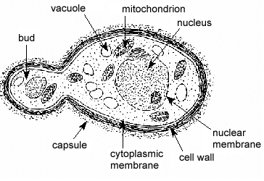
Oxygen vs. No Oxygen
Some organisms have developed strategies to survive in low-oxygen or anaerobic (zero oxygen) environments.
Many prokaryotic bacteria (which lack organelles like a mitochondria) are anaerobic and can produce ATP in the absence of oxygen.
Yeast, a single-celled fungi that is eukaryotic (has cellular organelles) and has mitochondria can function in both aerobic and anaerobic environments.
When oxygen is available, yeast will break down carbohydrates into CO₂ and H₂O.
The hydrogen protons from the carbohydrates will be used to turn the ATP Synthase in the mitochondria of the yeast cells in order to produce ATP.
Oxygen will be used to move hydrogen protons in order to ensure that the ATP Synthase continue to turn and produce ATP.
This process in which carbohydrates and oxygen are broken down into CO₂ and H₂O in order to produce ATP is known as cellular respiration.
Source: bookcoverimgs.com

Slide 6
Fermentation
When oxygen is not available, yeast will produce ATP via a process called fermentation.
Fermentation is less favorable to the yeast cells (and any living organism) because it results in much less ATP production.
However, fermentation ensures that yeast can still survive even if oxygen is completely absent from their environment.
Source: papapipi.com

Slide 7
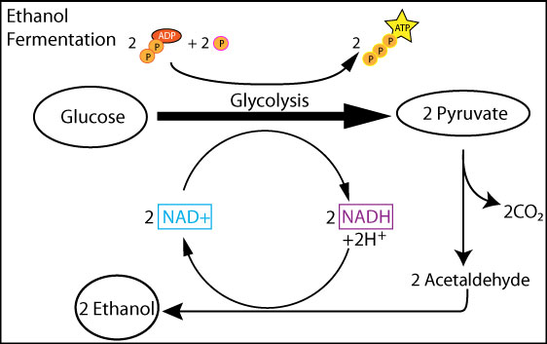
Fermentation
In fermentation, simple sugars are converted into ethanol and carbon dioxide.
Both cellular respiration and fermentation begin with the same process: glycolysis.
In glycolysis, a sugar molecule is split into two pyruvate molecules (think of pyruvate as just half a sugar molecule).
Two ATP molecules are used to power the process of splitting a pyruvate (it takes energy to break apart molecules and energy is released when molecules form).
The pyruvate molecules can be used to add P_{i} to ADP in order to form ATP in a process called substrate level phosphorylation.
Substrate level phosphorylation can be used to produce 4 ATP per sugar molecule
Because 2 ATP are used to break apart the sugar molecule, there is only a net gain of 2 ATP during substrate level phosphorylation.
Source: adapaproject.org

Slide 8
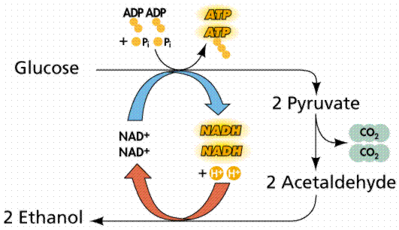
NADH → NAD+
After producing 4 ATP (but only a gain of 2 ATP overall), the yeast cell must reform NAD+.
NAD+ is a molecule that is used to acquire hydrogen atoms from the sugar molecule in order to break it into two pyruvates.
When NAD+ acquires the hydrogen atom, it becomes NADH.
NADH must be converted back into NAD+ in order to allow glycolysis to continue occurring (in other words, to allow the next sugar molecule to also be broken into two pyruvate molecules so that more ATP can be produced).
Source: https://apbionotebook.files.wordpress.com/2014/01/alcferm.gif

Slide 9
Pyruvate → Ethanol
In order to convert NADH back into NAD+, the yeast cell must convert the pyruvate molecules into acetaldehyde and then ethanol.
By changing pyruvate into acetaldehyde, and by transferring hydrogen from NADH to the acetaldehyde molecules, ethanol is formed and two NADH molecules are turned back into NAD+.
The newly re-created NAD+ can then be used to split another sugar molecule into two pyruvates during glycolysis in order to produce ATP through substrate level phosphorylation.
The newly created ethanol molecules are waste products and are expelled from the yeast cell (similar to how animals excrete waste from their own bodies after digestion).
Fermentation consists of the steps of glycolysis, substrate level phosphorylation, and the conversion of NADH molecules back into NAD+ through the conversion of pyruvate into acetaldehyde and then into ethanol molecules.
Source: https://apbionotebook.files.wordpress.com/2014/01/alcferm.gif

Slide 10
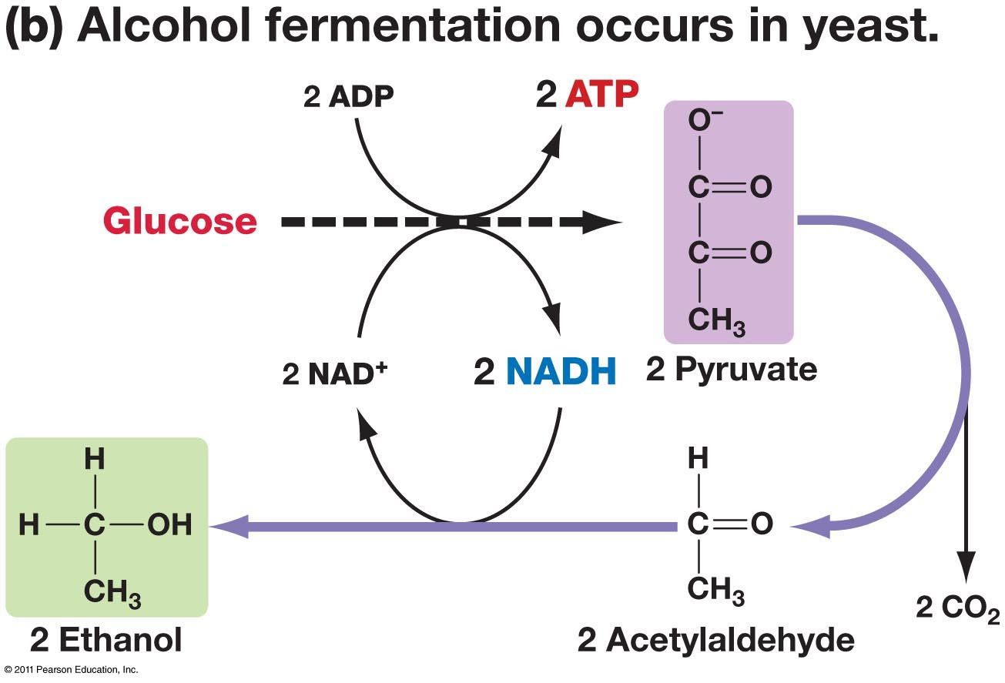
Summary of Fermentation
To summarize the steps of fermentation…
First a yeast cell (in an anaerobic environment) will use two ATP molecules and two NAD+ molecules to split a sugar molecule into two pyruvate molecules.
Next, the two pyruvate molecules will be used to produce 4 ATP molecules (a gain of 2 ATP overall) during substrate level phosphorylation. .
Third, the pyruvate molecules be converted into acetaldehyde.
Fourth, acetaldehyde will be used to acquire two hydrogen atoms from the NADH in order to form ethanol and NAD+.
The cycle then repeats with a new sugar molecule.
Source: www.uic.edu

Slide 11
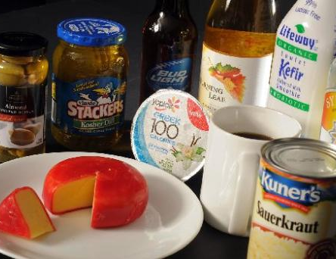
Fermentation & Society
The fermentation process is widely used in modern society.
Fermentation is used to produce many foods, beverages, and pharmaceuticals.
Examples of fermented products include bread, cheese, yogurt, pickles, vinegar, and sauerkraut as well as alcoholic beverages such as beer, wine, whisky, and vodka.
Fermented foods have many advantages over regular food. These advantages include…
Improved flavor.
More vitamins (particularly B-12).
Longer storage life (e.g. the shelf-life of cheese is much greater than fluid milk).
Decreased cooking time, and…
Increased sale value of the final product.
Source: www.reporterherald.com

Slide 12
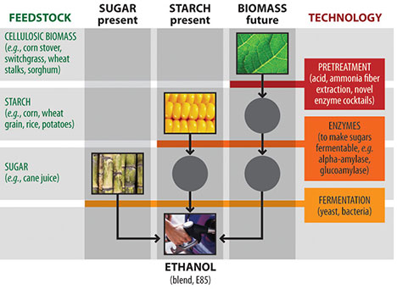
Fermented Fuel
Fermentation can also be used to create fuel ethanol.
The molecular structure of fuel ethanol is the same as consumable ethanol, and the fermentation process used to create fuel ethanol is also similar to what is used to produce food products.
The steps necessary to create fuel ethanol depend somewhat on the feedstock used.
Some feedstocks, such as sugarcane, can be fermented directly into ethanol.
Other feedstocks, particularly corn and cellulosic feedstocks, require pretreatment and hydrolysis in order to convert the complex carbohydrates they contain into simple sugars that can be fermented.
Source: www.treehugger.com

Slide 13
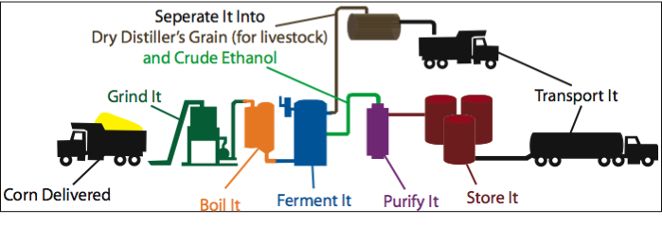
Dry Milling
There are two methods that can be used to produce ethanol from corn: wet-milling and dry-milling.
In dry milling, the entire corn kernel is first ground into a fine flour (called meal).
The ground corn meal is then mixed with water to create mash.
Third, enzymes are then added to the mash to convert the starches originally found in the corn kernel into a simple sugar (dextrose) that can be fermented.
Fourth, ammonia is also added to the mash to control the pH and to provide nutrients that the yeast can utilize.
Source: people.hws.edu

Slide 14
Dry Milling
Fifth, the mash is then heated to high temperatures that the yeast can withstand in order to cook off any threatening bacteria.
Sixth, the mash is cooled and moved to fermentation vessels where the yeast will convert the dextrose into ethanol and CO₂ over 40-50 hours.
Seventh, the newly-produced ethanol is then moved to a distillation column; the mash is heated to the boiling temperature of the ethanol, which evaporates from the mash and is collected.
Eighth, the ethanol is mixed with 5% gasoline so that it is not consumable (and also so that it is not subject to alcohol taxes) and is shipped to distributors.
The remaining components of the mash are made into corn syrup and dried distillers grains and are sold as byproducts of ethanol production.
Source: people.hws.edu

Slide 15
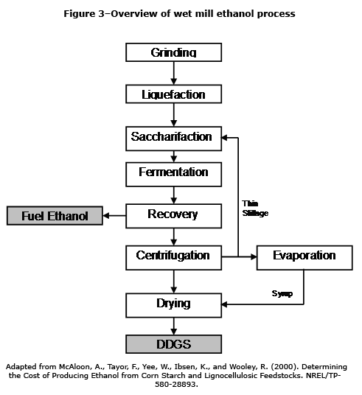
Wet Milling
In wet milling, the corn kernels are soaked in water and acid for 24-48 hours.
This process, known as steeping, allows the corn kernels to separate into its different components.
After 24-48 hours, the “slurry” is run through a series of grinders.
The oils of the corn are extracted and the remaining fiber, gluten, and starch are separated from each other.
The gluten is sold as animal feed and the leftover water can be used as an environmentally-friendly alternative to road salt.
The remaining starch is then fermented into ethanol in a manner similar to dry milling.
Source: bioweb.sungrant.org

Slide 16
Physiology of Alcohol Consumption
How the body processes alcohol.

Slide 17
Alcoholic Beverages
Alcohol for consumption has the same molecular structure as fuel ethanol: CH₃CH₂OH.
While moderate consumption of alcohol by legal adults can be a part of a healthy lifestyle for many people, alcohol is treated as a toxin by the human body.
Many of the effects associated with alcohol inebriation are actually a result of either the toxic impact of alcohol on the body or the body’s method of coping with the toxin.
Alcohol is also a drug and can form both dependency and addiction.
Alcohol abuse is defined as recurrent alcohol use where it impacts on work, school or home, or to the point that it is physically dangerous, gets you into trouble with the law, or continues despite the problems it has created.

Slide 18
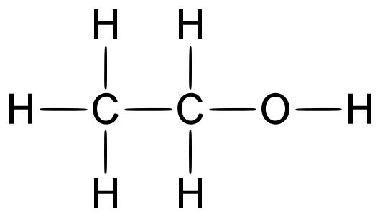
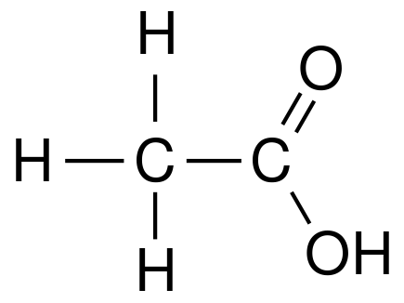
Steps of Metabolism
The metabolism of alcohol is the process in which the body converts alcohol into a less toxic substance.
Alcohol metabolism (processing) has three steps
Consumption – getting the liquid into the body
Absorption – absorbing the alcohol into the bloodstream
Processing – converting the alcohol into acetaldehyde and then acetate and finally into fatty acids, carbon dioxide, and water

Slide 19
Consumption & Absorption
When alcohol is consumed, 20% is immediately absorbed into the bloodstream from the mouth and esophagus.
The remaining 80% will be absorbed as the alcohol moves to the stomach and intestines.
Once the alcohol reaches the bloodstream, it is rapidly moved throughout the body.
Different parts of the body will absorb the alcohol at different rates depending on the type of tissue.
Muscular tissue will absorb the alcohol faster than fat tissue.
Because of this, individuals with a higher percentage of body fat will be more affected by alcohol than those with a lower percentage of body fat because the alcohol will remain in their bloodstream longer.

Slide 20
Processing
Once the alcohol is in the bloodstream, the liver will begin to break it down into less harmful substances.
The liver’s job is to remove harmful substances and toxins from the blood, including alcohol.
The liver can process about 1 ounce of alcohol per hour (roughly the equivalent of a 12 oz. beer or 4-5 oz. of wine).
The liver will depend on two key enzymes to break down alcohol: alcohol dehydrogenase (ADH) and aldehyde dehydrogenase (ALDH).
ADH converts alcohol into acetaldehyde.
ALDH converts acetaldehyde into acetate.
The body is able to digest acetate and completely respire this molecule into fatty acids, CO2, and water.
Acetaldehyde is actually much more harmful to the body than alcohol.
However, the conversion of alcohol to acetaldehyde is a necessary step in order to eventually convert it into acetate so that it can be removed from the body.

Slide 21
Steps of Alcohol Processing
Alcohol is consumed.
Alcohol is absorbed into the blood stream by the mouth, esophagus, stomach, and intestines.
Alcohol arrives at the liver via the bloodstream
ADH turns alcohol into acetaldehyde by ADH (this is the “bad” version).
ALDH converts acetaldehyde into acetate by ALDH (this is the “good” version that can be broken down).
Acetate is converted into CO2, H2O, and fatty acids by mitochondria in the liver cells.
Source: aje.oxfordjournals.org

Slide 22
Alcohol Impairment
Alcohol is a depressant, meaning that it impairs and reduces the ability of the body to perform normal physiological functions.
In the central nervous system, alcohol slows the rate at which neurons (nerve cells) can send signals.
As a result, all neurological function in the brain will be impaired by alcohol consumption, including judgment and emotional regulation.
Because of this, alcohol consumption is associated with increased self-confidence and a decrease in the ability to form rational judgment.
Alcohol can also lead to reduced inhibitions, making it more likely that an individual who is consuming alcoholic beverages will make choices that they wouldn’t have made when sober.
Decreased judgment and an increased sense of self-confidence that can result from alcohol consumption can result in increased risk taking, especially during periods of binge drinking (defined as consuming alcohol at a rate the elevates the blood alcohol level above 0.08%).

Slide 23
Sexual Assault
Because alcohol consumption depresses the ability of the brain to make rational judgments and reduces inhibitions, increased alcohol consumption can result in higher rates of sexual assault.
Alcohol increases the likelihood of assault by impairing the judgment and inhibition that would otherwise likely prevent this kind of behavior in a less intoxicated individual.
Additionally, physiological differences between men and women can disproportionately put women at risk for assault in environments with high levels of alcohol consumption.
Because a woman’s body has a higher percentage of body fat on average, and because a woman’s body tends to be smaller on average, consumption of the same amount of alcohol will usually have a greater impairment on a woman than a man.
25% of American women have experienced sexual assault, including rape.
Approximately one-half of those cases involve alcohol consumption by the perpetrator, victim, or both. (http://pubs.niaaa.nih.gov/publications/arh25-1/43-51.htm).

Slide 24
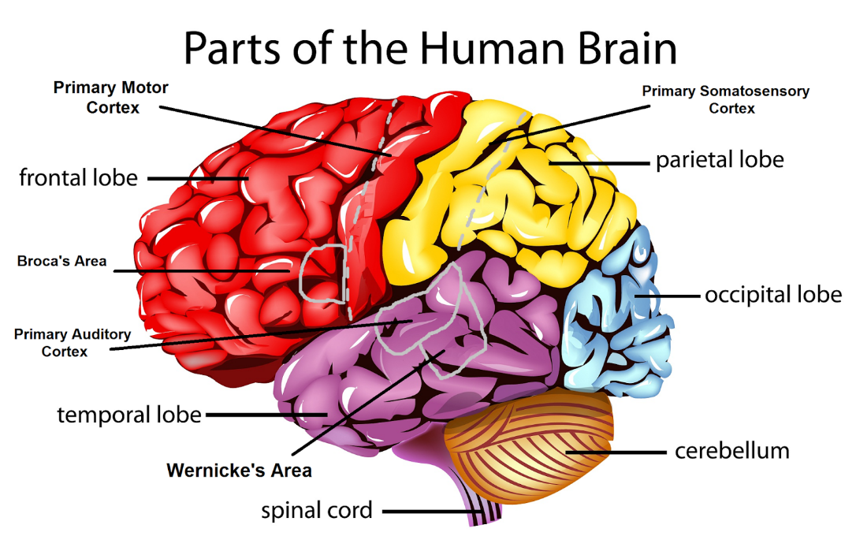
Neurological Impairment
Alcohol affects the brain in many other ways, including…
Reduced Sensory Input: the parietal lobe, which processes sensory input from the skin, tongue, ears, and eyes will be impaired by alcohol.
This reduces the ability to detect sounds and touch and sense pain and temperature changes.
Physical Impairment: the control of muscles occurs in the primary motor cortex of the frontal lobe.
Alcohol consumption will reduce the ability of the brain to communicate with the muscles to control movement.
The premotor cortex, which monitors movement using sensory feedback, will also be impaired; this will reduce the ability to correct and coordinate muscular function.
Alcohol will also impair the cerebellum, which controls precision, timing, and muscle memory.
Source: purpleisaprettycoolcolour.blogspot.com

Slide 25
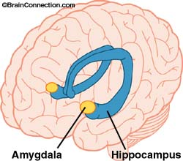
Neurological Impairment
Amnesia: because the central nervous system is impaired by alcohol, the process of creating and storing memory is also impaired.
The parts of the brain required for short-term memories (including the hippocampus, amygdala, and diencephalon) will have increasingly dampened activity as alcohol is consumed.
As function is impaired in these structures, so is the ability to form and retain memories.
Emotional Dysregulation: the amygdala of the brain (which is responsible for regulating emotion and emotional processing) will be inhibited.
This can lead to possible anxiety, anger, frustration, lust, and other primal human emotions to become over- or under-expressed.
Source: brainconnection.brainhq.com

Slide 26
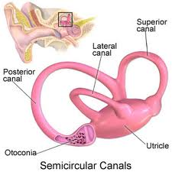
Lost Balance
In addition to impairing the primary motor cortex and the premotor cortex of the brain, alcohol consumption will also impair the sense of balance because of its impact on the structures of the inner ear.
Balance is regulated by the semicircular canals inside your ear.
The semicircular canals are looped structures that are filled with fluid called endolymph.
The movement of fluid inside these loops tells your body your position and orientation in space.
Alcohol thickens this fluid, reducing the ability to sense movement and maintain balance.
Source: www.heliummm.com

Slide 27
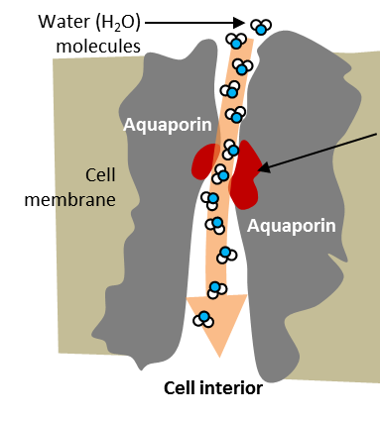
Dehydration
Alcohol dehydrates the body in multiple ways.
Alcohol is a diuretic and causes cells to shed water.
Alcohol also interferes with the kidney’s ability to regulate water balance in the body by disrupting aquaporin and vasopressin function.
Aquaporin proteins regulate reabsorption of water filtered out of the blood by the kidney. Vasopressin is a hormone that regulates whether or not an aquaporin channel is open.
Alcohol inhibits the function of vasopressin, limiting its ability to open aquaporin channels that would let filtered water back into the bloodstream, causing water to be moved to the bladder at an increased rate.
Because alcohol causes cells to shed water, because it prevents aquaporin proteins from opening, and because alcohol also causes the bladder to feel fuller than it actually is, alcohol consumption is also linked with an increased need to urinate.
This effect becomes amplified as more alcohol is consumed.
Source: www.appliedbiomimetic.com

Slide 28
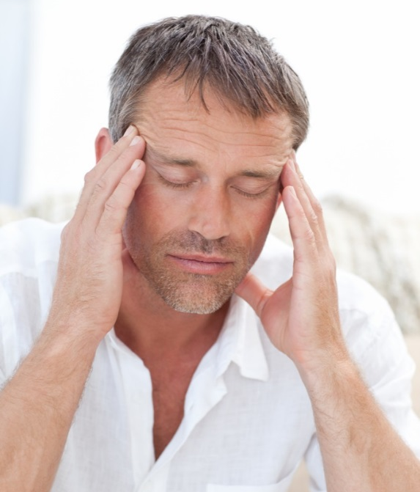
Fatigue
The exhaustion associated with excess consumption is due to alcohol’s inhibition of glutamine.
Glutamine is a stimulant produce by the body. Production of glutamine is inhibited by alcohol.
When the effects of alcohol wear off, glutamine production is increased to compensate for previous inhibition.
This causes a drinker to wake more in their sleep as glutamine production increases, preventing the deepest and most restful stages of sleep.
Glutamine rebound can also lead to tremors, anxiety, and restlessness.
Glutamine, like caffeine, is a stimulant.
Source: www.alcotox.com

Slide 29
Disease & Disorder
While moderate consumption of alcohol can provide health benefits for many individuals, excess alcohol consumption can cause many devastating diseases and disorders, including…
Liver Disease: years of heavy drinking may lead to irreversible destruction and scarring of liver tissue (cirrhosis).
Digestive Problems: excess drinking can cause inflammation of the stomach lining, ulcers, and impaired nutrient absorption.
Heart Problems: Excessive drinking can lead to high blood pressure and increases your risk of an enlarged heart, heart failure or stroke.
Sexual Impairment: excess drinking can cause erectile dysfunction in men and can interrupt menstruation in women.
Birth Defects: drinking during pregnancy can cause Fetal Alcohol Syndrome, which results in lifelong physical and developmental problems in the child.
Bone Loss: excess alcohol consumption can lead to thinning bones (osteoporosis) and an increased risk of fractures.
Cancer: excess alcohol consumption raises the risk of mouth, throat, liver, colon and breast cancer.

Slide 30
Addiction
Substance dependence, or addiction, depends on two factors:
Psychological dependence – a craving for and inability to stop using a chemical substance.
Physical dependence – a substance must be consumed in order to avoid withdrawal, or negative physical and emotional responses to the absence of a chemical substance.
Regular abuse of alcohol will often result in a chemical dependency on the consumption of alcohol in order to feel ‘normal’ and not experience withdrawal.
This is due to the effect of alcohol tolerance, or the need for constantly increasing doses in order to feel the desired effects of alcohol consumption.
As more alcohol is consumed over time, the body will produce more enzymes to degrade alcohol, requiring more alcohol over time to feel the same effect.
Abuse of alcohol can be addictive; of 100 people who regularly consume alcohol, 15 will develop a dependency on it on average. In comparison, 25/100 heroin users and 16/100 cocaine users will develop a dependency.

