Slide 1
Genetic Change
By C. Kohn
Agricultural Sciences
Waterford, WI

Slide 2
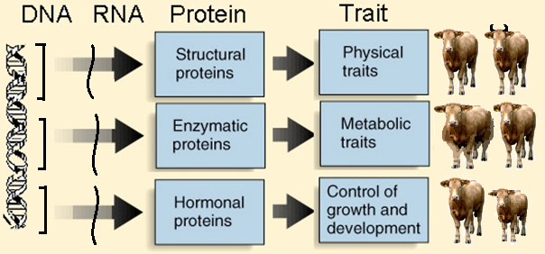
Species Change
The traits of a species are primarily determined by the types of proteins made in its cells.
All proteins are made from amino acids, and different arrangements of amino acids result in different proteins.
The order of amino acids is determined by the codons in a mRNA copy of a gene in the DNA of an organism.
A change (or mutation) in the DNA of an organism will usually result in a change the order amino acids that are assembled into a protein.
This will change the traits that are expressed by that organism.
The environment in which the organism is found affects whether or not a change to a trait due a gene mutation will be beneficial or harmful to that organism.
Source: igbiologyy.blogspot.com

Slide 3
Types of Genetic Change
Whether or not an individual can thrive in its environment depends on whether or not its traits help it to succeed in the types of conditions in which it is found.
A wide diversity of traits causes the rates of survival of an organism to vary.
All of the diversity of traits and of species on Earth ultimately results from genetic change.
Genetic change is how the individuals of a species change as a result of both mutations and the selection pressures of the environment in which those individuals are found.
Due to mutations, there is an ongoing change in the kinds of proteins made by all of the individuals found in a population of a species.
If these mutations are beneficial for a given environment, and if they can be passed on to offspring, a species may gradually change.
There are five types of genetic change: 1) mutation, 2) natural selection, 3) genetic drift, 4) migration, and 5) artificial selection.
Source; www.pinterest.com

Slide 4
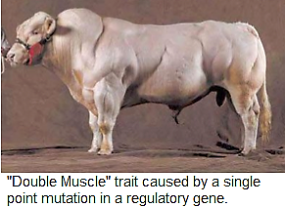
Mutations
Mutations are the main drivers of genetic change.
A mutation is when the order of bases found in the DNA of an organism are changed.
This can be because of a copying error, because of a mutagen, or because of other causes.
A mutation is usually harmful because it will cause at least one codon (group of 3 bases) in the mRNA copy to change.
A changed codon will usually result in a change to at least one amino acid, which usually causes a change to the shape and function of the protein.
A change to the shape of a protein is usually harmful because it often causes the protein to become dysfunctional.
Mutations are not always harmful.
Sometimes mutations have no impact whatsoever and cannot be detected in an organism.
In rare cases, a mutation can result in the development of a beneficial trait.
Source: blogs.lt.vt.edu

Slide 5
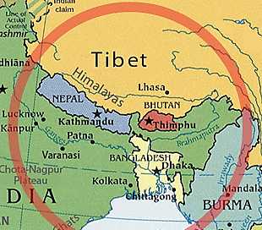
High Altitude Survival
For example, 87% of Tibetan people in the Himalayan mountains have a mutation that has resulted in a gene called EPAS1.
This gene codes for the assembly of a protein that helps the body cope with low oxygen levels.
The high altitudes where the Tibetan people live has 40% less oxygen than is found at sea level.
Most humans who live at high altitudes need more red blood cells to carry more oxygen to compensate for the low oxygen concentrations at those altitudes.
However, individuals with this mutated gene are able to function as well at high altitudes with the same amount of red bloods as those at lower elevations.
This random mutation has enabled these populations of people to function better in their unique environment and has become very prevalent among these people as a result.
Source: english.cntv.cn

Slide 6
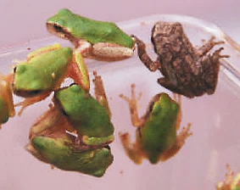
Natural Selection
If a beneficial mutation can be passed on to the next generation of offspring, it may result in an inheritable trait that makes it more likely for those individuals to thrive and to reproduce.
In natural selection, a trait that results from a mutation will become more prevalent if it enables an individual to function and reproduce more easily. A trait will become less prevalent if it reduces an individual’s ability to function and/or reproduce.
For example, there are both green and gray tree frogs in the eastern United States.
Green tree frogs have an advantage in wetlands with more green vegetation because it is harder for predators to spot them.
Gray tree frogs have an advantage in wooded areas because they blend in with the gray tree bark.
As a result of natural selection, higher proportions of green tree frogs are found in wetland areas, and wooded areas have a higher proportions gray tree frogs.
Source: aqualandpetsplus.com

Slide 7
Evolution
If the selection pressure is great enough, natural selection can change a group of organisms to the extent that they become an entirely new species that no longer resembles the original species.
The process of evolution occurs when the heritable traits found in the individuals of a species change due to both random mutation and due to selection pressures in an environment over time.
Evolution is usually a slow process.
It often takes many, many generations for enough changes to occur in order for a species to change.
Evolution and natural selection are not the same thing.
Evolution refers to the actual changes to a species that may eventually result in the formation of a new species.
Natural selection is the mechanism for those changes; it is what enables those changes to occur.
Source: ephshonorsbioblogfoley.blogspot.com

Slide 8
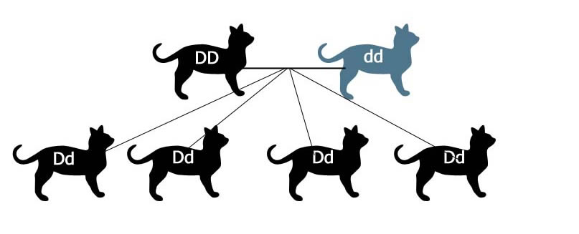
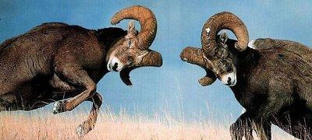
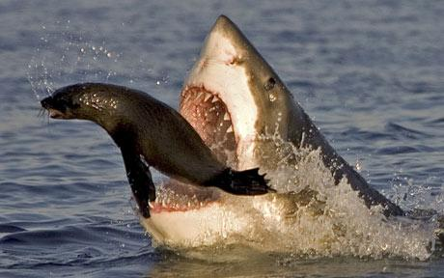
Evolution
Evolution by natural selection requires four key components:
Genetic Variation: individuals within a population need to have a variety of traits that have occurred as the result of random mutations to the genes in their DNA.
Inheritance: the changes to traits because of random mutation must be able to be passed on to offspring.
Competition: there must be competition for limited resources in order for individuals with beneficial traits to gain an advantage, outperform, and reproduce more often than individuals without those beneficial traits.
Differences in Reproductive Rates & Survival Rates: there must be a greater rate of reproduction and a reduced rate of predation or death among individuals with the beneficial traits compared to individuals without those beneficial traits.
Source: m.harunyahya.com
Source: www.odec.ca
Source: www.seahawks.net
Source; www.telegraph.co.uk

Slide 9
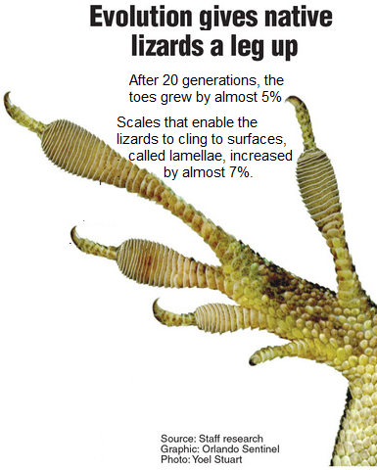
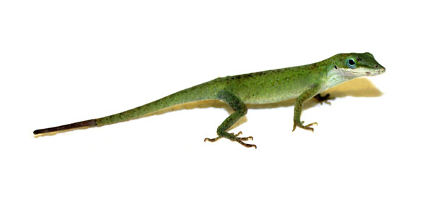
Pace of Evolution
The speed and pace of evolution depends on the pressure from natural selection.
While evolution is normally a slow process, in some cases, evolution can occur rapidly and can even be measured.
For example, a lizard in Florida called the green anole was affected when an invasive species called the brown anole was introduced.
The brown anole outcompeted the green anole, driving the green anole to higher branches in the trees of its habitat.
In only 20 generations, the green anole evolved to develop larger toepads with more scales so that it could better cling to the higher branches that now served as its habitat.
Source; www.hras.org
Source: www.reptilesmagazine.com

Slide 10
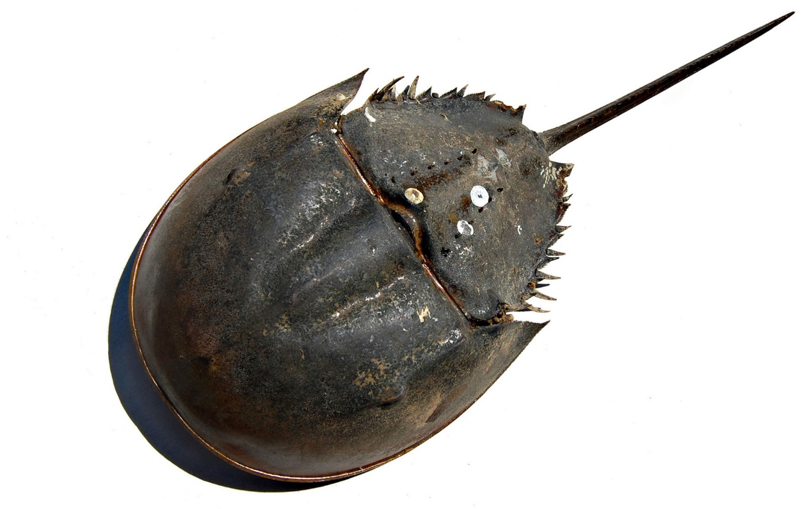
Pace of Evolution
In some cases, evolution can occur extremely slowly or may not occur for millions of years.
For example, the modern horseshoe crab (below) looks almost identical to the horseshoe crabs that existed when the dinosaurs roamed the earth.
The reason that species like the horseshoe crab, alligator, and shark have changed very little is because they have not had selection pressure from competition to encourage genetic change.
In other words, the adaptations of these ‘living fossils’ are sufficient for their needs, there is minimal competition from other species for the resources they need, and random mutations resulting in a beneficial new traits have not occurred to enable evolutionary change.
However, if another species were to have a mutation that would enable it to outcompete one of these ancient species for resources, the unchanged species would eventually go extinct unless it too had random mutations that enabled it to change and have a competitive advantage.
Source: www.tybeemarinescience.org

Slide 11
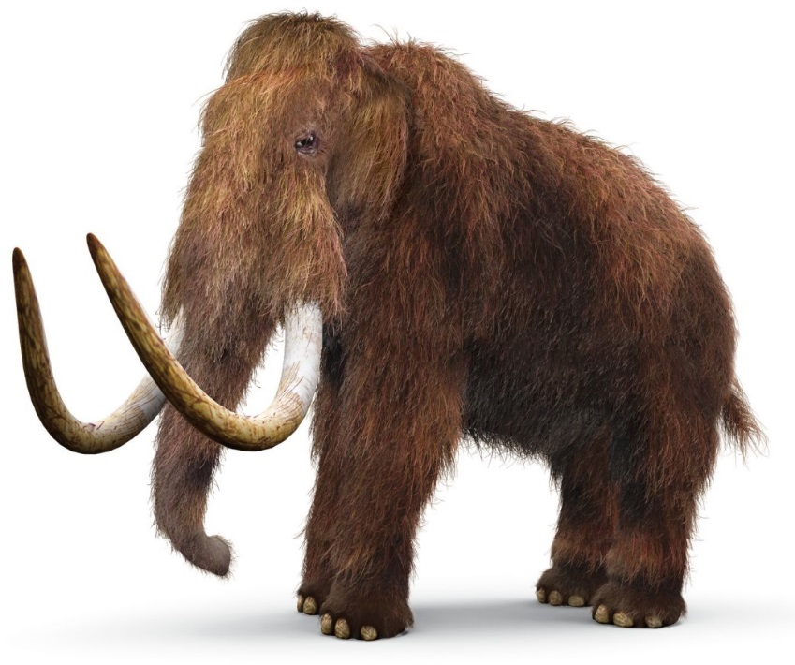
Woolly Mammoths
Even when there are changes and evolutionary pressure to change, this is not a guarantee that a species will evolve.
For example, a large species of elephant called the mammoth used to graze across large portions of North America.
Mammoths and Asian elephants both descended from a similar ancestor. Different environmental pressures (cold vs. warm) resulted in the evolution of two different species.
At the end of the last ice age, a warming climate made the traits of the mammoth less advantageous and less competitive in its changing environment.
Beneficial mutations did not occur quickly enough to allow the mammoth to adapt to these warming conditions, to compete with other species, or to defend itself from predators.
Because the changes to its environment made its traits less beneficial, this resulted in a lower ability to function and thrive.
This caused the mammoth to eventually go extinct.
Source: www.dkfindout.com

Slide 12
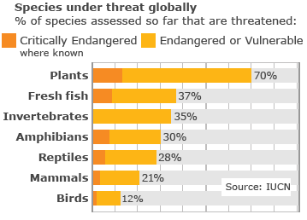
Extinction
Extinction is when a species is eliminated from the earth.
Extinction can be caused by many different factors, but usually a species goes extinct if their adaptations are insufficient for their survival needs.
If a species cannot evolve as quickly as their environment changes, an extinction is almost certainly going to occur.
Extinction is an eventual guarantee for every species; no species exists forever.
In fact, 99.9% of all species that have ever existed have already gone extinct.
Current rates of extinction are far more rapid than normal.
The planet is currently losing an average of about 2-3 species per hour!
This is largely because of human activity.
This is the greatest loss of species since the dinosaurs.
Source: www.the9billion.com

Slide 13
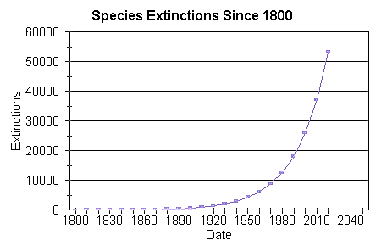
Causes of Extinction
4 factors are the main causes of this rapid rate of extinction.
These factors include: 1) destruction of habitat from human development, 2) pollution, 3) invasive species that are transported by human travel, and 4) overharvesting by humans.
These factors have create a rate of extinction that is 1500 times greater than the normal rate of extinction.
Because the existence of humans depends on a high level of biodiversity, this rate of extinction is a severe threat to all people as well as to all species that remain on the planet.
Immediate action is needed in order to reduce the rate of extinction to a more sustainable level.
There is no chance that mutation, natural selection, and evolution can create new species as quickly as they are being destroyed.
Source: people.eku.edu

Slide 14
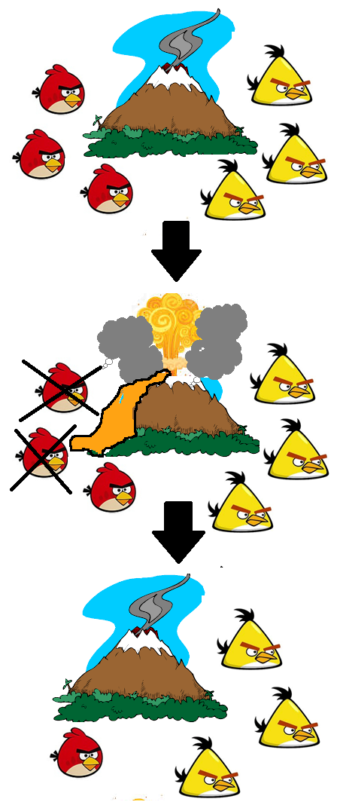
Genetic Drift
Natural selection is not the only way in which genetic change occurs; sometimes random chance can also change the prevalence of a trait.
Genetic drift is the term for changes that occur to the prevalence of traits or species due to random occurrences.
For example, imagine that a species of a bird has two colors: red or yellow.
Both red and yellow birds of this species have an equal chance of reproduction and color does not affect their function.
If a natural disaster wipes out more of the red birds than the yellow birds, this would cause the yellow trait to become more prevalent.
The fact that the yellow trait became more prevalent was not due to any benefits from the yellow color; it was solely due to random chance that yellow is now the more common color of bird.

Slide 15
Migration
Migration can also affect the prevalence of a trait in a population of a species.
Migration is the rate at which a species moves to new habitats or regions.
For example, humans did not originally exist in North America.
Long ago, humans and many other species crossed into North America as sea levels dropped during the previous ice ages.
This drop in sea levels created a land bridge between what is now Alaska and Russia, allowing new species to migrate into the area.
This eventually increased the genetic diversity of humans.
Source: www.yourgenome.org

Slide 16
Migration
Migration increases the variability of genetic traits by allowing a species to experience different levels of competition and changes the selection pressure from the environment.
For example, a species of beetle that lives in lush vegetation is more likely to have a green color.
A species of beetle that migrates to drier conditions with less vegetation is more likely to be selected for a mutation that causes a brown color.
This increase in genetic variability can decrease the risk of extinction because it allows for the introduction of new traits and adaptations.
This is true as long as the individuals in the migrating population can continue to intermingle and breed with individuals in the original population.
However, if a group of migrating individuals in a new environment becomes completely separated from the rest of their species, they are likely to eventually evolve into a new species (as was the case for the mammoth and the Asian elephant).
Source: www.boundless.com

Slide 17
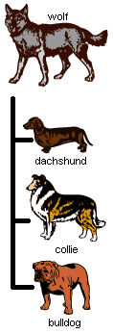
Artificial Selection
Artificial Selection can also change the prevalence of traits and genes in a population of organisms.
In artificial selection, a trait in a species that is beneficial for human needs becomes more prevalent because the individuals of that species that exhibit this trait are allowed to breed and reproduce more often than those without the beneficial trait.
Unlike natural selection, where traits become more prevalent if they enable a species to meet their own needs, artificial selection results in an increase in the number of organisms that exhibit traits that are beneficial to human needs.
Artificial Selection may result the formation of traits that might not even benefit the species that exhibits those traits.
Most domesticated species actually have a reduced likelihood of survival in the wild as a result of artificial selection.
Source: evolution.berkeley.edu

Slide 18
Artificial Selection
Through agriculture, humans have completely changed species of plants, animals, and fungi by continuously selecting and breeding the individuals that exhibit traits that are beneficial to human needs.
For agriculturalists, genetic change is an ongoing, continual, and intentional process that is necessary to improve a species used for food, fiber, or fuel.
Knowing how to change the genetics of a species is vital to ensure that domesticated species will become more productive, efficient, and valuable to humans.
Initially, early human civilizations did not know how their actions would change plants and animals.
Mostly, early humans unknowingly practiced artificial selection by allowing only those individuals with the most valuable traits to reproduce.
As isolated groups of people began to select for specific traits that were valuable for their particular needs in their specific regions, these animals and plants began to experience genetic change.
Source: sites.google.com

Slide 19
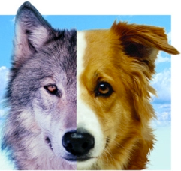
The Process of Domestication
Domestication is the process in which wild plants and animals are genetically changed through artificial selection for traits that benefit human needs.
The causes of these physical and behavioral changes that occur during domestication were a mystery to humans for most of history.
While it was well-understood how to select for genetic improvement through artificial selection, what was not understood was how the DNA of domesticated animals was different from their wild ancestors.
Scientists did not know if the changes that occurred during domestication were entirely genetically based, or if other factors (such as exposure to humans) were responsible for some of these traits and behaviors.
In general, domesticated animals (such as dogs) tend to be very different from similar species in the wild (such as wolves).
Domesticated animals tend to be less aggressive, reach sexual maturity at a faster rate, have more offspring per breeding, can be a different color, and often have differently-sized skulls and limbs.
Scientists did not know how or why these changes occurred at the genetic level during domestication.
Source: modernphilosophystandards.com

Slide 20
Domestication Experiments
One of the most notable experiments to test these questions about domestication began in Russia in the 1950s and 1960s.
This experiment was called the Farm-Fox Experiment.
Wild foxes were caught and only the tamest foxes of each generation were bred each year.
Those that were not tame were not allowed to breed and were used for their fur.
Within 30 years, these scientists had developed an extremely tame breed of this formerly-wild fox.
These tame foxes demonstrated behavior that was very similar to modern dogs: friendly, eager for human contact, licking, sniffing, and whimpering to attract human attention.
The bodies of the tamed foxes also changed: the skulls of tame foxes widened, their snouts and limbs became shorter, their ears became more floppy, their tails became curved, and their coloration changed from silver to white.
Source: www.prooffreader.com

Slide 21
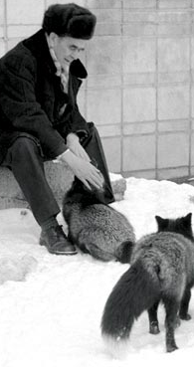
Domestication Experiments
Breeding experiments between tame foxes and wild foxes demonstrated that these results were genetically based and could be passed on to future generations of offspring.
Overall, these experiments confirmed that the changes that occur during domestication are entirely genetically-based.
When the genomes of these foxes were analyzed, researchers located clusters of genes in the fox genome that were responsible for the traits associated with domestication.
They found that a series of different groups of genes are responsible for these genetic changes.
When the foxes were selected for tame behavior, they were also unintentionally selected for the physiological changes that made the foxes start to look more like dogs.
This suggests that when the domestication of different species first occurred, many of the traits that we associate with domesticated species were not deliberately selected.
Source: scienceblogs.com

Slide 22
Gene Linkage
The results of the Fox-Farm Experiment demonstrated a key aspect of the process of domestication: genetic linkage.
Genetic linkage refers to the tendency of genes that are close to each on a chromosome to be inherited in groups or clusters.
The closer that genes are to each other, the more likely they are to be transferred with each other. The further apart genes are on a chromosome, the less likely they are to be inherited together.
The distance between two genes on a chromosome is what determines the likelihood of both of those genes being inherited together by offspring.
The closer that genes are to each other, the more likely it is that they will be inherited together when an egg cell is fertilized by a sperm cell.
Meiosis is the process in which cells divide to create sperm or egg cells, each with half the number of chromosomes.
In the process of meiosis, ordinary bodily cells are changed from having two copies of every chromosome to having one copy of every chromosome.
Source: learn.genetics.utah.edu

Slide 23
Crossing Over
During meiosis, an event called “crossing over” occurs.
Crossing over is the process in which chromosomes exchange segments with each other in order to increase genetic variation.
Each bodily cell of an animal has two copies of every chromosome (one from each parent).
In crossing over, a chromosome from the father will exchange segments with the similar chromosome from the mother.
The cell will randomly split up pairs of chromosomes so that each cell has only one copy in a process called independent assortment.
As a result of crossing over, the chromosomes in sperm and eggs cells will consist of a mix of genes from each parent.
Crossing over makes it more likely that genes near each other will be inherited together.
This also means that it is less likely that genes that are far apart on a chromosome will both be passed on to offspring through sperm or egg cells.
Source: www.ib.bioninja.com.au

Slide 24
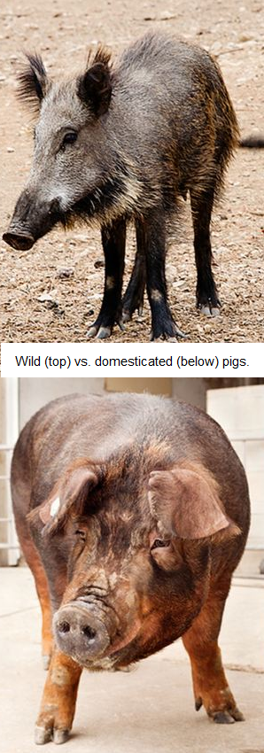
Genetic Linkage & Domestication
In domestication, the genes for the traits that we typically associate with tame animals are usually near each other on the chromosomes of that animal.
This is why domesticated, highly-productive animals also tend to have larger eyes, shorter snouts, shorter limbs, floppy ears, and less aggression.
The genes for all of these traits are near each other and therefore are more likely to be inherited together by the offspring of domesticated animals.
The Fox-Farm Experiment effectively demonstrated that the genes responsible for domestication also tend to be linked genes.
The gene that was responsible for lower production of adrenaline (which caused those foxes to be tamer) is also near the genes for changes to the shape of the skulls, for curvy tails and floppy ears, and for high fertility and greater rates of reproduction.
Because these genes are close to each other on the chromosome, they are less likely to be separated from each other during crossing over in meiosis.
Source: bohemiancaveman.com

Slide 25
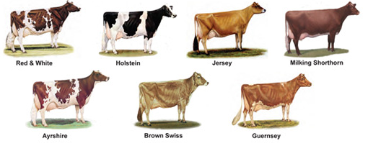
The Domestication of the Dairy Cow
A classic example of how dramatic genetic change can occur through artificial selection over thousands of years.

Slide 26
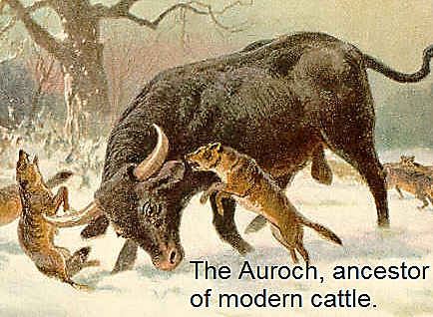
Early Domestication
Early efforts at domestication usually occurred in environments that were isolated from other populations.
Prior to 1900, most agricultural breeding was the result of trial and error, with little understanding of how or why it worked.
A classic example of this process occurred with dairy cattle.
All cattle descended from a genetic ancestor called the Auroch (below), a large aggressive animal that looked and behaved very differently from modern cattle.
With little outside interference, the cattle in one area would be selected for specific traits that were valuable to the people who lived in those regions.
As a result of selecting for unique traits suited to specific conditions, distinctive types of cattle began to emerge in different places.
Two factors (isolation and unique needs for different environments) resulted in the genetic changes that caused the formation of the different breeds of cattle.
Source: en.wikipedia.org

Slide 27
Breeds
A breed is a specific variety of individuals within a species of domesticated animal that have predictably-similar traits and qualities.
The major breeds of dairy cattle are Holsteins (red or black), Jerseys, Milking Shorthorn, Ayrshire, Brown Swiss, and Guernsey.
Source: www.purebreddairycattle.com

Slide 28
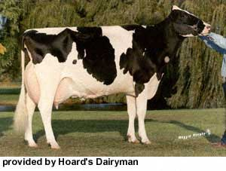
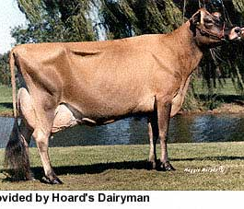
Holsteins & Jerseys
Holsteins are large black and white spotted cows that originated from the lush, productive pastures of the Netherlands. (Holsteins can sometimes be spotted red and white as well).
Holsteins produce the greatest quantity of milk among all the dairy breeds.
This is why they are the most common breed of dairy cattle in the US.
The rich pastures of Holland allowed the Dutch to select for cattle that could produce more milk than any other cow.
Jersey cows are small, light brown cows that originated from the islands off of the British coast in the English Channel.
Jerseys were bred to produce the richest milk that is the highest in butterfat.
The habitat on these islands could provide the nutrition needed to enable Jerseys to produce the highest quality milk.

Slide 29
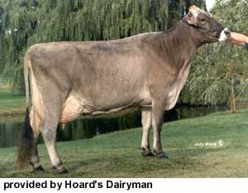
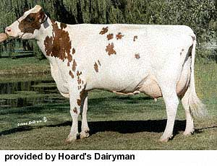
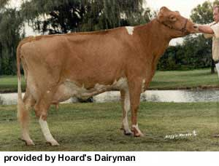
Brown Swiss, Ayrshire, & Guernsey
Brown Swiss cattle are large, rugged, grayish-brown cattle from Switzerland.
These cattle were bred to tolerate the rough, mountainous terrain of the snowy Swiss Alps.
Brown Swiss are hardy cows that can tolerate the severe mountain winters and heavy rainfall common to this area.
Ayrshire cattle are spotted, deep-red cattle from Scotland.
Guernsey cattle are light-red and are from islands off the coast of France.
Both breeds are excellent at grazing and can convert low-quality pasture into high-quality milk.
This was increasingly necessary in places like Scotland with rocky soil and pastures with lower productivity.

Slide 30
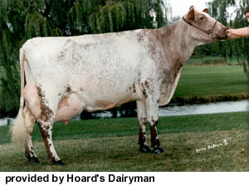
Milking Shorthorns
Milking Shorthorns are red, white, or roan cattle that originated in England.
They were bred to be good at producing both meat and milk, and their offspring are able to rapidly reach maturity.
The milking shorthorn is a multiple-purpose breed of cattle that is very versatile and are easy to care for on a farm.
As the benefits of selective breeding became better understood, breed associations began to form
These associations were formed to provide farmers with genetic information that would allow them to select for continuous genetic change and improvement for each of the breeds of cattle.
This genetic data allows individual farmers to select bulls with traits that are most needed to genetically improve their herd.
Because of this data, dairy cattle throughout the world continue to genetically change and improve, becoming more productive and efficient with each generation.

Slide 31
Benefits & Drawbacks of Breeds
There are many benefits to having highly-selected breeds of a species with specific, predictable traits.
Most notably, this allows farmers to accurately select the type of animals or plants that will be best suited to their needs.
For example, larger dairy farms tend to benefit from having Holstein cattle the produce large quantities of milk while smaller farms that depend on grazing tend to benefit from species such as the Guernsey that are more effective for this method of farming.
This ability to accurately select the right kind of animal or plant for specific circumstances can lead to higher profits while allowing for more food to be produced with fewer resources.
However, there are also disadvantages to the development of highly-selective breeds of plants and animals.
The main disadvantage is the loss of genetic variability.
As a species becomes more specifically selected, it also becomes more genetically similar, making the individuals of that species more susceptible to widespread losses from infectious disease, genetic disorders, or other problems.
Intense genetic selection can also lead to the formation of traits that may cause physiological problems or discomfort to the individuals in that breed.

