Slide 1
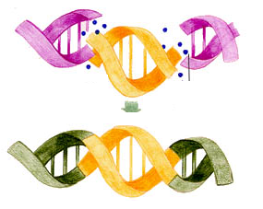
Genetic Engineering
By C. Kohn, Agricultural Sciences Waterford, W

Slide 2
Limits of Traditional Breeding
For thousands of years, human beings have been genetically modifying plants, animals, and other kinds of species through traditional breeding.
Through the process of artificial selection, many different species have been physically and behaviorally transformed into organisms that look very different from their wild ancestors.
While humans can create a vast amount of genetic change in a species through artificial selection and traditional breeding practices, there are two key limitations of these practices.
First, artificial selection cannot be used to create traits that do not already exist in that species.
Second, the outcomes of artificial selection are highly variable; you cannot control the presence of valuable traits or the prevent the emergence of harmful traits in offspring due to the ‘genetic shuffling’ that occurs as a result of crossing over and independent assortment.

Slide 3
Genetic Engineering
While traditional breeding practices cannot be used to add new traits to a species, it is possible to do this through genetic engineering.
Genetic engineering is the process of changing the DNA or an organism by adding or removing DNA from an organism’s genome (the complete set of genes in each organism’s cells).
The goal of genetic engineering is to add new valuable traits to a species that did not exist before through the addition of new genes, or remove harmful traits from a species by removing harmful genes from their genome.
Genetic engineering has produced incredible examples of new kinds of organisms that have traits that never could have occurred as a result of traditional breeding.
For example, Bt corn is one of the most well-known genetically modified organisms (GMOs are organisms that have been genetically engineered).

Slide 4
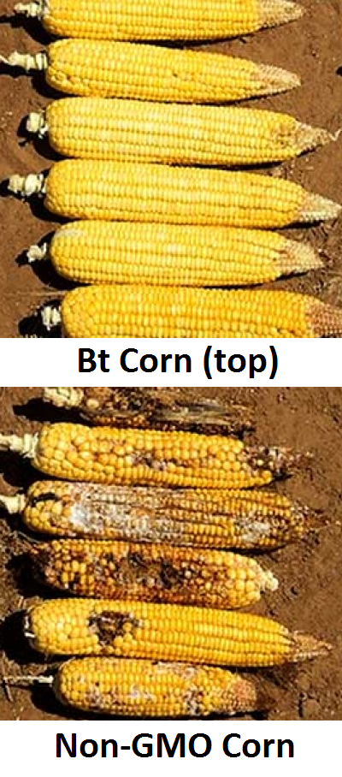
Bt Corn
Bt Corn is a kind of corn that produces its own pesticide to fight insects that consume the corn.
It is able to do this because it has a gene to produce a protein pesticide (a substance that fights harmful insects or other pests).
This insect-fighting protein is naturally produced by a kind of bacteria called Bacillus thuringiensis (or Bt for short).
The toxic protein produced by the bacteria paralyzes the gut of some insects, causing them to starve to death.
However, for animals like cows and humans, this protein is denatured and inactivated by stomach acid.

Slide 5
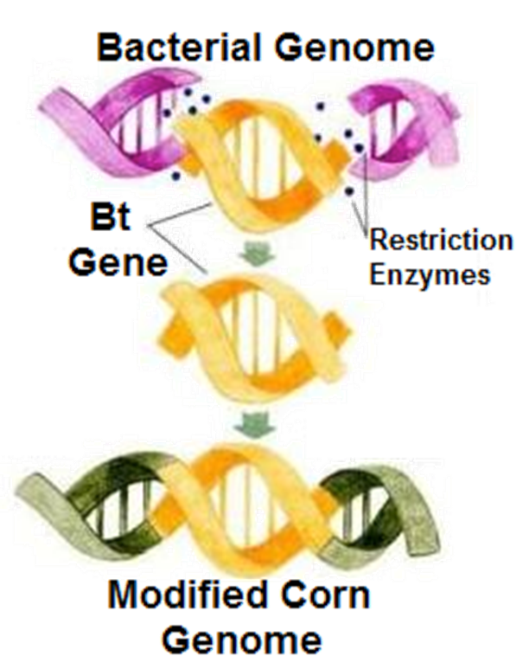
Bt Corn
Scientists were able to move the gene for this protein from the bacterial genome and insert it into the corn genome.
If an insect eats the corn, the corn’s cells will contain this protein and will kill the pests.
Insects that do not eat the corn will be unharmed and unaffected.
This means that a farmer who grows Bt corn can spend less money on insecticide, and beneficial insects in that field will not be harmed like they would if a farmer sprayed the field with a chemical insecticide that kills both beneficial and harmful insects alike.
Source: www.vox.com

Slide 6
Universality of DNA
It might seem surprising that a gene from a bacterium can be inserted the genome of a plant and still function.
This is possible because DNA is a ‘universal language’ among all living organisms.
The DNA in a plant or animal is made from the same A’s, T’s, G’s, and C’s as the DNA in bacteria.
The only major differences between the DNA of different species is the order in which those A’s, T’s, G’s, and C’s are arranged to form the genes needed to produce the proteins that enable each organisms’ cells to function.
Generally speaking, if you insert the gene for a protein into the genome of another organism, the cells of that organism will be able to utilize its amino acids to assemble that same protein in order to express that same trait.
Source: www.eurekalert.org

Slide 7
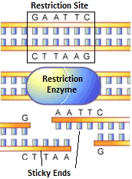
Restriction Enzymes
Genetic engineering most often involves the removal of a gene from one organism so that it can be inserted it into another organism.
To remove a gene from a genome, a restriction enzyme must be used.
A restriction enzyme is a protein that cuts DNA any time it encounters a specific sequence (such as AGCT or GAATC).
The particular sequence at which a restriction enzyme cuts DNA is called the restriction site.
There are many different kinds of restriction enzymes, and each one has a unique restriction site.
For example, the restriction site for the EcoRI restriction enzyme is GAATC, while the restriction site for the HindIII restriction enzyme is AAGCTT.
Source: www.scq.ubc.ca

Slide 8
Restriction Sites
Sometimes a restriction enzyme will cut DNA so that it has a blunt end.
This means that the double stranded DNA is cut straight down, creating a smooth end.
Some restriction enzymes cut DNA in a zig-zag fashion so that one portion of the double-stranded DNA sticks out farther than the other portion.
When DNA is cut so that a few unpaired bases stick out, this is called a sticky end.
Source: www.biology-pages.info

Slide 9
Sticky Ends
In order to insert a new gene into a genome, it is necessary to use a restriction enzyme that creates a sticky end.
If the gene to be inserted is cut with the same restriction enzyme as the genome into which it will be inserted, the ends of the new gene will have bases that are complementary to the ends of the genome where it was cut.
This will allow the new DNA to be added into the new genome.
For example, let’s assume that the gene to be inserted and the genome are cut so that they have AATT and TTAA for sticky ends.
This means that the AATT side of the gene to be inserted will be attracted to the TTAA side of the genome (A’s always bond to T’s).
Source: www.bbc.co.uk

Slide 10
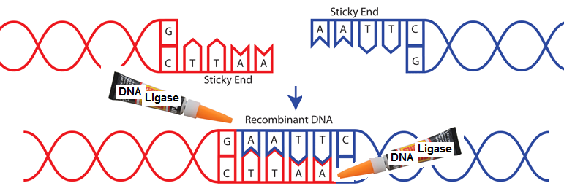
Recombinant DNA
DNA that has a new gene added to it is called recombinant DNA (meaning a genome that combines the DNA of two different organisms).
To make sure that the new gene remains a part of this genome, it has to be ‘glued’ into the genome using DNA ligase.
DNA ligase is an enzyme that connects the phosphate and sugar molecules between the nucleotides of the genome and its newly-inserted gene (DNA Ligase is sort of like ‘super glue’ for DNA).
DNA Ligase prevents the new gene from ‘falling out’ of its new genome and makes the addition of this DNA permanent.
Source: https://www.addgene.org/plasmid-protocols/dna-ligation/

Slide 11
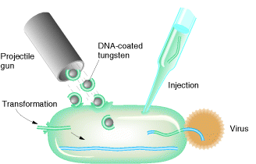
Vectors & Genetic Markers – The Movers and the Checkers
Source: sivabio.50webs.com

Slide 12
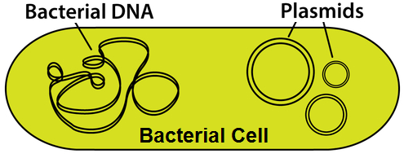
Vectors
A vector is necessary to deliver the new gene or genes to the host organism’s genome during the process of genetic modification.
A vector is the substance that delivers the new gene to a different genome for insertion into that DNA.
The most common vectors are plasmids, viruses, artificial chromosomes, or a particle of a heavy metal.
A plasmid is a small piece of circular DNA that is found in bacteria.
A plasmid is sort of like “extra DNA” for a bacterial cell and contains DNA for additional traits beyond what is found in the normal genome of a bacterial cell.
A bacterial cell can be modified by inserting a plasmid with a new gene from different organism into the bacterial cell. More on plasmids is included later in this presentation.
Source: alfa-img.com

Slide 13
Viruses
Viruses are a common cause of diseases in humans, animals, plants, and even bacteria.
Viruses are not actually living organisms. A virus is just a protein ‘shell’ that contains genetic material.
Viruses do not consume or digest food and must rely on other cells to reproduce.
A virus will attach to a host cell, inject its genetic material (DNA or RNA), and force the host cell to make more viral proteins through transcription & translation.
In a sense, the virus hijacks a cell’s own protein-making machinery as a method of reproduction.
Because a virus can naturally modify the genes of another cell, scientists can rewrite the DNA found inside of the virus and replace the viral DNA with a new beneficial gene.
The virus will then insert that new beneficial gene into a cell’s genome in the same manner that it would insert its own DNA.
Sources: www.bbc.co.uk, http://www.proprofs.com/flashcards/upload/q5938338.png

Slide 14
YACs
Yeast Artificial Chromosomes (YACs) are another common vector for introducing new genes to create a modified genome.
Yeast are single-celled fungi. Fungi are not bacteria, plants, or animals; fungi are their own separate kingdom of life and are eukaryotic (their cells have organelles).
The chromosomes of yeast can be cut using a restriction enzyme, after which a gene can be inserted using sticky ends.
Once a gene has been inserted into the yeast’s chromosome, it can be modified to perform just like any other eukaryotic chromosome.
The use of YACs is valuable because they can be used as a vector for very large pieces of DNA.
While bacterial plasmids and chromosomes tend to be very small, yeast chromosomes are much larger and can be used for the transfer of large amounts of DNA.

Slide 15
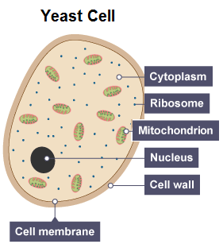
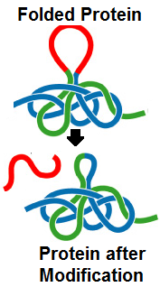
YACs
Source: www.bbc.co.uk
YACs can also be used for proteins that require posttranslational processing.
Not all proteins are ready to function once they have been assembled and folded; some proteins require modifications after this point (such as the removal of a section of that protein to activate it).
While prokaryotic organisms (like bacteria) cannot perform posttranslational processing of proteins, yeast is eukaryotic and can be programmed to perform this process if needed.
Yeast can also reproduce rapidly in a manner similar to bacteria, meaning that they can also quickly copy large amounts of the genetically modified DNA.
Source: faculty.smu.edu

Slide 16
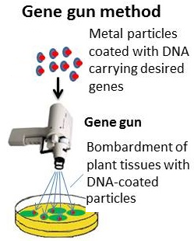
Shotgun Technique
The “Shotgun Technique” is when a particle made of a heavy metal (such as gold) is used as a vector to introduce a new gene into a cell.
Using a highly-specialized gun, this metal particle with the new gene is literally shot into a petri dish filled with the cells.
When the metal particle hits the dish, the DNA is released and enters the cells.
This method is more commonly-used with plants but has been successfully used with animal cells as well.
Source: biomedfrontiers.org

Slide 17
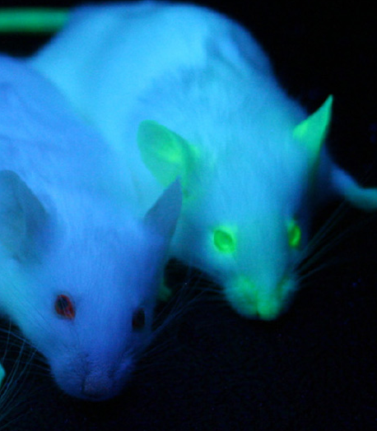
Checking for Failure
Whether plasmids, viruses, YACs, or the shotgun method are used, there is a high likelihood of failure for these methods.
Even if the gene is successfully inserted into the host cell’s genome, it may have been inserted into a region of non-active DNA (such as an intron).
Because of the high likelihood of failure, scientists need a method to determine whether or not a gene was successfully inserted into the genome of the organism they are trying to modify.
The purpose of a marker is to signal whether or not a gene was successfully added to a genome so that it can be expressed as a protein through transcription and translation.
Source: en.wikipedia.org

Slide 18
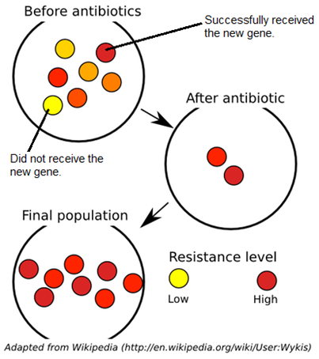
Antibiotic Markers
One of the most common markers are genes for antibiotic resistance.
Genes for antibiotic resistance enable a bacterial cell to survive in the presence of antibiotics (antibiotics are medical drugs that function by killing bacterial cells).
Once the new gene has been added to the bacterial cells, scientists will test whether or not that gene was successfully added to the genome by adding antibiotics to the bacteria.
If the organism’s genome was successfully modified, it will also have the gene for antibiotic resistance.
As a result, these genetically modified bacteria will not be killed by the antibiotics.

Slide 19
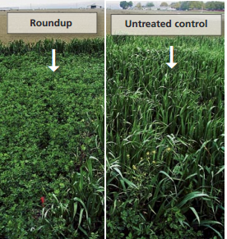
Herbicide Markers
For modification that does not involve bacteria, markers other than antibiotics are usually needed.
For plants, genes for herbicide resistance can be used as an effective marker.
Herbicides are chemical treatments that kill weeds and other plants.
Genes for herbicide resistance allow the plants to survive a treatment of herbicide.
This is a common method used for the production of transgenic crops such as corn, cotton, alfalfa, and soybeans.
By inserting genes for herbicide resistance (as is the case with Roundup Ready crops), a field can be sprayed with a chemical herbicide which kills all weeds, leaving only the transgenic crops to grow in a field.
Source: http://anrcatalog.ucanr.edu/pdf/8153.pdf

Slide 20
Visual Markers
A plant can be screened for whether or not it was successfully genetically modified by including genes for herbicide resistance along with the gene of interested that has been added.
If the plant dies when it is sprayed with the herbicide, then we would know that it did not receive the gene of interest.
If the plant survives the herbicide treatment, then we would know that both the herbicide-resistance gene as well as the gene of interest were both added to this plant.
Visual markers can also be used to determine whether or not a gene was successfully added to a genome.
By pairing the gene of interest with a gene for a glowing protein, we can simply look for the cells that produce the glowing protein to see which successfully received the gene of interest.
Glowing proteins such as the green jellyfish protein (called GFP) and the firefly protein (called luciferase) are commonly used to determine if the addition of a new gene was successful.

Slide 21
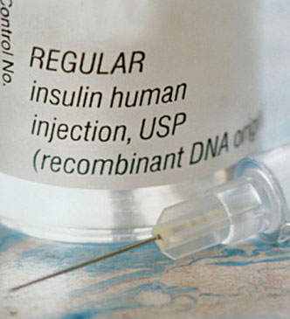
Transgenic Insulin: Saving Lives With GMOs
Source: www.health.com

Slide 22
Transgenic Insulin
One of the first applications of genetic modification through recombinant DNA was the development of genetically modified bacteria that could produce human insulin.
Insulin is a protein found in blood that regulates the amount of sugar in the bloodstream.
If a person has diabetes, their body is unable to produce enough insulin to regulate their blood sugar, and they must inject insulin into their bloodstream on a daily basis.
Originally, this insulin was taken from the pancreases of pigs and cattle that were used for meat.
However, by the 1980s, the amount of insulin that was needed was greater than what could be obtained from slaughterhouses.
In order to meet the demand for insulin, scientists needed to find a way to make insulin artificially.
Source: www.health.com

Slide 23
Transgenic Insulin
To produce insulin artificially, scientists inserted the human gene for insulin into the genome of bacteria.
This allowed the bacteria to produce this protein, which could then be harvested for human use.
However, the creation of insulin-producing bacteria was not as simple as just inserting the gene for human insulin.
The first concern was how to get the gene for human insulin into the bacteria once it has been cut out of the human genome.
For insulin-producing bacteria, a bacterial plasmid was used as the vector to get the insulin gene into the bacterial cells.

Slide 24
Transgenic Insulin
Most bacterial cells contain several plasmids in addition to their normal chromosomal DNA.
A new gene can be inserted into a plasmid which can then be directly added to a bacterial cell as a way to create a transgenic bacterium that will produce new proteins such as insulin.
To make sure that only the cells with the modified plasmid DNA survive, a gene for antibiotic resistance will also be added along with the gene for insulin to serve as a marker for successful transfer.
Only those cells that successfully absorbed the modified plasmids with the new gene and the gene for resistance will survive a treatment of antibiotics.
This ensures that scientists only have pure sample of genetically modified bacteria, all of which have a the gene for the insulin protein.

Slide 25
Controlling Gene Expression
Another major concern is how to regulate the expression of this gene once it was inserted into the bacterial genome.
The expression of genes is regulated by sections of DNA called promoters and operators.
The operator is the portion of DNA that will stop the expression of that gene if a repressor protein attaches to it.
Once the repressor protein is removed from the operator section of the DNA, a polymerase enzyme can make an mRNA copy of that gene so that it can be translated into a protein.
The promoter is a portion of the DNA where polymerase first attaches to create the mRNA copy during transcription.
The use of a promoter is key for ensuring that a new gene is actively copied into mRNA by polymerase during transcription so that it can be used to produce the needed protein during translation.

Slide 26
Lac operon Controls
To control how much insulin would be produced by the modified bacteria, scientists combined the human gene for insulin production with the regulatory genes found on the lac operon.
The lac operon is a group of genes that control and regulate the bacteria’s ability to break down lactose, the sugar found in milk.
When lactose is present, the lactose molecules attach to the repressor protein and causes it to detach from the operator strand of DNA.
This allows the polymerase enzyme to make the mRNA copy of these genes during transcription so that the proteins that are needed for the breakdown of lactose can be made during translation.
By inserting the human gene for insulin next to the operator and promoter for the lac operon, scientists could regulate the bacterial production of human insulin.
When lactose is present, the modified bacteria will make human insulin. When there is no lactose present, the modified bacteria will stop the production of the human insulin proteins.

Slide 27
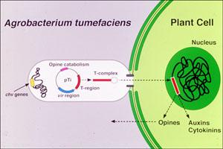
Agrobacterium: Nature’s Microbial Genetic Engineer
Source: rasbinbasnet.blogspot.com

Slide 28
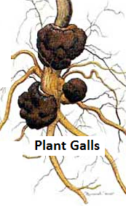
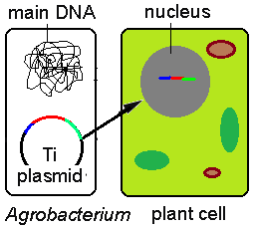
Agrobacterium
After the creation of insulin-producing bacteria and Bt corn, scientists began to look for easier methods of producing transgenic organisms (organisms that have modified DNA).
One of the best options for easier genetic modification was Agrobacterium, which modifies plants.
Agrobacterium is a type of bacteria that lives in the soil.
Agrobacterium is a plant pathogen (a pathogen is a bacterium, virus, or other organism that causes a disease).
Agrobacterium can create plant galls, which are tumors that grow on plants and produce food for the bacterial cells.
In the 1970s, it was discovered that Agrobacterium creates plant galls using a specialized plasmid called the Ti plasmid (Ti stands for tumor-inducing).
Agrobacterium uses the Ti plasmid as a vector to insert its own genes that cause uncontrolled cell division in the plant that it infects.
Source: www.dpi.nsw.gov.au
Source: hvp.osu.edu

Slide 29
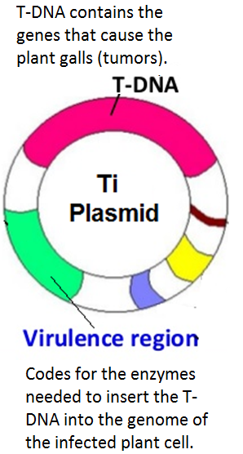
Agrobacterium
The Ti plasmid contains specialized genes called T-DNA (or Transfer DNA) which are what cause the tumor formation in plants that are infected by Agrobacterium.
T-DNA is any DNA that is inserted from a bacterial plasmid into a host’s genome.
In this case, Agrobacterium’s T-DNA is specific to the formation of plant tumors.
The Ti plasmid also contains virulence region genes that code for the creation of…
A) A pore-like structure to get the T-DNA into the host cell’s nucleus.
B) Genes for restriction enzymes that cut the DNA so that the T-DNA can be inserted.
C) Other proteins that are necessary to successfully integrate the T-DNA into the plant’s genome.
Source: foodsafetygrp3.blogspot.com

Slide 30
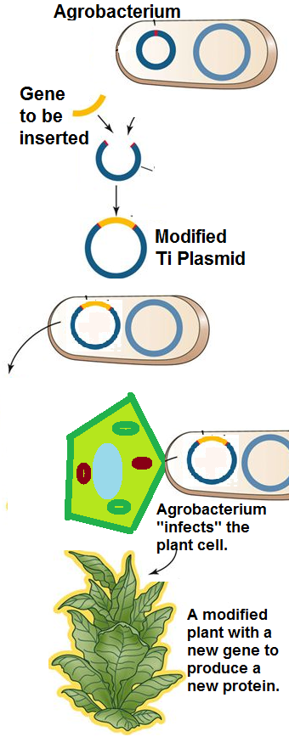
Agrobacterium
Because Agrobacterium is a naturally-occurring form of genetic modification, scientists can use it to create transgenic plants.
By replacing the T-DNA on the Ti plasmid with the gene they are trying to insert, scientists can use Agrobacterium to essentially do the rest of the work of gene insertion for them.
Scientists insert a new gene into the Ti plasmid using a restriction enzyme so that both sets of DNA have matching sticky ends.
When the Agrobacterium cell attaches to the plant cell, it inserts the Ti plasmid with the new gene.
The Ti plasmid will then insert this DNA into a chromosome in the nucleus of the plant cell.
As this plant cell divides, each new cell will also have a copy of this inserted gene.
Source: slideplayer.com

Slide 31
Golden Rice
Agrobacterium is most well-known for its role in the creation of Golden Rice.
Golden Rice is a transgenic species of rice that has had the genes for beta carotene added to its genome.
The beta carotene protein is needed by the human body because it is converted into Vitamin A once it is consumed.
Vitamin A deficiency is one of the most common nutritional problems in the world.
Vitamin A is needed for vision and for the immune system, and a shortage of Vitamin A can lead to blindness and an increased susceptibility to infectious disease.
Rice is one of the most commonly consumed foods in the world; by adding the genes for beta carotene production to the rice plant, millions of cases of blindness and disease could be prevented.

Slide 32
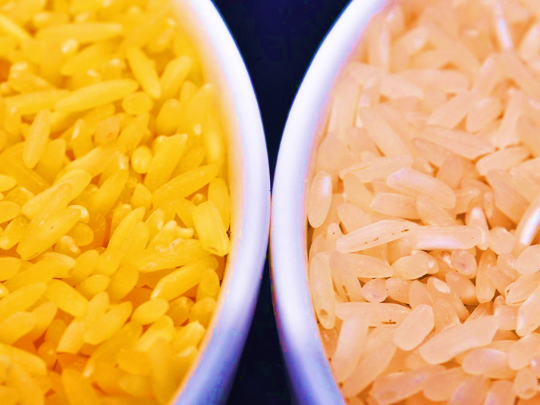
Golden Rice
To create Golden Rice, scientists used restriction enzymes to remove the tumor-causing gene from Agrobacterium’s Ti Plasmid and replaced it with the gene for the production of beta carotene.
The modified Ti Plasmid was then returned to the Agrobacterium.
The modified Agrobacterium then “infected” the rice plant with the gene for producing the beta carotene protein.
Once the gene for beta carotene was inserted into the rice plant’s genome, the rice plant’s cells produced the beta carotene proteins in the same manner it produced all other proteins.
Because the beta carotene protein has a deep reddish-yellow color, it also turned the rice from white to a deep yellow, which is why it is called Golden Rice.
Source: www.npr.org

Slide 33
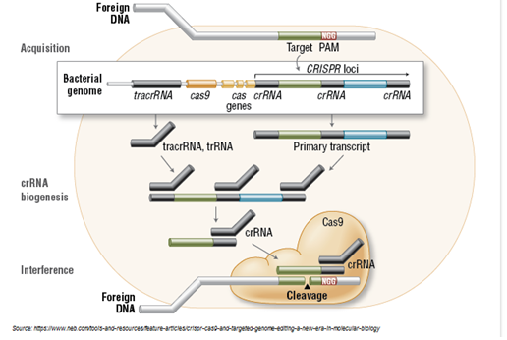
CRISPR-Cas9: Revolutionizing Genetic Engineering

Slide 34
CRISPR-Cas9
The newest method of genetic modification is called CRISPR-Cas9 (or just CRISPR).
CRISPR was used successfully for genetic modification for the first time in 2012.
While genetic modification would take months or even years with other methods, CRISPR allows for a genome to be modified in a matter of days. CRISPR has the potential to dramatically reduce the amount of time and money it takes to create a genetically modified organism (GMO).
CRISPR is actually a type of bacterial immune system that is used to identify if the bacterial cell is being attacked by a virus.
A CRISPR is actually just a short piece of DNA that is copied by a bacterial cell from the DNA of a virus.
If the bacterial cell detects that it is been injected with viral DNA or RNA, it will fight the virus using three distinct steps.

Slide 35
CRISPR-Cas9
The first step is called adaptation.
If a virus injects its DNA into the bacterial cell, the bacterium will cut the DNA of the virus into short segments.
These short segments of viral DNA are then inserted into the bacterial genome.
The next step is the production of gRNA.
The viral DNA that has been inserted into the bacterial genome will then undergo transcription (copying the DNA into single-stranded RNA by polymerase).
This copied RNA will then be cut into small pieces (called gRNAs, which is short for Guide RNAs).

Slide 36
CRISPR-Cas9
The third step is called targeting.
The gRNAs are read by a specialized restriction enzyme called Cas9.
Remember that restriction enzymes are like a chemical scissors for DNA, except that they only cut DNA at a specific sequence.
Cas9 reads the gRNAs to determine where to cut the viral DNA.
Cas9 then cuts the viral DNA anytime it finds a sequence that matches one of the gRNA copies of the viral DNA that was inserted into the bacterial genome.
This cuts out pieces of the viral DNA which creates frameshift mutations.
These frameshift mutations prevent the transcription and translation of that DNA into proteins.
This prevents the bacterial cell from being infected by the virus, giving that bacterium immunity from that virus.

Slide 37
CRISPR-Cas9
The original discovery of CRISPR occurred during the study of the bacteria that are used to produce cheese and yogurt.
If the bacteria that are used for the production of dairy products are infected by a virus, it can damage the quality of the cheese or yogurt.
Scientists realized that some bacteria were immune to these viruses and later determined that these particular bacteria have the CRISPR mechanism that prevented them from being infected.
CRISPR is a natural mechanism through which a bacterial cell can genetically modify itself by inserting DNA into its own genome in order to create ‘guides’ for restriction enzymes to cut up the viral DNA.
Because it is another form of natural genetic modification, CRISPR can be used to edit the genomes of not just bacteria but also human cells, yeast, mice and rats, many common crops, pigs, and more.
CRISPR can be most easily used for gene silencing, in which a gene is prevented from being expressed as a protein.

Slide 38
CRISPR-Cas9
By silencing (or ‘knocking out’) a specific gene, scientists can better learn its function by determining what cellular functions do not occur when that gene is eliminated.
Scientists just have to create an RNA copy of the gene that they wish to eliminate and the CRISPR mechanism can be used to create gRNA that can be used for removing that gene in order to learn its function.
Gene silencing could also be used to create new type of “smart drugs” that only attack the disease-causing bacteria or viruses based on genes specific to those pathogens (the disease-causing organism).
Currently, if someone takes an antibiotic for a bacterial disease, that treatment will kill both the harmful and the helpful bacteria.
Those antibiotics can also be used only for bacterial infections; viruses are unaffected by antibiotics.

Slide 39
HIV-AIDS
By determining which DNA sequences are specific to the harmful bacteria or virus, CRISPR could cut up the DNA of this bacteria to cause frameshift mutations and prevent it from producing the proteins that it uses to attack animals or plants when causing an infection or disease.
In fact, CRISPR was used in an experiment in July of 2014 to eliminate the HIV virus DNA from infected white blood cells.
The HIV virus attacks the body by inserting its genes into the genome of white blood cells. This causes these cells to produce more HIV viruses, which stops the function of the white blood cells and makes the people who are infected very susceptible to other infections.
If the HIV infection worsens and your white blood cell levels become too low, a person can acquire AIDS, a condition in which their bodies cannot fight infection.
A person with HIV-AIDS typically die after about 3 years.
Since it was discovered in the 1980s, HIV-AIDS has taken the lives of more than 25 million people.

Slide 40
HIV-AIDS
In the 2014 experiment, scientists found sequences of DNA that were specific to HIV and were vital to the function of this virus.
Scientists used these sections of viral DNA to create the gRNAs that guided the Cas9 restriction enzymes.
The Cas9 restriction enzymes would then use the gRNA to cut up the viral DNA that had been inserted into the white blood cell genome.
Using CRISPR, scientists were able to completely eliminate the HIV DNA from the genome of the infected white blood cells.
In addition to gene silencing, CRISPR can also be used for gene editing to replace a mutated gene with a “corrected” version of that same gene in order to treat and cure genetic diseases.
By using the Cas9 restriction enzyme to create a cut in the DNA where the gene should be inserted, scientists can take advantage of a cell’s own DNA repair mechanisms to incorporate new DNA into the chromosome of that cell.
This would enable that cell to produce new proteins using the newly-added DNA.

