Slide 1
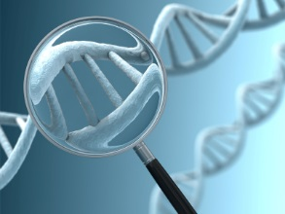
Genetic Testing
By C. Kohn
Agricultural Sciences
Waterford, WI
Image Source: http://www.geneticliteracyproject.org/wp/wp-content/uploads/2012/10/genetic-test-magnified.jpg

Slide 2
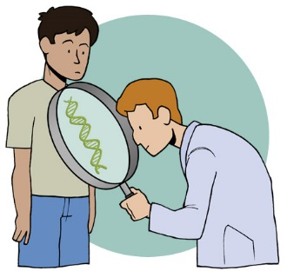
Genetic Testing
Genetic testing is any technique that involves analyzing DNA in order to find genetic differences, similarities, mutations, or diseases.
Genetic testing can use any kind of cell that has a DNA; in humans and animals this includes blood, hair, skin, amniotic fluid (surrounding a fetus during pregnancy), and other living tissue.
Genetic testing enables a scientist to determine if…
A specific gene is present in an organism.
Whether an organism carries or has a genetic disease.
Whether an organism has been infected by an infectious organism (such as a bacteria or virus).
Paternity.
Whether an individual’s DNA was found at the scene of a crime.
And much more.
Source: www.genesinlife.org

Slide 3
Forms of Genetic Testing
Genetic testing can take many forms, including:
Genomics: reading the entire genome of an organism using a technique such as the Sanger Method.
PCR (or Polymerase Chain Reaction): amplifying small amounts of DNA to create millions of copies of a particular DNA sequence for analysis or testing.
Gel Electrophoresis: a technique in which DNA is cut using a restriction enzyme and separated into bands to create a banding pattern.
Southern Blotting: a technique in which DNA fragments in an electrophoresis gel are transferred to a membrane to check for a specific gene sequence using a marker with a complementary sequence for that specific gene.
ELISA (or Enzyme-Linked Immunosorbent Assay): a technique in which a specific protein is found using an antigen and antibody which cause a color change if the protein is present.

Slide 4
Polymerase Chain Reaction
PCR is a technique in which a small amount of DNA is amplified to create millions of copies of a specific DNA sequence (called the target sequence).
PCR works by taking advantage of the way in which copies of DNA are naturally made.
When cells divide by mitosis, each cell must produce a new copy of every gene in DNA.
To do this, the DNA is opened by helicase and complementary bases are added by polymerase (where it sees a G, it adds a C, etc.) to make DNA double-stranded again.
This creates two new strands from one original strand.
Source: http://upload.wikimedia.org/wikipedia/commons/thumb/d/da/PCR.jpg/700px-PCR.jpg

Slide 5
PCR
In PCR, the sample of DNA is opened using heat (instead of helicase) in a process called denaturing.
Heat is a faster way to denature DNA than helicase because it will open all the DNA at once (rather than base-by-base, as occurs with helicase).
Once the DNA strand has been separated using heat, primers attach to the DNA.
A primer is a small stretch of DNA that tells polymerase where to begin adding bases to a strand of DNA.
Primers are important for two reasons.
First, the primer tells the polymerase where to start copying.
DNA polymerase can't start at just any point - it can only add onto an existing piece of DNA.
By adding a small (18-30 bases) piece of laboratory-made DNA, it binds to the denatured DNA strand and provides a starting point for polymerase to make a copy.
Source: http://upload.wikimedia.org/wikipedia/commons/thumb/9/96/Polymerase_chain_reaction.svg/840px-Polymerase_chain_reaction.svg.png

Slide 6
Primers
Second, the primer is also important because we only want to amplify a specific part of the DNA.
If we wanted to analyze the whole genome, we would use a genomic test such as the Sanger method or a Next Generation Sequencing method.
The primer ensures that only a specific portion of the DNA is amplified by indicating where polymerase should begin copying the DNA.
This enables the PCR process to happen quickly and affordably.
Two primers are needed – one for each side of the double-stranded DNA.
Once the primers attach to the specific portion of the DNA, polymerase makes a copy of the DNA, creating two copies of double-stranded DNA.
This heating-priming-copying process is repeated over and over until we have millions of copies of the same specific DNA sequence.
Source: http://upload.wikimedia.org/wikipedia/commons/thumb/9/96/Polymerase_chain_reaction.svg/840px-Polymerase_chain_reaction.svg.png

Slide 7
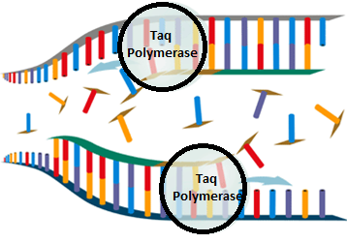
Thermocyclers & Taq Polymerase
To heat and cool the DNA over and over, a machine called a thermal cycler is used.
A thermal cycler heats the DNA to denature it, then allows the DNA to cool so that it can be copied, and then repeats the process until enough copies are made (usually 50 heating cycles).
Because the DNA is repeatedly heated and cooled, a special kind of polymerase must be used.
The extreme temperature fluctuations would cause human or animal polymerase to unravel (denature) and lose its shape and function.
Because the heat is necessary, a special heat-resistant polymerase is used.
This polymerase is called Taq polymerase and was found in unique heat-tolerant (thermophilic) species of bacteria in the Lower Geyser Basin of Yellowstone National Park.
Source: http://openwetware.org/images/6/66/Pcrstep3.gif

Slide 8
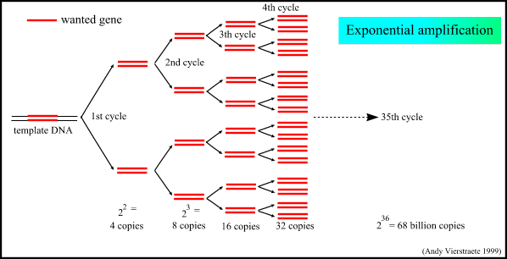
Millions of Copies of DNA
Once the PCR process has been completed, millions of copies of a specific genetic sequence will have been created.
Unlike genomic sequencing and the Sanger method in which bacteria were used to create many copies of DNA, PCR uses Taq polymerase and heat to copy the DNA.
This allows the process to happen much more quickly (in a matter of hours in most cases).
PCR alone does not provide any specific information – it only makes copies of a specific small portion of a genome.
To acquire information from this target sequence, the DNA must be cut up and separated into bands.
By cutting and separating the bands of DNA, we can identify the original source of DNA, determine if a gene is present, determine paternity, etc.
Source: http://users.ugent.be/~avierstr/principles/pcrcopies.gif

Slide 9
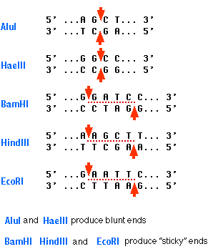
Restriction Enzymes & Gel Electrophoresis
DNA is cut using a special protein called a restriction enzyme.
A restriction enzyme is sort of like a chemical scissors for DNA.
Unlike a pair of scissors, the restriction fragment only cuts the DNA if it encounters a very specific sequence of DNA bases.
For example, one kind of restriction fragment is EcoRI.
EcoRI cuts DNA anytime it encounters the sequence GAATTC or the complementary sequence CTTAAG.
Once the DNA target sequence has been cut using a restriction enzyme, the cut DNA can be separated into individual bands using a gel.
In a process called gel electrophoresis, the bands of DNA are separated from longest to shortest to create a specific banding pattern.
The DNA is moved through the gel using electricity.
Because DNA is negatively charged, it will be attracted to a positive electrode placed into the gel.
Source: http://users.rcn.com/jkimball.ma.ultranet/BiologyPages/R/RestrictionEnzymes.gif

Slide 10
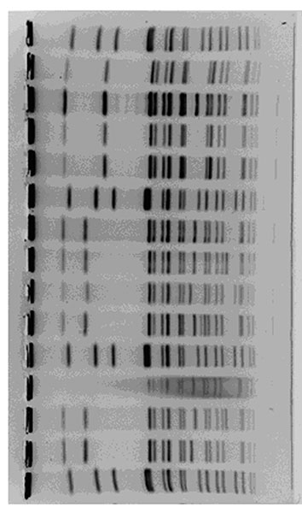
Banding Patterns
As DNA moves through the gel towards the positive electrode, the smaller fragments of DNA will move more easily than the larger fragments (just like it is easier to swim faster in a Speedo than in blue jeans).
The electricity will be disconnected before the smallest fragments can reach the positive electrode.
This will create a unique banding pattern specific to the individual from whom the DNA sample was taken.
The unique banding pattern from the DNA target sequence can provide a large variety of information for a researcher.
Some examples include determining the paternity of an individual, determining if the target sequence contains a mutation, or determining the source of DNA found at the scene of a crime.
Source: http://wwwnc.cdc.gov/eid/images/02-0423-F3.jpg

Slide 11
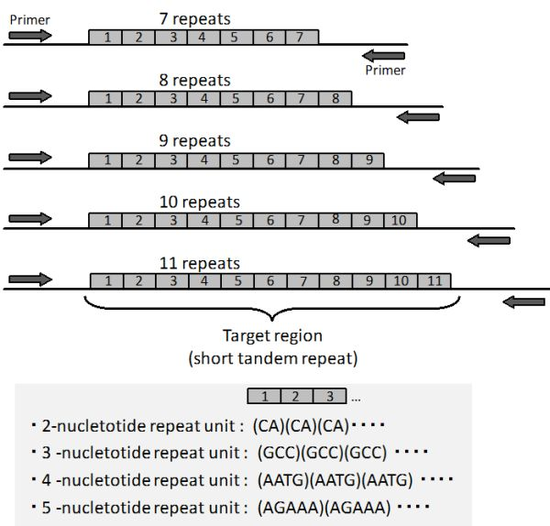
STR’s/Microsatellites
While most organisms share the same genes, the actual DNA varies from individual to individual.
The DNA that codes for a protein (exons) are usually very similar among individuals.
Changing even one base can completely change the shape & function of a protein.
However, introns (sections of DNA that do not code for proteins) can vary widely among individuals of the same species.
One specific kind of variation is called a Short Tandem Repeat, or STR.
STR’s are short regions of DNA that repeat over and over and over.
STRs are also sometimes called microsatellites (especially if they are five bases or smaller).
The number of STR’s an individual has at different genetic locations will be mostly different than what another individual has at the same locations.
If you looked at the number of STRs at a dozen different locations, the likelihood that any two individuals will have the same results is one in a billion (unless they are clones or identical twins).
Source: http://www.intechopen.com/source/html/16506/media/image2.jpg

Slide 12
Genetic Fingerprinting
Looking for differences in the DNA of individuals is called DNA Fingerprinting.
Just like no two people have the same fingerprints, no two individuals have the same genetic fingerprint (unless they are clones or identical twins).
Unlike fingerprints, we are not looking for ridges on a finger for a genetic fingerprint but instead are looking for differences among the target sequences of the individual’s genome.
This knowledge is incredibly useful for determining the source of a sample of DNA.
For humans, this could involve crime scenes, diagnosis of a genetic disease, or cases of paternity.
Genetic fingerprinting and STRs are used extensively in agriculture to determine the genes responsible for continuous traits (such as milk production, meat potential, or reproductive capabilities).
In environmental science, genetic testing can be used to determine migration patterns, identify the presence of invasive species, determine the genetic diversity of a species, and more.
Source: http://www.nature.com/nprot/journal/v1/n2/images/nprot.2006.73-F3.jpg

Slide 13
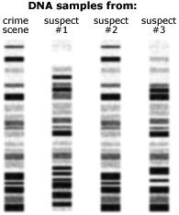
PCR & Crime Scenes
PCR-Electrophoresis and DNA Fingerprinting is used extensively in crime scene investigation.
Typically this involves collecting samples of DNA found at the scene of the crime and determining whether those samples match DNA collected from suspects of a crime.
If DNA found on the crime scene has the same banding patterns as DNA from a suspect, it provides evidence that a suspect was at the scene of the crime.
For example, you can tell which of these three suspects could be linked to the scene of the crime.
PCR-Electrophoresis does NOT prove a suspect committed a crime, but it does link that person to the place where the crime was committed.
Other evidence would be necessary (especially motive, witnesses, and opportunity) to prove that a person committed a crime.
Source: http://molecular.roche.com/pcr/PublishingImages/DNAsamples.jpg

Slide 14
PCR & Disease Diagnostics
PCR-Electrophoresis is also a valuable tool for the diagnosis of a genetic disease.
By scanning the functional sections (exon) of an individual’s genome where a genetic disease is known to occur, a geneticist can compare the genetic fingerprint of a patient to those from patients with and without the disease.
If the gene matches a sample of DNA that does have the disease, a doctor would know that the individual is free of the disease.
However, if the gene’s genetic fingerprint is similar to sample from a person with a disease, a doctor would know that the patient has the disease.
If the individual’s genetic fingerprint matches both the healthy and diseased samples, a doctor would know the patient is heterozygous for the disease (usually this means they carry the disease but do not express it).
Source: Case-It

Slide 15
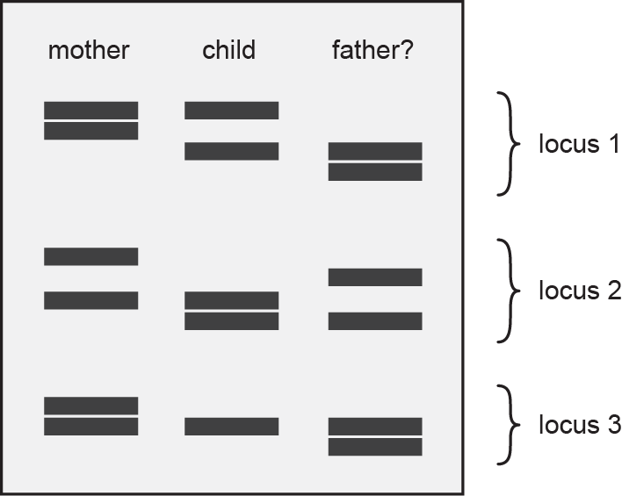
PCR & Paternity
PCR-Electrophoresis can also be used to determine if an individual is a parent of a child when the paternity is disputed.
Because a child inherits genes from both the father and the mother, they will have a genetic fingerprint that should partially match both parents (the child will have some bands that match the mother and some that match the father).
If a parent has a banding pattern that does not match the child’s genetic fingerprint, they are most likely not the biological parent.
Source: http://www.atdbio.com/img/articles/STR-analysis-parentage-large.png

Slide 16
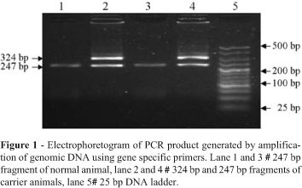
PCR & Agriculture
In agriculture, researchers are very interested in determining which genes in an animal or plant’s genome are responsible for productive traits.
For example if an agricultural researcher can identify the genes necessary for increased milk production, a cow’s genome could be analyzed to determine how many genes have the productive alleles (gene versions) in order to determine the genetic value of the animal.
By knowing which beneficial alleles a cow has, a researcher could compare their genetic fingerprint to that of a variety of bull’s to determine the optimal genetic match for producing the highest-value offspring.
Source: www.scielo.br

Slide 17
PCR & Ecology
Microsatellite analysis can also be used for ecological preservation.
For example, a major concern of ecologists is the genetic diversity of a species, especially when a species is threatened.
The greater the genetic diversity, the healthier a species.
If the genetic fingerprints of a species vary widely, a species’ population is usually less at risk than a species with minimal genetic diversity.
Microsatellite analysis can also help an ecologist to determine migration patterns (breeding populations of individuals tend to have more-similar genetic fingerprints than unrelated individuals).
Source:http://labs.russell.wisc.edu/samuel/welcome/cwd/genetics-epidemiology/lsg/

Slide 18
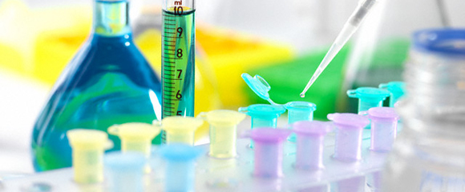
Southern Blotting
The Southern Blotting test enables us to detect if a specific gene exists on a PCR Electrophoresis DNA fingerprint.
For example, if you wanted to know if you were a carrier for a recessive genetic disease, you could run the PCR Electrophoresis on the section of your DNA that would contain the gene for this disease.
You could then run a Southern Blot on the gel containing the cut DNA to see if the gene for the disease is actually there

Slide 19
Southern Blotting
Southern Blotting allows a scientist to determine if a sample of DNA has a specific gene or mutation without having to go through the difficulty or expense of running the Sanger Method Test.
It provides the information of the Sanger Method at the cost and ease of PCR.
While the Sanger method tells us all of the genes in an individual, it takes a lot of time and money to find this information.
If we just want to know if a gene for a disease or trait is present, we can use Southern Blotting to determine this in less time and for less cost.
Source: http://cc.scu.edu.cn/G2S/eWebEditor/uploadfile/20120809154937742.jpg

Slide 20
Southern Blotting Steps
1. Run PCR Electrophoresis.
Amplification of a target sequence, addition of a restriction enzyme, gel electrophoresis.
2. Transfer the DNA to a membrane.
The membrane is sort of like a paper towel that absorbs the DNA from the electrophoresis gel.
3. Add a probe with the complementary sequence for the gene you are looking for.
E.g. GATCA if the gene sequence was CTAGT.
4. If the gene your are looking for is present, the probe will bind to it and create a signal.
For example, it may glow with bioluminescence if the gene in question is present.
Image Source: http://cc.scu.edu.cn/G2S/eWebEditor/uploadfile/20120809154937742.jpg

Slide 21
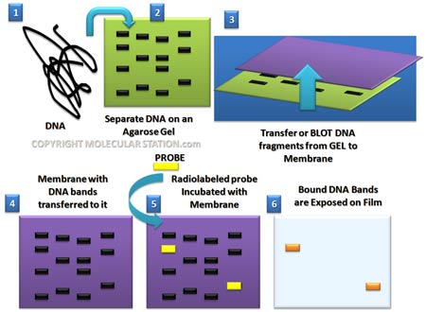

Slide 22
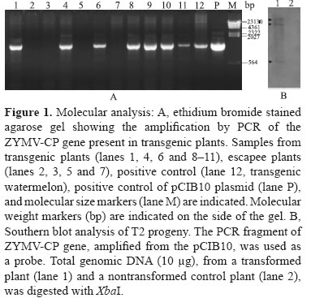
Genes and Disease
Southern Blotting enables a researcher to determine if a gene is present in an organism even if that gene is not expressed.
For example, Southern Blotting easily determines if an individual or animal is a carrier of a genetic disease
This can be especially valuable if the disease is recessive, or if the individual carries but does not express the disease.
E.g. if they are Rr for a recessive disease, they would carry it but not have the symptoms of it.
Southern Blotting is valuable for detection of both valuable or harmful genes.
While Southern Blotting is often used to detect genetic disorders, it can also be used to determine if an animal or plant carries a valuable trait that can be used to increase the productive capabilities of that individual.
Southern Blotting can also be used to confirm if a gene was successfully moved into a new organism when attempting to create a GMO (right).
Source: www.scielo.br

Slide 23
ELISA
While Southern Blotting is very useful for detecting genetic diseases, not all diseases are caused by mutations in the DNA.
For example, the common cold is caused by a virus.
Food poisoning is often caused by harmful bacteria.
ELISA is a test that checks for proteins specific to a virus or bacteria.
Proteins are related to DNA in that the information encoded in the DNA tells a ribosome how to assemble amino acids into a protein.
ELISA detects specific proteins called antibodies and antigens.
Antibodies are proteins used to ‘label’ things in the blood.
For example, your blood as antibodies that tell your body whether or not you have type A, B, O, or AB blood.

Slide 24
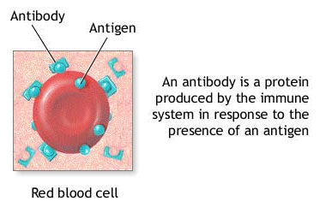
Antibodies → Molecular Post-Its
Antibodies help your body to recognize the antigens for other substances, including diseases.
Antigens are the proteins specific to an organism for which an individual produces the antibodies needed to recognize and destroy that organism.
For example, chicken pox has chicken pox antigens.
Your body would produce chicken pox antibodies to identify the chicken pox antigens.
Antigen is short for “antibody generator”

Slide 25
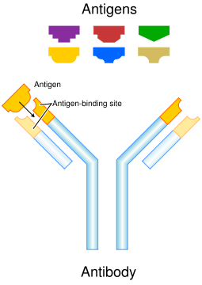
Antibodies & Antigens
Antibodies and Antigens are like locks and keys
With a lock, only one kind of key will fit
The same is true for antigens and antibodies
The shape of an antibody is specific to the antigen it binds to
An antibody will only bind to one kind of antigen
If an individual has a disease, their blood should produce antibodies specific to that disease.
These antibodies will indicate if they have the disease or not
Source: en.wikipedia.org

Slide 26
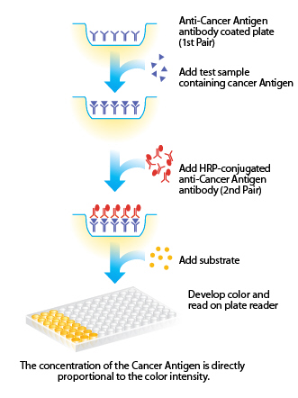
ELISA Testing – A Test for Antibodies
ELISA can be conducted in one of two ways. Either:
A) wells (depressions) in an ELISA plate can be coated with antibodies. A sample can be added and if antigens for a disease are present they will stick to the wells with the antibodies. A second round of antibodies are added; these second antibodies have a dye. If the antigen for a disease was present, they will stick to the antigen/antibodies already there and cause a color change (this is shown at the right). B) we use the same process but add the antigen first, then add the sample that may have the antibodies for the disease, and then add a dyed antigen and look for a color change.

Slide 27
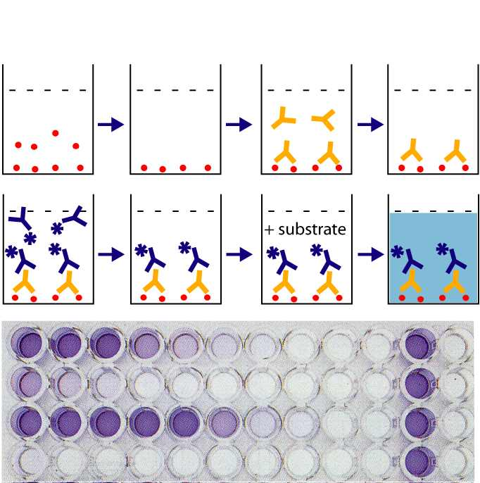
ELISA – Detection of Specific Proteins
How ELISA Works:
1. Add an antigen for a specific disease.
2. Add blood w/ antibody proteins for the antigen.
3. Add a second, colored antigen for the same disease.
4. If the antibody protein for a disease is there, the well will change color.
Source: http://virus.usal.es/web/demo_microali/enterotoxina/imagenes/portada.jpg

Slide 28
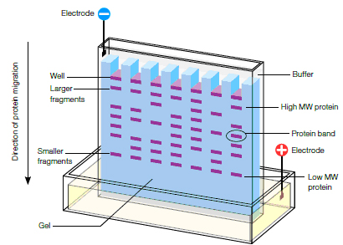
Summary
PCR (or Polymerase Chain Reaction) is a process in which small amounts of DNA are amplified to create millions of copies of a particular DNA sequence for analysis or testing.
This allows researchers to have a visible ‘chunk’ of the same target sequence to analyze.
PCR enables researchers to create millions of copies of a small amount of DNA.
Gel Electrophoresis is a technique in which DNA is cut using a restriction enzyme and separated into bands to create a banding pattern.
These unique banding patterns create a DNA fingerprint.
A DNA fingerprint is the banding pattern created as a result of single tandem repeats (STRs) causing each ‘chunk’ of DNA to have different sizes and move different distances in the gel.
Source: http://users.ugent.be/~avierstr/principles/pcrcopies.gif
Source: http://www.bio-rad.com/webroot/web/images/lsr/solutions//technologies/protein_electrophoresis_blotting_and_imaging/protein_electrophoresis/technology_detail/pet11_img1.jpg

Slide 29
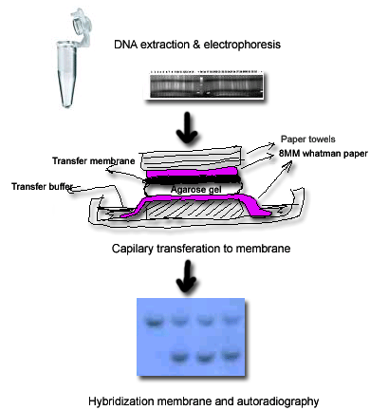
Summary
Southern Blotting is a test for specific genes (such as mutations that cause genetic disease or for genes responsible for specific traits).
It works by absorbing DNA on an electrophoresis gel onto a membrane.
The membrane is then treated with a probe that will bind only to a specific DNA sequence (such as a gene for a genetic disease).
If the gene is present, it will ‘light up’.
ELISA is a test for proteins specific to infectious disease.
ELISA works by coating wells in a dish with antigens and antibodies specific to a disease.
If the disease is present in a sample, it will cause a color change in the wells containing the sample.
Source: http://biowww.net/images/DNA-southern-blot-hybridiza.gif
Source: http://virus.usal.es/web/demo_microali/enterotoxina/imagenes/portada.jpg

