Slide 1
Genomics – Reading What we Can’t See
C. Kohn, Waterford, WI

Slide 2
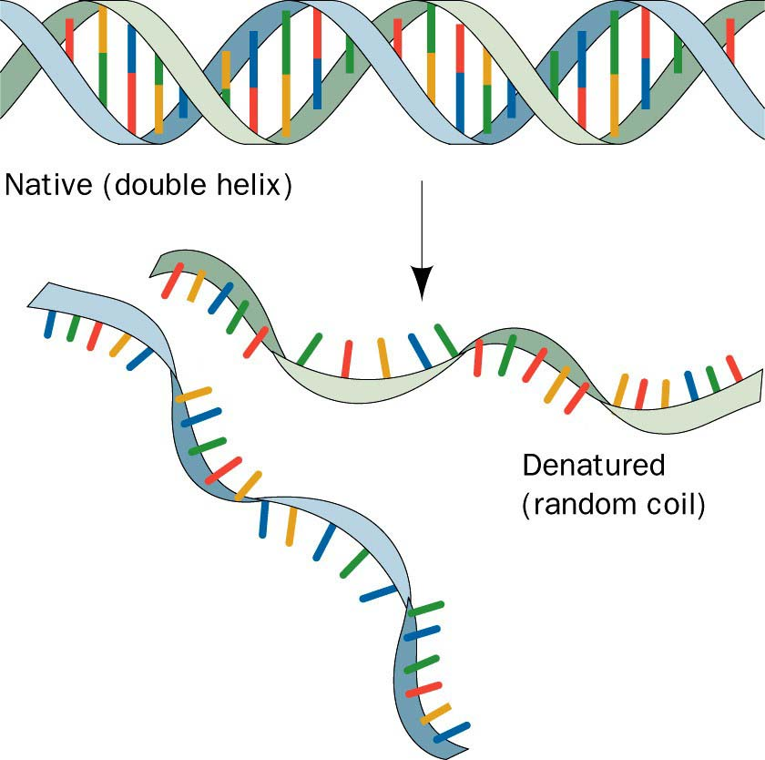
Reading DNA
In today’s society, we can take any living organism and read its DNA letter by letter.
Whether it is a cow, ear of corn, or a newborn baby, scientists now routinely read DNA to acquire details about species and individuals.
This has revolutionized science and agriculture, providing data that until recently was completely inaccessible.
So how do scientists read something that can’t be seen?

Slide 3
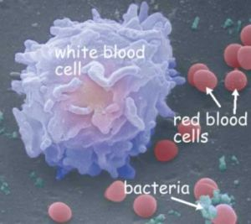
Studying DNA
To study DNA, scientists must first separate it from everything else that’s inside your cell
For example, if a doctor needed to run a genetic test on you, they might take a blood sample.
Each white blood cell contains your entire genome – all 3 billion base pairs!
The red blood cell do not have a nucleus and therefore do not have DNA

Slide 4
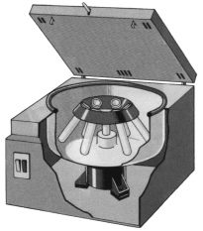
Isolating DNA
The first step is to centrifuge your blood
We’ll put a sample of your blood in a machine that spins it rapidly.
This rapid spinning will cause the denser, heavier portions to move to the bottom of a test tube.
The lighter components will move to the top.

Slide 5
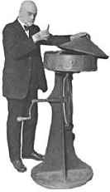
Centrifuging as a Science
In the late 1800s and early 1900s, Dr. Stephen Babcock used his centrifuges to perform much of his work.
His centrifuge is central in his most famous experiment – the butterfat test
His work led many other researchers to use this as a tool to explore cell biology.
We still use this as a primary tool today!

Slide 6
Centrifuging Your Blood
The fluid (plasma) of the blood will rise to the top after being centrifuged
The denser white blood cells will sink to the bottom
Below the white blood cells will be the red blood cells

Slide 7
Isolating and Lysing WBCs
After centrifuging your blood, the white blood cells can be removed.
The cells are then mixed in a solution that causes them to lyse, or burst open
Lysol works by bursting open bacterial cells
The sample is then centrifuged again
This separates the nuclei from the rest of the inside of the cell (ribosomes, mitochondria, etc.)

Slide 8
Breaking Open the Nuclei
Next, we have to break open the nuclei to get to the DNA.
The nuclei can be broken open by a mild detergent (like soap)
The remaining fats and proteins can be destroyed by special enzymes that kill them but leave your DNA alone.

Slide 9
Final Steps
After the ‘cleaning’ process is done, alcohol is added
DNA is not soluble in alcohol, and so it clumps and rises to the top
You now have pure DNA to study with a method so simple, we can do it right here at school.
In modern labs, commercial machines do this automatically to speed up the process.

Slide 10
Review of Steps
1. Get a blood sample.
2. Centrifuge the blood to separate white blood cells from red blood cells and plasma.
3. Break open the white blood cells with a detergent.
4. Centrifuge the white blood cell contents to separate the nuclei from the other cell contents
5. Break open the nuclei with a detergent
6. Add alcohol – DNA is not soluble in alcohol and will float to the top.

Slide 11
Reading DNA
Now that we’ve isolated it, how do we read it?

Slide 12
Sanger Method
The Sanger Method is what we use if we want to read a gene or even an entire genome step by step, letter by letter, base by base.
The Sanger Method works by creating strands of different lengths of the same sequence of DNA.
Each copied strand of DNA is color coded.
This color is determined by the last base added.
By lining up each chunk of the strand from shortest to longest, we can read each strand by its color to determine the next base in a sequence (next slide).

Slide 13
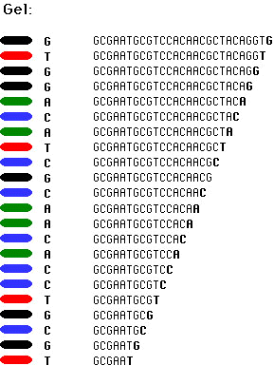
Sanger Method
As you can see, this is simply the same gene copied over and over.
Each time, the copying was stopped at a random point.
The snippets of DNA were then lined up shortest to longest, and the color reflects the last base added (A, T, G, or C)

Slide 14
Step 1: Cutting
1. The first step in the Sanger Method is to break up the DNA into more manageable chunks
6 billion bases are far too many to read all at once!
These chunks are created using a Restriction Enzyme.
The restriction enzyme is sort of like a chemical scissors.
However, it only cuts DNA when it sees a specific DNA sequence (e.g. GAATTC)
This gives scientists some control over where the genome is spliced.

Slide 15
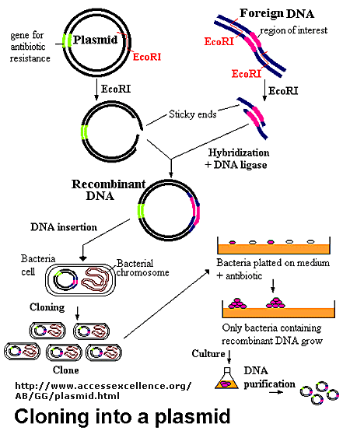
2. Copying
Step 2: once we’ve cut out the gene we’re interested in, we can put it into a bacterial genome.
The bacterial cell will divide, copying its DNA and the inserted gene over and over again.
Usually, scientists use a harmless version of E. coli, the same kind found in our stomachs

Slide 16
3. Denaturing
Step 3: the DNA is removed from the bacterial cells (by lysing and centrifuging) and purified.
The DNA is then heated so that it can be denatured (become single stranded)

Slide 17
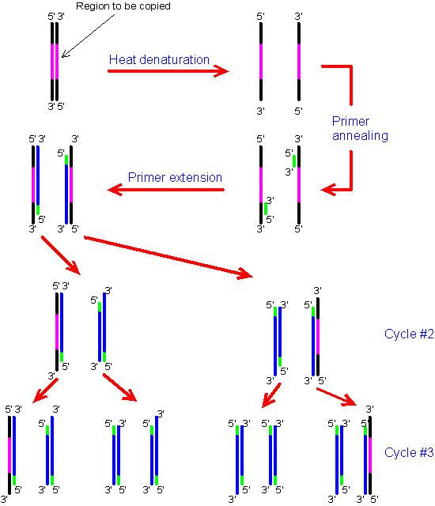
4. Addition of Primers
Step 4: primers are added to tell the polymerase where to add bases
Basically, the primer is sort of like the lights on an airport runway
Just like those lights tell the plane where to land, primers tell polymerase where to start.

Slide 18
5. Addition of Polymerase and ddNTPs
Step 5: Once the DNA has been denatured and primed, we can add the polymerase, bases, and ddNTPs
Reminder: polymerase is the enzyme that adds bases to make a copy strand of DNA
A ddNTP is a special nucleotide that makes this whole process work

Slide 19
ddNTPs
ddNTPs (or dideoxyribonucleotides) are really ‘fake’ nucleotides.
They are just like regular nucleotides, but with one crucial difference – no additional bases can be added afterwards.
For example, you might see the following: 5’-ATCGTAGTGACGTTATTCCCAT-3’
3’-TAGCTAGACTGCAATAAG
This last G was a ddNTP – nothing can come after it!

Slide 20
ddNTPs (cont)
A ddNTP will also be ‘tagged’ with a dye.
Each base will have a specific color.
We will repeat this process many times, creating many copies of the same gene (but of varying lengths).

Slide 21
6. Gel Electrophoresis
Next we will put all of the copies of that gene into an electrically charged gel.
DNA will move towards the positive end of the gel (because DNA is negatively charged.

Slide 22
6. Gel Electrophoresis (cont)
As it moves through the gel, the smaller fragments will move further than the large fragments
They have less resistance and will be able to go further in the same amount of time
Each fragment will line up longest to shortest.
Each gene will end with the color of the last base added (the ddNTP).

Slide 23
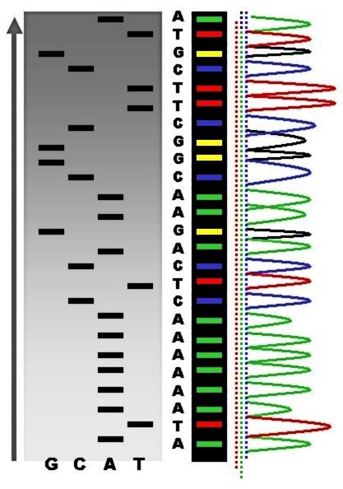
7. Reading the Sequence
A computer will then read each color and record the base found at each point.
The computer isn’t looking at just one individual nucleotide, but a collection of thousands of the same stretch of DNA.
Each stretch of DNA is dyed the same color corresponding to the letter of the last ddNTP added.

Slide 24
8. Analyzing the DNA
A problem we face when reading DNA is that most of our DNA codes for nothing.
Lengths of non-coding DNA are called introns.
Introns are genes for nothing – they aren’t used to create proteins (they are incapable of creating proteins).
They are like junk DNA (sort of).
On the other hand, we want to see exons, the DNA that is actually used to create a protein.
Exons are exceptional at creating proteins.

Slide 25
Introns vs. Exons
So how do we tell the difference between junk introns and useful exons?
Exons have an Open Reading Frame, or ORF
An ORF simply means that there are no STOP commands between the beginning and end.
A computer can be programmed to look for multiple STOP commands
This would tell us that a gene is a useless intron (non-colored below)
If none are found, we know that the stretch of DNA is a useful, protein-coding exon!
Source: simple.wikipedia.org

Slide 26
The Human Genome Project

Slide 27
The Human Genome Project
The Human Genome Project is among the greatest achievements ever in science.
It is comparable to landing a man on the moon, creating the Internet, and eradicating small pox.
It was created faster than expected, without going over budget, and united scientists all over the world from many nations.

Slide 28
Things to consider…
60 years ago, we didn’t even know what DNA looked like or how it worked.
In 1990 we hadn’t read any genomes
In 2000, we had only completed the genome of a few species.
Today, we can identify every letter in your genome or of any living species.
The progress and rate of discovery of biotechnology is still increasing, while the cost of this work is continually decreasing.

Slide 29
Other Genome Projects
Since the completion of the HGP, the genomes of the cow, dog, horse, pig, and many other animals have been sequenced as well.
So why would we want to know the entire genome of humans and other animals?

Slide 30
Benefits of the Genome Project
Since its completion in 2003 (2 years ahead of schedule), over 1800 genes for human disease have been discovered
Today, researchers can find the cause of a genetic disease in days. Before the HGP, it took years
Over 1000 proven tests now exist for genetic diseases as a direct result

Slide 31
Benefits to Come
According to the National Institute of Health, the Human Genome Project will make it likely that…
The genetic factors for heart disease, diabetes, mental illnesses, and many other problems will be discovered in a few years
The causes of all 50 types of cancer can be determined in detail, contributing to a cure
Drugs may possibly become tailor made to suit our specific genetic needs, making the more effective
Personalized and preemptive medical procedures may replaced reactive medicine practiced today
I.e. we may be able to predict who will have a heart attack and who won’t
http://www.nih.gov/about/researchresultsforthepublic/HumanGenomeProject.pdf

