Slide 1
The 7 Habits of Highly Effective People Habit 2: Begin With the End in Mind
C. Kohn, WHS
Based on the book by the same name by Stephen Covey

Slide 2
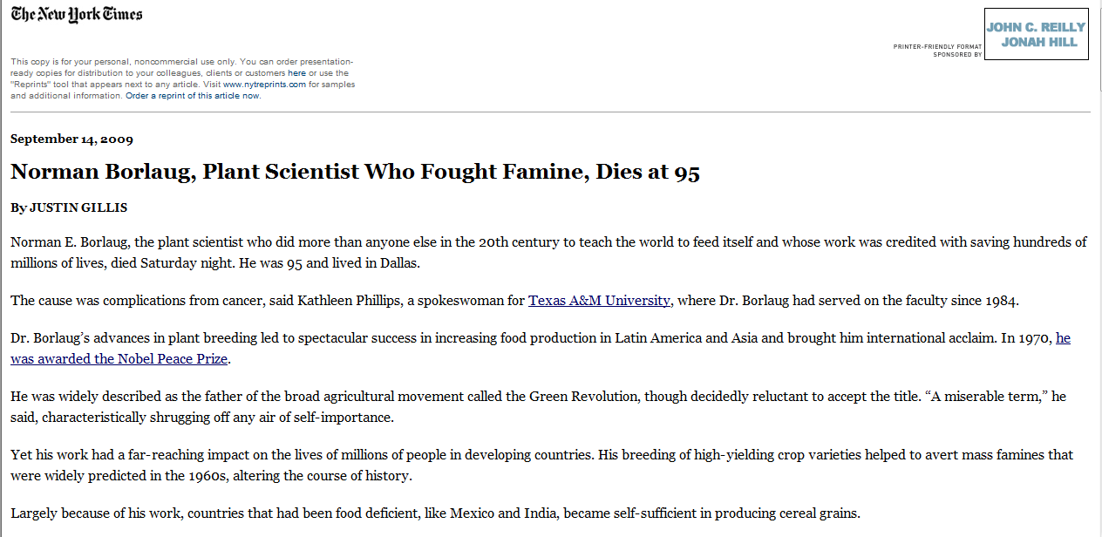
Your Obituary
Your obituary is the ultimate end-goal, the story of your life, your ideals and long-term goals.

Slide 3
Your Obituary, Now
If you write your obituary now, you would have to condense your ambitions into long-term goals.
You would have to choose your focus and prioritize your life.
Every day we write our own obituaries with our actions – our obituaries are being determined every day by the choices we make.
What happens at the end of our life is merely the last sentence of our obituary. What you do now is the main component.
If you died today, would you be satisfied with your life’s story?

Slide 4
If today was your last day…
If you were diagnosed with a terminal disease, and only given a few months to live, what would you change about your life?
Think to yourself for 30 seconds, discuss with a partner for 30 seconds, and then prepare to discuss with the class.
Key Question: Why aren’t you doing this now?
Is there anything wrong with this metaphor?

Slide 5
Your Glasses
It has been said that principles are like glasses – they keep everything else in your life in focus.
In other words, principles are guidelines for your life.
They affect every decision you make
They guide every step you take
They are the foundation for every action

Slide 6
A Principle-Based Life
A principle-based life is one in which you identify unchanging fundamental truths that regardless of the circumstances remain equally true.
For example, a universal fundamental truth to most people is that life is sacred.
We don’t run people off the road if they drive slow…even if they are an inconvenience, we do not take a life unless it is to save one.

Slide 7
Security
Center
Wisdom
Guidance
Power

Slide 8
Our Focus and Four Factors
Whatever is the center of your life, whether it be principles, your job, your grades, your boy/girlfriend, your family, your religion, etc., it gives rise to four factors in your life.

Slide 9
Security
Security represents your self-esteem
This is your identity, your basic personal strength or lack thereof
For example, some people have a money-centered life.
Their personal security and self-esteem comes from how much money they have
If they went bankrupt, their lives would be ruined; some actually will commit suicide
E.g. during the Great Depression, suicides skyrocketed

Slide 10
Guidance
Guidance is the direction in your life
This would be the principles and standards by which you make decisions
If you feel strongly about an issue, it is because you have developed a strong sense of guidance relating to the principle affected by that issue
E.g. Gun control, abortion, the environment, politics, and religion all are controversial issues that often reveal our inner sense of guidance.
If we are ambivalent to these issues, we do not have a strong sense of guidance regarding the issue represented

Slide 11
Wisdom
Wisdom is really just a clear perspective in life
It is your sense of balance in life and your understanding of the relationships between different issues.
Wise people can use previous experience and the experiences of others to better understand current experiences.
They see the interconnectedness of the world – they get the Big Picture
Their judgment is sound not because they know everything but because they seek to use old information in new ways.

Slide 12
Power
Power is the capacity to act
It is your ability to accomplish something in a given situation
It is the ability to create new ideas, solutions, and habits out of old situations and unclear circumstances.
Power is best measured by a sense of control
Those who feel they have no control over their lives probably have a poorly developed sense of power.

Slide 13
Change the Focus, Change the Four
Our focus in life determines the source of our security, guidance, wisdom, and power.

Slide 14
Money Centered
The classic example of a money-centered individual is Ebenezer Scrooge
Scrooge’s sense of power came from his wealth.
All his decisions were made based on how he could make the most money
E.g. shutting down an orphanage was a violation of most people’s principals
Scrooge’s principals, however, centered around money
From his standpoint, this made perfect sense

Slide 15
A Money-centered life
Oh! But he was a tight-fisted hand at the grind- stone, Scrooge! a squeezing, wrenching, grasping, scraping, clutching, covetous, old sinner! Hard and sharp as flint, from which no steel had ever struck out generous fire; secret, and self-contained, and solitary as an oyster. The cold within him froze his old features, nipped his pointed nose, shriveled his cheek, stiffened his gait; made his eyes red, his thin lips blue and spoke out shrewdly in his grating voice. A frosty rime was on his head, and on his eyebrows, and his wiry chin. He carried his own low temperature always about with him; he iced his office in the dogdays; and didn't thaw it one degree at Christmas.

Slide 16
Scrooge, cont.
Scrooge’s guidance came from money making
Decisions were simple – those that made money were correct. Those that lost money were incorrect.
Giving Bob Cratchet coal for his stove was a loss of money…he only allowed just enough to keep Bob employed and, well, alive.
Scrooge’s security and self-esteem came from counting his money.

Slide 17
Scrooge, 12/25
In A Christmas Carol, Scrooge is shown by three spirits how is life is not principal centered. The most chilling accounts come as he is shown the suffering endured by others because of his money- and self-centeredness.
He is shown starving children, the grave of Tiny Tim, and lastly his own funeral attended by businessmen who simply wanted to take his possessions for their own.

Slide 18
Other centers
There are plenty of other centers besides money. These include
Possession centered – prestige, happiness, and decision making abilities all come from personal possessions – clothing, vehicles, etc.
Pleasure centered – satisfaction is based on individual “highs”. All decisions, money making, and relationships are based on obtaining highs
Social centered – these people will become anyone and do anything to be accepted by others
Work/School centered – studying or a career are the only things that matter

Slide 19
And the most common…
Self-centered is by far the most common center
Security for the self-centered individual comes from always getting your own way
Guidance and decision making are based solely on what is in it for you
Wisdom is manifested by viewing the world only by how they affect you. If it doesn’t affect you personally, it doesn’t matter
Power is limited – you are dependent on personal gain in all situations

Slide 20
Other Centers
Other centers include…
Spouse/Signfiicant Other – you do everything to keep another person happy. You can’t break up/divorce a person because they are the center of your world.
Ideology– (not beliefs!) – your life is devoted to your way of thinking; other ideologies must be destroyed in order for your life to make sense
Enemy – you would rather leave school/a job than deal with an individual

Slide 22
Principal Centered

Slide 23
Conclusion
Begin with the end in mind.
What is your center and where are you being taken?
What would you see if the Spirit of Christmases Yet to Come showed you your life 5, 10, 15, 50 years from now?
Are you principal centered, or is your center focused on something that will never bring satisfaction or true happiness?

