Slide 1
Habit 4: Think Win/Win
By Craig Kohn, WHS
Based on “The 7 Habits of Highly Effective People”

Slide 2
A Judicial Dilemma
Imagine for a moment that you are a federal judge.
In the case before you, the plaintiff is claiming that the contractor hired for a skyscraper construction project was negligent.
The defendant (the contractor) has done
an inadequate job on the siding of a federal
building.

Slide 3
The Problem
The problem is that slabs of granite that adorn the side of the building are falling off; each slab of granite weighs over a 1000 lbs and is falling several stories at a time.
  If found guilty, the company will declare bankruptcy; they could never afford to replace the entire side of a building several stories tall.
  However, they are clearly guilty.
The case before requires you, as the judge,
to resolve this situation while serving justice.

Slide 4

TPS
Take a moment and quietly think to yourself how you could resolve this situation.
As the judge, what would you decide?
  Again, if the company can and will declare bankruptcy if they have to replace the siding of this tall building.
  However, they are clearly at fault.
Think, Pair, Share.

Slide 5
What Happened
This is a short summary of an actual case in Minneapolis.
  The judge there decided that the best course of action was not as black and white as it seemed on the surface.
  She ruled that the contractor company was responsible for finding a way to prevent the granite panels from falling off the building outside of the original blueprints and plans for the building.

Slide 6

The Outcome
The contractor company was told that if they failed to find a resolution, they would never receive a permit for a building in any company or situation.
  Failure was not an option, or if it was, it was not a good one
The company tried, and succeeded, in adding thick metal discs at the corner of each granite panel.
The discs held the panels in place and
added additional beauty to the building.

Slide 7

Win/Win Situations
This was a classic win/win situation.
  The federal government was not asked to pay to fix the mistake of a private company.
  The private company did not go bankrupt.
  From a bad situation, a more beautiful building was created.

Slide 8
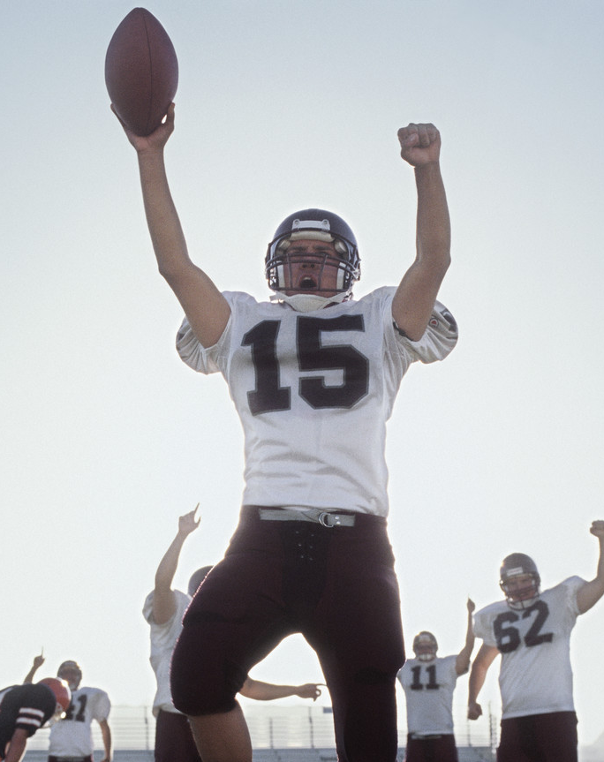
The Fourth Habit
The 4th Habit is to think “Win/Win”.
  In terms of human interaction, there are six different approaches –
1. Win/win -People can seek mutual benefit in all human interactions.
  This requires principle-based behavior.
2. Win/Lose - The competitive paradigm:
if I win, you lose.
  The leadership style is authoritarian.
  In relationships, if both people aren't
  winning, both are losing.

Slide 9

6 Approaches to Human Interaction
3. Lose/Win - The "Doormat" paradigm - the individual seeks strength from popularity based on acceptance.
  The leadership style is permissiveness.
  Living this paradigm can result in repressed resentment.
4. Lose/Lose - When people become obsessed
with making the other person lose, even at their
own expense.
  This is the philosophy of adversarial conflict,
  war, or of highly dependent persons.
  (If nobody wins, being a loser doesn’t seem
  so bad.)

Slide 10
6 Approaches to Human Interaction
5. Win - Focusing solely on getting what one wants, regardless of the needs of others.
6. Win/Win or No Deal - If we can't find a mutually beneficial solution, we agree to disagree agreeably - no deal.
  This approach is most realistic at the
  beginning of a business relationship
  or enterprise. In a continuing relationship,
  it's no longer an option.

Slide 11

Each Approach in More Detail
While the book clearly advocates Win/Win approaches, it also admits that this is not always feasible.
  E.g. only one team will win the NCAA Tournament; this would be a win/lose situation
Furthermore, Win/Win may not always be appropriate.
  E.g. this would not have worked for WWII
To understand when the distinction is made,
you must understand the approaches.

Slide 12

Win/Lose Approach
Win/Lose Approach
In this case, if one person or group wins, the other must lose.
For example, in a basketball game, only one team can win
  For you to win, another must lose
In the real world, this would be like a competition for a bid or a client.
  E.g. a particular person is only going to
  choose one of those cans of soda at a
  vending machine

Slide 13
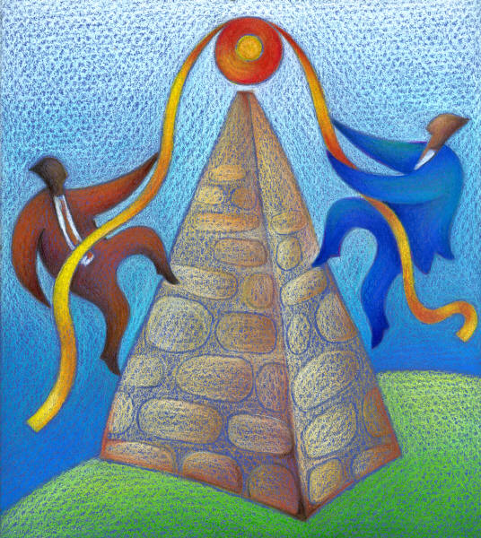
Win/Lose Mentality
Win/Lose only works with independence.
  Interdependence requires win/win.
Sometimes we are independent; e.g. Coca Cola is independent from Pepsi, and so Win/Lose makes sense.
  They aren’t going to buy both cans of soda.
However, if we will continue to interact
with a person or group, we must avoid
Win/Lose if we will depend on them in
the future.

Slide 14
Lose/Win
Lose/Win occurs most often in insecure people.
  E.g. take/do/say whatever you want; I only want you to be happy/want to fit in/want to be accepted.
Lose/Win is worse than Win/Lose because it has no standards, demands, or expectations.
  There is no vision; no end in mind.

Slide 15
Lose/Win
In negotiation, Lose/Win is seen as giving in or giving up.
  In leadership, it is permissiveness.
The problem is that Lose/Win people bury feelings of resentment that never die.
People who repress their feelings
lose their self-esteem and eventually
the quality of their relationships.
A Lose/Win relationship can be at best
temporary, and both sides will eventually
lose.

Slide 16
Lose/Lose Mentality
Lose/Lose
  This concept is most dramatically represented by MAD – Mutually Assured Destruction
  If you launch your nukes, we will too even if we aren’t here anymore to do it
Lose/lose is most likely to occur when
two Win/Lose people interact
  Win/Lose = determined, stubborn, egotistical

Slide 17
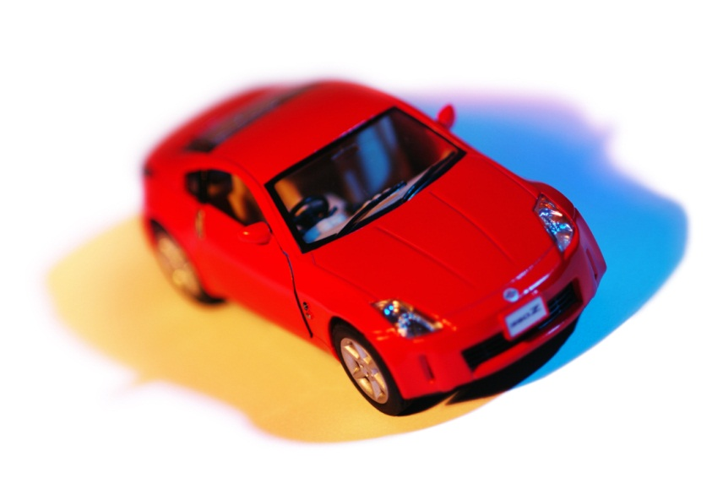
Lose/Lose Mentality
Lose/Lose is the “eye for an eye (makes the whole world blind” kind of approach
Lose/lose is the philosophy of a highly dependent person without an inner sense of direction
  If you will make my life miserable, I’m going to make yours miserable too
  If nobody ever wins, being a loser isn’t so bad
The story of the husband who sells his ex-wife’s Lexus for $50 is a classic example – he lost in order to make his wife lose too.
Lose/Lose is a sad, immature approach

Slide 18
Win Mentality
Win
  The Win mentality means that you don’t care whether someone else wins or loses; you only want to win
  This is the self-centered approach; in fact, it is so self-centered that no one else even exists
  The focus is only on getting what you want regardless of the costs

Slide 19
Win/Win
Win/Win (and Win/Win or No Deal)
  Win/Win is saying, “I want both of us to benefit because we both need each other”
  This is the company that wants to keep its customers returning each time
  This is the friend who repays favors
This is the ongoing, mutually beneficial
relationship in which both parties work
to make it work because it is good for both.

Slide 20
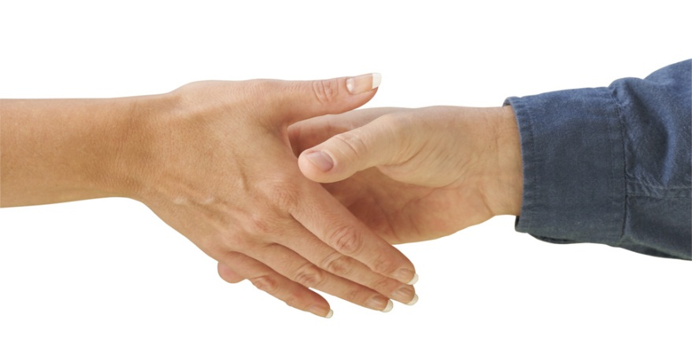
Win/Win or No Deal
Win/Win or No Deal says that regardless of whether I win or lose, if you don’t win we don’t negotiate
  We both have to win for this to work
“No Deal” means that if we both can’t find benefit, we agree to disagree agreeably.
  Lincoln – “Just as I would never be a slave, I would never be a slave-master”
In this case, it is better to have no
deal than to have a deal that is not
beneficial to both

Slide 21
In the end…
The most appropriate model depends on the situation.
When relationships are paramount, Win/Win is the only viable alternative.
In a competitive situation where building a relationship isn't important, Win/Lose may be appropriate.

Slide 22
The 5 Dimensions
There are five dimensions of the Win/Win model:
  Character
  Relationships
  Agreements
  Supportive Systems
  Processes
For Win/Win to work, all of these
must be in place

Slide 23

Character
Character is the foundation of Win/Win on which everything else builds.
Character has three components.
  1. Integrity – values and principles around which all actions are directed
    Without integrity, all actions are superficial; your motives will always be questioned
  2. Maturity - moving from dependent to independent to interdependent
    i.e. the ability to express your own thoughts and convictions with consideration for other’s thoughts and convictions
    Without maturity, you will not seek to rise above problems, and you will not seek to work with others because it requires a partial
    release of control; emotionally dependent people
    cannot handle the release of control – they must be 1st
    Maturity is the balance between Courage and Conviction

Slide 24
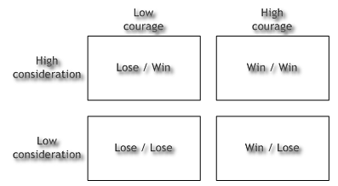
Maturity – the Balance of Courage and Conviction

Slide 25
Character: Abundance Mentality
3. Abundance Mentality – there is plenty for everybody.
  For example, if someone in class receives praise, do you feel threatened? Or do you feel happy for them?
  Is the pie limited, so that if someone else gets a slice, you can’t?
  Can we run out of compliments?
  Is it that you have to have more, or simply have to have more than others?

Slide 26

Character and Public Victory
Character is about Public Victory.
Public victory does not mean victory over the public, but victory of the public.
Ask yourself this: if someone else beat you to doing something great and generous, would you feel angry at this or happy because the same people benefited earlier than they would have under you?

Slide 27

Relationships
Relationships - After character, Win/Win approaches are maintained by relationships.
  This is that “Emotional Bank Account” approach.
Win/Win situations are where persons or groups want continued interaction.
A positive relationship is needed for this continued, mutually beneficial interaction to continue to occur.

Slide 28
Relationships
The stronger you are and the more genuine your character, the more committed you are to Win/Win.
  The more committed you are to Win/Win, the stronger your relationship with a person will be.
Without an Emotional Bank Account, the other
person will become reactive, saying nice things
to your face but working to sabotage you from
behind.
  Your power will become a threat to them, not a benefit.
  Relationships must be about mutual benefit.

Slide 29
Agreements
The 3rd Component of a Win/Win scenario are Agreements.
Five elements make up a good Agreement.
  1. Desired results and goals are clear.
  2. Guidelines specify how to reach results.
  3. Resources are identified to accomplish goals.
  4. Accountability is ensured; each person knows their role.
  5. Consequences are in place for positive and negative behavior and are known by all in advance.

Slide 30
Reward Systems
The 4th component of Win/Win is A Supportive System (aka A Reward System).
The spirit of Win/Win cannot survive in an environment of competition or contests.
All systems should be based on the principle
of Win/Win.
  I.e. all successes should be rewarded, not just the
  top example of success
  Raise the Praise, Minimize the Criticize.

Slide 31
Win/Win Processes
The 5th and Final Component of Win/Win is The Process. The Win/Win Process has 4 steps.
  See the problem from the other point of view, in terms of the needs and concerns of the other party.
  Identify the key issues and concerns (not positions) involved.
  Determine what results would make a fully acceptable solution.
  Identify new options to achieve those results.

Slide 32

Final Word
Win/Win is not a technique; it is a way of living and thinking.
  You cannot achieve Win/Win results with anything less than Win/Win approaches.
  The Ends and the Means must be the same.
Win/Win approaches grow out of proactive thinking, personal maturity, well-established and maintained relationships, and goal-oriented, principle-centered strategies.
  Anything less than this will not suffice.
  It is all or nothing.

