Slide 1
Habit 6: Synergize
C. Kohn
Agricultural Sciences
Waterford, WI

Slide 2
Business Hypotheticals
Imagine a business is competing for a bid to be the marketer for a major soft-drink.
  This business consists of…
    An accountant – they determine the profits
    A marketer – they determine how to reach people
    An advertiser – they determine what the message will be
How would this business do if each person worked alone by themselves up until the day they presented to the client company?
  How would it differ if they worked with each other throughout the process?

Slide 3
Synergy
Synergy: when two parts cooperate, or work cohesively together, to produce a result that is greater than the individual efforts combined.
Synergy is basically a fancy way of saying "two heads are better than one."
  This is the habit of creative cooperation.
  It is teamwork, open-mindedness, and finding new solutions to old problems.
Synergy is a process, and through that process, people bring all their personal experience and expertise to the table.
  Together, they can produce far better results that
  they could individually.
  When people begin to interact together genuinely,
  and they're open to each other's influence,
  they begin to gain new insight.
    Source: https://www.stephencovey.com/7habits/7habits-habit6.php

Slide 4
Synergy
Synergy is less about the pieces & parts and more about the big picture.
  You cannot ‘create’ synergy alone.
  Synergy is the result the other 6 habits.
To create positive synergy, we must:
  Utilize the each 7 habits effectively.
  Accept our weaknesses and
  work to improve them.
  Say "no" to anything that is not
  true synergy (good is the enemy of great)
  Commit to the "no deal" of win/win or no deal.
  Value the product over personal recognition.
  Value diversity of every kind and appreciate
  differences of opinion.

Slide 5
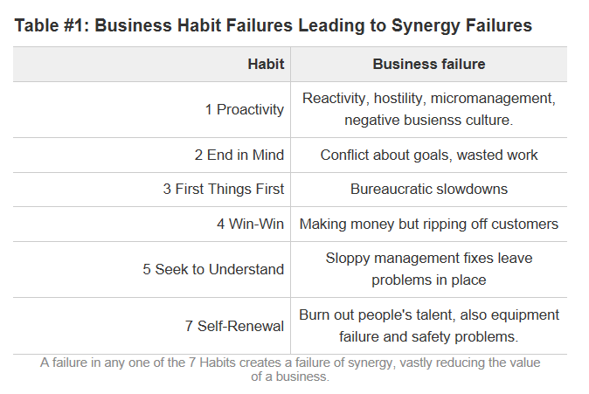
When a Habit Fails, Synergy Fails
Source: http://sidkemp.hubpages.com/hub/The-Seven-Habits-A-Practical-Summary-Habit-6-Synergy

Slide 6
Valuing Differences
Valuing differences is what really drives synergy.
  Those that thrive in environments high in diversity are most able to take advantage of the increased productivity that can result from collaboration.
  Vice versa, those that feel less comfortable when working with those who have different ideas, ideologies,
  religions, or backgrounds are least able to take advantage of
  synergy.
Many people mistake
uniformity for unity or
sameness for oneness.
  Unity does not equal uniformity!
    Source: https://www.stephencovey.com/7habits/7habits-habit6.php

Slide 7

Three Approaches to Diversity
There are three ways in which people view diversity.
  Diversity can be a positive thing or a negative thing depending on your perspective and background.
Level 1: Shun diversity - People who shun others are afraid of differences.
  It disturbs them that someone may have a different skin color, worship a different God, or wear a different brand of jeans.
  They are convinced their way of life is the
  “best” or “right”, or “only way.”
  The person who is truly effective has the
  humility to recognize his/her own personal
  physical, mental, and cultural limitations.
    Source: http://mrpschneider.wikispaces.com/file/view/Habit+6+Synopsis.pdf

Slide 8
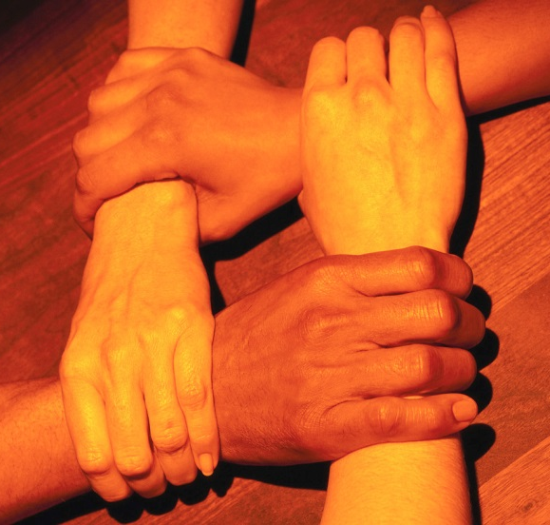
Three Approaches to Diversity
Level 2: Tolerate diversity – Tolerators believe that everyone has the right to be different.
  They don’t shun diversity but don’t embrace it either.
  It’s the “Don’t bother me and I won’t bother you” attitude.
Level 3: Celebrate diversity - Celebrators value differences.
  We should celebrate differences.
  To celebrate diversity on every
  issue is actually hard for most people.
      Source: http://mrpschneider.wikispaces.com/file/view/Habit+6+Synopsis.pdf

Slide 9
We are all a minority
We need to realize that diversity isn’t just an external thing, it’s also internal.
  Although we may be alike in so many ways, we are also so different.
We should celebrate our own differences.
  Our differences are what give us the ability to create possibilities that otherwise would not exist.
  If we were all the same, our abilities would be reduced.
We need to identify roadblocks to
celebrating diversity: ignorance,
cliques, & prejudice.
  Unless we can identify and eliminate prejudice,
  we cannot achieve our maximum effectiveness.
    Source: http://mrpschneider.wikispaces.com/file/view/Habit+6+Synopsis.pdf

Slide 10
Ways we differ on the inside.
We have different learning styles and intelligences – we learn best through our dominant intelligence. The various intelligences identified are:
  Linguistic – learn through reading, writing, telling stories
  Logical – Mathematical – learn through logic, patterns, categories, relationships
  Bodily-Kinesthetic – learn through bodily sensations, touching
  Spatial – learn through images and pictures
  Musical – learn through sound and rhythm
  Interpersonal – learn through interaction and
  communication with others
  Intrapersonal – learn through their own feelings
    Source: http://mrpschneider.wikispaces.com/file/view/Habit+6+Synopsis.pdf

Slide 11

Why this Matters
Knowing how we learn is important because it helps us to relate to those who learn differently.
  How we learn affects how we view the world.
  Those that are skilled in linguistic or logical learning may not value the contributions of someone who learns differently.
    They may not see this as something of ‘real’ value.
Those who cannot understand how
others learn may not appreciate
what others can contribute.

Slide 12
One View of Leaders
In addition to learning styles, we have different leadership styles.
One view of leadership breaks people into four color categories:
  Blue: These people need to feel unique and authentic. They are enthusiastic, sympathetic, warm, communicative, flexible and imaginative.
  Orange: These people will act on a moment’s notice. They are witty, charming, spontaneous, impulsive, optimistic, bold and physical.
  Gold: These people follow the rules and respect authority. They are loyal, dependable, prepared, thorough, sensible, punctual,
  faithful, organized, caring and concerned.
  Green: These people seek knowledge and understanding.
  They are analytical, conceptual, calm, collected, inventive,
  logical, problem solvers and often perfectionists.
    Source: http://www.bizjournals.com/phoenix/blog/business/2011/04/Leadership-isnt-black-and-white.html?page=all

Slide 13

Challenges
While it may aid people to understand how they view the world, knowing how others view the world can help us to navigate conflicts.
  Blue’s tend to find the analytical nature of Green’s to be off-putting and isolating.
  Green’s tend to find the emotional-based views of Gold’s and Blue’s to be flaky.
  Gold’s tend to value tradition and loyalty over spontaneity and creativity which can make it seem like they are dragging their feet when new ideas need to be adopted.
  Orange’s are often seen as dangerously
  impulsive and quick to jump to conclusions.

Slide 14
Opportunities
However, while each style of leadership has differences, these differences of leadership lead to more creative and effective outcomes.
  Blue’s ensure fairness and that everyone is
  heard and appreciated.
  Orange’s contribute energy to the group and
  enable quick, decisive action when needed.
  Gold’s value tradition and encourage loyalty
  to the group.
  Green’s are the thinkers and identify the
  problems, causes, and solutions.
All are needed for a group to function.

Slide 15
No one is “right” – we all interpret the world differently.
We see differently – Everyone sees the world differently and has different views about themselves, others, and life in general.
  There is no one “right” way to view the world – our own views are shaped by our own experiences and culture.
  We are all products of our time and place.
We all have different styles, traits, and characteristics.
  Different personalities enable different ideas and promote creativity.
  Without different viewpoints, we would not have new ideas.
  Those who avoid diversity reduce their own effectiveness as a leader.
  Those who seek and appreciate different viewpoints
  are best poised to develop novel ideas and creative
  solutions to most effectively solve their group’s problems.

Slide 16

How to be Synergistic
Step 1: Accept that all humans are conditioned to viewing the world by their experiences.
  Rarely is one way the right way.
  Differences of opinion do not lessen your own position – they strengthen it.
  A different opinion does not mean the other person is wrong – our view of what is right/wrong is not absolute.
  There is no “them”, only “us” – by viewing many ideas as “ours” and not “theirs”, we will gain more perspective.
If you insist you are right, be sure
you know how you know you are
not wrong.
  If you don’t know, withhold judgment.

Slide 17
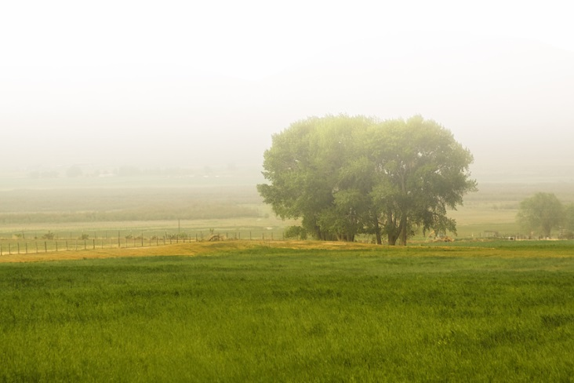
How to be Synergistic
Step 2: Appreciate why you view the world in the way that you do, and recognize that your viewpoint was not the creation of a perfect system.
  I.e. your view of the world will continue to change and develop as you have more and more experiences.
  The wealth of your experiences are yet to come – you have only experienced a small amount of what the world has to offer.
  To resist new ideas would be to resist the more perfect view of the world you will (hopefully) have some day.
  Views, like habits, can be improved through
  self-awareness – actively seek and consider
  new ideas and perspectives.

Slide 18
How to be Synergistic
Step 3: Live each moment with purpose.
  Know why you are doing what you are doing.
  Identify your principles and goals, and know why you do what you do.
  Do not go through life reacting to stimuli – control your life and mold it to fit unselfish principles of service, charity, and justice.
  Embrace the future and let go of the past – focus on the outcomes of decisions that are happening now and not on those that have happened before.
  Commit yourself to something greater
  than yourself.
  Know that good is the enemy of great.

Slide 19

How to be Synergistic
Step 4: Surround yourself with excellence.
  Incorporate the kinds of people into your life that reflect the 7 Habits.
  You are known by the company you keep – make sure that the people you are surrounded by in your life are positive, proactive people with a commitment to their own unselfish principles.
  Ensure that you actively include the kinds of people in your life that value the good of the group over themselves.
  Your examples mean more than your words
  – make sure your actions reflect your ideals
  on a daily basis.
  Identify excellence and seek to emulate it.

Slide 20

How to be Synergistic
Step 5: Get over yourself.
  You can be wrong. You are not always right.
  “The fool doth think he is wise, but the wise man knows himself to be a fool.” ― William Shakespeare
  Accept that multiple views/ideas/perspectives have their merits and that both can be right at the same time.
  Just because one idea is correct does not mean that another is incorrect.
  Seek another’s opinion
  before offering your own.

Slide 21
How to be Synergistic
Step 6: Raise the praise and minimize the criticize.
  Criticism should only occur with careful thought and consideration.
  While criticism can be necessary, it should only be used constructively and in small doses.
  On the contrary, praise should be constant and continuous when deserved.
  Be quick to praise and slow to criticize.

Slide 22
How to be Synergistic
Step 7: Reflect, Reconsider, Repeat
  The only way to improvement is through self-awareness. The only way to self-awareness is through reflection.
  Whatever may be your strategy, be sure you are intentionally scheduling time to consider your actions, reflect on their results, and adjust how you live your life.
  Those who fail to reflect also fail to improve.

