Slide 1
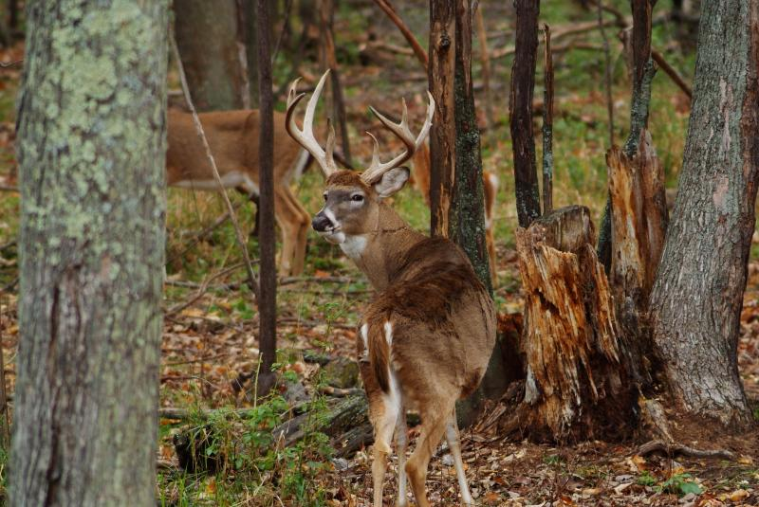
Habitat Management
By C. Kohn Based on Wisconsin Woodlands: Wildlife Management by Dr. Scott Craven, UW-Madison

Slide 2
Benefits of Habitat Mgmt
While landowners benefit from well managed woodlands, so does society
The better privately-owned woodlands are managed, the more the public can view, enjoy, and utilized Wisconsin’s natural resources.
Better management = increased carrying capacities = greater resources

Slide 3
A Public Need
There is also a growing need for managing habitat for the needs of wildlife
60% of Wisconsin’s forest are privately owned
The average woodland contains less than 100 acres
The threat of habitat loss to subdivisions increases the need for well managed woodlands
Existing habitats need to be well managed to make up for the lost habitat from sprawl.

Slide 4
Considerations
Different plant communities favor different Wildlife Communities
A thick stand of conifers will support different kinds of wildlife than an oak-hickory woods
Climate, soil, type, history of land use, and other factors affect which wildlife can exist in a habitat
In general, the more diverse the plant community, the more diverse and numerous the wildlife.
Wildlife management starts with plant management.

Slide 5
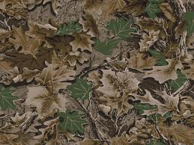
Considerations
Wildlife needs are both basic and complex
All species require food, water, and cover
However, each species has its own specific requirements
These requirements can also change with the season
Excellent spring cover for birds may be useless as winter shelter
To provide for a species, you must first understand their basic ecology

Slide 6
Considerations
Do not set unreasonable objectives for a particular species or for a level of population
Many animals cannot survive on specific habitats no matter how well managed they are because of the habitat’s size or plant life.
Many animals require large areas and will not “stay” on your habitat
E.g. wild turkeys may wander over thousands of acres, only visiting your land from time to time.

Slide 7
Considerations
If you are interested in a particular species, find out what their territorial requirements are.
E.g. you cannot expect more than 4-5 rabbits or 1-2 pairs of squirrels per acre of good habitat
10 deer in a 100 acre hardwoods would be a higher density for Wisconsin
Areas in northern Wisconsin will have lower deer densities than this.

Slide 8
Considerations
Patience is a virtue
It takes a long time to change vegetation and an even longer time for wildlife to respond to those changes
You can get faster results from some actions, such as setting up a bird feeding station
However, severe winters, wet cold springs, and other natural events will affect wildlife more negatively than any of your positive actions.

Slide 9
Considerations
The woodlands surrounding your property may be more important than the your own habitat
Look to neighboring land as a source of wildlife, a barrier to wildlife movement, or a source of a habitat requirement that you cannot provide (e.g. drinking water or nest areas).

Slide 10
Considerations
Know how much is too much
Abundant wildlife can cause problems.
At high population levels, many species become pets that compete with other land users.
Deer can and do cause considerable damage in Wisconsin
Your woodland could worsen an already bad problem if it overly increases the size of their herd
An overly large deer herd can also negate any positive action you took through native plantings and food plots

Slide 11
Considerations
Know the implications of “too much”
Wildlife belongs to everybody – no one “owns” the wildlife on their property
An excessive population will increase the likelihood of trespassing on your property
The implications and costs of an excessive population will be felt by many people besides yourself.
Others, especially motorists and farmers, can pay higher costs than you if you cause an overpopulation
Competing species will see the greatest cost through reduced biodiversity

Slide 12
Habitat Management Practices & Techniques

Slide 13
Practices & Techniques
Remember that any activity intended to benefit one species usually affects a whole group of species.
This impact can be beneficial
It can also be harmful
A professional biologist and the WDNR can help you to identify specific practices for your property to maximize biodiversity gains.

Slide 14
Categories of Management Practices
Plantings
Feeding
Den Trees
Brushpiles
Nesting Boxes
Habitat Diversity
Grazing

Slide 15
Plantings
You can make special plantings to increase cover and plant diversity and to provide food sources
Common plantings include –
Scattered groups of conifers for escape and winter cover
Food plots corn, sorghum, millet, or clover (or a combination of these) can raise the carrying capacity of a habitat, as can shrubs such as nannyberry, dogwoods, autumn olive, and buffalo berry.

Slide 16
Feeding
Setting up and stocking a bird feeding station is the best-known example of a wildlife feeding program
See a publication for the “what, when, and how” of bird feeding
NOTE: direct feeding of other species (beyond food plots) is difficult and a very BAD idea.
Feeding results in tameness, dependence, and the spread of disease – ALL are very bad for a population.

Slide 17
Den Trees
Large, hollow, or dead trees provide valuable living space for many species.
If you cut firewood or harvest timber from your woodland, be sure to preserve adequate trees for cover and protection.
Live not-producing trees (such as oak) tend to have cavities that are doubly valuable for wildlife
They get a home and a meal
Preserve at least 2-3 per acre

Slide 18
Brushpiles
Constructing piles of brush from cuttings or old Christmas trees provides habitat while recycling organic material.
The piles should have a foundation of crisscrossed logs 4 inches or larger in diameter
This provides living spaces for wildlife
Smaller brush and twigs should be piled on top
Large piles last longer than small piles.

Slide 19
Nesting Boxes
Nesting boxes aid wildlife, especially if suitable den trees are in short supply
Wood ducks, gray squirrels, screech owls, and some songbirds use nest boxes.
Use the WDNR’s sources or the internet to find specific plans for the desired species.

Slide 20
Habitat Diversity
Habitat diversity is dependant on the type of land on which you live
I.e. you may not be able to change your habitat’s levels of plant diversity
If your land is mainly wooded, consider clearly some timber to create openings and varying stages of habitat succession
The higher levels of grasses and shrubs provide higher densities of plants needed for feeding and cover

Slide 21
Grazing
While creating a variety of stages of succession in a habitat is a good idea, it is a bad idea to open up native habitat to cattle grazing
Cattle remove valuable cover and food supply form the ground and understory vegetation
Keeping domesticated species out of native habitat will improve the biodiversity of that habitat.

